Slide 1
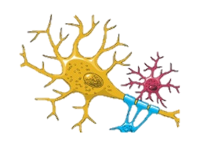
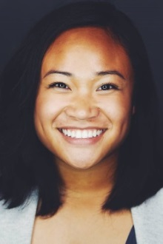
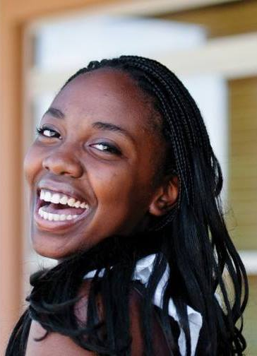
Myelination in Jeopardy: Polyethylene Glycol for CNS Repair
Seth Campbell is a 3rd year Biochemistry student at Andrews University, an avid sports fan, and an aspiring physician. As an academic enthusiast, he currently conducts research on dendrimers. His experience in biochemistry has led to his interest in the field of neuroscience.
Adrianne Magsipoc is a 3rd year Biochemistry student at Andrews University, and hopes to use experiences gained here to pursue a career as a medical missionary. She currently serves as Religious Vice President of AUSA, where her passion for service and burden for souls culminate.
Alanna James is a 3rd year Biochemistry student at Andrews University. Serving as the Junior Class President, she leads and inspires others to achieve their goals. She aspires to become a medical missionary, and will begin her studies in medicine in the fall of 2015 at Loma Linda University.
Andrews University Chemistry & Biochemistry
Thursday, March 5, 4:30 PM @ Halenz Hall Amphitheatre

