Slide 1
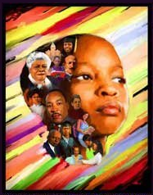
Black History Month
celebrating black education and early educators

Slide 2
The history of black folk in America unfolds across the canvas of America, beginning before the arrival of the Mayflower and continuing to the present. From port cities where Africans disembarked from slave ships to the battle fields where their descendants fought for freedom, from the colleges and universities where they pursued education to places where they created communities during centuries of migration, the imprint of Americans of African descent is deeply embedded in the narrative of the American past. The establishment of colleges and universities within the HBCU system gave African Americans the opportunity for higher education.

Slide 3
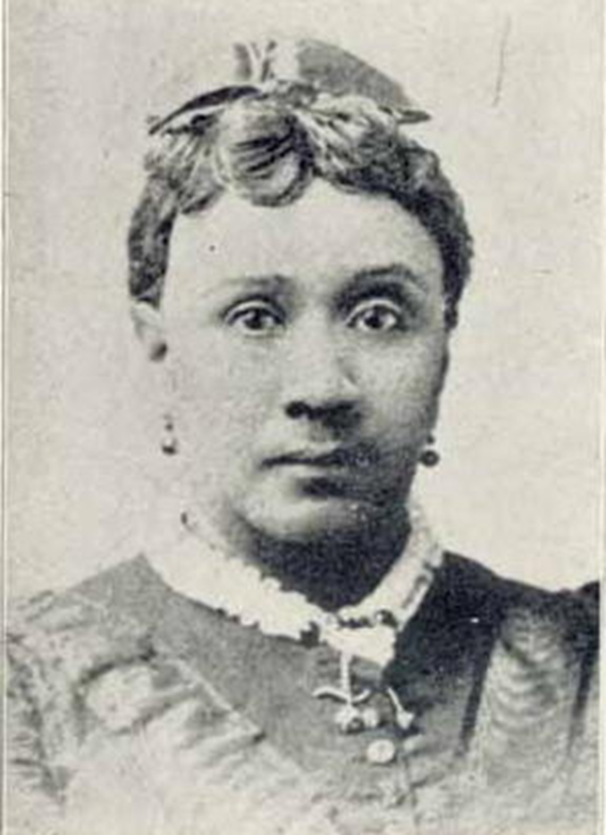
Susan Paul (1809–1841) was an abolitionist from Boston, MA. A primary school teacher and member of the Boston Female Anti-Slavery Society, Paul wrote the first biography of an African American published in the US—Memoir of James Jackson (1835). Paul began her abolitionist career with the inclusive New England Anti-Slavery Society (NEASS). In 1833, William Lloyd Garrison and others visited Paul's classroom, and being impressed by Paul and her students’ music performances, the Society invited them to join. Teaching her students songs about slavery, Paul informed African American children about Northern abolitionism and expanded the African American anti-slavery movement. After the Boston Female Anti-Slavery Society (BFASS) was formed as an auxiliary of NEASS, Paul was welcomed as one of the first African American members.

Slide 4
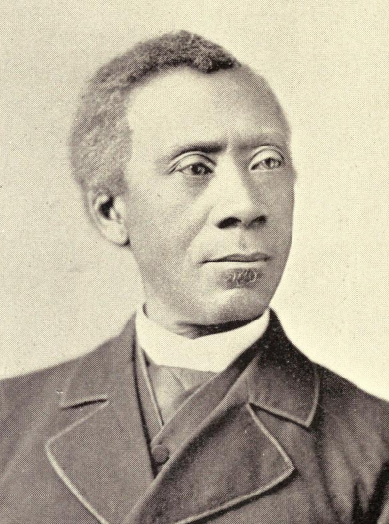
William H. Gibson (1829- 1906) was one of the first African American teachers in Louisville, KY. Born in 1829 in Baltimore, MD to free blacks, Gibson attended a school taught by John Fortie. In 1847, he moved to Louisville and opened a school in the basement of the Methodist church; many these early students were slaves. Gibson played the violin, piano, and guitar, and taught them to others. In 1852, Gibson traveled to the Free Soil Convention in Pittsburgh, PA. He opened another school in the 1850s on Seventh Street between Green and Jefferson, and in 1859 he opened a school at Quinn Chapel AME Church.

Slide 5
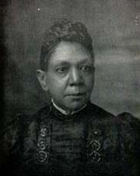
Fanny Jackson Coppin (1837–1913) was born a slave, however, her freedom was bought when she was 12. Jackson spent the rest of her youth working as a servant for author George Henry Calvert. In 1860, she enrolled in Oberlin College, the first college to accept black and female students. During her years at Oberlin College, she taught an evening course for free African Americans in reading and writing; she graduated in 1865. In 1865, Jackson accepted a position at Philadelphia's Institute for Colored Youth (now Cheyney University of Pennsylvania). She served as the principal of the Ladies Department and taught Greek, Latin, and Mathematics. In 1869, Fanny Jackson was appointed as principal, becoming the first African American woman to be named a school principal. In her 37 years at the Institute, Jackson initiated several educational improvements in Philadelphia; she was promoted by the board of education to superintendent. She was the first African American superintendent of a school district in the US. In 1893, Coppin was one of 5 African American women invited to speak at the World's Congress of Representative Women in Chicago.

Slide 6
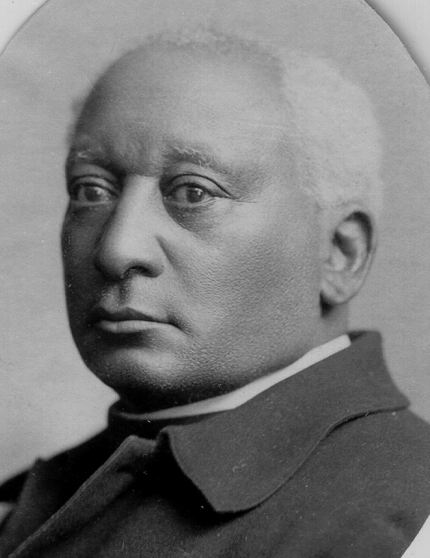
Benjamin W. Arnett (1838–1906) was born a free man in Brownsville, PA. In the 1860s, Arnett was a member of the PA State Equal Rights League and the National Convention of Colored Men in Syracuse, NY; secretary of the National Convention of Colored Men in Washington, DC in 1867; and chaplain of the convention in Louisville, KY, in 1883. In 1872, Arnett became the first black man to serve as foreman of an otherwise all-white jury. In 1885, he was elected as a Republican representative to the Ohio General Assembly from a district with an 85 percent white majority, becoming the first African American to represent a predominantly white constituency. In 1886, Arnett introduced legislation to repeal the state's "Black Laws.” Arnett was particularly concerned that state law did not ensure that black children had the same educational opportunities as white children. In 1887, statues regarding education were changed; requiring the state to provide equal opportunities to all children regardless of race.

Slide 7
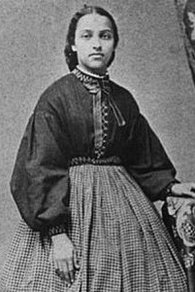
Mary Jane Patterson (1840–1894) was the daughter of a bricklayer and plasterer who gained his freedom in 1852 and moved his family to Oberlin, Ohio. In 1862, she became the first African American woman to earn a BA. After graduation, Patterson taught in Chillicothe, OH before joining Fanny Jackson Coppin at Philadelphia's Institute for Colored in 1865. From 1869 to 1871 Patterson taught at the Preparatory High School for Colored Youth known today as Dunbar High School (Washington, DC). She served as the school's first black principal from 1871 to 1872. During her administration, the school grew from less than 50 to 172 students, high school commencements were initiated, and a teacher-training department added to the school. Patterson's commitment to education as well as her "forceful" and "vivacious" personality helped establish the school's high academic standards. Patterson also devoted time and money to Black institutions in Washington, DC, including the Colored Woman's League of Washington DC, which was committed to the "racial uplift" of black women by teaching training, rescue work, and home economic classes

Slide 8
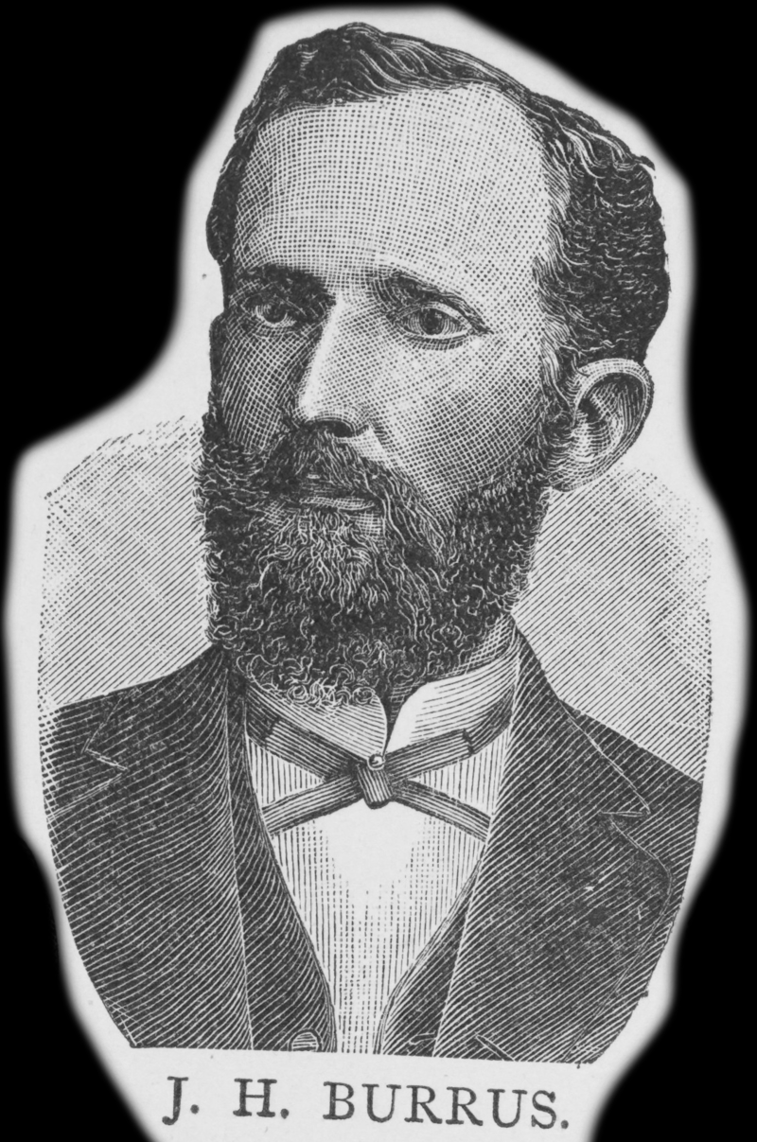
John Houston Burrus (1849-1917) was a professor at Fisk University (TN) and president of Alcorn Agricultural and Mechanical College (MS). He graduated from Fisk University in Nashville among the first group of African Americans from a liberal arts college in the South. After graduation, Burrus taught at a school outisde of Nashville and became its principal. In 1876, he was a delegate to the Republican National Convention and supported Rutherford B. Hayes on the last ballot. He became a principal of the Yazoo city school In Yazoo, MS, and in 1877, was offered a position of instructor of mathematics at Fisk University. In 1878, he was elected secretary of the Tennessee Republican State convention and was secretary and treasurer of the State executive committee for two years. He was elected to the board of school directors for his district for consecutive three-year terms from 1878 to 1884.

Slide 9
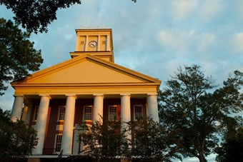
He served as chairman of the board and succeeded in equalizing the salaries of the white and black teachers. In 1880, he spoke at the State Teachers Institute convention in Nashville about unequal funding in schools. He was chosen alternate delegate to the 1880 Republican National Convention. In 1882 he was a candidate for register in Davidson County, Tennessee in August, and in November he was a candidate for the Tennessee House of Representatives. While at Fisk, Burrus began to study law and he was admitted to the bar in 1881. In August 1883, he was offered the presidency of Alcorn Agricultural and Mechanical College in Lorman, Mississippi. He held the position until 1893 until forced to retire due to health issues. He was very successful and the enrollment at Alcorn increased greatly during his tenure.

Slide 10
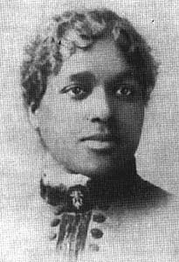
Maria Louise Baldwin (1856–1922) was born in Cambridge, MA. In 1874, Baldwin graduated from Cambridge High School, and a year later from the Cambridge training school for teachers. Baldwin first taught in Chestertown, MD. In 1881, she was hired as a teacher at the Agassiz Grammar School of Cambridge. In 1889, she became principal of the school, making her the first African American female principal in MA and the Northeast. As principal, Baldwin supervised white faculty and a predominantly white student body. In 1916, as a new Agassiz school was erected to include higher grades, Baldwin was made master, supervising 12 teachers and 500 students. She was one of only two women who held the position of master and the only African American in New England. Baldwin served as master of Agassiz school for 40 years. Under her leadership, the school became one of the best in the city, attended by children of Harvard professors and Cambridge wealthy. She introduced new methods of teaching (such as “open-air” classroom), art classes, and a school nurse.

Slide 11
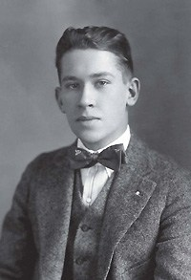
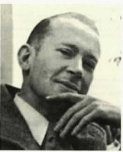
One of Baldwin’s students, poet E. E. Cummings described her in his book Six Nonlectures:
"Miss Baldwin, the dark lady mentioned in my first nonlecture (and a lady if ever a lady existed) was blessed with a delicious voice, charming manners, and a deep understanding of children. Never did any demidivine dictator more gracefully and easily rule a more unruly and less graceful populace. Her very presence emanated an hour and a glory: the honour of spiritual freedom—not mere freedom from—and the glory of being, not (like most extant mortals) really undead but actually alive. From her I marvellingly learned that the truest power is gentleness."

Slide 12
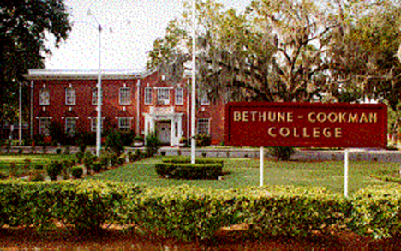
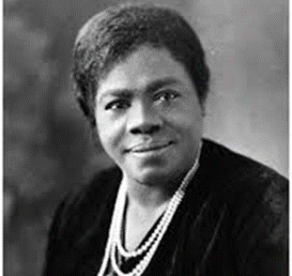
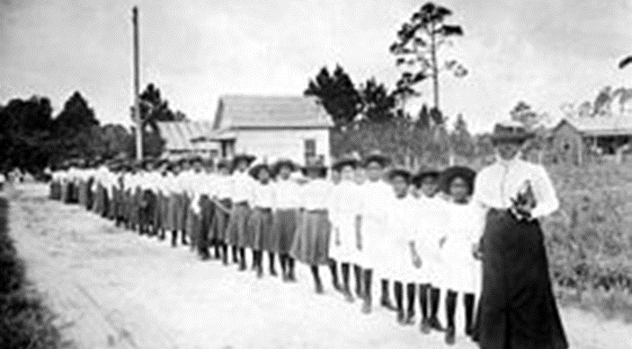
Mary Jane McLeod Bethune (1875-1955) was an educator who started schools and supported women’s rights, welfare, and other political issues. The school she started in Daytona Beach, FL merged with a boys school to become Bethune-Cookman College (later University). Bethune maintained high standards and promoted the school with tourists and donors, to demonstrate what educated African Americans could do. She was president of the college from 1923-1942, and 1946- 1947. Bethune’s work in women's clubs and support of welfare and politics gave her the opportunity to became a national leader. After working on the presidential campaign for Franklin D. Roosevelt in 1932, FDR appointed her to his “Black Cabinet.” Eleanor Roosevelt frequently referred to Bethune as "her closest friend in her age group."

Slide 13
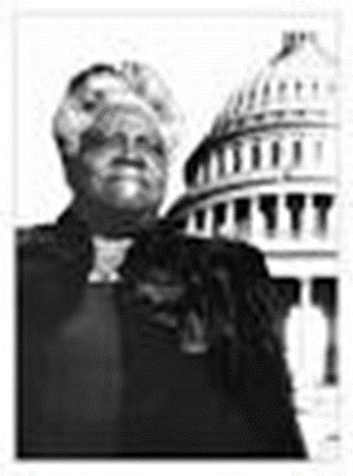
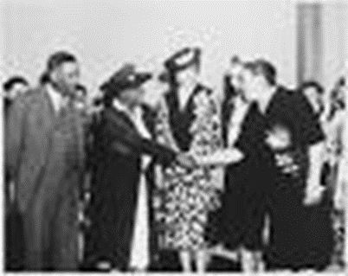
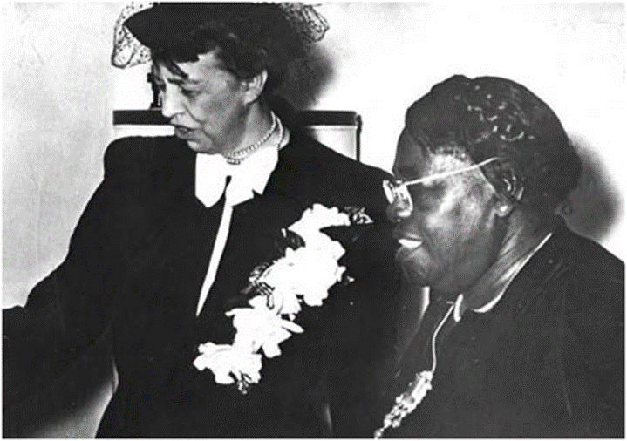
Bethune’s work with the National Association of Colored Women and the Federation of Colored Woman’s Clubs gave her the experience to form the National Council of Negro Women in 1935. In 1938, she obtained the position of Director of the Division of Negro Affairs, National Youth Administration and the first African American female division head.

Slide 14
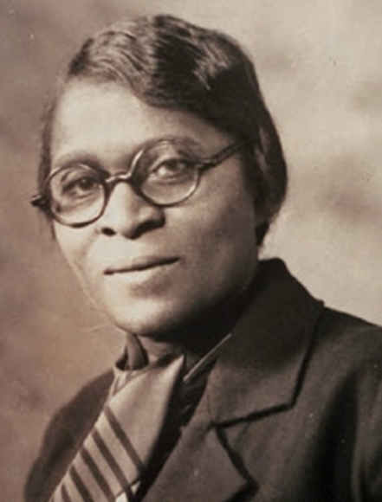
Charlotte Hawkins Brown (1883–1961) was an author, educator, and founder of the Palmer Memorial Institute in NC. Educated one year at a normal school in Salem, MA, she began teaching at the Bethany Institute, a small school run by the American Missionary Association in NC. When the school closed a year later, Brown decided to start her own school combining industrial training with a standard curriculum. The new school started small, in an old log cabin with just two teachers and few students. Brown raised money, eventually securing enough to erect a new building, completed in 1905. The school was named the Palmer Memorial Institute. By the 1920s, the Palmer Memorial Institute was a successful boarding school attracting students from around the country, many of whom went on to become educators. Brown lectured frequently and received several honorary degrees. She became the first African American woman named to the national board of the YWCA. In 1941, she published The Correct Thing To Do--To Say--To Wear, committing many of her educational philosophies and maxims in print. She continued to run the school until her retirement in 1952.

Slide 15
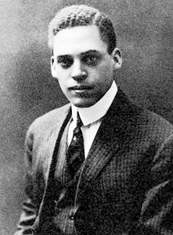
Ernest Everett Just (1883–1941) was a biologist and an academic and science writer. Just's primary legacy is his recognition of the fundamental role of the cell surface in the development of organisms. In his work within marine biology, cytology, and parthenogenesis, he advocated the study of whole cells under normal conditions, rather than simply breaking them apart in a laboratory setting. At the age of 13, Just’s mother sent him to the Colored Normal Industrial Agricultural and Mechanical College of South Carolina, later known as South Carolina State University. At 16, he enrolled at the Meriden, NH college-preparatory high school Kimball Union Academy. Just graduated in 1903 and went on to Dartmouth College where he graduated magna cum laude. Just won special honors in zoology, and distinguished himself in botany, history, and sociology. Upon graduation, Just accepted a teaching position at Howard University in Washington, DC. At Howard, he chaired the departments of biology and zoology.

Slide 16
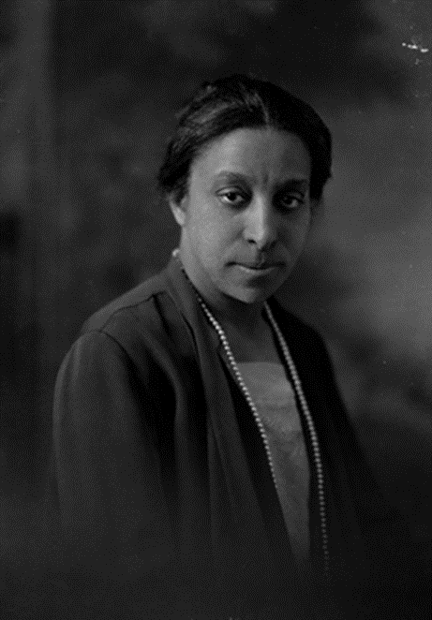
Lucy Diggs Slowe (1885–1937) attended Howard University and while a student founded Alpha Kappa Alpha Sorority, Inc. in 1908. After graduation, Slowe returned to Baltimore, MD to teach high school English. She later earned a Masters of Arts degree from Columbia University (NY). Slowe returned to Washington, DC to teach. Within the federal district of DC, African American teachers were paid on the same scale as Caucasian teachers. The system attracted outstanding teachers, and in 1919, the District asked Slowe to create the first junior high school for blacks and then appointed her principal. She stayed at the public school until 1922 when she was appointed the first Dean of Women at Howard University. She continued as a college administrator for 15 years until her death. In addition, Slowe created and led both the National Association of College Women and the Association of Advisors to Women in Colored Schools.

Slide 17
Lucy Diggs Slowe—Slowe was also a tennis champion, winning the national title of the American Tennis Association's first tournament in 1917, the first African American woman to win a major sports title. Lucy Diggs Slowe demonstrated in her work as an educator, tennis champion, college administrator and civic organizer how African American sororities supported women "to create spheres of influence, authority and power within institutions that traditionally have allowed African Americans and women little formal authority and real power."

Slide 18
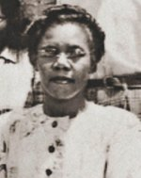
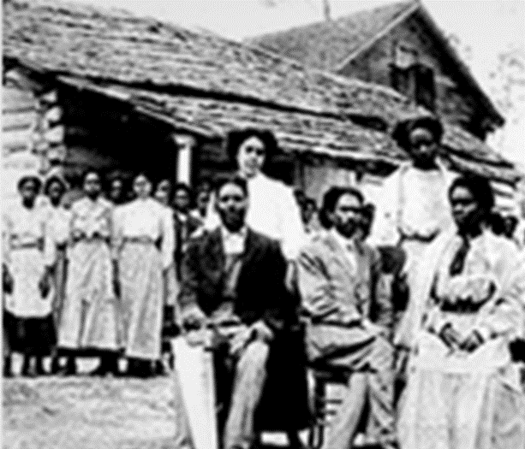
Martha Louise Morrow Foxx (1902–1975) was a pioneering educator of the blind in Mississippi. Becoming partially blind as a child, Foxx attended schools for the blind in NC and PA. She attended Temple University and then moved to MS to begin teaching. She later completed her degree and attended West Virginia State College, University of Wisconsin–Madison, and Hampton Institute. Foxx founded the Mississippi Blind School for Negroes on the Piney Woods School campus in 1929. In 1945, Helen Keller visited the Piney Woods School and appeared before the state legislature to appeal for funding. Foxx’s techniques and leadership are credited with guiding the Mississippi Blind School for Negroes towards integration, and creating the Mississippi School for the Blind for blacks and whites in 1950. The school, located in Jackson, installed Foxx as its first principal.

Slide 19
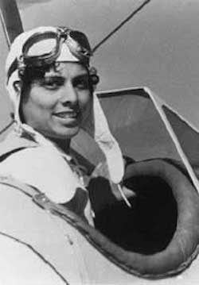
Willa Beatrice Brown (1906–1992) was an aviator, lobbyist, teacher, and civil rights activist. She was the first African American woman to earn her pilot's license in the US (Bessie Coleman earned her license in France), the first African American woman to run for US Congress, and the first African American officer in the US Civil Air Patrol. Brown graduated from Indiana State Teachers College with a business degree in 1927 and Northwestern University with a MBA in 1937. She worked as a high school teacher in Gary, IN, and social worker in Chicago. But Brown sought greater challenges than the limited career fields open to African Americans. She decided to learn to fly, studying with Cornelius Coffey, a certified flight instructor and expert aviation mechanic at one of Chicago's racially segregated airports. In 1938, she earned a private pilot's license.

Slide 20
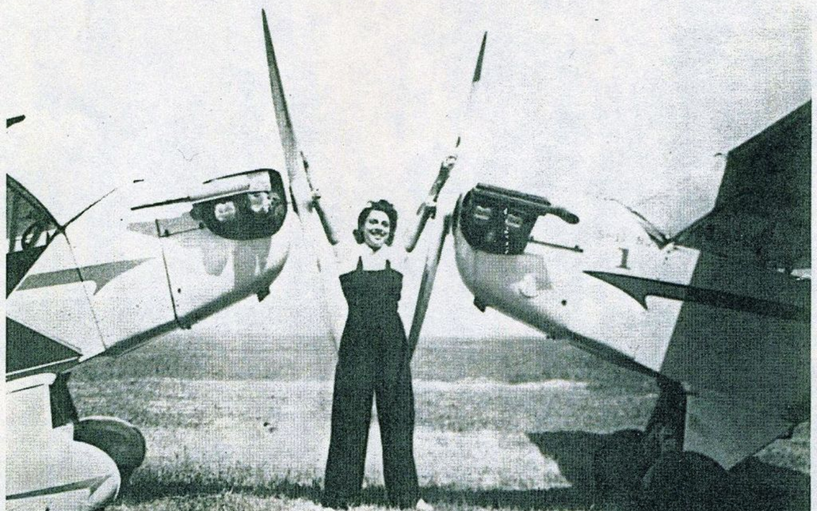
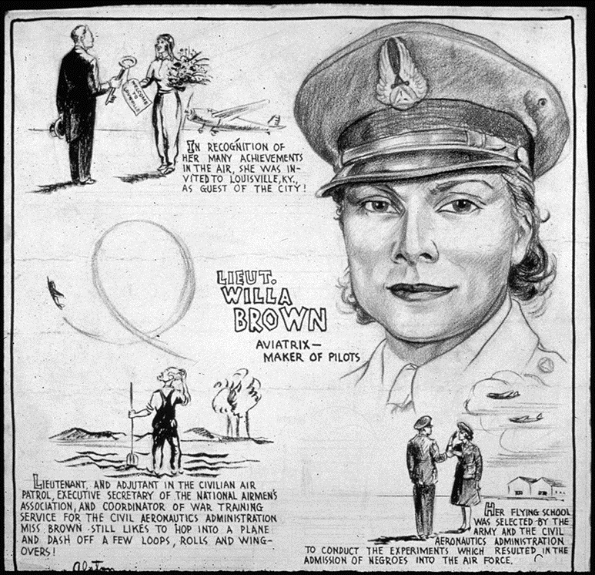
A lifelong advocate for gender and racial equality, Brown not only lobbied to integrate the US Army Air Corp and include African Americans in the Civilian Pilot Training Program (CPTP), but also co-founded the Cornelius Coffey School of Aeronautics with Cornelius Coffey, the first private flight training academy in the US owned/operated by African Americans. She trained hundreds of pilots, several of whom would go on to become Tuskegee Airmen. Brown organized flight schools for children, ran for US Congress three times (1946, 1948, and 1950, respectively), and taught in the Chicago Public School System until 1971.

Slide 21
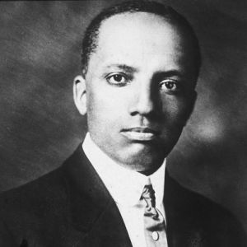
In 1915, historian Carter G. Woodson and others founded the Association for the Study of Negro Life and History (ASNLH), now the Association for the Study of African American Life and History (ASALH). These men saw the need for dedicated research, promotion, and preservation of African American achievement, culture, and history.

Slide 22
Woodson believed that once presented, the truth about African Americans would end racial stereotypes and bring about a new era of equality, opportunity, and racial democracy. In 1926, the ASNLH organized “Negro History Week” for the second week in February to coincide with both Abraham Lincoln’s and Frederick Douglass’ birthdays. Schools and communities embraced the week as a time of remembrance and celebration of black culture as plays, performances, and lectures occurred. In addition, communities established history clubs to continue the study of African American history year-round. The leaders of ASNLH promoted the work of black scholars, artists, athletes, and leaders through the media and The Journal of Negro History.

Slide 23
Over the next decades communities issued “official” week celebrations, college campuses extended the celebration for the entire month coinciding with the Civil Rights Movement. As black populations grew, mayors issued Negro History Week proclamations. Well before his death in 1950, Woodson believed that the weekly celebrations—not the study or celebration of black history–would eventually come to an end. In fact, Woodson never viewed black history as a one-week affair. He pressed for schools to use Negro History Week to demonstrate what students learned all year. In the same vein, Woodson established a black studies extension program to reach adults and looked forward to the time when an annual celebration would no longer be necessary. Woodson believed that black history was too important to be crammed into a limited time frame. He spoke of a shift from Negro History Week to Negro History Year.

Slide 24
The 1960s helped the cause and celebration of black history. During the Civil Rights Movement, Freedom Schools incorporated black history into the curriculum to advance social change. Before the decade was over, Negro History Week was on its way to becoming Black History Month. By the late 1960s, as young blacks on college campuses became increasingly conscious of links with Africa, the Black Studies Movement, the creation of black professional associations, and a host of doctoral programs at major American universities emerged. Younger intellectuals prodded Woodson’s organization to change with the times. In 1976, 50 years after the first celebration, the ASALH used its influence to institutionalize the shifts from a week to a month and from Negro history to black history.

Slide 25
In 1976, during the nation’s bicentennial, President Gerald R. Ford “officially recognized Black History Month calling upon the public to ‘seize the opportunity to honor the too-often neglected accomplishments of black Americans in every area of endeavor throughout our history’.” Every president since Ford has declared February to be Black History Month. Carter G. Woodson built Negro History Week around existing traditions of commemorating the black past. Woodson understood that by attaching his celebration to Lincoln and Douglass, rather than create a new tradition, he increased his chances for success.
To read more about ASALH (http://asalh100.org/) and its programs see information on the website.

Slide 26
Sources:
http://asalh.org/black-history-themes/
https://en.wikipedia.org/wiki/
https://www.womenshistory.org/education-resources/biographies/mary-mcleod-bethune

Slide 27
The study of history and political science provides enhanced understanding of society, increases communication skills, and teaches critical thinking. These, and other benefits of a liberal arts education, bring confidence and increased enjoyment in every area of life by broadening the students’ intellectual experience. The History & Political Science Department serves Andrews students in several ways. It provides general educational courses required for all students and offers degree programs for those interested in further study of American and European history, political science, or social studies. Faculty in the department aid students in understanding the relationship of the past and present and demonstrate how local, national, and international political processes affect and respond to events. All teachers approach their subjects from an explicit, biblically based, Christian perspective.
https://www.andrews.edu/cas/history/

Slide 28
A major in History from Andrews University equips students with knowledge and skills for success in a wide range of areas. Students understand the past and its relationship to the present through a variety of American, European, and non-western history courses, training in a foreign language, hands-on experience in historical research, and an introduction to historical philosophy and theory. Our degree prepares students for careers in teaching, research, law, and for graduate work in a wide range of professional and academic areas. In addition, it encourages the moral, intellectual, civic, social, and spiritual maturity to accompany a life well-lived.
A Political Science major from AU equips students with unique knowledge and skills that find practical solutions to some of the world's most urgent social, economic and political problems. It prepares students for careers in teaching, government and politics, law, and for graduate student in a wide range of professional and academic areas. In preparing students for a specific profession, a political science major teaches lessons in citizenship and statesmanship and seeks to encourage moral, intellectual, civic, social, and spiritual maturity to accompany a life well-lived. The discipline of Political Science also teaches students to critically assess a host of difficult problems and aims at finding.
Our Social Studies degree from AU is an interdisciplinary program that prepares students for teaching elementary and secondary education.

