Slide 1
Mes de la Herencia Hispana
September 15-October 15
Hispanic Americans: Embracing, Enriching, and Enabling America

Slide 2
National Hispanic Heritage Month celebrates the histories, cultures, and contributions of American citizens whose ancestors came from Spain, Mexico, the Caribbean, and Central and South America each year from September 15 to October 15. In 1968, PL 90-498 initiated Hispanic Heritage Week (including September 15 and 16) under President Lyndon B. Johnson and in 1988, Congress expanded the week-long celebration to a month with PL 100-402 during President Ronald Reagan’s final term. The expansion of a thirty-day celebration allows for commemoration of Costa Rica, El Salvador, Guatemala, Honduras, and Nicaragua independence September 15; Mexico, Chile, and Belize independence days on September 16, 18, and 21, respectively; and Columbus Day or Día de la Raza on October 12.

Slide 3
Hispanics have a profound and positive influence on the United States through strong commitment to family, faith, hard work, and service. They enhance and shape national character with centuries-old traditions that reflect the multiethnic and multicultural customs of community. The term Hispanic or Latino, refers to Puerto Rican, South or Central American, or other Spanish culture/origin regardless of race. On the 2010 US Census, people of Spanish, Hispanic and/or Latino origin identified as Mexican, Mexican American, Chicano, Puerto Rican, Cuban, or "another Hispanic, Latino, or Spanish origin“ and numbered 50.5 million people or 16 percent of the population. This represents a significant increase from 2000, which registered the Hispanic population at 35.3 million (13 percent) of the total US population.
For more information: http://www.hispanicheritagemonth.org/

Slide 4
Demographics from the 2010 US Census
Race/Ethnicity | Number | Percent of 2010 population
Non-Hispanic White | 196,817,552 | 63.7 percent
Non-Hispanic Black or African American | 37,685,848 | 12.2 percent
Non-Hispanic Asian | 14,465,124 | 4.7 percent
Non-Hispanic Native American | 2,247,098 | 0.7 percent
Non-Hispanic Native Hawaiian/Pacific | 481,576 | 0.2 percent
Non-Hispanic other race | 604,265 | 0.2 percent
Non-Hispanic two or more races | 5,966,481 | 1.9 percent
Hispanic/Latino (specific numbers below) | 50,477,594 | 16.4 percent
White Hispanic | 26,735,713 | 8.7 percent
Black or African American Hispanic | 1,243,471 | 0.4 percent
Native American Hispanic | 685,150 | 0.2 percent
Asian Hispanic | 209,128 | 0.1 percent
Native Hawaiian/Pacific Hispanic | 58,437 | 0.0 percent
Some other race Hispanic | 18,503,103 | 6.0 percent
Two or more races Hispanic | 3,042,592 | 1.0 percent

Slide 5
Early Spanish Exploration and Colonization in North and South America began when advances in maps, ships, and technology emerged in Europe. With Portugal’s Prince Henry the Navigator’s maps and school, explorers left Europe in search of new lands. In Spain, the marriage of Ferdinand and Isabella consolidated monarchical power and under the crown of Castile developed the Monarchy of Spain through its administrators, conquistadors, and missionaries. Spain’s motivations for colonial expansion were trade and the spread of the Catholic faith through indigenous conversions. Beginning with the 1492 arrival of Christopher Columbus and continuing for over three centuries, the Spanish Empire expanded across half of South America, most of Central America and the Caribbean Islands, and much of North America (Mexico, Florida and the Southwestern and Pacific Coastal regions of the US).

Slide 6
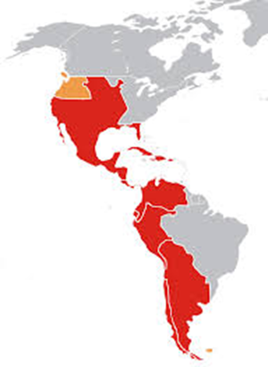
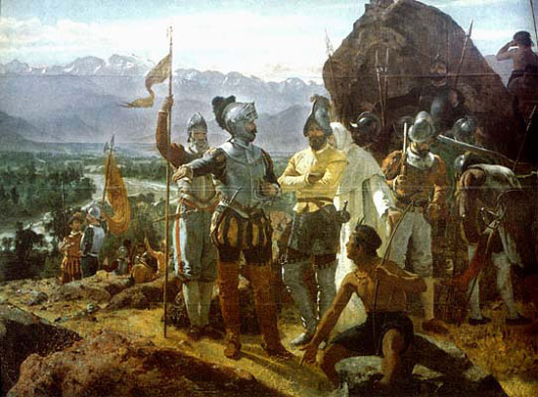
Spain in the New World

Slide 7
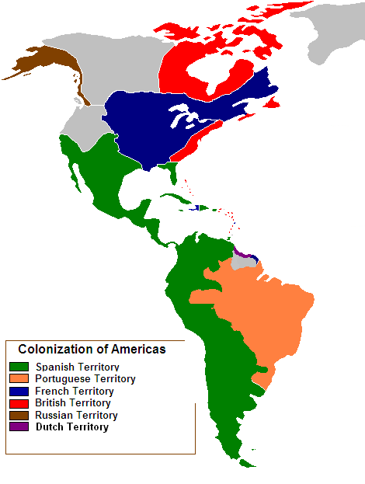
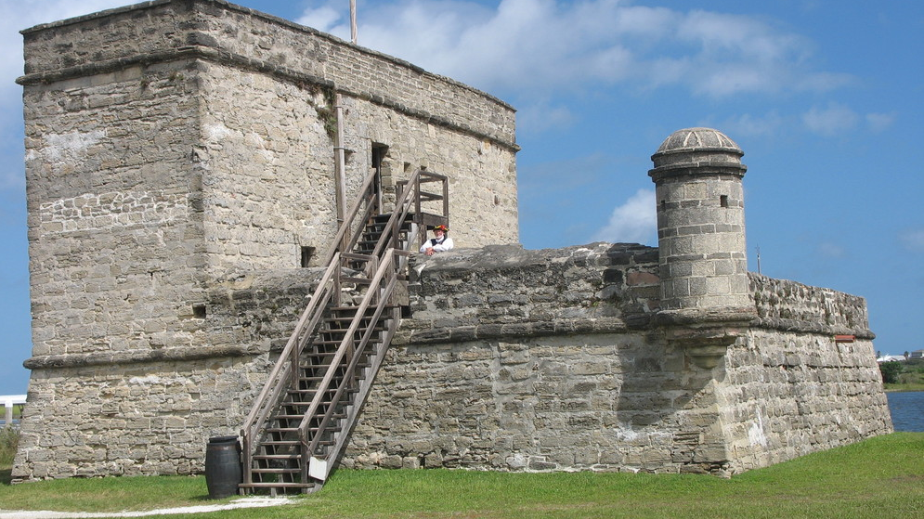
Colonial Americas

Slide 8
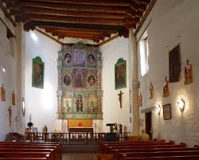
Spanish Explorers and Missionaries to New Spain—Specifically the region that becomes the United States
The San Miguel Chapel in Santa Fe, NM is considered the oldest church in the continental United States. The adobe church was constructed under the direction of Franciscan friars to serve a small congregation of soldiers, laborers, and Indians who lived in the Analco Barrio. Oral tradition holds that San Miguel Chapel was built around 1610. The original church, the “Hermita de San Miguel,” was built on the site of an ancient kiva of the Analco Indians. It is believed that Tlaxcalan Indians, who came to New Mexico from Mexico in 1598 with a Spanish contingent led by Don Juan Onate built the chapel. It was partially destroyed during the Pueblo Revolt of 1680. The present building dates from 1710, although it has undergone significant structural changes.

Slide 9
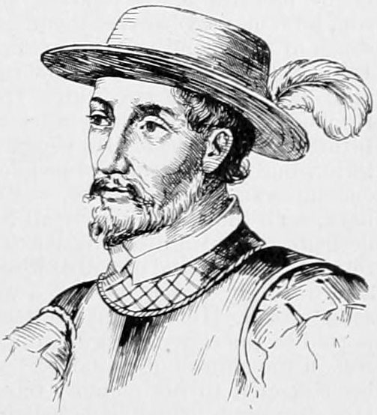
Juan Ponce de León (1460-1521) became the first Governor of Puerto Rico appointed by the Spanish crown. In 1493, he joined Christopher Columbus’ second voyage to the New World. The fleet reached the Caribbean in November 1493. They visited several islands (including Puerto Rico) before arriving in Hispaniola. Later he became the governor of PR. In the 1510s, after leaving Puerto Rico, he led the first European expedition to Florida. Ponce de León equipped three ships with at least 200 men and set out from Puerto Rico in 1513. They sailed northwest along the great chain of Bahama Islands. On March 27, they sighted an island unfamiliar to the sailors. Scholars believe that this "island" was actually Florida, as it was thought to be an island for several years after its formal discovery. For the next several days the fleet crossed open water until April 2, 1513, when they sighted land which Ponce de León believed was another island. He named it La Florida in recognition of the verdant landscape and because it was the Easter season, which the Spaniards called Pascua Florida (Festival of Flowers).

Slide 10
Hernando de Soto (c. 1496/98–1542) also explored the southeastern United States and led the first European expedition deep into the territory of the modern-day states of Florida, Georgia, Alabama, and Arkansas, and the first documented European to have crossed the Mississippi River. De Soto's North American expedition ranged throughout the southeastern United States searching for gold, silver and passage to China. De Soto died in 1542 on the banks of the Mississippi River. Some believed that de Soto was influenced by Juan Ponce de León, Vasco Núñez de Balboa, and Ferdinand Magellan. In May 1539, de Soto landed nine ships with over 620 men and 220 horses in south Tampa Bay. He named it Espíritu Santo after the Holy Spirit. The ships brought priests, craftsmen, engineers, farmers, and merchants; some with their families, some from Cuba, most from Europe and Africa. Few had traveled before outside of Spain, or even their home villages. De Soto established a unique method for guiding the expedition and communicating with various tribal dialects. He recruited guides from each tribe along the route. A chain of communication was established whereby a guide who lived in close proximity to another tribal area passed his information and language on to a guide from a neighboring area. From Florida, the expedition turned north-east through what is now Georgia. The expedition found no gold, however, other than pieces from an earlier coastal expedition. De Soto headed north into the Appalachian Mountains of North Carolina, where his men searched for gold. De Soto next entered eastern Tennessee. At this point, De Soto either continued to Alabama or turned south and entered northern Georgia.

Slide 11
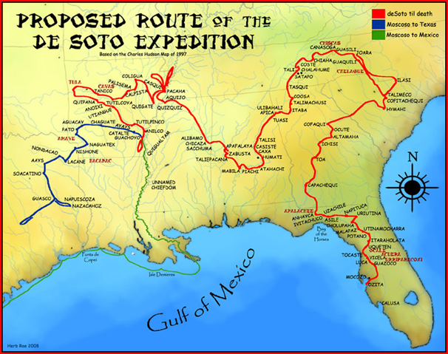
De Soto's expedition shifted south and headed toward the Gulf of Mexico to meet two ships from Havana. Frequent Native American attacks on the group decimated the expedition and tribal numbers. While the Spanish lost an estimated 200-plus men, they killed an estimated 2,000-6,000 warriors in one battle. Fearing that word of these atrocities would reach Spain if his men reached the ships at Mobile Bay, de Soto led them away from the Gulf Coast, into Mississippi, where they spent the winter. On May 8, 1541, de Soto's troops reached the Mississippi River. He and 400 men crossed the river at or near Memphis, TN and continued westward through modern-day Arkansas, Oklahoma, and Texas. De Soto and his men stayed just long enough to claim the area for Spain. Eventually, the Spaniards returned to the Mississippi River. De Soto died of a fever on May 21, 1542 on the western banks of the Mississippi.

Slide 12
Francisco Vázquez de Coronado y Luján (1510 – 22 September 1554) was a Spanish conquistador and explorer, who led a large expedition from Mexico to present-day Kansas through parts of the southwestern United States between 1540 and 1542. Coronado had hoped to reach the mythical Seven Cities of Gold. His expedition marked the first European sightings of the Grand Canyon and the Colorado River. Coronado’s expedition included 400 European, 1,300 to 2,000 Mexican Indian allies, 4 Franciscan monks, and several slaves. They traveled north and Coronado decided to divide his expedition into small groups and time their departures so that grazing lands and water holes along the trail could recover. At intervals along the trail, Coronado established camps and garrisoned soldiers to keep the supply route open. Coronado traveled north on one side or the other of today's Arizona-New Mexico state line, and from the headwaters of the Little Colorado River continued to the Zuni River. The members of the expedition were almost starving and demanded entrance into the village of Hawikuh. The natives refused, in response, Coronado and his expeditionaries attacked the Zunis. Although Coronado was injured, his men continued their exploration and some of his men reached the Colorado River. Once recovered, Coronado joined the expedition through Texas and into Kansas. In 1542, Coronado had returned to New Mexico and from there decided to return to New Spain. His group left behind two clergymen. Although he remained governor of Nueva Galicia in New Spain, Coronado’s expedition was viewed a failure and forced him into bankruptcy. Coronado remained in Mexico City, where he died of an infectious disease on September 22, 1554.

Slide 13
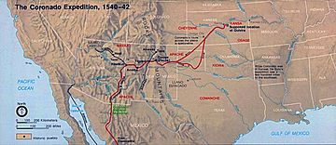
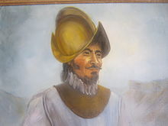

Slide 14
Pedro Menendez de Avilés (1519-1574) was a Spanish admiral and explorer from the region of Asturias, Spain, who is remembered for planning the first regular trans-oceanic convoys and for founding St. Augustine, Florida, in 1565. This was the first successful Spanish settlement in La Florida and the most significant city in the region for nearly three centuries. Following the French occupation of the region and founding of Ft. Caroline, Spain sent Menendez to establish a Spanish presence and conquer the French. Menéndez subsequently became the first governor of colonial Florida.
Don Juan de Oñate y Salazar (1550–1626) was a Spanish Conquistador, explorer, and colonial governor of the Santa Fe de Nuevo México province in the Viceroyalty of New Spain. He led early Spanish expeditions to the Great Plains and Lower Colorado River Valley, encountering numerous indigenous tribes in their homelands there. Oñate founded settlements within the present day American Southwest. In 1601, Oñate undertook a large expedition east to the Great Plains region of central North America. There were 130 Spanish soldiers and 12 Franciscan priests, similar to the expedition of the Spanish conquest of the Aztec Empire, and a retinue of 130 Indian soldiers and servants, and 350 horses and mules. Oñate journeyed across the plains eastward from New Mexico in a renewed search for Quivira, fabled "city of gold." As had the earlier Coronado Expedition in the 1540s, he encountered Apaches in the Texas Panhandle region. He proceeded eastward following the Canadian River into the "Oklahoma" region.

Slide 15
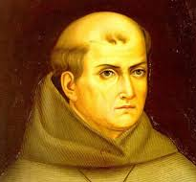
Junipero Serra (1713-1784) was a Spanish Franciscan friar who founded a mission in Baja California and the first nine of twenty-one Spanish missions in California from San Diego to San Francisco, which at the time were in Alta California in the Province of Las Californias, New Spain. He began in San Diego on July 16, 1769, and established his headquarters near the Presidio of Monterey, but soon moved a few miles south to establish Mission San Carlos Borromeo de Carmelo in today's Carmel, California. The missions were primarily designed to bring the Catholic faith to the native peoples. Other aims were to integrate the neophytes into Spanish society, to provide a framework for organizing the natives into a productive workforce in support of new extensions of Spanish power, and to train them to take over ownership and management of the land. As head of the order in California, Serra not only dealt with church officials, but also with Spanish officials in Mexico City and with the local military officers who commanded the nearby garrison. Serra was beatified by Pope John Paul II on September 25, 1988, in Vatican City. Pope Francis canonised him on September 23, 2015, at the Basilica of the National Shrine of the Immaculate Conception in Washington, DC, during his visit to the US. Because of Serra's recorded acts of piety combined with his missionary efforts, he was granted the posthumous title Apostle of California. The declaration of Serra as a Catholic saint by the Holy See was controversial with some Native Americans who criticize Serra's treatment of their ancestors and associate him with the suppression of their culture.

Slide 16
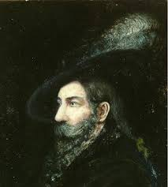
Juan Bautista de Anza (1735-1788) was born in Sonora, New Spain into a military family living on the northern frontier of New Spain. He enlisted in the army at the Presidio of Fronteras and advanced rapidly. His military duties mainly consisted of forays against hostile Native Americans during the course of which he explored much of what is now Arizona. In 1772, Anza proposed an expedition to Alta California to the Viceroy of New Spain. This was approved by the King and on January 8, 1774, with 3 padres, 20 soldiers, 11 servants, 35 mules, 65 cattle, and 140 horses, Anza set out. The expedition took a southern route along the Rio Altar (Sonora y Sinaloa, New Spain), then paralleled the modern Mexico/California border, crossing the Colorado River at its confluence with the Gila River. Anza reached Mission San Gabriel Arcángel on March 22, 1774, and Monterey, California, on April 19. He returned to Arizona and later led a group of colonists to California. The expedition continued on to Monterey with the colonists. Having fulfilled his mission from the Viceroy, he continued on with Father Pedro Font and a party of twelve others exploring north and found an inland route to the San Francisco Bay described by Portolà. On his return he journeyed to Mexico City and the Viceroy of New Spain appointed Anza as the Governor of the Province of Nuevo México, the present day US state of New Mexico.

Slide 17
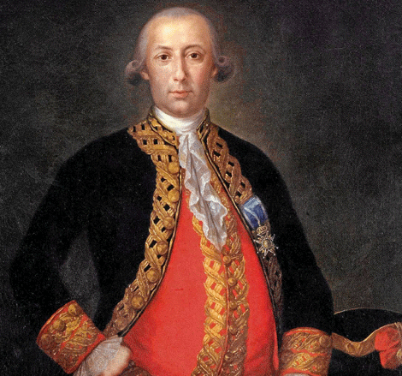
Bernardo de Gálvez (1746 – 1786) was a Spanish military leader and colonial administrator who served as colonial governor of Louisiana and Cuba, and later as Viceroy of New Spain. Under a royal order from Charles III of Spain, Gálvez continued the smuggling operations to supply the American rebels early in 1777. Gálvez worked with Oliver Pollock, an American patriot, shipping gunpowder, muskets, uniforms, medicine, and other supplies. Gálvez let an American force through New Orleans before Spain joined the cause. Gálvez was sent to Florida by New Spain Viceroy Martín de Mayorga, at the head of an expedition of colonial troops to aid American colonists in their rebellion against Great Britain. Spain's motive was the chance both to recover territories lost to the British, particularly Florida, and to remove the ongoing British threat. Gálvez carried out a masterful military campaign and defeated the British colonial forces at Manchac, Baton Rouge, and Natchez in 1779. The Battle of Baton Rouge, on September 21, 1779, freed the lower Mississippi Valley of British forces and relieved the threat to the capital of Louisiana, New Orleans. In 1780, he recaptured Mobile from the British at the Battle of Fort Charlotte. In 1781, at the Siege of Pensacola, Gálvez recaptured Florida for Spain. He spent the last two years of his life as Viceroy of New Spain. The city of Galveston, Texas, was named for him.

Slide 18
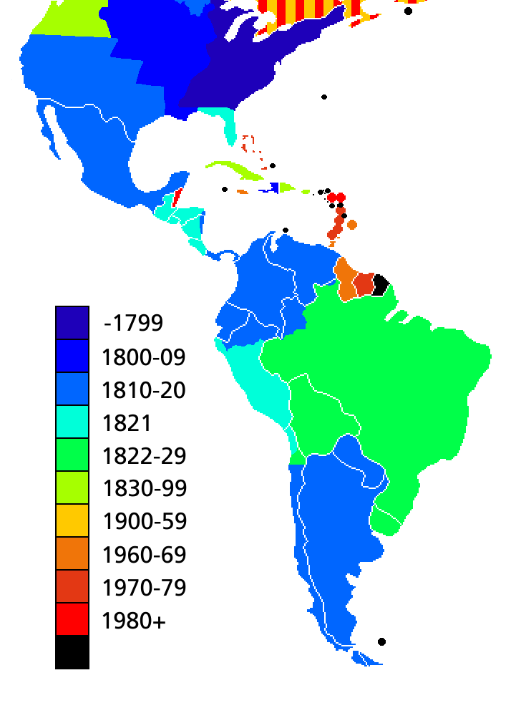
In the early 19th century, the Spanish American wars of independence resulted in the freedom of most Spanish colonies in the Americas, except Cuba and Puerto Rico—given up in 1898 after the Spanish-American War, together with Guam and the Philippines in the Pacific. Spain’s loss of these last territories politically ended Spanish Colonization in the Americas.

Slide 19
Sources:
https://en.wikipedia.org/wiki/
http://sanmiguelchapel.org/

Slide 20
Please share in this special annual tribute by learning and celebrating the generations of Hispanic Americans who have positively influenced and enriched our nation and society.

Slide 21
The study of history and political science provides enhanced understanding of society, increases communication skills, and teaches critical thinking. These, and other benefits of a liberal arts education, bring confidence and increased enjoyment in every area of life by broadening the students’ intellectual experience. The History & Political Science Department serves Andrews students in several ways. It provides general educational courses required for all students and offers degree programs for those interested in further study of American and European history, political science, or social studies. Faculty in the department aid students in understanding the relationship of the past and present and demonstrate how local, national, and international political processes affect and respond to events. All teachers approach their subjects from an explicit, biblically based, Christian perspective.
https://www.andrews.edu/cas/history/

Slide 22
A major in History from Andrews University equips students with knowledge and skills for success in a wide range of areas. Students understand the past and its relationship to the present through a variety of American, European, and non-western history courses, training in a foreign language, hands-on experience in historical research, and an introduction to historical philosophy and theory. Our degree prepares students for careers in teaching, research, law, and for graduate work in a wide range of professional and academic areas. In addition, it encourages the moral, intellectual, civic, social, and spiritual maturity to accompany a life well-lived.
A Political Science major from AU equips students with unique knowledge and skills that find practical solutions to some of the world's most urgent social, economic and political problems. It prepares students for careers in teaching, government and politics, law, and for graduate student in a wide range of professional and academic areas. In preparing students for a specific profession, a political science major teaches lessons in citizenship and statesmanship and seeks to encourage moral, intellectual, civic, social, and spiritual maturity to accompany a life well-lived. The discipline of Political Science also teaches students to critically assess a host of difficult problems and aims at finding.
Our Social Studies degree from AU is an interdisciplinary program that prepares students for teaching elementary and secondary education.

