Slide 1

Servant Leadership for Principals
Principal’s Webinar
November 11, 2013
Presenters:
Jeff A. Bovee, PhD – Vice President for Education, Pennsylvania Conference
Donovan B. Ross, PhD - Associate Director for Secondary Education, Columbia Union Conference

Slide 2
Servant Leadership
For principals

Slide 3

Leadership
Notes:
Talk Briefly about Leadership Styles especially Paternalistic Leadership
Does this reflect any leadership style that you know or know of?
You must hold them up, NOT the other way around

Slide 4
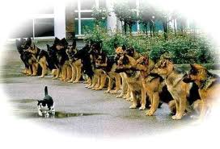
Courage Under Fire….
I wanted to run, but knew I was needed to stay to do
the right thing - Wallace
Notes:
Jeff shares experience SVA Fire 5+ minutes

Slide 5
Servant Leadership..….
Is an understanding and practice of leadership that places the good of those led over the self-interest of the leader.
Emphasizes – increased service to others, a holistic approach to work, a sense of community, shared decision making & spirituality in the workplace.
Notes:
Servant leadership is a paradoxical leadership philosophy which suggests that the leader is first a servant….and then a leader. It emphasizes increased service to others, a holistic approach to work, a sense of community and shared decision making power and spirituality in the workplace.

Slide 6
Description of Servant Leaders
Create a trusting work environment in which people are highly appreciated.
Listens to and encourages followers.
Visibly models appropriate behavior and functions as effective teachers.
Notes:
They seek not to be served, but to serve.
View leadership positions as opportunities to help, support, and aid other people.

Slide 7
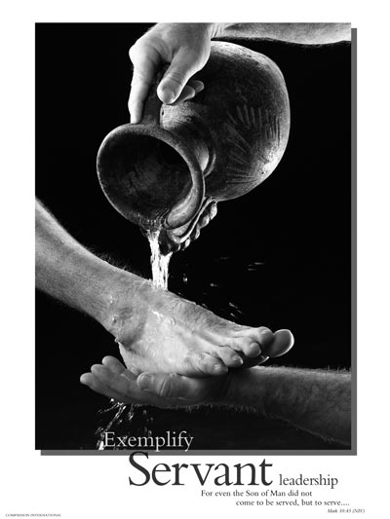

Slide 8
Description of Servant Leaders
Have a high degree of credibility because of their honesty, integrity, and competence.
Have a clear leadership vision and implement pioneering approaches to work.
Conscientious stewards of resources.

Slide 9
Description of Servant Leaders
Have good communication with followers and exercise ethical persuasion as a means of influence.
Invite others to participate in carrying out their leadership vision.

Slide 10
Description of Servant Leaders
Empower people by enabling them to perform at their best and by delegating decision-making responsibilities.
Overall, servant leaders provide direction and guidance by assuming the role of attendant to humanity (Russell, 2001)

Slide 11
Building Community
If you love kids and are good with people, the rest will fall into place.
You build organizations that succeed by putting people first.
A mature leader will automatically be engaged in empowering and equipping all of the human resources so all that energy can be integrated into a powerful force for positive change.
Notes:
Spend time with your staff whether or not you think they like you.
Success boils down to one thing: the relationships among the people that make up the organization

Slide 12
Characteristics of Servant Leadership
Listening
Foresight
Listen to others, stop talking so much, begin taking notes, and really listen.
Servant leadership calls on each team member in an organization to think about the ethics and values that need to be in place.
Notes:
Listen to others, stop talking so much, begin taking notes, and really listen

Slide 13
Awareness
If you live by your core values and principles, your staff will always respect you, and sooner or later, will do the right thing in what is best for the school.
Culture – when I walk into a place, I know at once if I am among friends or strangers.
Notes:
A servant leader realizes that change has to begin with the leader. When the servant leader lets go, real change in the organization begins.
Leadership is not about pulling and controlling the sled. It is more about equipping it so you can let it go.

Slide 14
Stewardship
EMPATHY
Servant leadership is about being a shepherd not a gatekeeper.
Your team needs you to get to know them, to laugh with them, cry with them, and care when they have experienced a loss. This will make you a principal with purpose
Notes:
Love your staff and pat them on the back for the faithful work they do.

Slide 15
Servant Leadership is characterized by a consistent pattern of:
Persuasion over coercion
Sustaining spirit over ego
Foresight over control
Listening over directing
Healing over judgment

Slide 16
A Servant Institution:
Honors the acts of question and criticism.
Acknowledges and tends to the corrupting influence of power.
Makes explicit its aspirations to serve, and monitors both the accomplishments and attitudes of the served.

Slide 17
A Servant Institution:
Balances the stability of good administration with the creativity of leadership.
Builds trust by performance and in the process rejects both blind trust and trust based on charisma. (Greenleaf, 1996)

Slide 18
Traditional School Leadership Pyramid
Principal
Administrative Team
Teaching & Support Staff

Slide 19
The Inverted Pyramid of Servant Leadership
Teaching & Support Staff
Administrative Team
Principal

Slide 20

Applications
The best leaders are so little about themselves, and so much about their people, one does not even know they are in the building, but their influence is in every room.

Slide 21
Applications
Come to an agreement on vision and mission and make sure core values are aligned.
Every three months review and refine your plan to reach annual goals.
Live the vision, mission and core values. Schools without a well-planned and articulated vision and without a process in place to follow through and implement it - are in real trouble.
Notes:
Make sure your school has an inspiring vision and go after it – every day!

Slide 22
Applications
Meet and talk out issues and follow three rules:
  1. Be honest.
  2. Be gentle, with lots of grace.
  3. Listen so that you can understand other’s
  perspectives.
Notes:
Make sure your school has an inspiring vision and goes after it – every day!
Stay away from sharing your opinion too much unless you know you really need to say it.

Slide 23
Applications
Don’t take your work home with you.
Put your health above the school or organization.
Take care of your mental, emotional, and spiritual well-being.
Notes:
It’s about the people, not just the test scores and the data reports.
Go home early more often, your spouse and kids are PRIORITY not your job!!!

Slide 24
Applications
Rest, renew & spend time with your family. Take time away from the office during breaks especially summer, Christmas & spring break.
Exercise more, eat healthy, sleep more, but more importantly take care of your relationship with GOD, then practice what you preach.
As far as possible do not obsess about work while at home.

Slide 25
Applications
Get to know your staff one to one. Schedule time to talk to each one on one and listen.
Engage each staff person in honest self-assessment about where they are and where they want to be in the coming months.
Notes:
Put people first and let them know you value them and their ideas.
Have lunch with your teachers and let them know you appreciate their faithfulness

Slide 26
Applications
Every staff member needs to be plugged into where he or she most benefits the school. Assign them where you need them most and then equip them with the training and resources so they will be successful with their new work.

Slide 27
Applications
Meet with your office staff once per month for a few hours.
Never rush anyone out of your office.
Keep the front office organized and presentable and be nice to people.
Notes:
Get comfortable with the concept of mentoring and coaching

Slide 28
Applications
School business is a people business. You, the leader, are in the business of bridge building, not bridge burning.
The joy of the work is not in getting away from the people but being with the people and helping them whenever you can.
Delegate, delegate, delegate.

Slide 29
Applications
During school hours remain focused on school.
Know what is happening (be a presence in the hallway and classrooms) and provide instructional support to your teachers.

Slide 30
Applications
Conduct a mid-year survey to get feedback from students, teachers, staff, parents, & board. Ask them what is going well, what needs more attention, and vision for the future.
Notes:
Walk through the halls first thing in the mornings, and just stop and visit in classrooms and spend time with kids.

Slide 31
Applications
Hold all your teachers to a high standard. Support your strong teachers, work tirelessly with your weak teachers towards their improvement. If there is evidence that a teacher is unfit for the classroom then part ways with that teacher.
Notes:
Be totally focused on students
Your teachers should be role models and mentors to your students, hold your teachers accountable

Slide 32
Applications
Find ways to show appreciation to volunteers who have given so much of themselves to the school over the years.
Go out with the kids at recess, play with them.

Slide 33
Applications
When hiring, go after the best teachers and provide all teachers with a mentor/instructional accountability partner, and get one for yourself!
Make staff meetings meaningful.
Create a learning culture among your staff.
Notes:
Respect those giving you advice, and listen, but do not agree to anything that you know your staff and school is not ready for.

Slide 34
Applications
Model instructional leadership by empowering and equipping every instructional staff member to do what they are trained to do. Hold all staff (including yourself) accountable with ongoing growth plans and professional development.
Notes:
Do less busy work in the office, instead be "out there" with your people several times during the day
Spend more time listening, supporting, coaching and shepherding.

Slide 35
Applications
It should be so little about you and so much about your people. You must be your people’s support network
Notes:
Be there both physically and emotionally for your people

Slide 36
Results of Research
Ross (2006) surveyed principals, superintendents, and teachers in elementary and secondary schools in the North American Division school system and found that principals, superintendents, and teachers perceive a paternal style of leadership in the organization.
Bovee (2012) surveyed principals, superintendents, and teachers in K-12 and 9-12 schools with at least five teachers in the North American Division school system and found that principals, superintendents, and teachers as a whole perceive a paternal leadership style rather than a servant leadership style of leadership. However, principals and superintendents as a group perceive a servant leadership style of leadership in the organization.

Slide 37


Slide 38
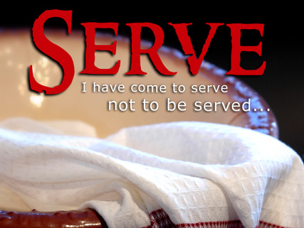
Mathew 20:26-28 NIV
“Not so with you. Instead, whoever wants to become great among you must be your servant, and whoever wants to be first must be your slave – just as the Son of Man did not come to be served, but to serve, and to give His life as a ransom for many.”

Slide 39

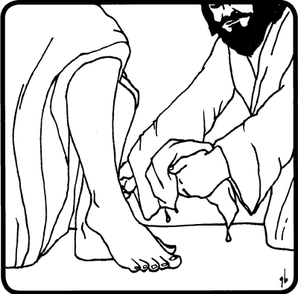
Matthew 23:11, 12
“The greatest among you will be your servant. For those who exalt themselves will be humbled, and those who humble themselves will be exalted.”

Slide 40

Notes:
Sitting down, Jesus called the Twelve and said, “Anyone who wants to be first must be the very last, and the servant of all.” -Mark 9:35

Slide 41
Philippians 2:1-5
“Therefore if you have any encouragement from being united with Christ, if any comfort from his love, if any common sharing in the Spirit, if any tenderness and compassion, then make my joy complete by being like-minded, having the same love, being one in spirit and of one mind. Do nothing out of selfish ambition or vain conceit. Rather, in humility value others above yourselves, not looking to your own interests but each of you to the interest of the others. In your relationships with one another, have the same mindset as Christ Jesus . . .”

Slide 42

Notes:
Jeff say a few words about the fire and his epiphany (after Robin & Mark discussion regarding office remodel)

Slide 43
In Closing
Stand up for what is right and have the courage to advocate for those who can’t advocate for themselves. This in a nutshell, is the essence of leading as a servant leader and not as a politician.

Slide 44


Primary References

Slide 45
Primary References
Bovee, J. A., (2012) School Leadership Retention: A Study of Servant Leadership and School Leader Satisfaction, (Doctoral Dissertation Abstracts International)
Ross, D.B., (2006) Perceptions the Evidence of a Servant Leadership Culture Among Educators in the P-12 School System of the North American Division of Seventh-day Adventists, (Doctoral Dissertation Abstracts International)

