Slide 1
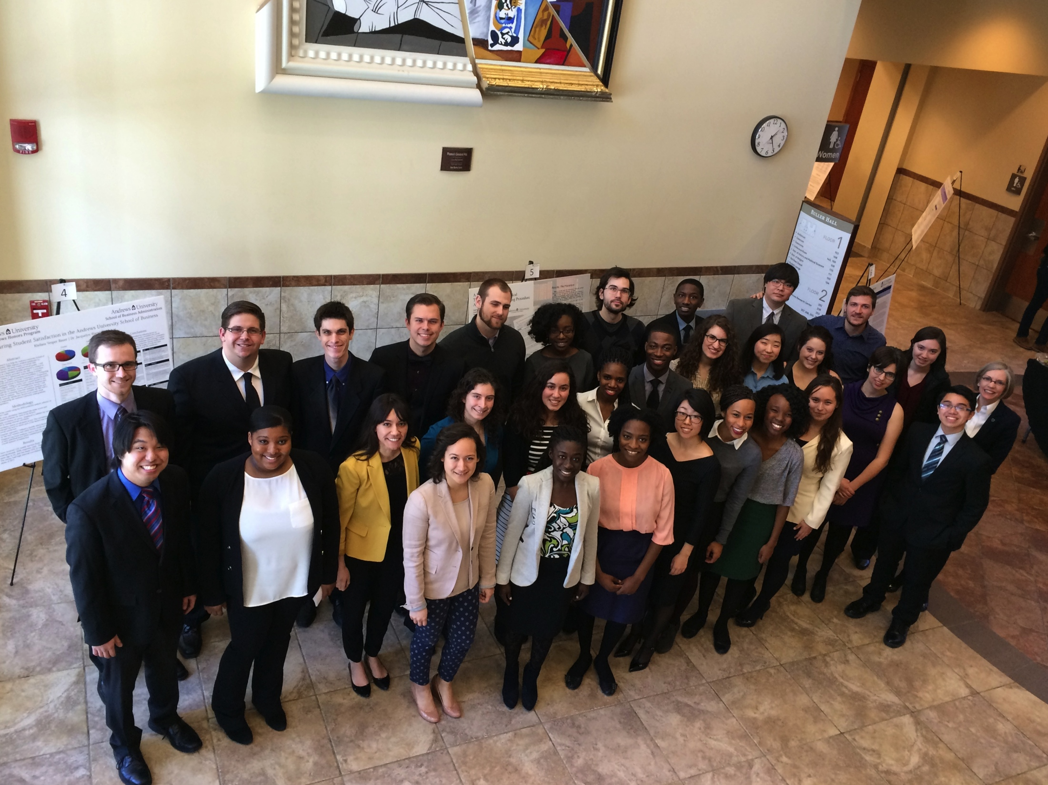
Celebrating Honors Seniors and Researchers 2015

Slide 2
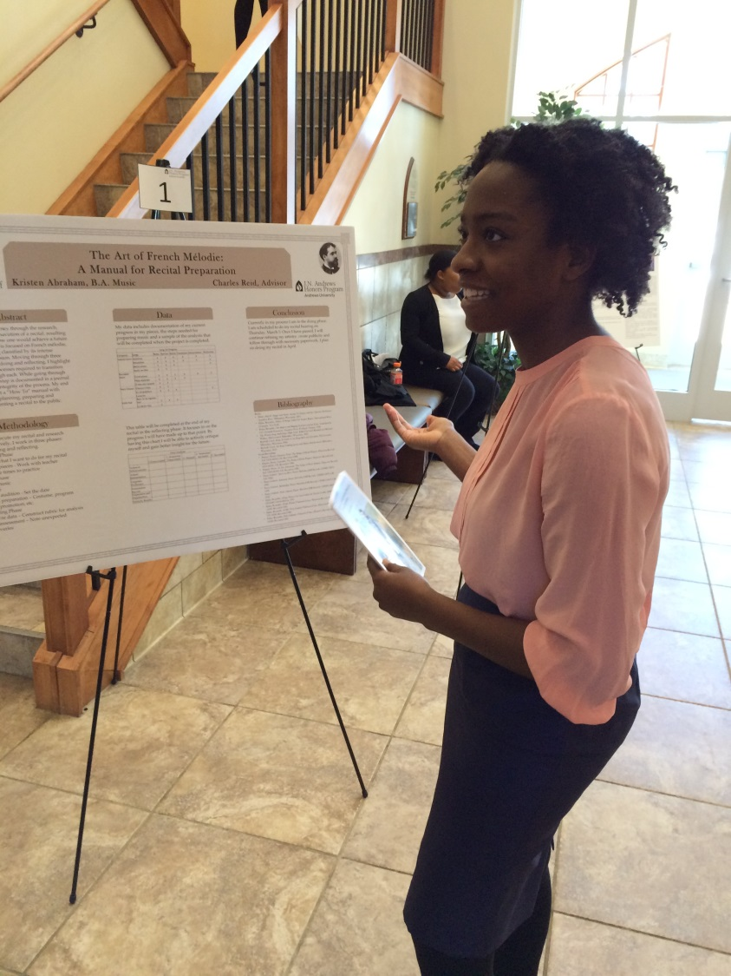
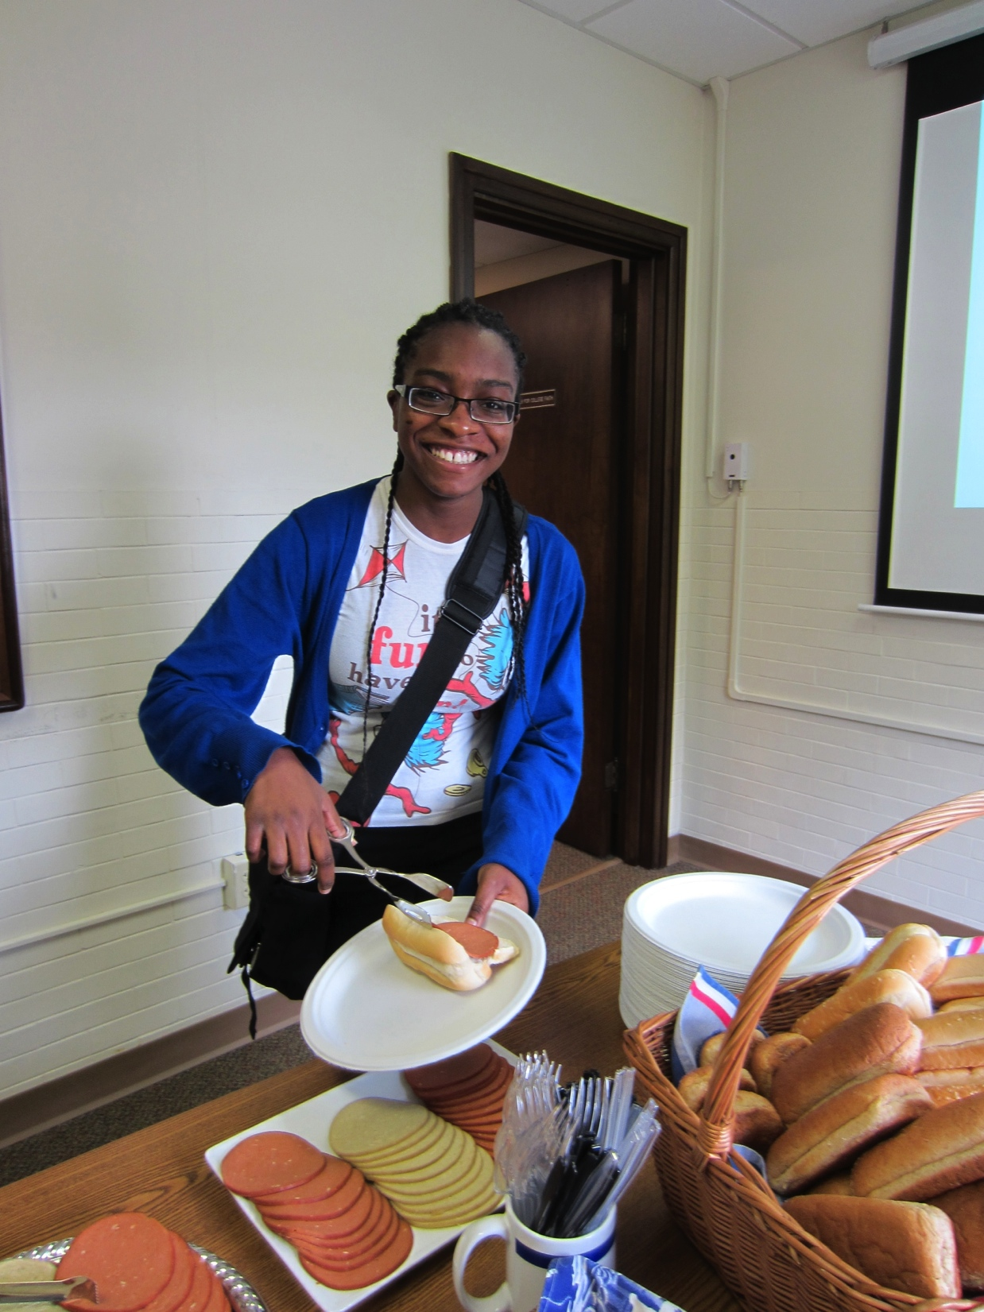
Kristen Abraham
Music
Will graduate May 2015

Slide 3
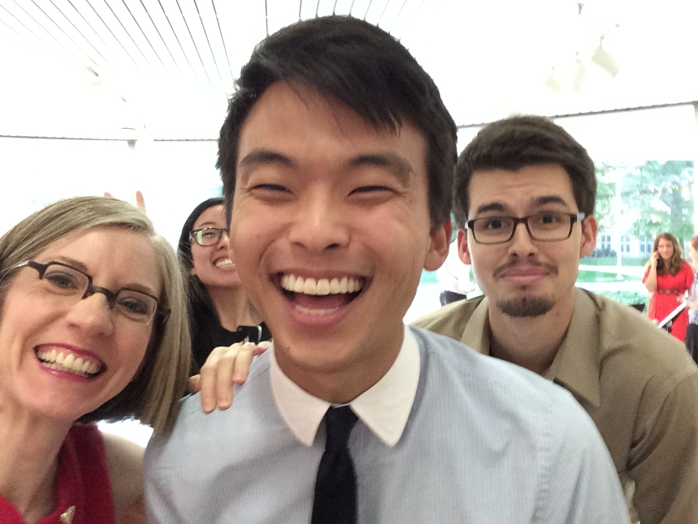
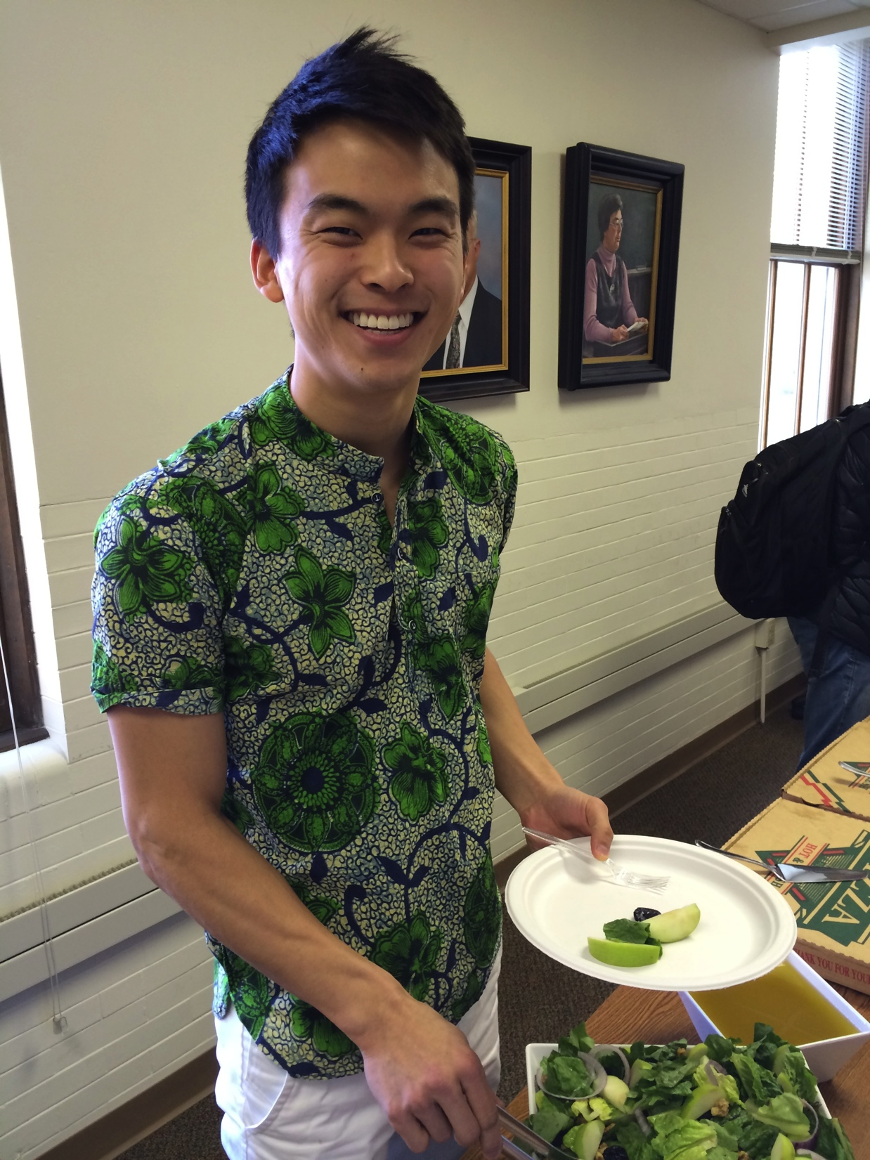
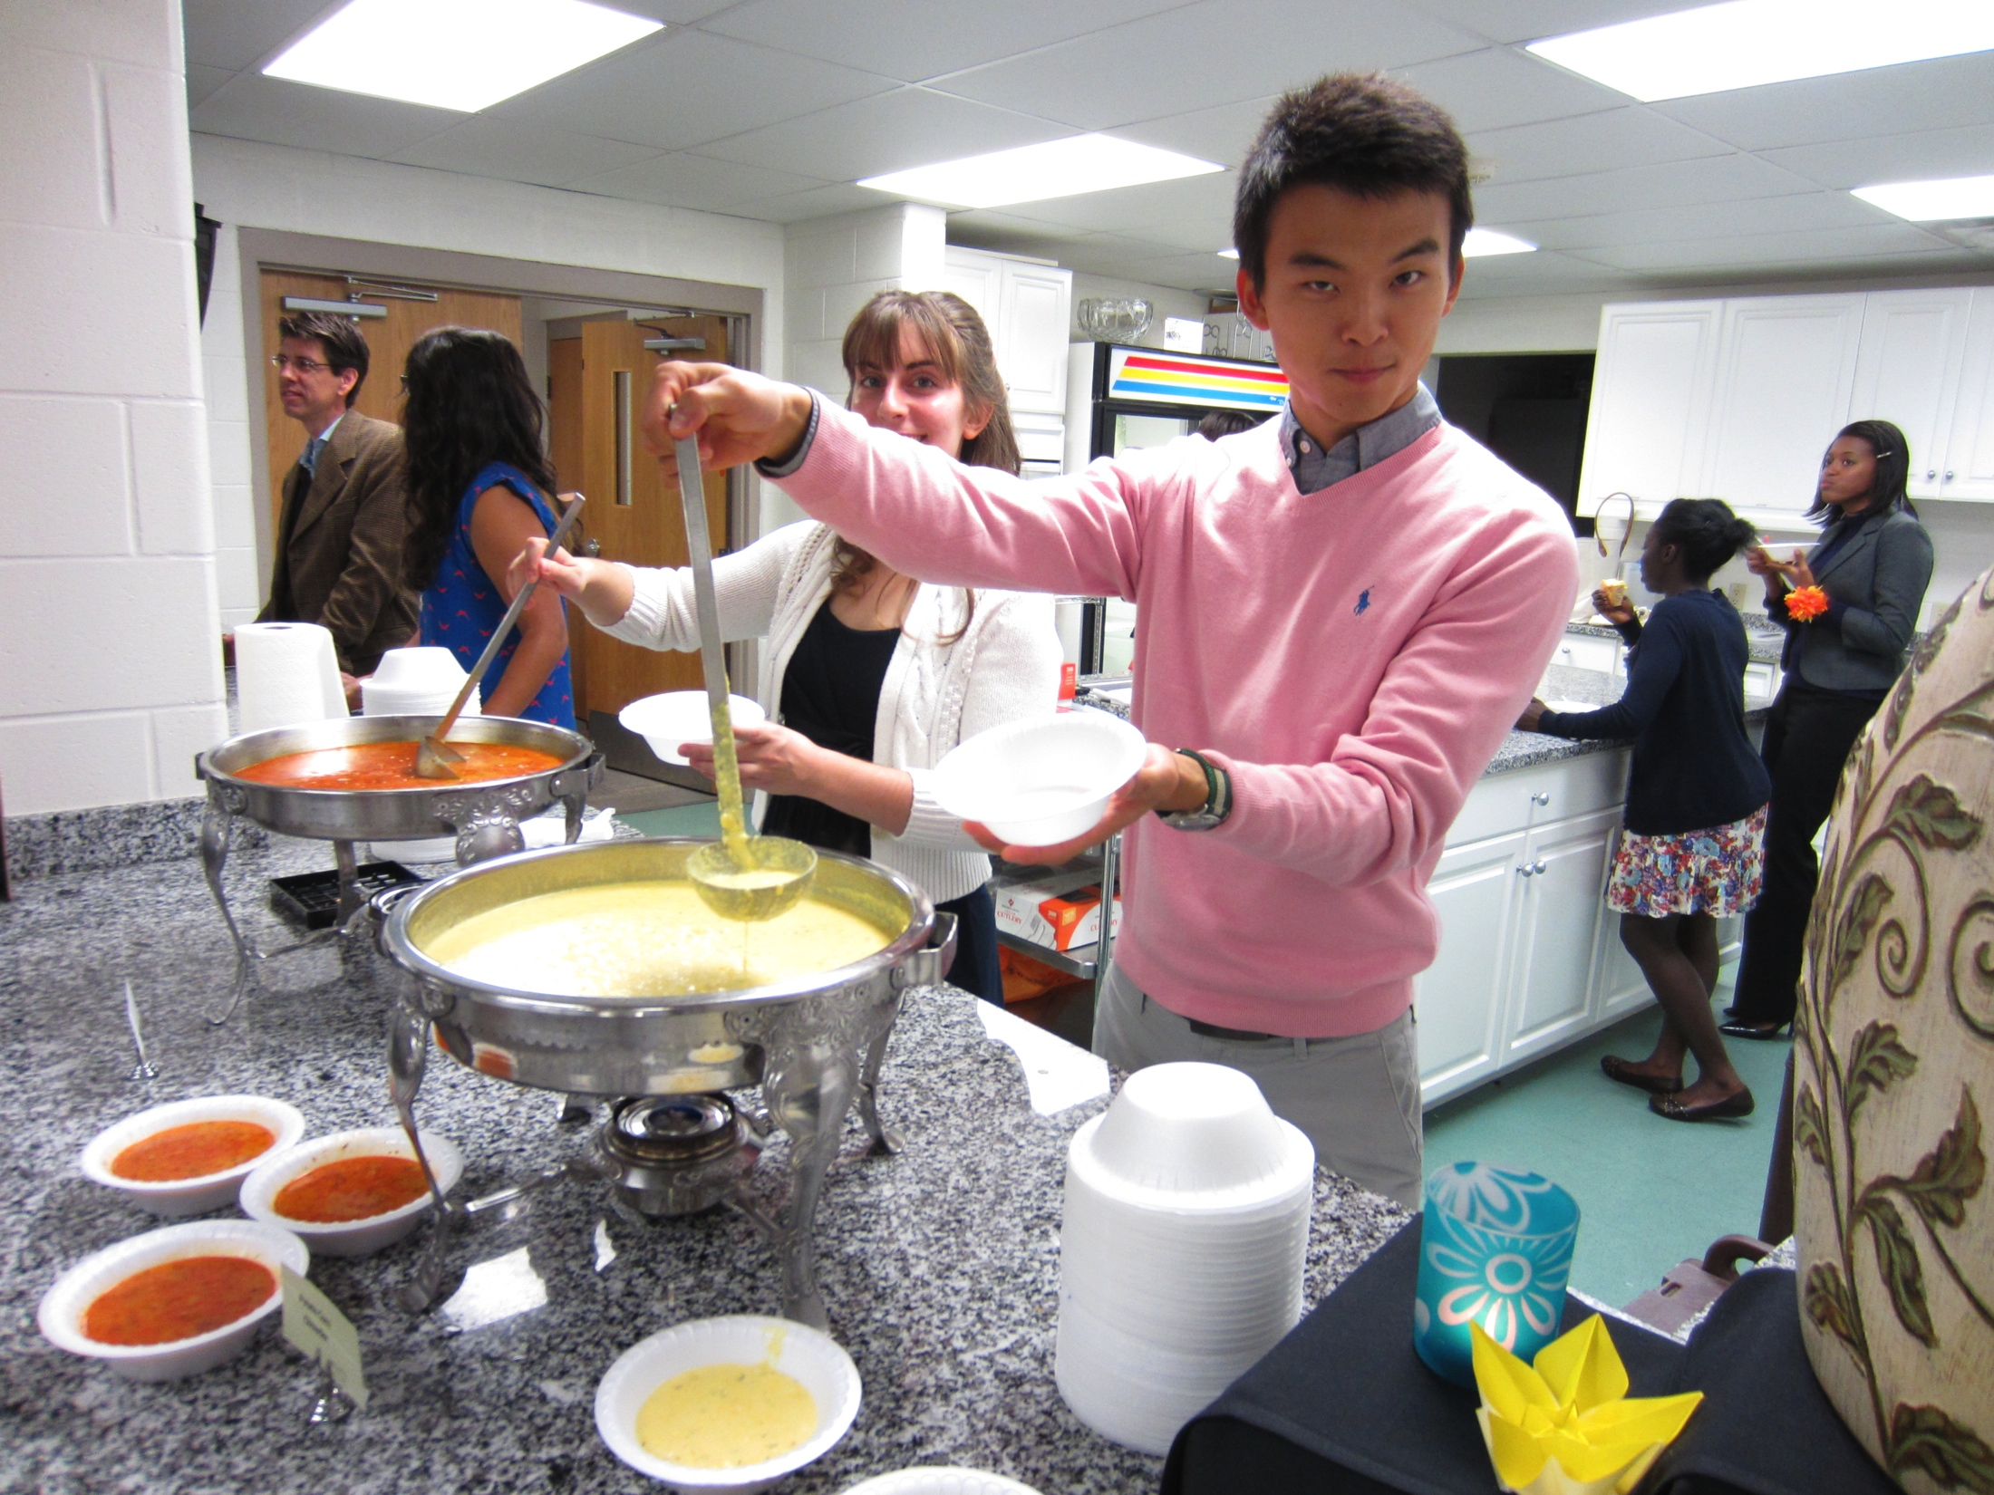
Johnny Ahn
Biology
Accepted to Loma Linda University School of Medicine
Georgia Medical College (received 100% scholarship)
Graduated December 2014

Slide 4
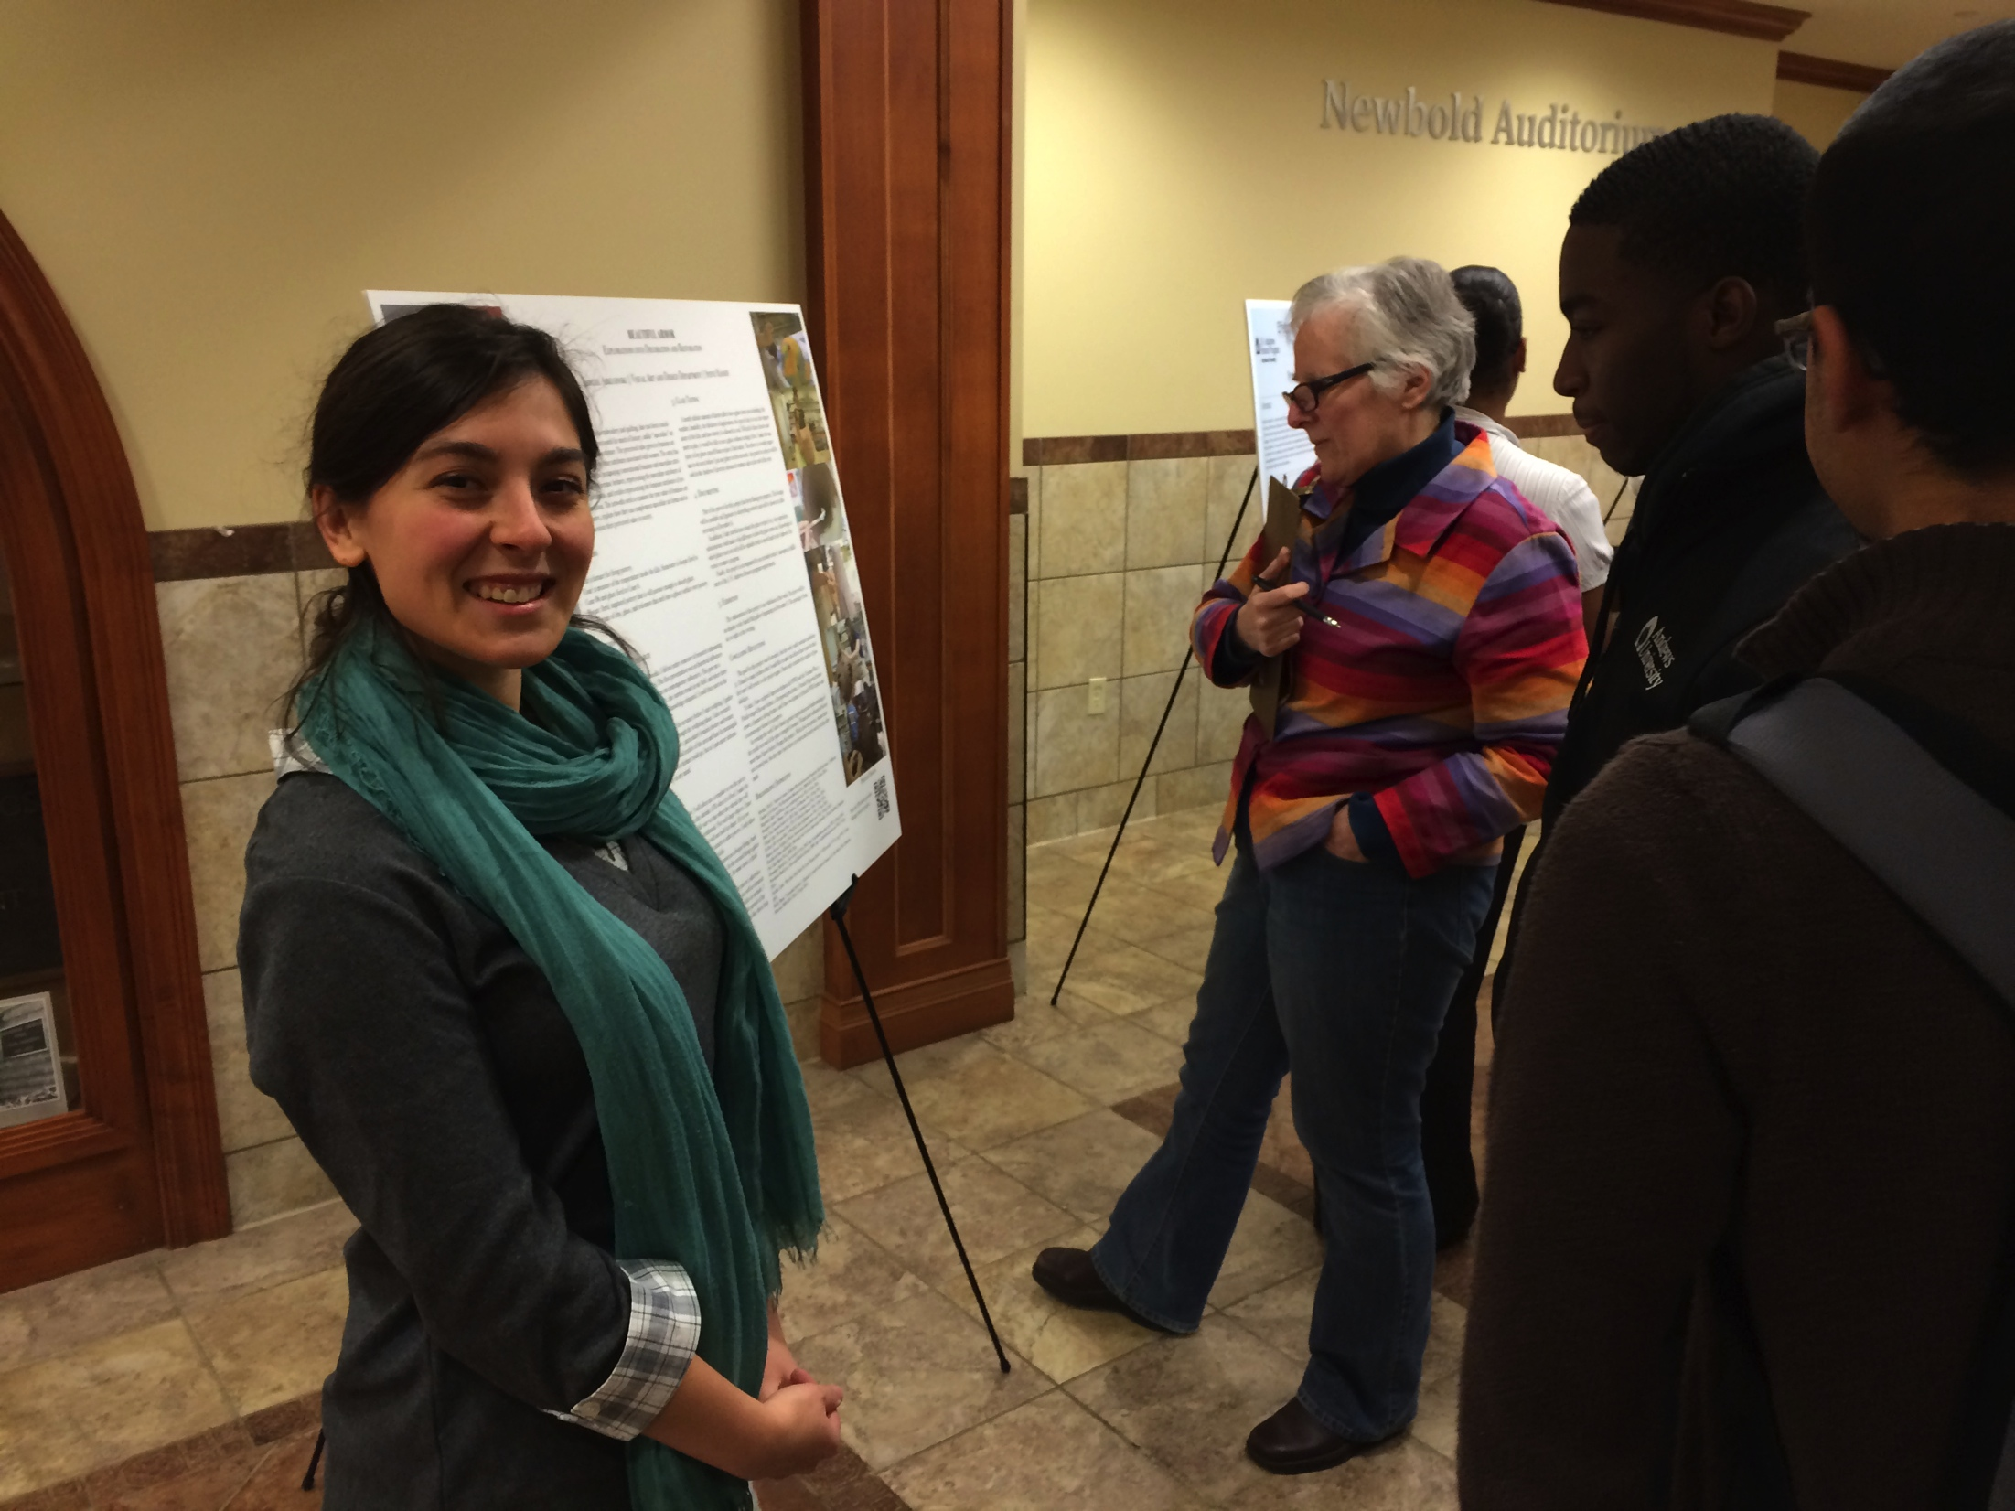
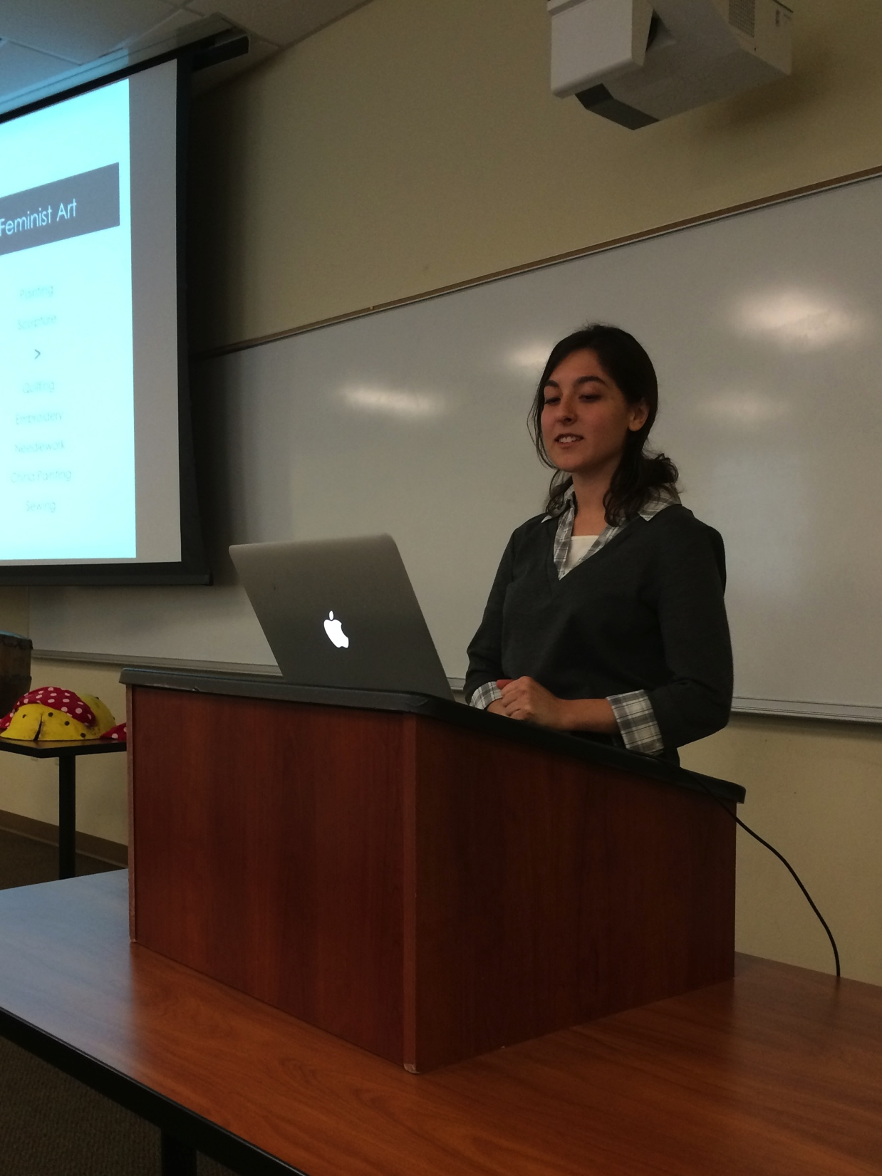
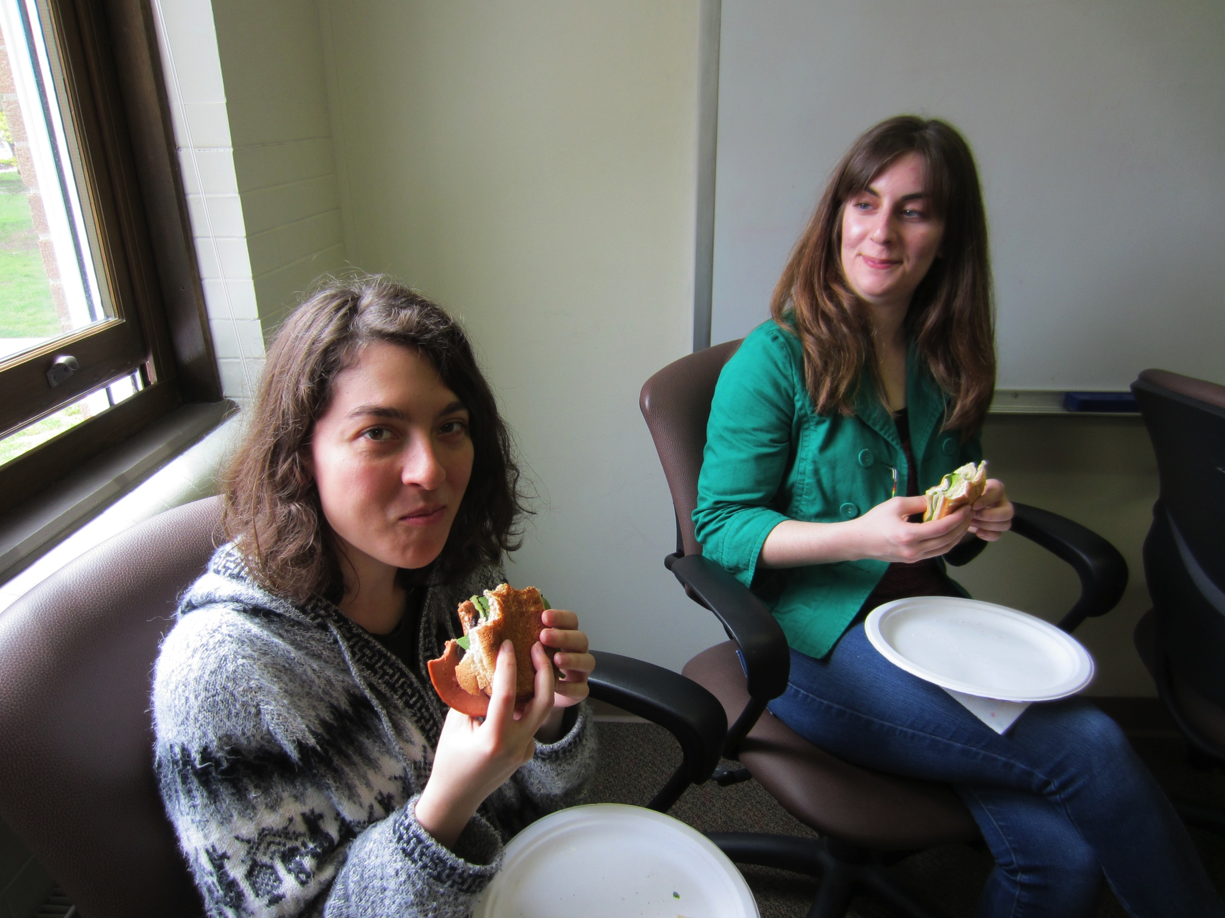
Abigail Arkunsinski
Visual Art
Concentration in Fine Art
Graduated December 2014
Along with her husband, Jeanmark Kessler, Abigail will be moving to a post in ministry and establishing her studio.

Slide 5
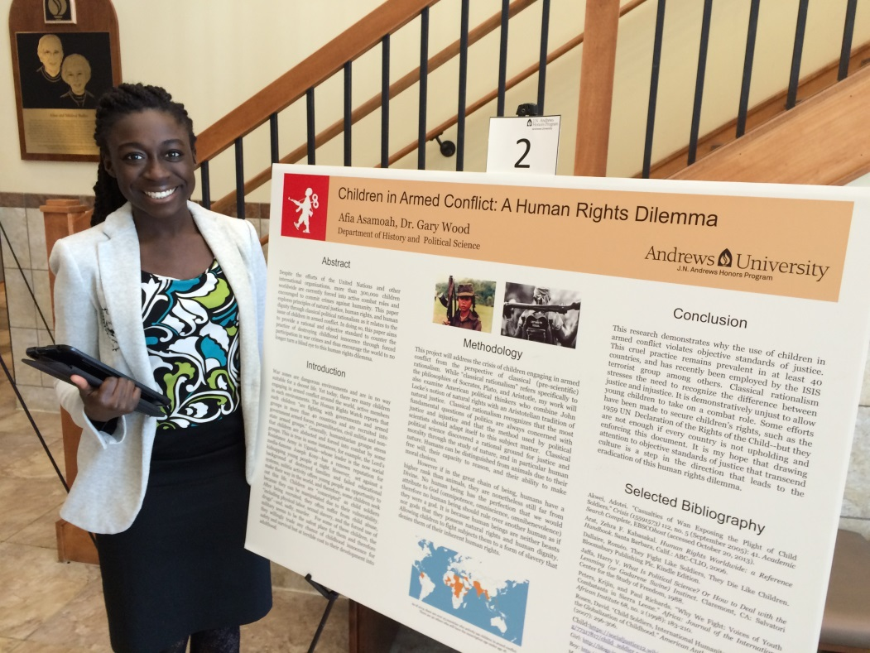
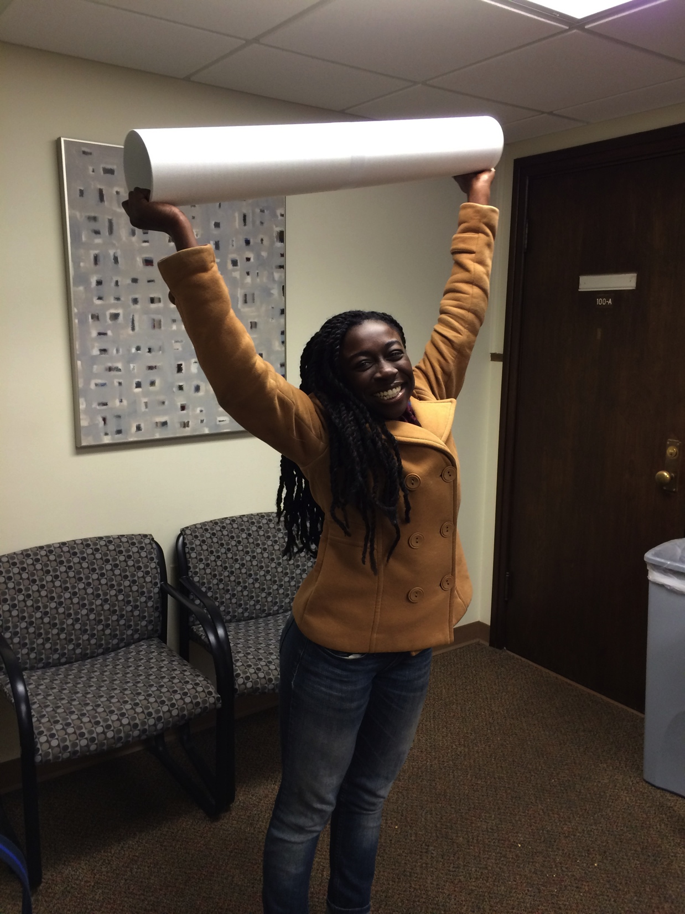
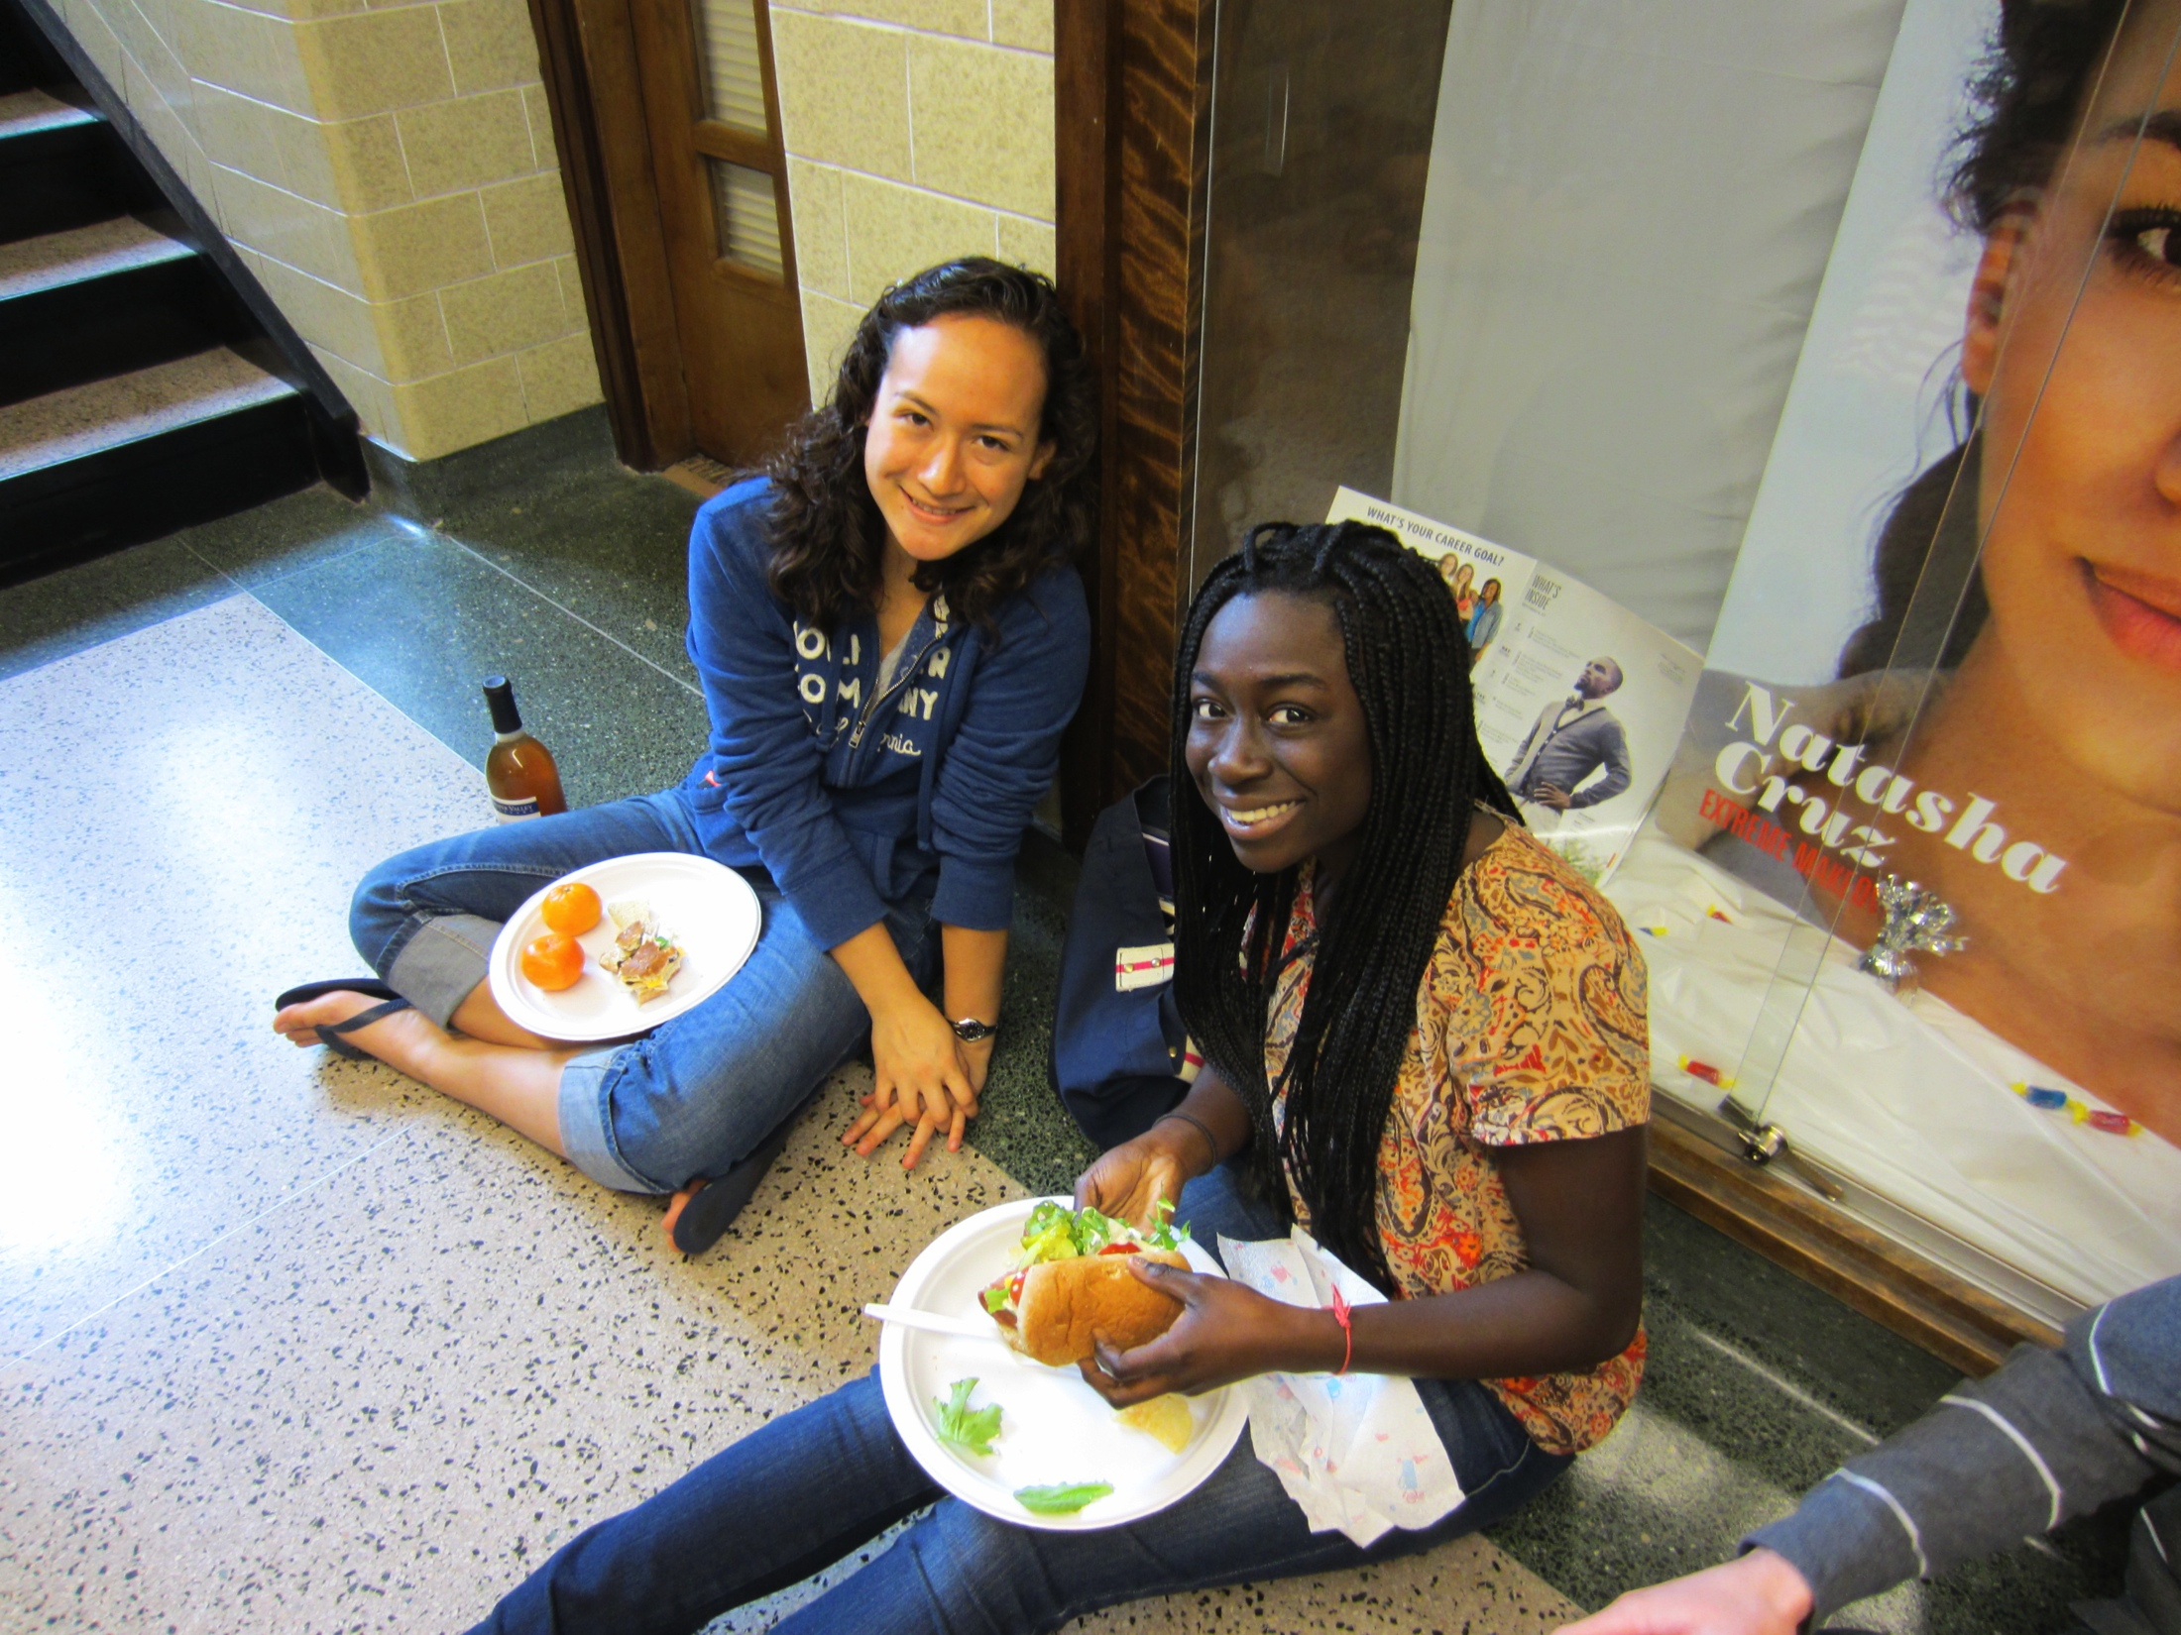
Afia Asamoah
Political Science, Music
Minor in Community and International Development
Plans to continue graduate studies in Community and International Development at Andrews University in the Fall of 2015

Slide 6
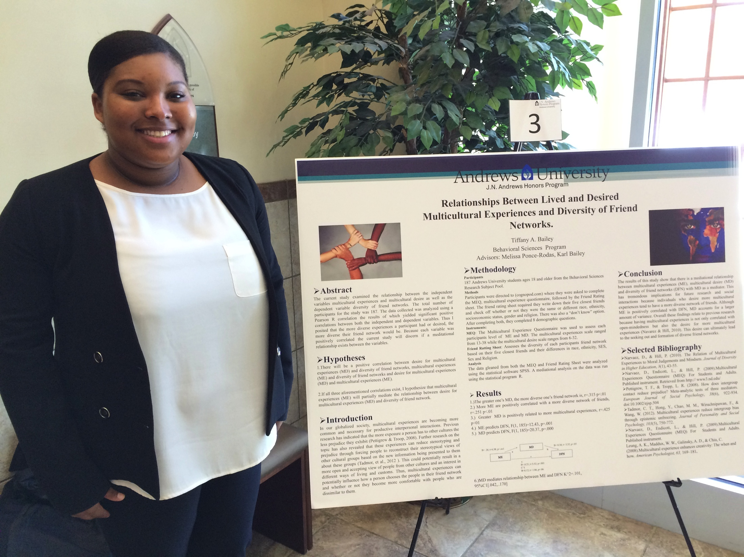
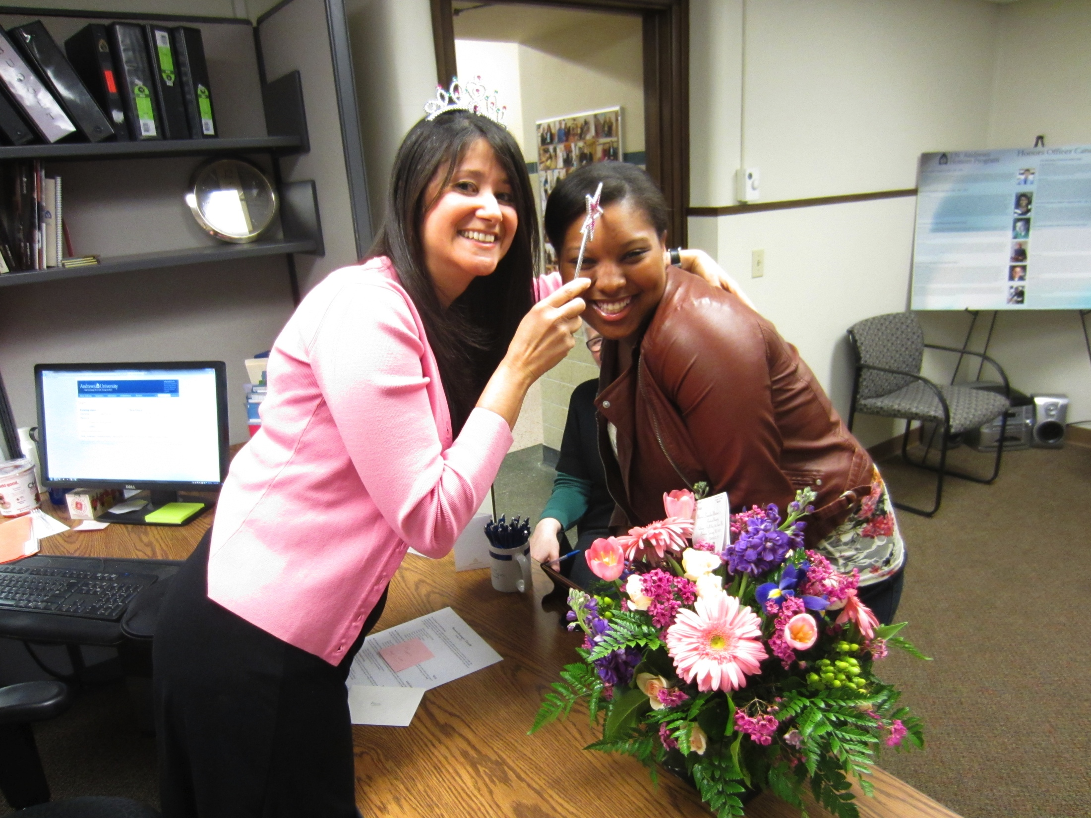
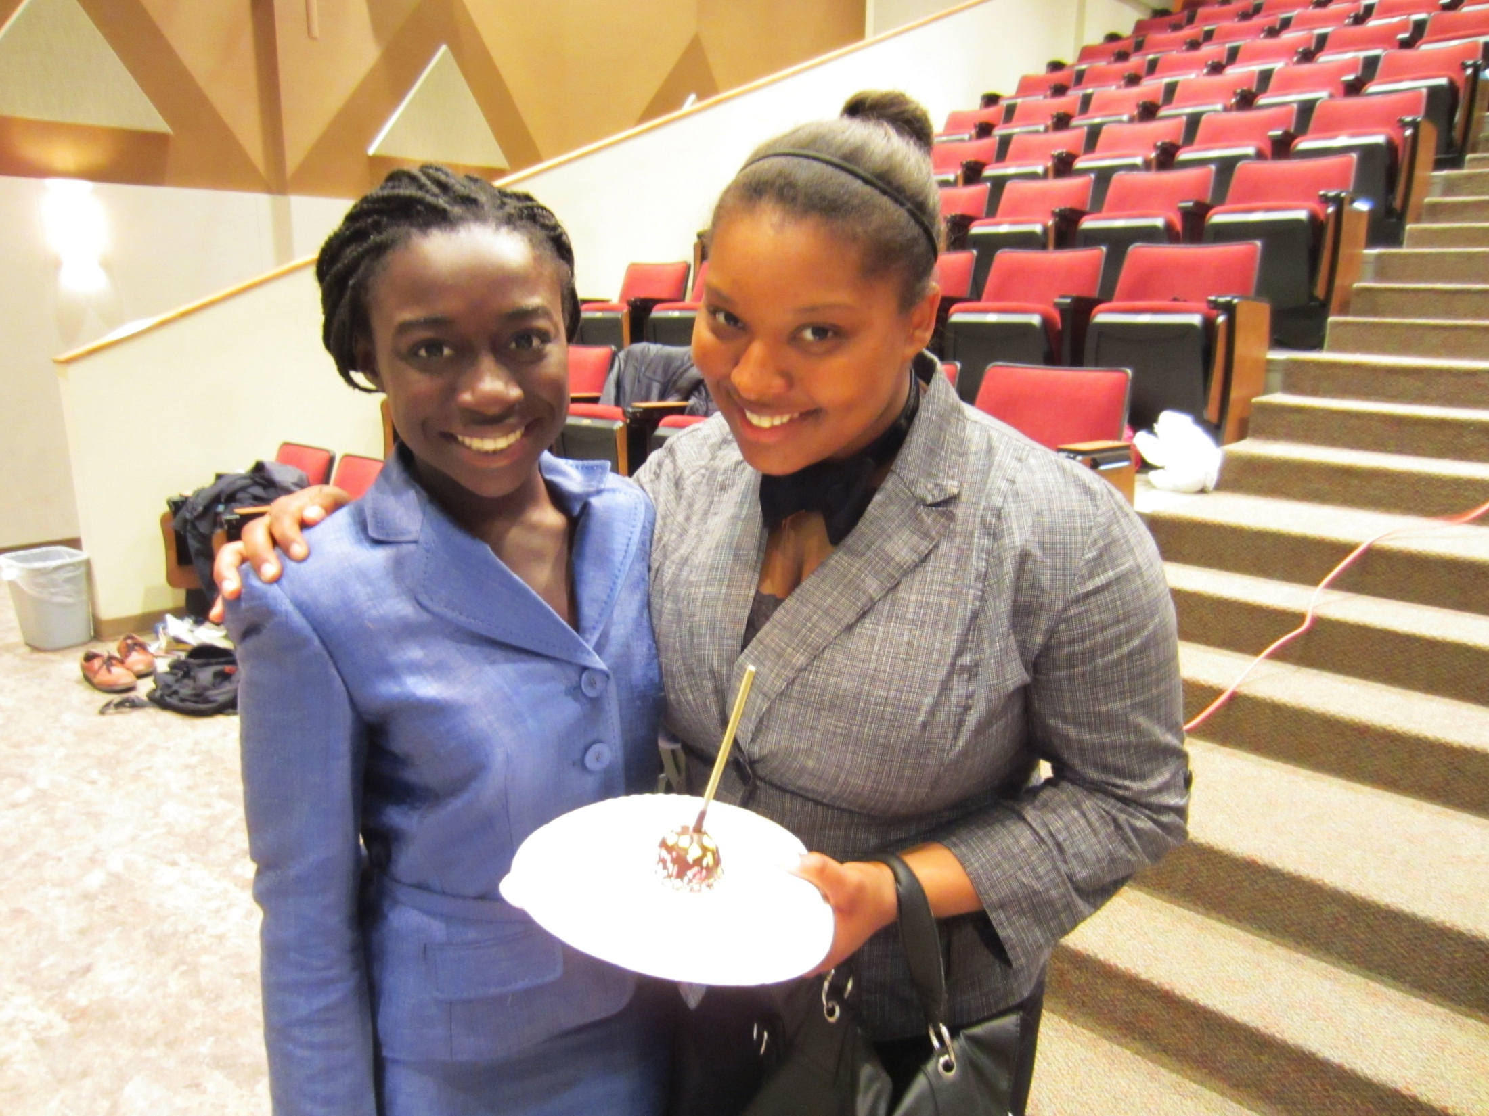
Tiffany Bailey
Psychology
Minor in Advocacy of Public Policy
Plans to continue graduate studies in Community and International Development at Andrews University in the Fall of 2015

Slide 7
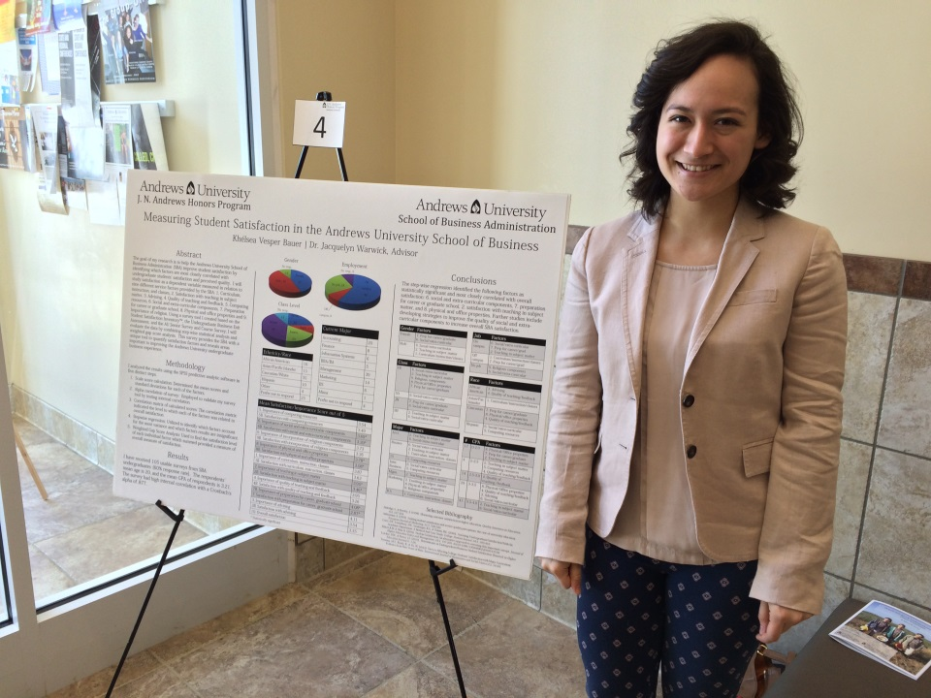
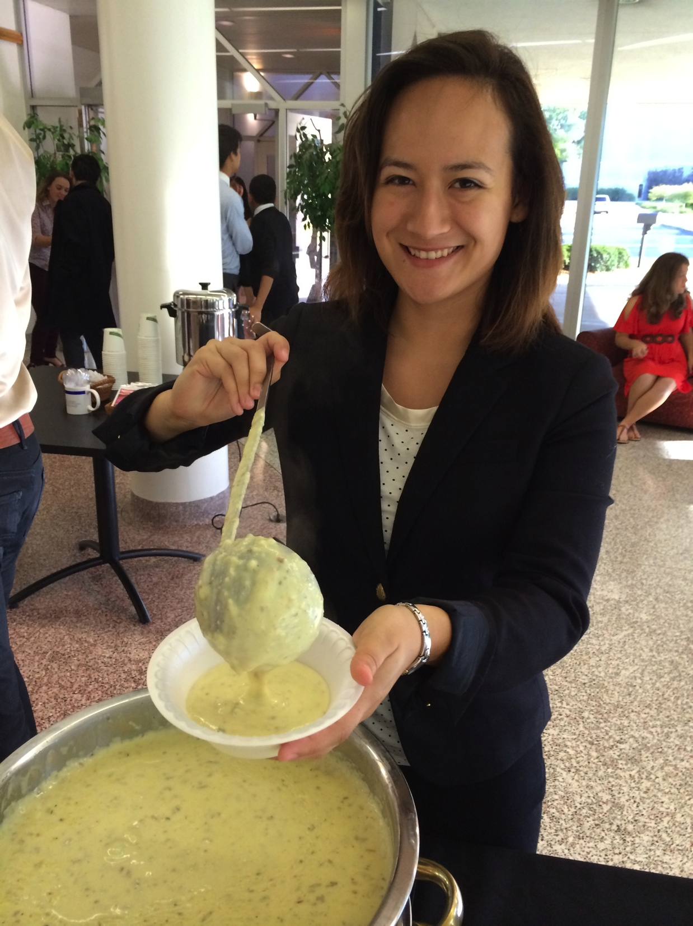
Khelsea Bauer
Management: International Business and Languages
Spanish for International Trade
Hired by Adventist Health Systems in Florida for a 3-year General Management Residency
Applying to Crummer Graduate School of Business – Rollins College
Will work and pursue MBA

Slide 8
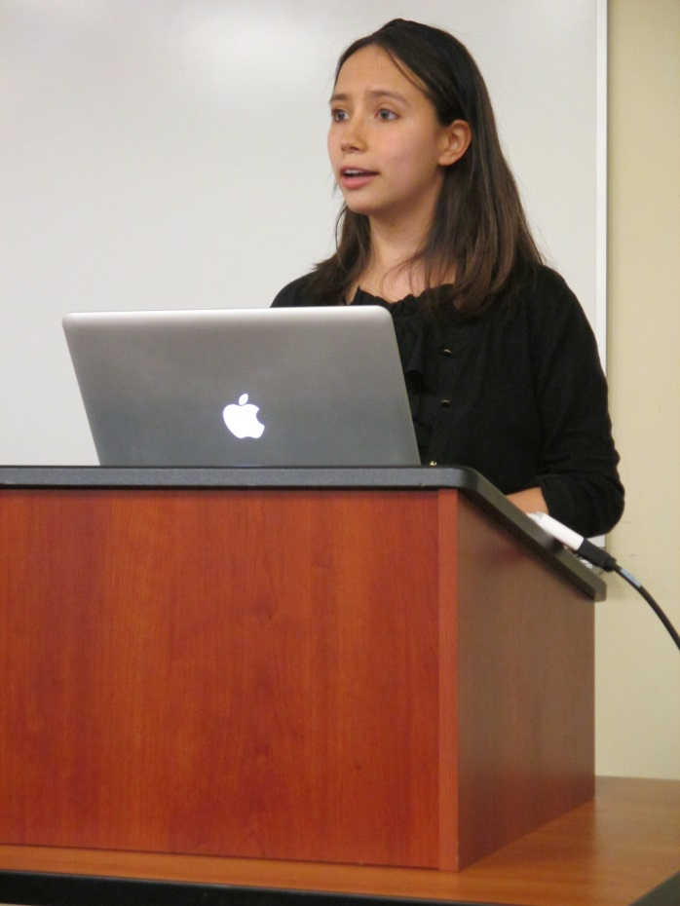
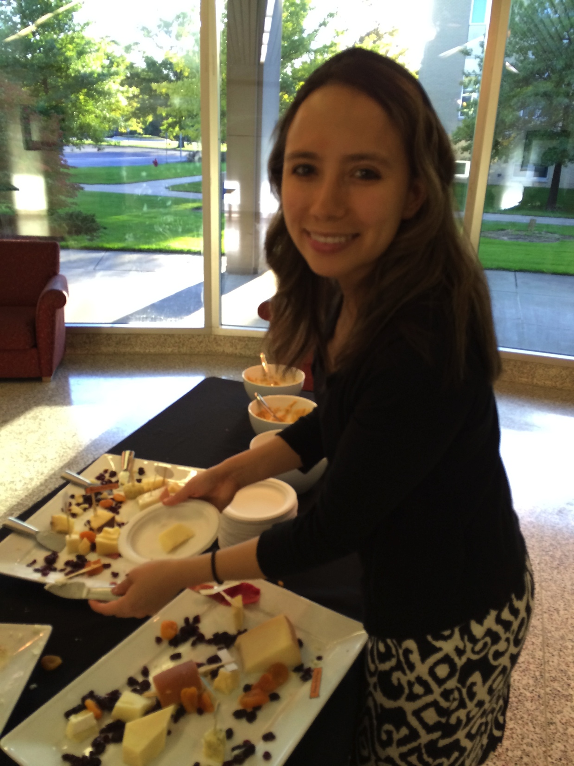
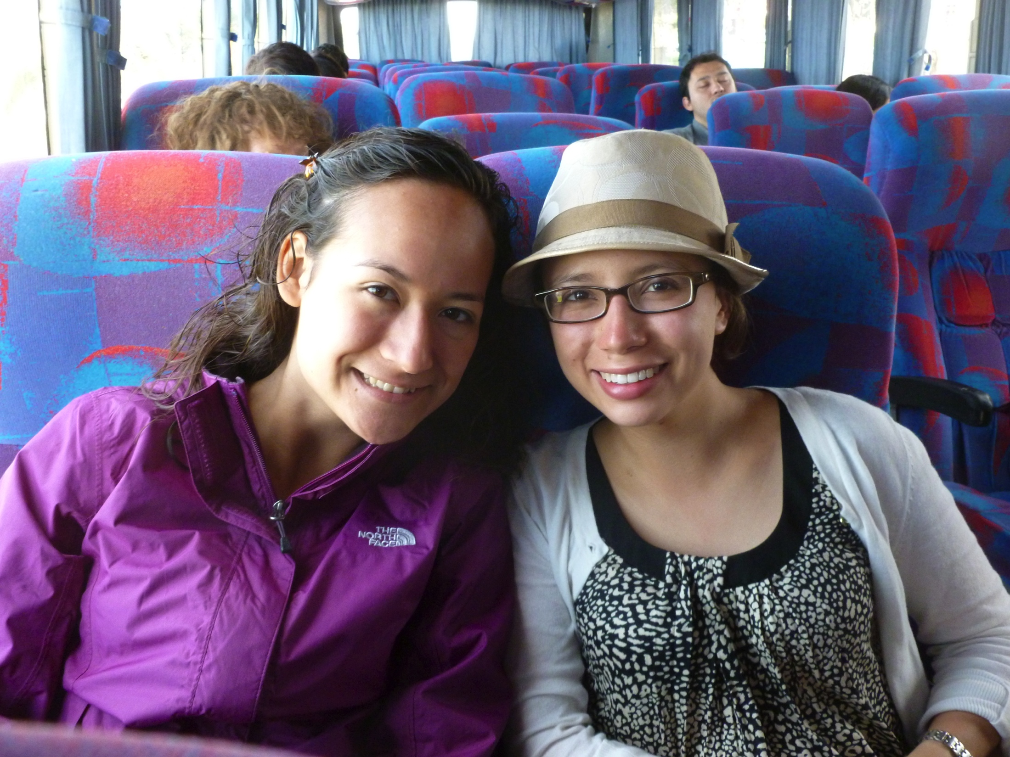
Kylynda Bauer
Biology, Biomedical concentration
Music
Graduated December 2014
Will commence a PhD in Microbiology at the University of British Columbia in the fall. (Fully Funded)
Accepted to:
University of California, San Francisco,
University of Chicago
Duke University.

Slide 9
Nathan Berglund
English concentration Writing
Minor in Business Administration
Plans on moving with his wife Winnie to Puyallup, WA.

Slide 10
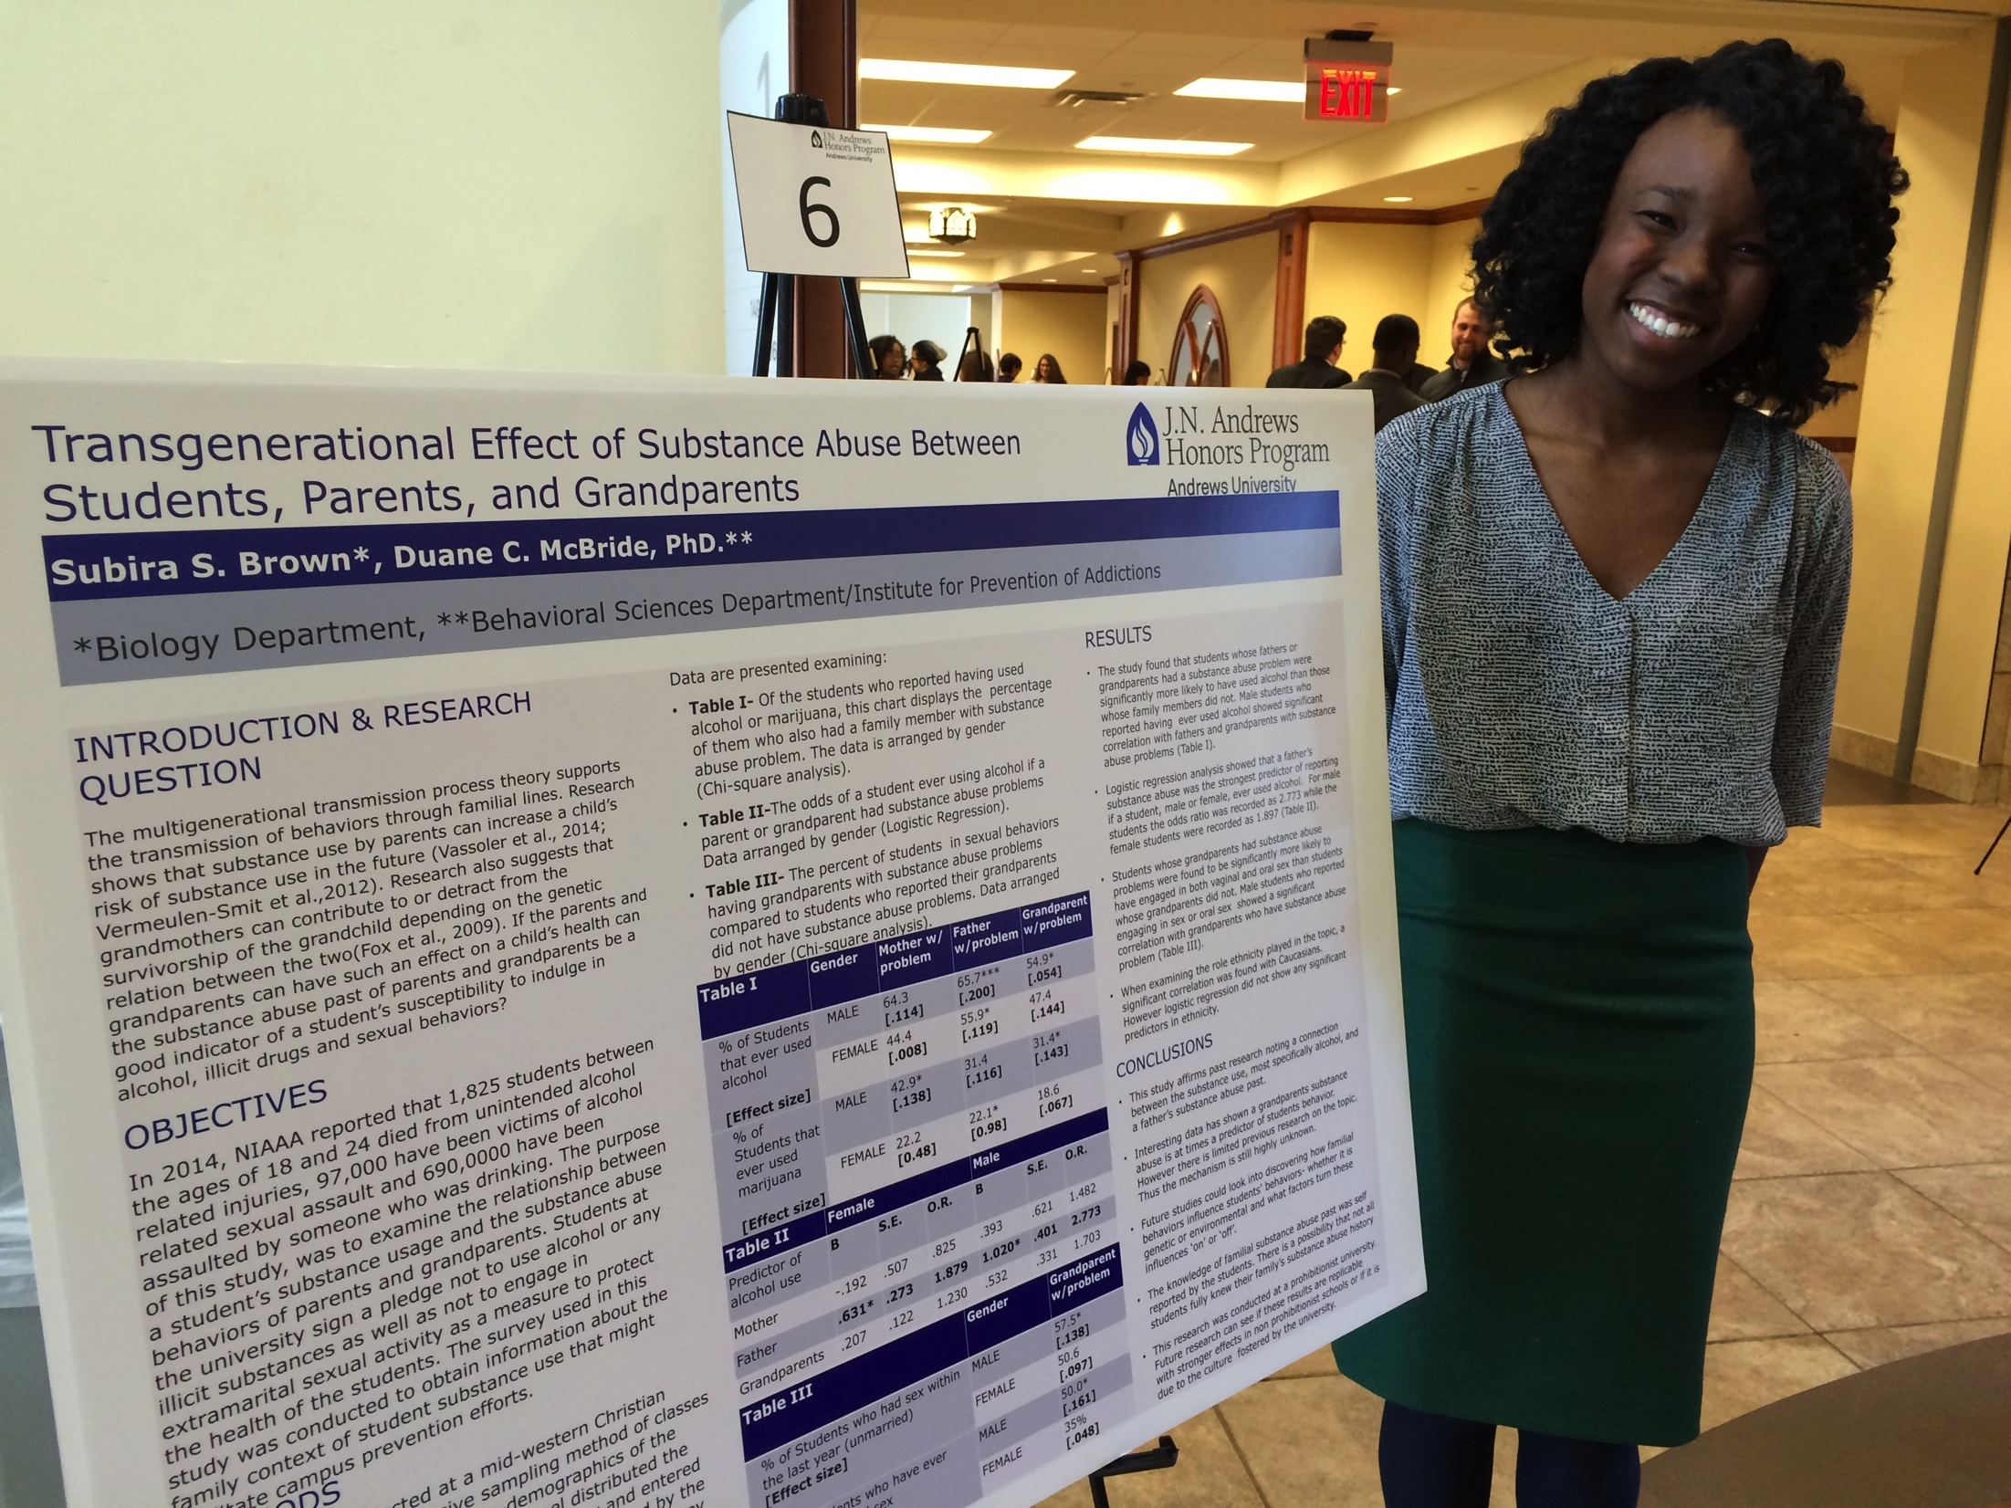
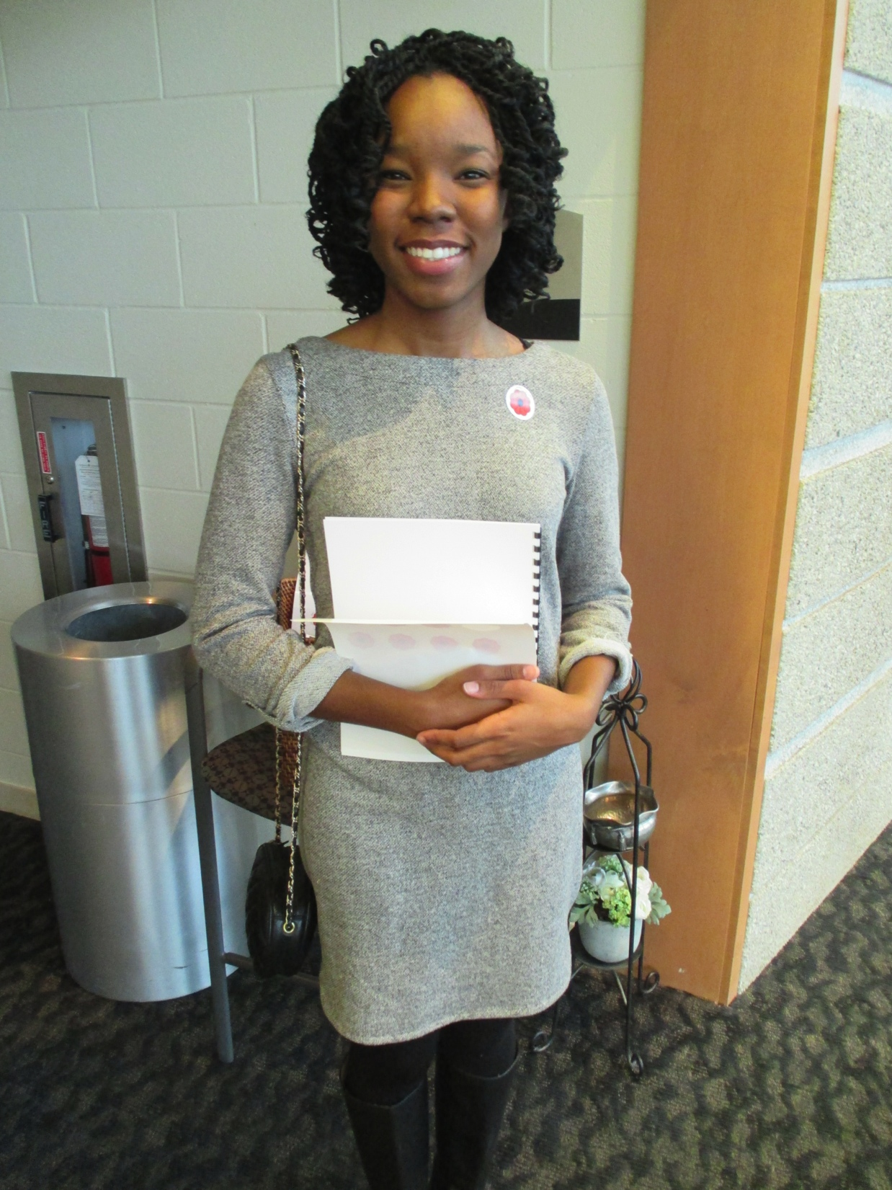
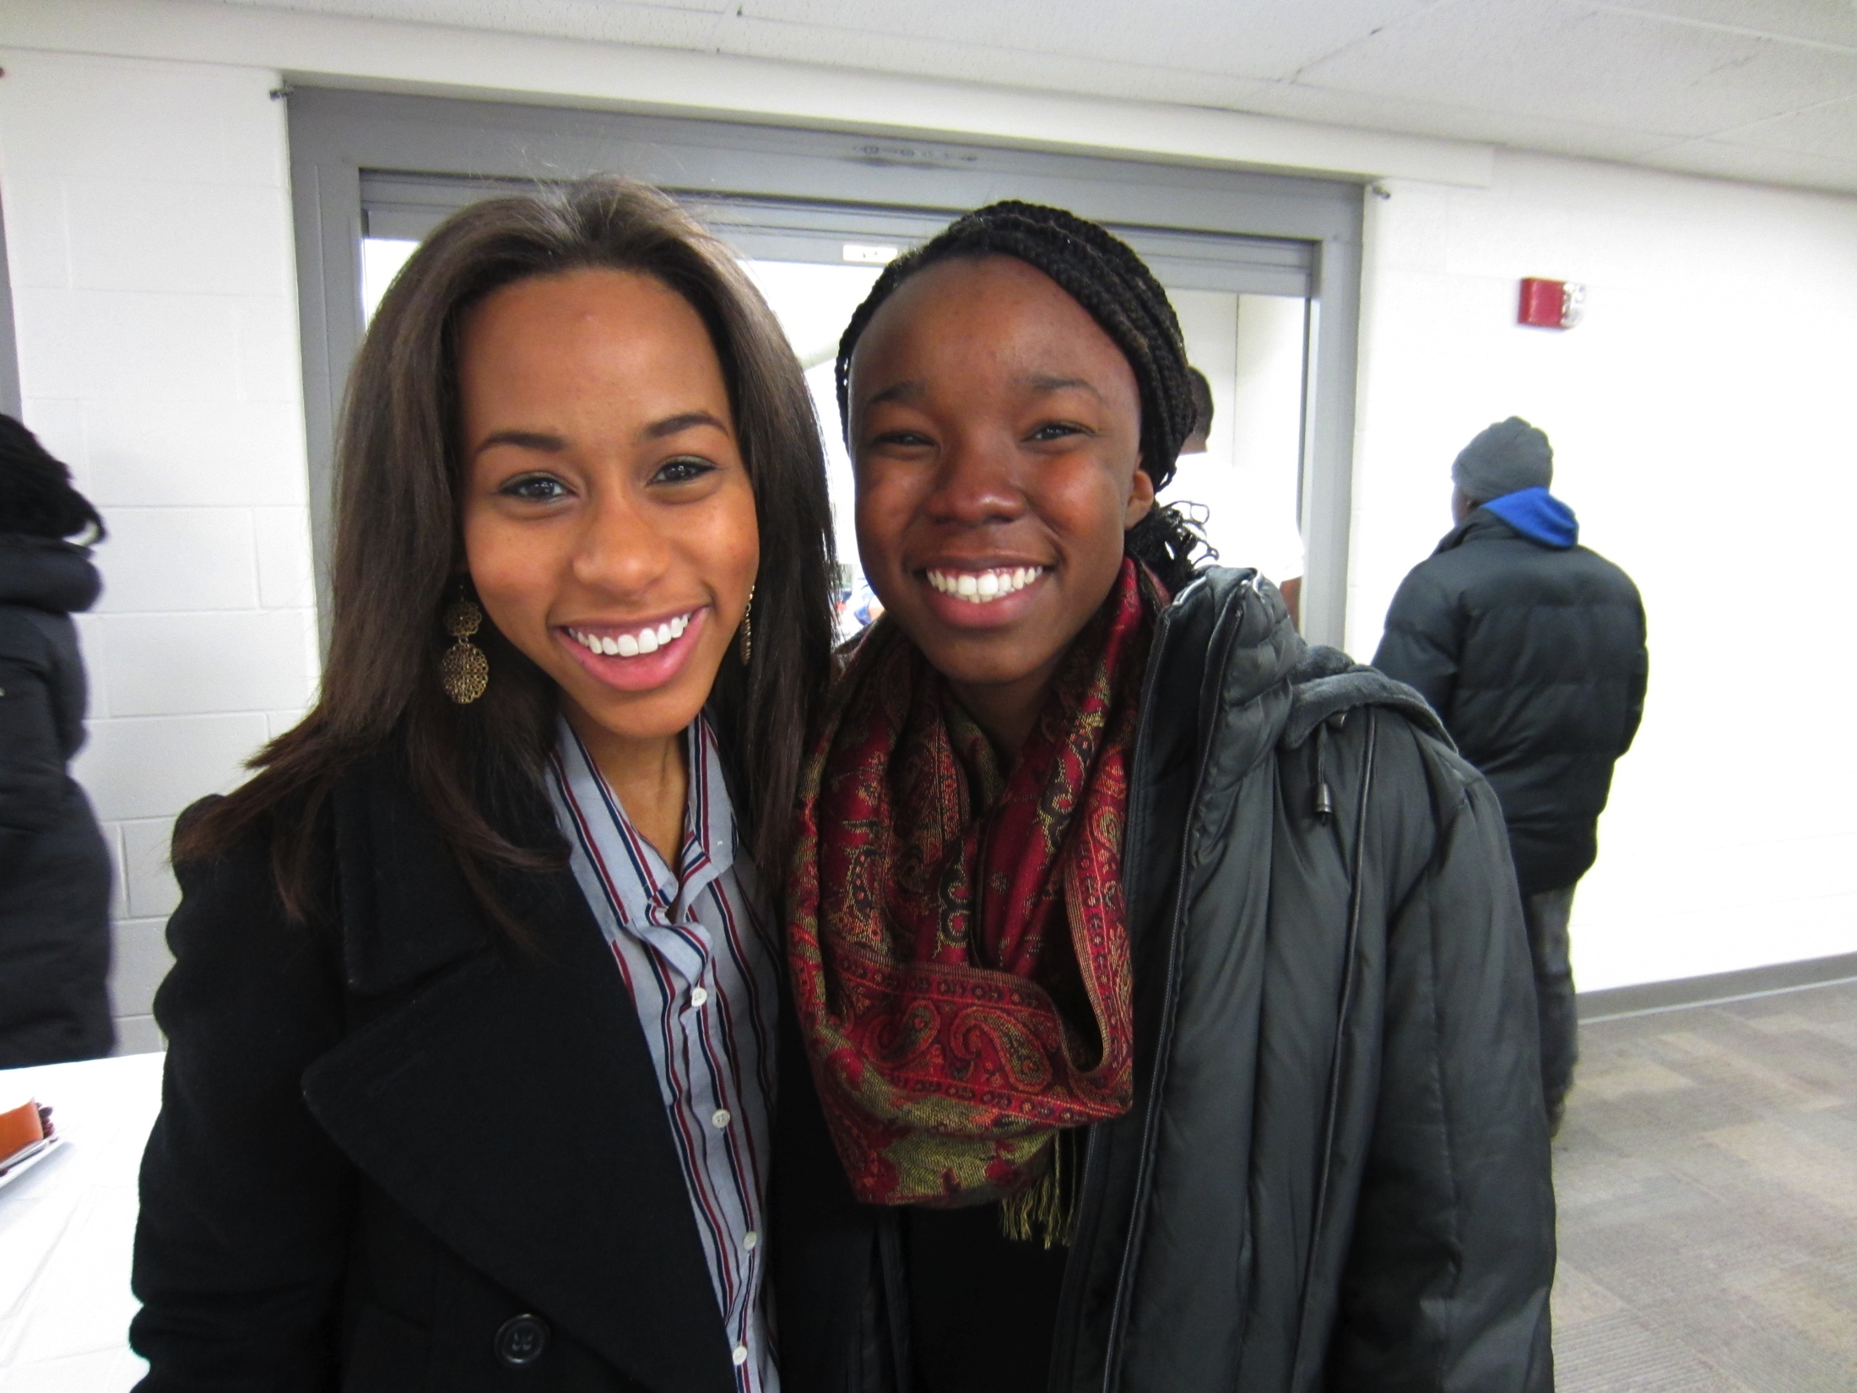
Subira Brown
Biology
Minor in Community and International Development and Chemistry
Will graduate May 2015

Slide 11
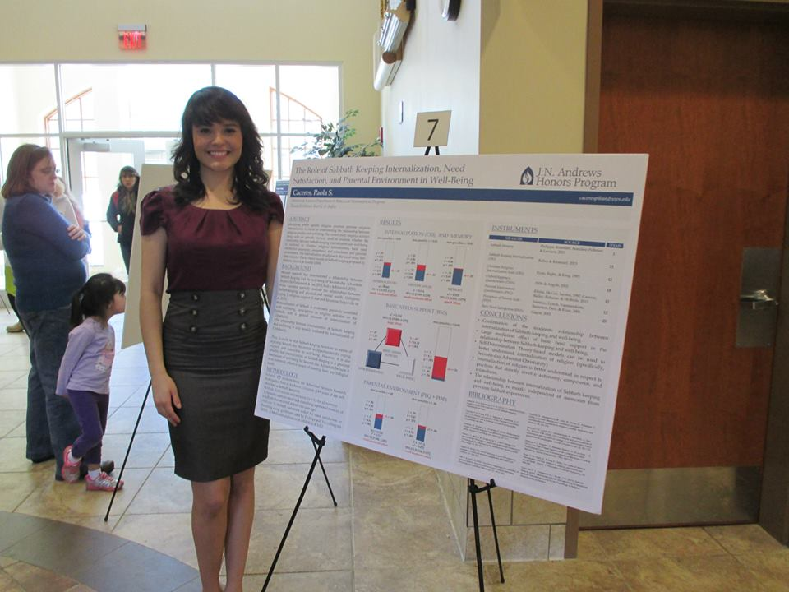
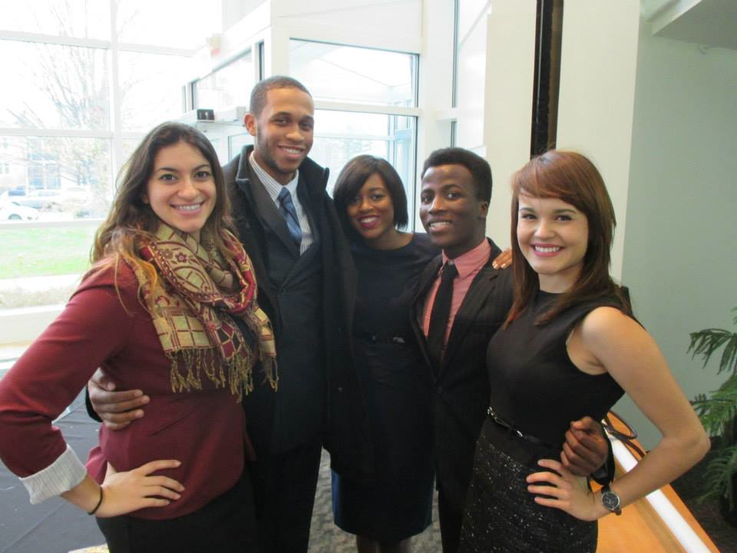
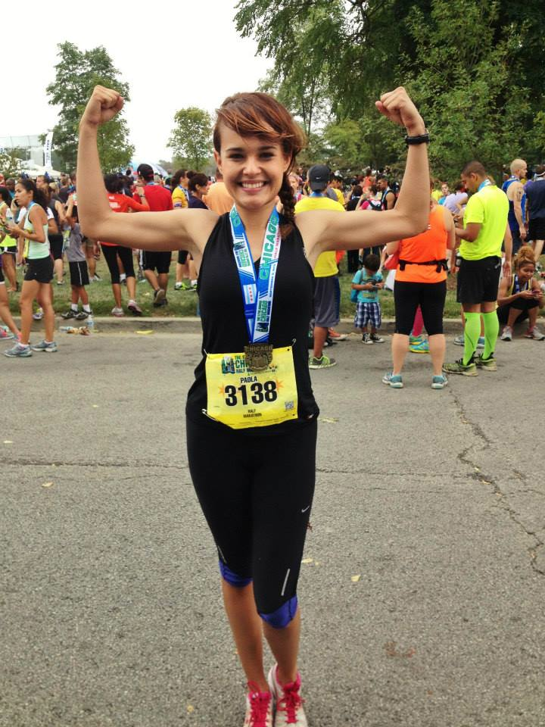
Paola Caceres
Psychology, Behavioral Neuroscience concentration
Minor in French
Plans to study abroad in France and then graduate in May 2015

Slide 12
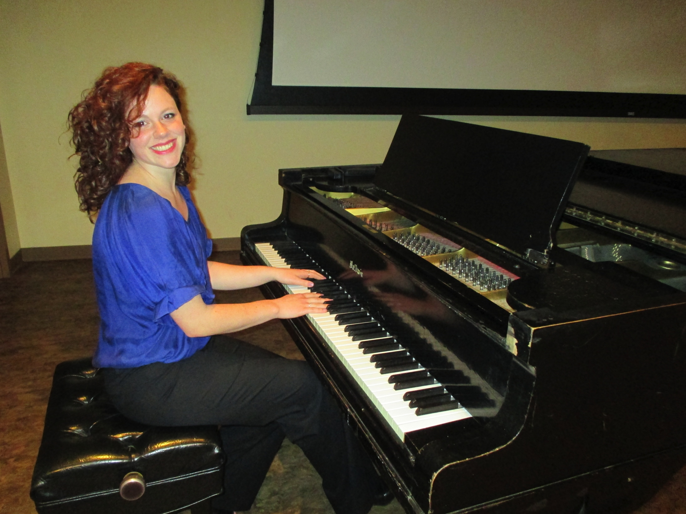
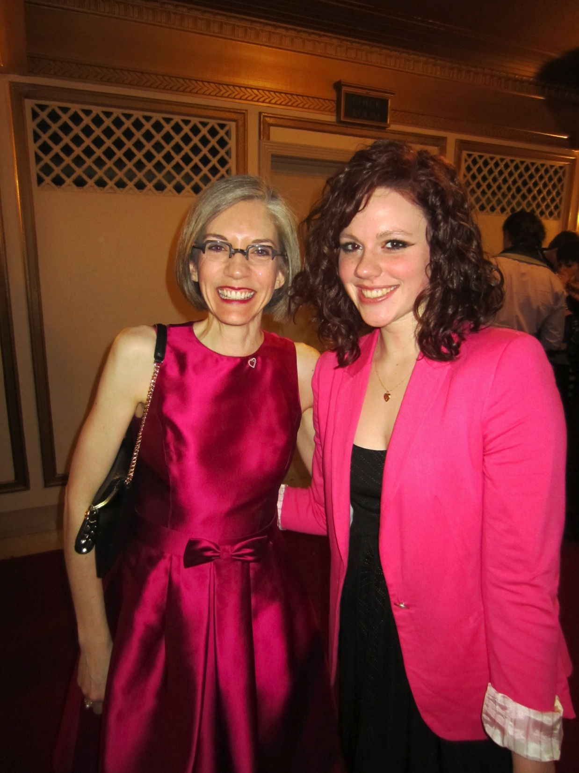
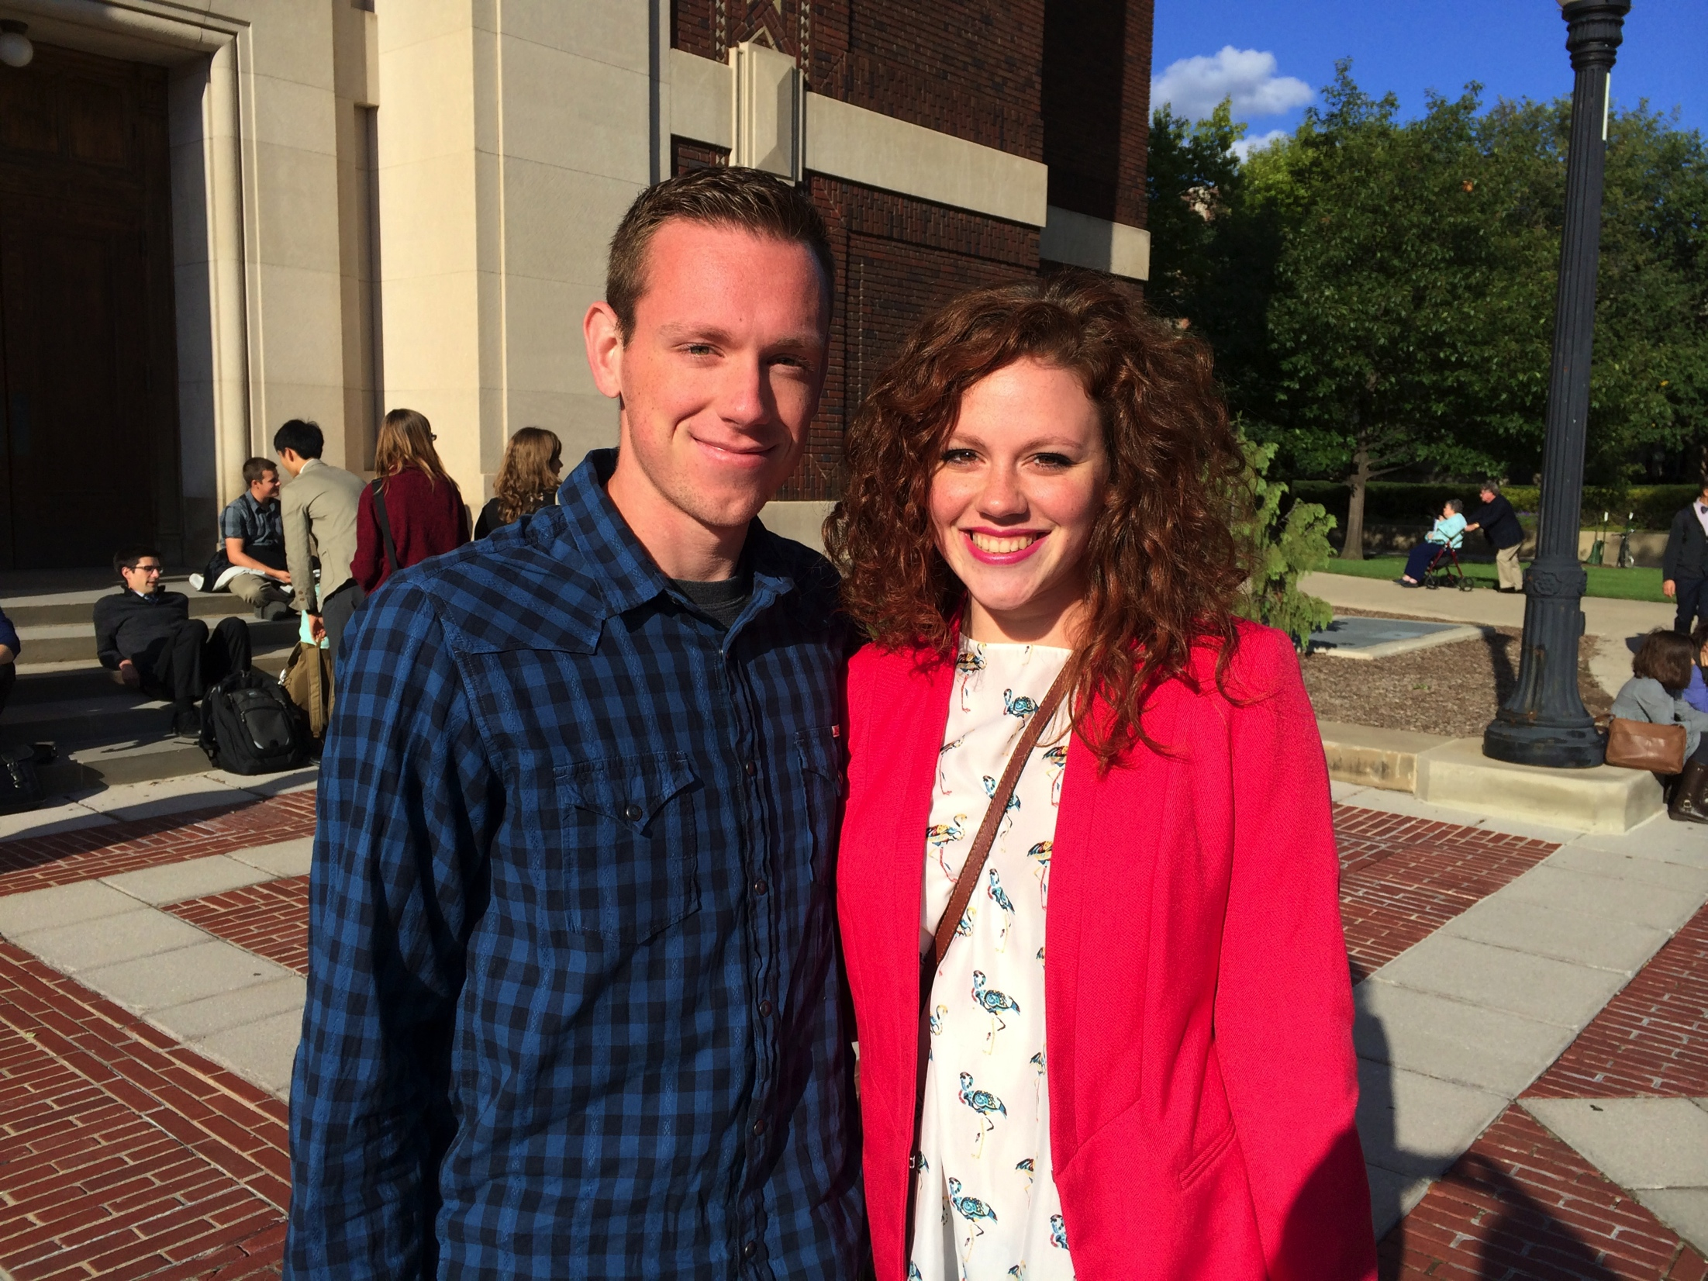
Ilana Cady
Music Performance
Pursuing Masters Degree at Longy School of Music at Bard College in Cambridge, MA

Slide 13
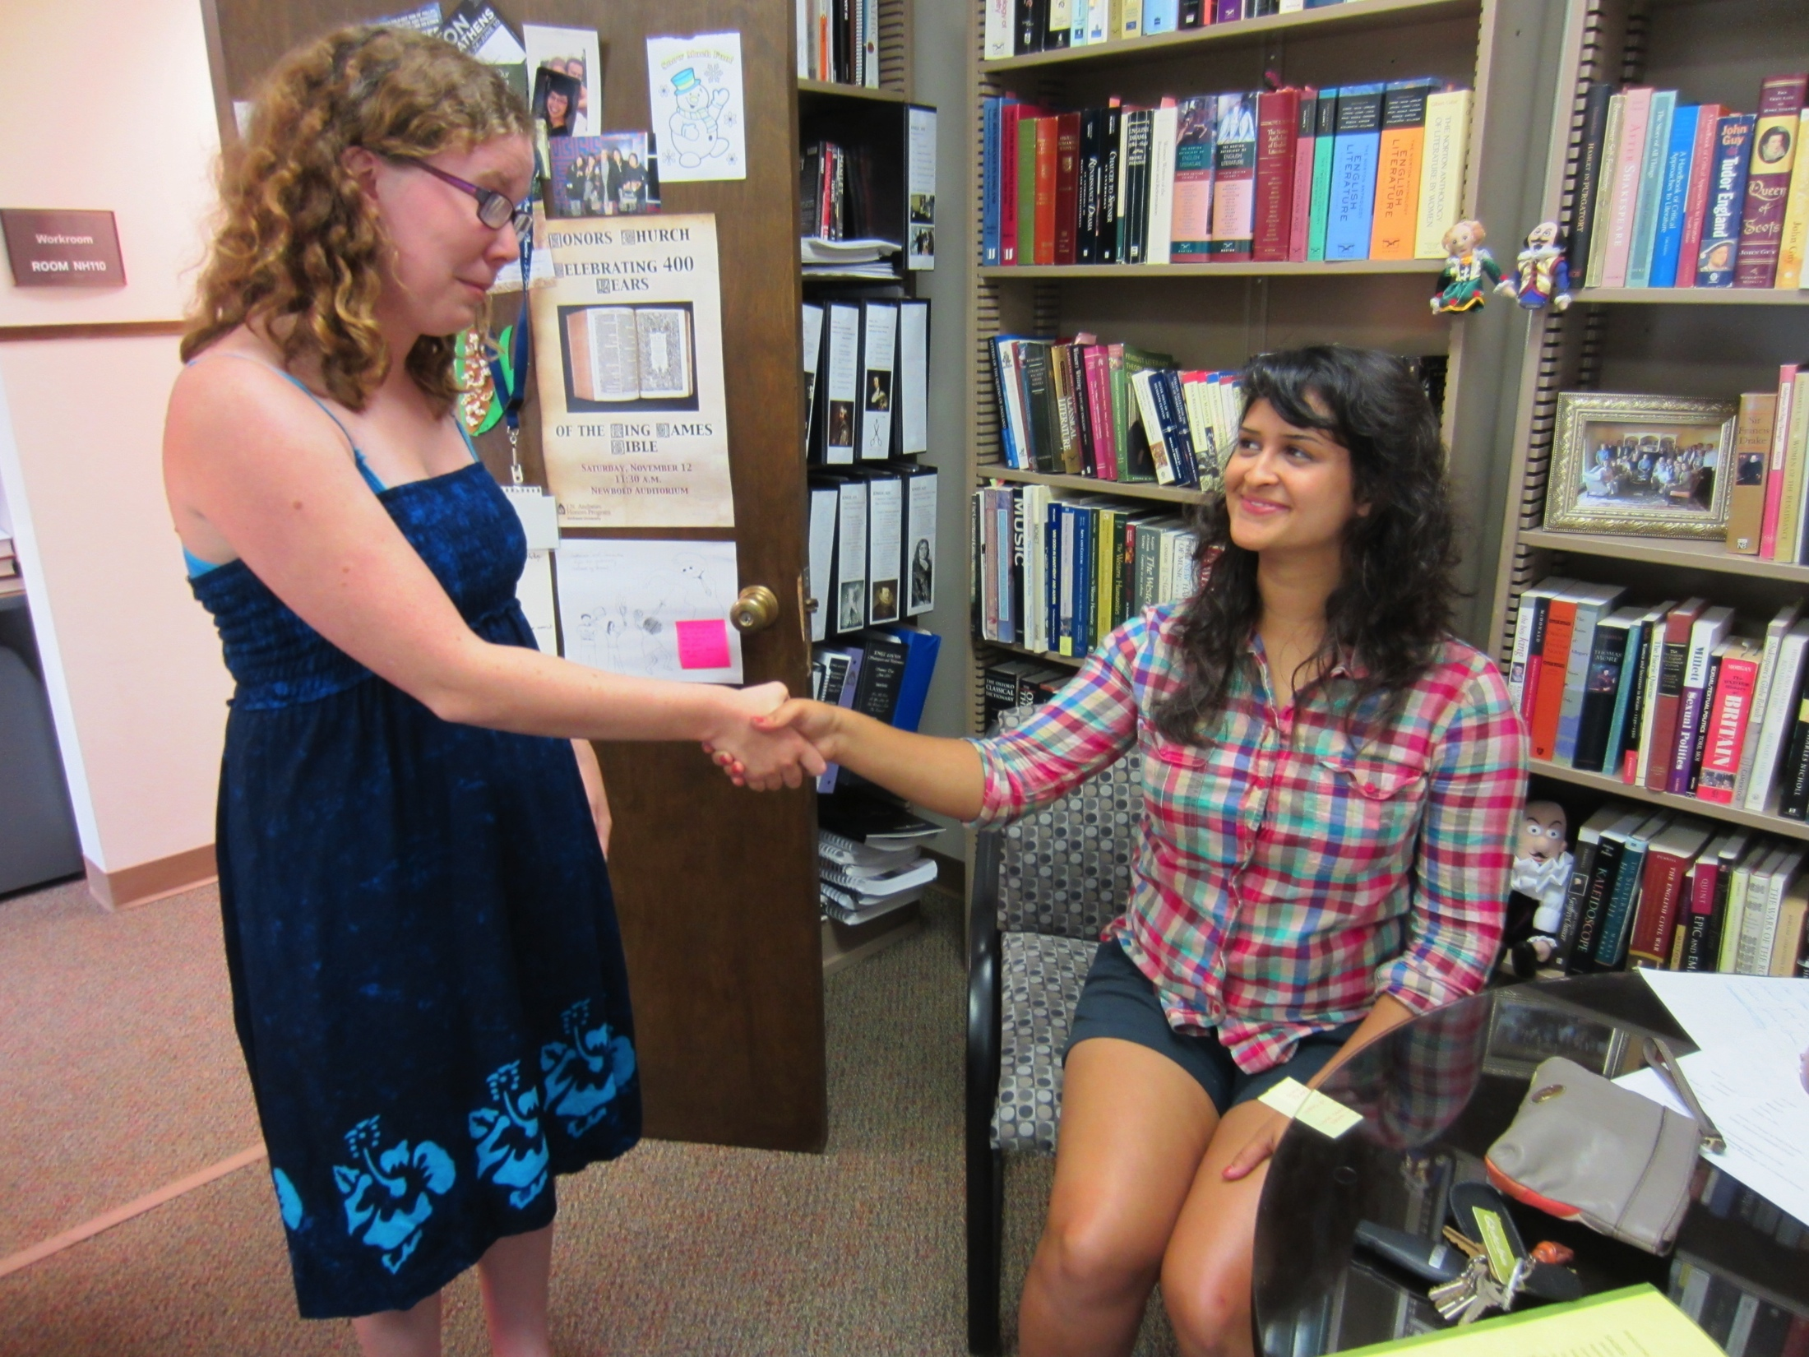
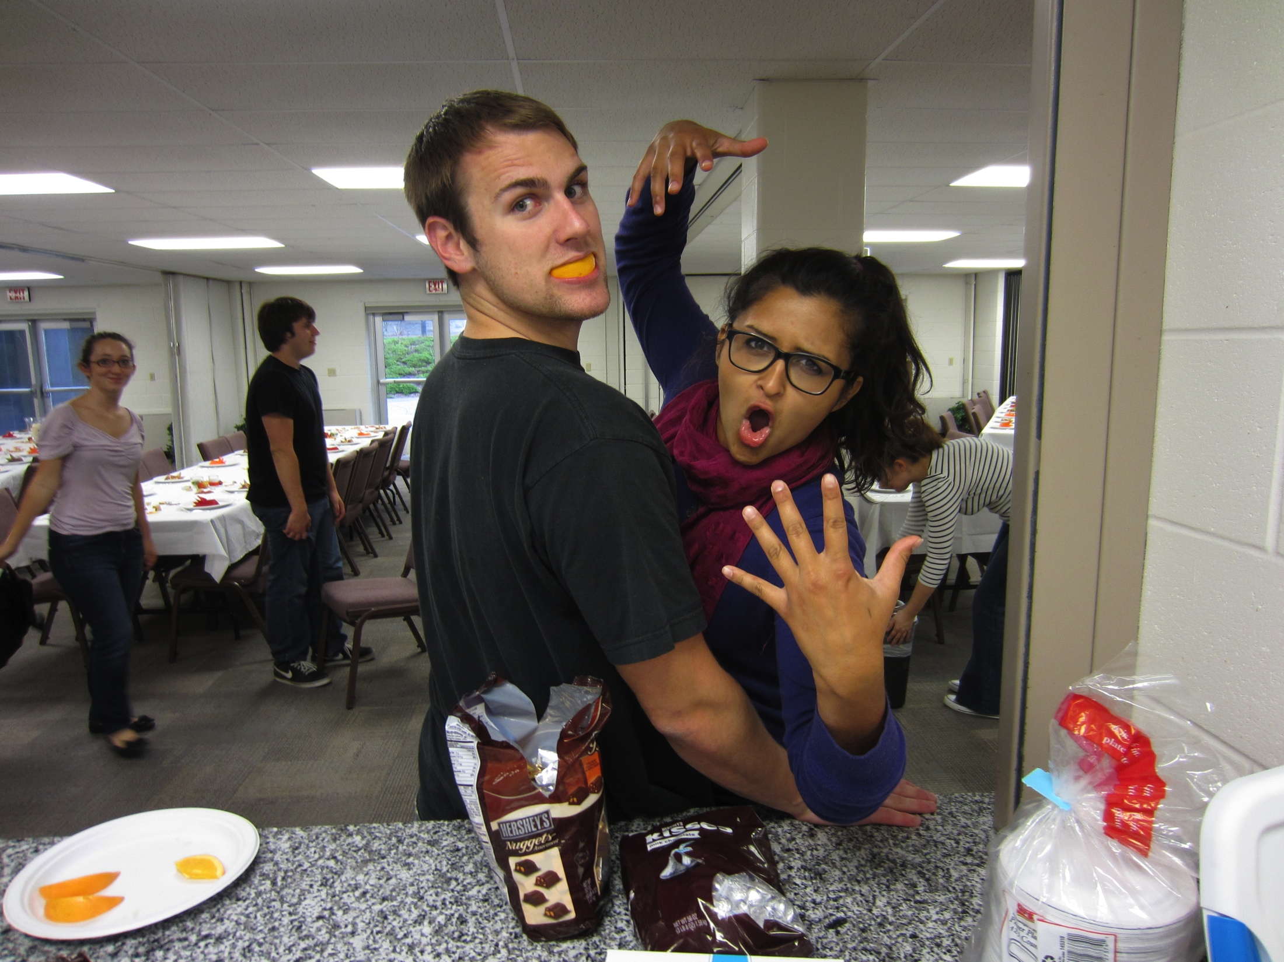
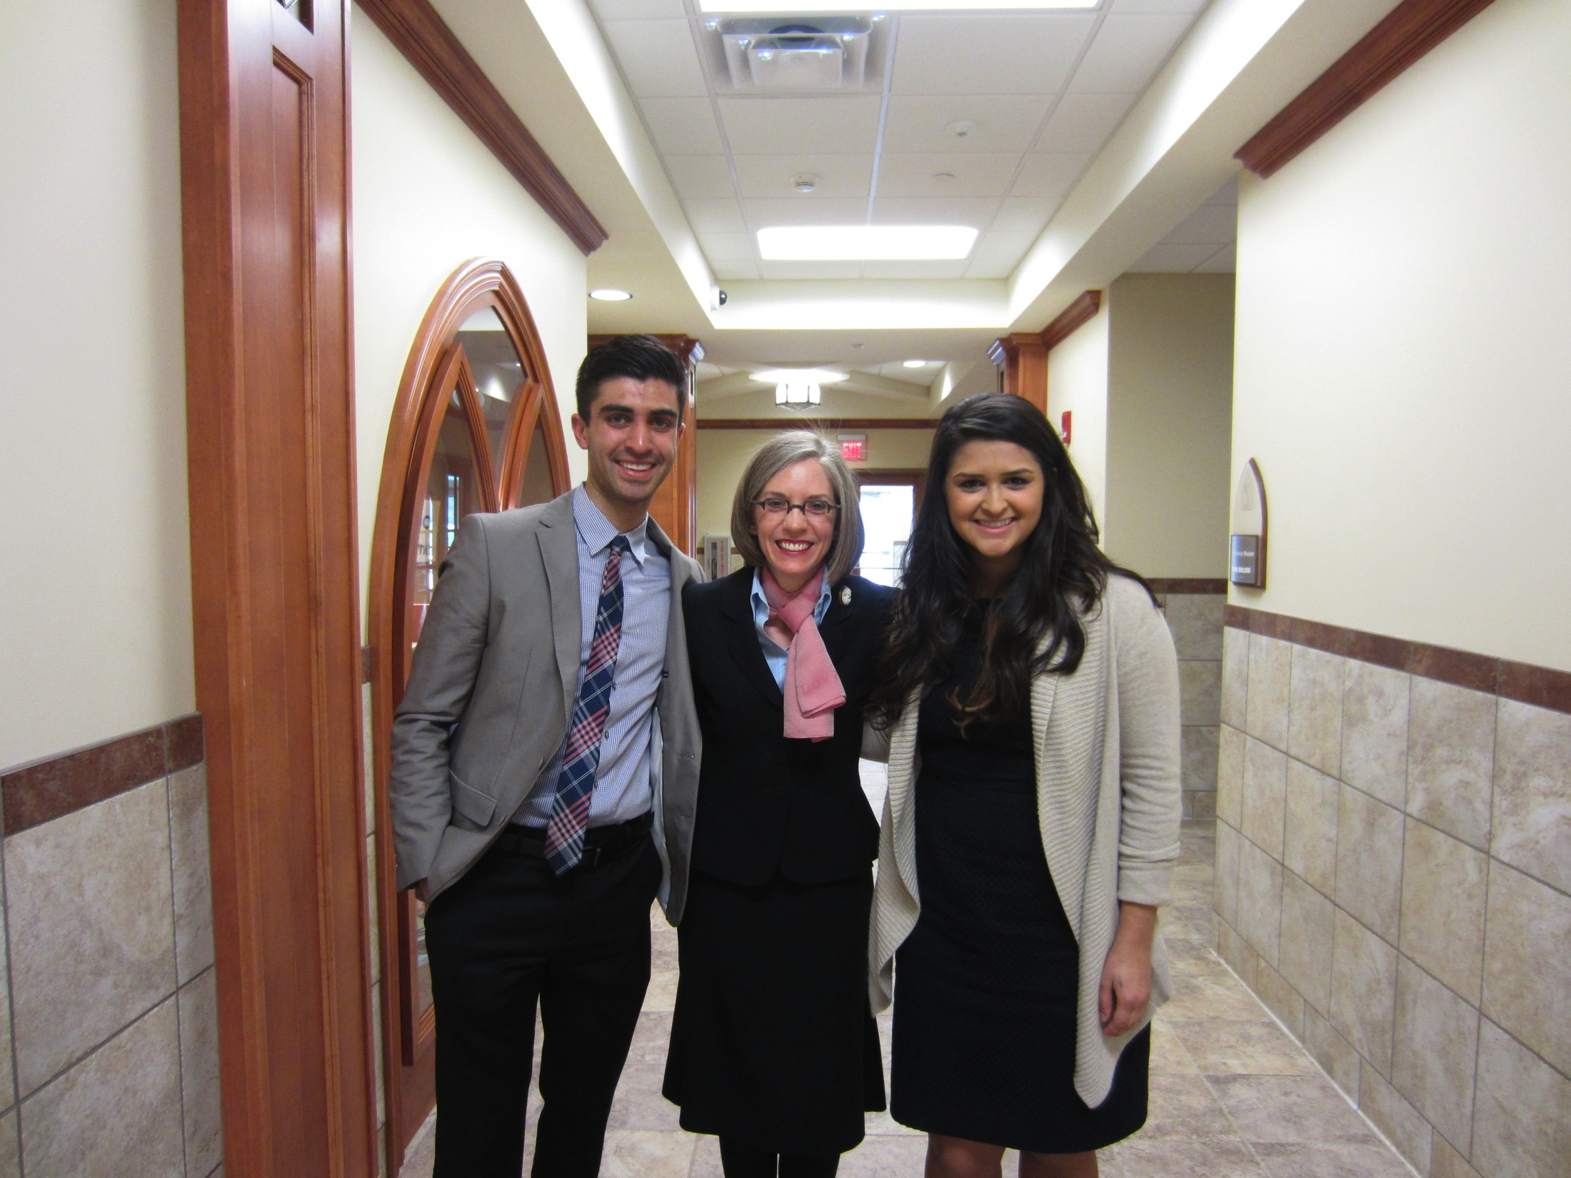
Allie Chacko
Biology Major
Will Graduate May 2015
Accepted to Loma Linda University School of Medicine

Slide 14
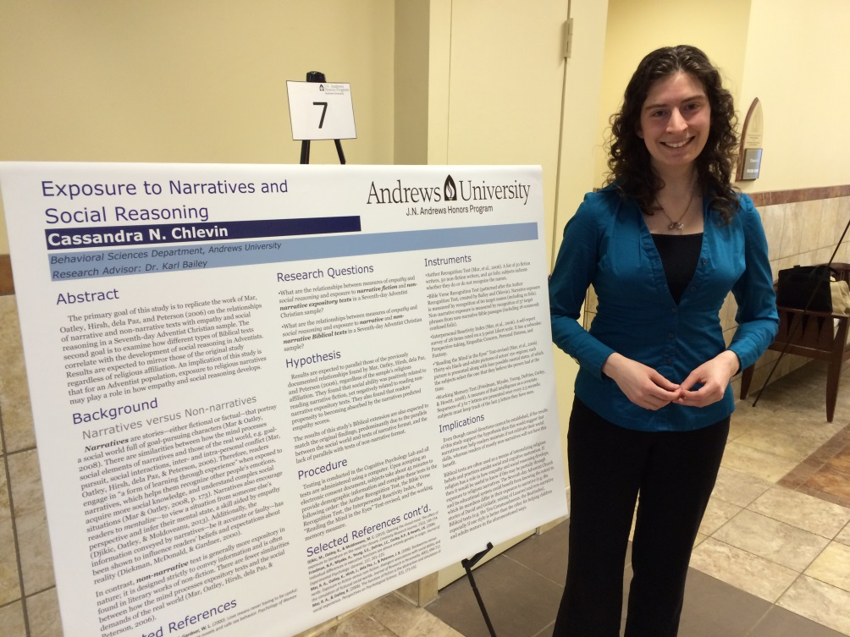
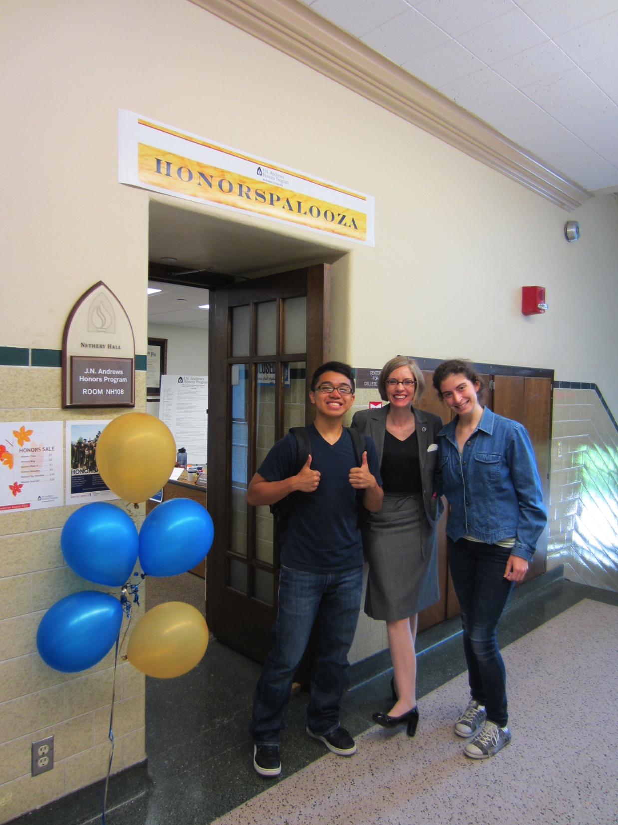
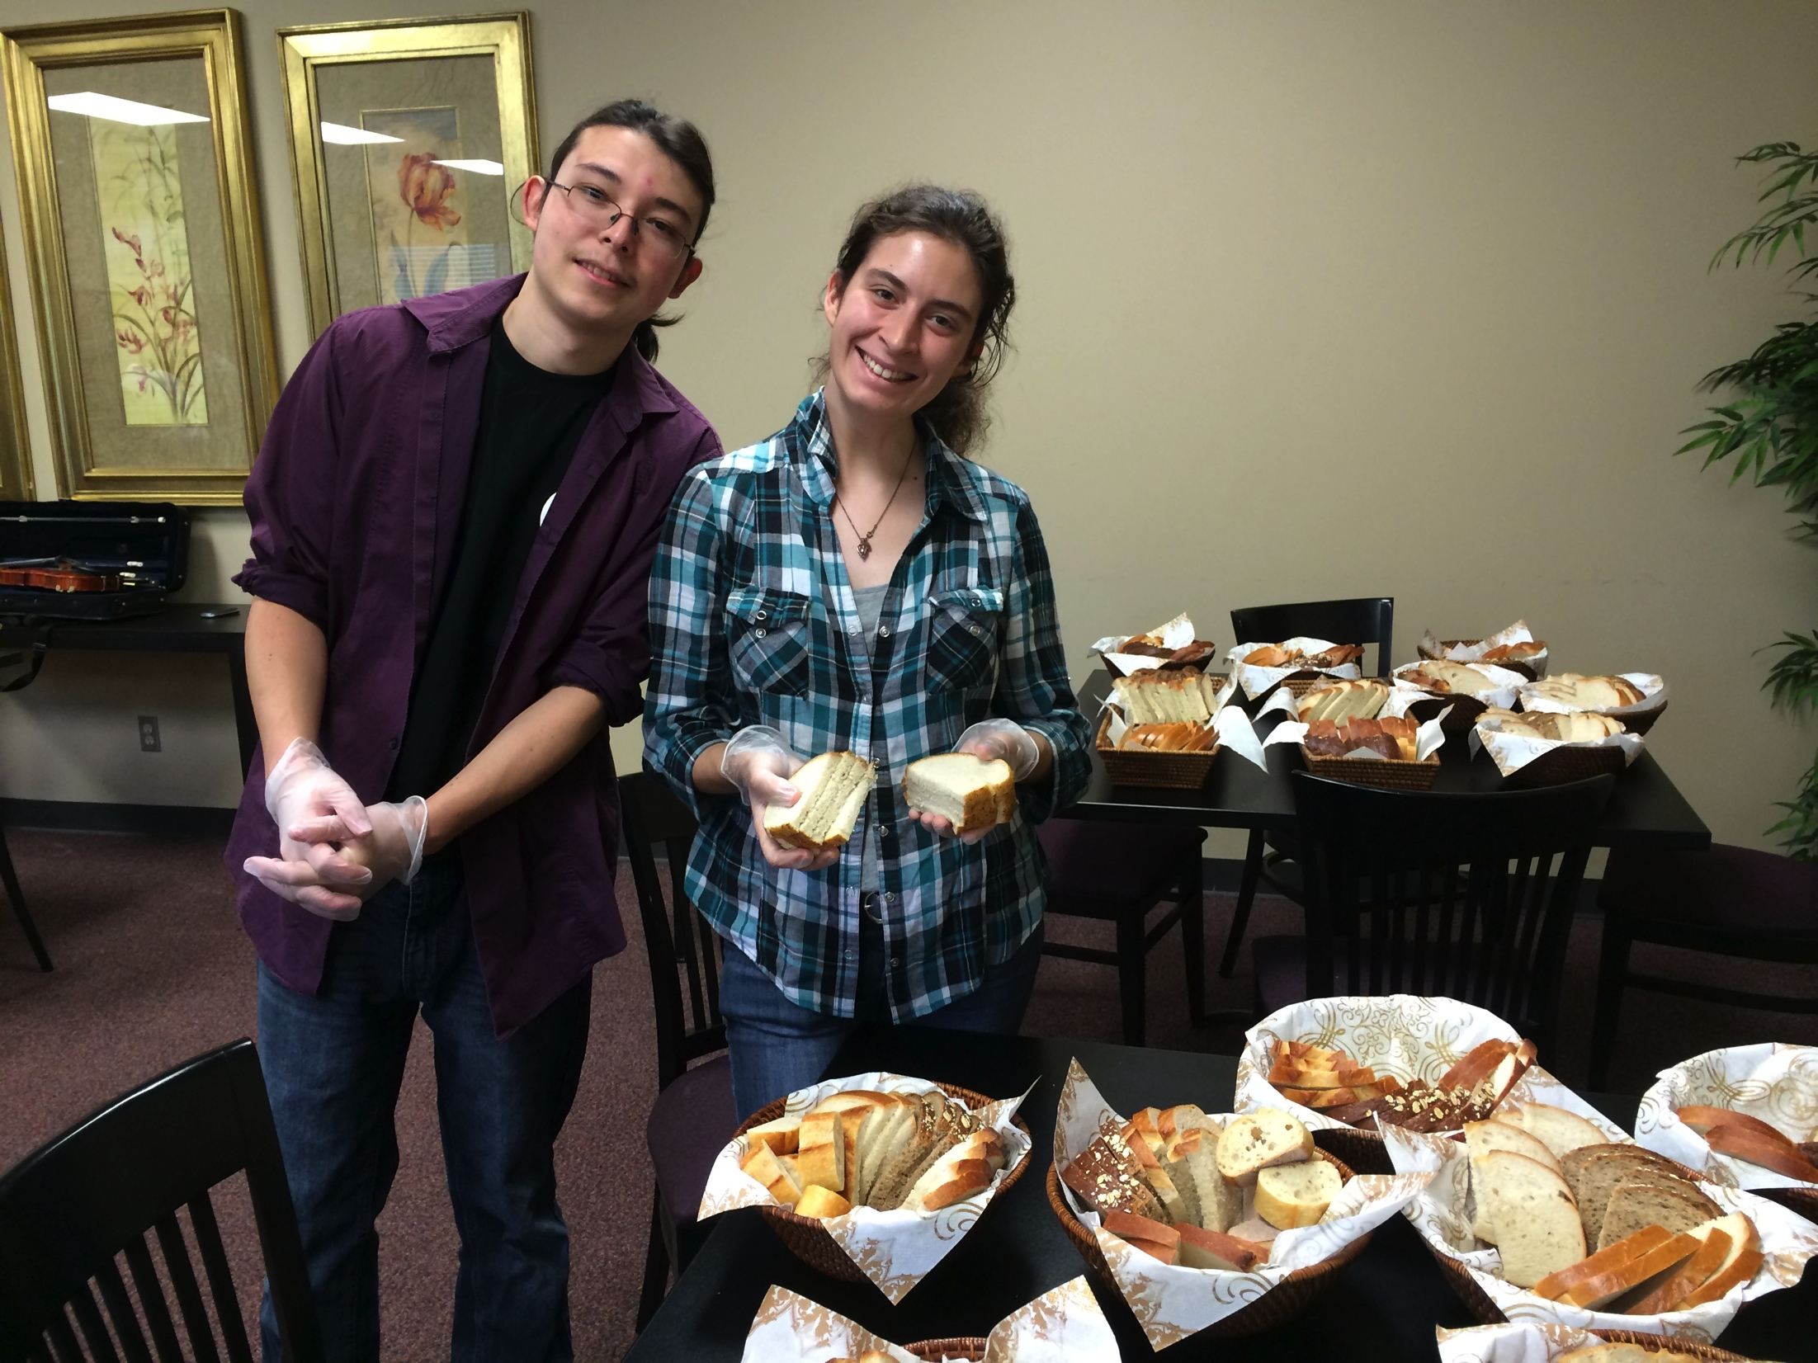
Cassandra Chlevin
Psychology
Will graduate May 2015
Plans to spend the summer volunteering at a Day Camp for Preschoolers and spend the coming year in Chicago working

Slide 15
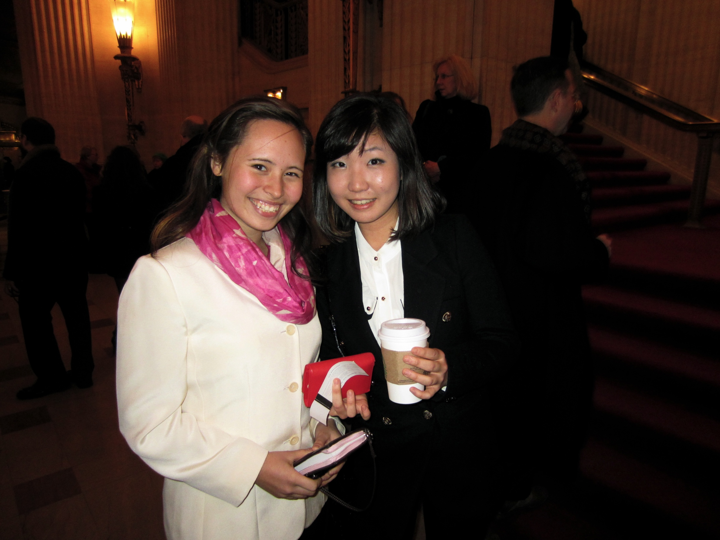
Alyson Drew
Biology
Concentration: Biomedical
Minored in Religion, Chemistry
Accepted to Loma Linda University School of Medicine

Slide 16
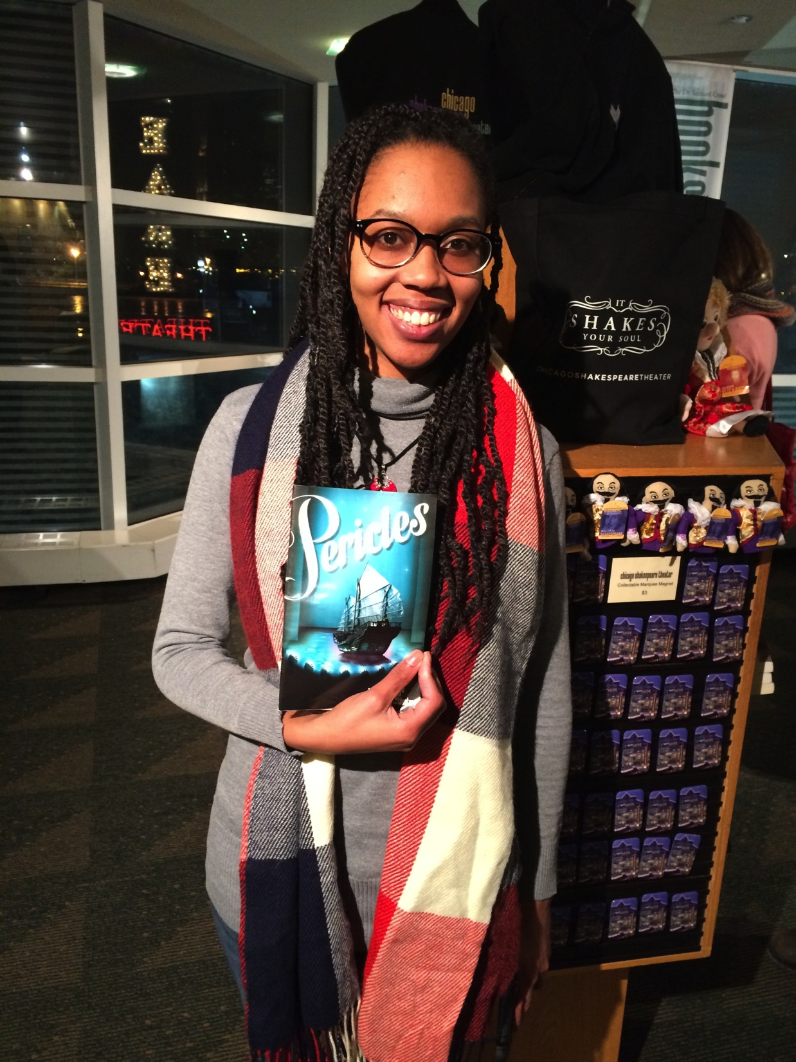
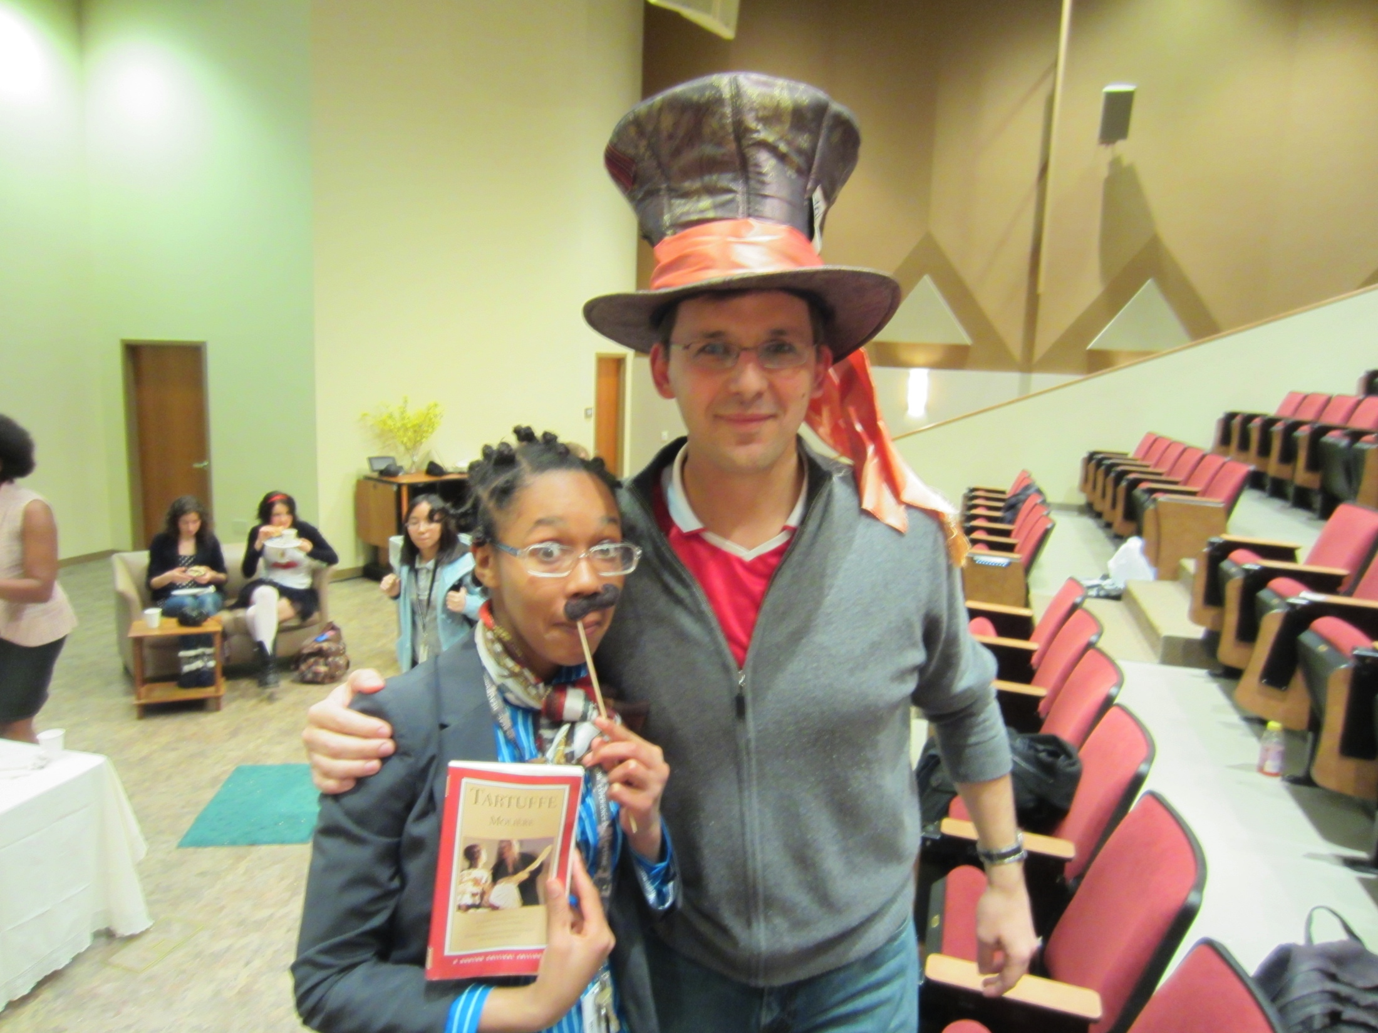
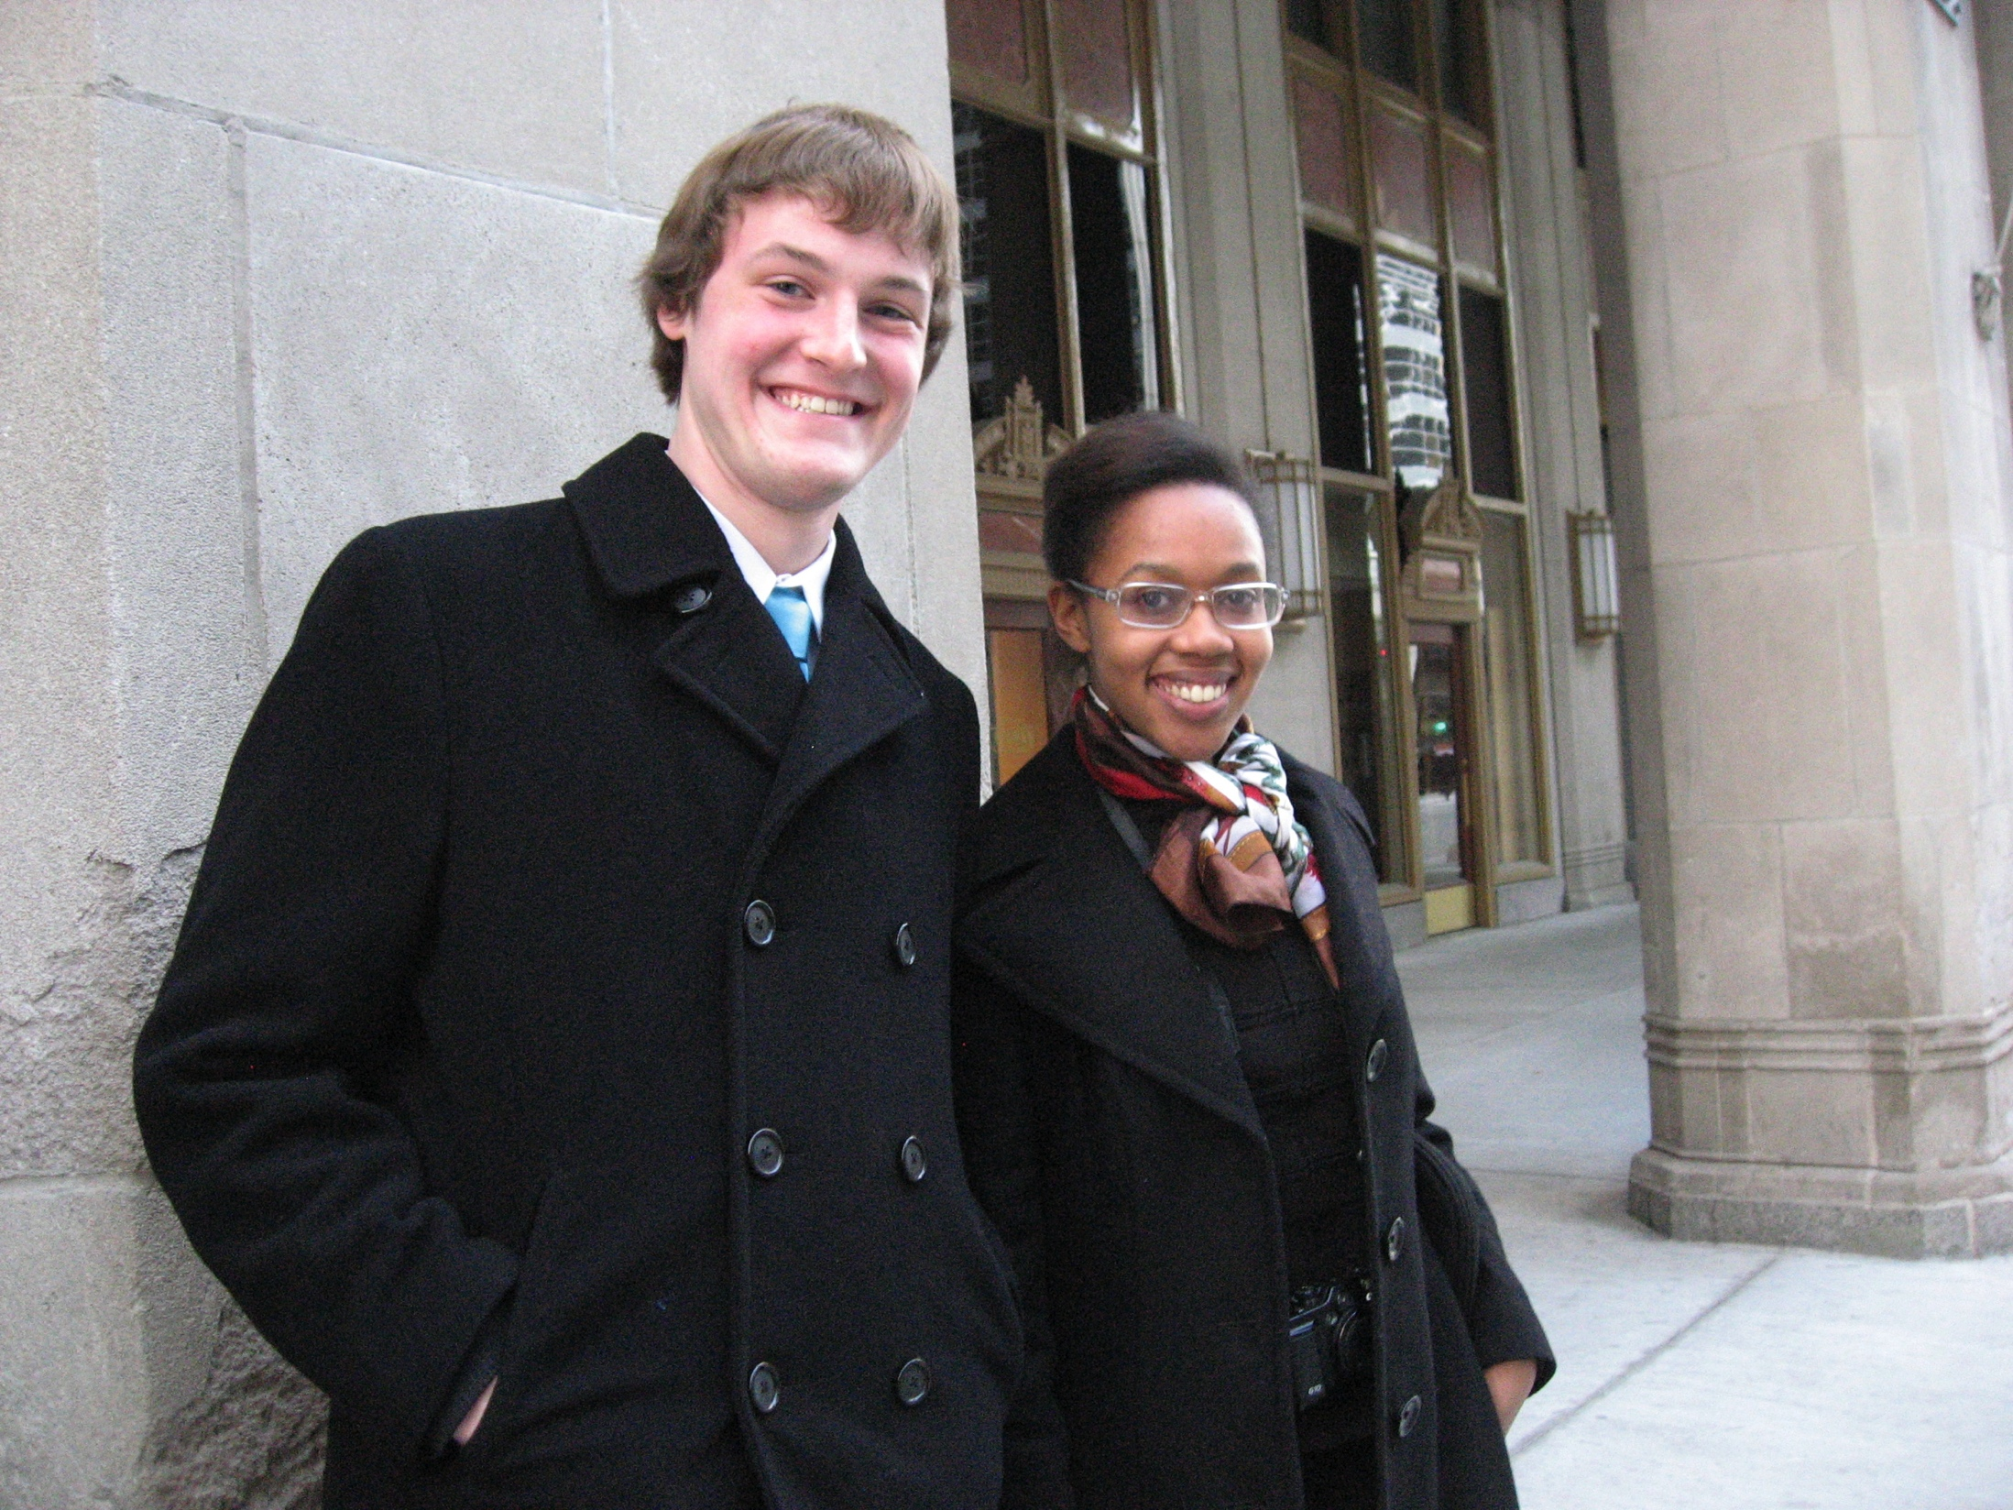
Givan Hinds
Liberal Arts, History
Will graduate May 2015
Accepted to the Loma Linda University School of Public Health Global Health MPH Program
Master of Arts degree in Curriculum and Instruction at Andrews University

Slide 17
Taylor Huffman
Animal Science, Pre-Veterinarian Medicine
Will finish degree at Andrews University and then apply to Veterinary School

Slide 18
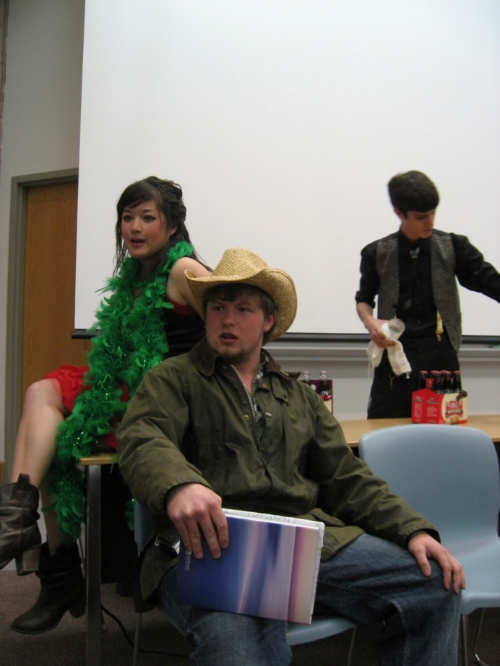
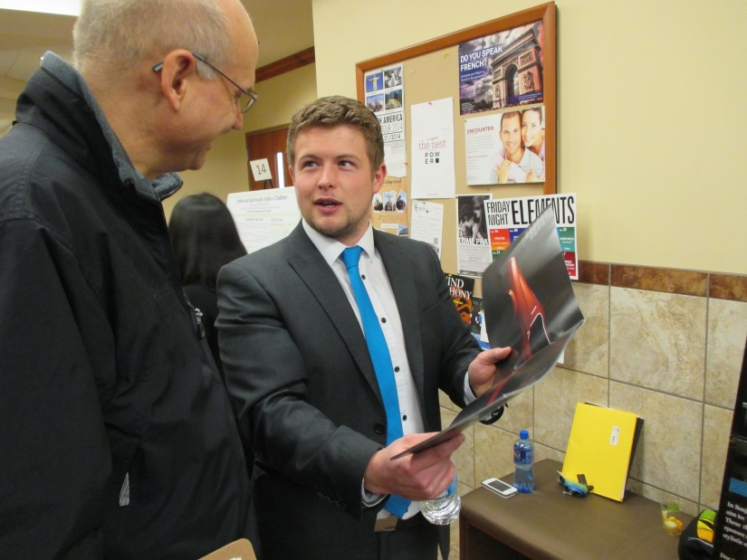
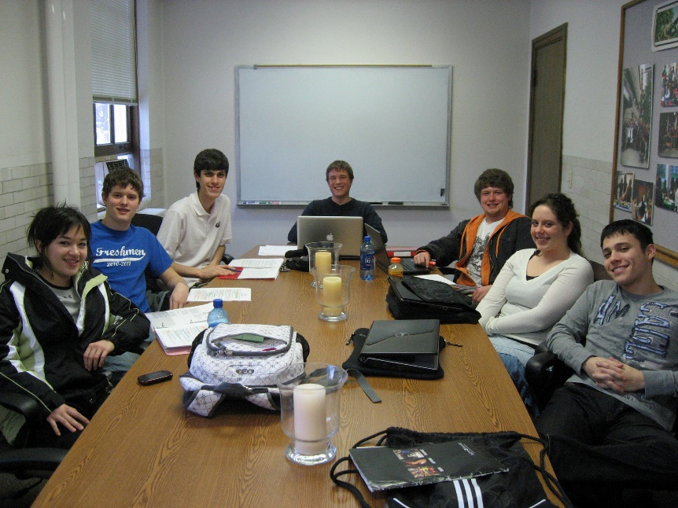
John Irvine
English, Literature concentration
Graduates May 2015
Plans to join the Royal Air Force and later attend law school

Slide 19
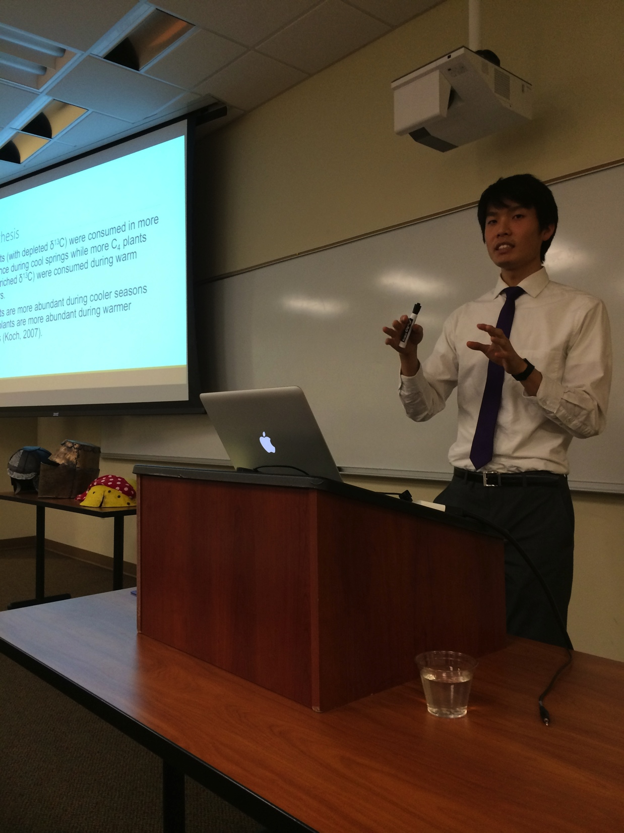
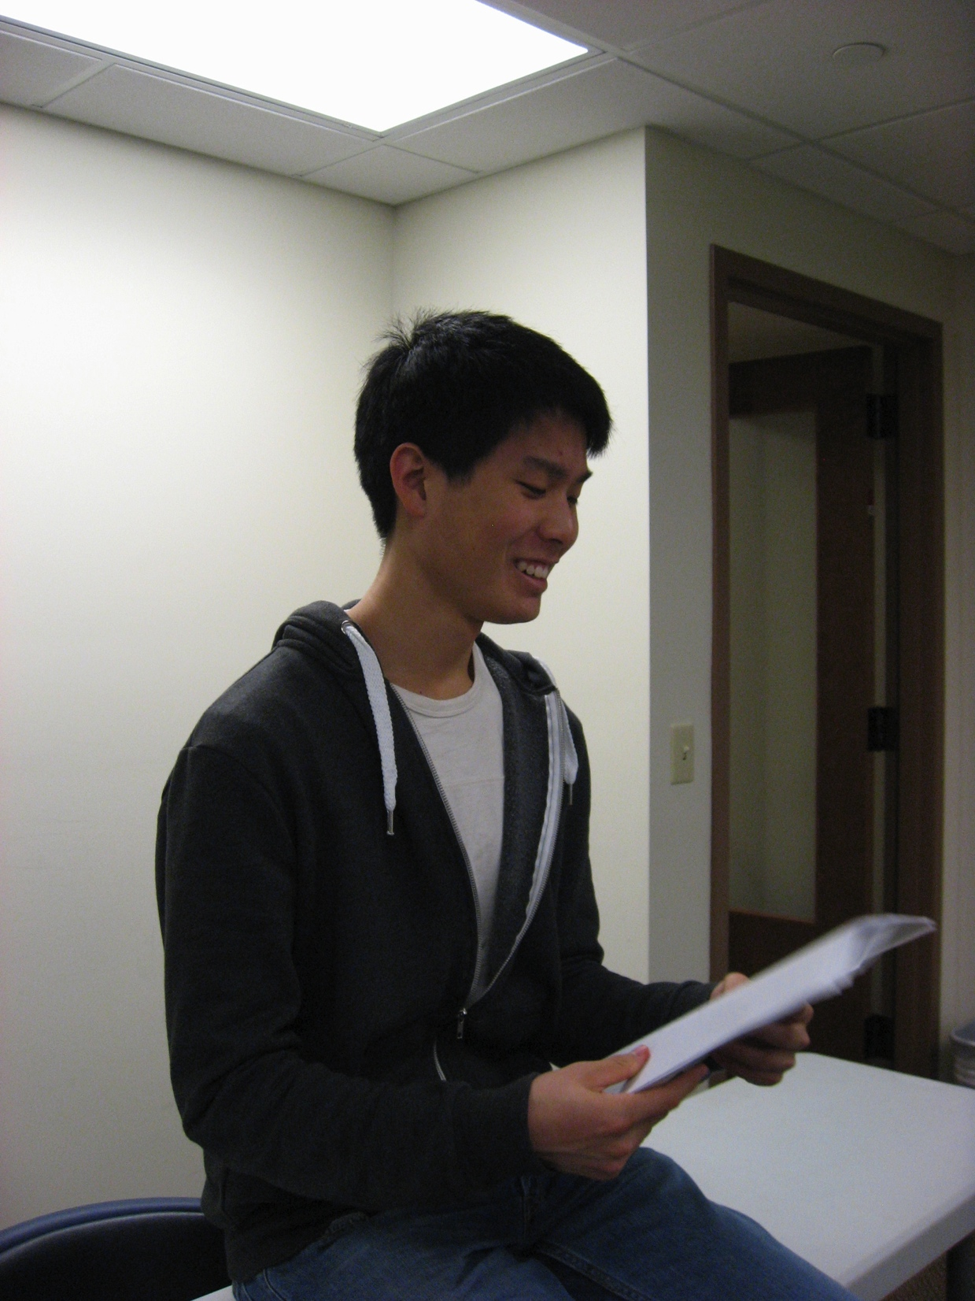
Luke Kang
Biology
Minor in Chemistry
Graduated December 2014

Slide 20
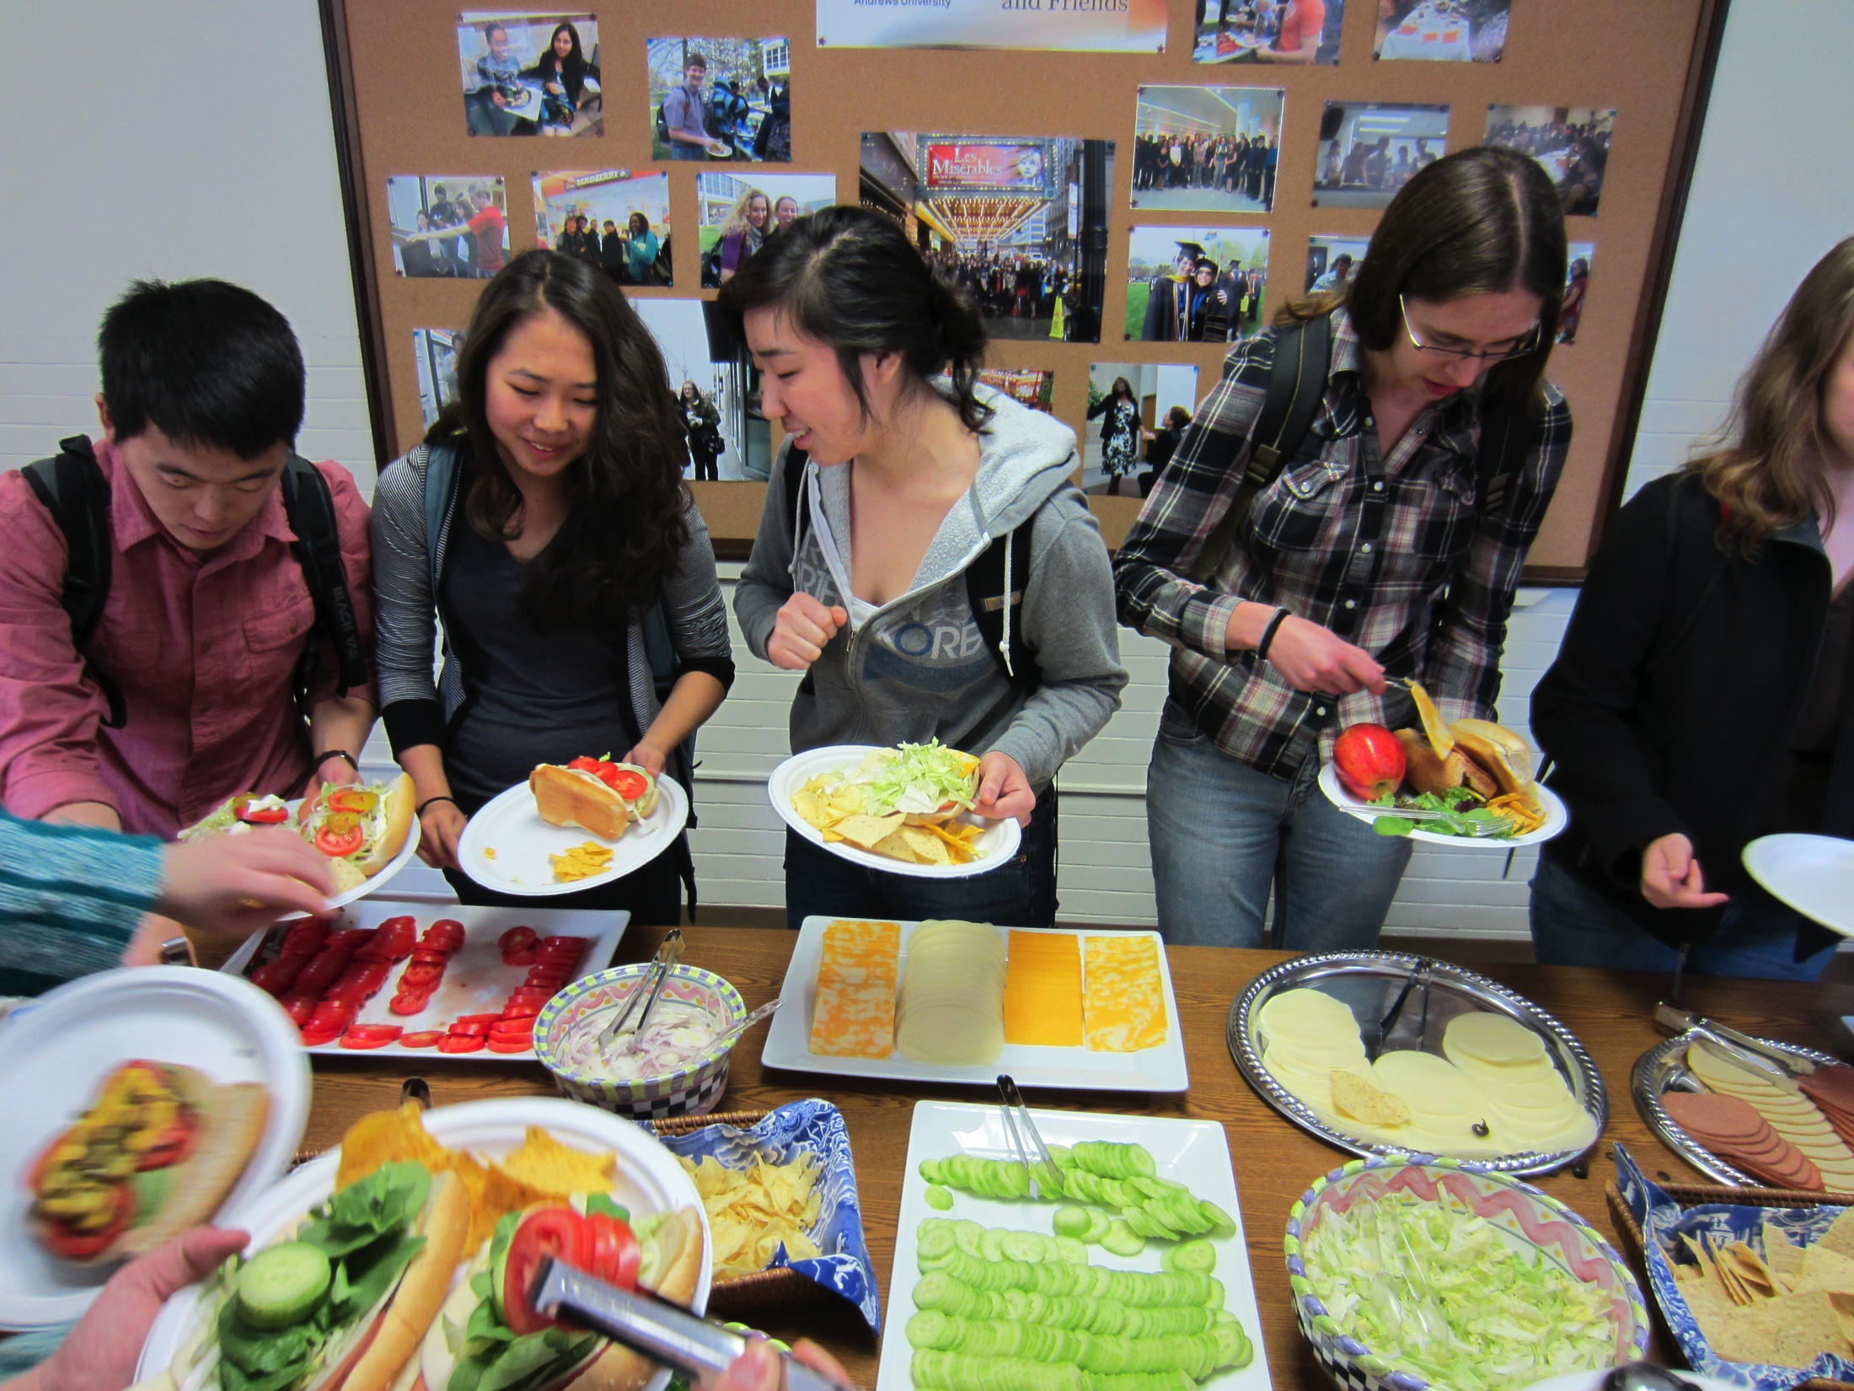
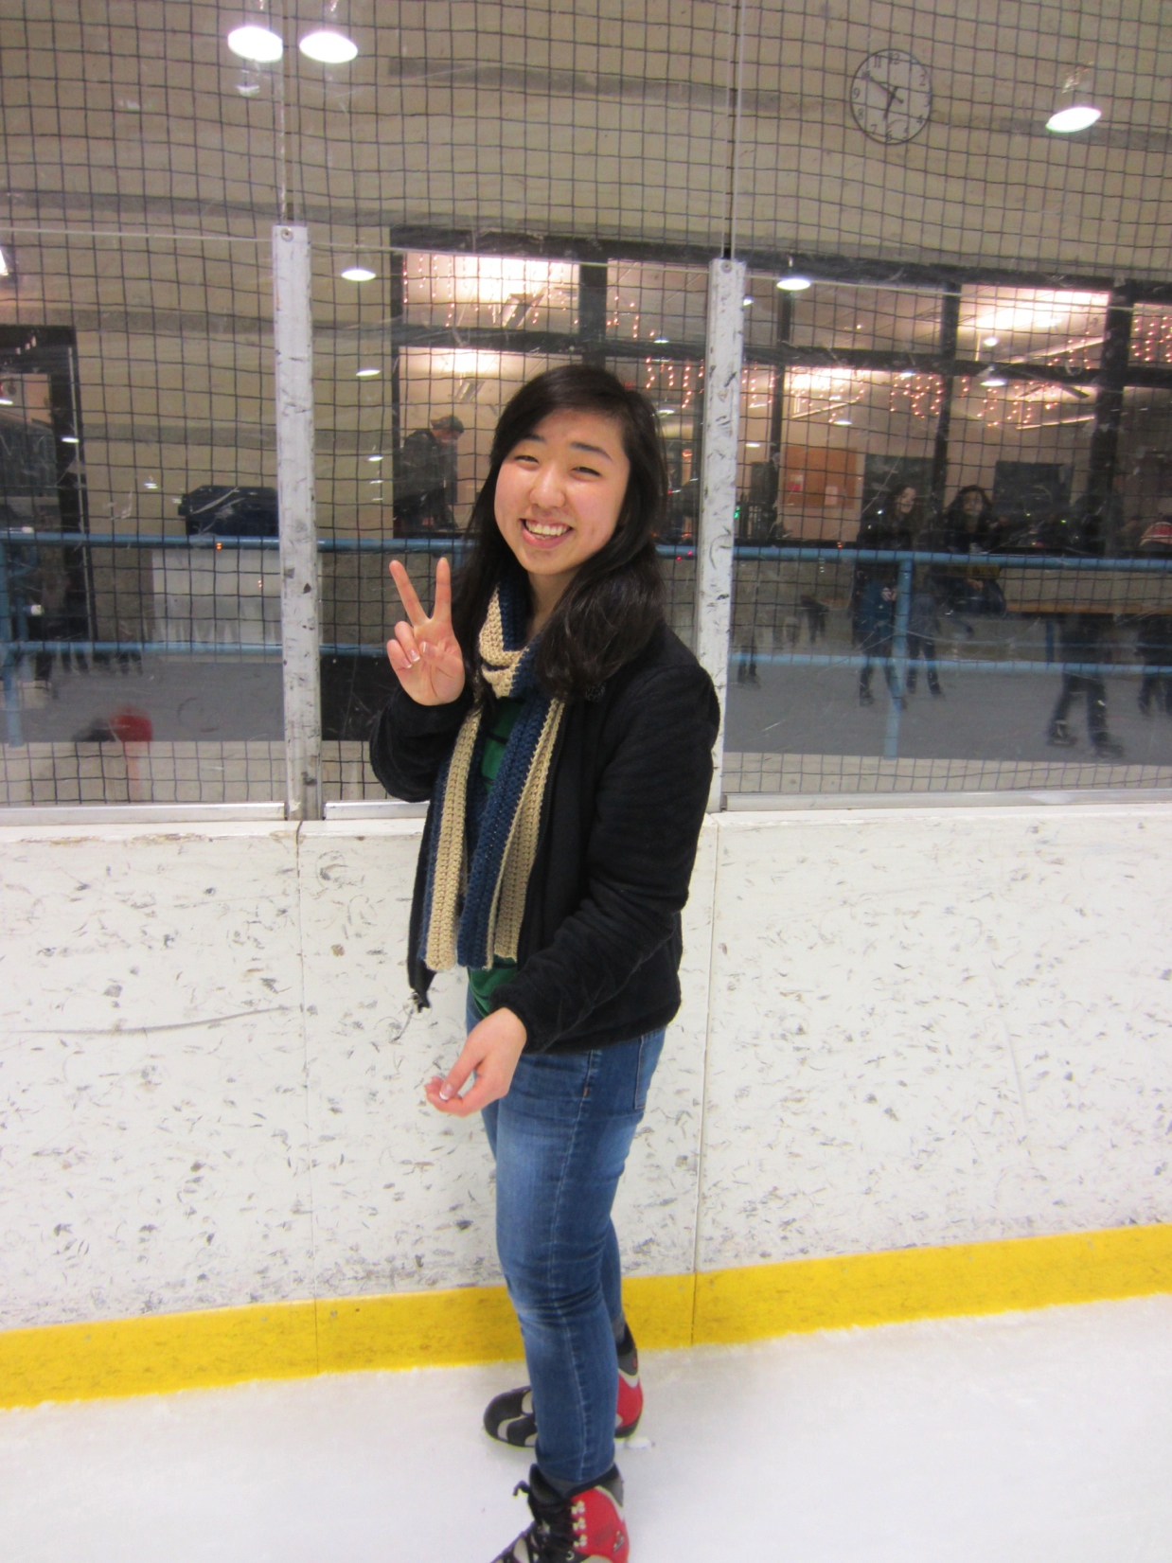
Yoona Kang
Animal Science, Pre-Veterinary Medicine
Accepted to Loma Linda University School of Medicine

Slide 21
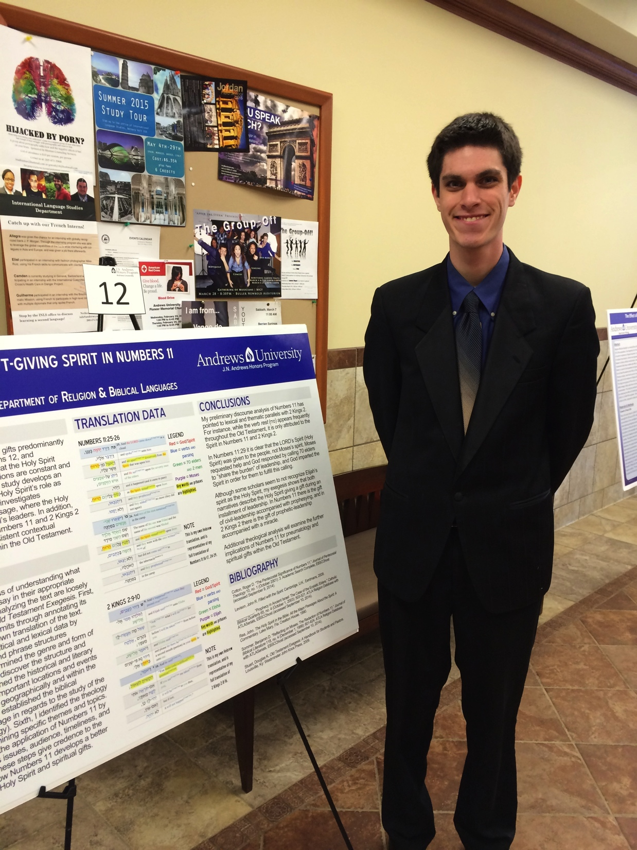
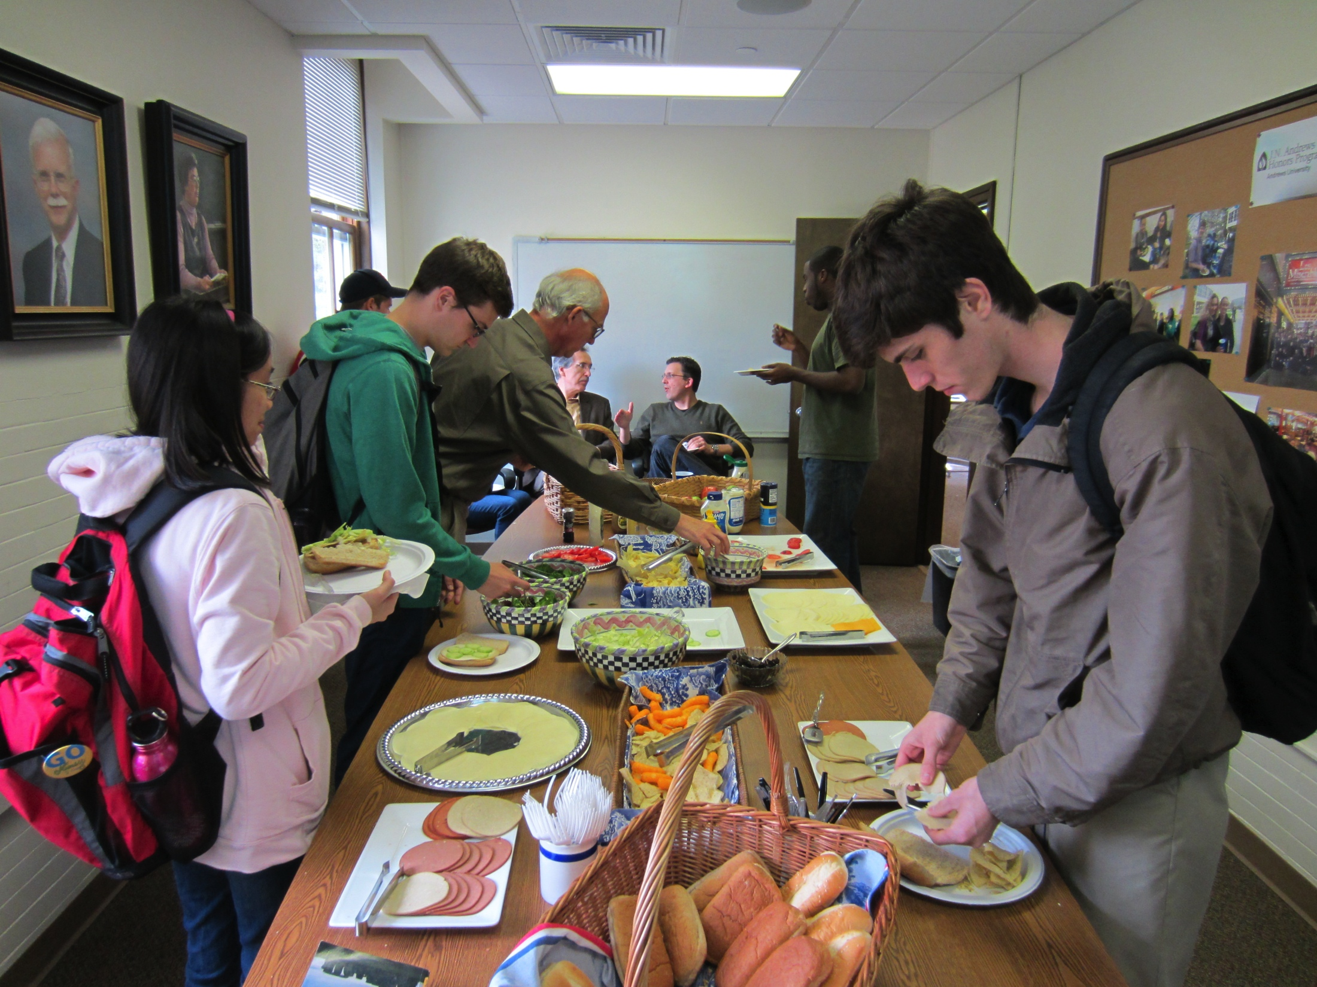
Jeanmark Kessler
Theology and Speech Language Pathology and Audiology
Will graduate May 2015
Pursuing M Div at the SDA Theological Seminary, Andrews University

Slide 22
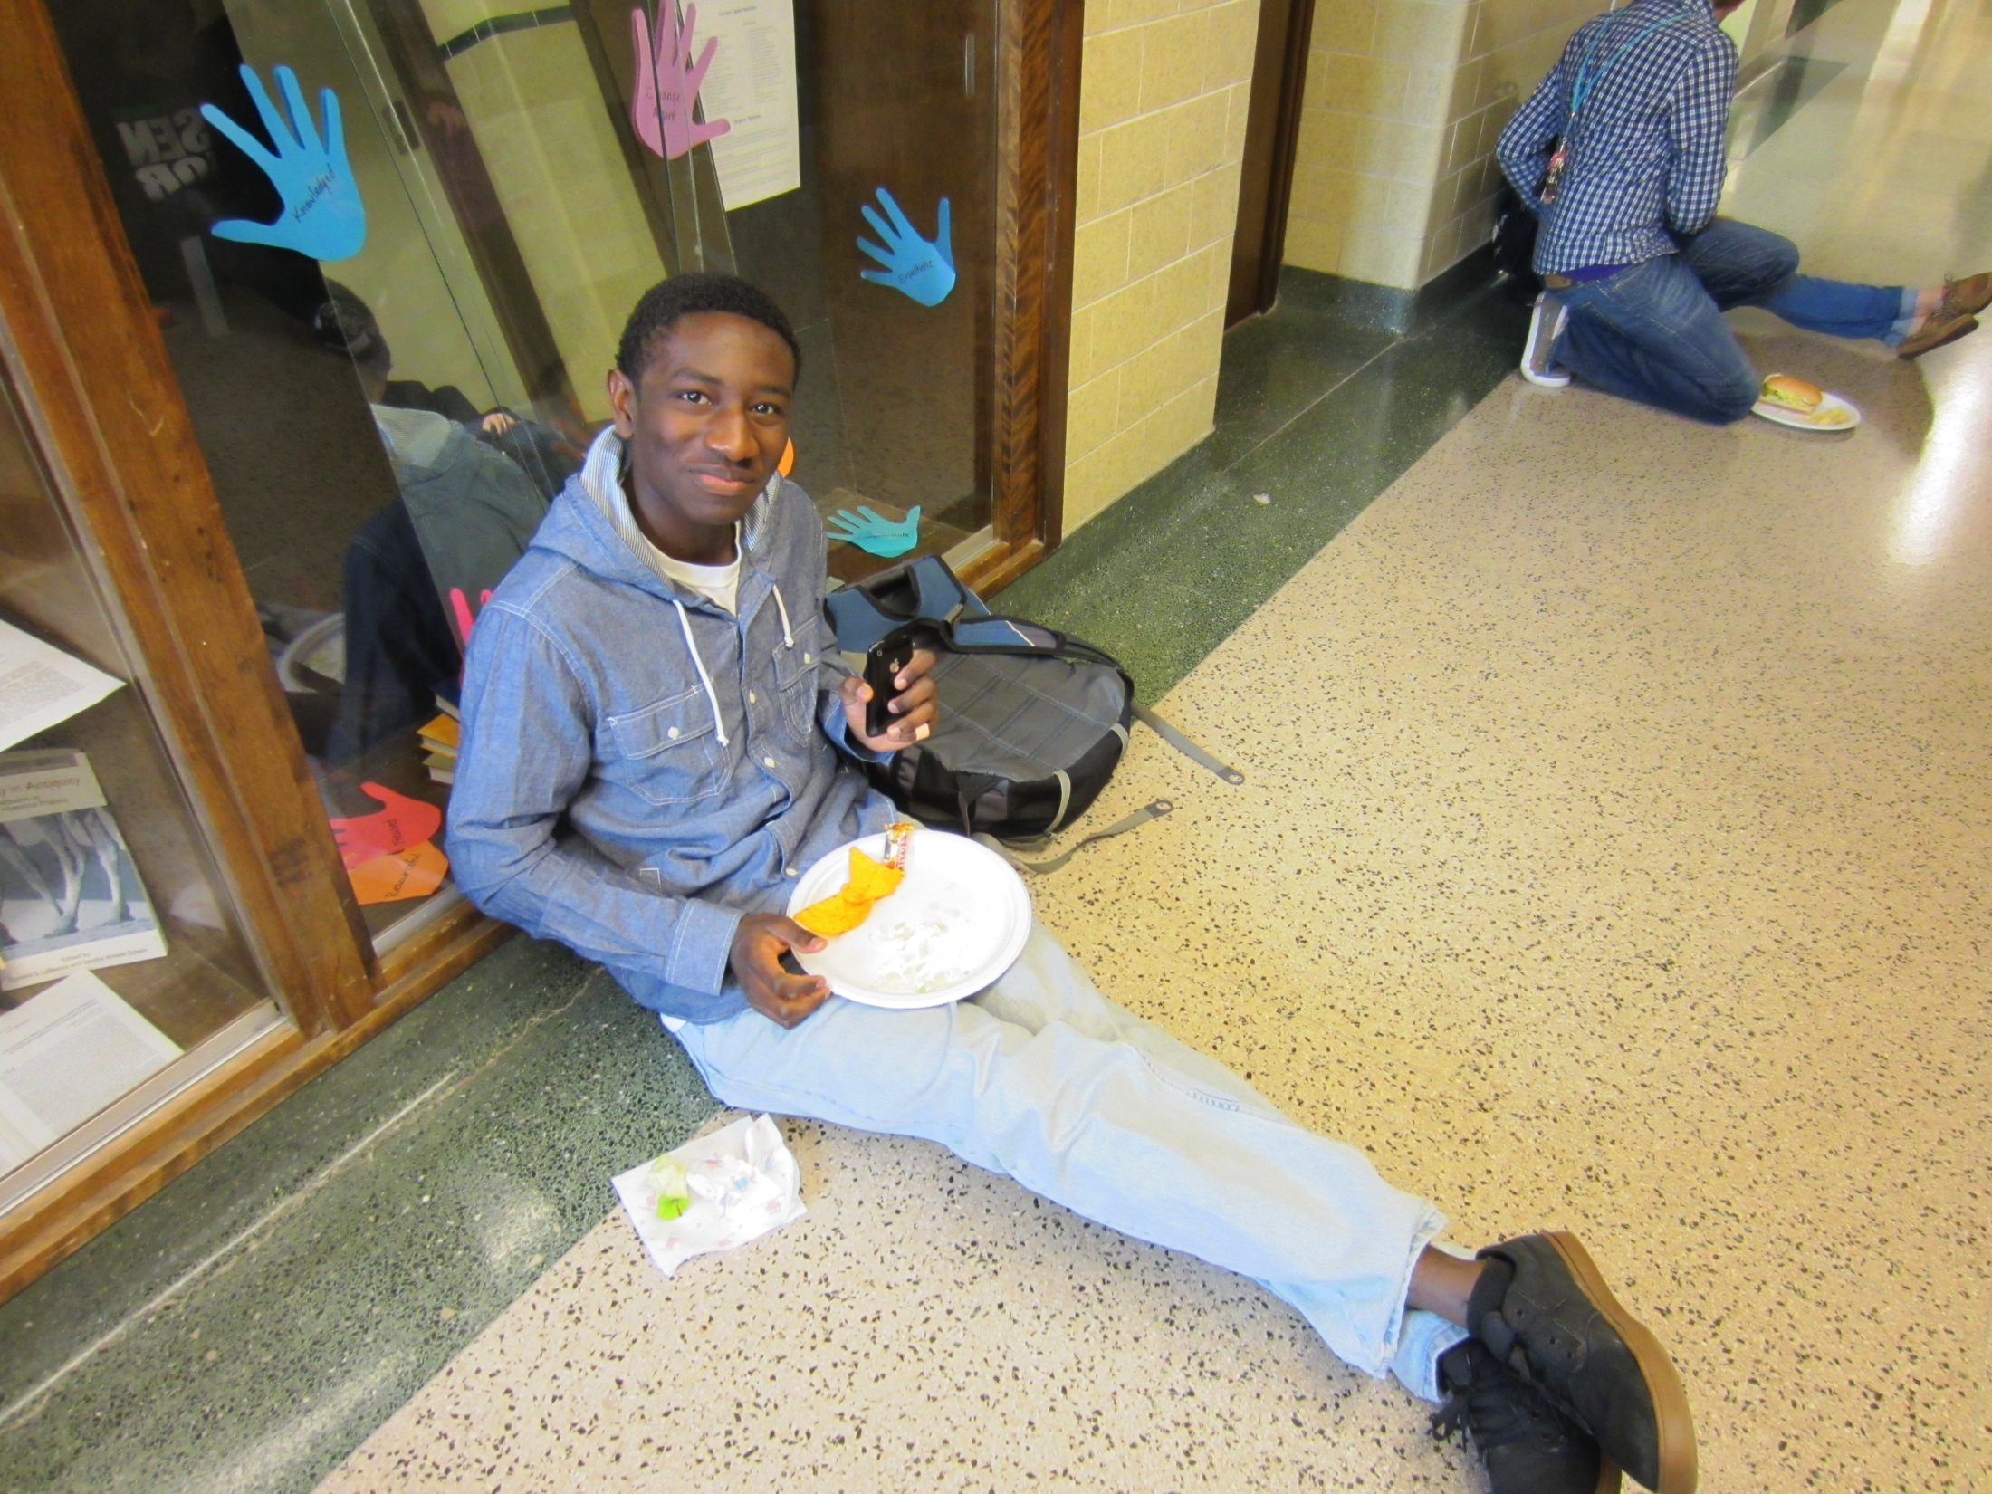
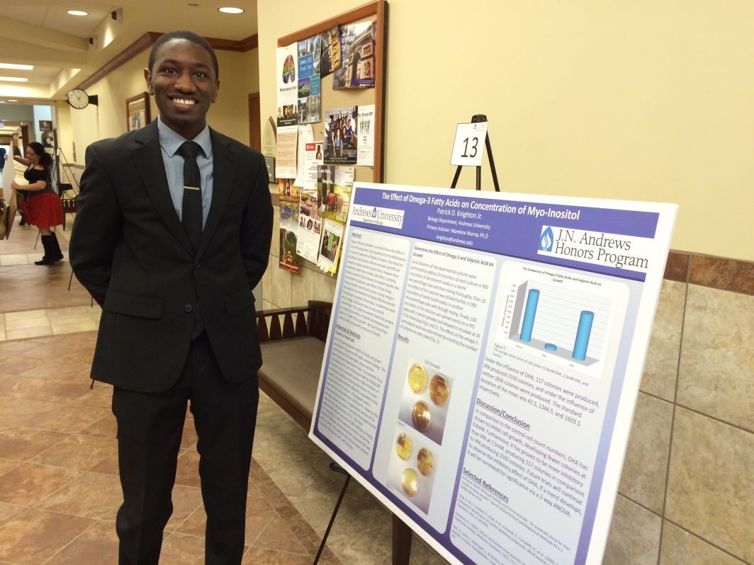
Patrick Knighton
Biology, Minor in Chemistry
Will graduate May 2015
Plans to take a gap year and then apply to medical or graduate school

Slide 23
Anna Kwon
Biology
Minor in Chemistry
Graduated December 2014

Slide 24
Charles Lee
English, concentration literature
Will graduate May 2015
Plans on taking a gap year

Slide 25
James Magbauna
Engineering, Mechanical Engineering
Will graduate May 2015

Slide 26
Michael VanderWaal
Psychology major
Spanish minor
Will graduate May 2015

Slide 27
Michael Momohara
Music
Will graduate May 2015
Accepted to Loma Linda University School of Medicine

Slide 28
Andre Moncrieff
Music, Biology concentration in Zoology
Graduated December 2014
PhD Candidate at Louisiana State University
Working in a lab at the LSU Museum of Natural History that specializes in Neotropical birds

Slide 29
Megan Reed
Marketing
Will graduate May 2015
Assistant brand manager for Nutella at Ferrero Company

Slide 30
Melodie Roschman
Journalism and English
Will graduate May 2015
Accepted to MA in English Literature programs at:
University of Toronto
University of British Columbia
McMaster University
University of St. Andrews
University of London
University of Washington
Oxford University

Slide 31
Olivia Ruiz-Knott
Religion and Communication
Will graduate May 2015
Plans to move to Boston to do communication and Bible work for the Southern New England Conference and a ministry called “Compassion Boston”

Slide 32
Seth Stacey
Biochemistry
Accepted to Loma Linda University School of Dentistry
Will graduate May 2015

Slide 33
Nelson Starkey
Biology
Minor in Chemistry
Will graduate May 2015
Accepted to Loma Linda University School of Medicine

Slide 34
Andrew Stewart
Biology, minor in Chemistry
Will graduate May 2015
Accepted to Loma Linda University School of Medicine

Slide 35
Kyungje Sung
Biology
Plans to attend Loma Linda University School of Medicine
Graduated December 2014

Slide 36
Rosanne Thornhill
Biochemistry
Accepted to Loma Linda University School of Medicine
Will graduate May 2015

Slide 37
Doug Van Putten
Biology
Minor in Chemistry
Will graduate May 2015
Plans on taking a gap year to shadow, travel and do mission work around the world

Slide 38
WayAnne Watson
Music
Will graduate May 2015
Plans on teaching at Taiwan Adventist Academy for a year
Accepted to Loma Linda University School of Medicine

Slide 39
Joyce Yoon
Communication
Minor in Business Administration
Graduates May 2015
Plans to take a gap year to travel and complete an internship in Los Angeles, Chicago or Washington D.C.

