Slide 1
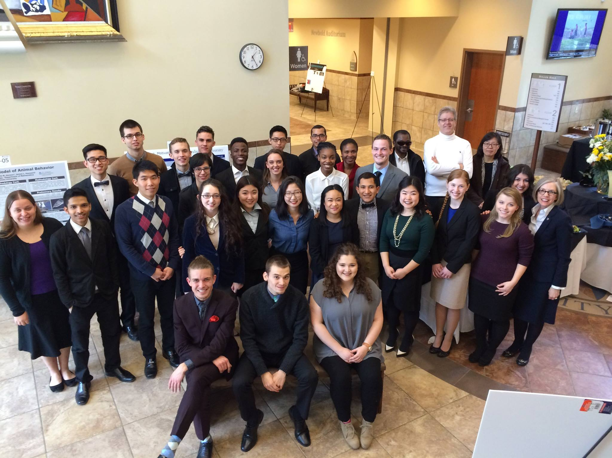
Celebrating Honors Researchers 2015-16

Slide 2
Emily-Jeans Bankes
Biochemistry
Will graduate May 2016
Plans to attend Pennsylvania State University, PhD in Chemistry with full funding
Also accepted to:
University of Virginia, University of Maryland, and West Virginia University.

Slide 3
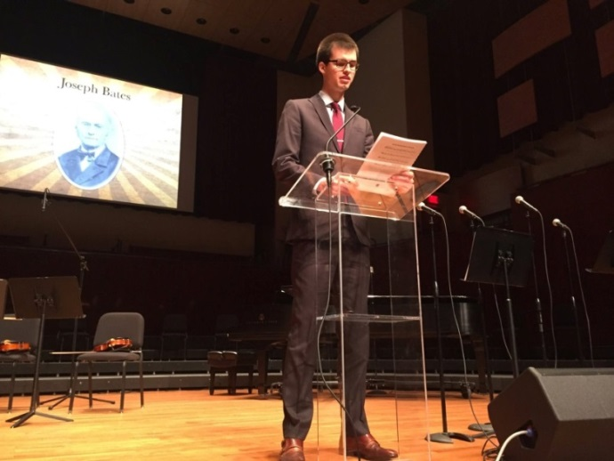
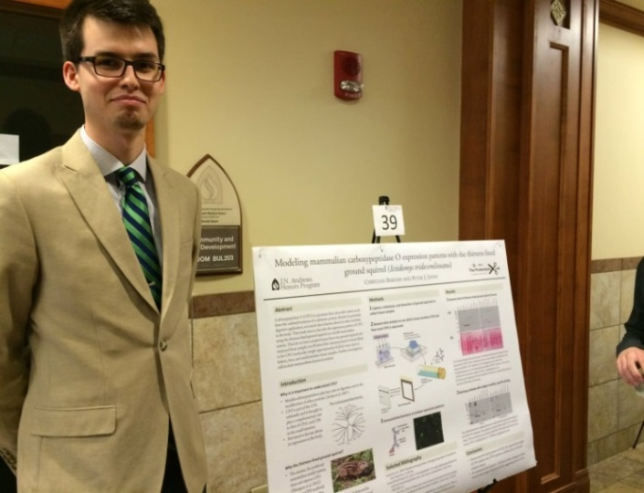
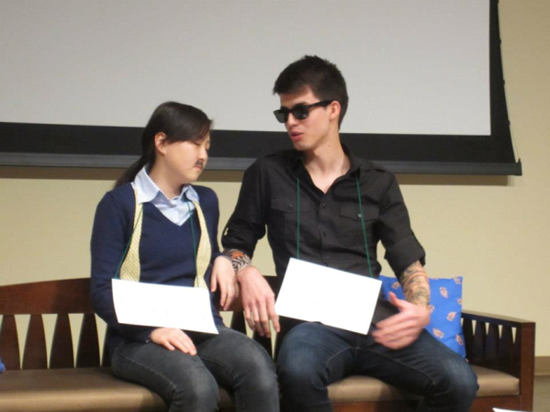
Christian Bardan
Biology
Minor in Chemistry
Will graduate May 2016
Accepted to Loma Linda University School of Medicine

Slide 4
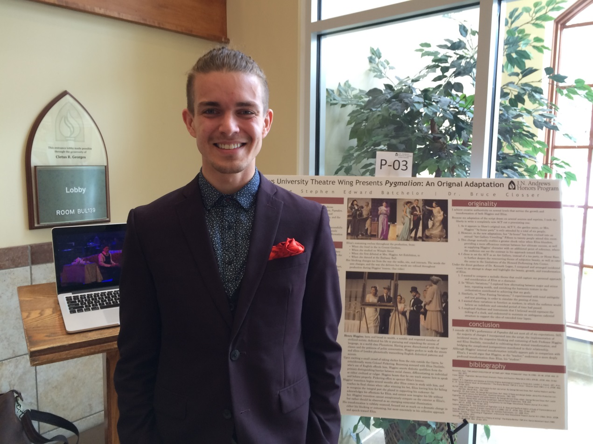
G. Stephen E. Batchelor
English and Spanish
Minor in Music
Will graduate May 2016
Plans to open a coffee shop

Slide 5
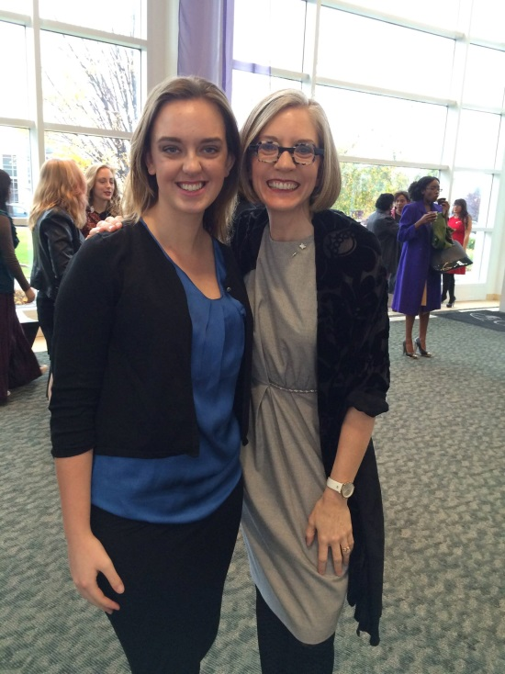
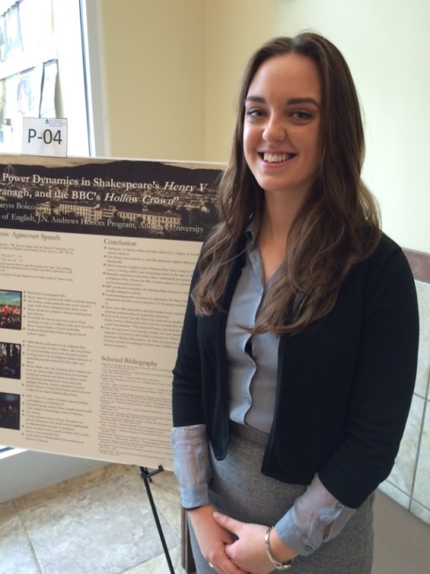
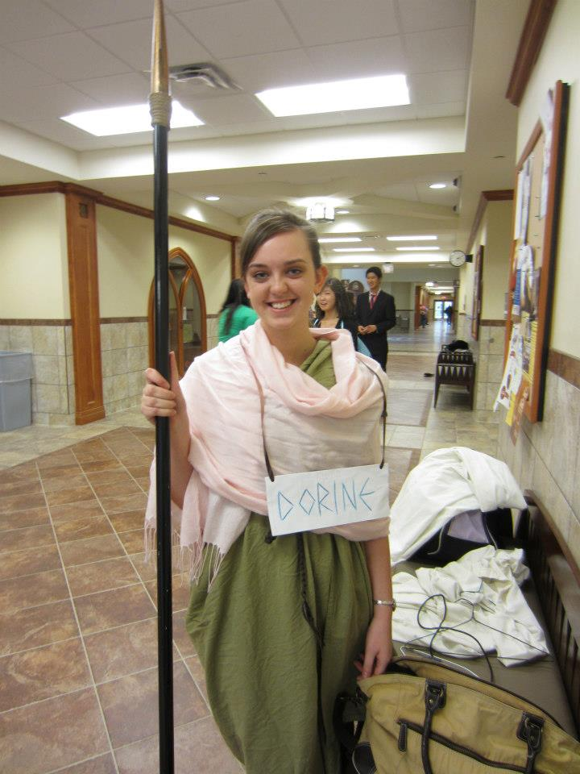
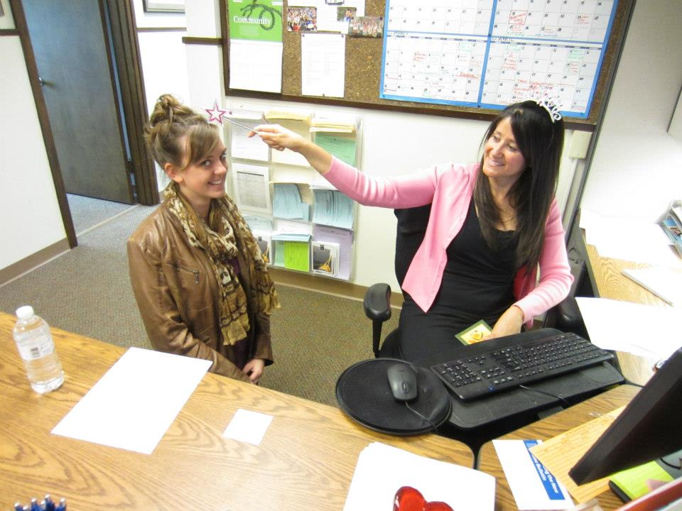
Alaryss Bosco
Political Science
Minor in English
Will graduate May 2016
Plans to travel abroad before attending Law School 2017

Slide 6
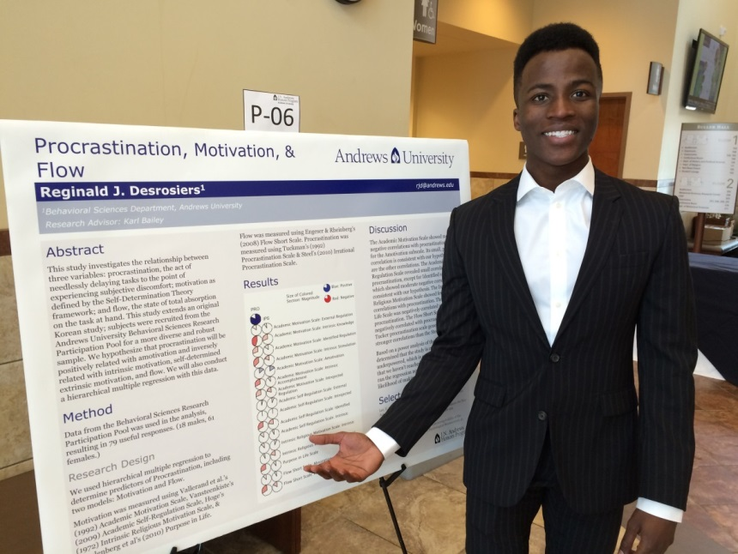
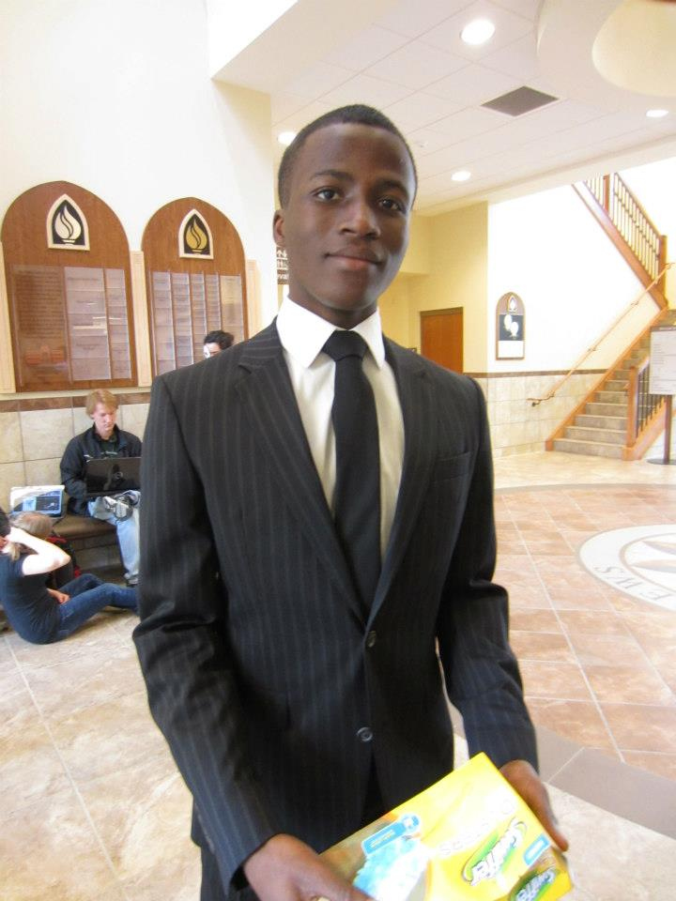
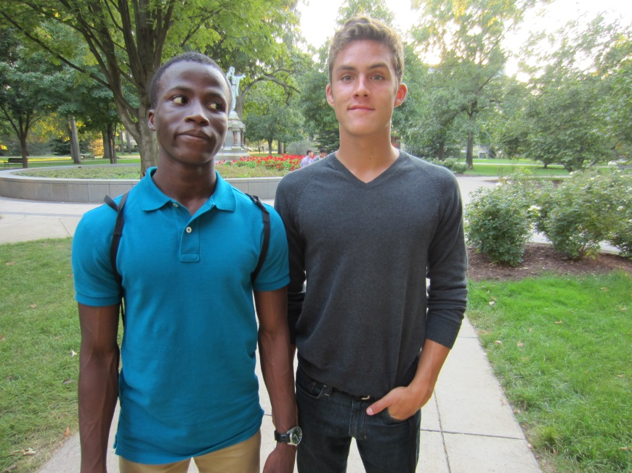
Reginald Desrosiers
Psychology
Will Graduate May 2016
Hired by Whirlpool

Slide 7
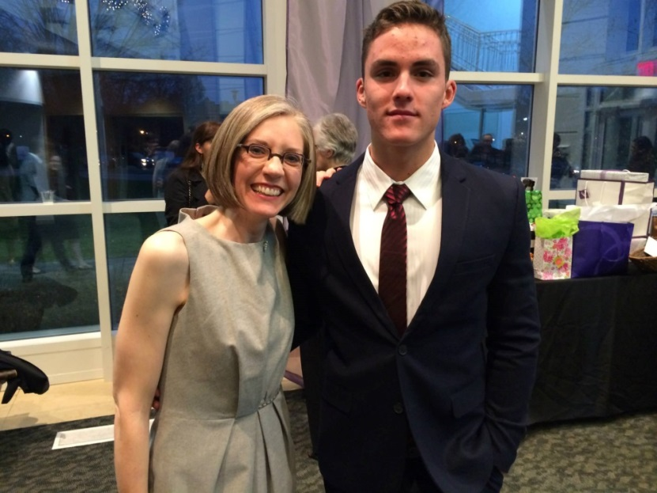
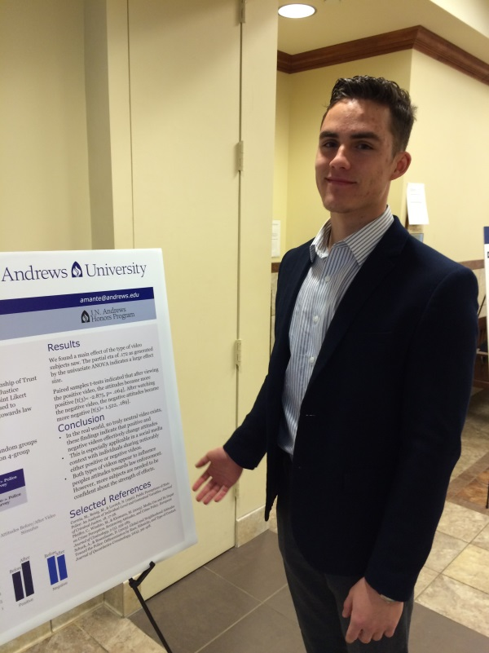
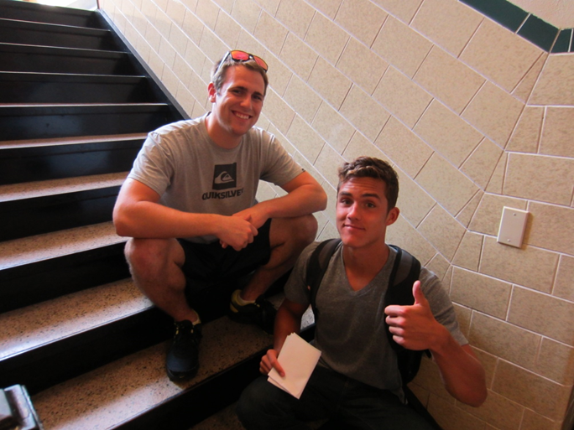
Amante Gonzalez
Psychology
Will graduate May 2016
Plans to attend graduate school

Slide 8
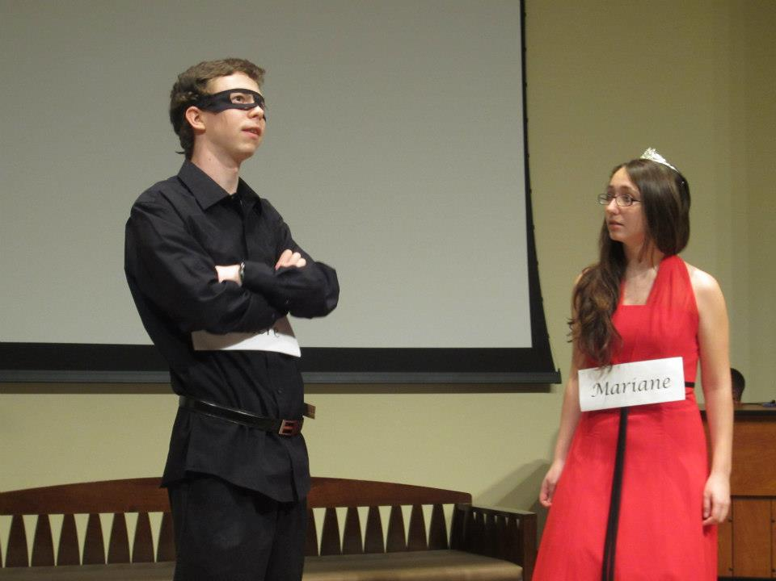
Michael Hess
Engineering
Will graduate May 2016
Plans to teach Mathematics in the Philippines with Adventist Frontier Missions for a year.

Slide 9
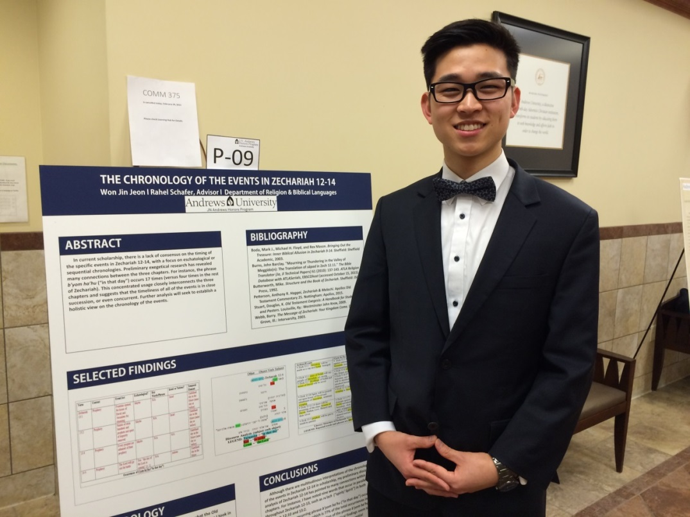
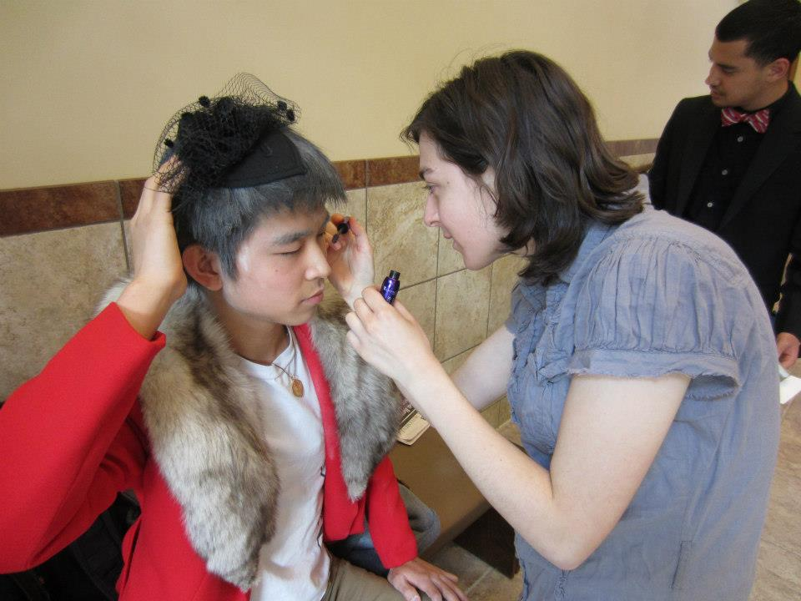
Won Jin Jeon
Religion Pre Med?
Will graduate May 2016
Accepted to Loma Lind University School of Medicine

Slide 10
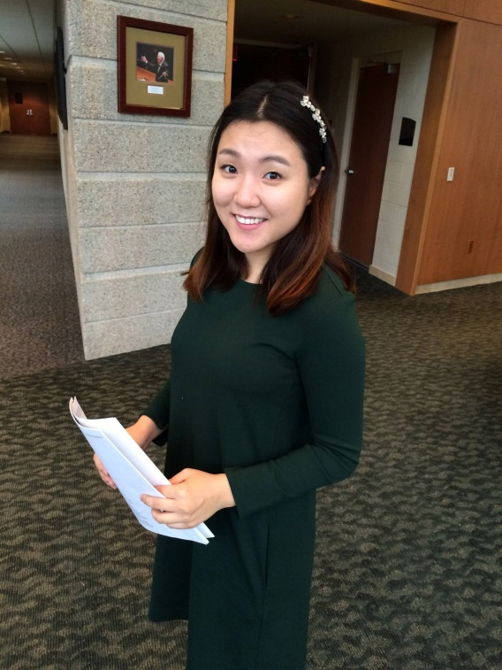
Shanelle Kim
English
Will graduate May 2016
Accepted to the University of Maryland, MA in English

Slide 11
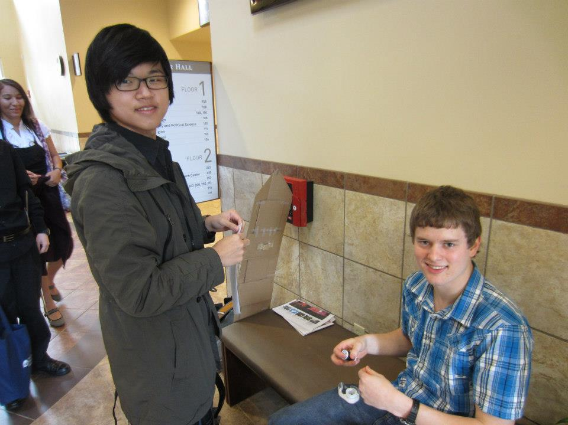
Jeong Bin Lee
Biochemistry
Graduated December 2015
Accepted to MD/PhD Program at Loma Linda University

Slide 12
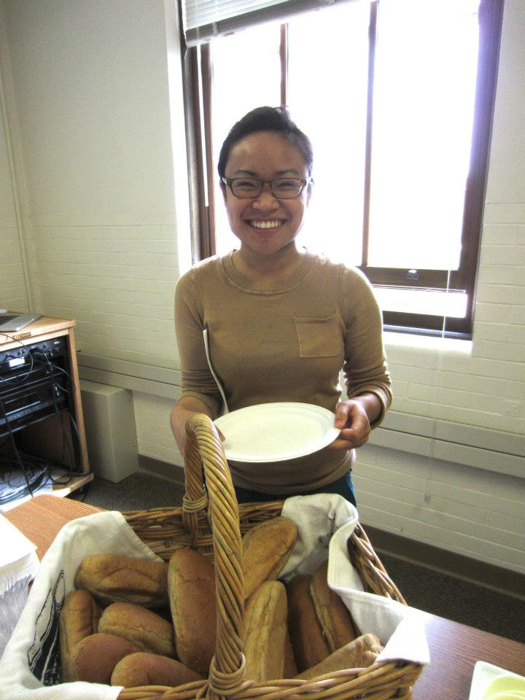
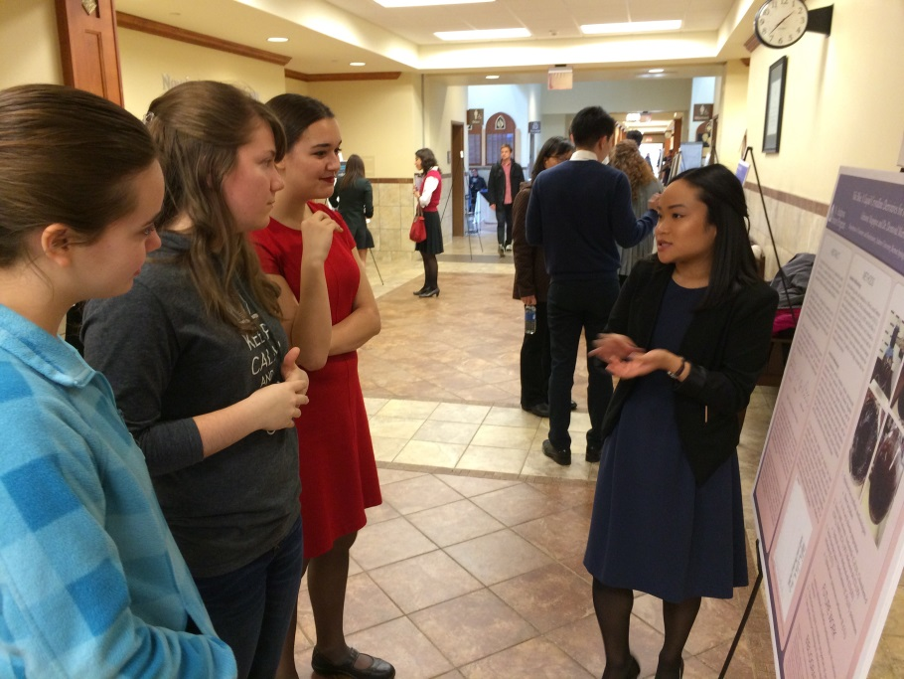
Adrianne Magispoc
Biochemistry
Will Graduate May 2016
Accepted to Loma Linda University School of Medicine

Slide 13
Ashley Reichert
Biology
Will graduate May 2016
Accepted to Loma Linda University School of Medicine, University of Texas Houston

Slide 14
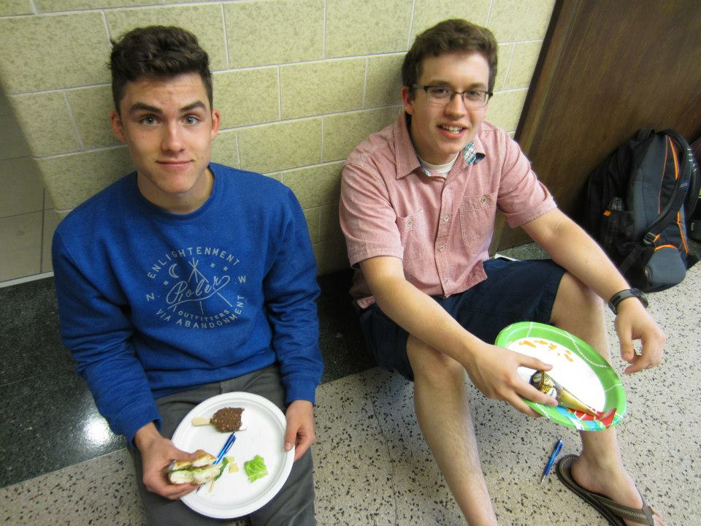
Zachary Reichert
Biology
Will graduate May 2016
Accepted to Loma Linda University School of Medicine

Slide 15
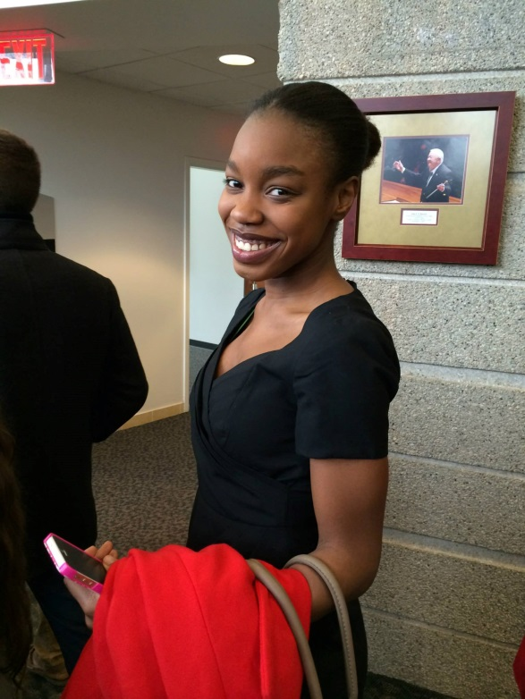
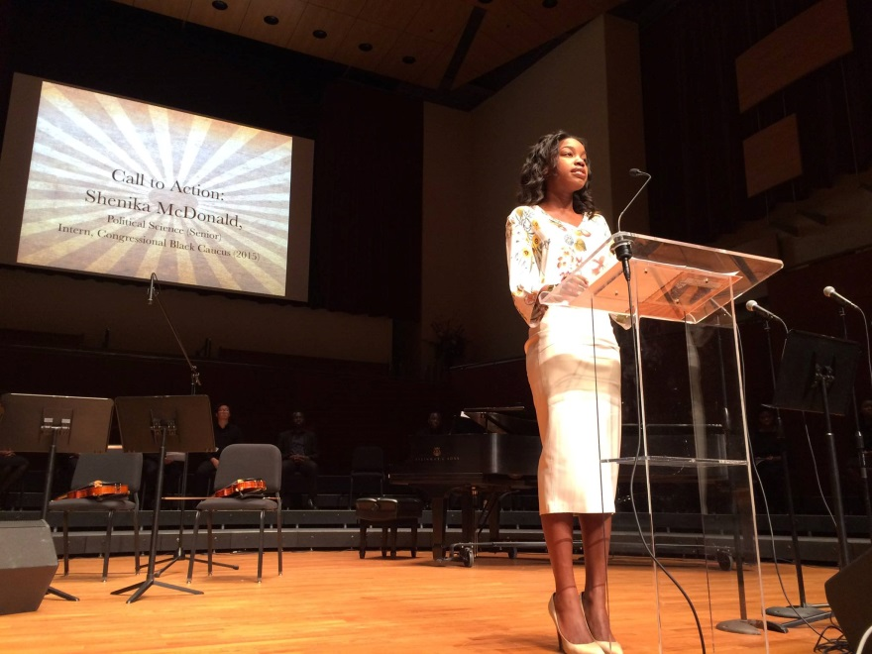
Shenika McDonald
Political Science
Will graduate May 2016
Plans to work in New York before attending Law School

Slide 16
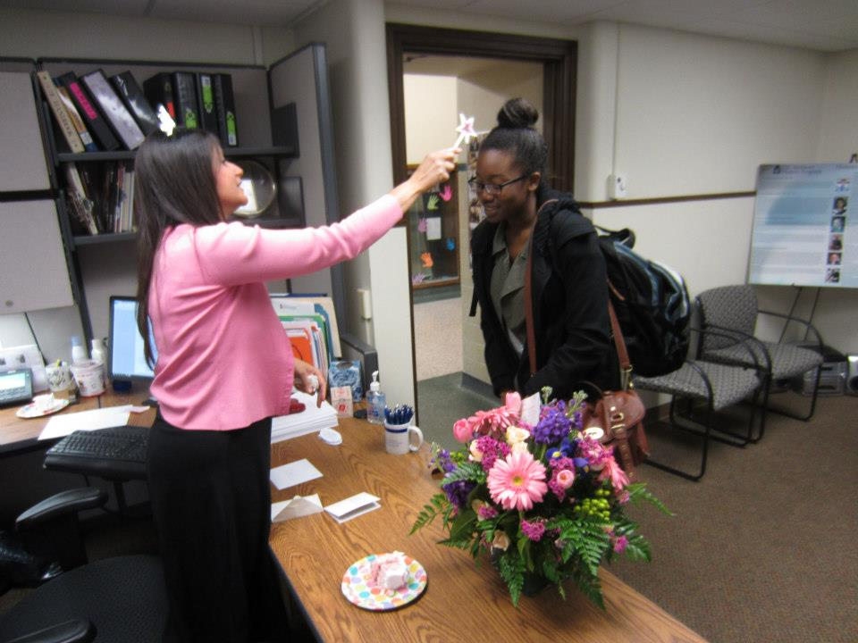
Martha Duah
Psychology, Behavioral Neuroscience
Graduated December 2015
Currently serving as a Student Missionary in Korea.
Accepted to Loma Linda University School of Medicine

Slide 17
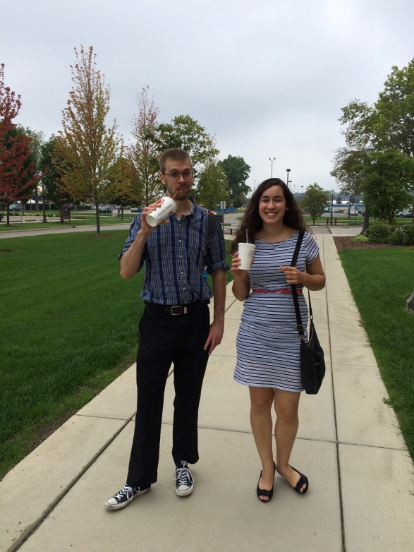
Sumiko Weir
Biology
Will graduate May 2016
Accepted to Loma Linda University School of Medicine and Kansas University School of Medicine

Slide 18
Joy Kim
Biology
Graduated December 2015
Currently serving as a Student Missionary in Thailand
Accepted to Loma Linda University School of Medicine

Slide 19
Juliette Young
Mathematics Education
Will graduate May 2016
Plans to

Slide 20
Abraham Fogel
Architecture
Graduated December 2015
Plans to

Slide 21
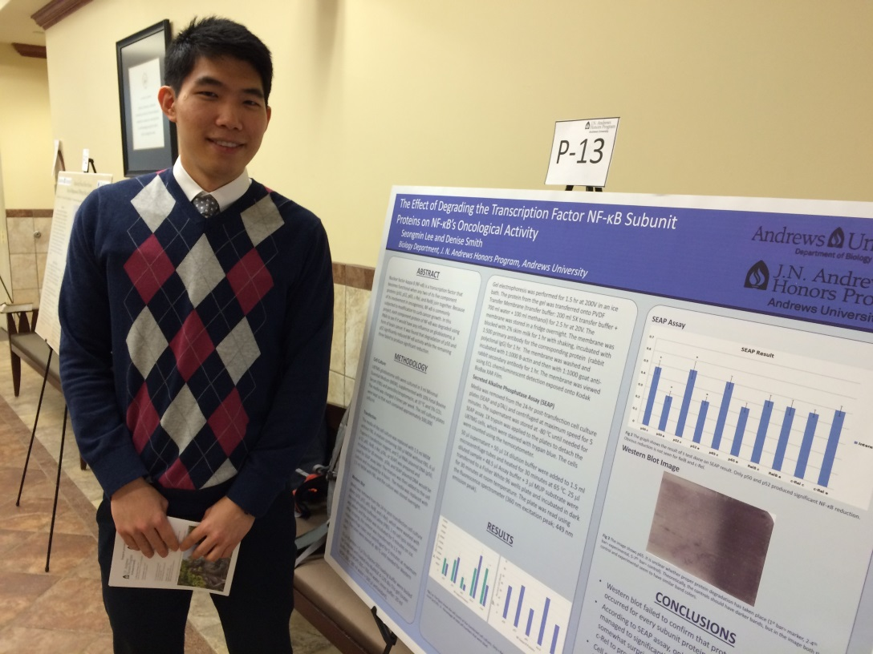
Seongmin Lee
Biology and English
Will graduate May 2016
Plans to attend Loma Linda University School of Medicine

Slide 22
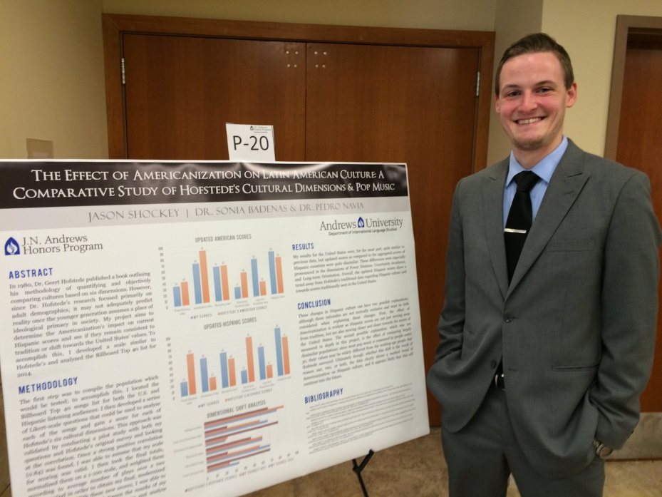
Jason Shockey
Management, Accounting and Spanish for International Trade
Will graduate May 2016
Plans to

Slide 23
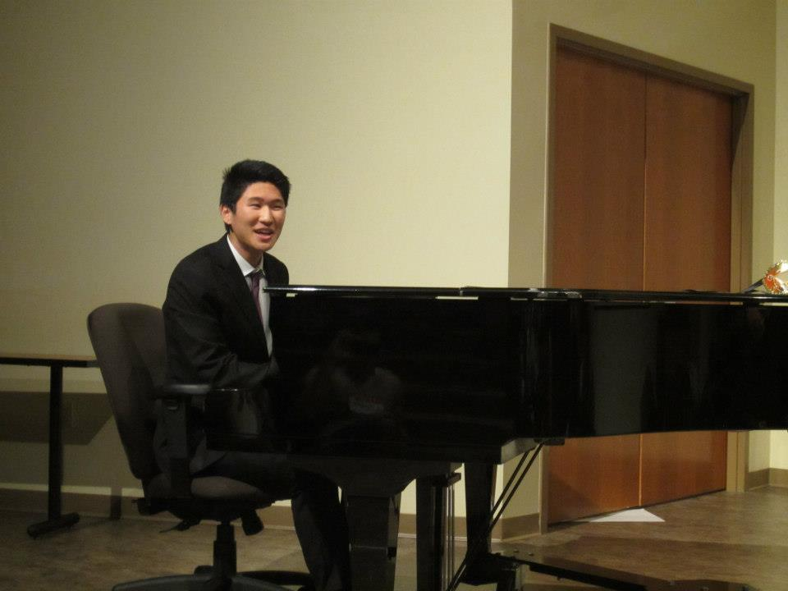
Kenneth Choi
Integrated Science for Secondary Education
Will graduate May 2016
Plans to

Slide 24
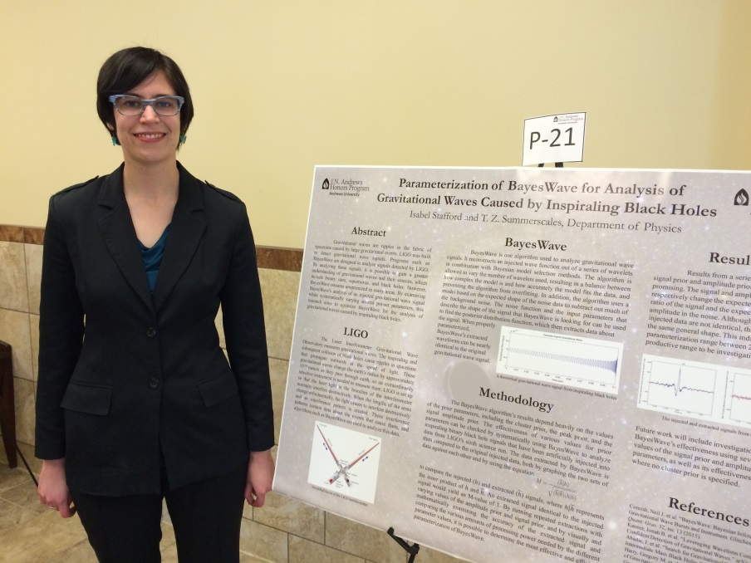
Isabelle Stafford
Physics and Mathematical Studies
Will graduate May 2016
Plans to

Slide 25
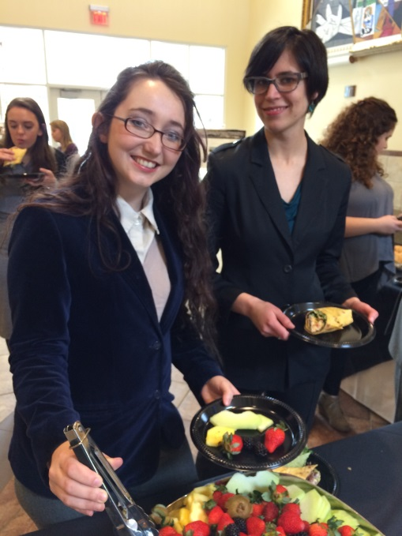
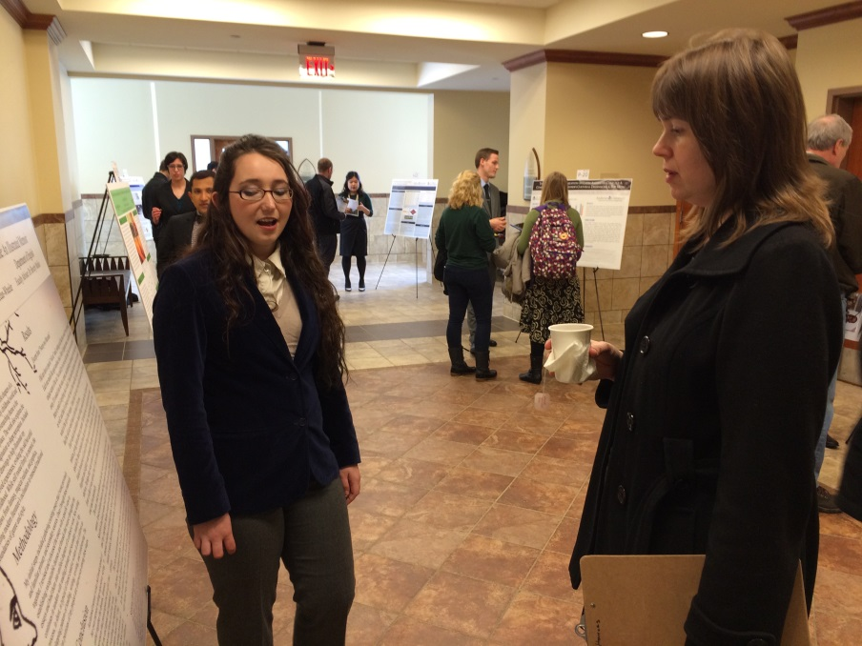
Mercedes McLean
Secondary Education: Religion, English, History
Will graduate May 2016
Plans to

Slide 26
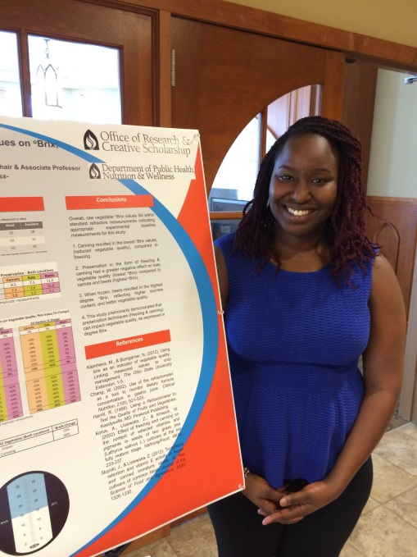
Hannah Mbungu
Nutrition
Will graduate December 2016

Slide 27
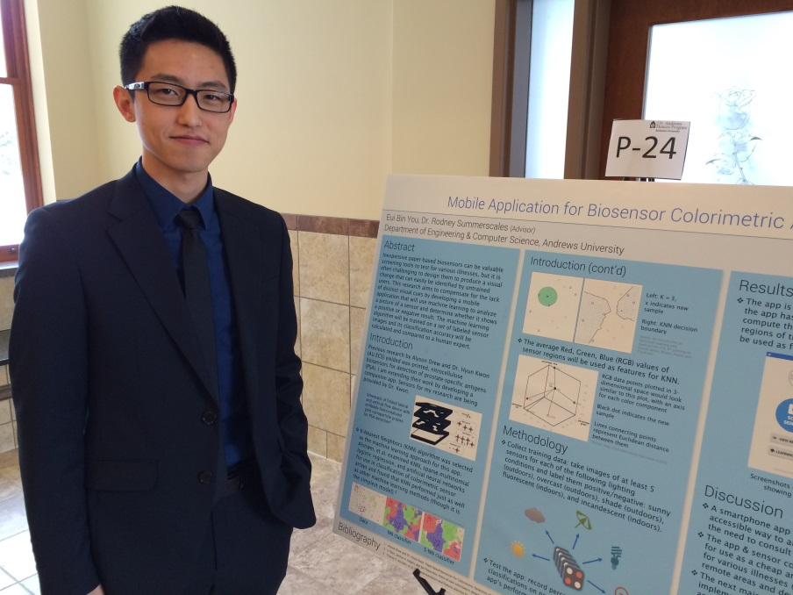
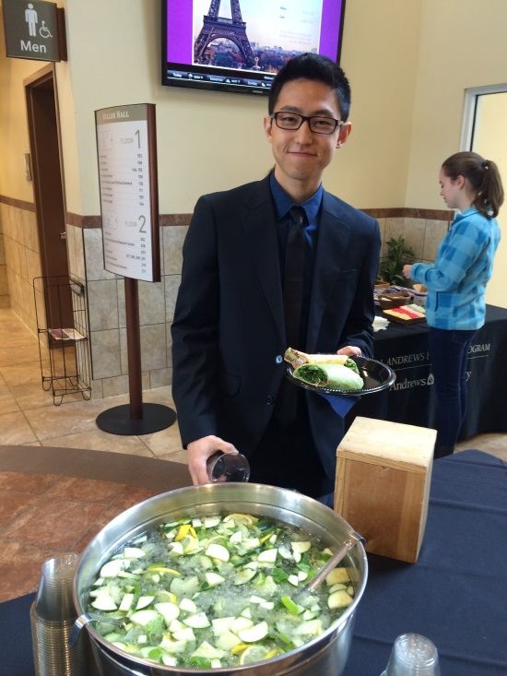
Eui Bin You
Computing
Will graduate May 2016
Plans to

Slide 28
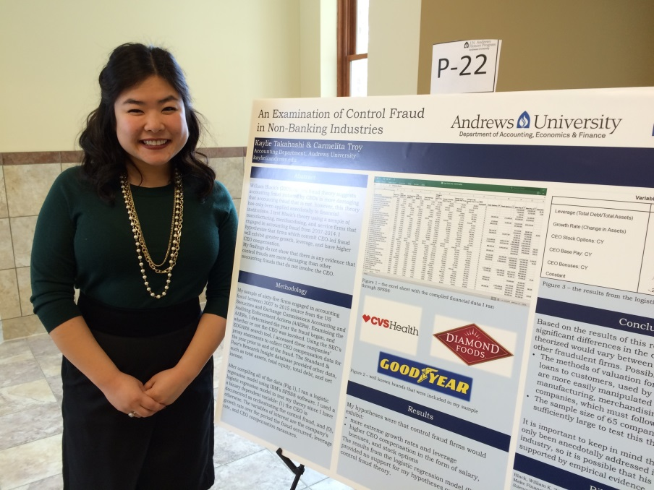
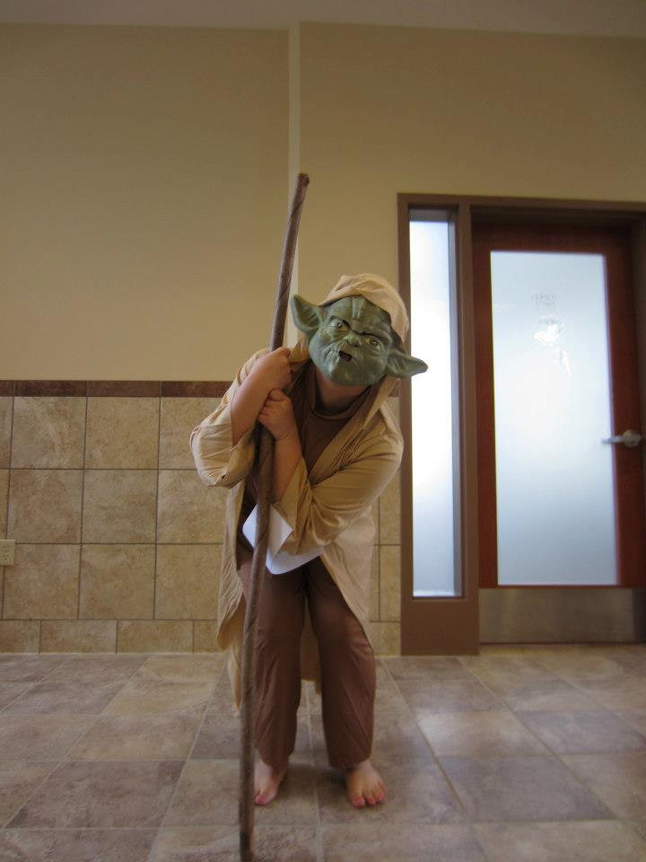
Kaylie Takahashi
Accouting
Will graduate May 2016
Plans to

Slide 29
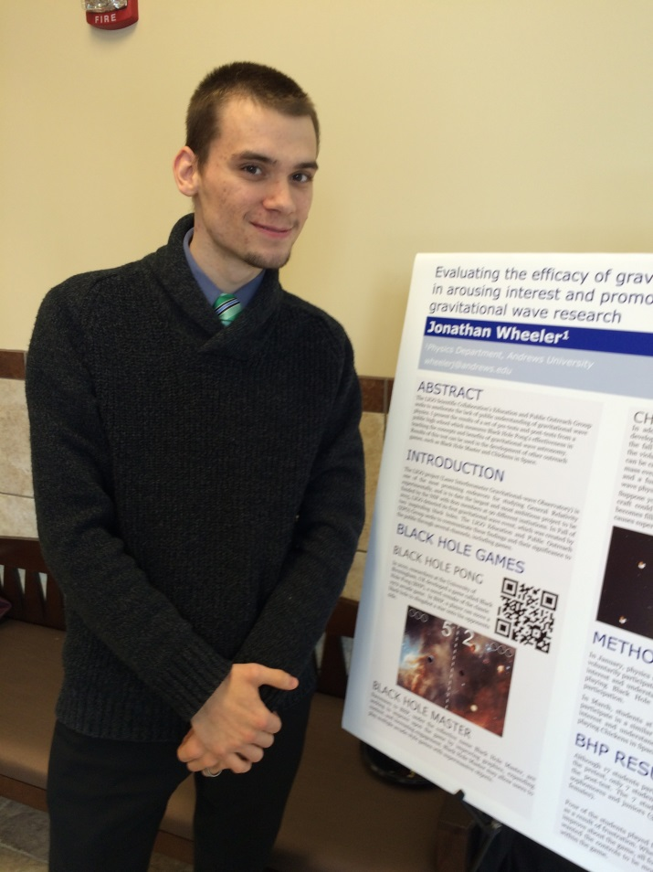
Jonathan Wheeler
Will graduate May 2016
Plans to

Slide 30
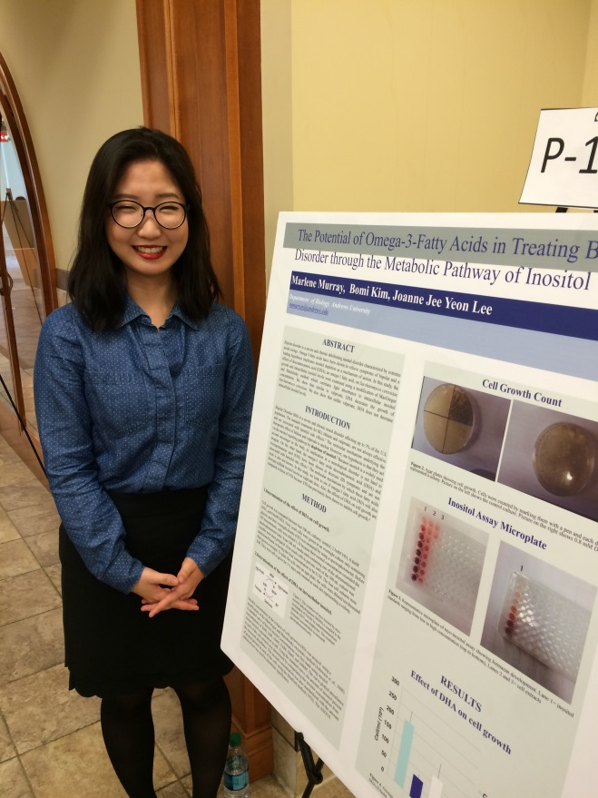
Joanne Lee
Biology
Will graduate May 2016
Plans to

