Slide 1
Assurance of Salvation
In Scripture and Ellen White

Slide 2
The Problem
Many Christians who sincerely believe in Jesus do not have confident assurance of present salvation.

Slide 3
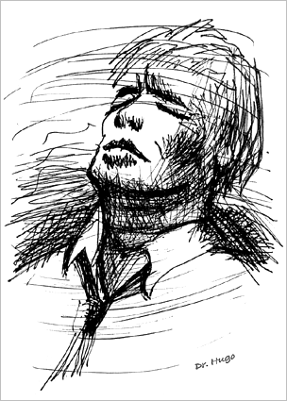
Assurance and Witness
Lack of Assurance is a significant hindrance to witness. You can’t give what you don’t have.
Lack of assurance may be why so many professed Christians are
  Afraid of death
  Afraid of risk taking for God
  Afraid of making major sacrifices for God.

Slide 4
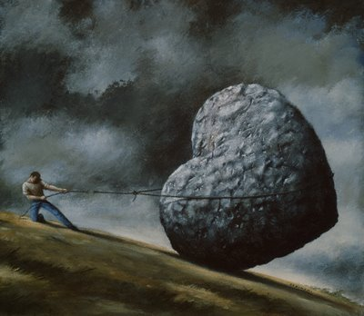
I know from my years as a pastor that many Adventists think EGW does not teach present assurance.
I have also noticed what this misconception leads to—
  Legalism, trying to be saved by performance
  Giving up on heaven, living for this life only
  Throwing out Ellen White and Adventist beliefs, because they seem to be the problem.
4

Slide 5
Is it true?
Did Ellen White deny the doctrine of assurance?
Did Ellen White teach that no one should ever say ‘I am saved’?

Slide 6
No. She herself said:
“This I do know, that our churches are dying for the want [lack] of teaching on the subject of righteousness by faith in Christ, and for kindred truths.”
        (1888 Materials, 547)

Slide 7
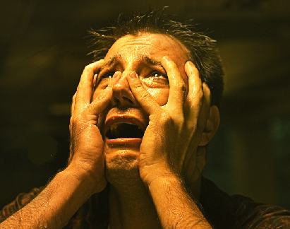
The Opposite Problem—
False Assurance
The Bible says that many who believe they are saved, will find out in the judgment that they are lost (Matt 7:21-23; 13-14; 8:11-12; Luke 13:23-27).
Therefore Paul says, ‘Examine yourselves, whether you are in the faith.’
(2 Cor 13:5)

Slide 8
Working Definitions
Salvation: Having one’s name in the Book of Life; being “in Christ,” hence, possessing eternal life in Christ.
Assurance of Salvation: The inward witness of the Holy Spirit (Rom 8:16; Gal 4:6) that one has present salvation in Christ.

Slide 9
Working Definitions
It is possible to be saved without being sure of it. (Rom 2:11-16; DA 638)
It is also possible to have false assurance without salvation; that is, to “feel sure” that one is saved, when one isn’t actually saved. Matt 7:21-23: “Many will say to Me in that day, ‘Lord, Lord, have we not prophesied in Your name?’ . . . I will say to them, ‘I never knew you.’”
(See also 1T 133-134, 158, 163, 242-243.)
9

Slide 10
Working Definitions
But genuine biblical assurance is essential to the normal Christian life. Jesus said, “Rejoice, because your names are written in heaven.” Luke 10:20.
How can you rejoice that your name is in heaven if you don’t know it?
10

Slide 11
Three Essentials of Assurance according to Scripture
1. New Birth, forgiveness, cleansing, new heart.
2. Abiding in Christ, through the Holy Spirit.
3. Doing the will of the Father. “Not everyone who says to Me, ‘Lord, Lord,’ shall enter the kingdom of heaven, but he who does the will of My Father in heaven.” Matt 7:21.
11

Slide 12
Unpacking Step 1
12
New Birth includes 2 elements:
Forgiveness of sins, and Cleansing from sin.
“If we confess our sins, He is faithful and just to forgive us our sins and to cleanse us from all unrighteousness. 1John 1:9

Slide 13
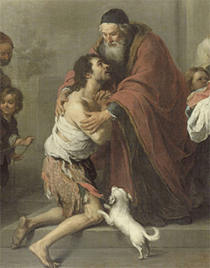
New Birth includes 2 elements
Forgiveness of sins, and Cleansing from sin.
“Wash me thoroughly from my iniquity,
And cleanse me from my sin. . . .
Create in me a clean heart, O God,
And renew a right spirit within me. Ps 51:2, 10
Prodigal Son
13

Slide 14

New Birth includes 2 elements
14
Forgiveness of sins, and Cleansing from sin.
“I will cleanse you from all your filthiness and from all your idols. I will give you a new heart and put a new spirit within you; I will take the heart of stone out of your flesh and give you a heart of flesh.”
Ezek 36:25, 26.

Slide 15
New Birth includes 2 elements
15
Forgiveness of sins, and Cleansing from sin.
These texts teach—and we could read many more—that the new birth is both forgiveness and a new creation, a new heart.
2 Cor 5:14: “If anyone is in Christ, he is a new creation; old things have passed away: behold, all things have become new.”

Slide 16
New Birth includes 2 elements
16
The new birth is both forgiveness and new creation.
Ellen White agrees: “God’s forgiveness is not merely a judicial act by which He sets us free from condemnation. It is not only forgiveness for sin, but reclaiming from sin. It is the outflow of redeeming love that transforms the heart.” Mount of Blessing, 114.

Slide 17
Three Steps to Biblical Assurance
17
Step 1: New Birth, forgiveness, cleansing, new heart. “You are . . . clean, because of the word which I have spoken to you.” John 15:3.
Step 2: Abiding in Christ, through the Holy Spirit. “Abide in Me, and I in you. As the branch cannot bear fruit of itself, unless it abides in the vine, neither can you, unless you abide in Me.” John 15:4.

Slide 18
Three Steps to Biblical Assurance
18
Step 1: New Birth, forgiveness, cleansing, new heart.
Step 2: Abiding in Christ, through the Holy Spirit.
Step 3: Doing the will of the Father. “Not everyone who says to Me, ‘Lord, Lord,’ shall enter the kingdom of heaven, but he who does the will of My Father in heaven.” Matt 7:21

Slide 19
Once saved, always saved?
Some read these texts from the viewpoint of predestination, which teaches that God decided before the Creation who would be saved and who would be lost. The ‘elect’ cannot be lost and the ‘non-elect’ can never be saved.
However, the most knowledgeable proponents of this theology admit that it is possible for individuals to think they are among the elect when, in fact, they are not.
Therefore one cannot infallibly know that one was ‘once saved.’

Slide 20
Once saved, always saved?
However, the most knowledgeable proponents of this theology admit that it is possible for individuals to think they are saved, and think they among the elect when, in fact, they are not.
If they eventually fall away, it shows they weren’t truly saved, because the saved cannot fall away.
20

Slide 21
Once saved, always saved?
But if you can think you are saved when you are actually not saved, then you cannot infallibly know that you are ‘once saved.’
And if you cannot infallibly know that you have been saved, then you cannot infallibly know that you will always remain saved.
So the supposed guarantee is not a guarantee, but only an opinion about a degree of probability.
21

Slide 22
A truer perspective
God guarantees that the repentant sinner will always be welcomed home. “The one who comes to Me I will by no means cast out.” John 6:37.
Once saved, it is possible to fall from grace, but it is not necessary. He “is able to keep you from falling and to present you faultless before the presence of His glory with exceeding joy.” Jude 24; see also 1 Cor 10:13; Phil 1:6; 2:12, 13, etc.

Slide 23
A truer perspective
23
“For if, when we were enemies, we were reconciled to God through the death of His Son, much more, having been reconciled, we shall be saved by His life.” Rom 5:10
“Therefore He is able to save to the uttermost [perfectly and permanently] those who come to God through Him, since He ever lives to make intercession for them.” Heb 7:25

Slide 24
A truer perspective
The guarantee of our salvation is not based on the doctrine of predestination, but on the permanent love of One who identified Himself completely with us, died in our place, and “ever lives to make intercession for us.”
24

Slide 25
“So ready, so eager, is the Saviour’s heart to welcome us as members of the family of God, that in the very first words we are to use in approaching God, He places the assurance of our divine relationship, ‘Our Father.’ Here is the announcement…that God loves us as He loves his Son.”
(Mount of Blessing, 103-104; John 17:23)

Slide 26
EGW’s Concept of Assurance
Based on three elements:
  “Justification through faith in the atoning blood of Christ,
  the renewing power of the Holy Spirit upon the heart, and
  fruit brought forth in a life conformed to the example of Christ.” (Great Controversy, 256; compare Acts of the Apostles, 563)

Slide 27

EGW’s Concept of Assurance
27
When you understand these three elements, and how they relate to each other, her view of assurance becomes crystal clear.
Each of these elements has both similarities and clear differences from the way they are understood in the popular doctrine of “once saved, always saved.”

Slide 28
1. The Objective Basis of Assurance
The ‘root’ and ‘ground’ of salvation is always and only justification through the work of Christ, which the believer receives by faith.
Unpack and discuss that statement.

Slide 29
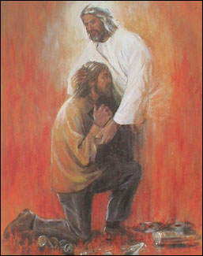
1. The Objective Basis of Assurance
Ellen White’s declaration:
“The blessings of the new covenant are grounded purely on mercy in forgiving unrighteousness and sins,” and all who humble their hearts, confessing their sins, will find mercy and grace and assurance.” Letter 276, 1904, in 7BC 931.
How can she say that?
29

Slide 30
1. The Objective Basis of Assurance
30
Remember the biblical picture of justification includes both ___ and ___.
1 John 1:9
Ps 51: “Create in me a clean heart, O God.”
Ezek 36:26
2 Cor 5:14

Slide 31
1. The Objective Basis of Assurance
Remember EGW’s definition of forgiveness/justification.
“God’s forgiveness is not merely a judicial act by which He sets us free from condemnation.
“It is not only forgiveness for sin, but reclaiming from sin.
“It is the outflow of redeeming love that transforms the heart.”
Mount of Blessing, 114.
31

Slide 32
1. The Objective Basis of Assurance
This “transformation” can take place in a moment.
“In words that fell like music on the sufferer's ear, the Saviour said, "Son, be of good cheer; thy sins be forgiven thee.” [Matt 9:2].
“The burden of despair rolls from the sick man's soul; the peace of forgiveness rests upon his spirit, and shines out upon his countenance. His physical pain is gone, and his whole being is transformed. The helpless paralytic is healed! the guilty sinner is pardoned!” Desire of Ages, 268.
32

Slide 33
1. The Objective Basis of Assurance
33
In other words, justification is not merely a declaration, but a new creation.
“Create in me a clean heart, O God.” Ps 51

Slide 34
1. The Objective Basis of Assurance
34
In other words, justification is not merely a declaration, but a new creation.
“Create in me a clean heart, O God.” Ps 51
Why am I dwelling so long on this?

Slide 35
1. The Objective Basis of Assurance
35
Because right here is where many Adventists lose all hope of assurance.
If the BASIS of your salvation depends to any extent on the perfection of your performance, you can never be sure.
Many Adventists believe that justification is a declaration only—that God accounts me righteous, even though I am not. That is half right. Half right means a 50-50 mixture of truth and lie.

Slide 36

The Truth about the Basis of Assurance
Justification is not God accounting me righteous when I am not.
Justification is God creating in me a righteous heart which did not exist before, but now does. What He declares righteous, is righteous.
In the words of the old English, “Man looketh on the outward appearance, but God looketh on the heart.” 1 Sam 16:7.

Slide 37
The Truth about the Basis of Assurance
“Man looketh on the outward appearance, but God looketh on the heart.” 1 Sam 16:7.
If God creates in me a “clean heart,” then my outward appearance may not yet have changed, but God, looking at my new heart, sees that I am a new creation.
He declares me righteous, not contrary to fact, but because, in Christ, my heart has been made righteous. (“Create in me a clean heart, O God” Ps. 51)

Slide 38
Let’s look again at what EGW says about
1. The Objective Basis of Assurance
38
“The blessings of the new covenant are grounded purely on mercy in forgiving unrighteousness and sins,” and all who humble their hearts, confessing their sins, will find mercy and grace and assurance.” Letter 276, 1904, in 7BC 931.

Slide 39
EGW on the Objective Basis of Assurance
39
Thousands of Christians, including some Adventists, “depend on their obedience to the law of God to commend them to His favor. When they are bidden to look to Jesus, and believe that He saves them solely through His grace, they exclaim, ‘How can these things be?’ ” (DA 175)

Slide 40
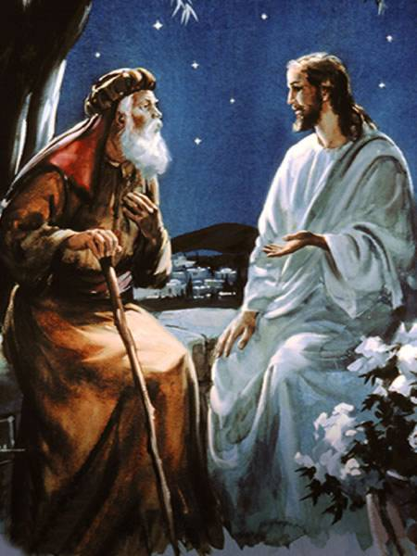
EGW on the Objective Basis of Assurance
“Like Nicodemus, we must be willing to enter into life in the same way as the chief of sinners. . . . Through faith we receive the grace of God; but faith is not our Saviour. It earns nothing. It is the hand by which we lay hold upon Christ, and appropriate His merits, the remedy for sin. And we cannot even repent without the aid of the Spirit of God…Repentance comes from Christ as truly as does pardon.’ Desire of Ages, 175
40

Slide 41
Why is this so hard to grasp?
“The thought that the righteousness of Christ is imputed to us, not because of any merit on our part, but as a free gift from God, is a precious thought. The enemy of God , and man is not willing that this truth should be clearly presented; for he knows that if the people receive it fully, his power will be broken…”

Slide 42
Why is this so hard to grasp?
Satan seeks to confuse this issue because this is the central truth that frees us from his power.
He knows that “if he can control minds so that doubt and unbelief and darkness shall compose the experience of those who claim to be the children of God, he can overcome them with temptation.” Gospel Workers, 161

Slide 43
How EGW’s View of Justification differs from “once saved, always saved”
1. Her theology was thoroughly Arminian.
2. She rejected Calvinistic predestination.
3. She never reduced faith to mere belief. (James 2:19)

Slide 44
3 Parts to EGW’s Definition of Faith
  Intellectual belief in the facts of the gospel,
  Trust in the personal character of God and Christ, and
  Voluntary surrender of the will to God

Slide 45
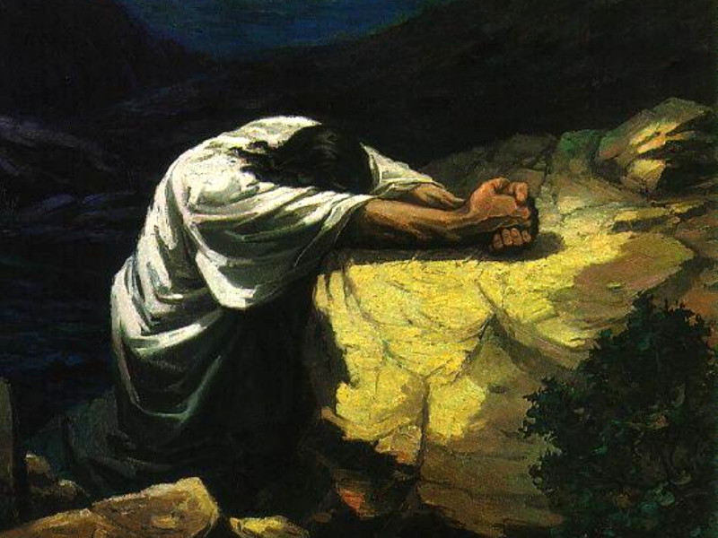
Faith that does not lead to surrender is only partial faith, that has not yet matured to the point of assurance.

Slide 46
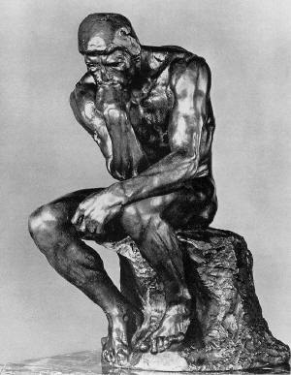
“A nominal faith in Christ, which accepts Him merely as the Saviour of the world, can never bring healing to the soul. The faith that is unto salvation is not a mere intellectual assent to the truth…It is not enough to believe about Christ; we must believe in Him… (DA 347).
Thinker

Slide 47
“The only faith that will benefit us is that which embraces Him as a personal Saviour; which appropriates His merits to ourselves. Many hold faith as an opinion. Saving faith is a transaction by which those who receive Christ join themselves in covenant relation with God…”(DA 347).

Slide 48
“Genuine faith is life. A living faith means an increase of vigor, a confiding trust, by which the soul becomes a conquering power.”
(DA 347).

Slide 49
“The devils ‘believe, and tremble,’ but their belief does not bring them justification, neither will the belief of those who give a merely intellectual assent to the truths of the Bible bring them the benefits of salvation. This belief fails of reaching the vital point, for the truth does not engage the heart or transform the character”
(3SM 191-192).

Slide 50
“Christ…is anxious to be our Helper, to bear our griefs and carry our sorrows. Will you let him help you? Say to the world, ‘Jesus is my Saviour; he saves me today, making me his obedient child, and enabling me to keep all his commandments. (ST June 8, 1891).

Slide 51
EGW’s Definition of Faith
“There is no saving faith that does not produce good fruit… the moment true faith in the merits of the costly atoning sacrifice is exercised, claiming Christ as a personal Saviour, that moment the sinner is justified before God.”
(Ms 46, 1891, in 8MR 357)

Slide 52
Step 2 in EGW’s view of Assurance: Ongoing Life in the Soul
When Christ is received by faith, the Spirit of God produces a new life in the soul (Rom 6:4-11-14; 8:9-11; Gal 2 :20-21; Eph 2:5-6; Col 1:27; 3:1-10 )
This “life in the soul” is the actual beginning of “the life eternal” (DA 176, 331)

Slide 53
The Critical Difference
This insistence on the absolute necessity of ongoing “life in the soul” is the critical difference between biblical assurance and the popular notion that a one-time act of believing guarantees eternal security.

Slide 54
“We must not base our salvation upon supposition; we must know of a surety that Christ is formed within, the hope of glory. We must know that we can hold communion with God. Then if He should come to us quickly, if by any chance our life should suddenly be ended, we would be ready to meet our God” (Ms 21, 1903, in 6MR 32)

Slide 55
This ongoing “life of the soul” is the difference between those who merely profess faith in Christ and those who truly know Him and walk by faith in Him. It is both the believer’s highest privilege and the most basic essential.

Slide 56
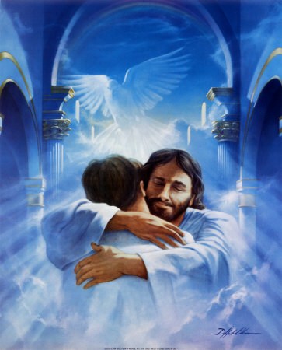
“We may have the assurance today that Jesus lives, and is making intercession for us. We cannot do good to those around us while our own souls are destitute of spiritual life” (RH April 22, 1884 par. 11)

Slide 57
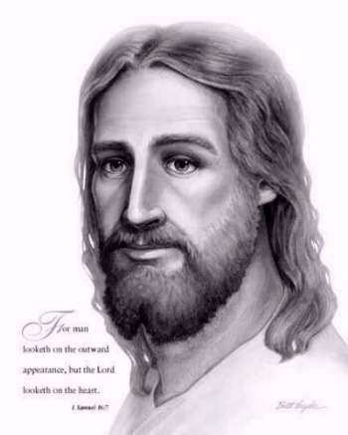
Of her own conversion, Ellen White said, “I felt the assurance of an indwelling Saviour”

Slide 58
The Goal is Life, but the
Means to the Goal is by Dying
We are “always carrying about in the body the dying if the Lord Jesus, that the life of Jesus also may be manifested in our body (2 Cor 4:10).
“For if you live according to the flesh, you will die; but if by the Spirit you put to death the deeds of the flesh, you will live” (Rom 8:13)

Slide 59
Indeed I also count all things loss for the excellence of the knowledge of Christ Jesus my Lord,…that I may know Him and the power of His resurrection, and the fellowship of His sufferings, being conformed to His death, if, by any means, I may attain to the resurrection of the dead” (Phil 3:8-11)

Slide 60
A mere assent to this union, while the affections are not detached from the world, its pleasures and its dissipations, only emboldens the heart of disobedience” (ST Nov.29, 1910, in 5BC 1143-1144). The inevitable result of false assurance is to “embolden the heart in disobedience.”

Slide 61
The dying is both once for all (with Christ on the cross, Rom 6:3, 6, 11; 2 Cor 5:14-15), and a continuing process (2 Cor 4:10). The continuing process means that it is never finished in this life until we lay off this “body of death” (Rom 7:24).

Slide 62

Even though the process isn’t finished, we are to continually assert and practice the reality that we are “dead to sin, but alive to God in Christ Jesus” (Rom 6:11).

Slide 63
“Why is it so hard to lead a self-denying, humble life? Because professed Christians are not dead to the world. It is easy living after we are dead” (MYP 127-128)
But the process of dying to self is not legalism. It is not a work of merit, but a gift of grace.

Slide 64
Thus she says, “no man can empty himself of self. We can only consent for Christ to accomplish the work.
“Then the language of the soul will be, Lord, take my heart; for I cannot give it. It is thy property. Keep it pure, for I cannot keep it for Thee. Save me in spite of myself, my weak, unchristlike self” (COL 159).

Slide 65
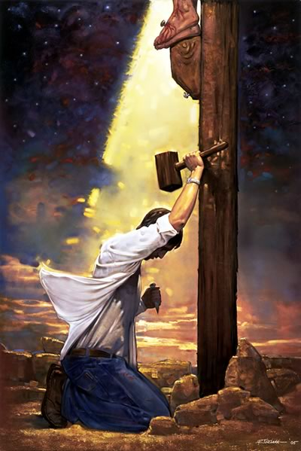
“He [Christ] is knocking at the door of your heart, asking for admittance. He longs to renew your heart, filling it with a love for all that is pure and true. He longs to crucify self for you, raising you to newness of life in him” (Youth’s Instructor, Sept. 9, 1897)

Slide 66
The Third Element of Assurance is the External Evidence of Salvation
Fruit bearing in obedience and loving service
(John 15:1-8; Gal 5:22-23; Col 3:1-11).

Slide 67
Because “those who are in connection with God are channels for the power of the Holy Spirit,” the “inner life of the soul will reveal itself in the outward conduct” (HP 22).
The human response of grateful love to God, is in no sense the root or ground of salvation, but it does constitute visible evidence that there is Holy Spirit life within.

Slide 68
External Evidence of Salvation
“As the mother watches for the smile of recognition from her little child, which tells of the dawning of intelligence, so does Christ watch for the expression of grateful love, which shows that spiritual life is begun in the soul”
(DA 191)

Slide 69
Relation between Steps 1, 2, and 3
“If Christ is dwelling in the heart [step 2], it is impossible to conceal His presence” (MB 41)
This impossibility of concealing the divine life in the soul is the consideration that explains Ellen White’s frequent emphasis on the external evidence of salvation

Slide 70
The lack of visible change [step 3] in the life of a professed Christian she regards as clear evidence that there is no divine life within [step 2], hence that the new birth [step 1] has not yet occurred. If [step 1] the new birth has not yet occurred, the person does not have salvation, and any claim to assurance would be self-deception.

Slide 71
Summarizing
The ground of assurance is justification by grace alone through faith alone
The experience of assurance is the ongoing life of the Holy Spirit in the soul
The outward evidence of assurance is fruit bearing in obedience and loving service

Slide 72
Where any of these is absent, assurance must be called in question.
Where these are present believers should rejoice and not let Satan steal away their sense of security.

Slide 74
Related Aspects of Assurance
Assurance is maintained by faith, through a daily (continual) union with Christ (John 15:4-5’ Phil 4:13; Col 2:6; 1 John 5:11-13)
“Nothing is apparently more helpless, yet really more invincible, than the soul that feels its nothingness and relies wholly on the merits of the Saviour.”

Slide 75
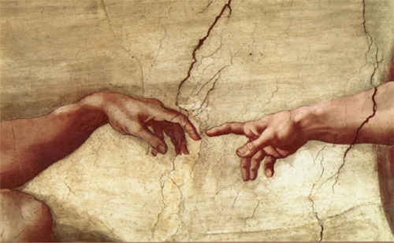
By prayer, by the study of His word, by faith in His abiding presence, the weakest of human beings may live in contact with the living Christ.
He will hold them by the hand that will never let go (MH 182)

Slide 76
A Biblical Concept of Security
A Biblical concept of security recognizes that biblical teaching that believers retain for eternity the freedom to turn away from God. (Ezek 33:12-20)
Hence the necessity and privilege of a daily renewal of conversion (Luke 9:23)

Slide 77
But for those who yield to the Lordship of Christ through the Holy Spirit, daily responding to His love and daily seeking a more complete surrender to His will, there is an abundant and solid security.

Slide 78
It is not the security of an irreversible guarantee, but the security of serving a God whose persistence in seeking the sinner goes far beyond the weakness of the believer’s faith (John 10:28; Luke 10:20; 15:4-7, 8-10, 20-24; 1 John 1:9; 2:1; Rom 5:10; 8:28-30. 35-39)

Slide 79

Thus we do have one “irreversible guarantee”—God’s promise that the one who keeps coming to Him will never be cast out (John 6:37).

Slide 80
Thus she writes, “All who have put on the robe of Christ’s righteousness will stand before Him as chosen and faithful and true. Satan has no power to pluck them out of the hand of the Saviour. Not one soul who in penitence and faith has claimed His protection will Christ permit to pass under the enemy’s power” (PK 587, on Zech 3:4-7; cf. MB 71 and 1Cor 10:13)

Slide 81
EGW favorite text on security
1 John 2:1
She wrote a letter to a woman who was in desperate need of assurance
White reported hearing this text in vision quoted by an angel.

Slide 82
“Said the angel, ‘God leaves not His people, even if they err. He turns not from them in wrath for any light thing. If they sin they have an advocate with the Father, Jesus Christ the righteous.’
“He who so loved you as to give His own life for you will not turn you off and forsake you unless you willfully, determinedly forsake Him to serve the world and Satan (Lt. 17, 1862 to *Susan G. Russell, excerpted in HP 119)

Slide 83
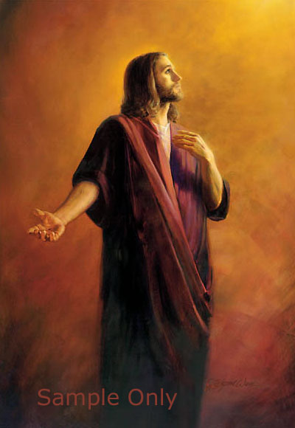
Again she wrote, “if any man sin, he is not to give himself up to despair, and talk like a man who is lost to Christ. ‘If any man sin, we have an Advocate with the Father, Jesus Christ the righteous’” [1 John 2:1] (ST, Jan. 3, 1895)

Slide 84
Confronting some ministers, delegates at the 1883 General Conference, who were anxious and worried, “talking fears and doubts” as to whether they would be saved, she challenged, “Brethren, you have expressed many doubts; but have you followed your Guide? You must dispense with [Him] before you can lose your way; for the Lord has hedged you in on every side”
(RH, April 15, 1884)

Slide 85
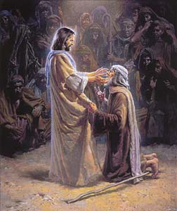
One of Her Most Powerful Appeals to Trust in Christ
“Faith comes by the word of God. Then grasp His promise, ‘Him that cometh to Me I will in no wise cast out.’ John 6:37. Cast yourself at His feet with the cry, ‘Lord, I believe; help Thou mine unbelief.’ You can never perish while you do this—never” (DA 429)

Slide 86
“If you are right with God today, you are ready if Christ should come today” (HP 227)

Slide 87
How to Find True Assurance
The ground of salvation is the merit of Christ alone
To those seeking to merit salvation, she writes, “It makes all the difference in the world with us spiritually whether we rely upon God without doubt, as upon a sure foundation , or whether we are seeking to find some righteousness in ourselves before we come to Him. Look away from self to the Lamb of God, that taketh away the sin of the world.”

Slide 88
Those who “seem to feel that they must be on probation and must prove to the Lord that they are reformed before they can claim His blessing,” she reassures that “these dear souls may claim the blessing of God even now. They must have His grace, the spirit of Christ to help their infirmities, or they cannot form Christian characters. Jesus loves to have us come to Him just as we are-- sinful, helpless, dependent.” RH April 22, 1884

Slide 89
“We are not to doubt his mercy, and say, ‘I do not know whether I shall be saved of not.’ By living faith we must lay hold of his promise, for he has said, ‘Though your sins be as scarlet, they scarlet, they shall be as white as snow.’”
ST, April 4, 1892, par. 3.

Slide 90
“Each one of you may know for yourself that you have a living Saviour, that he is your helper and your God. You need not stand where you say, ‘I do not know whether I am saved.’”
GCB, April 10, 1901 par. 14

Slide 91
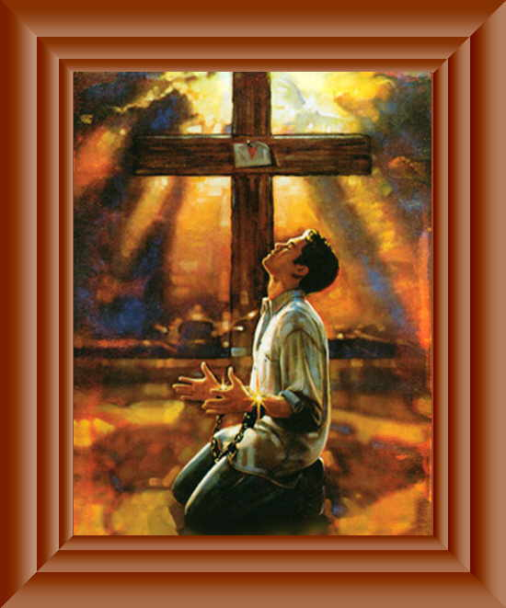
Say, “I am a sinner, and He died and rose again for my justification, and He will save me now. I accept the forgiveness He has promised.’” (1SM 392)

Slide 92
The Danger of False Assurance
“Desires for goodness and holiness are right as far as they go; but if you stop here, they will avail nothing. Many will be lost while hoping and desiring to be Christians. They do not come to the point of yielding the will to God.” (SC 47-48)

Slide 93
The Danger of False Assurance
“We are never to rest in a satisfied condition, and cease to make advancement, saying, ‘I am saved.’” 1 SM 314
“When this idea is entertained, the motives for watchfulness, for prayers, for earnest endeavor to press onward to higher attainments, cease to exist…” 1 SM 314

Slide 94
The Danger of False Assurance
When the conflict of life is ended, when the armor is laid off at the feet of Jesus, when the saints of God are glorified, then and then only will it be safe to claim that we are saved, and sinless” (3SM 355)

Slide 95
The Danger of False Assurance
“Never can we safely put confidence in self or feel, this side of heaven, that we are secure against temptations…Those who accept Christ, and in their first confidence say, I am saved, are in danger of trusting to themselves.” COL 155

Slide 96
The Danger of False Assurance
“Our only safety is in constant distrust of self, and dependence on Christ” (COL 155).
“Saved” is here equated with putting “confidence in self” and feeling that one is “secure against temptation.”
“When we give ourselves to Christ” we may “know that He accepts us,” showing that her opposition is not against true biblical assurance, but against presumption leading to false assurance.

Slide 97
How EGW Thinks on
Righteousness by Faith
On the one hand, she is deeply concerned to protect believers against Satan’s devices of self-confidence and self-dependence
On the other hand, she is equally concerned that believers have legitimate biblical assurance, that is based in Christ, not in self

Slide 98

EGW on Righteousness by Faith
This close combination of caution and encouragement is totally typical of Ellen White’s writings, especially her writings on salvation, spirituality, discipleship, and righteousness by faith.
When you discover that these balancing counsels occur practically everywhere in her writings, you realize that this is the way she thinks.

Slide 99

EGW on Righteousness by Faith
On the one hand, she knows the danger of going to the over-confident extreme (false assurance).
On the other hand, she knows you can also fail spiritually by focusing on your own performances as the basis of your acceptance with God (legalism).
Saved
Not Yet

Slide 100
EGW on Righteousness by Faith
She is always seeking to guard against these two extremes.
Which category (caution or encouragement) predominates in a given passage depends on the audience and context.
In some testimonies of rebuke, the rebuke may predominate, but the encouragement is there also if you look for it.

Slide 101
EGW on Righteousness by Faith
She is always thinking in these “both/and” categories, because . . .
She is always concerned for the dual or multiple dimensions of a spiritual issue.

Slide 102
EGW on Righteousness by Faith
This is what I have elsewhere referred to as the paradigm shift that occurs when a person realizes that Ellen White is really a believer in righteousness by faith.
I have of an old man, hard-headed, do-it-yourself, strong-willed believer in sanctification by stern effort, who late in life confessed, “I never used to find righteousness by faith in the writings of Ellen White, but when you see it, it’s everywhere you look.”

Slide 103
EGW on Righteousness by Faith
One of my highest hopes and most earnest prayers for this class is that every student discover that this deep-rooted, dyed-in-the-wool, righteousness by faith is pervasive in the writings of Ellen G. White. Because when you see it you will never again find condemnation in her writings, but rather hope and courage and faith.

Slide 104
The Necessity of True Assurance
The broader context of Ellen White’s writings on righteousness by faith shows that her warnings against false assurance do not by any means negate her strong teaching on true assurance.
On the contrary, she insisted that “it is essential to believe you are saved”
(RH, Nov. 1, 1892)

Slide 105
The Necessity of True Assurance
Of herself she wrote, “Jesus has saved me, though I had nothing to present to Him” (RH, July 14, 1891, par.11)
“The perishing sinner…need not remain a moment longer unsaved’” (1SM 392)
Repentant sinners may “claim the blessing of God even now” (GCB April 10, 1901, par. 14)

Slide 106
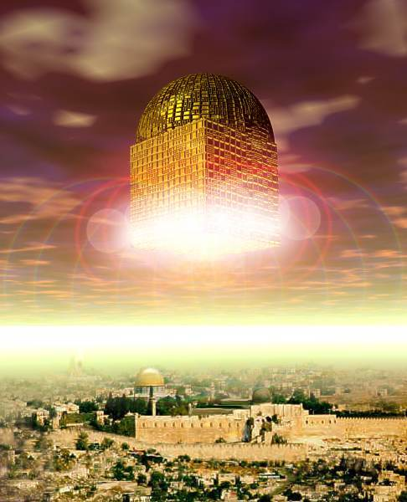
The Necessity of True Assurance
And the one who clings to Christ with present active faith can be “as safe as though inside the city of God”
(10MR 175)

Slide 107
What Happens to Assurance
When We Sin?
“My little children, these things I write to you may not sin. And if anyone sins, we have an Advocate with the Father, Jesus Christ the righteous” (1 John 2:1).
Again she wrote, “if any man sin, he is not to give himself up to despair, and talk like a man who is lost to Christ. “If any man sin, we have an Advocate with the Father, Jesus Christ the righteous” (ST, Jan. 3, 1895)

Slide 108
What Happens to Assurance
When We Sin?
Salvation is a gift which precedes and enables overcoming.
“Some seem to feel that they must be on probation, and must prove to the Lord that they are reformed, before they can claim His blessing. But they may claim the blessing of God even now. They must have His grace, the Spirit of Christ, to help their infirmities, or they cannot resist evil.” Steps to Christ, 52.

Slide 109
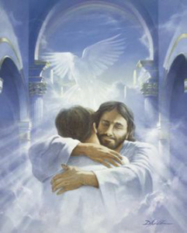
What Happens to Assurance
When We Sin?
Jesus loves to have us come to Him just as we are, sinful, helpless, dependent. We may come with all our weakness, our folly, our sinfulness, and fall at His feet in penitence.
It is His glory to encircle us in the arms of His love and to bind up our wounds, to cleanse us from all impurity” (SC 52)

Slide 110
What Happens to Assurance
When We Sin?
To go forward without stumbling, we must have the assurance that a hand all-powerful will hold us up, and an infinite pity be exercised toward us if we fall. God alone can at all times hear our cry for help” (ST, July 28, 1881)
Our steadfast goal must be, not to sin. But if that is our goal, we are not cast off when we fall (1 Jn 2:1)

Slide 111
What Happens to Assurance
When We Sin?
There are those who have known the pardoning love of Christ and who really desire to be children of God, yet they realize that their character is imperfect, their life, and they are ready to doubt whether their hearts have been renewed by the Holy Spirit…

Slide 112
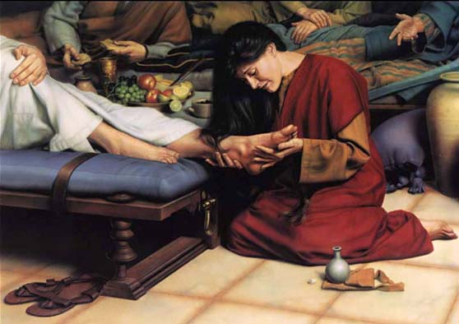
What Happens to Assurance
When We Sin?
… To such I would say, Do not draw back in despair. We shall often have to bow down and weep at the feet of Jesus because of our shortcomings and mistakes, but we are not to be discouraged. Even if we are overcome by the enemy, we are not cast off, not forsaken and rejected of God.

Slide 113
What Happens to Assurance
When We Sin?
“We shall fail often in our efforts to copy the divine pattern. We shall often have to bow down to weep at the feet of Jesus, because of our shortcomings and mistakes; but we are not to be discouraged; we are to pray more fervently, believe more fully, and try again with more steadfastness to grow into the likeness of our Lord…

Slide 114
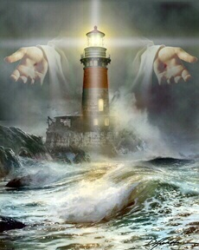
What Happens to Assurance
When We Sin?
…As we distrust our own power, we shall trust the power of our Redeemer, and render praise to God.” (1SM 337)

Slide 115
Learning to Trust
“You may not obtain the entire victory at once; but persevere, keep trying”
(AY 56)

Slide 116
Learning to Trust
“When you fell into sin you walked in darkness. When you yielded to temptation, you must have ceased to look unto Jesus, the Author and Finisher of your faith. But, having confessed your sins, believe that the word of God cannot fail, but that he is faithful that hath promised. It is just as much your duty to believe that God will fulfill his word, and forgive your sins, as it is your duty to confess your sins.”

Slide 117
Learning to Abide
The one who is striving for an uninterrupted connection with God stands in a different position than the unbelieving sinner.
He learns a lesson from the words of the Master, and takes heed that he be not again deceived.

Slide 118
Conclusion
Ellen White’s warnings against the misuse of the claim, “I am saved” were not directed at a true biblical concept of present assurance in Christ, but against the idea of an irreversible guarantee leading to self-confidence, presumption, and casual disobedience.

Slide 119
Conclusion
119
She was just as forceful about the necessity of true present assurance, understood in the context of justification by faith, daily abiding in connection with Christ, and obedience to the known will of God.

Slide 120
Conclusion
120
Those who come to God daily, trusting in His love, feeding on His word, and submitting themselves to His loving discipline, are “right with God today,” and “ready if Christ should come today” (HP 227). And every day we live by faith makes it easier and more likely that we will make that choice again tomorrow.
Romans 5:10.

Slide 121
Sinner’s Prayer
“The perishing sinner may say: ‘I am a lost sinner; but Christ came to seek and to save that which was lost. He says, “I came not to call the righteous, but sinners to repentance” (Mark 2:17). I am a sinner, and He died upon Calvary's cross to save me. I need not remain a moment longer unsaved. He died and rose again for my justification, and He will save me now. I accept the forgiveness He has promised.’ ” 1SM 392.

Slide 122
Believer’s Prayer
“Lord, take my heart; for I cannot give it. It is Thy property. Keep it pure, for I cannot keep it for Thee. Save me in spite of myself, my weak, unchristlike self. Mold me, fashion me, raise me into a pure and holy atmosphere, where the rich current of Thy love can flow through my soul.” COL 159

Slide 123

Morning Prayer
“Consecrate yourself to God in the morning; make this your very first work. Let your prayer be, ‘Take me, O Lord, as wholly Thine. I lay all my plans at Thy feet. Use me today in Thy service. Abide with me, and let all my work be wrought in Thee.’ This is a daily matter. . . .”
SC 70-71

Slide 124
Morning Prayer
“Each morning consecrate yourself to God for that day. Surrender all your plans to Him, to be carried out or given up as His providence shall indicate. Thus day by day you may be giving your life into the hands of God, and thus your life will be molded more and more after the life of Christ.” Steps to Christ, 70-71

Slide 126
The Sinners Need
“It is peace that you need—Heaven’s forgiveness and peace and love in the soul. Money cannot buy it, intellect cannot procure it, wisdom cannot attain to it; you can never hope, by your own efforts to secure it. But God offers it to you as a gift, ‘without money and without price”
(Isaiah 55:1).

