Slide 1
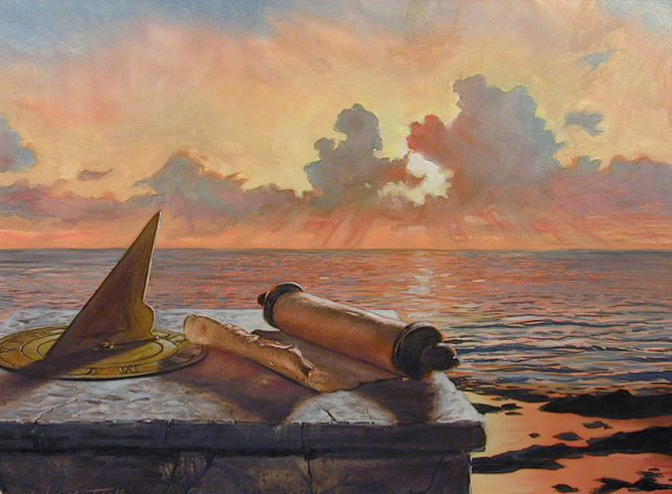
Seven Major Prophecies in
Process of Fulfillment

Slide 2
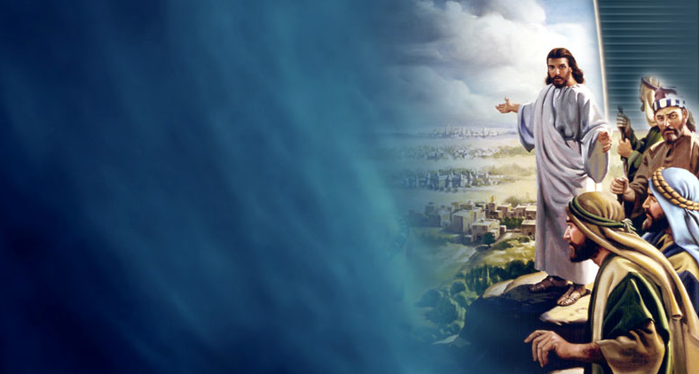
Purpose of this Presentation
To strengthen faith that despite delay, the prophecies of Scripture as upheld by Ellen G. White have not failed, nor have they become “irrelevant” in the 21st century. They are moving steadily toward fulfillment.
Notes:
The contention of some that Ellen White had a “19th century eschatology” that is irrelevant

Slide 3
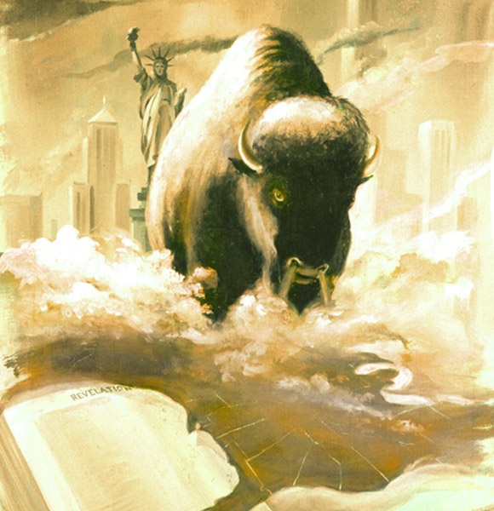
I. American Domination of the World
“Then I saw another beast coming up out of the earth, and he had two horns like a lamb and spoke like a dragon.”
Revelation 13:11

Slide 4
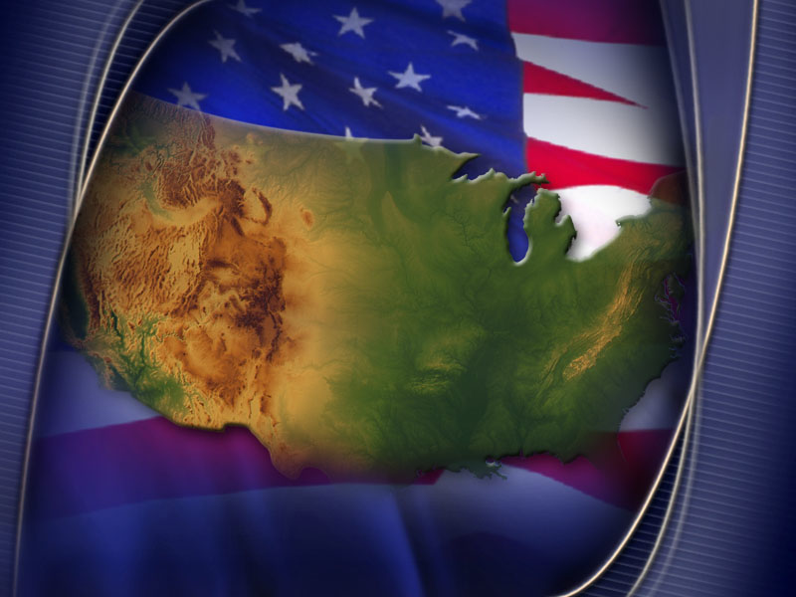
A Dominant America
A. Revelation 13:11
1. “Then I saw” = as Sea Beast was wounded
2. “Another beast” = Land Beast
3. Horns = form of government
4. Lamb-like = Christ-like
5. Two Horns =
a. Civil liberty (democracy)
b. Religious liberty (separation of church and state)

Slide 5
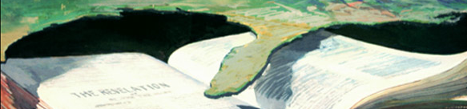
A Dominant America
1851: J. N. Andrews was the first to identify the Land Beast as the USA (RH, May 19, 1851).
1888: Ellen White expressed the established consensus of Seventh-day Adventists: “One nation, and only one, meets the specifications of this prophecy; it points unmistakably to the United States of America.” Great Controversy (1888), 440.

Slide 6


1979: Some Adventists were ready to say that the prophecy had failed. After all, there were two “superpowers,” America and Soviet Russia. Some spoke of the “disconfirmation” of EGW, saying she had “a 19th century eschatology.”
In view of 2 superpowers, how could EGW’s interpretation of Rev 13—that America would dominate the world—possibly come true?
But the prophecy wasn’t finished yet…

Slide 7
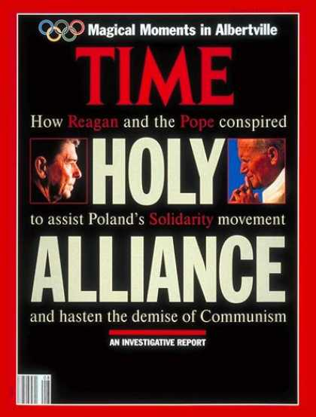
1989: Fall of Communism as a global superpower

Slide 8

1991--After the first Gulf war, TIME called America
“the world’s sole remaining superpower.”
Yassir Arafat called Washington, DC “the new Rome.”

Slide 9
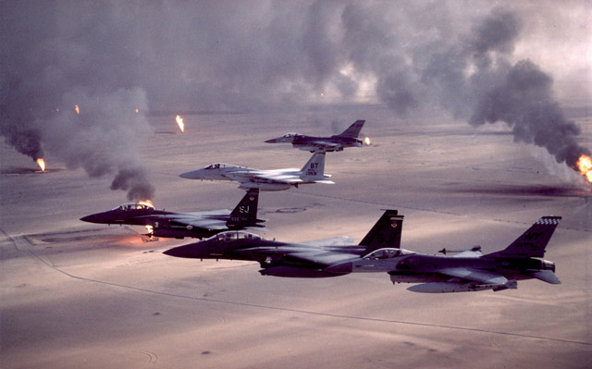
The Washington Post said the significance of the Gulf War victory in 1991 was that “America would now determine all major global events.”

Slide 10
German newsweekly, Der Speigel (2003)
“Throughout the history of mankind, certainly no country has existed that has so thoroughly dominated the world with its politics, its tanks and its products as the United States does today.”
(Der Speigel, quoted by Richard Bernstein in “Europe Seems to Hear Echoes of Empires Past,” NY Times, April 14, 2003)

Slide 11
“…spoke like a dragon…”
Rev 13:12 “And he exercises all the authority of the first beast in his presence, and causes the earth and those who dwell in it to worship the first beast, whose deadly wound was healed.”
13:14 “He deceives those who dwell on the earth by those signs which he was granted to do in the sight of the beast, telling those who dwell on the earth to make an image to the beast who was wounded by the sword and lived.”

Slide 12
Rev 13:16 “And he causes all, both small and great, rich and poor, free and bond, to receive a mark on their right hand or on their foreheads,
13:17 “and that no man might buy or sell except one who has the mark or the name of the beast or the number of his name.”

Slide 13
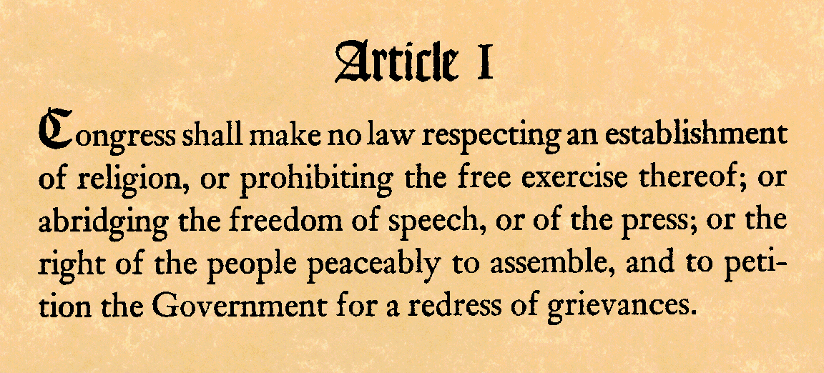
Thus, to speak “as a dragon” according to Rev 13:11-17, means:
1. To follow the example of the Sea Beast of Rev 13:1-8, making an “image” to that beast and exercising the same persecuting authority;
2. Which will mean repudiating America’s foundational principles.
3. Obviously the complete fulfillment of this prophecy is still future.

Slide 14
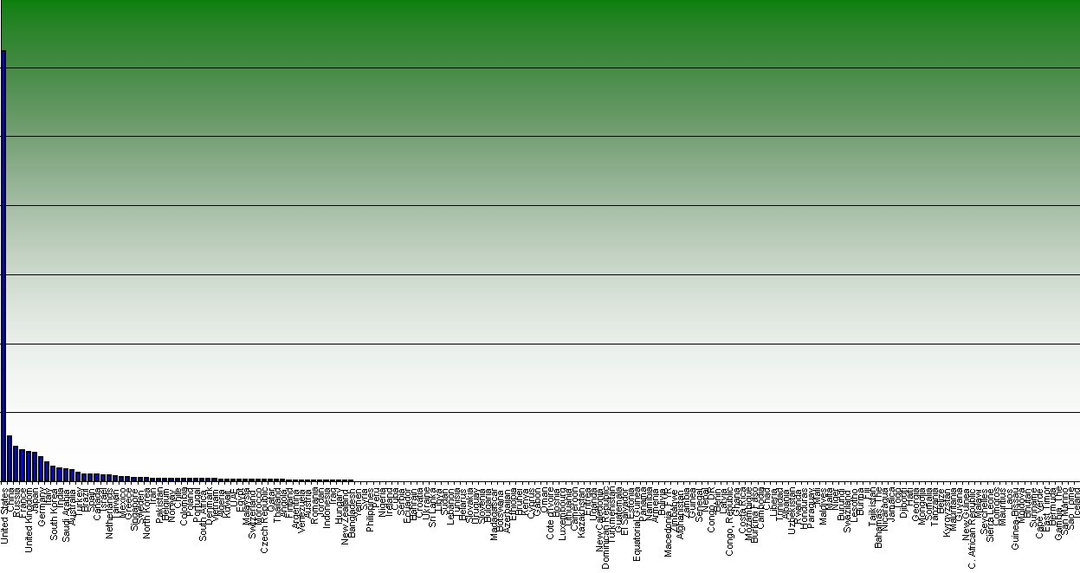
1. Military dimensions of “speak as a dragon”
a. The U.S. military budget for 2003-2004 exceeded the combined military budgets of the rest of the nations of the world (Newsweek, March 24, 2003, p. 23). Unfortunately, it has continued to increase since then. The annual military budget for 2008-09 was $40 billion higher than that of 2007-08.

Slide 15
1. Military dimensions of “speak as a dragon”, continued
b. The “War on Terror” shows both the capability and the will to pursue a single individual (like Saddam Hussein or Osama bin Laden) or small groups (like al-Qaeda cells), anywhere on the planet.

Slide 16
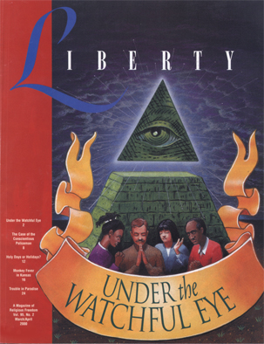
2. Political dimensions of “speak as a dragon”
Limiting civil liberties to prevent acts of terrorism.
Since 2003, Student Entry Verification Information System (SEVIS) tracks international students in 70,000 schools.
National Real ID voted in 2005 began to take effect in 2008.
Designed to catch illegal aliens, the Federal database of eligible employees could be used to deny employment for other reasons.

Slide 17
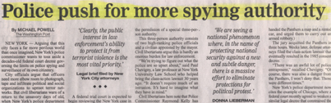
3. Judicial dimensions of “speak as a dragon”
  a. Disregard for individual civil rights.

Slide 18
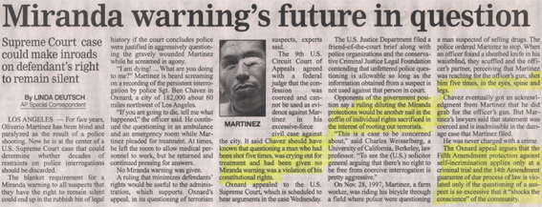
3. Judicial dimensions of “speak as a dragon”
  b. The ideal of “innocent until proven guilty” is changing to a zero-tolerance attitude toward suspected offenders

Slide 19
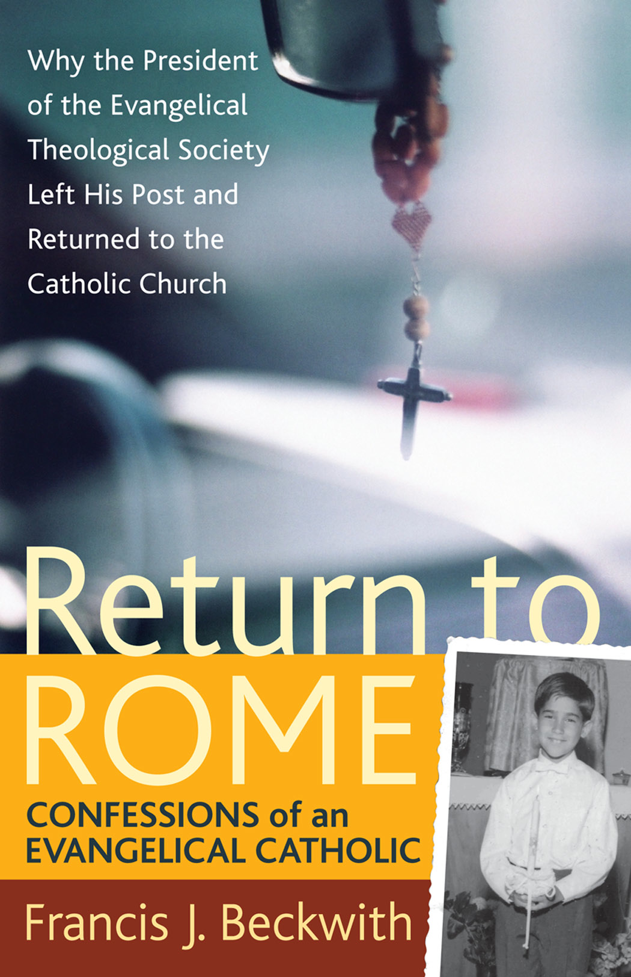
4. Religious dimensions of
“speak as a dragon.”
a. Revelation 13:11-17
b. “Under the influence” of a “threefold union of Protestantism, Catholicism, and Spiritualism, “our country shall repudiate every principle of its Constitution as a Protestant and republican government” (5T, 451 [1885]).

Slide 20
4. Religious dimensions of
“speak as a dragon.”
c. Erosion of the First Amendment
(1) “Establishment” clause – Separation of Church and State has been widely rejected
(2) “Free exercise” clause has been gutted as a constitutional guarantee. We are presently “coasting” on our political tradition, but in time of emergency, this tradition will not provide legal protection.

Slide 21
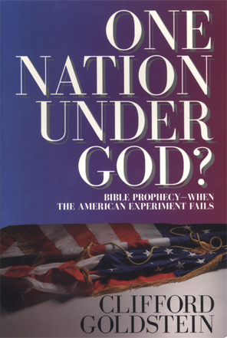
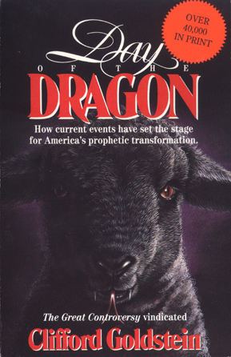
Further reading: Clifford Goldstein

Slide 22
II. The “deadly wound” of Revelation 13 Fully Healed
A. Revelation 13:1-3
“Then I stood on the sand of the sea. And I saw a beast rising up out of the sea, having seven heads and ten horns . . . .”
“And the dragon gave him his power, his throne, and great authority. . . .
“I saw one of his heads as if it had been mortally wounded, and his deadly wound was healed. And all the world marveled and followed . . . .”

Slide 23
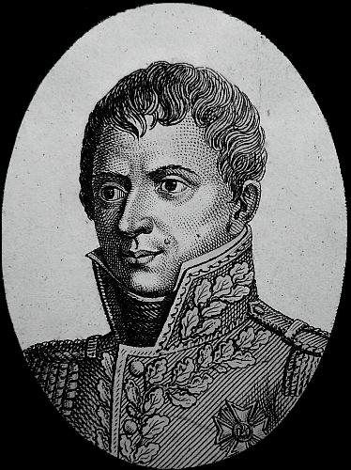
The “deadly wound” of
Revelation 13
B. In 1798, after the French Revolution, General Berthier captured Pope Pius VI and carried him to exile in France where he died a year later.
Political pundits speculated that the papacy was finished as a political power.
But Protestant biblical expositors recognized this as the deadly wound predicted in Rev. 13:3.
General Berthier

Slide 24
The “deadly wound” of
Revelation 13
C. The same verse that predicted the apparently “mortal” wound, also predicted its miraculous healing:
“I saw one of his heads as if it had been mortally wounded, and his deadly wound was healed. And all the world marveled and followed” (Rev. 13:3).

Slide 25
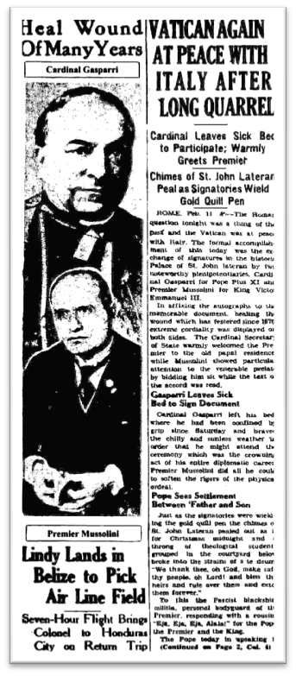
The “deadly wound” to be fully healed
C. “Healing” has come in stages.
    1929, Concordat with Mussolini restored the political independence of the Vatican City.
    1963-65, Second Vatican Council
    1980s, “Holy alliance” between Pope John Paul II and President Ronald Reagan led to collapse of communism in Eastern Europe.
    1999, during a visit of Pope John Paul II to St. Louis, USA, the crowds sang to the pontiff, “He’s got the whole world in his hands.”

Slide 26
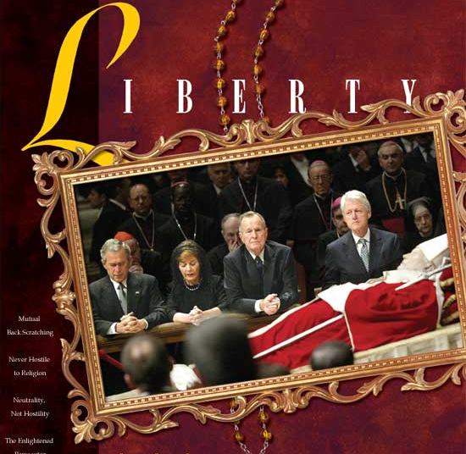

Slide 27
III. Ecumenism: The Maturing of Spiritual Babylon
  Revelation 16:13-14
  “And I saw three unclean spirits like frogs coming out of the mouth of the dragon, out of the mouth of the beast, and out of the mouth of the false prophet.
  “For they are spirits of demons, performing signs, which go out to the kings of the earth and of the whole world, to gather them to the battle of that great day of God Almighty.”

Slide 28
Ecumenism: The Maturing of Spiritual Babylon
  B. “Through the two great errors, the immortality of the soul and Sunday sacredness, Satan will bring the people under his deceptions. While the former lays the foundation of spiritualism, the latter creates a bond of sympathy with Rome. The Protestants of the United States will be foremost in stretching their hands across the gulf to grasp the hand of spiritualism; they will reach over the abyss to clasp hands with the Roman power; and under the influence of this threefold union, this country will follow in the steps of Rome in trampling on the rights of conscience” (Great Controversy, 588).

Slide 29
Ecumenism: The Maturing of Spiritual Babylon
  C. Chuck Colson: “In truth the gulf between evangelicals and Roman Catholics, opened by the Reformation, is being bridged. Today, we stand shoulder to shoulder as the most significant religious block in America.” (New York Times, March 2, 2000, quoted by Lincoln Steed in Adult Sabbath School Bible Study Guide, April-June 2002, Teacher’s Edition, 117).

Slide 30
Ecumenism: The Maturing of Spiritual Babylon
  Documentary evidence that
  the Reformation is over.
  1. Evangelicals and Catholics Together (ECT),
  1994.
  2. Gift of Salvation (ECT II), 1998.
  3. Joint Declaration on the Doctrine of
  Justification (Lutheran-Catholic Accord), 1999

Slide 31
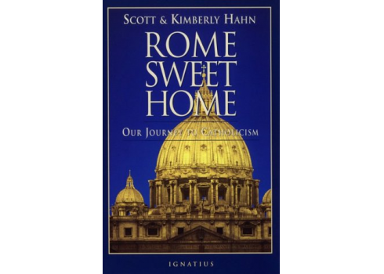
Rome Sweet Home: Our Journey to Catholicism
Scott and Kimberly Hahn, 1993

Slide 32
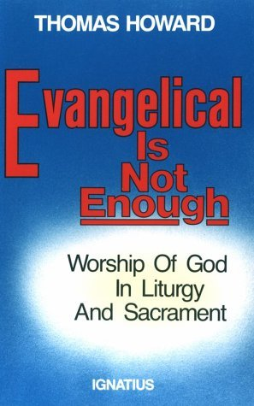
Evangelical
Is Not Enough
Thomas Howard

Slide 33
IV. Exaltation of Sunday: Preparing for the Mark of the Beast
A. Rev. 13:14-17
B. The mark of the beast will involve civil enforcement of Sunday observance.
  1. No one has yet received the mark of the beast.
  2. But the preliminary stage, exaltation of Sunday, is in progress (Ms 51, 1898, in Evangelism, 234-235).
C. Mark of the Beast given in:
Forehead: conformity based on belief
Hand: conformity without belief

Slide 34
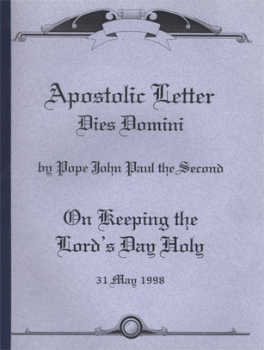
Encyclical
Dies Domini
1998
Notes:
A student in my class in Spring 2007 said that Deis Domini paraphrases some thoughts from Bacchiocchi’s dissertation, though it doesn’t quote him.

Slide 35
Main points
The Sabbath is sacred from Creation (par. 15 quotes A. J. Heschel on “sacred architecture” in time).
Notes:
A student in my class in Spring 2007 said that Deis Domini paraphrases some thoughts from Bacchiocchi’s dissertation, though it doesn’t quote him.

Slide 36
Main points:
The Sabbath is sacred from Creation (par. 15 quotes A. J. Heschel on “sacred architecture” in time).
2. Sunday is the New Covenant Sabbath (par. 13, 59). Church had “authority” to “transfer” the meaning of Sabbath to Sunday (par. 63).
Notes:
A student in my class in Spring 2007 said that Deis Domini paraphrases some thoughts from Bacchiocchi’s dissertation, though it doesn’t quote him.

Slide 37
Main points:
Sabbath is sacred from Creation (&15 quotes A. J. Heschel on “sacred architecture” in time).
Sunday is the New Covenant Sabbath (&13, &59). Church has “authority” to “transfer” the Sabbath’s “meaning” to the Sunday (&63).
The Church approves past Sunday legislation, beginning with that of Constantine in 321 (&64).
Notes:
A student in my class in Spring 2007 said that Deis Domini paraphrases some thoughts from Bacchiocchi’s dissertation, though it doesn’t quote him.

Slide 38
Main points:
“Sunday rest [is] a worker’s right which the state must guarantee” (par. 66, note 110, quoting Pope Leo XIII in Rerum Novarum, 1891).
In “our own time,” Christians should “strive to ensure that civil legislation respects their duty to keep Sunday holy” (67).

Slide 39
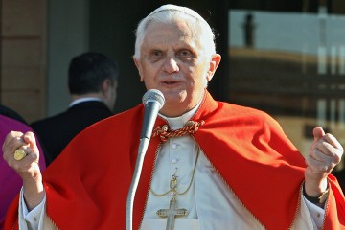
2000, Dominus Iesus
Protestant and other Christian denominations are not true “churches,” but merely “ecclesial communities” because they do not have the “means of salvation.”

Slide 40
September 12, 2006, Speech at University of Regensburg
Benedict XVI quoted a historic dialogue (ca. 1391) between the Byzantine emperor Manuel II Paleologus and an educated Persian on the subject of Christianity and Islam and the truth of both.
40
Notes:
40

Slide 41
September 12, 2006, Speech at University of Regensburg
Through this dialogue, the Pope asserted that “spreading the faith through violence is something unreasonable,” and that “not to act in accordance with reason is contrary to God’s nature.” Pope's speech at Regensburg (full text) http://www.cwnews.com/news/. . .
41
Notes:
41

Slide 42
September 12, 2006, Speech at
University of Regensburg
The Pope’s reference to Islamic jihad aroused instant international controversy, which led in turn to immediate direct dialogue between Muslims and Roman Catholics and a new degree of understanding between them.
But was such deliberate antagonism merely a means to Muslim-Catholic dialogue? I think it was a smoke screen to divert world attention from the rest of the speech.

Slide 43
The Regensburg Speech:
The Rest of the Story
The Pope went on to argue that biblical faith must be moderated by union with Greek philosophical reason in order to maintain a balanced Christianity.
[This union is necessaryfor Roman Catholic theology because the immortality of the soul and many related concepts cannot be supported from Scripture alone. These concepts were imported into post-apostolic and medieval Christianity from Greek philosophy.

Slide 44
The Regensburg Speech:
The Rest of the Story
The Protestant Reformation moved toward sola Scriptura, but never went all the way because the Reformers did not realize that their very worldview and thought patterns reflected Greek philosophy.
What the Roman Church calls “tradition” is actually a hybrid formed by reinterpreting Scripture through Greek philosophy.

Slide 45
The Regensburg Speech:
The Rest of the Story
Adventists are the most visible group today challenging this union of Scripture and Greek philosophy.
Most mainline Protestants, because they hold the immortality of the soul, cannot see the inconsistency of this hybrid.
In the Regensburg speech, the Pope made a direct attack on sola Scriptura.

Slide 46
The Regensburg Speech:
The Rest of the Story
Benedict XVI: “This inner rapprochement between Biblical faith and Greek philosophical inquiry was an event of decisive importance. . . .”
“Given this convergence, it is not surprising that Christianity, despite its origins and some significant developments in the East, finally took on its historically decisive character in Europe” [referring to the rise of the papacy].

Slide 47
The Regensburg Speech:
The Rest of the Story
Benedict acknowledged that not everyone agreed with him: “The thesis that the critically purified Greek heritage forms an integral part of Christian faith has been countered by the call for a dehellenization of Christianity. . . .”
What did the Pope mean by the “dehellenization of Christianity”?

Slide 48
What the Pope meant by the “dehellenization” of Christianity
By “dehellenization,” the Pope meant removing from the church the Greek philosophical elements, in order to have a faith based on Scripture alone.
He condemned as “false” the concept that non-European cultures “have the right to return to the simple message of the New Testament” before it was combined with Greek philosophy.

Slide 49
Summary: The Regensburg Speech
The pope rejected the Protestant Reformation as intellectually and theologically irrational, and rejected Scripture alone as being an inadequate basis for a reasonable faith.
He argued that following Scripture alone leads to fanaticism and violence, but Greek philosophy brought Christianity to maturity, as seen in the Roman Catholic faith and the European culture.
This speech was a direct frontal assault on the basic premise of the Protestant Reformation, that Scripture is the supreme authority and does not need tradition or philosophy to interpret it.

Slide 50
2009, Caritas in Veritate
“Love in Truth”
Just before the G-8 summit in L’Aquila, Italy, July 2009, Benedict XVI released an encyclical in which he suggested a solution for the ailing world economy.
50
Notes:
50

Slide 51
Pope Calls for a World Political Authority
“To manage the global economy, to revive economies hit by the crisis, . . . there is urgent need of a true world political authority.”
This authority “would need to be universally recognized and vested with the effective power.”
The Pope called for “a reform of the United Nations Organization, and likewise of economic institutions [banks] . . . so that the concept of the family of nations can acquire real teeth.”

Slide 52
Pope Calls for a World Political Authority
The encyclical also stressed the importance of empowering labor unions. According to Ellen White, labor unions will play a major part in the final crisis. Maranatha, 182.
How could something like this happen without the backing of an economic and military power like the United States? It couldn’t. Perhaps that’s why the day after the G-8 summit, the pope had his first meeting with President Obama—and gave him a white leather-bound copy of the encyclical.

Slide 53
Pope Calls for a World Political Authority
The encyclical also advocated, “The economy needs ethics in order to function correctly—not [just] any ethics, but an ethics which is people-centered.”
If not just any ethics will do, who do you suppose might provide the moral authority to guide such ethics?

Slide 54
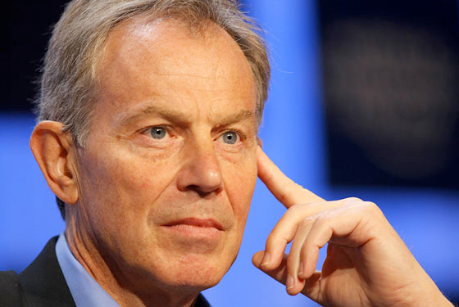
“and all the world wondered . . .”
54
Notes:
54

Slide 55
Former Prime Minister Tony Blair in 2009 left the Church of England to become a Roman Catholic
55
Notes:
55

Slide 56
The U.S. Supreme Court
In 1987, just 23 years ago, the U.S. Supreme Court had 8 Protestant justices and one Roman Catholic.
In 2010, there are 6 Roman Catholic justices, 3 Jewish justices, and no Protestants.
Catholics, who make up 23% of the U.S. population, now hold 67% of the seats in the Supreme Court.

Slide 57
National Apostasy → National Ruin
“When our nation, in its legislative councils, shall enact laws to bind the consciences of men in regard to their religious privileges, enforcing Sunday observance, and bringing oppressive power to bear against those who keep the seventh-day Sabbath, the law of God will, to all intents and purposes, be made void in our land; and national apostasy will be followed by national ruin” (RH, Dec. 18, 1888, in 7BC 977).

Slide 58
Why National Apostasy Will Lead to National Ruin What was the basis of America’s rise?
Freedom of Conscience and Religion
Political Freedom and the rule of law
Economic Freedom, free enterprise
Judicial Freedom, presumed innocent until proven guilty
All these are biblical principles restored by the Protestant Reformation. When they are perverted/abandoned, America’s greatness will be lost.

Slide 59
Signs of Renewed Interest in the
Seventh-day Sabbath
Many books and articles by Sunday keepers link pervasive stress to pervasive “Sabbath” breaking.
Sabbath keepers in positions of prominence (e.g., Barry Black, Chaplain of the Senate; Joseph Lieberman, Senator and 2004 candidate for vice-president).
Focus on the Sabbath Commandment leads to the realization that the commandment cannot be fully kept on the wrong day.
Many individuals and even whole churches are accepting the true Sabbath.

Slide 60
V. Spiritualism Infiltrating Christianity
  Revelation 16:13-14
  “And I saw three unclean spirits like frogs coming out of the mouth of the dragon, out of the mouth of the beast, and out of the mouth of the false prophet.
  “For they are spirits of demons, performing signs, which go out to the kings of the earth and of the whole world, to gather them to the battle of that great day of God Almighty.”

Slide 61
Great Controversy, 588
“Through the two great errors, the immortality of the soul and Sunday sacredness, Satan will bring the people under his deceptions. While the former lays the foundation of spiritualism, the latter creates a bond of sympathy with Rome.”

Slide 62
Great Controversy, 588
“Church members love what the world loves and are ready to join with them, and Satan determines to . . . strengthen his cause by sweeping all into the ranks of spiritualism.”

Slide 63
Great Controversy, 588
Roman Catholics, “Protestants, and worldlings will alike accept the form of godliness without the power, and they will see in this union a grand movement for the conversion of the world and the ushering in of the long-expected millennium.”

Slide 64
V. Spiritualism Infiltrating Christianity
C. Emergence of Modern Spiritualism:
“Mysterious rapping“ began March 31, 1848, near Rochester, New York

Slide 65
V. Spiritualism Infiltrating Christianity
D. Bible Truth about spiritualism
Genesis 2:7
Genesis 3:4-5
Ecclesiastes 9:5
1 Samuel 28:19
2 Corinthians 11:14

Slide 66
Spiritualism Infiltrating Christianity
Near-death experiences promotede
Appearances of Mary. (According to the Bible, where is Mary now?)
Halloween now the #2 commercial holiday (News headline: “Is Satan catching up to Jesus?”)

Slide 67
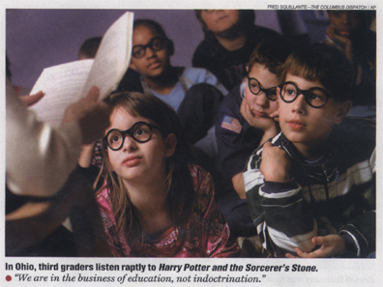
4. The Harry Potter books:
Candy-coated witchcraft for kids

Slide 68
5. Spiritualism imitating Christianity
“As spiritualism more closely imitates the nominal Christianity of the day, it has greater power to deceive and ensnare. . . . [A]s the spirits will profess faith in the Bible, and manifest respect for the institutions of the church, their work will be accepted as a manifestation of divine power” (GC 588).

Slide 69
VI. The Gospel to All the World
Matthew 24:14
“This gospel of the kingdom will be preached in all the world, as a witness to all the nations, and then the end will come.”

Slide 70
VI. The Gospel to All the World
“Christ’s coming . . . will not tarry past the time that the message is borne to all nations, tongues, and peoples.”
(Ellen White in Review and Herald, June 18, 1901, par. 6; quoted in Evangelism, 697).

Slide 71
VII. The Shaking of the Church
Hebrews 12:26-27
At Sinai, God’s “voice . . . shook the earth; but
now He has promised, . . . ‘Yet once more I
shake not only the earth, but also heaven.’
Now this, ‘yet once more,’ indicates the
removal of those things that are being
shaken, . . . that the things which
cannot be shaken may remain.”

Slide 72
VII. The Shaking of the Church
Hebrews 12:26-27
At Sinai, God’s “voice . . . shook the earth; but
now He has promised, . . . ‘Yet once more I
shake not only the earth, but also heaven.’
Now this, ‘yet once more,’ indicates the
removal of those things that are being
shaken, . . . that the things which
cannot be shaken may remain.”
Will you be removed, or remain?

Slide 73
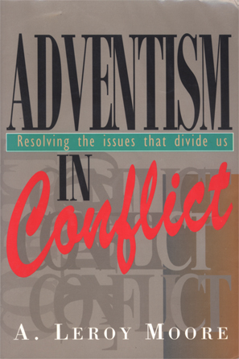
The Shaking of the Church
A former member, returning after ten years away, asked, “What’s wrong in the church? All Adventists used to believe alike. Now it seems like there is an endless variety of beliefs.”

Slide 74
The reply was . . .
“We are in the shaking time,
the time when everything that
can be shaken
will be shaken.”
--EGW, The Faith I Live By, 336.

Slide 75
Satan’s Last Deception
(within the Adventist Church)
“Satan is . . . constantly pressing in the spurious [the false]--to lead away from the truth. The very last deception of Satan will be to make of none effect the testimony of the Spirit of God. "Where there is no vision, the people perish" (Prov. 29:18). Satan will work ingeniously, in different ways and through different agencies, to unsettle the confidence of God's remnant people in the true testimony.” Selected Messages, bk. 1, p. 48

Slide 76
“A Hatred . . . which is Satanic”
(in both origin and intensity--Roger Coon)
“There will be a hatred kindled against the testimonies which is satanic. The workings of Satan will be to unsettle the faith of the churches in them [the testimonies], for this reason: Satan cannot have so clear a track to bring in his deceptions and bind up souls in his delusions if the warnings and reproofs and counsels of the Spirit of God are heeded.”
Selected Messages, bk. 1, p. 48

Slide 77
VII. The Shaking of the Church
“Most Bitter Enemies of
. . . Former Brethren”
“As the storm approaches, a large class who have professed faith in the third angel's message, but have not been sanctified through obedience to the truth, abandon their position and join the ranks of the opposition. . . .

Slide 78
“Most Bitter Enemies,” continued
“Men of talent and pleasing address, who once rejoiced in the truth, employ their powers to deceive and mislead souls. They become the most bitter enemies of their former brethren. When Sabbathkeepers are brought before the courts to answer for their faith, these apostates are the most efficient agents of Satan to misrepresent and accuse them, and by false reports and insinuations to stir up the rulers against them” (Great Controversy, 608).

Slide 79
VII. The Shaking of the Church
2 Thessalonians 2:9-10
“The coming of the lawless one is according to the working of Satan, with all power, signs and lying wonders, and with all unrighteous deception among those who perish, because they did not receive the love of the truth, that they might be saved.”

Slide 80
VII. The Shaking of the Church
The root issue is not
merely whether you
know the truth,
but whether you
love the truth.
Do you love the truth?

Slide 81
VII. The Shaking of the Church
“Every soul in every Conference, in every part of the Lord's vineyard, has the privilege of knowing the truth. But truth is not truth to those who do not practice it. Truth is only truth to you when you live it in the daily life, showing the world what those people must be who are at last saved.”
Ellen White, General Conference Bulletin, April 3, 1901 par. 10.

Slide 82
Two Ways to “Prepare” for the Shaking?
“As the storm approaches, a large class who have professed faith in the third angel's message, but have not been sanctified through obedience to the truth, abandon their position and join the ranks of the opposition. By uniting with the world and partaking of its spirit, they have come to view matters in nearly the same light; and when the test is brought, they are prepared to choose the easy, popular side.”
Great Controversy, 608

Slide 83
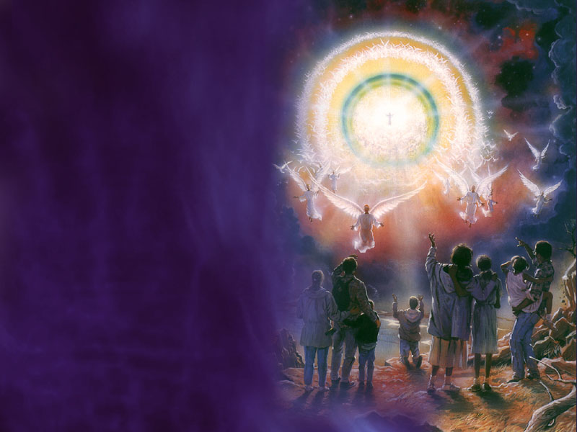
The Only Preparation that Will Stand
Complete this sentence:
“If you would stand through the time of trouble, you
must . . .
Ellen White, Review and Herald, Nov. 22, 1892

Slide 84
The Only Preparation that Will Stand
“If you would stand through the time of trouble, you must know Christ,
and appropriate
[actively accept]
the gift of his righteousness,
which he imputes to the repentant sinner.”
Ellen White, Review and Herald, Nov. 22, 1892

Slide 85
The Only Preparation that Will Stand
“If you would stand through the time of trouble, you must know Christ,
and appropriate
[actively accept]
the gift of his righteousness,
which he imputes to the repentant sinner.”
Ellen White, Review and Herald, Nov. 22, 1892

Slide 86
We wait for the blessed hope—the glorious appearing of our great God and Savior, Jesus Christ…
Titus 2:13
86

Slide 87
We wait for the blessed hope—the glorious appearing of our great God and Savior, Jesus Christ…
Titus 2:13
87

Slide 88
Web addresses
www.andrews.edu/~jmoon
www.andrews.edu/~fortind
www.WhiteEstate.org

