Slide 1

AAA Orientation
Adventist Accrediting Association

Slide 2

The Context
The Visit
The Report

Slide 3
The Context
The Visit
The Report

Slide 4
Focus of AAA & IBE
Adventist
Accrediting
Association
International
Board of
Education
Institutional
Accreditation
New Program
Approval

Slide 5
Philosophy
The task of accreditation is based on the philosophy that each educational institution operated in the name of the Seventh-day Adventist Church assumes a dual responsibility:
To offer
an excellent
education
To support
the mission of
the church

Slide 6
Philosophy
Every Seventh-day Adventist institution
receives an under-
lying obligation to
provide quality
education within
the context of the
beliefs, mission, and practices of the Seventh-day Adventist Church
Adventist Beliefs, Mission, and Practices
Quality
Education

Slide 7
Rights
AAA accreditation supports:
The right of each institution to pursue its educational mission, under the guidance of a governing board elected by its constituency and reflecting the identity of the Seventh-day Adventist Church
The right of the faculty to teach, carry out and publish research, within the framework of the philosophy and mission of the institution
The right of students to learn and to develop their God-given talents

Slide 8
Purpose of the AAA Visit
To seek evidence
of a quality,
Seventh-day Adventist
institution

Slide 9
Objectives
To assess that the various aspects of the institution and its programs align with Adventist mission, identity, and purpose.
To determine if the degree programs offered are comparable in content and quality to those of similar SDA institutions.
To provide guidance on ways in which the institution may strengthen its operation and better achieve its mission.
To verify that the institution possesses the resources, programs, and services sufficient to accomplish its goals.

Slide 10
Process
The institution carries out a process of ongoing self-evaluation
Periodically the evaluative pro-cess culminates in a Self-study and an institu-tional visit by an evaluation team
The successful fulfillment of the accreditation requirements results in initial or extended accreditation

Slide 11
Types of Visits
Regular
Interim
Focused

Slide 12
Regular Visit
Form A
Most institutions are accredited under the terms of Form A, which combines a strong focus on issues of institutional quality in general, with the specific mission focus expected of Seventh-day Adventist institutions.
Form B
Where institutions undergo rigorous and external accreditation by regional or government accreditation agencies in their countries and have a track record of managing a quality and mission-focused institution, Form B may be authorized.

Slide 13
Form A Areas
History, Philosophy, Mission and Objectives
Spiritual Development, Service and Witnessing
Governance, Organization and Administration
Finances, Financial Structure, and Industries
Programs of Study
Faculty and Staff
Library and Resource Centers
Academic Policies and Records
Student Services
Physical Plant and Facilities
Public Relations and External Constituencies
Pastoral and Theological Education

Slide 14
Old Form B Areas
History, Philosophy, Mission and Objectives
Spiritual Development, Service and Witnessing
Governance, Organization and Administration
Finances, Financial Structure, and Industries
Programs of Study
Faculty and Staff
Library and Resource Centers
Academic Policies and Records
Student Services
Physical Plant and Facilities
Public Relations and External Constituencies
Pastoral and Theological Education

Slide 15
New Form B Areas
Mission and Identity
Spiritual Development, Witness, and Service
Governance, Organization and Administration
Programs of Study
Faculty and Staff
Educational Context (finance, facilities, library, and student services)
Pastoral and Theological Education

Slide 16
Form A: Institution of Excellence
[ 1 ]
History, Philosophy, Mission and Objectives
Standard: The institution will have a clear sense of mission and identity, encapsulated in statements of mission, philosophy, objectives and ethics, and evidenced in the total life of the institution.
[ 2 ]
Spiritual Develop-ment, Service and Witnessing
Standard: The institution will have a strong and vibrant spiritual life program, encapsulated in a spiritual master plan, that widely involves and impacts both the institution and communities beyond.

Slide 17
Form A: Institution of Excellence
[ 3 ]
Governance, Organization and Adminis-tration
Standard: The institution will have a governance structure and administrative leadership that provides strong mission-driven direction to the institution, ensures the institution’s educational objectives can be met, and nurtures a campus environment characterized by good communication, inclusive decision-making, and strong internal continuous quality improvement of educational and management processes as evidenced through outcomes.
[ 4 ]
Finances, Financial Structure, and Industries
Standard: The institution will have a financial operation that has a strong financial base (including support from the church), is managed efficiently, and selects budget priorities to support institutional mission.

Slide 18
Form A: Institution of Excellence
[ 5 ]
Programs of Study
Standard: The institution will provide a curriculum that, evidenced by appropriate outcomes, is (a) of an equivalent standard to other tertiary institutions both in the country and within the Seventh-day Adventist college/university sector, and (b) meets the mission and objectives of the institution and church, particularly in the preparation of students for service in the church.
[ 6 ]
Faculty and Staff
Standard: The institution will have faculty and staff personally supportive of the institutional mission, effective in their transmission of both their discipline and values in the classroom, administrative processes to ensure adequate faculty and staff development, and evaluation procedures include mission-focused elements.

Slide 19
Form A: Institution of Excellence
[ 7 ]
Library and Resource Centers
Standard: The institution will have resource centers (library and computer services, in particular) that provide adequate resources to support the academic program, and policies to ensure ethical and mission concerns are involved in the resourcing choices that are made.
[ 8 ]
Academic Policies and Records
Standard: The institution will have academic policy and records procedures that are efficient and secure and which reflect best practice in tertiary institutions.

Slide 20
Form A: Institution of Excellence
[ 9 ]
Student Services
Standard: The institution will have student services that provide strong support for the personal and spiritual needs of students, and which model and nurture Seventh-day Adventist lifestyle in a constructive manner in all areas of student life.
[ 10 ]
Physical Plant and Facilities
Standard: The institution will have a physical plant, including laboratories, that provides adequate and well-maintained facilities for the development of a quality education program, and plans for development that are supportive of the total institution strategic plan.

Slide 21
Form A: Institution of Excellence
[ 11 ]
Public Relations & External Consti-tuencies
Standard: Public relations activities of the university/college will provide an opportunity for dialogue with external constituencies that provides useful and accurate feedback to the institution and positions the school/university positively in the minds of the various constituent groups.
Standard: Pastoral and theological education with curriculum that, evidenced by appropriate outcomes, is (a) of an equivalent standard to other tertiary institutions offering pastoral and theological education in the country and within the Seventh-day Adventist college/university sector, and (b) meets the mission and objectives of the institution and church, particularly in the preparation of students for service in the church.
[12] Pastoral and Theological Education

Slide 22
The Context
The Visit
The Report

Slide 23
Peer Evaluation
The AAA team consists of professional peer evaluators whose goals are to assist the institution by evaluating its effectiveness in:
Reaching its own stated goals
Meeting the ideals of the criteria identified by AAA

Slide 24
A Perceptive Friend
The team should not take a confrontational attitude,
but at the same time should be willing to provide constructive analysis
The institution should not be able to conclude that accreditation is a mere formality; consequently, the team should be willing to make difficult recommendations if they are needed
The visit should take place in an environment of genuine concern for the institution and its challenges, and in which its successes and strengths should also be celebrated

Slide 25
Data
Sources
Interview
Observation
Document
Analysis
Students, faculty, staff, administrators, alumni, employers, committees, etc.
Facilities, equip-ment, teaching, interactions, etc.
Course syllabi, statistical/financial reports, committee minutes, etc.

Slide 26
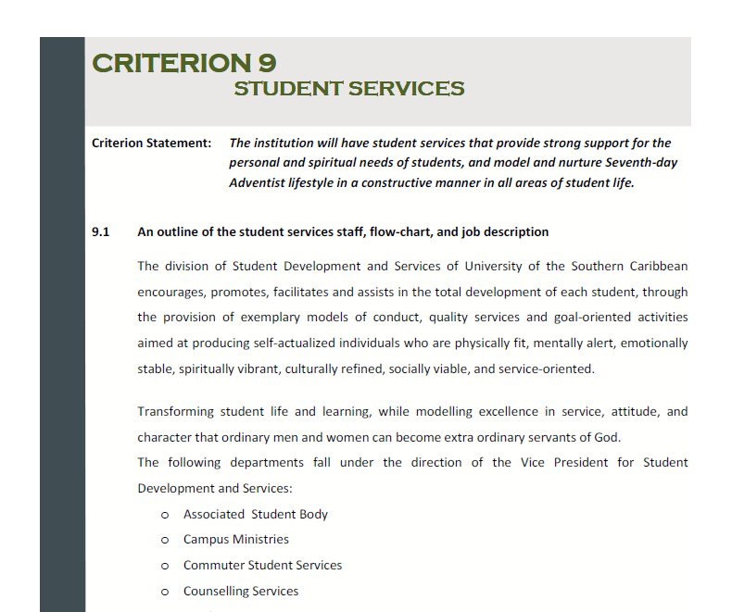
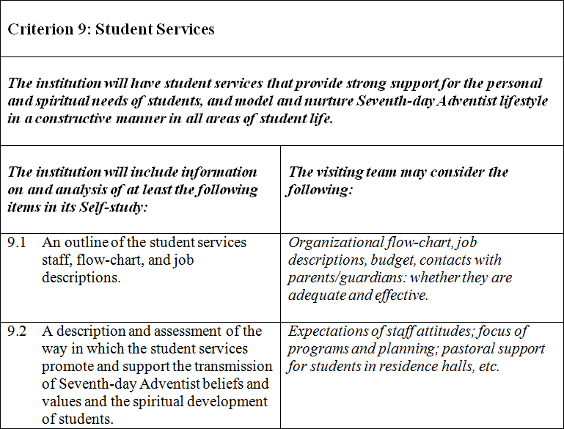
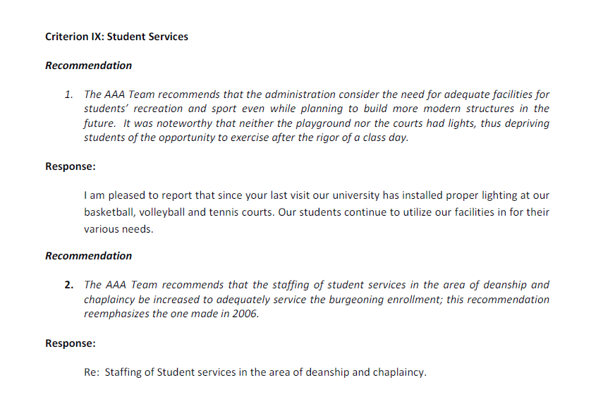
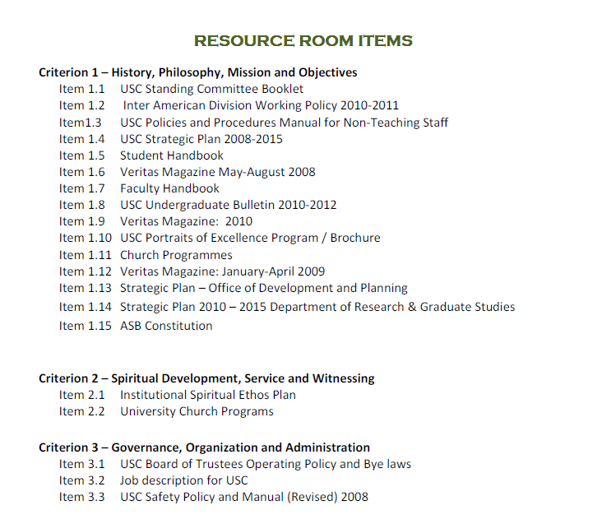
Documents
Accreditation Handbook: AAA Criteria
Self-Study: Response to Recommen-dations
Self-Study:
Response to
AAA Criteria
Document Room: Required Evidences
Additional Solicited Materials

Slide 27
Professional Responsibilities
A constructive spirit that assesses objectively the strengths and weaknesses of an institution, a program, or an individual, and also seeks to enhance their respective potential.
Confidentiality in reporting any sensitive information that has been entrusted to him/her, both during and after the visit.
Avoidance of any unethical behavior, such as using the visit as an opportunity to recruit faculty, staff or students for another institution.

Slide 28
The Context
The Visit
The Report

Slide 29
Before Writing
Consider context: Although there are certain core expectations of all accredited Seventh-day Adventist institutions, the institution should be evaluated according to its own mission.
Triangulate: Confirm your assessments by checking at least 2 or 3 data sources. Crosscheck your conclusion with at least one other team member before writing it as a recommendation.
Differentiate: Avoid including every issue as a possible recommendation. Focus should be on the key areas that will assist the institution in moving forward as a quality SDA institution. Minor aspects can be included as suggestions.

Slide 30
Before Writing
Set limits: As a team, define the approximate number of recommendations overall. Recommendations should focus on major issues and should be limited to a number reasonable for the institution to manage in the period before the next full evaluation visit. From among these, 10-12 recommendations will be designated as major recommendations, those on which the institution should focus with some urgency.
Seek balance: All institutions have strengths and it is important that these be recognized. Identify these areas of strength and incorporate them as commendations. Commendations, however, should be given only for outstanding achievements or tasks performed in a superior manner, not for the normal fulfillment of a duty.

Slide 31
The Writing
Observations and findings
Prior recommendations
Commendations
Recommendations
Suggestions

Slide 32
The Writing
Criterion 1: History, Philosophy, Mission and Objectives
Observations and findings
[Insert descriptive text that summarizes the team’s observations and findings regarding this criterion. Specific statistics can be included.]
Prior recommendations
In the AAA visit of [year], there were [#] recommendations pertaining to Criterion 1: History, Philosophy, Mission and Objectives. The institution has fully complied with [#] of these recommendations. [Add explanatory text regarding recommendations which are unfulfilled or only partially fulfilled. Also include in this section the recommendations from any interim or intervening focused visits.]

Slide 33
The Writing
Identify an entity: Each commendation or recommendation should be addressed to a specific group, department, or unit in the institution; but never to individuals by name.
Indicate effect: For a commendation, include not only what is being, and also the effect. This helps explain why what is being done is of merit.
Make it measurable: A recommendation should be concise and specific, with measurable ingredients. Think, how will an observer know if a specific recommendation has been fulfilled?

Slide 34
The Writing
Avoid problem solving: A recommendation should identify what needs to change, but should not specify how that change should be brought about. “Giving solutions” preempts the governance role of the board or the administrative authority of the administrators.
Consider explanations: For a key recommendation,
a lead paragraph explaining the context of the recommendation can be very appropriate. This is particularly important for controversial or sensitive issues, and helps underscore the reasonableness of the recommendation.

Slide 35
The Writing
Include sources: Commendations and recommendations must be based on at least two sources. These can include:
  The Self-study or another pertinent document
  A direct observation
  An interview with a board member, administrator, faculty, staff, or students (no names)
  Or, preferably, a combination of these.
  The sources that that substantiate the statement are to be enclosed in parentheses following the statement. Page numbers for documents should be included.

Slide 36
The Writing
Criterion 1: History, Philosophy, Mission and Objectives
The Visiting Committee commends:
The [institutional entity] for [commendation] which [explanation of its importance] (sources).
The Visiting Committee recommends:
That the [institutional entity][recommendation][measureable aspect—how they will know when the recommendation has been met] (sources).
The Visiting Committee suggests:
That the [institutional entity][suggestion] (sources).

Slide 37
Sample Commendations
The visiting team commends:
  The administration for their high level of positive communication with the local church community which has resulted in a series of collaborative evangelistic endeavors (Self-Study, p. 32, interview with administrators).

Slide 38
Sample Commendations
The visiting team commends:
  The administration for their high level of positive communication with the local church community which has resulted in a series of collaborative evangelistic endeavors (Self-Study, p. 32, interview with administrators).

Slide 39
Sample Commendations
The visiting team commends:
  The administration, faculty, staff and students for their active involvement in the development of a spiritual master plan that is making an appreciable difference in the spiritual programming and ethos of the campus (Self-Study, pp. 17, 47, student interviews).

Slide 40
Sample Commendations
The visiting team commends:
  The administration, faculty, staff and students for their active involvement in the development of a spiritual master plan that is making an appreciable difference in the spiritual programming and ethos of the campus (Self-Study, pp. 17, 47, student interviews).

Slide 41
Sample Recommendations
The visiting team recommends:
  That the administration reconsider its plans to build a new classroom block until the debt on the library construction has been fully paid (Self-Study, p. 35, audited financial statement, interviews with administrators).

Slide 42
Sample Recommendations
The visiting team recommends:
  That the administration reconsider its plans to build a new classroom block until the debt on the library construction has been fully paid (Self-Study, p. 35, audited financial statement, interviews with administrators).

Slide 43
Sample Recommendations
The visiting team recommends:
  That the Academic Committee develop a process for more structured evaluation of courses and teaching, that will involve feedback from students as well as from peers and administration (Self-Study, p. 63, interviews with teachers and administrators).

Slide 44
Sample Recommendations
The visiting team recommends:
  That the Academic Committee develop a process for more structured evaluation of courses and teaching, that will involve feedback from students as well as from peers and administration (Self-Study, p. 63, interviews with teachers and administrators).

Slide 45
Assembling the Report
Eliminate redundancy: Since team members may be submitting individual items without consultation with the whole group, it is possible that some items will be duplicated in various sections of the report. Eliminating duplication will be one of the responsibilities of the team in its final meetings.
Make a fair distribution: It is important to ensure that recommendations are widely distributed and that while they may focus on particular areas where needs are clear, lack of balance should not be the result of over-preoccupation of the team with one particular area.

Slide 46
Assembling the Report
Identify the majors: An important section of the report is the one identifying major recommendations. These should be those items that most impact the whole institution and are most essential to the institution’s continuing quality and Seventh-day Adventist ethos. This helps the institution identify where they should place their immediate focus.
Arrive at consensus: The AAA visit is a team effort.
It is important that all members of the team be willing to support the conclusions of the group. Items that are not supported by the group should not be included in the final report.

Slide 47
Assembling the Report
Determine the outcome: The team must decide and fully support the final accreditation recommendation. The team should vote this action.
  It is also important that all members sign the signature page in the report that shows their agreement with both the major accreditation recommendation and the report that will follow it.

Slide 48
The Final Recommendation
A five-year institutional accreditation with no interim revisit.
May include written reports.
A five-year institutional accreditation with an interim visit..
May also include written reports.
Three- or four-year institutional accreditation.
Interim reports or visits may be included.
Probationary status, with a time limit of two years or less.
Suspension of accreditation.

Slide 49
1. A five-year institutional accreditation with no interim visit
This is for an institution that has fulfilled or satisfactorily addressed all the previous recommendations, submits an acceptable Self-study in advance of the visit, shows adequate strength in each major area identified in the Self-study, and anticipates no major changes that will impact its mission, SDA focus or the financial and administrative stability of the institution. The recommendation may include the request for interim written reports on specific items at established times.

Slide 50
2. A five-year institutional accreditation with an interim visit
This is for an institution that has satisfactorily addressed the previous recommendations, submits an acceptable Self-study in advance of the visit, shows weaknesses in a few areas, and/or is experiencing or will experience in the near future important changes in its administration, status, programs, or size that could impact the institutional mission and/or SDA identity. These specific issues will be identified in major recommendations. At the time of the interim visit the team will expect that the institution has fulfilled or made substantial progress in fulfilling all of the major recommendations.

Slide 51
3. Less than a five-year institutional accreditation
This is for an institution that has not fulfilled several previous recommendations, has not prepared an acceptable Self-study, shows significant weaknesses in several areas of its operation or leadership, and/or is experiencing or will experience significant changes in its leadership and/or programs that could impact on the institutional mission and SDA identity. An interim visit or annual reports may be required.

Slide 52
4. Probationary status, with a specific time limit of two years or less
This is for an institution that either does not submit an acceptable Self-study on time, has not fulfilled many of the recommendations of the previous evaluation visit, shows substantial weaknesses in major areas of its operation or leadership, and/or is not representative of SDA quality education. These weaknesses need to be carefully documented, with specific conditions, expected evidence of their fulfillment, and a timeframe for the removal of the probationary status. In situations where one particular area shows significant weaknesses, the team may recommend a focused visit within a two-year period to review that program. If the institution has not resolved the identified problems by that time, then the whole institution can be placed on probation.

Slide 53
5. Suspension of accreditation
This is for an institution that either refuses to fulfill the recommendations of previous evaluation visits, does not welcome an AAA visit, and/or openly deviates from the philosophy and objectives of Seventh-day Adventist education. These circumstances will need to be carefully documented, with specific conditions that will allow the institution to regain regular status with the Adventist Accrediting Association.

Slide 54
The Final Recommendation
A five-year institutional accreditation with no interim revisit.
May include written reports.
A five-year institutional accreditation with an interim visit..
May also include written reports.
Three- or four-year institutional accreditation.
Interim reports or visits may be included.
Probationary status, with a time limit of two years or less.
Suspension of accreditation.

