Slide 1
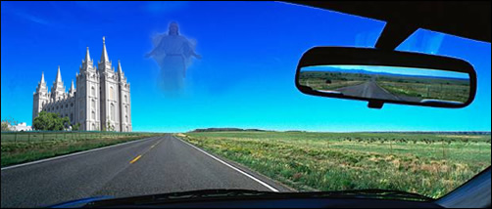
Haughville Praise Team
under the direction of
Minister Cloie Logan
presents their
ANNUAL CONCERT
“I won’t go back”
November 15, 2014
at 5:30 PM
Special guests:
Golden Lights, The Light of the World Church
Expressions of Joy Youth Choir, St. John's MB Church
Souled Out Youth Choir, Haughville P&W Center
Even Me Children’s Choir, Haughville P&W Center
Ricky Smiley, Poet, Tabernacle of Hope Church
Fetima Dugger-Knox, Soloist, New Birth Family Worship Center
MC: Rodnie Bryant
Haughville Praise & Worship Center
2716 W. 20th Street
Indianapolis, IN 46222
Elder L. L. Logan, Senior Pastor

