Slide 1
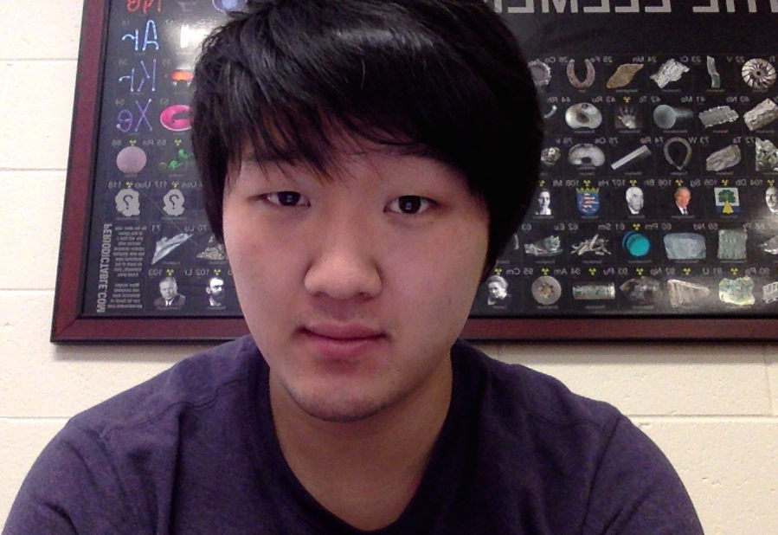
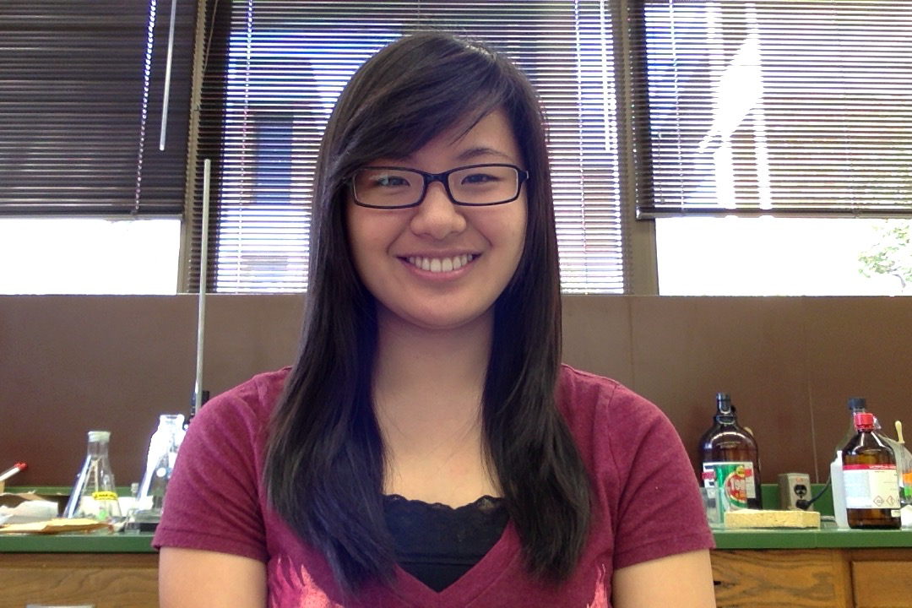
Ultra High-Molecular Weight Polyethylene
Tokin Kim is currently in his third year studying Biochemistry major with Chemistry minor and has plans to go to dental school after graduation from Andrews University. He is highly interested in Cancer research and loves laboratory work.
Irene Hwang is in her second year as a Biochemistry major and Business Management minor. She also has plans to go to dental school after Andrews. Not only does she really enjoy studying the natural world from a chemical standpoint, but Irene also really has a passion for music. As part of her current research topic, she is exploring how the complex process of photosynthesis requires the unique structure of magnesium in chlorophyll demonstrates the workings of something or Someone besides evolution.
ANDREWS UNIVERSITY CHEMISTRY AND BIOCHEMISTRY
HALENZ HALL AMPHITHEATER (Thursday, March 12, 4:30 PM)

