Slide 1
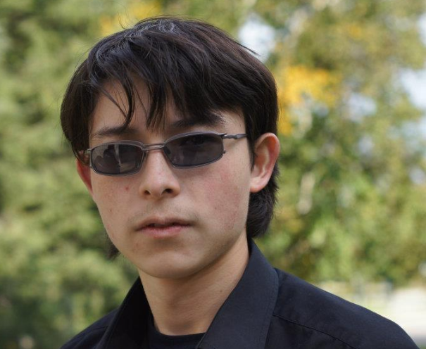
Illicit Drugs: A look at Phencyclidine
Satoshi K Thiele is from Nebraska and is a senior Chemistry ACS major at Andrews University in Berrien Springs, MI. Upon graduation in May 2015, he anticipates attending graduate school where he hopes to obtain a MSE in Chemical Engineering.
Phencyclidine commonly goes by the street names PCP or Angel Dust. It is a synthetic drug with dissociative properties. Originally, designed as a general anesthetic in the 1950’s it became a popular recreational drug in the 1960’s. In the United States it is a Schedule II controlled substance. Phencyclidine is a NMDA-receptor antagonist.
This presentation will focus on the history, synthesis, and biological interactions of phencyclidine.
Satoshi Thiele
Chemistry Senior
Andrews University
Berrien Springs, MI 49104
ANDREWS UNIVERSITY CHEMISTRY & BIOCHEMISTRY
HALENZ HALL AMPHITHEATER (Thursday, March 12, 4:30 pm)

