Slide 1
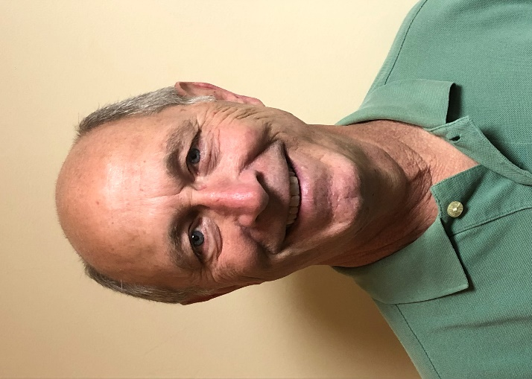
Announcing:
Oral Doctoral Dissertation Defense
The PhD/ThD Office is happy to announce the Doctoral Dissertation Defense of Ronald Wakeman entitled:
“A STRATIGRAPHIC ANALYSIS OF THE MIDDLE BRONZE AGE FROM THE TELL TAANACH EXCAVATIONS IN 1963, ‘66 AND ‘68”
The defense will be held on: Friday, Nov. 1, 2019
at 1:30 pm in Horn Museum
Ronald Wakeman
Doctoral Candidate
All wishing to attend must make their request by October 25, 2019
Requests can be made by sending an email to phd@andrews.edu
Please note space is limited & seats are reserved on a first come, first served basis

