Slide 1

Asian Pacific American Heritage
Walk Together, Embrace Differences, Build Legacies

Slide 2
May is Asian Pacific American Heritage Month. Asian Pacific encompasses all of the Asian continent and the Pacific islands of Melanesia (New Guinea, New Caledonia, Vanuatu, Fiji and Solomon Islands), Micronesia (Marianas, Guam, Wake Island, Palau, Marshall Islands, Kiribati, Nauru and Federated States of Micronesia) and Polynesia (New Zealand, Hawaiian Islands, Rotuma, Midway Islands, Samoa, American Samoa, Tonga, Tuvalu, Cook Islands, French Polynesia and Easter Island). On October 5, 1978, President Jimmy Carter signed a Joint Resolution designating the annual celebration. President George H.W. Bush established the month-long celebration. May was chosen to commemorate the immigration of the first Japanese to the United States on May 7, 1843, and to mark the anniversary of the completion of the transcontinental railroad on May 10, 1869. The majority of the workers who laid the western tracks were Chinese immigrants.

Slide 3
“In the United States, the sun first rises over the skies of Guam in the middle of the Pacific Ocean and awakens its indigenous people, the Chamorro. Guam was acquired after the Spanish American War of 1898 and the Chamorro, native to the land, became Americans with no political voice in the matter. Similarly, Native Hawaiians, who have called the Hawaiian Islands home for almost 2,000 years, became Americans at the turn of the twentieth century without any declaration of war. The Islands became a US protectorate after the Kingdom of Hawai'i was overthrown by Americans. . . . In addition, other Pacific Islands such as the Federated States of Micronesia have long cultural histories and historic and strategic ties to the US. There are now over one million people of Pacific Islander or Native Hawaiian descent in the US. Together, Asian and Pacific Americans make up approximately 6 percent of the population-more than 20 million.”
https://www.nps.gov/articles/asian-americans-and-pacific-islanders-in-the-making-of-the-nation.htm

Slide 4
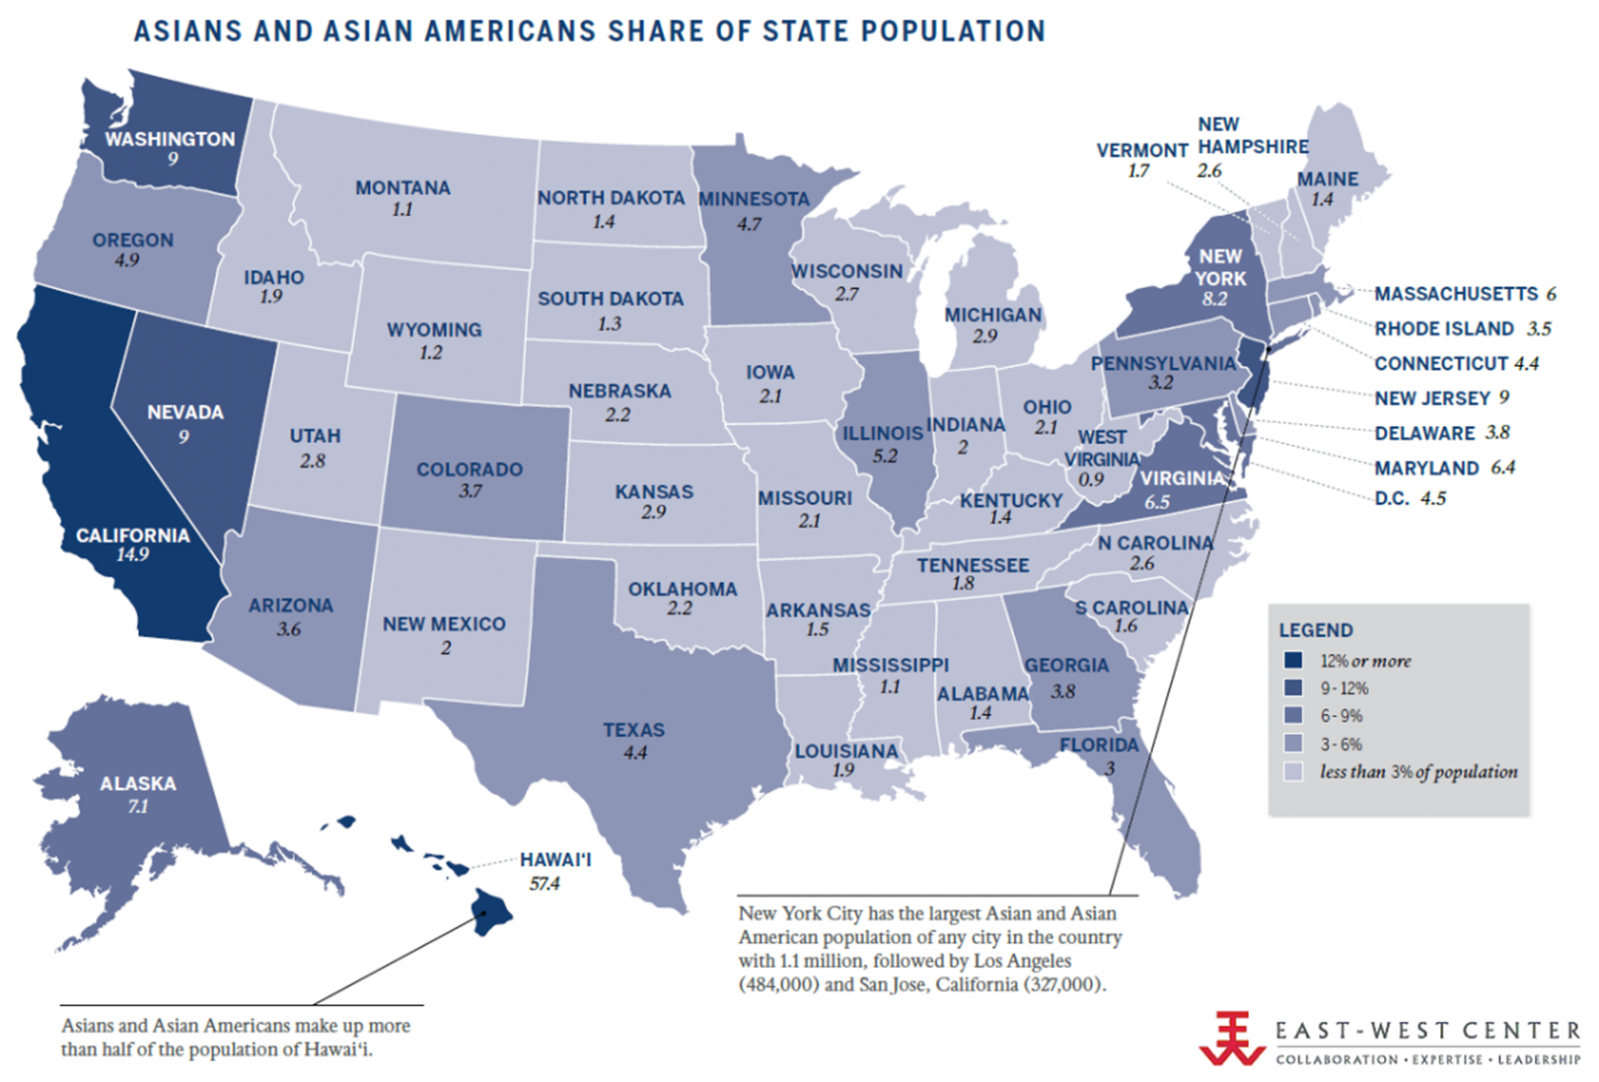

Slide 5
The first Asian-origin people to come to North America were Filipinos known as "Luzonians" or Luzon Indians part of the crew and landing party of the Spanish ship Nuestra Señora de Buena Esperanza. The ship left Manila and landed in Morro Bay, California on October 17, 1587, as part of the trade route between the Philippines and California. Filipino migration continued with reports of "Manila men" in Mariposa County, California in the late 1840s.
More Filipino sailors arrived and spread eastward. Almost 2 hundred years later in 1763, a Filipino settlement called St. Malo had been established outside of New Orleans, LA. The Filipinos or “Tagalas,” create their fishing village that remained on the shore of Lake Borgne into the early 20th century, until it was destroyed by a hurricane. St. Malo led to several Filipino communities in Louisiana.

Slide 6
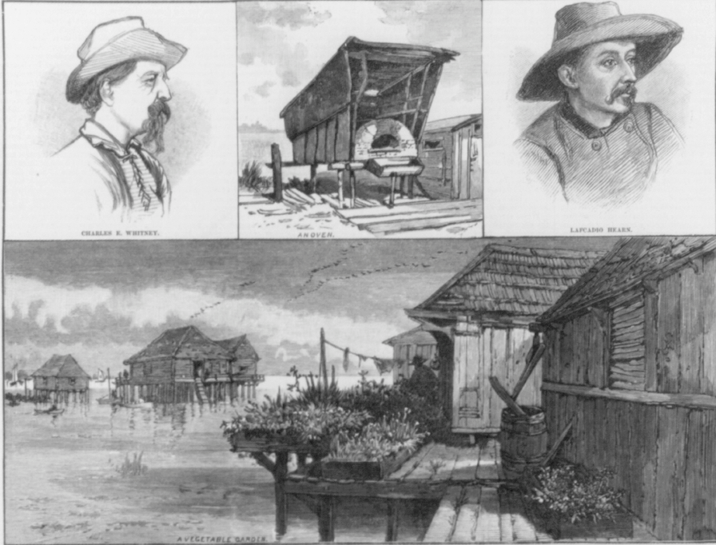

Slide 7
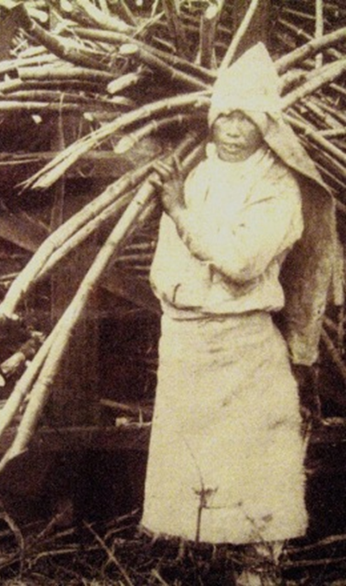
By the 1830s, East Asian groups had begun arriving to Hawai’i, settling in communities and on plantations established by American businessmen and missionaries. Originating primarily from China, Japan, Korea, and the Philippines, these early migrants worked on sugar cane and fruit plantations. The plantations owners used organizations such as the Royal Hawaiian Agricultural Society, to bring laborers to Hawaii as early as the 1830s. By 1852, the first formal contract was used to bring Chinese laborers. Protests from low wages and tensions between ethnic groups encouraged plantation owners to use immigrant groups against each other. The sugar and fruit industries took off in Hawai'i after the Civil War which disrupted shipment of southern commodities to northern markets.

Slide 8
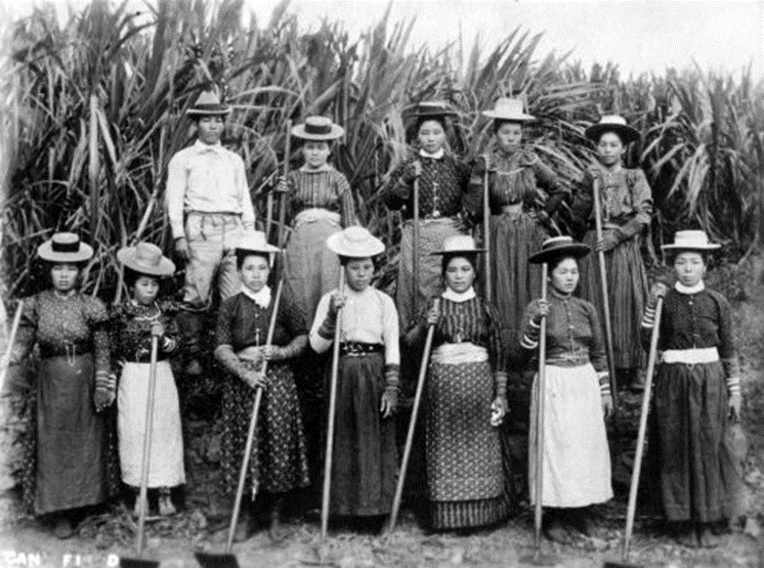
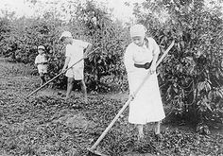

Slide 9
Japanese immigrant labor formed the majority of the plantation labor force, joined by small numbers of African Americans, Americans, Koreans, Portuguese, and Puerto Ricans.
Thousands of Koreans, escaping Japanese imperialism and poverty at home, migrated to Hawai’i in the early 1900s. After the Spanish-American War in 1898, Filipinos become colonial subjects and not subject to exclusion laws allowing them to came as agricultural laborers. Until the arrival of organizers from the International Longshoremen's and Warehousemen's Union [ILWU] in the 1930s, the spontaneous uprisings and organized strikes had been based on single ethnic/nationality bonds. These strikes were broken by planters who hired scabs from other ethnic groups until the strike broke. As a result of organizing work, negotiations, and strikes, Hawai’i's plantation labor was the highest paid agriculture work force in the world by the late 1950s.

Slide 10
With the establishment of the Old China Trade in the late 18th century, a handful of Chinese merchants were recorded as residing in the US by 1815. The first major wave of Asian immigration to the continental US occurred primarily on the West Coast during the California Gold Rush, starting in the 1850s. Whereas Chinese immigrants numbered less than 400 in 1848, there were 25,000 by 1852. Most Chinese immigrants in California were from Guangdong province; they sought sanctuary from conflicts and ensuing economic instability, and hoped to earn wealth to send back to their families. Chinese laborers generally arrived in California with the help of brokers under the credit-ticket system, where they would pay back money loaned with their wages. In addition to laborers, merchants also migrated from China, opening businesses and stores, that formed the beginnings of Chinatowns.

Slide 11
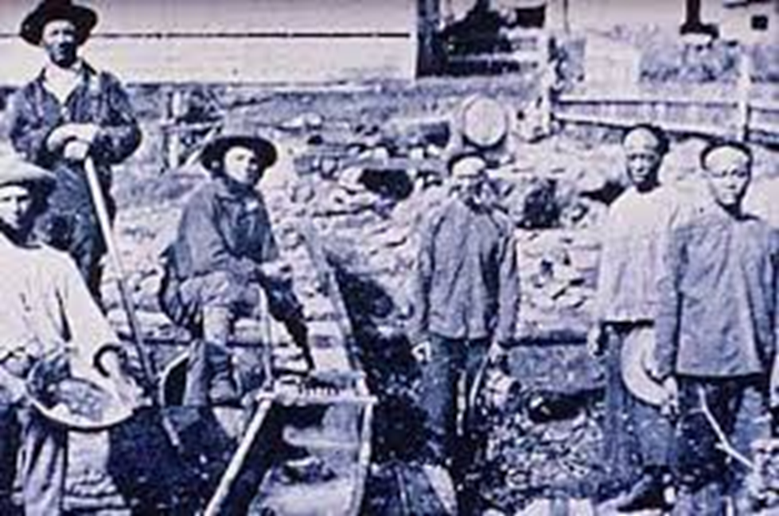

Slide 12
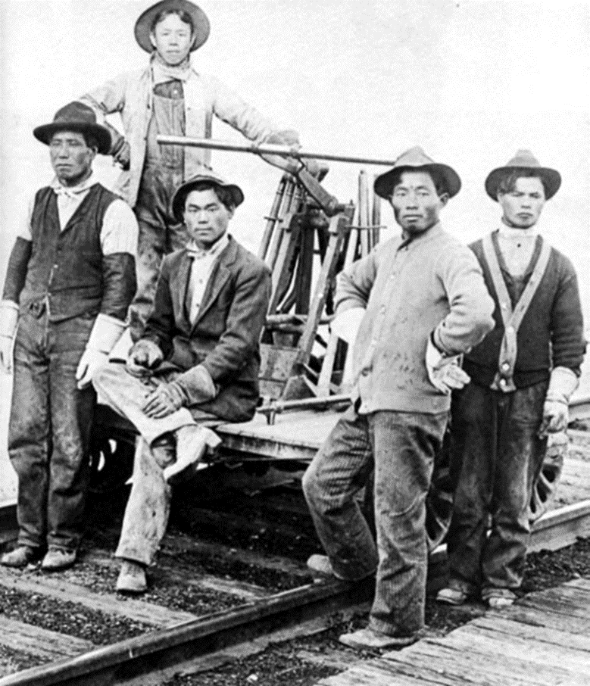
Beginning in the 1850s, when single men were recruited as contract laborers from Southern China, Asian immigrants held a vital role in the development of the West. Working as miners, railroad builders, farmers, factory workers, and fishermen, the Chinese represented at least 20 percent of California's labor force by 1870, but only .002 percent of US population. Some plantation owners in the South sought Chinese labor as a cheap means to replace the free labor of slavery. With the depression of 1876, amidst cries of "They're taking away our jobs!," anti-Chinese legislation and violence raged throughout the West Coast.

Slide 13
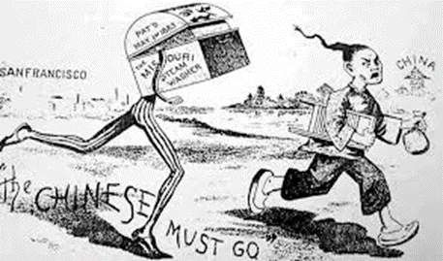
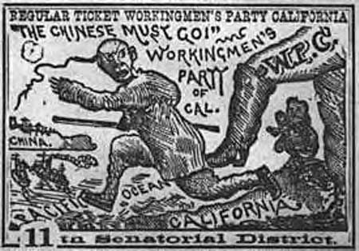
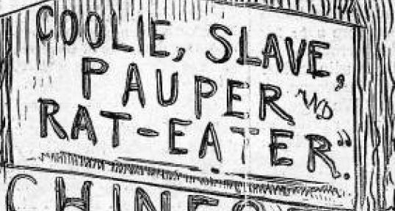
In the 1860s and 70s, nativist hostility to the presence of Asian laborers in the US grew, with the formation of organizations such as the Asiatic Exclusion League. Asian immigrants, particularly Chinese Americans, were seen as the "yellow peril" and endured violence and discrimination. Lynchings of Chinese were common, and large-scale attacks occurred, most prominently the Rock Springs massacre in which a mob of white miners killed nearly 30 Chinese immigrants. In 1875, Congress passed the Page Act, the first restrictive immigration law, which identified forced laborers and prostitutes from Asia as "undesirable" and barred their entry into the US.

Slide 14
The law instituted a near-complete exclusion of Chinese women from the US, preventing male laborers from bringing their families with or after them. The Chinese Exclusion Act (1882) prohibited all immigration from China, the first immigration law on the basis of race or national origin. The "Chinese Must Go" movement was so strong that Chinese immigration to the US declined from 39,500 in 1882 to only 10 in 1887. The Geary Act (1892) required Chinese to register and have proof of their residency. With intensified racial discrimination, Chinese immigrants continued to pursue voting rights and citizenship. In 1905, the San Francisco School Board supported the segregation of Asian ethnic children. “Our children should not be placed in any position where their youthful impressions may be affected by association with pupils of the Mongolian race.” This policy came after decades of Asian immigration and discrimination toward Asians. The School Board established a segregated Chinese Primary School.

Slide 15
Initially, Japanese and South Asian laborers filled the demand that was left by the lack of new Chinese immigrants. The 1880 census counted 105,465 Chinese and 145 Japanese; by 1900, the census counted 24,326 Japanese and 89,863 Chinese residents. From 1885 to 1924, about 30,000 Japanese arrived as government-sponsored contract laborers; 170,000 Japanese arrived as private contract laborers. The first South Asian immigrants landed in the US in 1907, and were predominantly Punjabi Sikh farmers. As immigration restrictions specific to South Asians would begin two years later and against Asians generally eight years after that, only 6400 came by 1915. Like the Chinese and Japanese immigrants of the time, these South Asians were predominantly men. The 1910 census, the first to count South Asians, recorded that there were 2,545 "Hindus" in the US.

Slide 16
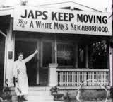
Japanese, Korean, and South Asian immigrants also arrived in the continental US starting in the late 1800s. By the twentieth century, after Japanese immigrants had settled in the wake of Chinese exclusion, the San Francisco School Board also applied the Chinese segregation policy to Japanese students. School superintendent, Aaron Altmann, advised the city's principals: "Any child that may apply for enrollment or at present attends your school who may be designated under the head of 'Mongolian' must be excluded, and in furtherance of this please direct them to apply at the Chinese School for enrollment."

Slide 17
Anti-Asian hostility against older and newer Asian immigrant groups continued with the Pacific Coast race riots of 1907 in San Francisco, CA; Bellingham, WA; and Vancouver, Canada. The San Francisco riot, led by anti-Japanese activists, hoped to establish segregated schools. In Bellingham, white men attacked the homes of South Asian immigrants, beating them and driving them out of town, with over 400 South Asians held in protective custody. These events encouraged the 1907 Gentleman's Agreement with Japan, wherein the Japanese government agreed to prohibit emigration to the US and the US agreed to impose less restrictions on Japanese immigrants. Japanese immigration ceased unless emigrants had previously acquired property or were immediate relatives of existing immigrants. Still, the family reunification provision allowed for wives/brides to emigrate. Koreans, as Japanese colonial subjects, could be issued Japanese passports, and also immigrated as family members and "picture brides.“

Slide 18
In 1917, the exclusion of all Asians occurred with the Asiatic Barred Zone Act, which prohibited all immigration from Southeast Asia, South Asia, and the Middle East. The Immigration Act of 1924 introduced national origin quotas for the entire Eastern Hemisphere, and barred the immigration of "aliens ineligible for citizenship." This introduced near complete exclusion of Asian immigration to the US. Exceptions existed: Filipino immigration continued due to their status as US nationals and Asian immigrants continued to emigrate to Hawaii, which was a US territory and not a state until 1959. The Tydings–McDuffie Act (1934), set Filipino independence by 1945 and immigration with a quota of 50 per year.

Slide 19
Asian immigrants to the US entered through the immigration processing center on Angel Island in California. The period from 1910 to 1940 was particularly difficult for Asians to enter as many were detained and questioned. The Chinese became a particular target once the Chinese Exclusion Act passed and became permanent with the immigration law of 1924. Although Chinese immigration was restricted, Chinese-arriving immigrants claimed citizenship through birth—children born to a US father were allowed to enter the country. Immigrants whose fathers were not US citizens bought papers identifying them as children of male Chinese American citizens; “Paper sons" and "paper daughters" went through an interrogation process, if passed, allowed to enter the country as citizens. Alerted to possible fraud, officials suspected all entering Chinese and devised intricate questions to trick them into revealing their true nationality.

Slide 20
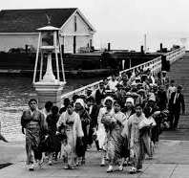
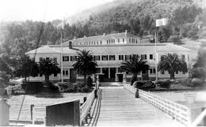

Slide 21
This, in turn, led to a substantial cottage industry of "coaching books" memorized by those seeking entry. Would-be immigrants memorized trivial details as the number of windows in the rear bedroom or the number of stone steps in the walkway between the front door and the peach tree in the yard. As a result, well-prepared paper sons and daughters succeeded in duping immigration officials while some genuine children of citizens were deported. Some of these experiences remain as poems rendered in classical Chinese carved into the walls of Angel Island's barracks. The national refusal to admit Asian Americans and Pacific Islanders on an equal basis with peoples from other regions of the globe lasted until passage of the Immigration and Nationality Act of 1965 which ended nearly a full century of exclusion and restriction.
.

Slide 22
The People of the State of California v. George W. Hall, 4 Cal. 399, was “an appealed murder case in which the California Supreme Court established that Chinese Americans and Chinese immigrants had no rights to testify against white citizens.” In 1853, a California court convicted George Hall, a white man, of the murder of Ling Sing, a Chinese miner, based on the testimony of three Chinese witnesses. Hall appealed the verdict, arguing that the testimony of the Chinese witnesses should not be accepted and that Section 394 of the Act Concerning Civil Cases, that barred the use of testimony by blacks, mulattoes, and Indians against whites, should also be extended to ban the testimony of Chinese. The California Supreme Court sided with Hall. The case did not make violence against Chinese legal: it was still possible to convict a white person of murdering Chinese if credible white witnesses, or other evidence, could be produced.

Slide 23
The California Alien Land Law of 1913 prohibited "aliens ineligible for citizenship" (everyone except whites and African Americans) from owning land or property. It affected Chinese, Indian, Japanese, and Korean immigrant farmers. Other states passed restrictive land laws – Washington had a statute as early as 1886. Such land control laws can be traced to English common law.
US Supreme Court cases determined the citizenship status of Asian Americans. With the 1898 case US vs. Wong Kim Ark as precedent (all persons born in the US were citizens), immigrants fought for naturalization. In 1922, the Court ruled in Takao Ozawa v. US that ethnic Japanese were not Caucasian, and did not meet the "free white persons" requirement to naturalize. In 1923, the Court ruled in US v. Bhagat Singh Thind that while Indians were considered Caucasian, they were not seen as "white" and therefore ineligible for naturalization. These cases confirmed that Asian immigrants were excluded from citizenship based on race.

Slide 24
Because they were forbidden from owning land, intermarrying with whites, owning homes, working in many occupations, getting an education, and living in certain parts of the city, Asians had no other choice but to retreat into their own isolated communities as a matter of survival. The first Chinatowns allowed immigrants to make a living. This is where the stereotypical image of Chinese restaurants and laundry shops, Japanese gardeners and produce stands, and Korean grocery stores began. The communities did not begin out of any natural or instinctual desire on the part of Asians, but as a response to prejudice, exclusion, and institutional discrimination. Nonetheless, even in the face of this hostile anti-Asian climate, Asian Americans fought for not only their rights, but also for their dignity and self-respect. They consistently challenged their unequal treatment and unjust laws by filing thousands of lawsuits at the local, state, and federal levels.

Slide 25
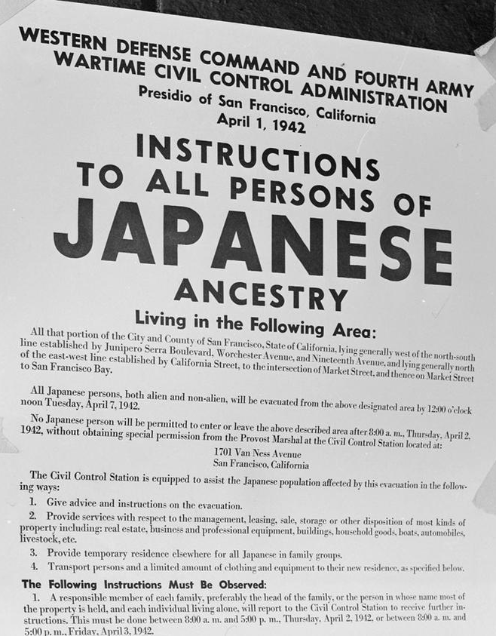
Of 127,000 Japanese Americans living in the continental United States at the time of the Pearl Harbor attack, 112,000 resided on the West Coast. About 80,000 were nisei (literal translation: "second generation"; American-born Japanese with U.S. citizenship) and sansei ("third generation"; the children of Nisei). The rest were issei ("first generation", immigrants born in Japan who were ineligible for US citizenship). The internment of Japanese Americans in the US was the forced relocation and incarceration during World War II of between 110,000 and 120,000 people of Japanese ancestry who lived on the Pacific coast in camps in the interior of the country. Sixty-two percent of the internees were US citizens. President Franklin D. Roosevelt ordered the incarceration shortly after Imperial Japan's attack on Pearl Harbor.

Slide 26
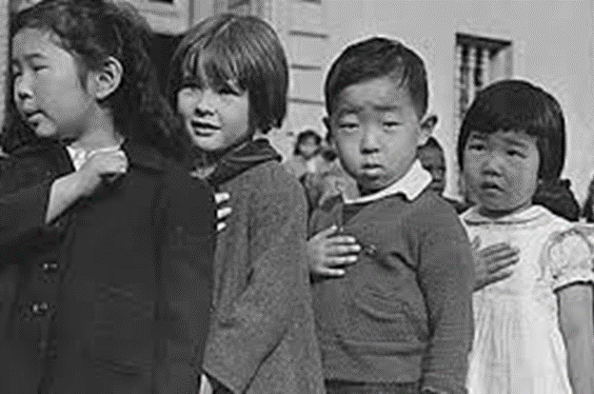
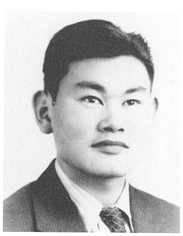
Incarceration was applied unequally due to differing population concentrations and state and regional politics: more than 110,000 Japanese Americans, who lived on the West Coast, were forced into interior camps, but in Hawaii, where 150,000-plus Japanese Americans lived only 1,200 to 1,800 were interned. Internment has been determined to have resulted more from racism than any military danger posed by Japanese Americans. In 1944, the Supreme Court upheld the constitutionality of the removal by ruling against Fred Korematsu's appeal for violating an exclusion order. The Court limited its decision to the validity of the exclusion orders, avoiding the issue of the incarceration of US citizens with no due process.

Slide 27
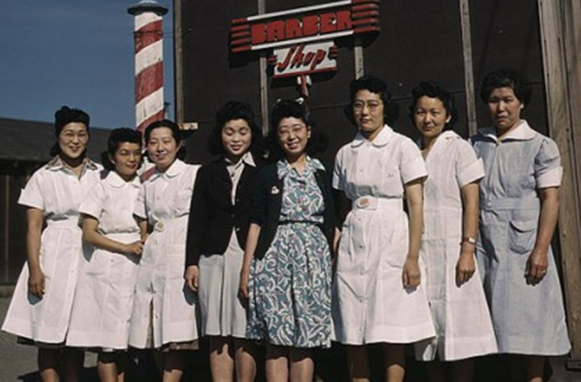
President Franklin D. Roosevelt authorized the deportation and incarceration with EO 9066, issued February 19, 1942, which allowed regional military commanders to designate "military areas" from which "any or all persons may be excluded." This declared that all people of Japanese ancestry were excluded from the entire West Coast, including CA, OR, WA, and AZ, except for those in government camps. About 5,000 Japanese Americans relocated outside the exclusion zone before March 1942, and 5,500 community leaders arrested after the Pearl Harbor attack were already in custody. But, the majority of Japanese Americans were evacuated (forcibly relocated) from their West Coast homes during the spring of 1942.

Slide 28
In 1980, under pressure from the Japanese American Citizens League and others, President Jimmy Carter opened an investigation to determine whether the Japanese Americans internment camps had been justified. He appointed the Commission on Wartime Relocation and Internment of Civilians (CWRIC) to investigate. The report, Personal Justice Denied, found little evidence of Japanese disloyalty and concluded the incarceration had been the product of racism. The Commission “recommended that the government pay reparations” to the survivors. In 1988, President Ronald Reagan signed into law the Civil Liberties Act, which apologized for the internment on behalf of the US and authorized a payment of $20,000 to each individual camp survivor. The legislation admitted that government actions were based on "race prejudice, war hysteria, and a failure of political leadership." The US government eventually disbursed more than $1.6 billion in reparations to 82,219 Japanese Americans who had been interned.

Slide 29
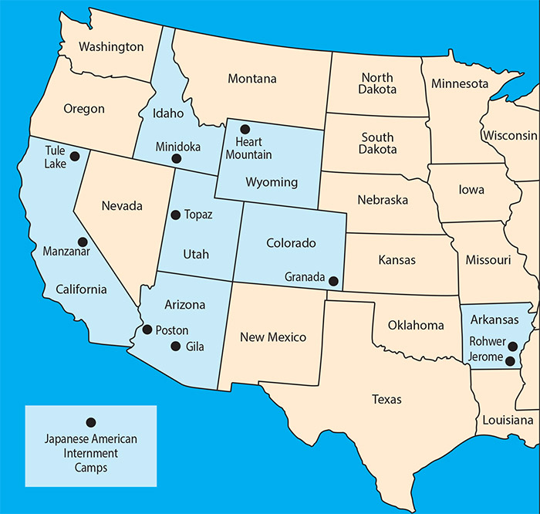
Ten internment camps were established in the US. These along with POW camps and camps for conscientious objectors interned not just Japanese Americans, but also German and Italian Americans, along with Prisoners of War from each of the enemy countries.

Slide 30
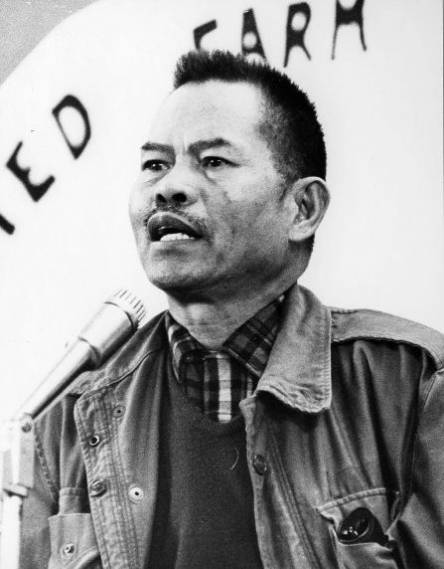
In the mid-twentieth century, Asian Americans, particularly Filipinos, fought for the rights of workers. The Cannery Worker's and Farm Laborer's Union was formed in Seattle in the 1930s to protect the rights of Filipinos working in the Alaskan salmon canneries. In the late 1950s, the Agricultural Workers Organizing Committee (AWOC) was created to fight for farm workers' rights in California. Led by and primarily made up of Filipinos, the AWOC went on strike in 1965, against California grape growers. They were joined by Cesar Chavez and the National Farm Workers Association in the famous Delano Grape Strike. The five-year strike was a major victory for farm laborers and resulted in the merging of the two organizations into the United Farm Workers, which became a major force in politics and civil and labor rights in the US.

Slide 31
World War II witnessed the formal end of the 1882 Chinese Exclusion Act. In 1943, Congress allowed current Chinese residents to apply for naturalization and permitted an annual total of 105 Chinese to enter the country. Shortly after the war ended, Filipinos and Asian Indians were allowed to naturalize as well. Later, in 1952, after the Treaty of Peace with Japan was signed by the US, Japanese Americans could also become naturalized. But it was the momentous Immigration Act of 1965 which forever changed the immigration dynamic, allowing Asians and Pacific Islanders to immigrate under the same conditions as aspirants from other parts of the globe. Today, the Asian American population in the US is rising at a faster rate than any other "racial" group in the country.

Slide 32
America's war in Southeast Asia, notably in Vietnam but also in Laos and Cambodia, produced a long stream of refugees – including many who fought for the US or supported the effort and others who had been impoverished by the cruelties of that devastating conflict. Some were multi-lingual scholars trained under French colonial regimes, others were doctors and other professionals who fled Communist rule. From Laos came not only Laotians like General Vang Pao who had commanded his troops but also the Hmong peoples, largely illiterate, who had assisted the war from beyond the Vietnamese borders. In today's America, Asian Americans and Pacific Islanders occupy a set of widely diverse and deeply complex niches. There are pockets of intense poverty and social dislocation, but there are successive Asian Indian American winners of national spelling contests and wildly successful entrepreneurs like Amar Bose, founder of the Bose Corporation and Vera Wang, noted American fashion designer.

Slide 33
Asian Americans and Pacific Islanders influence local and national elections and threaten to overwhelm admissions statistics for elite universities. But they are still subject to racial profiling, sometimes in the form of Sikhs with turbans or dark—skinned South Asians vilified as "terrorists." In an age when it is more common to see Asian Americans and Pacific Islanders for what they actually are—Americans of all walks of life—it is time to recognize and preserve more historic sites which tell their stories. When the sun finally sets on US territory, its last rays diminish as the horizon darkens over American Samoa in the Pacific Ocean, just on the other side of the International Date Line from Guam. On the American mainland in North America, a host of historic places await to tell the histories of Asian Americans and Pacific Islanders and their roles in the making of the nation.

Slide 34
Sources:
https://asiasociety.org/education/asian-americans-then-and-now
https://en.wikipedia.org/wiki/
https://www.nps.gov/articles/asian-americans-and-pacific-islanders-in-the-making-of-the-nation.htm

Slide 35

The study of history and political science provides enhanced understanding of society, increases communication skills, and teaches critical thinking. These, and other benefits of a liberal arts education, bring confidence and increased enjoyment in every area of life by broadening the students’ intellectual experience. The History & Political Science Department serves Andrews students in several ways. It provides general educational courses required for all students and offers degree programs for those interested in further study of American and European history, political science, or social studies. Faculty in the department aid students in understanding the relationship of the past and present and demonstrate how local, national, and international political processes affect and respond to events. All teachers approach their subjects from an explicit, biblically based, Christian perspective.
https://www.andrews.edu/cas/history/

Slide 36
A major in History from Andrews University equips students with knowledge and skills for success in a wide range of areas. Students understand the past and its relationship to the present through a variety of American, European, and non-western history courses, training in a foreign language, hands-on experience in historical research, and an introduction to historical philosophy and theory. Our degree prepares students for careers in teaching, research, law, and for graduate work in a wide range of professional and academic areas. In addition to preparing students for a specific profession, it encourages the moral, intellectual, civic, social, and spiritual maturity to accompany a life well-lived.
A Political Science major from AU equips students with unique knowledge and skills that find practical solutions to some of the world's most urgent social, economic and political problems. It prepares students for careers in teaching, government and politics, law, and for graduate student in a wide range of professional and academic areas. In preparing students for a specific profession, a political science major teaches lessons in citizenship and statesmanship and seeks to encourage moral, intellectual, civic, social, and spiritual maturity to accompany a life well-lived. The discipline of Political Science also teaches students to critically assess a host of difficult problems and aims at finding.
Our Social Studies degree from AU is an interdisciplinary program that prepares students for teaching elementary and secondary education.

