Slide 1

2018 Women’s History Month:
“NEVERTHELESS SHE PERSISTED:
Honoring Women Who Fight All Forms of Discrimination Against Women”
Our History is Our Strength
Source for slides: National Women’s History Project, http://www.nwhp.org/

Slide 2
The 2018 National Women’s History theme presents the opportunity to honor women who have shaped America’s history and its future through their tireless commitment to ending discrimination against women. The theme embodies women working together with strength, tenacity, and courage to overcome obstacles and achieve joyful accomplishments. In 2018, we honor fifteen outstanding women for their unrelenting and inspirational persistence, and for understanding that, by fighting all forms of discrimination against women, they have shaped America’s history and our future. Their lives demonstrate the power of voice, of persistent action, and of believing that meaningful and lasting change is possible in our democratic society. Through this theme we celebrate women fighting not only against sexism, but also against the many intersecting forms of discrimination faced by American women including discrimination based on race and ethnicity, class, disability, sexual orientation, veteran status, and many other categories. From legislation against segregation to the reproductive justice movement, our 2018 honorees are dismantling the structural, cultural, and legal forms of discrimination that for too long have plagued American women.

Slide 3
In additional to National and Community Honorees we recognize the ongoing persistence of our mothers, grandmothers, aunts, sisters, neighbors, and friends. We hope you will join us in celebrating all women this month and throughout the year.
Nevertheless She Persisted: This phrase was born in February 2017 when Senator Elizabeth Warren, D-MA, was silenced during Jeff Sessions’ confirmation hearing for Attorney General. At the time, Warren read an opposition letter penned by Coretta Scott King in 1986. Senate Majority Leader Mitch McConnell, R-KY, later said “Senator Warren was giving a lengthy speech. She had appeared to violate the rule. She was warned. She was given an explanation. Nevertheless she persisted.” Feminists immediately adopted the phrase in hashtags and memes to refer to any strong women who refuse to be silenced. Fighting all forms of discrimination against women takes persistence. The 2018 honorees have all gotten the message to stop, either directly or indirectly, yet they have persisted to bring positive change to the lives of diverse American women.

Slide 4
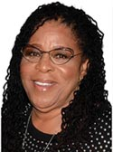
After Susan Burton’s five-year old son was accidentally hit and killed by a car, she numbed her grief through alcohol and drugs. As a result, she became trapped in the criminal justice system for nearly two decades before finding freedom and sobriety in 1997. Just one year later, Burton founded a nonprofit, dedicating her life to helping others break the cycle of incarceration—A New Way of Life Re-Entry Project (ANWOL) in 1998. Starting with one residential house and participants she found at bus stops, ANWOL now operates five residential homes in Los Angeles and provides resources such as case management, employment, and pro bono legal services. ANWOL has provided direct services to over 1,000 women, with more than 75 percent stay drug free and out of prison. Burton is also the co-founder of All of Us or None (AOUON) and the Formerly Incarcerated and Convicted People’s Movement (FICPM), both national grassroots civil rights movements comprised of formerly incarcerated individuals, their families, and community allies.

Slide 5
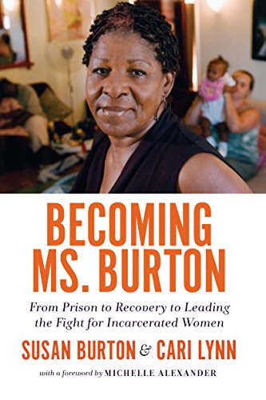
In collaboration with UCLA’s Critical Race Studies Program, Burton launched the Employment Rights Re-Entry Legal Clinic which has grown to be the largest of its kind in southern California.
Susan Burton has earned numerous awards and honors, and in 2015 was named by the Los Angeles Times as one of eighteen New Civil Rights Leaders in the nation. Her memoir Becoming Ms. Burton: From Prison to Recovery to Leading the Fight for Incarcerated Women was released in 2017.

Slide 6
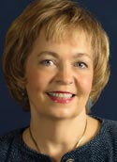
Margaret Dunkle played a key role in implementing Title IX, the law that transformed education for women and girls, from athletic fields to graduate schools. Her groundbreaking 1974 report documenting discrimination against female athletes became the blueprint for the Title IX regulations on athletics. Dunkle joined the Association of American College’s Project on the Status and Education of Women in 1972. Three years later, she became the first Chair of the National Coalition for Women and Girls in Education, which led the successful fight for strong Title IX rules. In the 1980s, she documented widespread discrimination against pregnant and parenting students. As Director of the AAUW Educational Foundation, she commissioned the landmark 1992 study, How Schools Shortchange Girls. Dunkle conceived 1986 legislation that enabled low-income women to receive student aid without losing health insurance for their children. While President of the Federation of Organizations for Professional Women, she worked with Senator Edward Kennedy on the 1980 Science and Technology Equal Opportunities Act.

Slide 7
Dunkle turned her focus to child development in the 2000s, when a family member was vaccine-injured, sustaining brain injury and developmental disabilities. She led successful 2007 efforts to require accurate developmental screening in Head Start programs and partnered with federal policymakers to ensure insurance reimbursement for such screenings. She spearheaded 2015 efforts to honor forgotten civil rights heroine Harriet Elizabeth Brown. In 1937, Brown, represented by 29-year-old NAACP attorney Thurgood Marshall, successfully fought for equal pay for African American teachers in rural Maryland. Dunkle’s Task Force implemented 3 recommendations: naming a community center and stretch of state highway in Brown’s honor and commissioning a courthouse portrait.

Slide 8
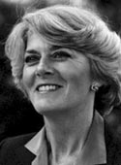
Geraldine Ferraro was the first female vice-presidential candidate representing a major political party. Suffering multiple election defeats, she went on to serve as US Ambassador to the United Nations Commission on Human Rights. Geraldine Ferraro first ran for public office in 1978 and was elected to the U.S. House of Representatives where she served three terms representing the 9th district of New York. Ferraro quickly rose in her party’s hierarchy where she was twice elected Secretary of the House Democratic Caucus. In Congress she focused much of her energy on gender equity in wages, pensions, and retirement benefits.
As the 1984 presidential primary season drew to a close, women’s organizations including the National Organization for Women (NOW) and the National Women’s Political Caucus, put pressure on the frontrunner to select a woman for vice president.

Slide 9
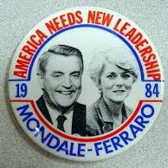
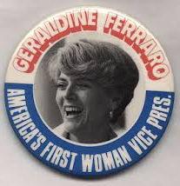
In July 1984 Walter Mondale announced his selection of Ferraro as his running mate. She was both the first woman and first Italian American to run on a major party national ticket and her candidacy was celebrated by feminists and immigrant communities alike. Ferraro faced sexism on the campaign trail, reporters regularly asking if she was tough enough to serve as commander-in-chief. On November 6, 1984 Mondale and Ferraro lost the election. In 1993, President Clinton appointed Ferraro US Ambassador to the United Nations on Human Rights and in 1995 appointed her Vice-Chair of the US delegation to the Fourth World Conference on Women in Beijing. In both roles she served as an effective voice for women’s human rights around the world.

Slide 10
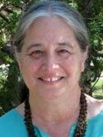
Jill Moss Greenberg is a crusader for fairness and the rights of underrepresented groups. She has been a trailblazer in the intersection of women’s rights and history with issues of race, national origin, disability, religion, age, sexual orientation, gender identity, homelessness, and socioeconomic status. She worked for years in the civil rights and disability rights movements and applied those experiences to gender equality. Moss Greenberg advocated for the passage of Title IX and assembled representatives of diverse women’s, civil rights, and civic organizations to pilot the initial Title IX Institutional Self-Evaluation for public school systems. As the Race Equity Specialist at the Maryland State Department of Education, she initiated “Black History at Your Doorstep” and conducted weeklong, residential academies for school administrators. In 1980, she initiated the Maryland Women’s History Project, which expanded in 2010 to become the Maryland Women’s Heritage Center. Moss Greenberg served as the Founding Executive Director and coined the center’s mantra, “Adding Herstory to History to tell Ourstory.”

Slide 11
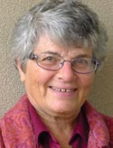
Roma Guy is a social justice activist and leader on homelessness, public health, poverty, LGBTQI rights, immigrant rights, and women’s rights. She started her career as a Peace Corps volunteer and training director in West Africa working in literacy and health education. Over the years Guy was a co-founder of organizations including: San Francisco Women Against Rape (1973, the city’s main rape crisis center), San Francisco Women’s Centers/the Women’s Building (1975/79, a nonprofit arts and education center), La Casa de las Madres (1976, the nation’s second domestic violence shelter), and the California Women’s Agenda (1995, which advocates for universal healthcare and reproductive justice). Guy also co-founded and served as Co-Director of the Women’s Foundation of California which trains women as policy advocates and philanthropic leaders. In 1994 Guy joined the San Francisco State University as Director of the Bay Area Homelessness Program, a consortium of sixteen colleges working to end homelessness. Currently, she is a community organizer and policy advocate for Taxpayers for Public Safety; she was nominated for the 2005 Nobel Peace Prize.

Slide 12
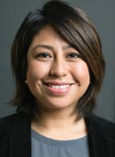
Cristina Jiménez is a leader in the youth-led immigrant rights movement. By sharing her own story of being undocumented, Jiménez inspired others to come forward, and helped change the discourse on immigration. She is Executive Director & Co-founder of United We Dream (UWD), the largest immigrant youth-led organization in the country. Originally from Ecuador, Jiménez came to the US with her family at the age of 13, attended high school and college as an undocumented student. She has been organizing in immigrant communities for over a decade and was part of UWD’s campaign team that led to the historic victory of the Deferred Action for Childhood Arrivals (DACA) program in 2012. Under Jiménez’s leadership UWD has grown to a network of 55 affiliates in 26 states with over 400,000 members. Cristina Jiménez co-founded the NY State Youth Leadership Council and the Dream Mentorship Program at Queens College. She holds a Masters degree in Public Administration & Public Policy from the School of Public of Affairs at Baruch College, CUNY and a BA in Political Science and Business from Queens College, CUNY.

Slide 13

Saru Jayaraman is a national labor leader and researcher who helps restaurant workers mobilize with employers and consumers for better wages and working conditions through policy change, workplace justice campaigns, cooperatively-owned restaurants, and more. Saru Jayaraman is the Co-Founder and President of the Restaurant Opportunities Centers United (ROC United) and Director of the Food Labor Research Center at University of California, Berkeley. After 9/11, together with displaced World Trade Center workers, she co-founded ROC, which now has more than 25,000 worker members, 300 employer partners, and several thousand consumer members in a dozen states nationwide. ROC United is a leader in the ONE FAIR WAGE Campaign to end the two-tiered minimum wage system. The federal minimum wage for tipped workers remains at $2.13 per hour. Seven states, including California, have one minimum wage; ROC has demonstrated that these seven states are faring better than the 43 with lower wages for tipped workers. The story of Jayaraman and her co-founders’ work founding ROC has been chronicled in the book The Accidental American.

Slide 14


Jayaraman has authored two books; national bestseller Behind the Kitchen Door (Cornell University Press, 2013) and Forked: A New Standard for American Dining (Oxford University Press, 2016).
Saru Jayaraman is a graduate of Yale Law School and the Harvard Kennedy School of Government. She has received numerous awards and recognitions including being listed in CNN’s “Top 10 Visionary Women” (2014), recognized as a Champion of Change by the White House (2014), and she received a James Beard Foundation Leadership Award (2015).

Slide 15
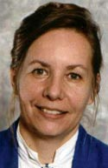
Marty Langelan is a leader in the global effort to end harassment and gender-based violence and called “the godmother of direct intervention.” She’s an economist, martial artist, past president of the DC Rape Crisis Center, and the author of Back Off: How to Confront and Stop Sexual Harassment. She’s been derailing harassers for decades. Langelan pioneered feminist self-defense training and bystander tactics, organized the first major city-wide anti-harassment campaign (1985-87), and conducted the first feminist survey on harassment. She recently designed the first effective harassment-prevention strategy for public bus/subway systems, training thousands of transit workers. Her self-defense and anti-harassment programs are used worldwide. She’s taught hundreds of thousands of people how to interrupt sexist/racist behavior, reclaim jobs and neighborhoods from harassers, and shut down sexual predators. Unlike legal/administrative remedies, direct-action works fast. These intervention tools are an efficient form of nonviolent civil disobedience, designed to disrupt the aggressor’s agenda.

Slide 16

Langelan provides violence-intervention skills for international human-rights organizations, anti-rape activists, environmentalists, and many others. She teaches kids how to stop bullies, and communities how to intervene to stop white-supremacist bigots. In 1971, she filed and won one of the earliest federal sex-discrimination actions, tackling the sexist disparity in graduate student funding. As president of the National Woman’s Party (1999-2005), Langelan launched and led the massive preservation project to save Alice Paul’s headquarters in Washington, DC. She rescued the historic building, suffrage banners, and archives. A lifelong activist, Langelan committed her first act of feminist civil disobedience 60 years ago, when she catapulted 30 second-grade classmates into action to stop a teacher from brutally humiliating a child. Even seven-year-olds can do fast intervention.

Slide 17
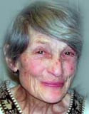
Pat Maginnis was the first abortion activist in US history. She was inspired to fight for reproductive freedom while serving in an Army hospital in Panama where she witnessed horrible treatment of pregnant women. Upon returning stateside in 1959, she immediately went to work for abortion rights. In 1962 Maginnis founded the Society for Humane Abortion (SHA) where she advocated for “elective abortion” and argued that all women had the right to safe and legal abortion. The organization sponsored symposia for medical and legal professionals, provided literature to libraries, family planning centers, and individuals, published a quarterly newsletter, and operated a free post-abortion clinic. In 1966, Maginnis founded the Association to Repeal Abortion Laws (ARAL) to conduct unlawful underground activism. ARAL coordinated an “underground railroad” linking over 12,000 American women with abortion clinics in Mexico. ARAL is considered a predecessor to NARAL Pro Choice America. Maginnis’ organizations disbanded in 1973 following Roe v. Wade, the US Supreme Court Case legalizing abortion.

Slide 18
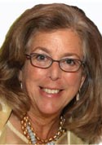
Arlene Mayerson has been a leading attorney in disability rights law, including playing a key role in drafting and negotiating the Americans with Disabilities Act (ADA) and amendments to the Individuals with Disabilities Education Act (IDEA), litigating precedent setting disability rights cases and teaching disability rights law. Mayerson provided expert testimony before several Congressional committees with jurisdiction over the ADA and filed comments on the Department of Justice ADA regulations for over 500 disability rights organizations. Mayerson has also litigated historic disability rights cases, including precedent for the inclusion of public school children with disabilities in general education classrooms, and the landmark Netflix decision that internet-only businesses are covered by the ADA. She has also provided representation, consultation to counsel, and coordination of amicus briefs on key disability rights cases before the US Supreme Court. Mayerson was appointed by the Secretary of the US Department of Education to the Civil Rights Reviewing Authority, responsible for reviewing the civil rights decisions of the department.

Slide 19
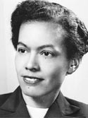
Pauli Murray was a civil rights and women’s rights activist decades ahead of her time. Facing lifelong discrimination based on her race and sex, she persisted and become an accomplished attorney, author, activist, academic, and spiritual leader. Murray finished first in her class at Howard Law School where she was the only female student. She was denied admission to UNC graduate school in 1938 due to her race and denied a fellowship to Harvard Law in 1944 due to her sex. She went on to be the first African American awarded a law doctorate from Yale (1965) and later became the first African American woman to be ordained an Episcopal priest (1977). In 1940, fifteen years before Rosa Parks, Murray was arrested for sitting in the whites only section of a Virginia bus. She coined the term “Jane Crow” referring to the intersecting discrimination faced by African American women and was highly critical of sexism within the civil rights movement.

Slide 20
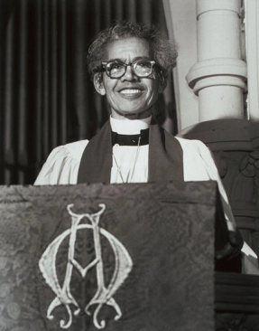
JFK appointed her to the Presidential Commission on the Status of Women (1961) and she was a co-founder of the National Organization for Women (NOW) in 1966. Many of Murray’s legal theories were decades ahead of their time and she is considered a pioneer of women’s employment rights. Her papers while a Howard law student arguing against segregation were used over a decade later in the landmark Brown v. Board of Education case (1955). Similarly, in the early 60s she argued that the 14th amendment forbade sex discrimination, a full ten years before the US Supreme Court came to the same finding in Reed v. Reed (1971).

Slide 21
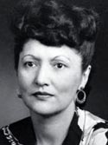
An Alaska Native of the Tlingit nation, Elizabeth Peratrovich was a civil rights leader whose activism led to passage of the Alaska Territory’s first anti-discrimination act (1945). She grew up in a small Alaska village and was orphaned at a young age. She married, had three children, and moved to Juneau seeking more opportunities. During the 1940s Juneau was segregated; signs in shops and public facilities reading “No dogs or natives allowed.” Neighborhoods and schools were segregated and it was difficult for Alaska Natives to secure good jobs. As a leader of the Alaska Native Sisterhood, she refused to tolerate the second-class treatment and petitioned the territorial governor to end segregation. An Anti-Discrimination Act failed to pass the Territorial Legislature in 1943. Peratrovich continued to lobby for civil rights and in 1945 the law again came for a vote. Peratrovich was the last to testify saying in part “I would not have expected that I, who am barely out of savagery, would have to remind gentlemen with five thousand years of recorded civilization behind them, of our Bill of Rights.”

Slide 22
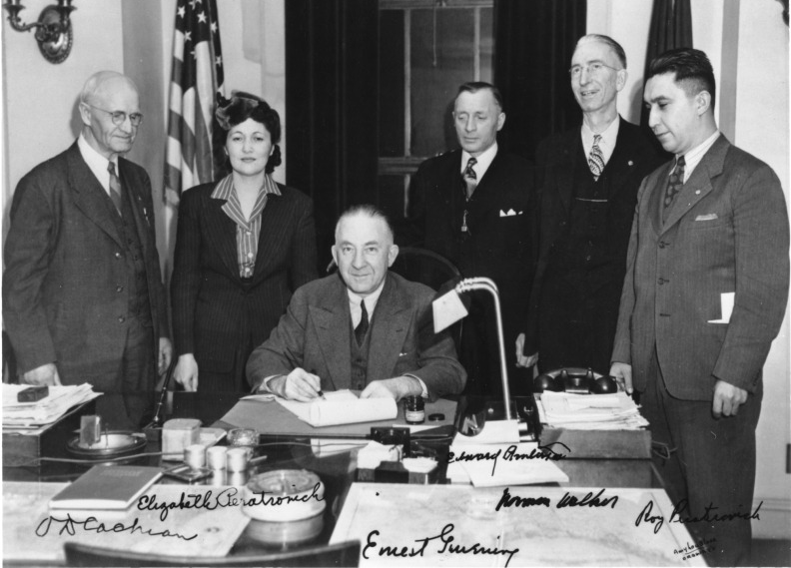
Peratrovich spoke of the personal hardships experienced by her children and her community as a result of segregation. Her impassioned testimony and tireless lobbying efforts are credited with securing the legislation’s passage. On February 16, 1945, the Alaska Territory passed an anti-discrimination act to protect the civil rights of Alaska Natives. The law was the first of its kind nationwide and passed a full 19 years before the US Congress passed the Civil Rights Act of 1964.

Slide 23
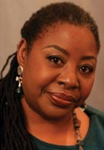
Loretta Ross has dedicated her career to feminist issues with a focus on women of color. Ross launched her feminist career in the 1970s as director of the DC Rape Crisis Center, one of the first centers primarily run by and for women of color. She launched the Women of Color Program for the National Organization for Women (NOW) in the 1980s, and was national program director of the National Black Women’s Health Project. She was the Program Research Director at the Center for Democratic Renewal/National Anti-Klan Network where she led projects researching hate groups, and working against all forms of bigotry. She founded and led the National Center for Human Rights Education (NCHRE) from 1996-2004. In 1994 Ross co-created the theory of Reproductive Justice. She co-authored Undivided Rights: Women of Color Organize for Reproductive Justice in 2004. She released two books in 2017, Radical Reproductive Justice and Reproductive Justice: An Introduction, co-written with Rickie Solinger. Ross is a rape survivor and survivor of sterilization abuse.

Slide 24
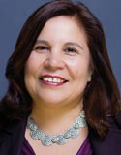
Angelia Salas is a key strategist and leader in the national movement for immigrant rights and policy reform. She works at the local, state, and national level to build coalitions among unions, faith groups, and students and seeks to give voice to the lives and experiences of individual immigrants. Since becoming Executive Director of the Center for Humane Immigrant Rights (CHIRLA) in 1999, Angelica Salas spearheaded several ambitious campaigns locally, state-wide, and nationally. She helped California become a pro-immigrant state by winning in-state tuition and financial aid for undocumented immigrant students and established day laborer job centers that serve as a model for the rest of the nation. She led efforts to allow all California drivers to obtain a driver license and is a spokesperson on federal immigration policy as an active member of FIRM (Fair Immigrant Rights Movement) and RIFA (Reform Immigration FOR America). Under Salas’s leadership, CHIRLA and its partners across the country have built the foundation for the upsurge in immigrant rights activism.

Slide 25

As part of FIRM, Salas helped convene a coalition of organizations in California and across the country which have successfully mobilized millions of immigrants to demand comprehensive immigration reform including legalization with a path to citizenship, family reunification, and the protection of civil and labor rights. One of Salas’s greatest accomplishments at CHIRLA has been the transformation of a coalition of social service providers into an organization that empowers immigrants to engage in advocacy on their own behalf. She comes by her understanding of the immigrant experience firsthand. As a five-year-old, Angelica Salas came to the US from Mexico to rejoin her parents who had come to the US to find work and better provide for their family.

Slide 26
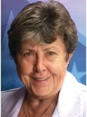
Linda Spoonster Schwartz overcame a military injury to become a leading veterans’ advocate, focusing especially on the unmet needs of women veterans. The Honorable Linda Spoonster Schwartz has served our country, since 1967, as an Air Force Nurse, veteran advocate, and public servant. After 16 years of military service, she was medically retired after sustaining injuries in a 1983 aircraft accident, while serving as a USAF Flight Nurse. She looked to the Veterans Administration for help but found a pervasive attitude of neglect toward women veterans (inadequate facilities, lack of privacy, and physicals that didn’t include breast or gynecological exams). Inspired to make a difference, she earned a Master’s from Yale School of Nursing and Doctorate in Public Health from Yale School of Medicine. Schwartz has testified over 24 times on women veteran issues before both Houses of Congress. She spearheaded legislative efforts to authorize VA’s “Center for Women Veterans.” As Chair of VA’s Advisory Committee on Women Veterans, she emerged as a credible leader-champion for equal benefits, care, and services for women veterans.

Slide 27
Schwartz served as Connecticut Commissioner/Commandant of Veterans Affairs (2003-2014) focusing on improving programs for women veterans, homeless veterans, and mental health services. In 2013, President Obama nominated her to be Assistant Secretary of Veteran Affairs for Policy and Planning where she continued to fight for issues such as veteran suicide prevention, and survivors of military sexual trauma.
She has served on the National Boards of the American Nurses Association, Vietnam Veterans of America, and the Vietnam Women’s Memorial. She is the first and only woman elected President of the National Association of State Directors of Veteran Affairs. Among her many honors are being inducted into the American Academy of Nursing, National Commendation Medal of Vietnam Veterans of America for “Justice, Integrity, and Meaningful Achievement” and both the Ohio and Connecticut Veterans Hall of Fame. After leaving Federal Service, Dr. Schwartz returned to Connecticut where she has resumed many of her veteran advocacy activities.

Slide 28

The study of history and political science provides enhanced understanding of society, increases communication skills, and teaches critical thinking. These, and other benefits of a liberal arts education, bring confidence and increased enjoyment in every area of life by broadening the students’ intellectual experience. The History & Political Science Department serves Andrews students in several ways. It provides general educational courses required for all students and offers degree programs for those interested in further study of American and European history, political science, or social studies. Faculty in the department aid students in understanding the relationship of the past and present and demonstrate how local, national, and international political processes affect and respond to events. All teachers approach their subjects from an explicit, biblically based, Christian perspective.
https://www.andrews.edu/cas/history/

Slide 29
A major in History from Andrews University equips students with knowledge and skills for success in a wide range of areas. Students understand the past and its relationship to the present through a variety of American, European, and non-western history courses, training in a foreign language, hands-on experience in historical research, and an introduction to historical philosophy and theory. Our degree prepares students for careers in teaching, research, law, and for graduate work in a wide range of professional and academic areas. In addition, it encourages the moral, intellectual, civic, social, and spiritual maturity to accompany a life well-lived.
A Political Science major from AU equips students with unique knowledge and skills that find practical solutions to some of the world's most urgent social, economic and political problems. It prepares students for careers in teaching, government and politics, law, and for graduate student in a wide range of professional and academic areas. In preparing students for a specific profession, a political science major teaches lessons in citizenship and statesmanship and seeks to encourage moral, intellectual, civic, social, and spiritual maturity to accompany a life well-lived. The discipline of Political Science also teaches students to critically assess a host of difficult problems and aims at finding.
Our Social Studies degree from AU is an interdisciplinary program that prepares students for teaching elementary and secondary education.

