Slide 1







Invention
Project
Notes:
Invention Project
PowerPoint Lesson Slides
Created by Michael Bryson
www.andrews.edu/go/invent
Andrews University STEM Division
January 2022
Note:
Some slides in the PowerPoint have text or images that appear out of place until full-screen playback. This is because some elements are animated and will not appear in the right place until the slide is played. There are also some animated transitions that require an extra slide to animate properly.

Slide 2





Invention
Project
Notes:
(animated transition)

Slide 3


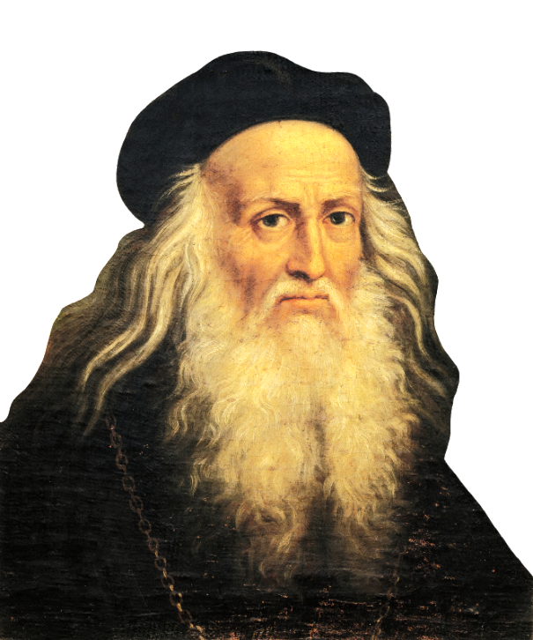
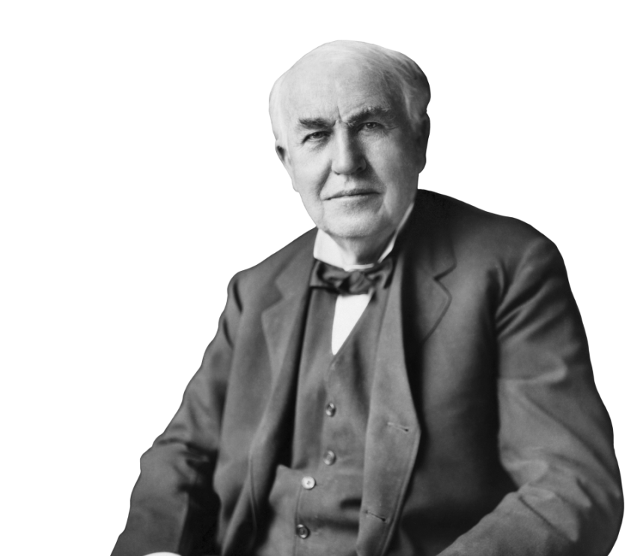

Who are
Inventors?
Notes:
Lesson 1: Who Are Inventors?

Slide 4
Who are
Inventors?
Notes:
(animated transition)

Slide 5
Question:
How would you describe an inventor?
Notes:
Discussion Question 1

Slide 6
Question:
Do you think you could become
an inventor?
Notes:
Discussion Question 2

Slide 7


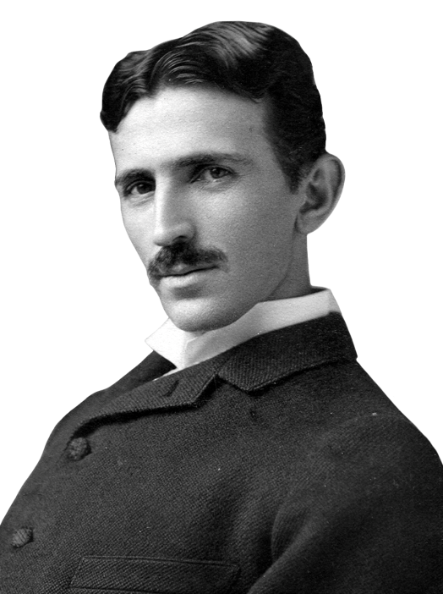
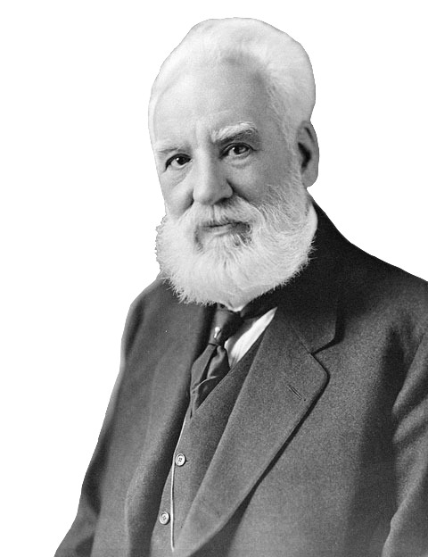
But Inventors Are Old!
Right?
Notes:
Possible Preconceptions:
All inventors are adults.
Inventors are a thing of the past.

Slide 8
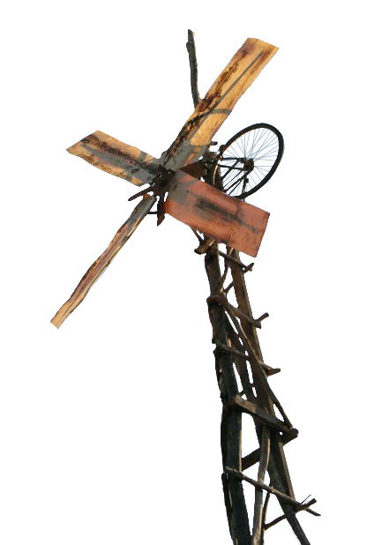
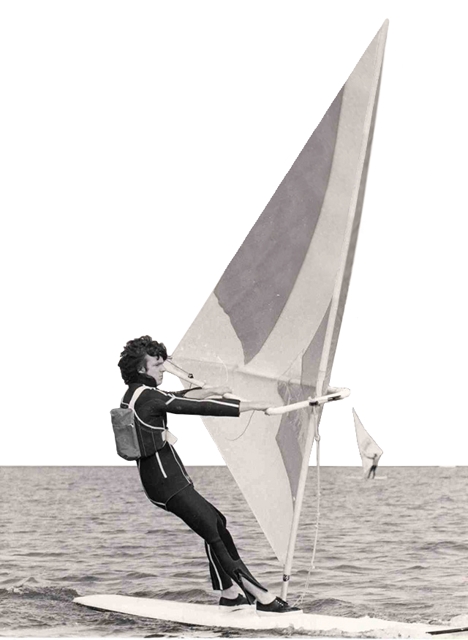
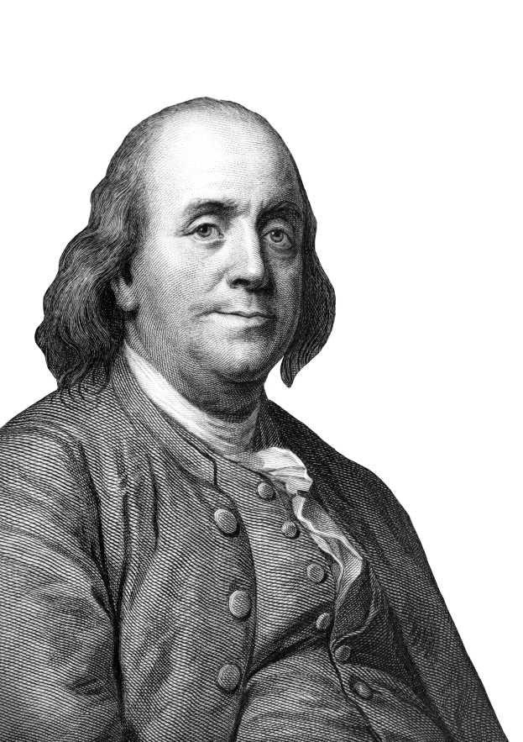
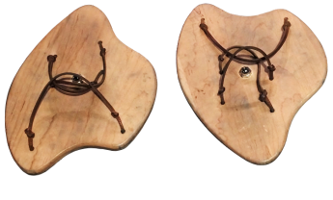
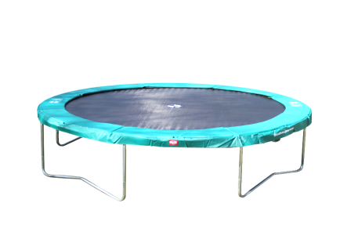
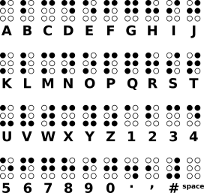

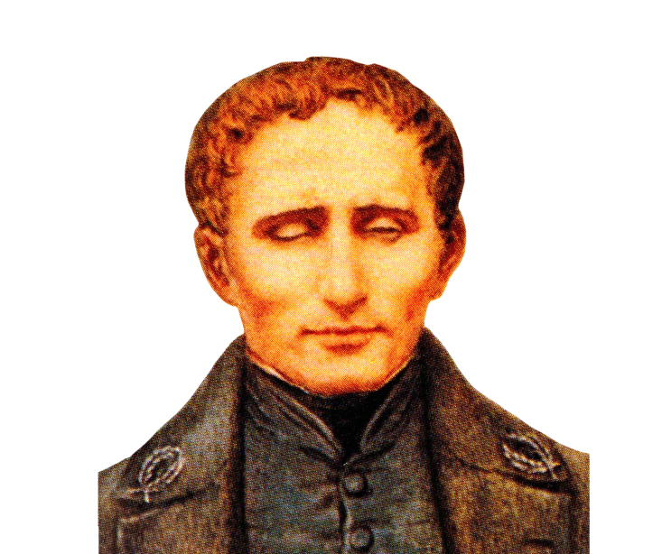

Young Inventors
12
14
16
11
12
Notes:
Inventors can be YOUNG too! (examples – ages shown)
Benjamin Franklin (11 years old) – Swim Fins (1717) – handheld wooden paddles to swim faster
Louis Braille (12 – 15 years old) – Braille Alphabet (1824) – alphabet for blind people
Peter Chilvers (12 years old) – Windsurfing Sailboard (1958) – a surfboard with sail attached
William Kamkwamba (14 years old) – Makeshift Windmill (2001) – recreated a windmill to power his family home
George Nissen (16 years old) – Trampoline (1930) – fun athletic equipment for gymnasts

Slide 9
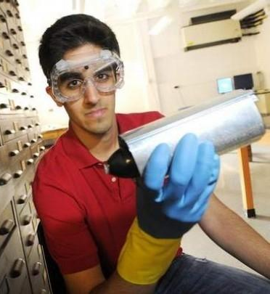
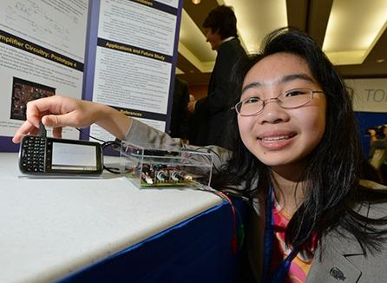

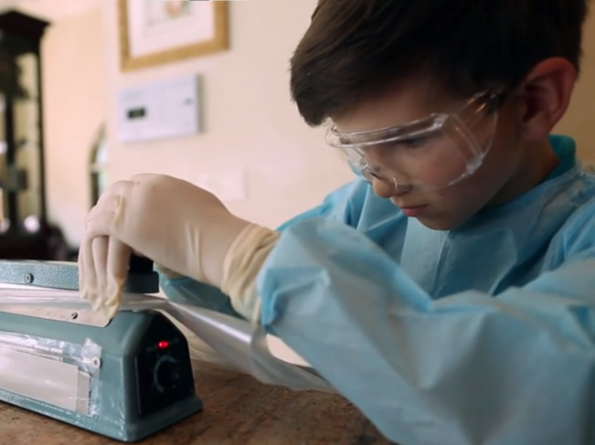

Young Inventors
8
17
16
9
10
Notes:
Young Inventors: (modern examples – ages shown)
Kids and teens of all ages can be inventors!
Examples taken from activity (next slide)

Slide 10
Young Inventors
Choose an Inventor
Name?
Age?
Problem?
Solution?
Favorite part?
8
17
16
9
10
Notes:
Suggested Activity: Young Inventors
Print activity sheets, provide websites, or direct students to other lists of inventors.
Let each student/group choose 1-2 inventors.
Students should identify the inventor’s name, age, problem, solution, and favorite thing about the inventor/invention.
Students can share with the class, in groups, or in a written response.
Handout available on our website: (Activities section in Teacher Resources)
https://www.andrews.edu/cas/stem/invent/downloads/young-inventors-activity_6-8.pdf

Slide 11


Invention Project
Team Project
Choose a problem
Invent a solution
Build the invention
Presentation
Tri-fold presentation board
Present to judges
Notes:
Invention Project Overview:
Major components
Goals & expectations
Local invention fair

Slide 12
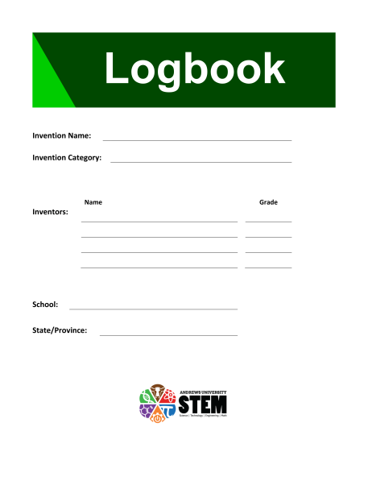
Logbook
Instructions & Tips
Document your work
A record if you decide to patent the invention
Fill out during the project
1 Logbook per team
Notes:
Introduce the Logbook:
Explain its purpose and use
Fill out over time, not all at once
Give each team 1 Logbook
Logbook available on our website: (Project Resources section in Teacher Resources)
https://www.andrews.edu/cas/stem/invent/downloads/logbook_6-8.pdf

Slide 13


Teams
3-4 Students per team
Same members for the entire project
Notes:
Form Teams for the Project:
3-4 Students per team
Smaller classes may need a team of 2

Slide 14
Schedule
Mar 10 Choose a Problem
Mar 24 Choose a Solution
- Design, Build, Test, & Improve
May 6 Finalize Invention
May 8 Invention Fair (presentations)
Notes:
Example Project Schedule:
Adjust the deadlines to match your schedule

Slide 15
Mission: Invent
Date: July 11, 2022
Where: Andrews University, Michigan
Who: NAD K-12 Students
What: Showcase Inventions
Awards Ceremony
Engage with other students
Notes:
Introduce Mission: Invent 2022
Annual NAD-wide invention fair
Top inventions from each school are eligible to enter

Slide 16

Hold up!
Hold up!
What if I don’t
want to become
an inventor?
What if I don’t
want to become
an inventor?
Why does it even matter?
Notes:
Question:
What if someone doesn’t want to be an inventor?
Why does this project matter?
(answered on next slide)

Slide 17
Inventors are simply
Problem Solvers…
and
Everyone is a Problem Solver!
Notes:
This project is important because it teaches students to be problem solvers. Everyone needs to solve problems of some kind, whether professionally or privately. This project emphasizes STEM and teaches problem solving in this context, but the skills can be extended to every area of life.

Slide 18
Problem Solvers
Inventors
Scientists
Engineers
Business People
Construction Workers
Police Officers
Farmers
Doctors
Athletes
Artists
Chefs
Parents
Students
Everyone!
Notes:
Everyone is a Problem Solver!

Slide 19
Assignment (due Mar 10)
Look for problems to solve:
Each student must find at least
5 problems to share next time
Look around your home, school,
community, etc.
Talk to friends and relatives
Notice things that are challenging
Notes:
Assignment: (due next class – adjust date accordingly)
Each team will need to choose a problem by the end of next class. To prepare for this, students need to find problems to share with their team.
Read the Logbook for more information (pg. 7).
Worksheet available on our website: (Project Resources section in Teacher Resources)
https://www.andrews.edu/cas/stem/invent/downloads/logbook_6-8_problem.pdf

Slide 20
Invention
Project
Notes:
End Title Slide (opening animation)

Slide 21
Invention
Project
Notes:
End Title Slide (closing animation)

