Slide 1







Invention
Project
Notes:
Invention Project
PowerPoint Lesson Slides
Created by Michael Bryson
www.andrews.edu/go/invent
Andrews University STEM Division
January 2022
Note:
Some slides in the PowerPoint have text or images that appear out of place until full-screen playback. This is because some elements are animated and will not appear in the right place until the slide is played. There are also some animated transitions that require an extra slide to animate properly.

Slide 2





Invention
Project
Notes:
(animated transition)

Slide 3


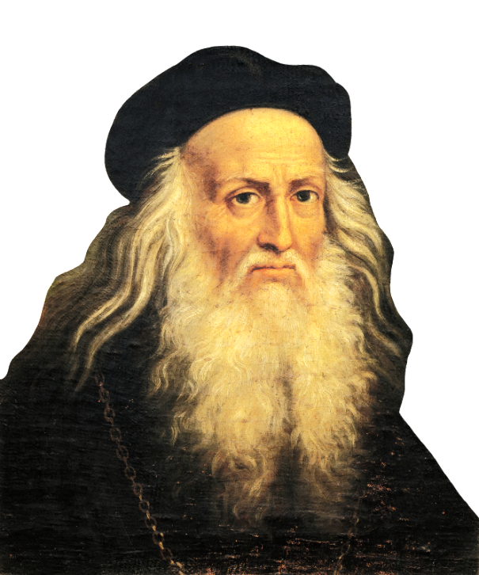
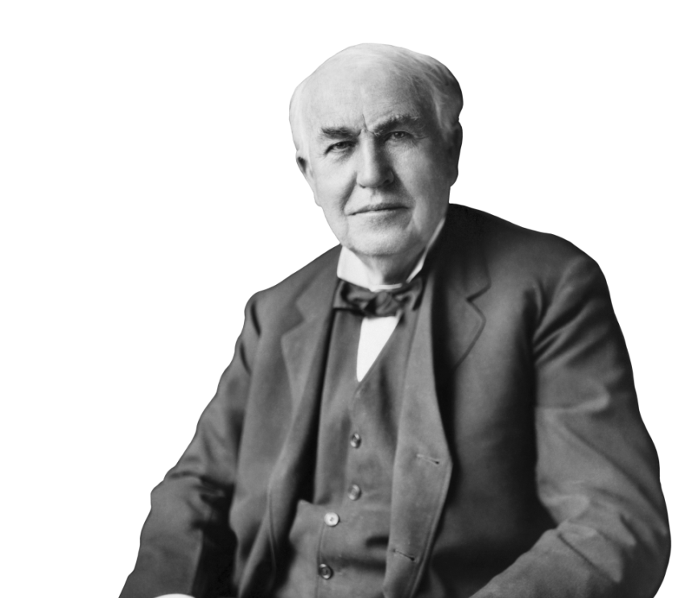

Who are
Inventors?
Notes:
Lesson 1: Who Are Inventors?

Slide 4
Who are
Inventors?
Notes:
(animated transition)

Slide 5
Question:
How would you describe an inventor?
Notes:
Discussion Question 1

Slide 6
Question:
Do you think you could become
an inventor?
Notes:
Discussion Question 2

Slide 7


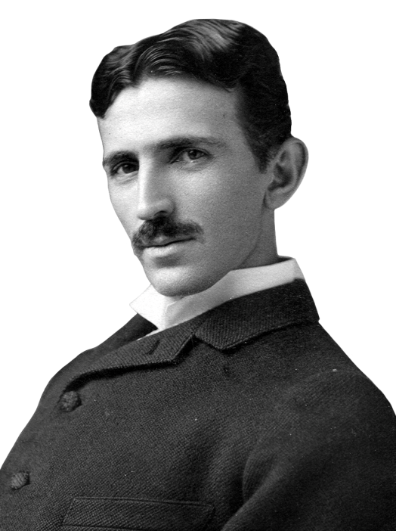
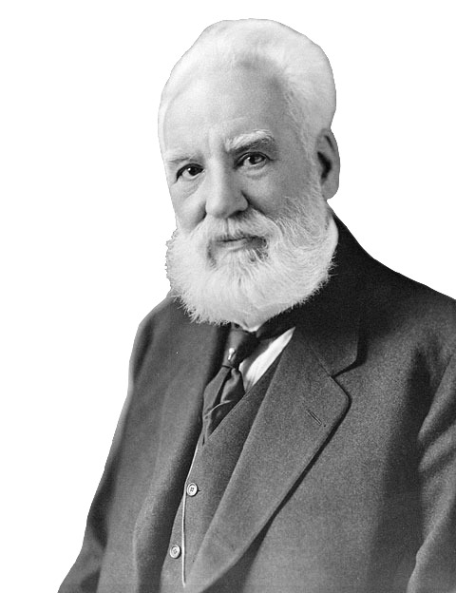
But Inventors Are Old!
Right?
Notes:
Possible Preconceptions:
All inventors are adults.
Inventors are a thing of the past.

Slide 8
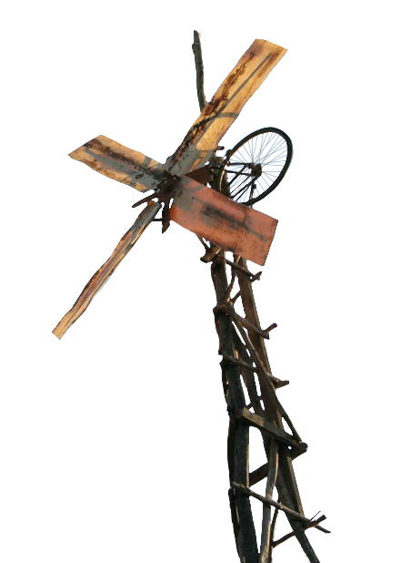
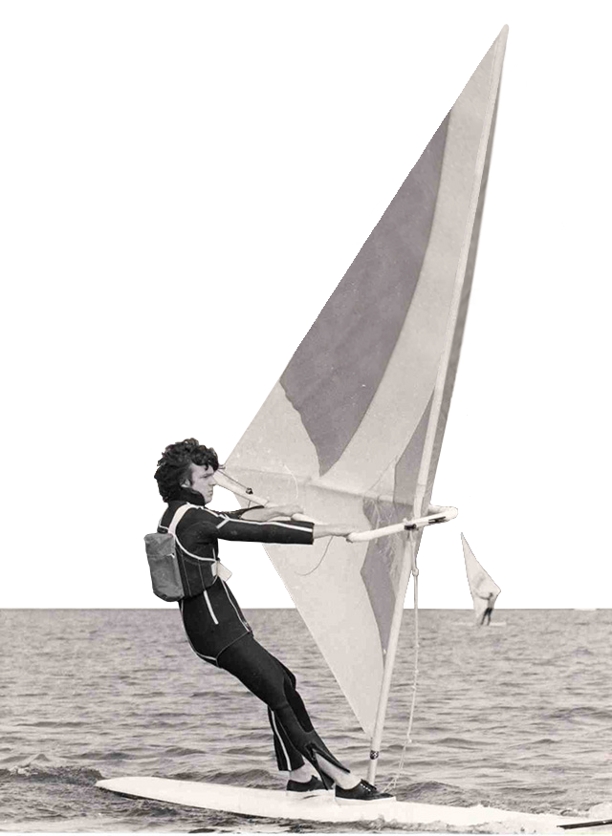
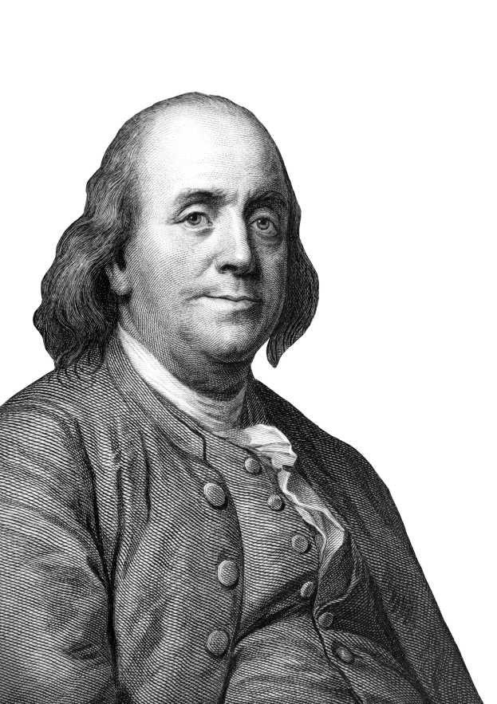
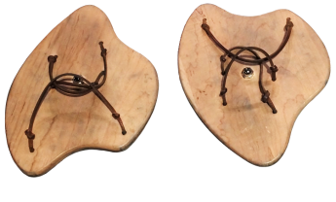
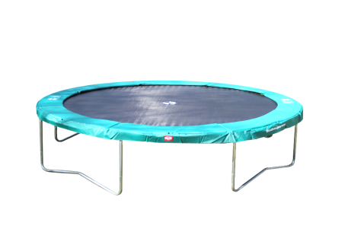
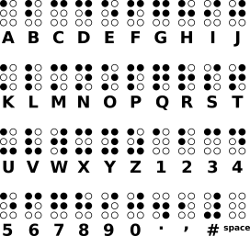

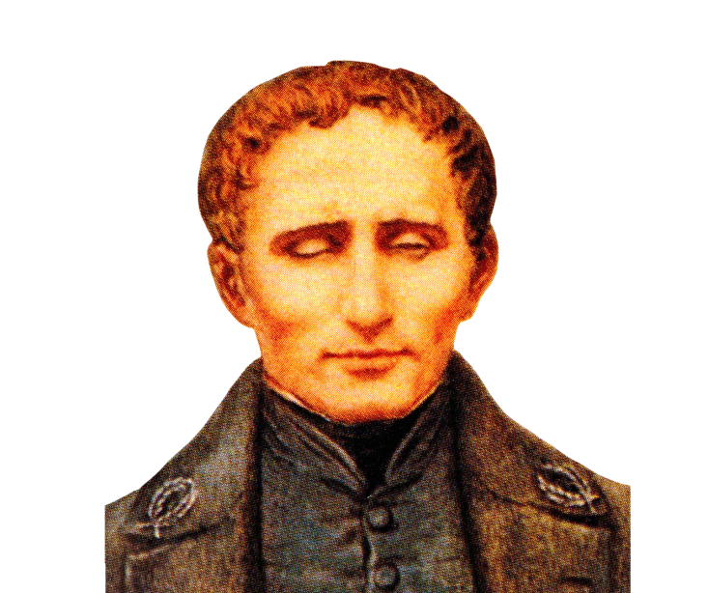
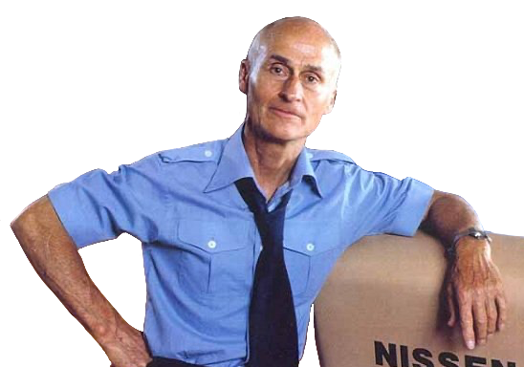
Young Inventors
12
14
16
11
12
Notes:
Inventors can be YOUNG too! (examples – ages shown)
Benjamin Franklin (11 years old) – Swim Fins (1717) – handheld wooden paddles to swim faster
Louis Braille (12 – 15 years old) – Braille Alphabet (1824) – alphabet for blind people
Peter Chilvers (12 years old) – Windsurfing Sailboard (1958) – a surfboard with sail attached
William Kamkwamba (14 years old) – Makeshift Windmill (2001) – recreated a windmill to power his family home
George Nissen (16 years old) – Trampoline (1930) – fun athletic equipment for gymnasts

Slide 9
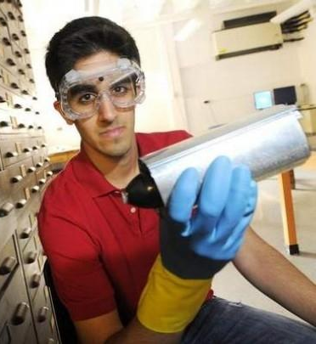
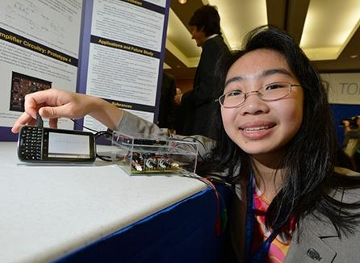
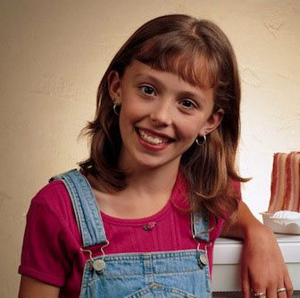
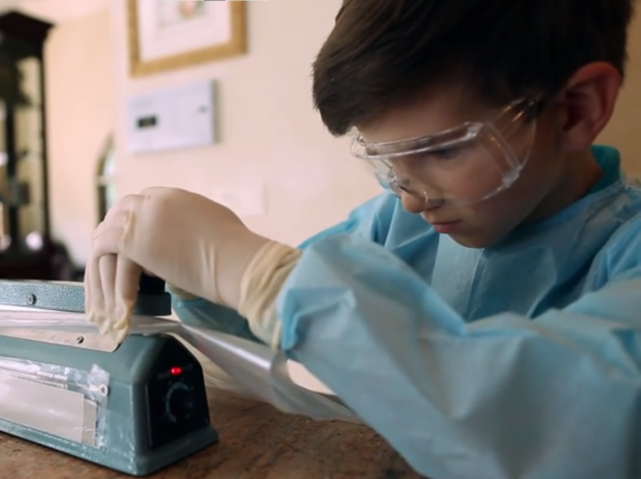
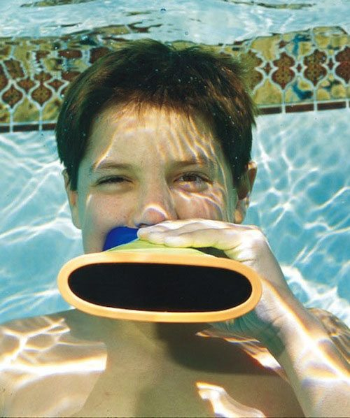
Young Inventors
8
17
16
9
10
Notes:
Young Inventors: (modern examples – ages shown)
Kids and teens of all ages can be inventors!
Examples taken from activity (next slide)

Slide 10
Young Inventors
Choose an Inventor
Name?
Age?
Problem?
Solution?
Favorite part?
8
17
16
9
10
Notes:
Suggested Activity: Young Inventors
Print activity sheets, browse provided websites, or find other lists of young inventors.
Choose several young inventors (as a class, in small groups, or individually).
Identify the inventor’s name, age, problem, solution, and your favorite thing about the inventor/invention.
Talk about the inventors together as a class or extend it into an art prompt, craft, or other hands-on activity.
Handout available on our website: (Activities section in Teacher Resources)
https://www.andrews.edu/cas/stem/invent/downloads/young-inventors-activity_k-2.pdf

Slide 11

Can everyone be an inventor?
Wait!
Wait!
Notes:
Question:
Can everyone be an inventor?
(answered on next slide)

Slide 12


… because
Everyone is a Problem-Solver!
Wait!
YES!
YES!
Can everyone be an inventor?
Notes:
Answer:
Everyone can be an inventor because everyone is a problem-solver!

Slide 13
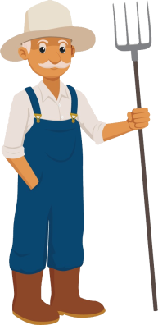













Problem Solvers
Notes:
Everyone is a Problem Solver!
Inventors
Scientists
Engineers
Business People
Construction Workers
Police Officers
Farmers
Doctors
Athletes
Artists
Chefs
Parents
Students
Everyone

Slide 14
Assignment (due Mar 10)
Look for problems to solve:
Find at least 2 problems to share next time
Look around your home, school,
community, etc.
Talk to friends and relatives
Notice things that are challenging
Notes:
Assignment: (due next class – adjust date accordingly)
Each team will need to choose a problem by the end of next class. To prepare for this, students need to find problems to share with everyone.
Read the Logbook for more information (pg. 6).
Worksheets available on our website: (Project Resources section in Teacher Resources)
https://www.andrews.edu/cas/stem/invent/downloads/logbook_k_problem.pdf
https://www.andrews.edu/cas/stem/invent/downloads/logbook_1-2_problem.pdf

Slide 15
Invention
Project
Notes:
End Title Slide (opening animation)

Slide 16
Invention
Project
Notes:
End Title Slide (closing animation)

