Slide 1







Invention
Project
Notes:
Invention Project
PowerPoint Lesson Slides
Created by Michael Bryson
www.andrews.edu/go/invent
Andrews University STEM Division
January 2022
Note:
Some slides in the PowerPoint have text or images that appear out of place until full-screen playback. This is because some elements are animated and will not appear in the right place until the slide is played. There are also some animated transitions that require an extra slide to animate properly.

Slide 2





Invention
Project
Notes:
(animated transition)

Slide 3

What is
Engineering?
Notes:
Lesson 3: What Is Engineering?

Slide 4
What is
Engineering?
Notes:
(animated transition)

Slide 5
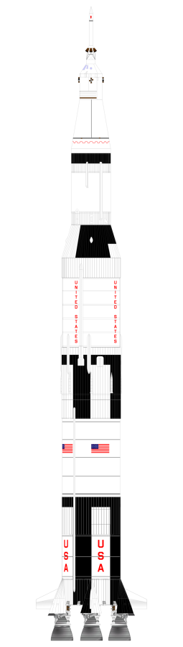









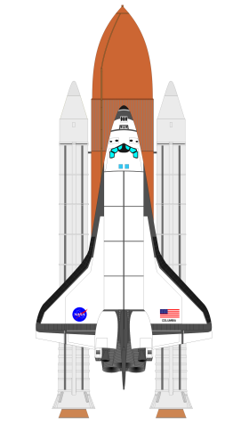



What do Engineers do?
Design
Things
Notes:
What do Engineers do?
Engineers design things to solve problems – computers, bridges, rockets, toasters, drink cups, and more.

Slide 6







What do Engineers do?
Engineering Design Process
Design
Things
Notes:
(animated transition)

Slide 7
Engineering Design Process
Problem
Research
Requirements
Solution
Prototype
Testing
Communicate
Notes:
How do engineers solve problems?
They follow the engineering design process. These systematic steps allow them to design solutions to real-world problems.
This process will help students create an invention to solve their team’s problem.
Briefly explain each step (next slide)

Slide 8

Engineering Design Process
Problem
Step 1: Problem
Observe the problems around you and choose one to solve. Then define the important
aspects of the problem.
Research
Requirements
Solution
Prototype
Testing
Communicate
Notes:
Step 1: Problem
Find a problem by observing the world around you.
Define (describe) the problem in detail.

Slide 9

Engineering Design Process
Problem
Step 1: Problem
Observe the problems around you and choose one to solve. Then define the important
aspects of the problem.
Step 2: Research
Research who/what is affected by the problem, existing solutions/inventions, and areas
for improvement.
Research
Requirements
Solution
Prototype
Testing
Communicate
Notes:
Step 2: Research
Learn more about the problem and other potential solutions.

Slide 10

Engineering Design Process
Problem
Step 2: Research
Research who/what is affected by the problem, existing solutions/inventions, and areas
for improvement.
Research
Step 3: Requirements
List the specific requirements for your solution. The design is successful when it has met
these requirements.
Requirements
Solution
Prototype
Testing
Communicate
Notes:
Step 3: Requirements
List the requirements for your solution, but don’t choose a solution yet. These are the things you will have to address to solve the problem.

Slide 11

Engineering Design Process
Problem
Research
Step 3: Requirements
List the specific requirements for your solution. The design is successful when it has met
these requirements.
Requirements
Step 4: Solution
Brainstorm and discuss to find original ideas. Compare with the requirements to choose
the best solution.
Solution
Prototype
Testing
Communicate
Notes:
Step 4: Solution
Consider any and all possible solutions. Compare these solutions to the requirements and pick the one with the best chance of success.

Slide 12

Engineering Design Process
Problem
Research
Requirements
Step 4: Solution
Brainstorm and discuss to find original ideas. Compare with the requirements to choose
the best solution.
Solution
Step 5: Prototype
Design how your invention will work and
what it will look like. Then follow the design
and build it.
Prototype
Testing
Communicate
Notes:
Step 5: Prototype
Design and build a prototype (model) of the solution you chose.

Slide 13

Engineering Design Process
Problem
Research
Requirements
Solution
Step 5: Prototype
Determine how your invention will work and
what it will look like. Then follow the design
and build it.
Step 6: Testing
Test to see if the prototype works as planned and meets the requirements.
Step 6: Testing & Iteration
Test to see if the prototype works as planned and meets the requirements. Repeat previous steps until it does.
Prototype
Testing
Communicate
Notes:
Step 6: Testing (& Iteration)
Test the prototype to see how well it works. Return to previous steps and make improvements as necessary (iteration).

Slide 14

Engineering Design Process
Problem
Research
Requirements
Solution
Step 6: Testing & Iteration
Test to see if the prototype works as planned and meets the requirements. Repeat previous
steps until it does.
Step 7: Communicate
Present and explain your problem,
the research, the process you followed,
and the invention you created.
Prototype
Testing
Communicate
Notes:
Step 7: Communicate
Tell others what you accomplished. Show them the final result and explain the steps you took.

Slide 15
Engineering Design Process
Problem
Research
Requirements
Solution
Step 7: Communicate
Present and explain your problem,
the research, the process you followed,
and the invention you created.
Prototype
Testing
Communicate
Notes:
(animated transition)

Slide 16
Example Problem
Problem
Find a Problem:
Choose a simple problem to practice solving as a class.
Research
Requirements
Solution
Prototype
Testing
Communicate
Notes:
Example Problem:
This activity should be completed together as a class. Let the students think for themselves and discuss together as you guide the process. This is an opportunity for them to practice the engineering design process before doing it with their own problem. You will not be doing the entire design process with this example (only the first 4 steps). As you progress through the example, write and draw on the board.
Find a Problem:
Choose a simple example to solve with the class.
You can find Example Problems on our website (Activities section in Teacher Resources) or choose your own.
https://www.andrews.edu/cas/stem/invent/downloads/example-problems_6-8.pdf

Slide 17
Example Problem
Problem
Define the Problem:
List the important aspects of the problem.
Imagine you are describing the problem to someone who knows nothing about it.
Tell them everything!
Research
Requirements
Solution
Prototype
Testing
Communicate
Notes:
Define the Problem:
Describe the problem in detail.
List anything that might be important to know when looking for a solution.

Slide 18
Example Problem
Problem
Research the Problem:
Who or what is affected
by this problem?
Are there existing solutions or inventions?
Are there things you can improve?
Research
Requirements
Solution
Prototype
Testing
Communicate
Notes:
Research the Problem:
Consider the questions for the chosen problem.
To save time, this step can be simplified or skipped for the example.
Students will go more in depth when doing it for their own problem.

Slide 19
Example Problem
Problem
List Solution Requirements:
Criteria & Constraints
Safety, size, weight, strength, time, cost, etc.
Be specific
Don’t choose a solution yet.
Research
Requirements
Solution
Prototype
Testing
Communicate
Notes:
List Solution Requirements:
Write the requirements on the board.
Criteria – things the solution must meet or do
Constraints – things the solution must not do (limitations or restrictions for the design)
Consider the requirements for the solution without choosing a specific solution yet.
The requirements will be the checklist for the invention.

Slide 20
Example Problem
Problem
Find Solutions:
Brainstorm as many ideas
as possible.
Write or draw every idea.
There are no bad ideas!
Research
Requirements
Solution
Prototype
Testing
Communicate
Notes:
Find Solutions:
Write/draw the solutions on the board.
Let students think of and draw solutions on their own or in groups.
Have the students share with the class.
Think of as many ideas as possible.
Even bad ideas may spark an idea in someone else.
Consider solutions you can make.

Slide 21
Example Problem
Problem
Choose the Best Solution:
Share, discuss, compare,
and revise ideas.
Does the solution meet the requirements?
Is it original or innovative?
Research
Requirements
Solution
Prototype
Testing
Communicate
Notes:
Choose the Best Solution:
Discuss as a class or in small groups.
Choose the solution that best meets the requirements.
The solution should be original or innovative (improve on existing inventions).

Slide 22
Example Problem
Problem
Remaining Steps:
Design and build a prototype.
Test the prototype and
make improvements.
Show and tell others.
Research
Requirements
Solution
Prototype
Testing
Communicate
Notes:
Remaining Steps:
When students do this with their own project, they will then design, build, test, and improve their solution.
At the end, they will prepare a presentation.

Slide 23
Next Class
Collaborate with your team to…
Define the problem
Research the problem
Notes:
Starting next time, the students will work on the project in their teams. They will follow the engineering design process and document their progress in the Logbook (available on our website, Project Resources section in Teacher Resources).

Slide 24
Invention
Project
Notes:
End Title Slide (opening animation)

Slide 25
Invention
Project
Notes:
End Title Slide (closing animation)

