Slide 1
Invention
Project
Notes:
Invention Project
PowerPoint Lesson Slides
Created by Michael Bryson
www.andrews.edu/go/invent
Andrews University STEM Division
January 2022

Slide 2
Goals for Today
Collaborate with your team to…
Define the problem
Research the problem
Notes:
Project: Define & Research the Problem
Read the Logbook for more information (pg. 7-9).
(may need to finish research next time)

Slide 3
Requirements
What makes a good requirement?
Criteria – What does the solution need to do?
Constraints – What must the solution not do?
Describe the conditions where it should work
Detailed (How will you know you’ve met it?)
Do not say how it will be solved
Notes:
Project: Requirements
What makes a good requirement?
Criteria – things the solution must meet or do
Constraints – things the solution must not do (limitations or restrictions for the design)
Consider the requirements for the solution without choosing a specific solution yet.
The requirements will be the checklist for the invention.
Read the Logbook for more information (pg. 10).

Slide 4
Goals for Today
Collaborate with your team to…
Finish research
List solution requirements
Notes:
Project: Requirements
Show the previous slide and read the Logbook for more information (pg. 10).

Slide 5
Goals for Today
Collaborate with your team to…
Brainstorm solutions
Compare solutions
Research originality
Choose the best solution
Notes:
Project: Find & Choose a Solution
Read the Logbook for more information (pg. 11-13).
(this step may require extra time)

Slide 6
Goals for Today
Collaborate with your team to…
Create invention design
Build the prototype
Notes:
Project: Design & Build the Prototype
Read the Logbook for more information (pg. 14-16).
(this step may require several days)

Slide 7
Goals for Today
Collaborate with your team to…
Continue/finish building the prototype
Test the prototype
Notes:
Project: Test the Prototype
Read the Logbook for more information (pg. 17-18).
(this step may require several days)

Slide 8
Goals for Today
Collaborate with your team to…
Improve the prototype
Run new tests
Finalize the prototype
Notes:
Project: Improvement
Read the Logbook for more information (pg. 14-18).
(this step may require several days)

Slide 9
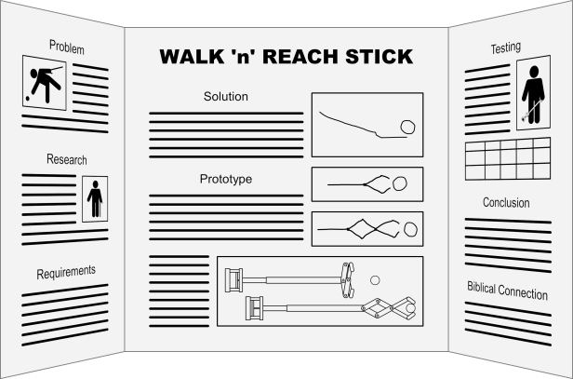
Goals for Today
Collaborate with your team to…
Write Logbook conclusion
Prepare for presentation
Notes:
Project: Wrap-Up
Read the Logbook (pg. 19-20) and the Presentation Guidelines (available on our website, Presentation Resources section in Teacher Resources) for more information.
(additional resources available in the Presentation Resources section)

