Slide 1







Invention
Project
Notes:
Invention Project
PowerPoint Lesson Slides
Created by Michael Bryson
www.andrews.edu/go/invent
Andrews University STEM Division
January 2022

Slide 2
Goals for Today
Work with your team to…
Research the problem
Notes:
Project: Research the Problem
Read the Logbook for more information (pg. 7).

Slide 3
Requirements
What are requirements?
What does the solution need to do?
What must the solution not do?
Safety, size, weight, strength, time, cost, etc.
Do not say how it will be solved
Notes:
Project: Requirements
What are requirements?
What things must the solution meet or do?
What must the solution not do (limitations or restrictions for the design)?
Consider the requirements for the solution without choosing a specific solution yet.
The requirements will be the checklist for the invention.
Read the Logbook for more information (pg. 8).

Slide 4
Goals for Today
Work with your team to…
List solution requirements
Notes:
Project: Requirements
Show the previous slide and read the Logbook for more information (pg. 8).

Slide 5
Goals for Today
Work with your team to…
Draw solution ideas
Share and compare ideas
Choose the best solution
Notes:
Project: Find & Choose a Solution
Read the Logbook for more information (pg. 9).
(this step may require extra time)

Slide 6
Goals for Today
Work with your team to…
Draw and describe invention design
Build the prototype
Notes:
Project: Design & Build the Prototype
Read the Logbook for more information (pg. 10-11).
(this step may require several days)

Slide 7
Goals for Today
Work with your team to…
Continue/finish building the prototype
Test the prototype
Notes:
Project: Test the Prototype
Read the Logbook for more information (pg. 12).
(this step may require several days)

Slide 8
Goals for Today
Work with your team to…
Improve the prototype
Run new tests
Finish the prototype
Notes:
Project: Improvement
Read the Logbook for more information (pg. 10-12).
(this step may require several days)

Slide 9
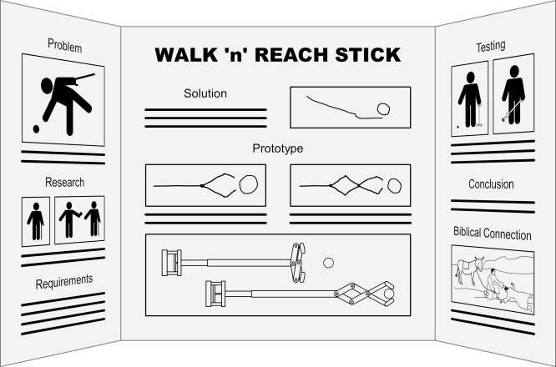
Goals for Today
Work with your team to…
Prepare for presentation
Notes:
Project: Wrap-Up
Read the Logbook (pg. 13) and the Presentation Guidelines (available on our website, Presentation Resources section in Teacher Resources) for more information.
(additional resources available in the Presentation Resources section)

