Slide 1


COGNITIVEGENESIS: FACTORS RELATED TO GOOD ACHIEVEMENT. WHAT NEXT?
Elissa Kido, Ed.D.
Principals’ Webinar
Monday, June 18, 2012

Slide 2
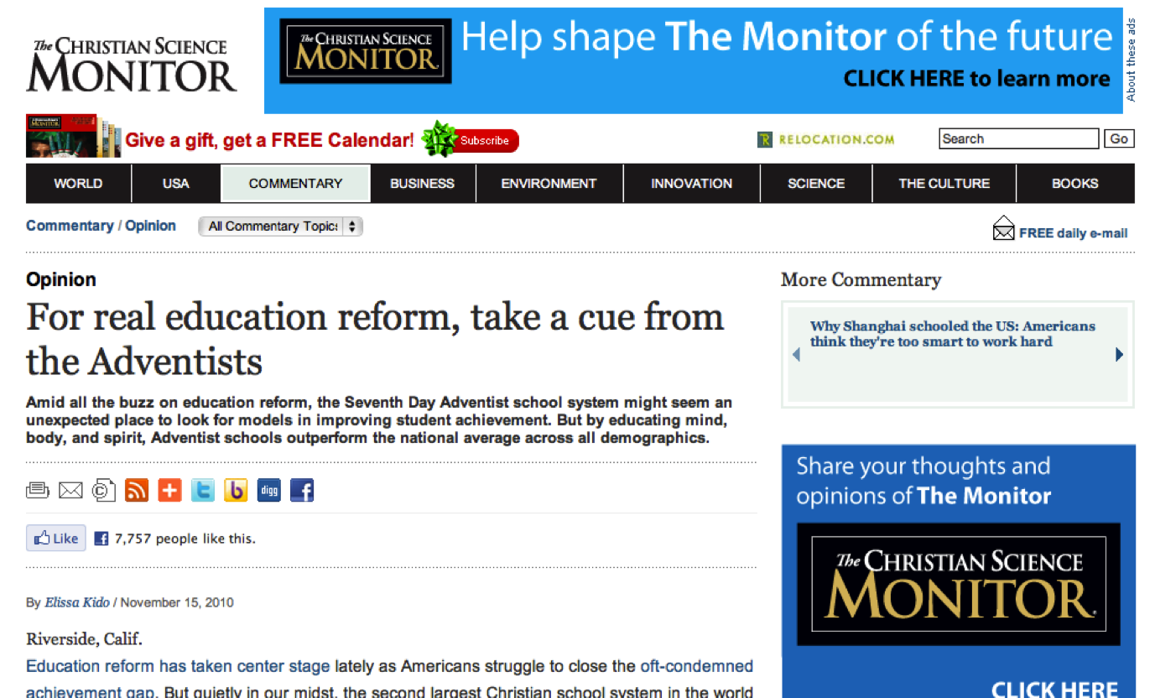
NATIONAL MEDIA ATTENTION

Slide 3

Teach the Children Well
A documentary film for PBS television that explores the extraordinary story of Adventist Education from the producers of The Adventists.
20 million plus viewers
2013 scheduled release

Slide 4
WHY?
Why is Adventist education receiving national media attention?
Why does a documentary filmmaker (not an Adventist) want to make a film about Adventist schools to show on television (with at least 20 million viewers)?

Slide 5
ANSWER: COGNITIVEGENESIS
What is CognitiveGenesis?
A 4-year research study of students in Adventist schools in the North American Division (NAD). It included:
800+ Schools in United States, Canada, Bermuda (NAD)
51,706 Students in grades 3 – 9 and 11
Parents of the students participating
Teachers and Principals at the participating schools

Slide 6


How are students doing?
  Achievement
  Ability
What factors
may contribute to their achievement?

Slide 7
CognitiveGenesis
Project Design
Student
Survey
Ability
Measured
by CogAT
(Controlled for)
Prediction of Achievement
Parent
Survey
Achievement in
SDA Schools
ITBS/ITED
Effects of variables
Teacher
Survey
School
Survey
Achievement in
All Schools
(National Norms)
Comparison of Achievement
Notes:
The four survey groups (students, parents, teachers, school/administrator) are seen in the left column. Their surveys were used to measure how achievement and ability are related to these four factors.
The primary focus of CognitiveGenesis was to look at achievement in SDA schools (the purple blue box at the right) as an outcome variable as it related to achievement in all schools in the national norm (the gold box at the bottom).
In addition, ability was used as a control variable in the study. That is, the ability would not change as a variable in the study.
A secondary focus was to look at ability of students in SDA schools as an outcome variable. This information would predict the level of achievement for SDA school students (light red box at top).

Slide 8

UNITED STATES
DESCRIPTIVE RESULTS

Slide 9
TEST RESULTS
  Achievement of students in SDA Schools is:
Above the national average
  in all subjects (science being one of the highest)
  for all grade levels
Above predicted/expected achievement
  in all subjects
  for all grade levels
  for all school sizes
  regardless of ability level

Slide 10
SCIENCE ACHIEVEMENT
Summary
Above average in science in every grade
Higher in science than would be predicted by ability scores
Above average for all sub-areas of science
Highest sub-area is Scientific Inquiry
Higher science the more years in Adventist schools

Slide 11
SCHOOL SIZE
Small differences between smaller and larger schools in both achievement and ability.
However, differences are consistently in favor of smaller schools.

Slide 12
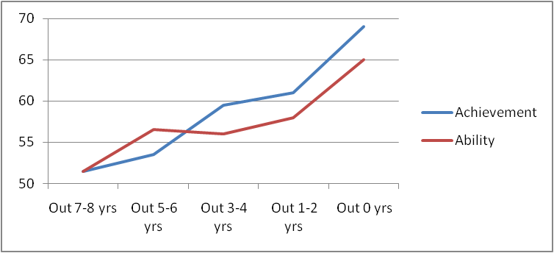
YEARS IN ADVENTIST SCHOOLS
0 1-2 3-4 5-6 7-8
Years in the Adventist School System
Notes:
One of the most dramatic findings: The more years a student attended an Adventist school, the more his/her performance improved. Students with more years in our schools scored higher in achievement and ability than those with fewer years. Students who transferred to Adventist schools saw a marked improvement in academic achievement.
Students enrolled for more years in Adventist schools scored higher in both achievement and ability.

Slide 13

ADVENTIST
SCHOOL EFFECT
Change in Achievement and Ability
over 1 and 3 years for Continuing Students

Slide 14
ONE-YEAR CHANGE
Median Percentile Rank
Continuing Students–35,698/41,552 student records (3 groups)
Achievement
Ability
Year 1 Grade | Year 1 | Year 2 Same students 1 year later | Difference
3-7 | 62 | 63 | +1
3 | 62 | 65 | +3
4 | 64 | 63 | -1
5 | 62 | 61 | -1
6 | 59 | 63 | +4
7 | 63 | 65 | +2
8 |  | Different test in 9th grade
Year 1 Grade | Year 1 | Year 2 Same students 1 year later | Difference
3-8 | 57 | 62 | +5
3 | 48 | 57 | +9
4 | 55 | 60 | +5
5 | 57 | 62 | +5
6 | 57 | 62 | +5
7 | 60 | 65 | +5
8 | 65 | 67 | +2
Notes:
The previous results were for all students in our schools, including new students.
To evaluate our system, it is more important to look at the change in achievement from one year to the next for the same students.
35,698 student records for achievement and 41,552 student records for ability from 2006-7, 2007-8, and 2008-9.
If our system is doing its job as well as the national norm group in the objectives measured by the Iowa tests, we would expect our percentile scores (our position in relation to the norm group) to remain constant. If students were at the 60th percentile one year, we would expect the same students to be at the 60th percentile the following year (or perhaps slightly lower due to regression to the mean).
We see that for achievement during the elementary years, our scores basically stayed the same over one year, maintaining the same degree of higher achievement compared to the norm group.
There were gains more than expected in grades 3, 6, and 7, and gains less than expected in grades 4 and 5. Here again, we would need to look at how our curriculum aligns with the tests. We would also want to expand this to look at the differences for each subject area.
Also since results based on medians and percentile ranks are not as precise as results based on means and standard scores, we should not make much of small differences here (e.g., +1 difference).
No results are presented for achievement because 8th graders took ITBS in grade 8 and ITED in grade 9 – the tests are not directly comparable (different content and different norm groups – ITED has older norms).
In ability there was a definite gain over one year. The one-year changes were positive in all grades – grade 3 the largest, and grade 8 the smallest. You would expect ability to change less with older students. Part of this may be due to practice effect.

Slide 15
THREE-YEAR CHANGE
Median Percentile Rank
Continuing Students – 4,822 / 7,755 students
Achievement
Ability
Year 1 Grade | Year 1 | Year 4 Same students 3 years later | Difference
3-5 | 65 | 68 | +3
3 | 66 | 66 | 0
4 | 65 | 68 | +3
5 | 64 | 68 | +4
6 |  | Different test in 9th grade
7 |  | No testing done in 10th grade
8 |  | Different test in 11th grade
Year 1 Grade | Year 1 | Year 4 Same students 3 years later | Difference
3-8 | 57 | 69 | +12
3 | 50 | 69 | +19
4 | 55 | 69 | +14
5 | 57 | 69 | +12
6 | 57 | 69 | +12
7 |  | No testing done In 10th grade
8 | 65 | 71 | +6

Slide 16
Students Tested
All Four Years
Change in Median ABILITY
from 2006 to 2009
Composite +12 percentile points
Subtotals: +7 to +13 percentile points
    Verbal
    Quantitative
    Nonverbal
Notes:
Looking at change in ability for students tested all four years, we see a strong increase in all areas.

Slide 17
THREE-YEAR CHANGE
By ABILITY Level (Grades 3-11)
Students Attending an Adventist School All 4 Years
 | 2009 Ability NPRank
2006 Ability NPRank | 1-25 | 26-50 | 51-75 | 76-99 | Total that Moved to Higher Quartile
1-25 | 36% | 48% | 13% | 3% | 64%
26-50 | 5% | 41% | 44% | 9% | 53%
51-75 | 1% | 8% | 48% | 43% | 43%
76-99 | 0% | 0% | 8% | 92%
Notes:
Results for ability were even more striking than for achievement.
64% (48%+13%+3%) of students in the bottom quartile of ability (NPRank 1-25) moved up to a higher quartile in achievement 3 years later.
53% (44%+9%) of students in the 2nd quartile moved up.
43% of students in the 3rd quartile moved up.
8% of students in the top quartile moved down (much could be explained by regression to the mean).
Comparing the top and bottom quartiles, 64% of the bottom moved up and 8% of the top moved down.

Slide 18
INCREASE IN ABILITY
Increase in ability is greater than
increase in achievement.
“It is the work of true education to . . . train the youth to be thinkers [ability]
and not
mere reflectors of other people’s thoughts [achievement].
- Education, 17

Slide 19

FACTORS RELATED TO GOOD ACHIEVEMENT

Slide 20
STUDENT MODELS
GRADES 3-8
Students can be expected to have higher achievement when they exhibit the following traits:
Spend appropriate time after school in “positive” activities
  read things not required for school
  doing family chores
Spend less time after school in “detracting” activities
  watching TV
  listening to music
  talking with friends
  Try to do their best in school
  are diligent in their homework

Slide 21
STUDENT MODELS
GRADES 3-8
Have a healthy relationship with their parents
  interact with their parents each day
  talk frequently with their parents
Have positive friends
  friends are interested in spiritual things
  friends are interested in getting good grades
Have a positive spiritual outlook
Take care of their health
  have a good diet

Slide 22
HOME-PARENT MODELS
GRADES 3-8
Students can be expected to have higher achievement when their home or parents have the following characteristics:
Atmosphere of good reading material
  there are lots of good books and magazines in the home
  their parents like to read good books and magazines
Good family communication
  they have frequent lengthy conversations with their parents
  English is spoken in the home
  they have frequent time interacting with parents
Good involvement with the school
  their parents frequently attend or participate in after-school activities*

Slide 23
HOME-PARENT MODELS
GRADES 3-8
Discipline in the home
their parents limit their time on the internet or what they can do or see there
they are usually disciplined if they break a rule set by their parents
their parents limit the time they can watch TV or what they can watch; also with music
Spiritual home
Parents attend church
Spiritual things are important to parents
High expectations
their parents want them to have a high level of education
Harmonious home
there is a lot of love in their family

Slide 24
SCHOOL MODELS
GRADES 3-8
Schools can be expected to have higher average achievement when they have following characteristics:
Good school climate
  The rules are fair
  Students feel safe
Good academic climate
  Good quality of academic programs
  Good quality of instruction
Good support
  Parents participate in school activities
  Parent support the school
  Good support from constituent Adventist church members
  Good support from local SDA pastors
  Funds are available

Slide 25
STUDENT MODELS GRADES 9 & 11 DORMITORY STUDENTS
Students can be expected to have higher achievement when they exhibit the following traits:
Spend appropriate time after school in “positive” activities
taking music lessons
playing or singing in a musical group (moderate amount of time)
doing religious activities (moderate amount of time)
working on a school job
exercising other than sports
reading for pleasure
Spend less time after school in “detracting” activities
working on a non-school job
playing intramural sports
playing varsity sports
listening to music for fun
playing on the computer
talking with friends on the phone or computer

Slide 26
STUDENT MODELS GRADES 9 & 11 DORMITORY STUDENTS
Try to do their best in school
  being diligent in homework
Have positive friends
  friends are interested in spiritual things
  friends are spiritual
  friends are interested in getting good grades
Have a positive spiritual outlook
  Intend to be an active Christian as an adult
  think spiritual things are important
  I am spiritual
Take care of their health
  get optimal sleep
  have good health
  have a good diet

Slide 27
STUDENT MODELS GRADES 9 & 11
NON-DORMITORY STUDENTS
Students can be expected to have higher achievement when they exhibit the following traits:
Spend appropriate time after school in “positive” activities
reading for pleasure
taking music lessons
playing or singing in a musical group
non-school service projects
doing family chores (moderate amount of time)
doing religious activities (moderate amount of time)
exercise other than sports (moderate amount of time)
Spend less time after school in “detracting” activities
excessive work on a school job
working on a non-school job
playing intramural sports
playing varsity sports
listening to music for fun
watching TV
playing on the computer
talking with friends on the phone or computer

Slide 28
STUDENT MODELS GRADES 9 & 11
NON-DORMITORY STUDENTS
Try to do their best in school
being diligent in homework
Have a healthy relationship with their parents
talk frequently with their parents
talk with their parents about faith
Have positive friends
friends are interested in spiritual things
friends are interested in getting good grades
Have a positive spiritual outlook
intend to be an active Christian as an adult
think spiritual things are important
say “I am spiritual.”
Take care of their health
have a good diet
get adequate sleep
have good health

Slide 29

IS THERE AN ADVENTIST EDUCATION ADVANTAGE?

Slide 30
The Adventist Advantage
Harmonious Development
Spiritual
Valuegenesis
1, 2, & 3
Mental
CognitiveGenesis
(2006-2009)
Physical
PhysicalGenesis
(future)

Slide 31




81% of all of the students say:
“Attending an Adventist School is the most important thing that has helped them develop their religious faith.”

Slide 32
IMPORTANCE OF AN ADVENTIST EDUCATION
After the home, the Adventist classroom is the most significant influence on the child.
Quality Venues
Church
Home
School
By instruction and example, the Adventist teacher reinforces essential religious values.

Slide 33
George Barna’s Research
Before age 18 – 64% (2 out of 3) accept Christ
By the age of 13, young persons have already developed their world view.
Notes:
Based on interviews with 992 born again Christians nationwide conducted by the Barna Group of Ventura, California (2004).
Accessed from: http://www.barna.org/barna-update/article/5-barna-update/196-evangelism-is-most-effective-among-kids?q=evangelism+effective+among+kids

Slide 34
Quote from Barna
“Families, churches and parachurch ministries must recognize that primary window of opportunity for effectively reaching people with the good news of Jesus’ death and resurrection is during the pre-teen years. It is during those years that people develop their frames of reference for the remainder of their life [worldview]--especially theologically and morally. Consistently explaining and modeling truth principles for young people is the most critical factor in spiritual development.”

Slide 35

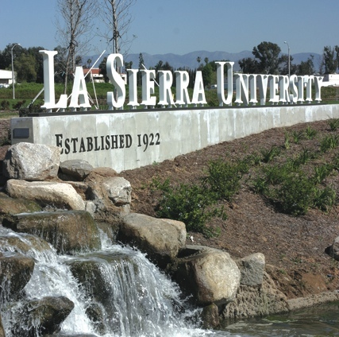

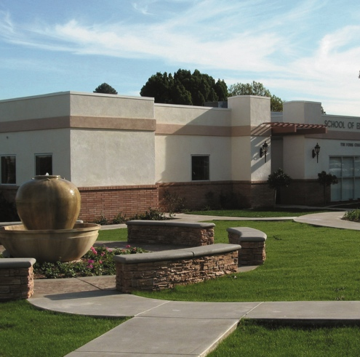
The mission of the Center for the Study on K-12 Adventist Education (CRAE) is to serve and advance Adventist education by seeking and sharing knowledge about the North American Division K-12 Adventist educational system--its values, its pedagogy, and its challenges.

Slide 36
CENTER INITIATIVES
Pastors and the Future of Adventist Education
Utilizing ABSM to find the critical stakeholders in Adventist Education.
The Achievement Gap
Analyzing CognitiveGenesis data to assess the academic outcomes of disadvantaged students. In collaboration with the University of Notre Dame.
Adventist Grad Rate Project
Collecting annual graduation data from all the academies in the NAD.

Slide 37



GRADUATION RATES
SDA academies in the NAD have a 97.5% graduation rate.
88.6% of these students go on to college.
--2011
Notes:
For 2011

Slide 38


Higher-Achieving Schools have
Good support from pastors and members of the constituent churches

Slide 39


A New Project Initiative: ABSM
Over 450 Clients:
Government Agencies & the Private Sector
Notes:
Clients of ABSM consultants include these agencies.
These are obviously agencies who recognize their high stakes situation and seek the most advanced tools available to help them identify the most optimal decision path.

Slide 40
TRADITIONAL WAY TO GUIDE DECISIONS
Empirical Statistical Models
  Assumptions must stay the same
  Fail in the face of great change
Dynamic Stochastic (probability) General Equilibrium
  Assume a perfect world
  Rule out crises
Most policy-makers are basing their decisions on common sense and on anecdotal analogies to previous crises.

Slide 41
A BETTER WAY TO GUIDE DECISIONS: ABSM
Using Game Theory, Risk and Decision Analysis, and Nobel-Winning Economic Theory….
ABSM predicts outcomes regarding a high-stakes issue based upon stakeholders’ profiles:
--Position --Importance --Influence

Slide 42
NAD-ABSM Results
NAD-ABSM identified the Pastors as a critical group, which can mobilize support as well as create opposition for Adventist educational outcomes.
Notes:
Most organizations identify these important stakeholders though a loose and qualitative review of their expert experience (wing it).
But organizations in a high stakes situations (severe SDA hemorrhage classifies as such) perform a more systematic analysis of who key stakeholders are and the role they can play in effecting a desired outcome.
ABSM is one such systematic approach drawing upon: game theory, decision analysis, risk analysis, and Nobel-winning economic theory.
This allows for better decision-making with more reliable and predictable results than a non systematic analysis.

Slide 43
CHALLENGE TO EDUCATORS
If pastors are the critical group in garnering support for Adventist Education
How can educators collaborate with pastors to harness their influence???
Can principals/school boards/conferences develop strategies for greater pastor involvement in their schools?
How can pastors help make the Adventist Education Advantage available to more students and their families?

Slide 44
EDUCATION IS EVANGELISM!
“In the highest sense, …the work of education and the work of redemption are one ….”
-Ellen White, Education, p. 30

Slide 45

MARKETING ACE
A COMPREHENSIVE STRATEGY

Slide 46


Slide 47


MARKETING COMPONENTS
Bookazine 16 pages
Bookazine, developed to speak to parents, educators and media.
Notes:
Available through AdventSource

Slide 48

Marketing Components
Bookazine
Includes not only information about the study but also quotes from individuals who have benefited from Adventist Education.

Slide 49
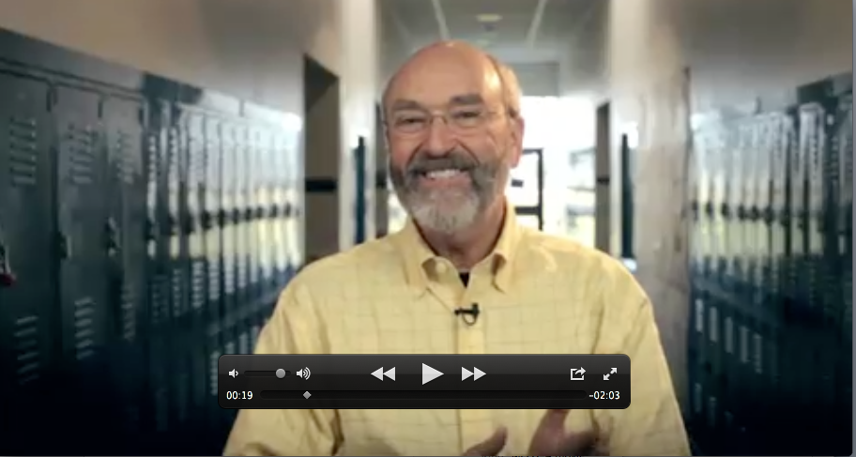
Marketing Components
20-part Video Series: DID YOU KNOW?
Short videos targeting students, parents & teachers.
2 - minute presentations narrated by Dick Duerksen

Slide 50

Teach the Children Well
A documentary film for PBS that explores the extraordinary story of Adventist Education from the producers of The Adventists.

Slide 51

STATISTICAL SERVICES AVAILABLE
School & Conference Level

Slide 52
Service: FULL REPORT
(77 pages, unformatted PDF)
NCE Composite and/or Subject Areas and/or Subject Sub-Area
By Grade - all Years combined
By Year - all Grades combined
Change in NCE Composite and/or Subject Areas and/or Subject Sub-Area
1-year change by Grade - all Years combined
2-year change by Grade - all Years combined
3-year change by Grade - all Years combined
4-year change by Grade - all Years combined
5-year change by Grade - all Years combined
1-year change by Year - all Grades combined
2-year change by Year - all Grades combined
3-year change by Year - all Grades combined
4-year change by Year - all Grades combined
5-year change by Year - all Grades combined
Notes:
Subject Areas (e.g., Math, Science)
Subject Sub-Area (e.g., Capitalization, Computation)

Slide 53
Service: SHORT REPORT
(11 pages, unformatted PDF)
NCE Composite
By Grade - all Years combined
By Year - all Grades combined
Change in NCE Composite
One-year change by Grade - all Years combined

Slide 54

CRAE
4500 Riverwalk Parkway
Riverside, CA 92515
www.lasierra.edu/crae
crae@lasierra.edu
(951) 785-2997
Notes:
Direct Link to CognitiveGenesis
www.cognitivegenesis.org
cognitivegenesis@lasierra.edu

