Slide 1

Math Principles for Principals

Slide 2


Hayden Planetarium
I grew up in New York City.
One of my favorite places is the American Museum of Natural History.

Slide 3
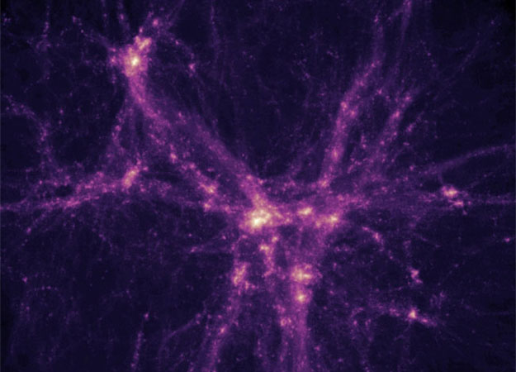

Slide 4
Concrete actions that will improve student achievement
Overview of 2012 NAD Math Standards
How Data Analysis Improves Math Performance
Teacher Knowledge
The Anatomy of a Math Lesson
Supervision Instruments
Notes:
Instructional Leadership
Research has shown that principals’ understanding of high quality mathematics instruction and their ideas about how they can support it are significantly influenced by their knowledge of mathematics and their beliefs about the nature of mathematics learning and teaching – their Leadership Content Knowledge (Nelson, 1998; Spillane & Halverson, 1998; Spillane & Thompson, 1997; Stein & D’Amico, 2000; Stein & Nelson, 2002).
CHANGE
Change is the constant evolution of life. Nothing in life remains static. Schools are constantly undergoing change. The change occurring in a school at any given moment is dynamic and multidimensional. The school, the community, the school division, government departments, business influences, economic climates, political demands, technological advances, and educational research are some of the dimensions that are impacting on every school at any one time. All of these influences create the ever changing context in which the school operates. A change in any one of these areas will, either implicitly or explicitly, require a change in the best practices of the school (Fullan, 1991).
Michael Fullan, an international leader in change research in education, confirmed that change is a snarled and complicated issue (Fullan, 1991). He also emphasizes that change is a process that involves simultaneous and multidimensional aspects. A simplified overview of Fullan’s view of the change process is shown in Figure 3. Fullan’s change model closely resembles Saskatchewan Education’s curriculum implementation model (DIME model) discussed earlier. Combining Fullan’s thoughts on change with the DIME model for curriculum development would support principals as they work to understand and enhance their role as curriculum and instructional leaders.
Change is the constant evolution of life. Nothing in life remains static. Schools are constantly undergoing change. The change occurring in a school at any given moment is dynamic and multidimensional. The school, the community, the school division, government departments, business influences, economic climates, political demands, technological advances, and educational research are some of the dimensions that are impacting on every school at any one time. All of these influences create the ever changing context in which the school operates. A change in any one of these areas will, either implicitly or explicitly, require a change in the best practices of the school (Fullan, 1991).
Michael Fullan, an international leader in change research in education, confirmed that change is a snarled and complicated issue (Fullan, 1991). He also emphasizes that change is a process that involves simultaneous and multidimensional aspects. A simplified overview of Fullan’s view of the change process is shown in Figure 3. Fullan’s change model closely resembles Saskatchewan Education’s curriculum implementation model (DIME model) discussed earlier. Combining Fullan’s thoughts on change with the DIME model for curriculum development would support principals as they work to understand and enhance their role as curriculum and instructional leaders

Slide 5


Slide 6
Overview of 2012 NAD Math Standards
Notes:
The math standards stress focus and coherence; the progressions are transparent from one grade to the next. The grade-level standards are a staircase to mastering the college and career readiness anchor standards.
Principals can convene and guide their school leadership teams in this initiative within their schools. More importantly, principals can work with their colleagues to facilitate vertical articulation so that the taught curriculum can be seamless in grades K–12
Standards of Math Practice
Make sense of problems and persevere in solving them.
Reason abstractly and quantitatively.
Construct viable arguments and critique the reasoning of others.
Construct viable arguments and critique the reasoning of others.
Model with mathematics.
Use appropriate tools strategically.
Attend to precision.
Look for and express regularity in repeated reasoning.

Slide 7


Slide 8
How Data Analysis Improves Math Performance
Notes:
Implement
Screening
Diagnostic
Progress Monitoring
Data Analysis
Standardized Testing Comparisons
ITBS READING Scores compared to MATH Scores
ITBS QUALITATIVE CogAT scores compared to MATH Scores
Assessment
Formative
Progress Monitoring
CBM
Observation
Summative
Screening: General assessment of
mathematics skills; administered within
5 days of entry
Diagnostic testing: Based on
identified needs and strengths from
initial screening, an in‑depth follow‑up
of specific skill areas
Progress monitoring: Ongoing
assessment of foundational numeracy
skills to record progress throughout
stay and to develop and refine learning
goals and instructional focus for
individual students
Curriculum‑based assessment
(CBA): Assessment tool that is directly
related to the curriculum; used to
measure instructional impact, change
instruction, and determine student
mastery of instructional objectives
Curriculum‑based measure (CBM):
One type of CBA with particular
features including brief, timed, and
standardized administration; repeated
measures are graphed for progress
monitoring; measure of fundamental skills

Slide 9
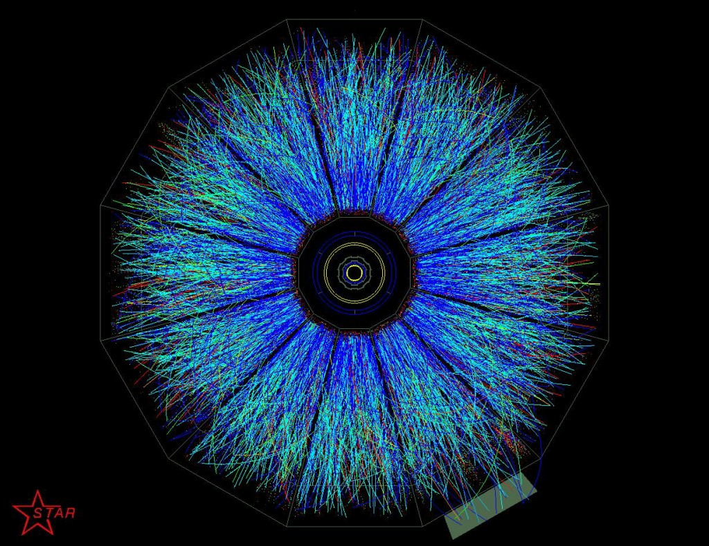

Slide 10
Teacher Knowledge
Notes:
Teacher Knowledge
Mathematical Content Knowledge (MKT)
Knowing mathematics content
Recognizing key mathematical ideas with which their students are grappling
Supporting the power and complexity of student thinking
Multiple representations,
Instructional strategies that meet the diverse needs.
Understanding how core mathematical ideas develop across the grades

Slide 11


Slide 12
The Anatomy of a Math Lesson
Notes:
Understanding how core mathematical ideas develop across the grades
Parts of a Math Lesson
Review
Distributed Review of Concepts
Timed Drills of Fact
Multiple Representations
Concrete
Pictorial
abstract
Direct and Explicit Lessons with Strong Conceptual Basis
Math Facts
Word Problems
Algorithms
Vocabulary
Number Sense
Student Motivation

Slide 13


Slide 14
Supervision Instruments
Notes:
Focusing on Mathematical Thinking
What is considerably harder to do during classroom observations, and harder to learn, is
to attend to the mathematical content of students’ thinking; use one’s own mathematical
knowledge to make an assessment of what the students are understanding correctly (and
what they do not yet understand); and analyze how the teacher’s instructional moves –
assignment of follow-up tasks, discussion questions, brief dialogues with particular
students, and so on – respond to the students’ mathematical ideas and give them the
opportunity to inspect the validity of those ideas an modify them if necessary.

Slide 15
Questions

