Slide 1
Finding balance in a crazy-busy world
Sylvia Gonzalez, PhD
Lisa Greco, M.Min, MATS

Slide 2
Objectives
Understanding the balanced life foundation
Acknowledging our personal “Why”
Taking 4 steps
Learn from each other

Slide 3
Scriptural foundation
“And Jesus increased in wisdom and stature, and in favor with God and man.”
Luke 2:52

Slide 4
the four foundational blocks
Knowledge, mental development – personal / professional
Physical well-being, holistic health
Spirituality
Emotional balance, social / familial connectedness
Wisdom
Stature
Favor with God
Favor with Man

Slide 5
Rate your balance

Slide 6
1.Houston, we have a problem.
2. I know what to do. I’m just not doing it.
3. Holding my own, but not really progressing as I would like.
5. Following God’s plan for my Life.
4. Not Bad; I’m a work in progress.

Slide 7
The straw that broke the camel’s back
In a crazy-busy world we are asked to carry heavy loads – and we do. We are Type A’s! That’s what we do.
But it is that one last, little straw that knocks us off balance.
How many times have you lifted the straw but did not adjust the whole load?

Slide 8
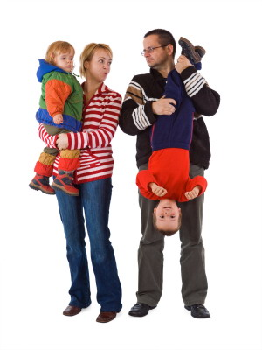
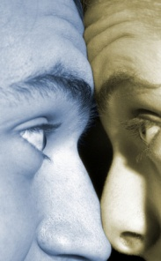
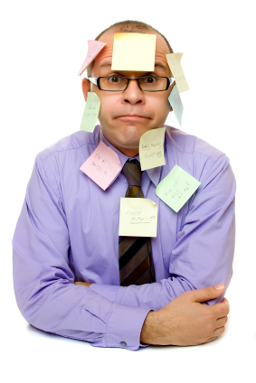
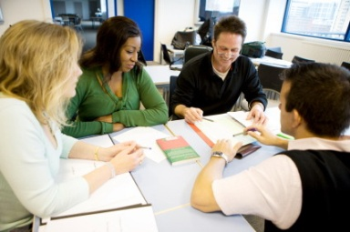
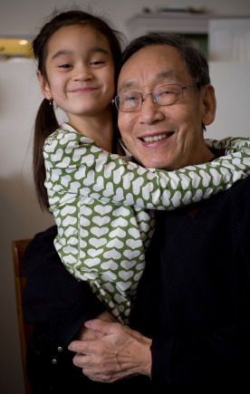
What is holding you back?

Slide 9
Remember the oxygen mask !

Slide 10
The mask is about creating margin for yourself
Margin is that space we create in our lives that allows us to be healthy, balanced stewards, overseeing what God has entrusted to us.
Wisdom. Stature. Favor with God and man.
It is learning the power of “No.”

Slide 11
Leadership & Sustainability – Fullan(2005)
1. Wisdom – Professional / personal knowledge
Fullan preaches “capacity” and “resilience.”
To improve the group, improve the leader.
To sustain significant behavior change, address the underlying meaning of the behavior in question.
You cannot expect people to change their underlying meanings without considering that we ourselves need to change.

Slide 12
Ellen White, 1951
2. Stature
Our first duty to God and our fellow beings is that of self-development. Every faculty with which the Creator had endowed us should be cultivated to the highest degree of perfection, that we may able to do the greatest amount of good of which we are capable. Hence that time is spent to good account which is used in the establishment and preservation of physical and mental health. We cannot afford to dwarf or cripple any function of body or mind. As surely as we do this we must suffer the consequences

Slide 13
Scriptural Foundation
3 Favor with God (Spiritual Relationship)
“Seek ye first the kingdom of God and His righteousness, and all these things will be added unto you.” Matthew 6:33 (NKJV)
“You were bought with a price, so do not be enslaved to the world.” I Corinthians 6:20 (ESV)
“Thou shalt have no other gods before Me.” Exodus 20:3 (KJV)

Slide 14
A Minute of Margin Swenson (2003)
“Love is the currency of the relational life. In the relational life, we spend love and receive love. That was God’s idea from the beginning . . . Must we love? That is a nonsensical question. It is like asking, “Must we breathe?” No, we do not have to breathe, and no, we do not have to love. But the consequences of both those decisions will be the same.”

Slide 15
1.Houston, we have a problem.
2. I know what to do. I’m just not doing it.
3. Holding my own, but not really progressing as I would like.
5. Following God’s plan for my Life.
4. Not Bad; I’m a work in progress.

Slide 16
Sharing Thoughts

Slide 17
Questions?
Thank you!

