Slide 1
The Real Leadership Lessons of Steve Jobs
And how these apply to leaders in Adventist education when it comes to fundraising

Slide 2

Dr. Lilya Wagner, CFRE
Director
Lilya.Wagner@nad.adventist.org
Direct: 301-680-6130
Cell: 317-250-8274
www.philanthropicservice.com
General phone line: 301-680-6131
General e-mail: info@philanthropicservice.com

Slide 3
Practices That Every CEO
Should Emulate
Adapted from a Harvard Business Review reprint,
“The Real Leadership Lessons of Steve Jobs,” April 2012
Six months after Jobs’s death, the author of his best-selling biography identifies the practices that every CEO can try to emulate.
by Walter Isaacson

Slide 4
Background
Cofounded Apple in parents’ garage in 1976.
Ousted in 1985.
Rescued company from near bankruptcy in 1997.
Died October 2011.
Had built Apple into the world’s most valuable company.
Helped transform seven industries: personal computing, animated movies, music, phones, tablet computing, retail stores, digital publishing.
Belongs in pantheon of America’s great innovators.
Lessons can be drawn from what he accomplished.

Slide 5
The keys to his success can also be applied to Adventist education and the people who lead them—most importantly, the leaders’ involvement in fundraising for the multiple benefits of their institutions.

Slide 6

Focus
Focus on mission.
Focus on great outcomes.
Focus on what can best be done.
Focus on priorities.
Application to fundraising and the leader’s role:

Slide 7

Simplify
Zero in on the essence, eliminate unnecessary components.
Simplicity comes from conquering, not just ignoring, complexity.
“It takes a lot of hard work to make something simple, to truly understand the underlying challenges and come up with elegant solutions.”
Application to fundraising and the leader’s role:

Slide 8

Take responsibility end to end
Parts of the institution and its programs are linked together.
Achieve delightful user experiences.
Where does the buck stop?
Application to fundraising and the leader’s role:

Slide 9

When behind, leapfrog
The mark of an innovative company is not only that it comes up with new ideas first.
It also knows how to leapfrog when it finds itself behind.
Instead of just catching up, transform!
Application to fundraising and the leader’s role:

Slide 10

Put products before profits
Jobs never spoke of profit maximization or cost trade-offs.
He focused on what the product did.
Focus on making the product great and the products will follow.
Application to fundraising and the leader’s role:

Slide 11

Don’t be a slave to focus groups
Customers don’t know what they want until we show them.
“If I’d asked customers what they wanted, they would have told me, ‘A faster horse!’”
Caring deeply about what customers want is much different from continually asking them what they want.
Intuition and instinct are important.
Application to fundraising and the leader’s role:

Slide 12

Bend reality
Push people to do the impossible.
Believe in performing extraordinary feats.
“You did the impossible because you didn’t realize it was impossible.”
Application to fundraising and the leader’s role:

Slide 13

Impute
People form an opinion about a product on how it’s presented and packaged.
People DO judge a book by its cover.
Application to fundraising and the leader’s role:

Slide 14

push for perfection
Go back to the drawing board if something isn’t perfect.
Don’t hesitate to revise, recreate, reinvent.
“A great carpenter isn’t going to use lousy wood for the back of a cabinet, even though nobody’s going to see it.”
Application to fundraising and the leader’s role:

Slide 15

tolerate only ‘a’ players
Jobs infused Apple employees with an abiding passion to create groundbreaking products and a belief that they could accomplish what seemed impossible.
In spite of challenges, top players tend to stick around longer.
Loyalty engenders a vibrant organization.
Application to fundraising and the leader’s role:

Slide 16

Engage face-to-face
Jobs knew too well the potential of the digital world so he was believer in face-to-face meetings.
Ideas can’t be developed by e-mail and iChat.
People should get out of offices and mingle.
Think instead of using slide presentations!
Engage, instead of showing slides.
Application to fundraising and the leader’s role:

Slide 17

Know both the big picture and the details
Deal with both large and minuscule issues with passion.
Some CEOs are great at vision, others know that the details are important.
Have the ability and desire to envision overarching strategy while focusing on tiniest aspects of design.
Application to fundraising and the leader’s role:

Slide 18

Combine the Humanities with the sciences
Both poetry and processors are important.
Creativity can occur with the joining of humanities and sciences.
Join the head and the heart!
Application to fundraising and the leader’s role:

Slide 19

stay hungry, stay foolish
Don’t be satisfied—keep striving.
Complement the business side with the artistic, nonconformist.
Don’t be afraid of risks.
Application to fundraising and the leader’s role:

Slide 20
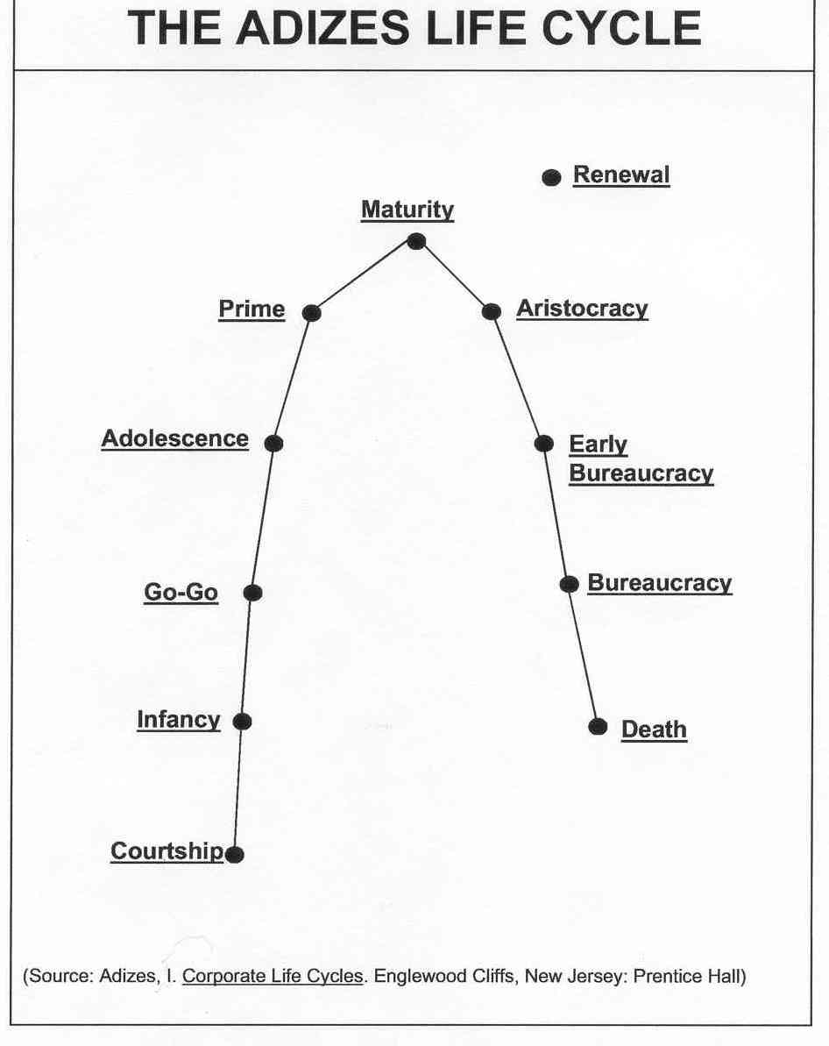

Slide 21
How does this relate to fundraising?
• Courtship: the organization is not yet born but exists only as an idea.
• Infancy: there is much support and the organization is not expected to survive without help.
• Go-Go Years: Market-driven times when the demand for services causes growth.
• Adolescence: An organization begins to be concerned about its status and future. A time of turnover and upheaval, yet also a time for strengthening and reaffirming the mission.
• Prime: Energy is high and a strong current of entrepreneurial behavior persists.
• Maturity: This stage is characterized by stability. The goal is to sustain maturity.
• Aristocracy: A feeling of self-satisfaction and inability to do wrong. Excesses may occur and communication breaks down.
• Early Bureaucracy: A function of fear, inability to take responsibility for decisions, lack of trust and teamwork.
• Bureaucracy (decay): The ultimate in negative attitudes such as fear, manipulation and distrust.
• Death: A phase-out that is not deliberate.

Slide 22
Indicators that an organization has embraced a culture of philanthropy
Everyone understands the need to raise money and is willing to do what is necessary to support the effort, regardless of role in the organization.
Everyone behaves as the organization’s ambassador, helping identify new friends and prospects whenever possible.
Everyone can articulate a case for giving and how the gift will be used.
Notes:
This is the concluding part of your presentation. What you want to do is match up, equate with, acknowledge the previous discussion, and stress that these indicators should guide in the discussion to follow until we actually develop action steps.

Slide 23
Organizational processes are donor-centric. They are set up with the donor in mind, not just the staff.
Visitors are welcomed; dialogue is encouraged. The organization is highly responsive.
The CEO sees him/herself as the “face of the agency.”
The CEO is 100% committed and personally involved in fundraising.

Slide 24
Recipients of the services of the organization are respected and viewed as experts in how the organization carries out its mission.
The CEO, board, all personnel make financial contributions at least annually.
- Adapted from OnCourse Consulting,
“Embracing a Culture of Philanthropy: Why it matters”

Slide 25

Fundraising is . . .
The right person asking
The right prospect
For the right cause
In the right way
For the right amount
At the right time
    From The Fund Raising School

Slide 26
The Fundraising Cycle
Awareness of
Marketing Principles
Planning Checkpoint:
Examine the Case
Strategic Checkpoint:
Demonstrate Stewardship
and Renew the Gift
Planning Checkpoint:
Analyze Market Requirement
Planning Checkpoint:
Prepare Needs Statement
Action Checkpoint:
Solicit the Gift
Planning Checkpoint:
Define Objectives
Action Checkpoint:
Activate Volunteer Corps
Action Checkpoint:
Involve
Volunteers
Planning Checkpoint:
Prepare Communication Plan
Planning/Action Checkpoint:
Validate Needs
Statement
Planning Checkpoint:
Prepare Fundraising Plan
Planning Checkpoint:
Identify Potential Giving Sources
Planning Checkpoint:
Select Fundraising Vehicle
Planning Checkpoint
Evaluate Gift Markets
Source: Adapted from Henry A. Rosso and Associates, Achieving Excellence in Fund Raising, 2nd edition, p. 24. Copyright © 2003
Jossey-Bass Inc., Publishers. Reprinted by permission of Jossey-Bass Inc., a subsidiary of John Wiley & Sons, Inc.

Slide 27
Questions? Answers?
Ideas? Suggestions?

Slide 28
Time is Up!

