Slide 1
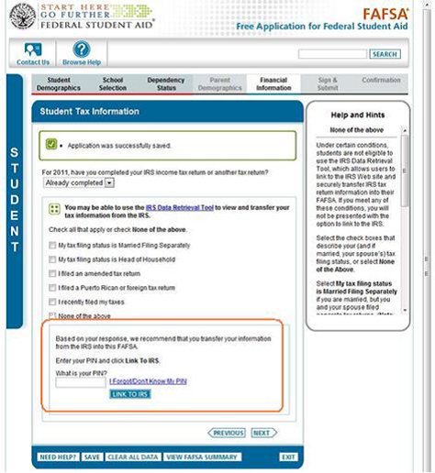

Irs data retrieval tool
Financial Information:
Answer questions to determine whether or not you (or your parents) are eligible to use the tool. If you are eligible to use the IRS tool, you will be prompted to:
1. Enter your PIN number
2. Select “LINK TO IRS”
Complete the information requested (Address entered must match IRS database address)

Slide 2
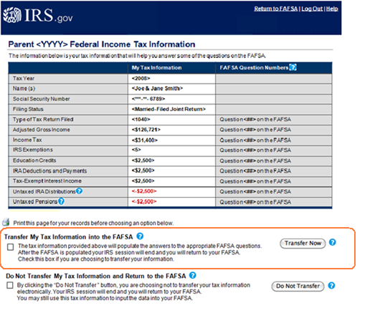
Irs data retrieval tool
1. Review your tax information for accuracy.
2. Check the appropriate box below.
3. Select Transfer now.
Data Transfer Completed!

Slide 3
Irs data retrieval tool
If you did not or could not use the IRS data retrieval tool on FAFSA, we will need:
IRS Tax Return Transcript
Order at www.irs.gov (select “Tools”).
Processing time is approximately 5-10 days, so don’t delay!
Visit your local IRS office.

Slide 4
Financial aid verification
WHAT IS VERIFICATION?
  It is a process to verify information on the FAFSA, not everyone is selected.
  If you are selected we are required to collect this information before awarding federal aid.
    WHAT TO DO IF SELECTED?
  Check FinVue for documents needed.
  Documents vary from student to student.
  Turn in verification documents promptly.

