Slide 1
Life Hacks for Remote and Hybrid Work
By Janine Lim, janine@andrews.edu
Associate Dean, School of Distance Education
Notes:
Do you spend part or all of your time working remotely? In this session we will explore a variety of tips and tricks to work effectively and keep communication and community alive. Share and hear strategies from colleagues as well.

Slide 2




School of Distance Education
3
2
1
Notes:
SDE & our remote/hybrid workers

Slide 3
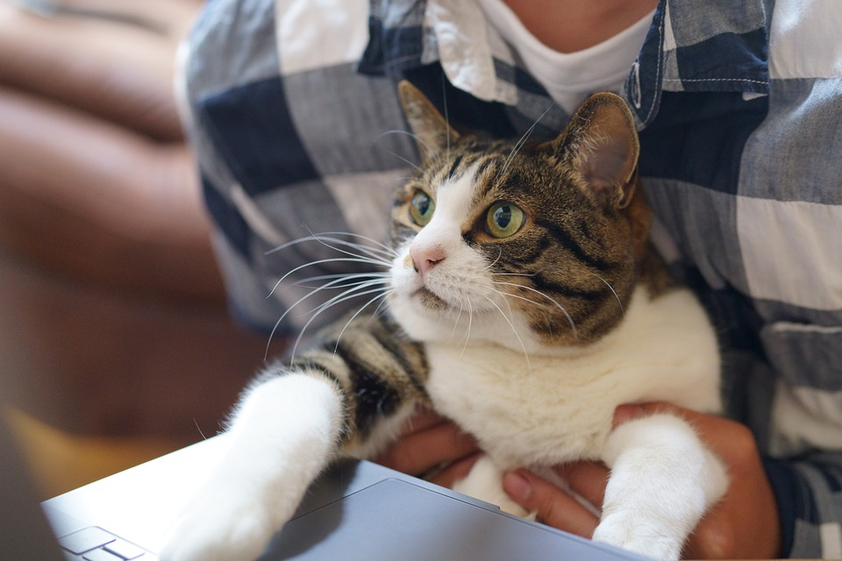
Remote & Hybrid Working Check-in
What’s working for you?
What’s not working for you?
Image credit: Pixabay
Notes:
Do photos

Slide 4



Community Productivity
Work-Life Rhythm

Slide 5
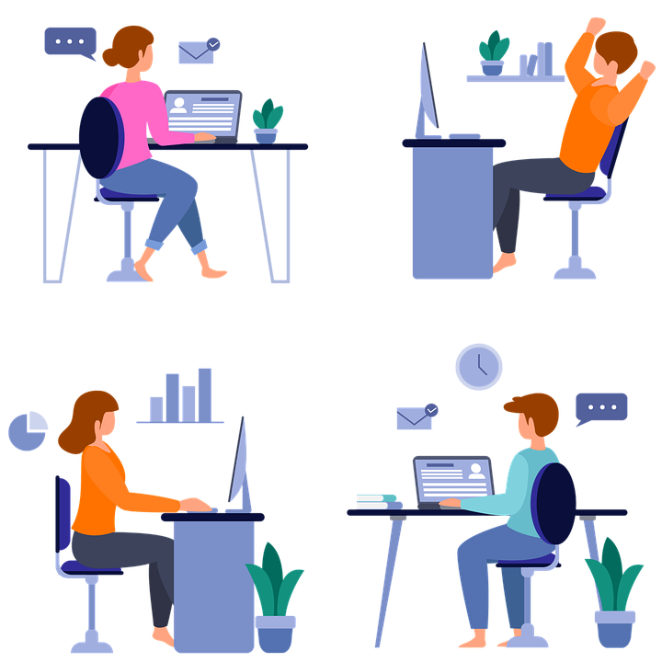
Departmental Community Building
Worship
Check-ins
Virtual lunch
Wellness activities
Other?
Image credit: Pixabay
Notes:
Team worships / worship with screen off time

Slide 6

Zoom: Camera on or camera off?
Non-verbal communication
Bandwidth and internet issues
Background issues
Communicating your situation as appropriate

Slide 7
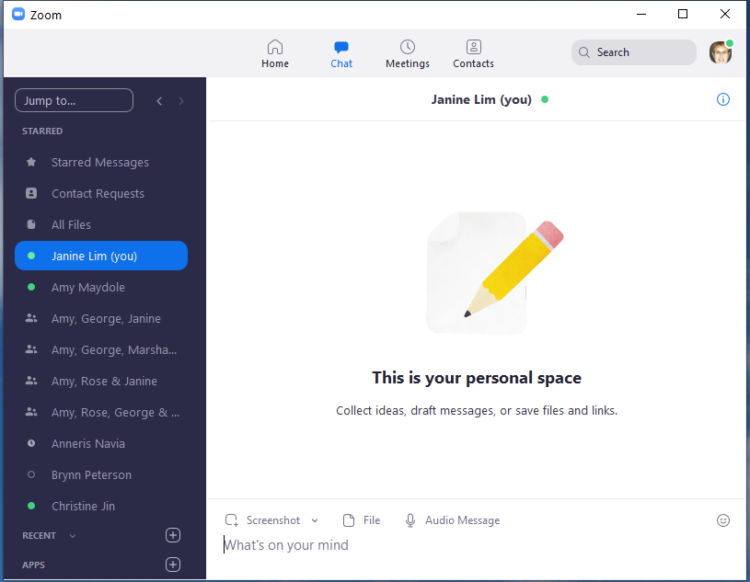
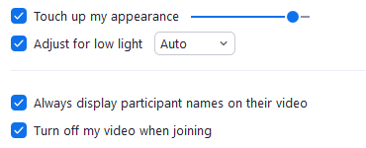
Zoom Settings
Free Andrews Pro account
Install the client: https://zoom.us/download#client_4meeting
https://zoom.us/profile/setting
Video: Touch up my appearance; adjust for low light, turn off my video when joining a meeting
Audio: Mute my microphone when joining a meeting
Choose Video Background or Filter
Notes:
If you need Zoom pro, email dlit@andrews.edu for an upgrade; available to all employees; for student employees, there should be a job task that requires it

Slide 8
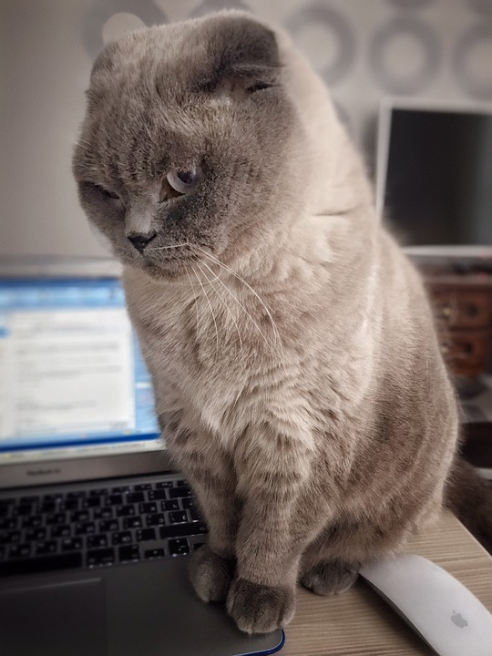
Keep Up Social Aspects of Work
Working “side by side”
Be “real” (show cats, dogs) as appropriate
Other?
Image credit: Pixabay

Slide 9
Community Productivity
Work-Life Rhythm

Slide 10
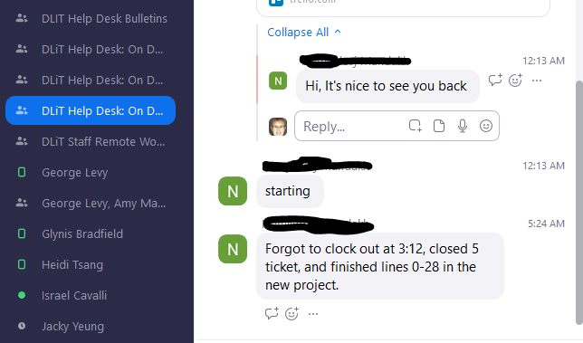
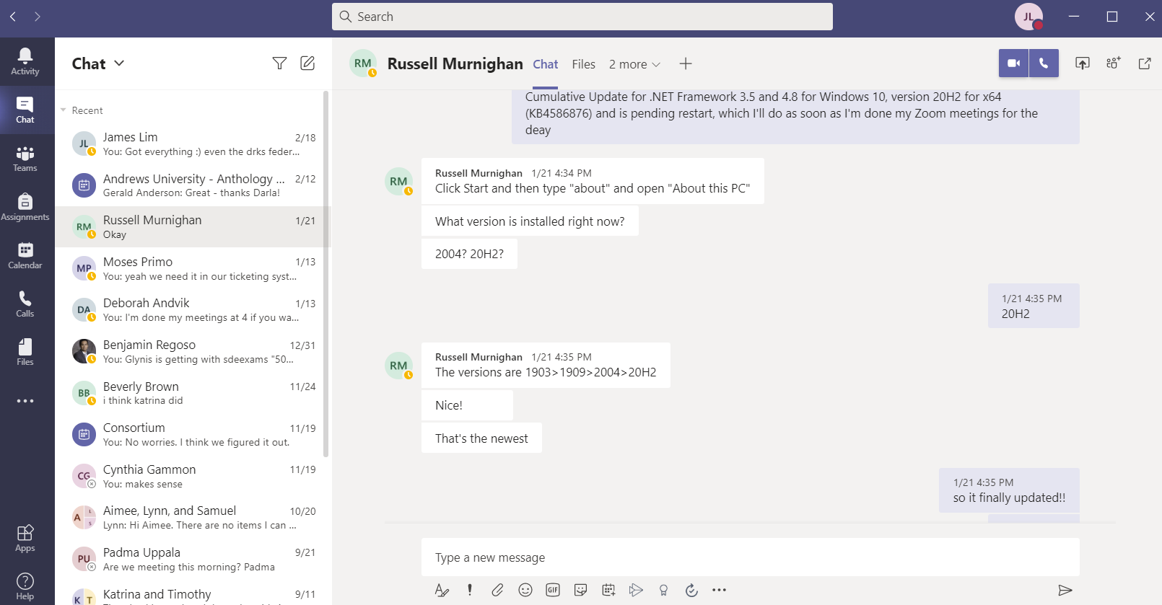
Chat Channels
When to text
When to chat
When to email
When to video call
Your ideas?
Notes:
How is it working for you?

Slide 11
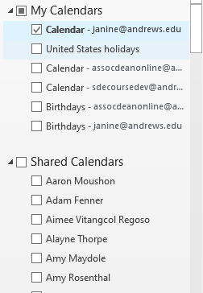
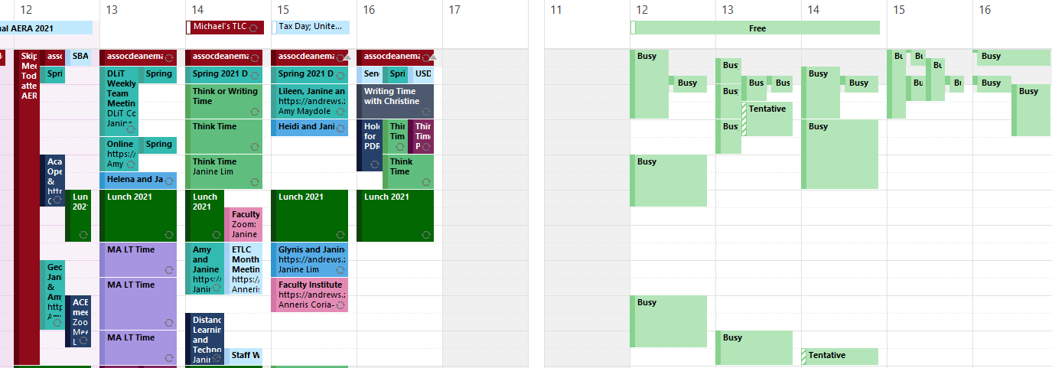
Scheduling Meetings Calendar Trick

Slide 12
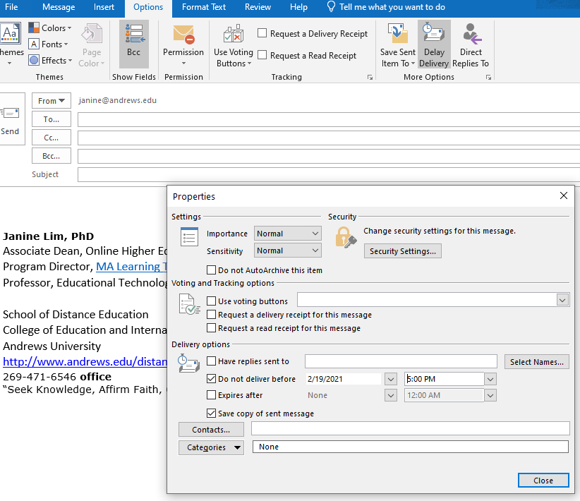
Email Tricks: Delay Delivery
Start an email
Pop it out if needed
Options
Delay Delivery
Choose time

Slide 13
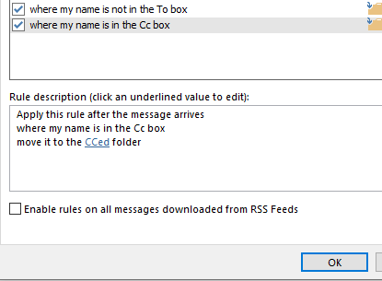
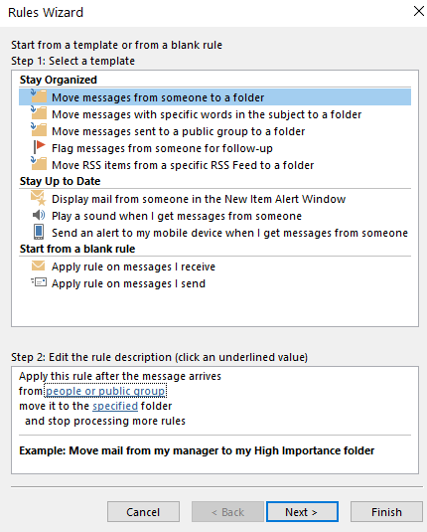
Email Tricks: Rules
Click on an example of a message you want to filter
Click Rules
Set the criteria
Newsletters: “unsubscribe, opt-out”
“CC”: you aren’t in the To: field
Shopping: “receipt, statement, bill, order, purchase, shipping”
Social Media: “Facebook, Twitter, Google+, YouTube”
Execs: your boss or executive team
http://www.postbox-inc.com/?/blog/entry/email_filtering_strategies/

Slide 14

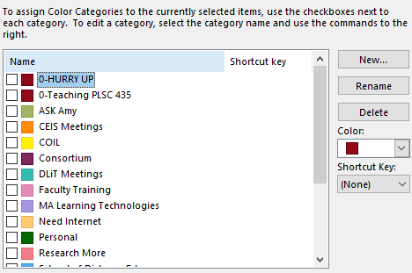
Email Tricks: Folders & Categories
Archive
Action
Waiting
Follow Up
Archive Hold
Filed
Urgent
Research More
Waiting
Filed & Sent
Search feature
Inbox Zero
GTD: Getting Things Done
http://lifehacker.com/182318/empty-your-inbox-with-the-trusted-trio
http://billzipponbusiness.com/5-folders-the-simple-system-for-getting-your-email-inbox-to-zero/

Slide 15
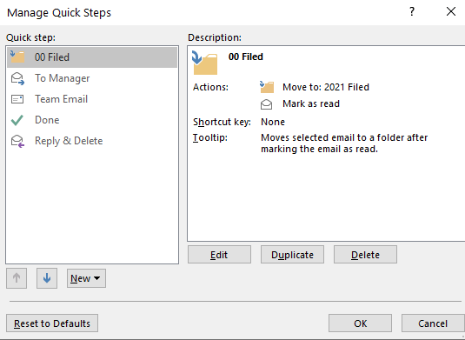
Email Tricks: Quick Steps
One click to do several things
Can have a shortcut key too
Notes:
https://support.microsoft.com/en-us/office/automate-common-or-repetitive-tasks-with-quick-steps-b184f89f-3738-4562-96de-c0244ea830f2

Slide 16
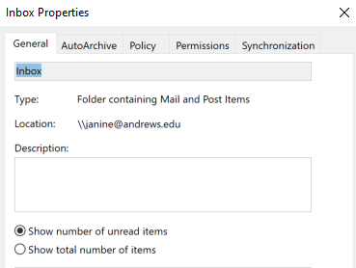

Email Tricks: Total Items or Unread Items
Do you want to see total items instead of unread items?
Right click on the folder, change the option

Slide 17
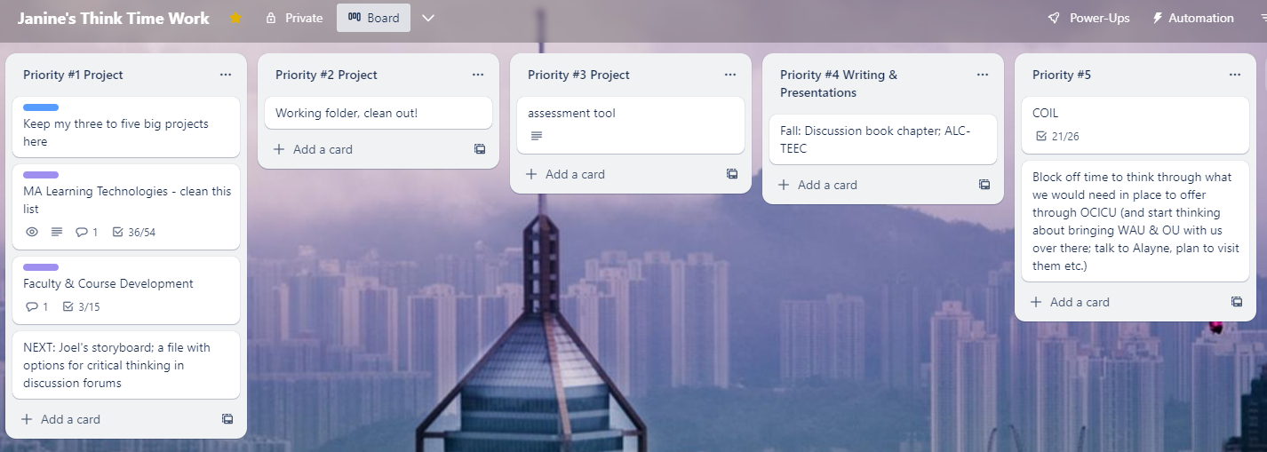
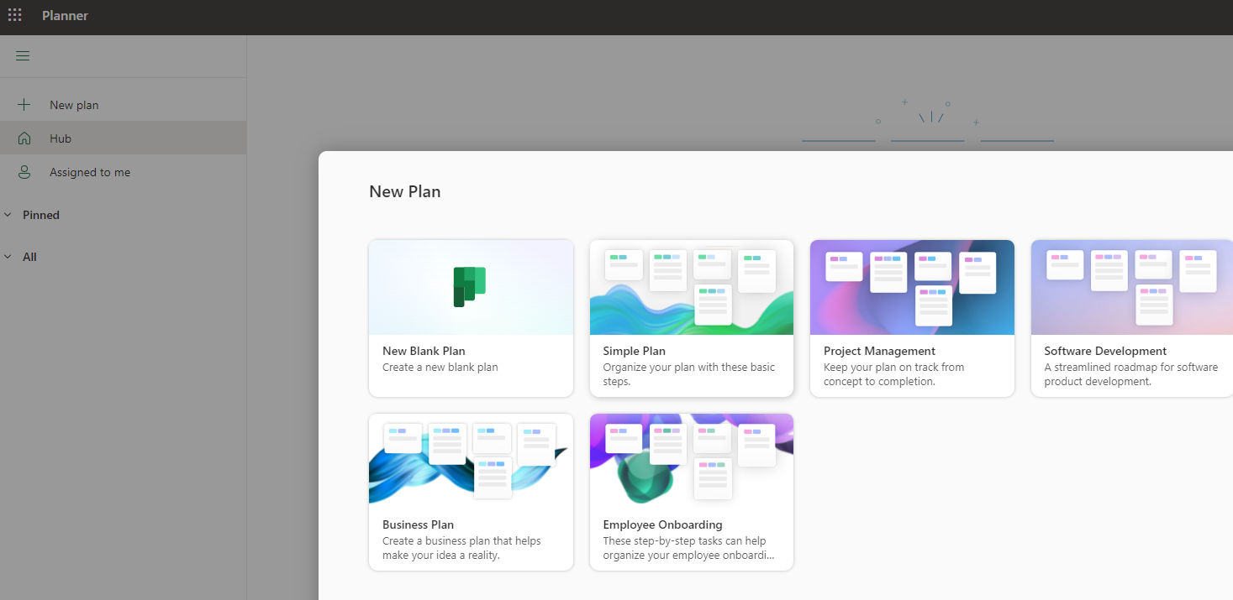
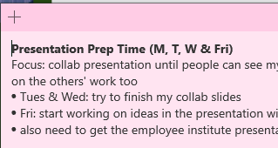
Tracking Work
Trello
Microsoft Planner
Stickies

Slide 18

Chunks of Time vs. All the Time
Windows of uninterrupted time to systematically work from the bottom up, or in alphabetical subject order. Discipline yourself to process each one.
Morning: Spend 1-2 hours accomplishing something BEFORE you check your email.
Photo credit: Public Domain Pictures
Notes:
https://support.microsoft.com/en-us/office/automate-common-or-repetitive-tasks-with-quick-steps-b184f89f-3738-4562-96de-c0244ea830f2

Slide 19
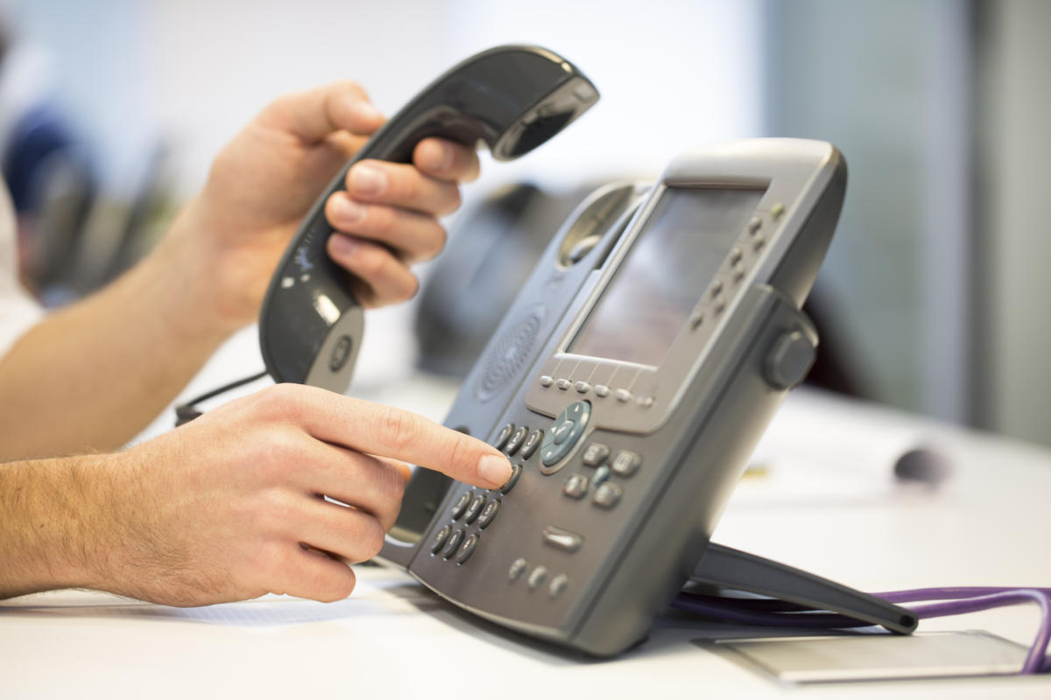
The Phone
Notes:
What are you experiencing? How is it going?
GoogleVoice
Voicemail to email

Slide 20
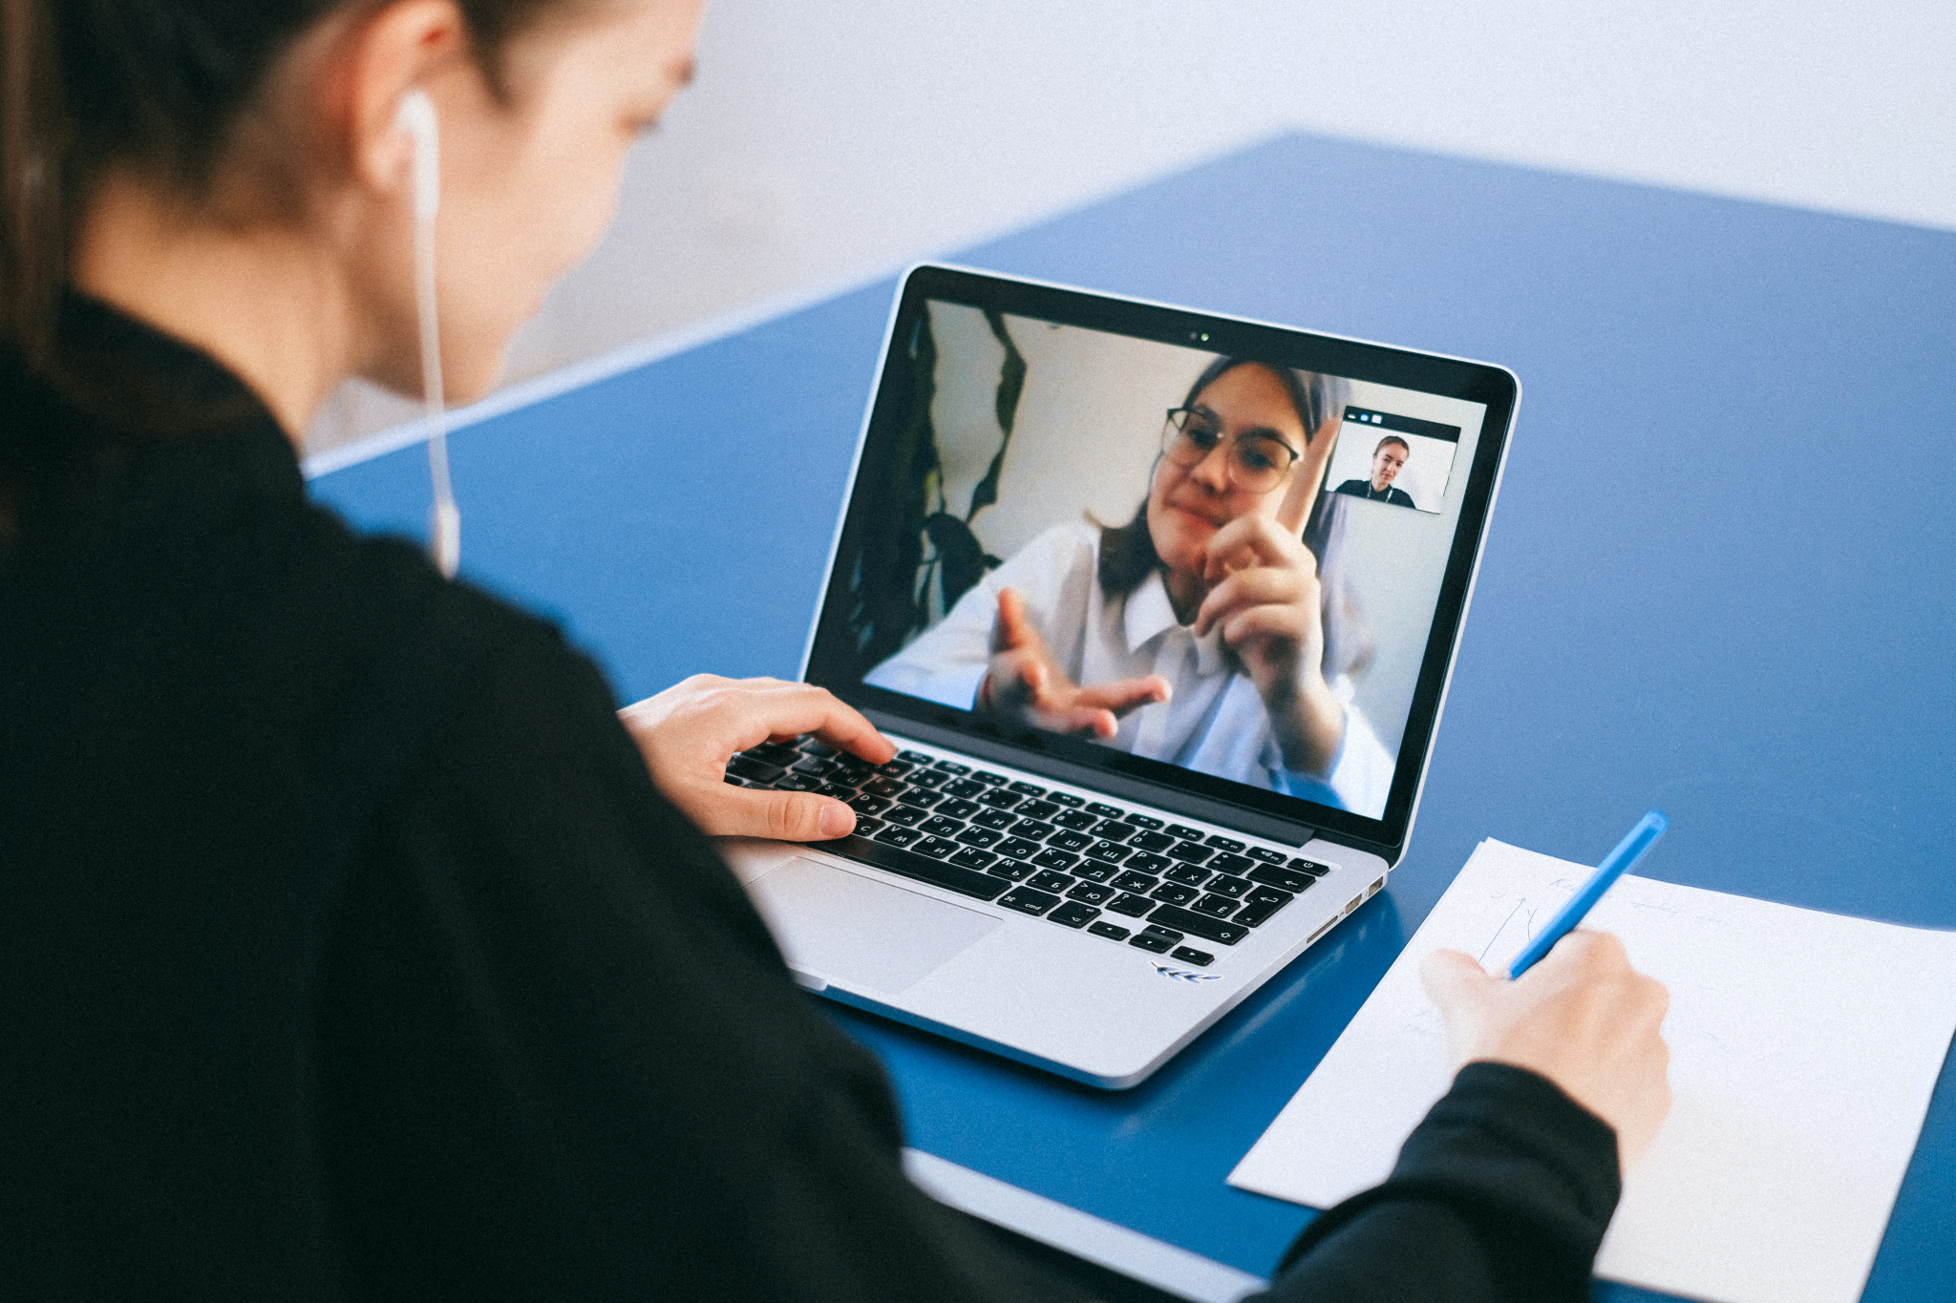
Keeping Your Boss in the Loop
Building trust
Maintain channels of communication
Communicating before things go wrong
Negotiate together what works
Photo Credit: Quality Improvement Center for Workforce Development

Slide 21
Community Productivity
Work-Life Rhythm

Slide 22

Faith as a Life Hack
Ministry of Healing “Work” chapter
Search “overwork”
…our business or calling is a part of God's great plan, and so long as it is conducted in accordance with His will, He Himself is responsible for the results. - ED 138
Artwork credit: Freepik
Notes:
Believing that God called you here, trusting him to take care of you and your work for him, moment by moment

Slide 23
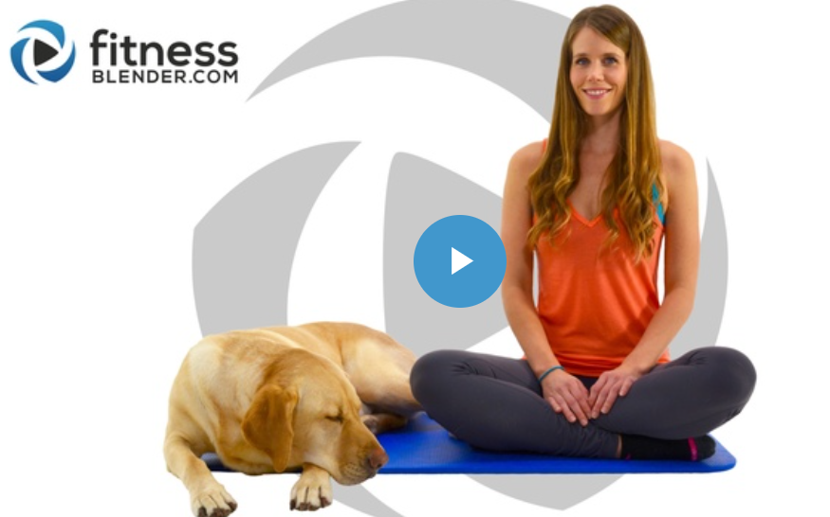

Slide 24

Screen / Wellness breaks
Pomodoro (25 min on / break)
My goal: at least one 2 min movement break each half day
DLiT Tues FitBreak
Standing desk
Stand during phone calls or meetings
Look out the window during phone calls/Zoom
Others?

Slide 25
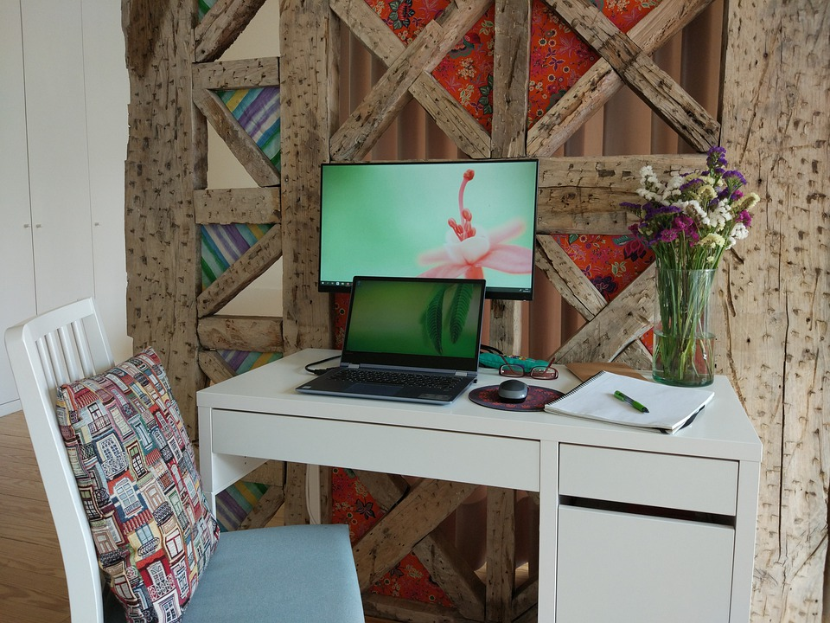
Physical Cues
Get dressed / change clothes
Basement / separate space
Special activity for children just for when they are waiting for you to get off a call
Others?
Image credit: Pixabay

Slide 26
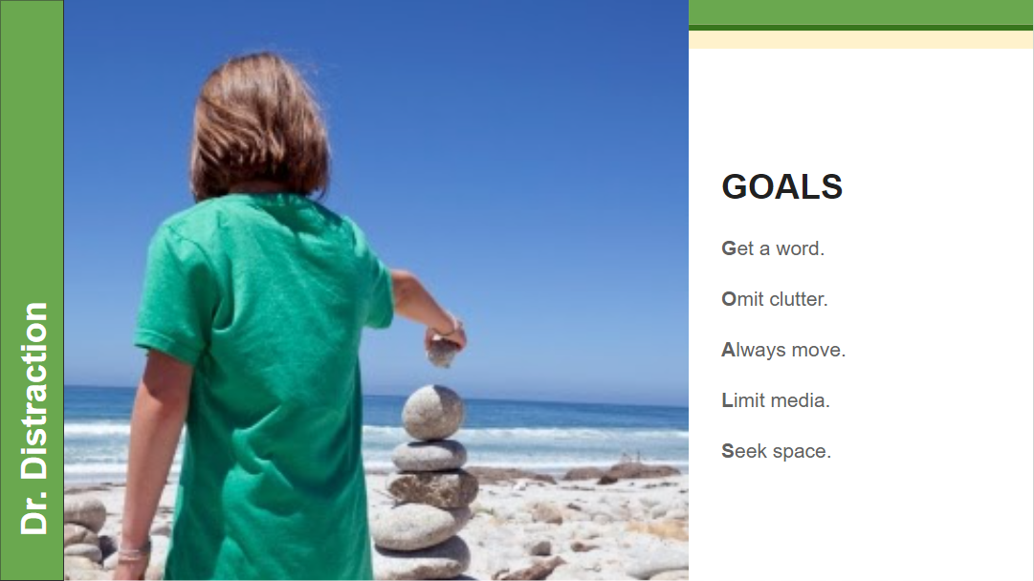

Slide 27
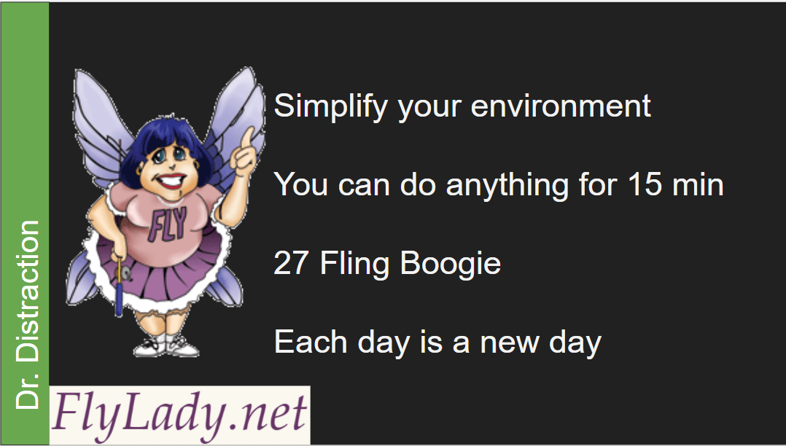

Slide 28
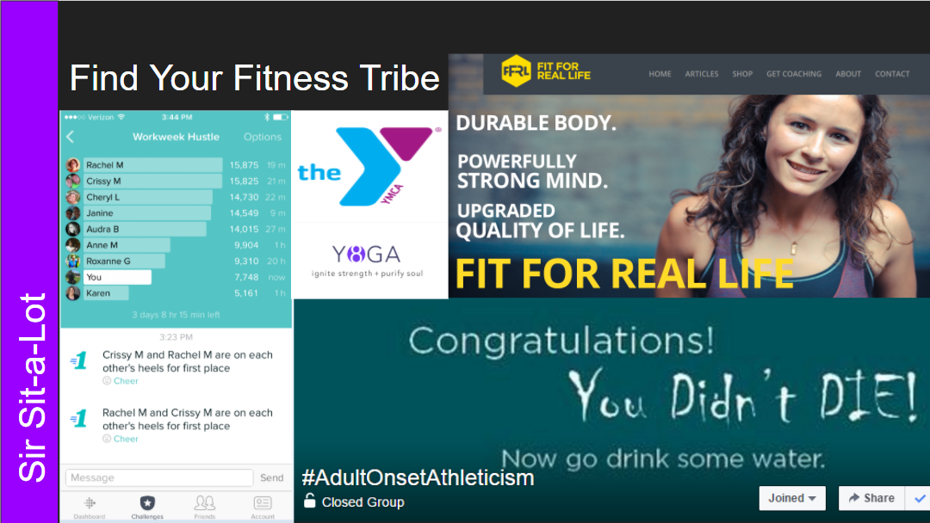


Slide 29
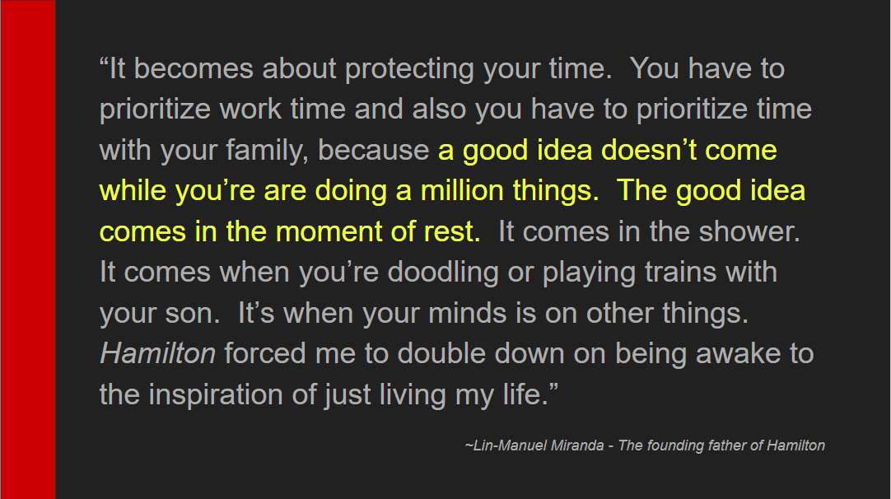

Slide 30
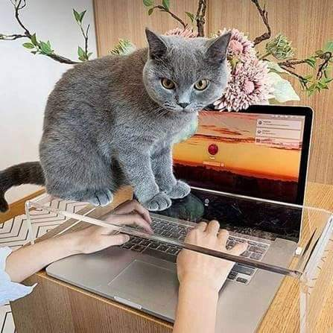
Q&A & Sharing & Problem Solving
May the favor of the Lord our God rest on us; establish the work of our hands for us— yes, establish the work of our hands. Psalms 90:17
Image credit: Facebook

Slide 31
Life Hacks for Remote and Hybrid Work
By Janine Lim, janine@andrews.edu
Associate Dean, School of Distance Education
Notes:
https://www.flexjobs.com/blog/post/things-successful-remote-workers-always-do/
https://www.google.com/amp/s/www.businessinsider.com/traits-remote-worker-work-from-home-2019-9%3famp
https://www.google.com/amp/s/elearningindustry.com/company-needs-provide-employees-effective-remote-work/amp

