Slide 1

Introducing the 25Live Campus Scheduling Tool
Stephen Payne & Marsha Beal
Employee Institute | July 31, 2023

Slide 2
A couple of key questions:
So, what is 25Live, exactly?
And, why was it chosen?

Slide 3
FIRST, A STORY:
The Summer of our Discontent
(A case study unfolding in multiple and conflicting simultaneous events!)

Slide 4
As discussions continued and solutions sought, the idea emerged that the right kind of scheduling tool might help.
Here are some types of software solutions we looked at (not just for events, but academic scheduling as well):
Connect policies, workflows, room allocation, faculty assignments, and course demand projections to create optimized schedules designed to serve students.
Manage requests, collaborate with colleagues, and publicize events in a platform that combines your academic calendar with campus events.
Simplify event planning and management with our event management solution is built to plan, promote, manage and report on in-person, virtual, or hybrid events for staff, students, alumni, or parents.

Slide 5


Looked at multiple solutions that met these needs and more — and also, critically, were Banner-compliant—and two options considered in the end:

Slide 6
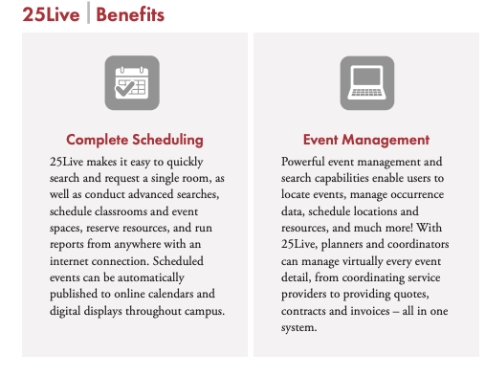

Slide 7
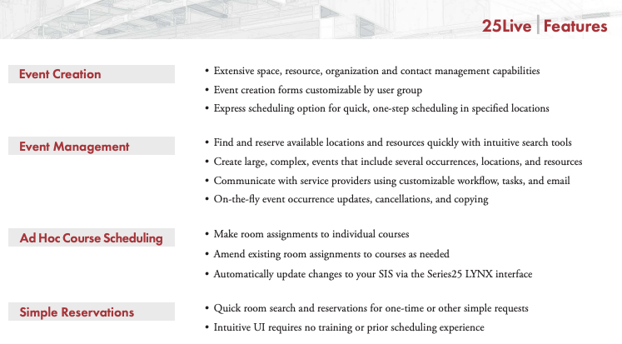

Slide 8
Review Committee (appointed by Institutional Operations Council)
  ITS/Dynamic Campus
  Student Life/Guest & Convention Services
  Academic Records
  Provost
  University Comm/Special Asst to President
  Safety
  Other key service departments

Slide 9
Choosing 25Live
25Live offered:
  Most options
  Best price
  Most significantly, best/most frequent Banner integration
Institutional Operations Council
  Approved selection of 25Live in Dec 2021

Slide 10
Choosing 25Live
Rollout/training/data collection
  February 2022 - Present
  Database development:
    Locations
    Resources
    Organizational Details
    Others (eg. Transportation)

Slide 11
Some of the data collected on campus locations (both academic & non-academic spaces) — 130 possible points of data for each classroom, non-academic and outdoor bookable space (250± locations):

Slide 12
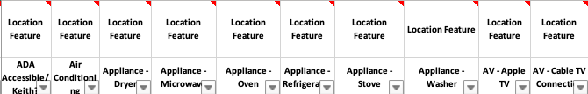

Slide 13
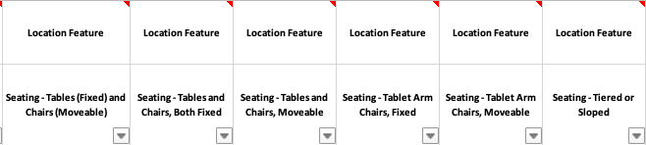

Slide 14
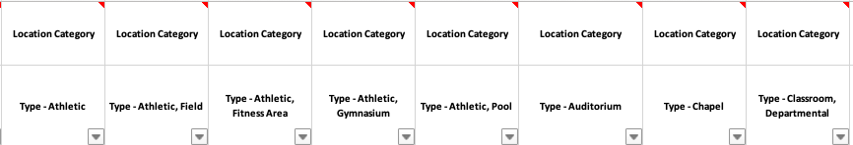

Slide 15
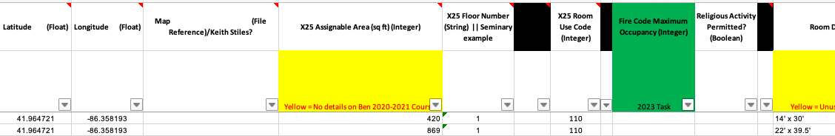

Slide 16
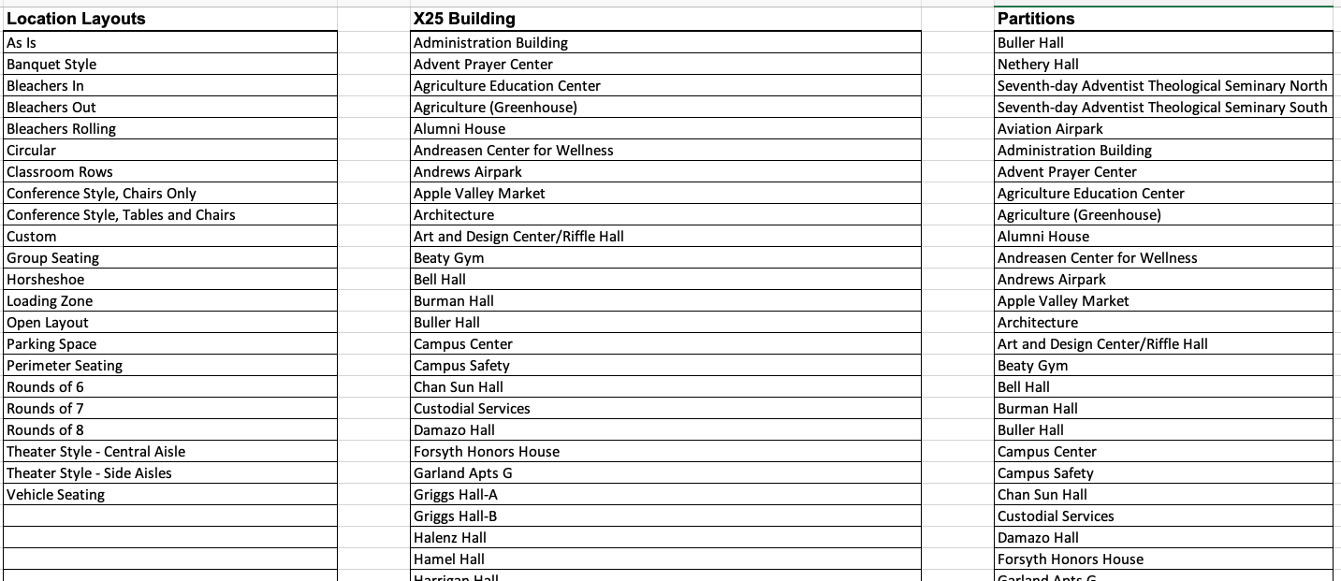

Slide 17
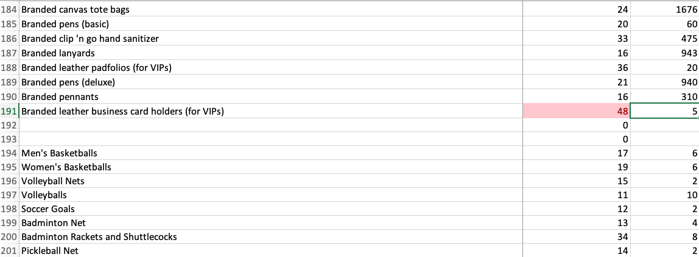
Sample of some of the data collected on campus resources:

Slide 18
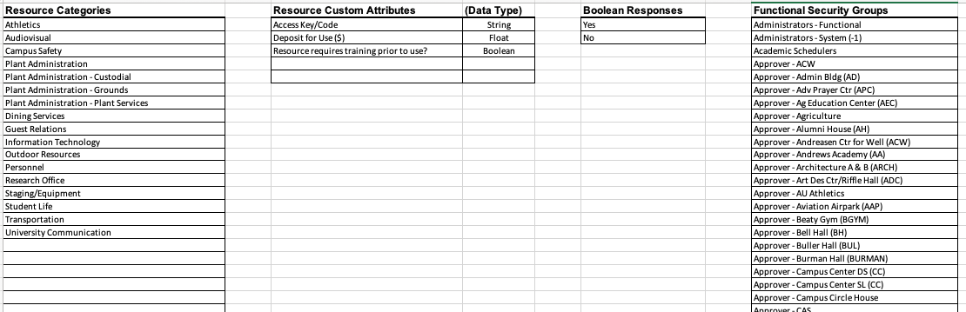

Slide 19
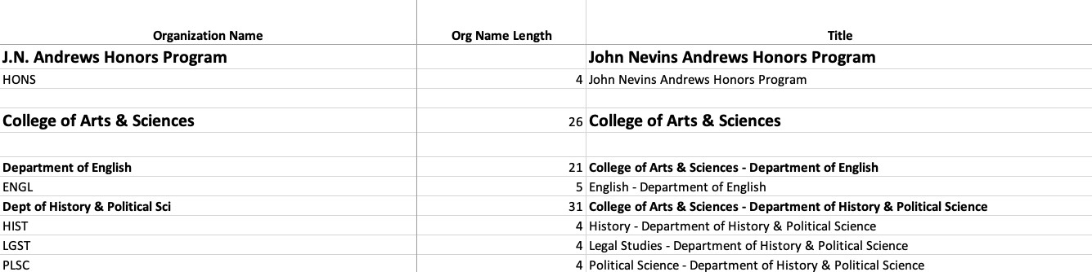
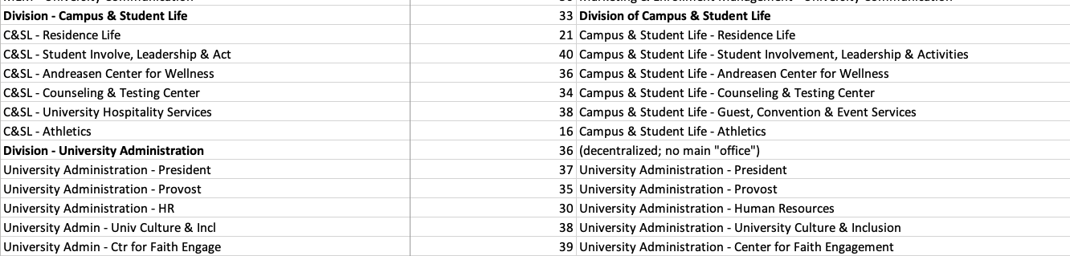
Sample of some of the data collected on campus organizations (275±):

Slide 20
What’s next?

Slide 21
Deliverables
Building & Classroom inventory including entry & maintenance
Optimize academic scheduling (for student completion &
classroom utilization)
Centralize & standardize fee scheduling
Establish criteria to govern space usage
One-stop shop for event planning
Master calendar of campus-wide events
Non-academic reservations

Slide 22
How will Andrews University use it?
Class Scheduling
5 year Calendar
Non-negotiable university events
Recurring events
Enhance summer event schedules with outside groups
Scheduling - committees, trainings, workshops, etc

Slide 23

The Goal of 25Live is to Have a
Positive Impact on YOU and
Those We Support & Serve,
Both On- and Off-Campus!

Slide 24
Next Steps: Rollout
October - Fall Break
Spring 2023

Slide 25
How will we do training?
In-person
LearningHub: Online Course

Slide 26

Questions?

