Slide 1

Diversity, Equity & Inclusion
CUSTOMER SERVICE FROM A DEI PERSPECTIVE

Slide 2
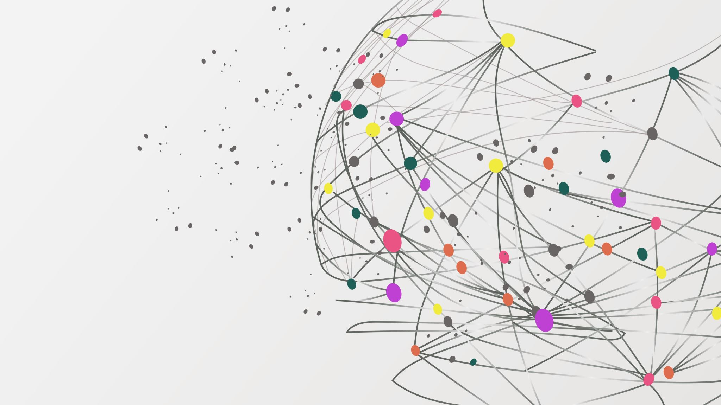
University Culture & Inclusion
Chief Diversity Officer – Danielle Pilgrim, Ph.D.
Associate Vice President, UCI – Stephen Yeagley, DMin.

Slide 3

Uplifting Human Value from a DEI Framework
Employee Training

Slide 4

Activity
Think about a colleague or campus office/ department that gives you the best customer service.
Think about an individual or department that when you interact with them, you feel seen and heard and feel better about yourself or your circumstance.
Notes:
1-3 people
Share the characteristics/qualities of that person
How do they make you feel?

Slide 5
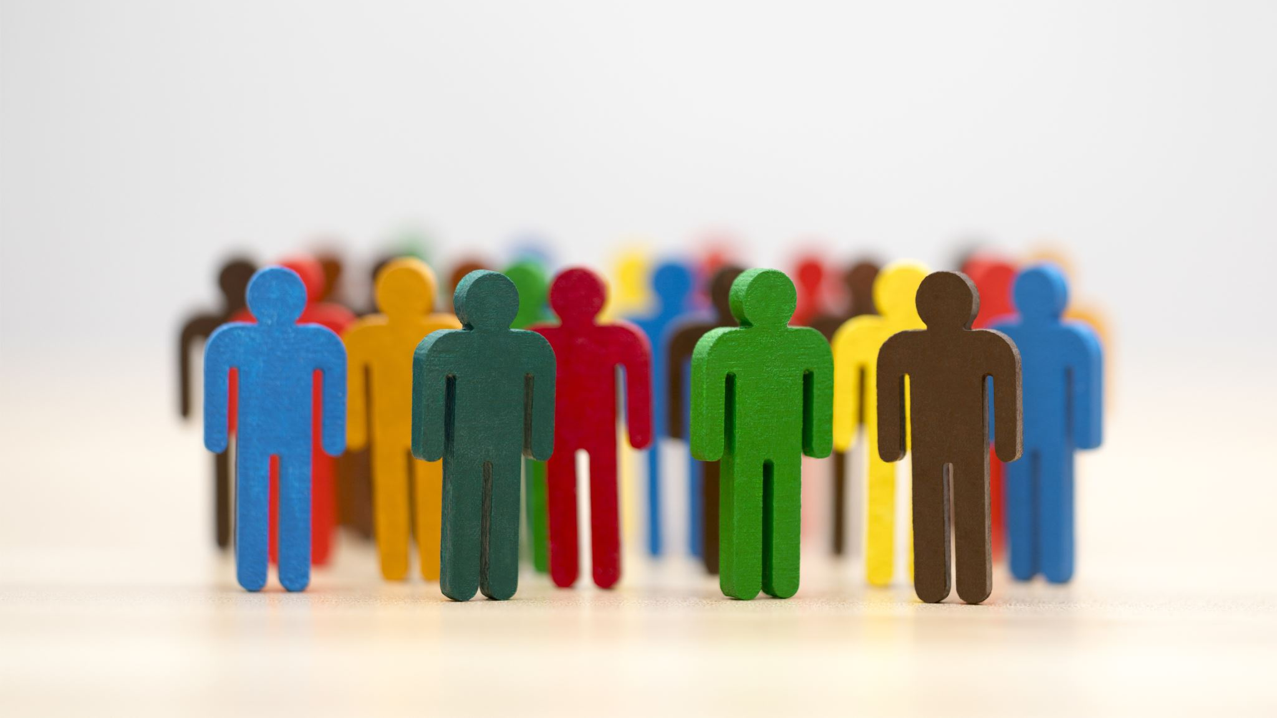
Diversity Equity Inclusion
The feeling and experience you described is the work of DEI

Slide 6

Quote
“I've learned that people will forget what you said, people will forget what you did, but people will never forget how you made them feel.”
Maya Angelou

Slide 7
Diversity Equity Inclusion
Clarifying the scope of DEI

Slide 8
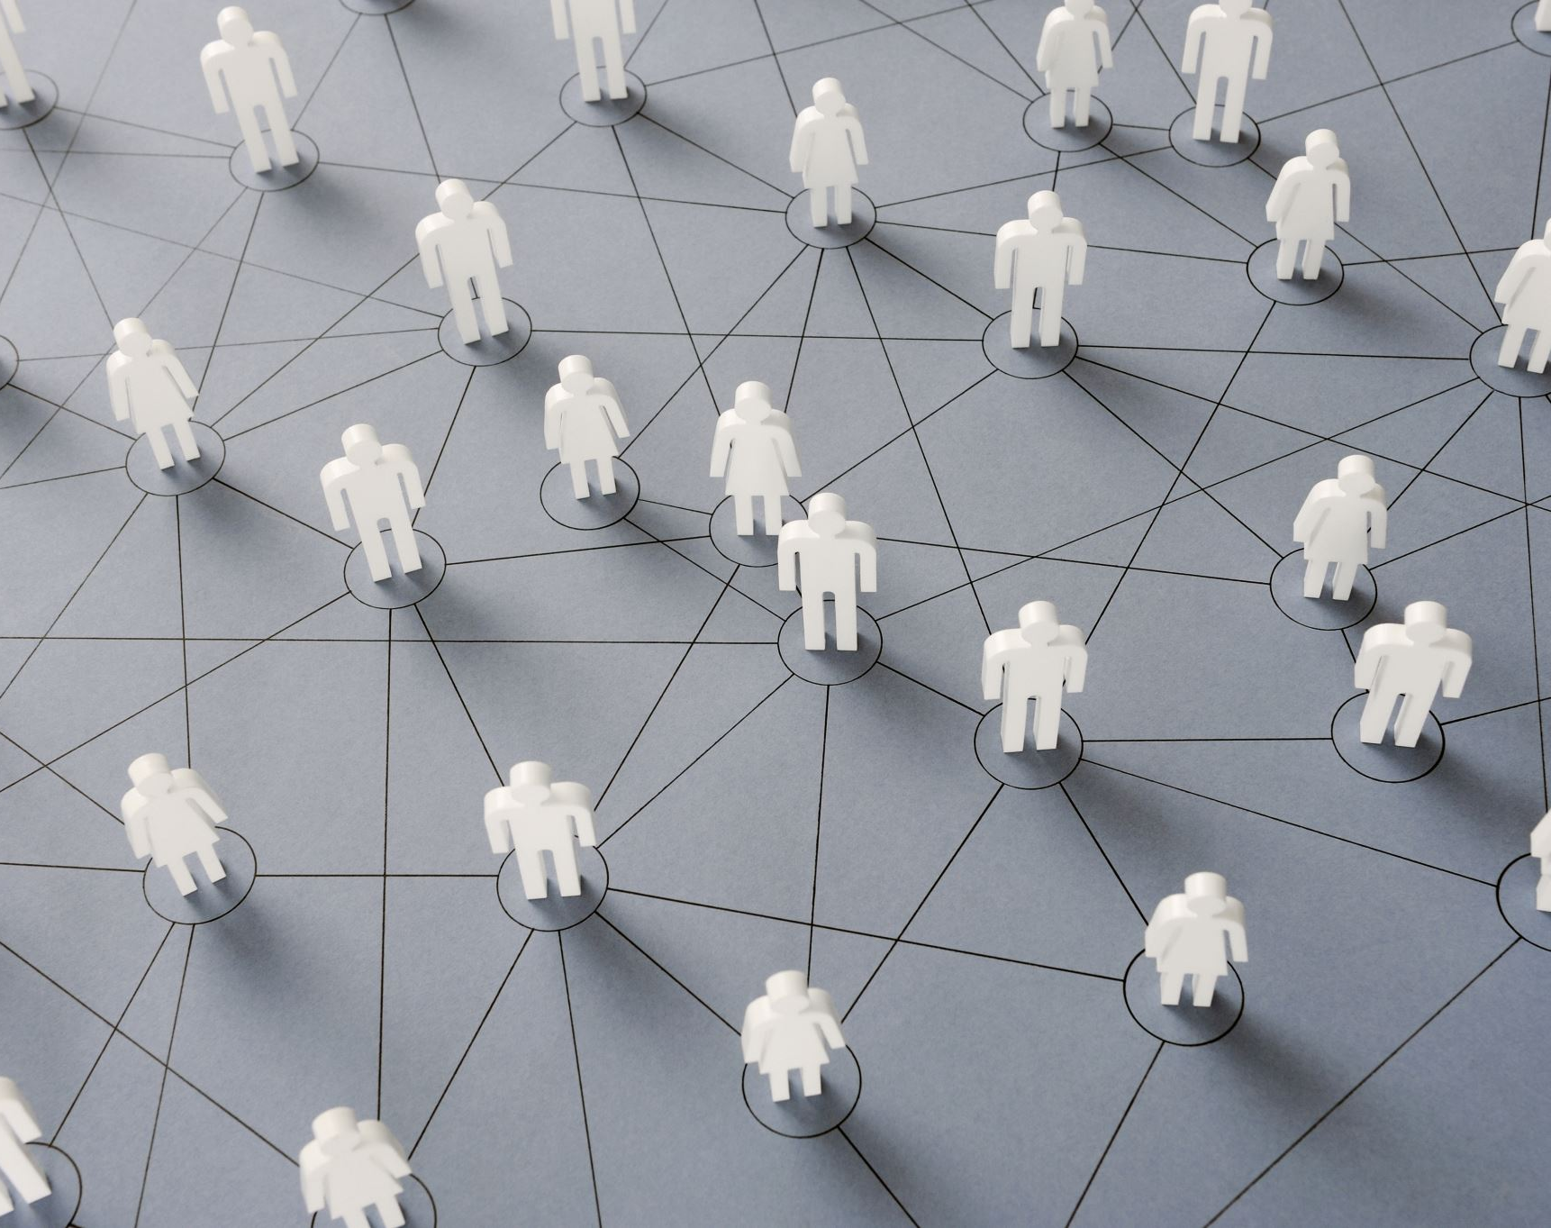
Diversity
The presence, recognition, and engagement of people of social, political, and organizational identities from the wide range of human experiences and the complex ways these identities intersect and are expressed.

Slide 9

Compositional Diversity
Race
Ethnicity
Culture
Ability
Gender
Age
Religion
Global
Neurodivergent

Slide 10

Equity
a) is defined as “the state, quality or ideal of being just, impartial and fair.”
b) equity means recognizing that we do not all start from the same place and must acknowledge and adjust to address the imbalances.

Slide 11
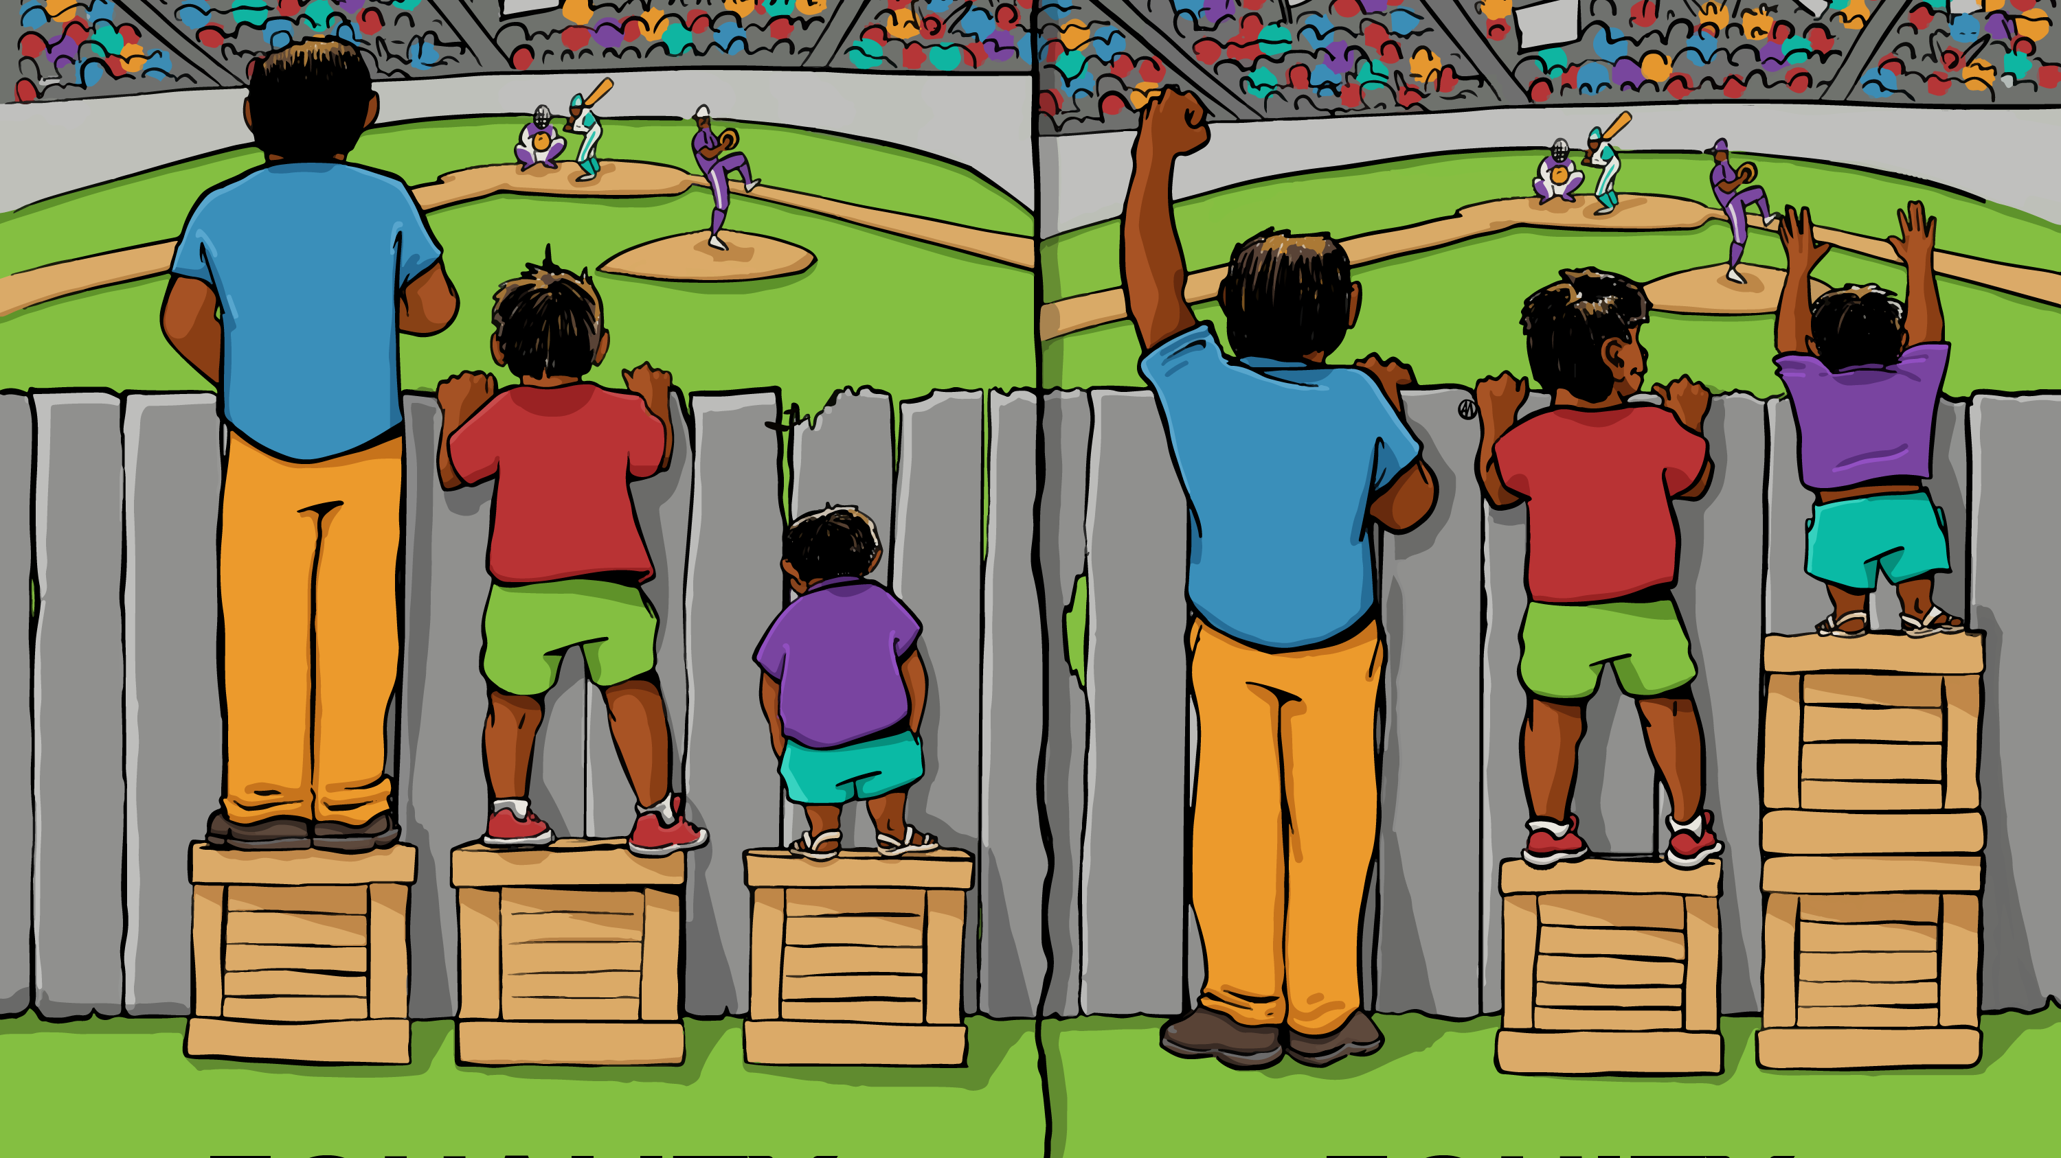

Slide 12

Inclusion
A process and practice of respect for and active, intentional, and sustained engagement of each person in the community that values and respects their perspectives, identities, experiences, and contributions.

Slide 13

Examples of Inclusion
Inclusive Language
Ethnic and Racial Designations
Preferred Names
Inclusive voice

Slide 14

Results of DEI
Each person is treated with dignity
Empathetic care
No hierarchy of human value

Slide 15
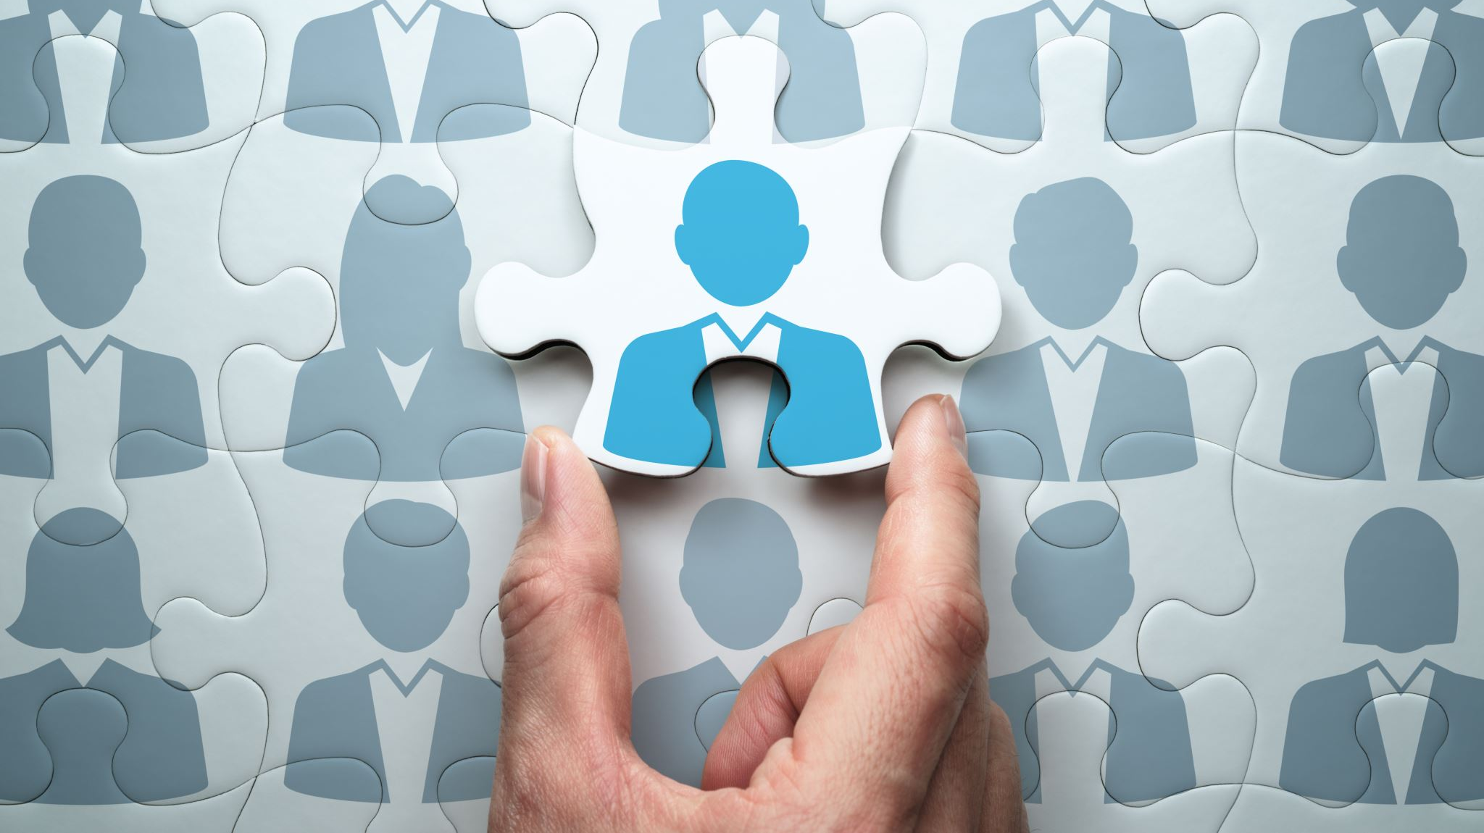
Customer Service from a DEI Framework
The “other” is also human. A person shouldn’t be diminished for their difference/uniqueness.

Slide 16

Barriers to DEI in Customer Service
Steve Yeagley

Slide 17

Glossary of Terms
Common Language

Slide 18

Scenarios

Slide 19
Moraya, a Black college student, was working on an academic paper in a common space at her Ivy League residence hall. Sara, a white resident, entered the room and found her asleep. She woke Moraya and exclaimed, “You’re not supposed to be sleeping here. I’m going to call the police.” When the campus police arrived, Moraya unlocked her room door to show officers she lived there. “I deserve to be here,” she said. “I pay tuition just like everyone else.” Following protocol, the officers asked for her ID: “You’re in a campus building, and we need to ensure you belong here.” After verifying Moraya’s ID, they admonished Sara, saying that Moraya had every right to be present. Moraya recorded the incident on her phone and posted it to social media, garnering a half million views and attention from national media outlets.
Scenario 1

Slide 20
Felipe is a graduate student diagnosed with schizophrenia. He manages his condition with medication. However, Felipe stopped taking his medication shortly after coming from out of state to the university. He began writing long, jumbled emails to professors in his department. Soon, concerned employees from across campus called in reports about a student showing up at their offices and engaging them in bizarre conversations. Although Felipe’s unmanaged condition makes him fearful and suspicious, a Campus Safety investigation found that his language and behavior were not physically threatening toward others. Nevertheless, many employees feel uncomfortable around Felipe and are afraid that he might become violent. Some are demanding that university administrators send Felipe home.
Scenario 2

Slide 21
Yejin works at a food establishment on campus. As a student worker, she noticed that Russell, a full-time staff member, treats faculty and staff differently than students. Sometimes it is subtle; at other times, quite noticeable. For instance, he greets professors warmly by name or asks administrators if their portion is large enough. Meanwhile, students barely receive a glance, and those who ask for larger servings are told bluntly to return for seconds—those are the rules. When international students ask questions with an accent unfamiliar to Russell, he replies in a loud, condescending tone. Yejin is frustrated by this differential treatment and wonders if she should say something to her supervisor.
Scenario 3

Slide 22
Charissa was recently hired into a tenure-track position with her newly minted Ph.D. She is the only female professor in her department. Over the first semester, she noticed that the department chair publicly introduced her male colleagues by their titles, “Dr. Stan Jones” and “Dr. Clinton Smith,” while referring to her simply as “Charissa.” Several times he referred to her as “our lady professor,” remarking once to a group of students that young women, in particular, would find her classes interesting. Charissa is troubled by the chair’s exclusion of her title and his awkward, if not dismissive, habit of highlighting her gender. “Am I being too sensitive?” she wonders. Yet the scenes keep replaying in her mind.
Scenario 4

Slide 23

Common Language
Naming and identifying behaviors is the first step in creating safe spaces and is a pathway to better customer service.

Slide 24

Belonging
The result of providing customer service from a DEI framework is that it fosters belonging.

Slide 25

Poll
Pollseverywhere.com/Daniellepilgrim889

Slide 26

How much does your institution provide a supportive environment for the following forms of diversity? (Senoirs)
Racial/ethnic identity
Gender identity
Political affiliation
Economic background
Religious affiliation
Disability status
Sexual Identity

Slide 27

Student Experience (Seniors)
To what extent do you agree or disagree with the following statements?
Freshmen
I feel comfortable being myself at this institution.
I feel valued by this institution.
I feel like part of the community at this institution.

Slide 28

Barriers to Belonging
Lack of self-awareness
Ignorance
Lack of skills when handling conflict
Cultural incompetence

Slide 29
Best Customer Service Practices that Lead to Belonging
1. Being fully present
2. No assumptions
3. Clarity

Slide 30

Philippians 2: 2-4
2 Is there any encouragement from belonging to Christ? Any comfort from his love? Any fellowship together in the Spirit? Are your hearts tender and compassionate? 2 Then make me truly happy by agreeing wholeheartedly with each other, loving one another, and working together with one mind and purpose.
3 Don’t be selfish; don’t try to impress others. Be humble, thinking of others as better than yourselves. 4 Don’t look out only for your own interests, but take an interest in others, too.

