Slide 1


Presented by: Lt. Marsha Beal

Slide 2
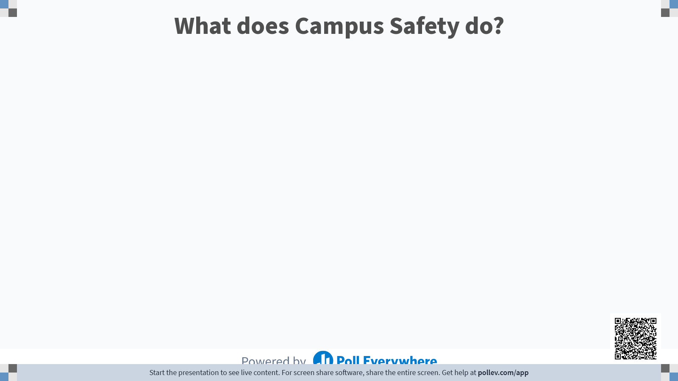

Slide 3
File Classes
Alarm | Assault | Assist | B&E | Building Assist
Compliance | Conservation | Disorderly Conduct | Drills | Fire
Fraud | General | Harassment | Intimidation/Threats | Medical Assist
Missing Person | Noise Complaint | Property Destruction | Public Education | Security Standby
Sexual Misconduct | Substance Abuse | Theft | Trespass | Vehicle Accident
Vehicle Assist | Vehicle Violation | Weapons Violation | Welfare Check

Slide 5
Campus Safety Website

Slide 6
Your part…
Drills
CPR Training
LearningHub courses
Building changes
More to come……

Slide 7
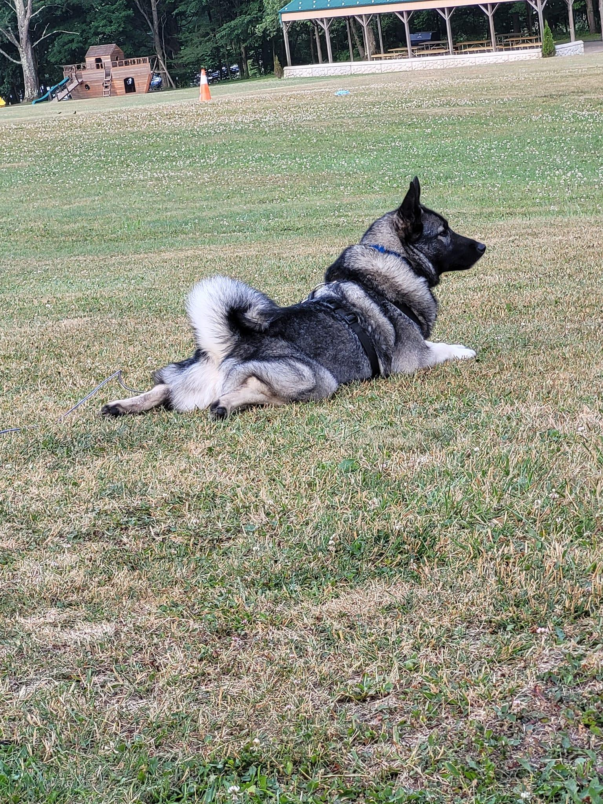
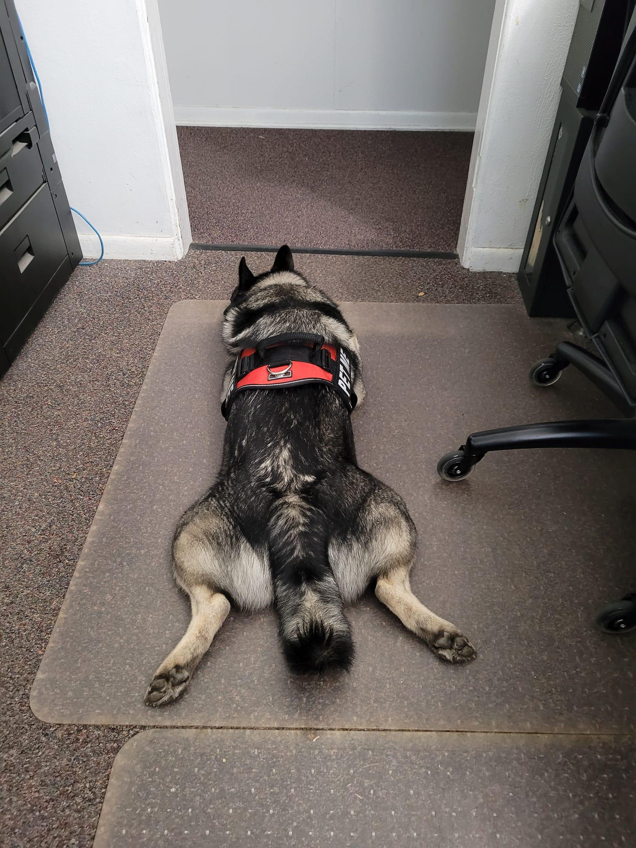
Finally
Harrison visits

Slide 8
Contact Information
Department Phone number: 269-471-3321
Website: www.andrews.edu/safety
Email: safety@andrews.edu

