Slide 1


Slide 2
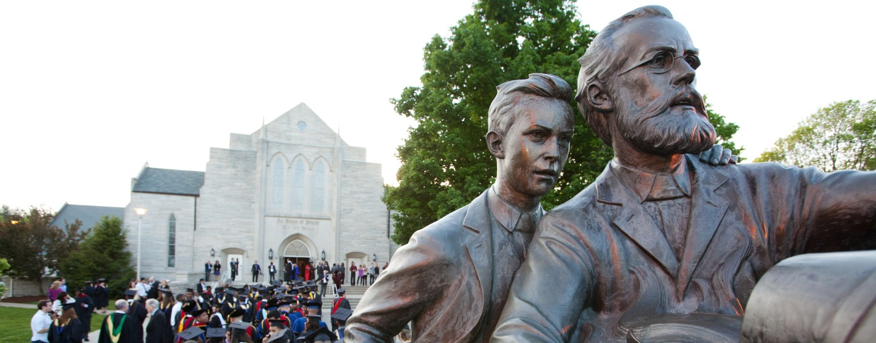
Office of Academic Records

Slide 3
Academic Records Overview: What & Who?
Services (What we do?) | Academic Records Staff (Who does it?) | Contact Information (email@andrews.edu)
General Inquiries: Registration; IDs Verifications Diplomas & Transcripts | Mark Mondak Sheila Jones | academicrecords verifications diplomas, transcripts
Grades | Janelle Strong | grades
Course Schedule | Samuel Villamizar | courseschedule
FERPA & Online Publications: Bulletin | Kevin Wiley | ferpa bulletin
Articulation (Transfer) Degree Audits & Graduation (Main campus & Distance) Major Change (UG only) | Naoko Jacobson Carolyn Hurst Jeonghyeon (Chloe) Bae | articulation ugrecords gradrecords majorchange
Degree Audits & Graduation (Off-Campus) | Angelica Munoz Melody Page | offcampusrecords
Notes:
Highlight changes in staff
Utilize departmental email addresses as points of contact

Slide 4
Most Frequently Used
Services/Forms | Email Address
General Inquiries Registration (Registration Form, Drop Form) | academicrecords@andrews.edu
Grades (Registration Appeal, Grade Change) | grades@andrews.edu
Articulation (Transfer courses) | articulation@andrews.edu
Major Changes - Undergraduate | majorchange@andrews.edu
Major Changes - Graduate | graduate@andrews.edu
Undergraduate Records (Degree Audit, Graduation, Petitions) | ugrecords@andrews.edu
Graduate Records (Degree Audit, Graduation, Petitions) | gradrecords@andrews.edu

Slide 5
Academic Records Overview: Where?
By phone: Extension 3375
By email:
  academicrecords@andrews.edu (general info)
  registrar@andrews.edu
Online:
andrews.edu/services/registrar
Location:
Administration Building, 2nd Floor

Slide 6
Resource Summary
Resource | Link
Bulletin | bulletin.andrews.edu
Course Schedule | vault.andrews.edu/schedule/
Vault | vault.andrews.edu Registration: Click on “Registration Central” Registration Overrides: Click on “Registration” → Click on “Registration Overrides” Grades: Click on “Registrar” → Click on “Grade Submission” Degree Planner/Audit Tool: Click on “Degree Works”
Academic Records | www.andrews.edu/services/registrar
Forms | https://www.andrews.edu/services/registrar/students/forms/index.html
FERPA | learninghub.andrews.edu
Notes:
The following slides are resources and reminders

Slide 7
Traits of Effective
Instructors/Advisors
Communicate a compassionate and caring attitude toward the student
Know and adhere to University academic policies and deadlines
Know program requirements
Navigate University systems (registration, grades, degree audit)
Utilize resources as questions arise
Ensure that students follow degree plan and register for courses accordingly
Complete degree audits every semester
Notes:
Student-centered
Integrity/consistency
*Degree audits ideally should be run and reviewed prior to registering for classes

Slide 8
Initiatives: Implemented
Fall 2022
Implemented Fall 2022
  Academic Calendar (bulletin.andrews.edu)
  Self-Service Banner (SSB)
  Automation of Roles & Assignments (deans, department chairs, program directors, administrative assistants)
  Change of Program (online request form)
Notes:
Self-Service Banner
Moving from iVue to SSB Fall 2022
Would like faculty to become familiar w/ Student Advisor SSB and provide feedback
Still in the process of configuration
Automatization of Roles & Assignments
First phase is to automate the assignment of deans, department chairs, program directors, administrative assistants
Currently, testing and reviewing data
Impact
Access to Degree Works & self-service Banner
Changes in employment & student curriculum
Second phase: automate faculty advisor assignments
Change of Program (screenshots)
Soft roll-out: sending change of major form to a select group of students to ensure it is functioning correctly
There are some approvals required depending circumstances which are being tested
ePetition
Currently completing testing within Academic Records
Estimate to have faculty & student testing in the Summer

Slide 9
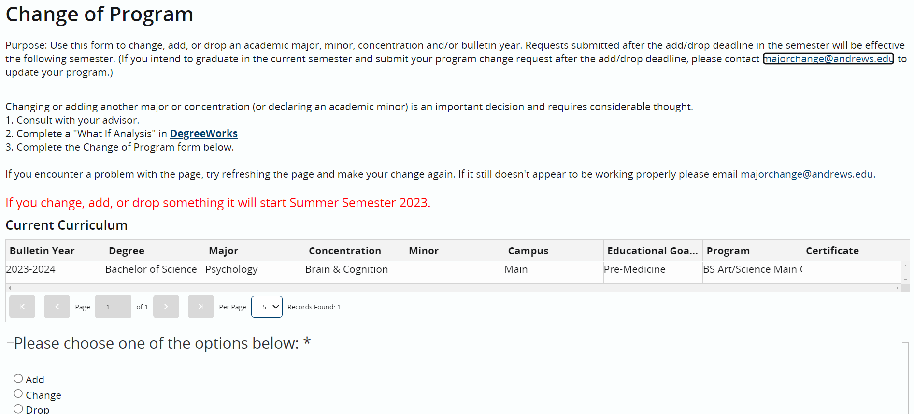
Change of Program

Slide 10
New Initiatives & Changes:
Fall 2023
University Policy Library (bulletin.andrews.edu)
  Academic Policy Changes in effect Fall 2023
25 Live & Academic Schedule
  All face-to-face classes (lecture/lab/seminar/workshop) must include a room location
Registration Process Updates
  Use Registration Central
  Drop/add form separated out as follows:
    Registration Form (only if errors)
    Drop Form (use after registration deadline)
Grade Policy & Process
ePetition
Graduation Process Updates
Notes:
Self-Service Banner
Moving from iVue to SSB Fall 2022
Would like faculty to become familiar w/ Student Advisor SSB and provide feedback
Still in the process of configuration
Automatization of Roles & Assignments
First phase is to automate the assignment of deans, department chairs, program directors, administrative assistants
Currently, testing and reviewing data
Impact
Access to Degree Works & self-service Banner
Changes in employment & student curriculum
Second phase: automate faculty advisor assignments
Change of Program (screenshots)
Soft roll-out: sending change of major form to a select group of students to ensure it is functioning correctly
There are some approvals required depending circumstances which are being tested
ePetition
Currently completing testing within Academic Records
Estimate to have faculty & student testing in the Summer

Slide 11
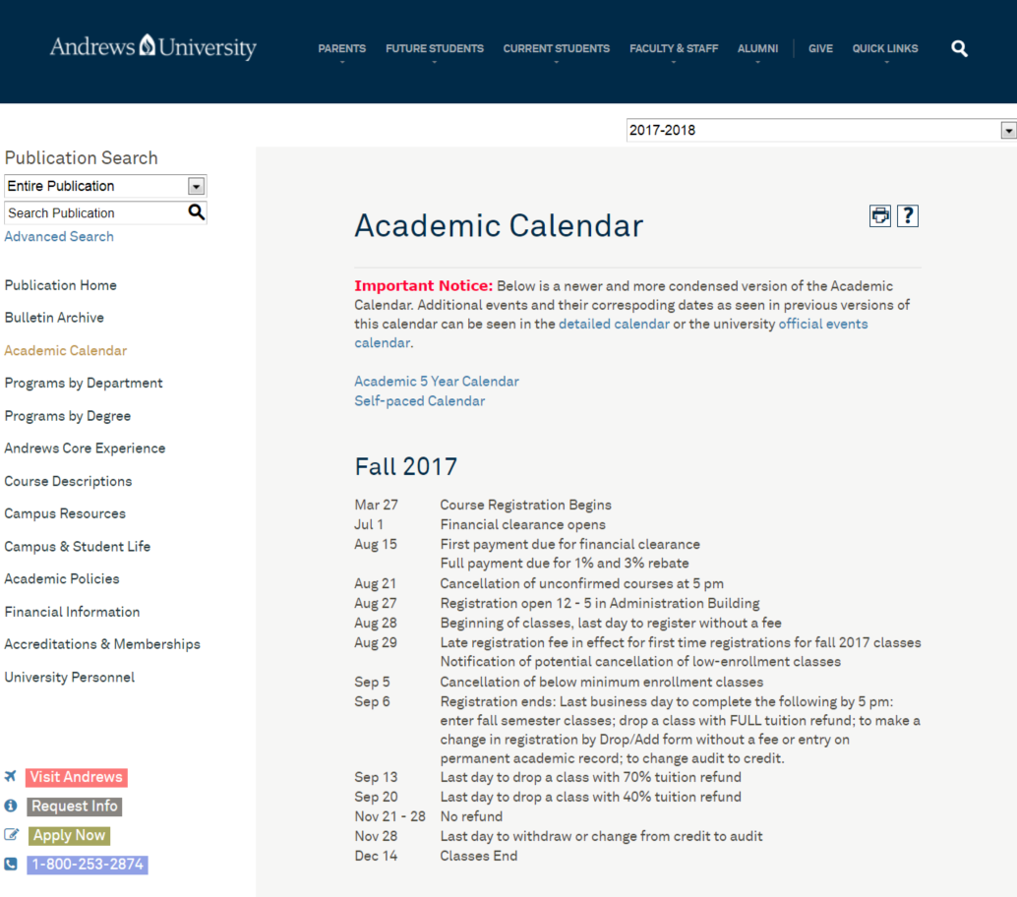
Semester Timeline
Registration Opens (Monday after Spring Break)
Classes Begin
Last day to register (day 10)
  Last day to add a class.
  Last day to drop without a fee.
  Last day to change from credit to audit.
Class Roster Notification
Mid-term Grades Due
Last day to withdraw (65% of the academic term)
Classes End
Final Grades Due (Wednesday after final exams)
bulletin.andrews.edu
Notes:
Glossary of Terms
Financial Cancellation
Drop/add Deadline
Withdrawal Deadline
Census Day: 10 days after the initial drop/add day
Process
Admissions: Students must first be admitted to register
Registration Central (RC): Register online through the Vault website
Financial clearance
Registration of classes
Students consult advisors to register (PINs)
Holds: Clearance in several other departments needed to register
Relevant registration topics for instructors
Registration timeline can be viewed in the Academic Calendar
Registration errors/flags requiring instructor intervention

Slide 12
Important Registration Process Updates (Add)
Prior to Day 10, registrations (add & drop) should be made through Registration Central
  Exceptions use Registration Form (Add Classes)
    Audit
    Time Conflict
    Overload
All classes should be added by the registration deadline (Day 10)
Adding classes after Day 10 will require the registration appeal form (effective Fall 2023)
  Explanation
    Must indicate dates of attendance in addition to explanation
  Required Signatures
    Instructor
    Advisor
    Dean
    Student Financial Services (SFS)
Notes:
Student-centered
Integrity/consistency
*Degree audits ideally should be run and reviewed prior to registering for classes

Slide 13
Important Registration Process Updates (Drop)
Dropping classes after Day 10 and before the withdrawal deadline will require the drop form
  Must include last date of attendance
  Required Signatures
    Instructor
    Advisor
Dropping classes after the withdrawal deadline will require a registration appeal form
  No longer accepting backdate requests. The last date of attendance will be used to determine the effective date of the change.
Notes:
Student-centered
Integrity/consistency
*Degree audits ideally should be run and reviewed prior to registering for classes

Slide 14
Registration Overrides
Online overrides: Go to vault.andrews.edu → Registration → Registration Overrides
Overrides requiring Registration Form (send completed form to academicrecords@andrews.edu)
INSTRUCTOR OVERRIDE | ADVISOR OVERRIDE
Capacity override: Closed Course Co-requisite / Pre-requisite Instructor permission override: Independent Study After instructor override is entered, student can proceed to RC to register. | Repeat Duplicate
INSTRUCTOR SIGNATURE REQUIRED | DEAN’S SIGNATURE REQUIRED
Audits Time Conflict (requires both instructors) | Overload
Notes:
*Encourage use of Registration Central. If an override can be completed online, do not use a drop/add form.

Slide 15
Registration Timeline
Notes:
*Encourage use of Registration Central. If an override can be completed online, do not use a drop/add form.

Slide 16
Grade Policy & Process Updates
An Incomplete (I) can be assigned only if the following stipulations are met
  when the major portion (approximately 70%) of the work for the course has been completed
  student’s work is incomplete because of illness or unavoidable circumstances; incompletes cannot be assigned because of negligence or inferior performance.
  student will earn a passing grade if no additional work is submitted (see minimum grade requirements for ACE, major/minor/cognates, graduate courses).
Ordinarily, incompletes should be resolved prior to the beginning of the next term. However, an I contracted in the spring semester may be extended to the autumn semester. Any request for an extension of time beyond the contracted time shall be made in writing before the end of the contracted date and approved by the dean of the college in which the course is offered.
Students with two incomplete courses may not register for more than 12 credits of new courses. Students with 12 or more credits of incompletes may not register for additional courses. Incompletes must be removed before graduation.
Notes:
Student-centered
Integrity/consistency
*Degree audits ideally should be run and reviewed prior to registering for classes

Slide 17
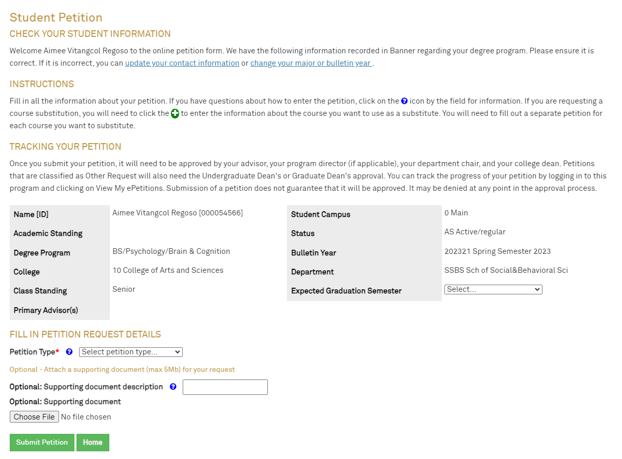
ePetition

Slide 18
Graduation Deadlines
Graduation Date | Level | Application Deadline | DG/Incompletes/Missing Grades Deadline | Project/Thesis/ Comps Completion Forms Due
December 31, 2023 | All Levels | September 21, 2023 | November 30, 2023 | November 30, 2023
May 5, 2024 | Undergraduate | September 21, 2023 | April 18, 2024 | April 18, 2024
May 5, 2024 | Graduate | January 18, 2024 | April 18, 2024 | April 18, 2024
August 4, 2024 | All Levels | May 16, 2024 | July 18, 2024 | July 18, 2024
Notes:
The graduate level application is online; the link is sent in the graduation deadlines email; it is also on the website.

Slide 19
Communication to Juniors
Check progress in Degree Works
Confirm program of study (major, concentration, minors) are correct
Register for Fall 2023 and Spring 2024 classes
After registering for Fall and Spring classes, go back to Degree Works to view Degree Progress.
  If the circle above Requirements is at 98%, and the circle above Credits is at 100%, you are ready to apply for graduation. You are on track to meet all your graduation requirements.
  If your circles don’t show 98% and 100%, review missing requirements and consult with advisor.
For students not showing 98% and 100%, you may need to do any or all of the following:
  Submit petitions for any courses you are going to substitute with another course or for any courses that you will be waiving
  If you plan to take a course at another college/university, submit a Transient Form
    Request the transcript to be sent as soon as you have finished the course
    Take all courses you plan to transfer into your degree no later than Fall Semester. If you take any transfer classes during Spring Semester, the transcript with the class(s) may not be available until too late to include you in May graduation, and you will have to graduate in August instead.
  If you plan to use any Credit for Prior Learning (CBE, CLEP, etc) toward your degree, make sure that the Credit for Prior Learning requests are submitted no later that the beginning of Spring Semester
  If you have any DG or I grades, complete the coursework to finish these classes.
Notes:
Student-centered
Integrity/consistency
*Degree audits ideally should be run and reviewed prior to registering for classes

Slide 20
Important Graduation Process Updates, effective Fall 2023
Undergraduate/Graduate Checklist for Graduating Students (requires student and advisor signatures)
SSB Graduation Application
  Will not be able to accept late applications using the SSB Graduation Application
Graduation Appeal Form (online form)
  New form for late graduation applications
Graduation Revision Form (for undergraduate/graduate students)
Notes:
Student-centered
Integrity/consistency
*Degree audits ideally should be run and reviewed prior to registering for classes

Slide 21
Academic Records Overview Q&A

