Slide 1
Helping Student Employees Thrive
José Bourget and Joydel Trail

Slide 2
Vocational Discernment
“A vocation is an approach to a particular life role that is oriented toward demonstrating or deriving a sense of purpose, or meaningfulness, and that holds other-oriented values and goals as primary sources of motivation.” (Dik & Duffy, 2009)
Why am I here? In this city? In this job? In this church? In this club? In this group?
Where should I be going? What should I be doing? How should I be living my life?

Slide 3
Vocation - A Biblical Basis
“I therefore, the prisoner of the Lord, beseech you that ye walk worthy of the vocation wherewith ye are called,” Ephesians 4:1 KJV
“As a prisoner for the Lord, then, I urge you to live a life worthy of the calling you have received.” Ephesians 4:1 NIV

Slide 4
Vocation - Adventist Education
God will accept the youth with their talent and their wealth of affection, if they will consecrate themselves to Him. They may reach to the highest point of intellectual greatness; and if balanced by religious principle, they can carry forward the work which Christ came from heaven to accomplish.

Slide 5
Vocation - Adventist Education
The students at our colleges have valuable privileges, not only of obtaining a knowledge of the sciences, but also of learning how to cultivate and practice virtues which will give them symmetrical characters.
They are God's responsible moral agents. The talents of wealth, station, and intellect are given of God in trust to man for his wise improvement. These varied trusts He has distributed proportionately to the known powers and capacities of His servants, to every man his work.

Slide 6
Vocation - Adventist Education
And the Giver expects returns according to the gifts. The humblest gift is not to be despised. Everyone has his peculiar sphere and vocation. He who makes the most of his God-given opportunities will return to the Giver, in their improvement, an interest proportionate to the entrusted capital.
The Lord does not reward the large amount of labor. He does not regard the greatness of the work so much as the fidelity with which it is done. The good and faithful servant is rewarded. As we cultivate the powers God has given us, we shall increase in knowledge and perception.
Counsels to parents, teachers, and students pg 512

Slide 7
The importance of Vocational Discernment for students
Capabilities
Present Activities
Goal Setting
Decision making
Recognizing God-given opportunities
Preparation and Effort
Notes:
“…colleges need to reflect on and embody their central educational missions; they should use all means possible to help students connect with that mission, believe in it, embody it, and gain from it over the course of a lifetime.”- Wendy Fischman and Howard Gardner, Chronicle of Higher Education
“[students] approach college with a “transactional” view — their overarching goal is to build a résumé with stellar grades, which they believe will help them secure a job post-college”- Wendy Fischman and Howard Gardner, Chronicle of Higher Education
Capabilities: “The specific place appointed us in life is determined by our capabilities” - Vocation by GC dept. Of ed.
Present Activities: “choices of hobbies, part-time work, and school classes indicate interests, aptitudes, amd achievements necessary for success.” - Vocation - GC dept of ed.
Goal Setting:
Let God select the place: “God knows the specific occupation and the specific locations where we can best use them.” Vocation by GC Dept. of ed.
Recognizing God-given opportunities: “When we work along God’s lines, trusting him, He will open up opportunities for career development.” - Vocation by Dept of Ed. GC
Preparation and Effort: “True success in any line of work in not the result of chance or accident or destiny. It is the outworking of God’s providences, the reward of faith and discretion, or virtue and perseverance.” - PK 486.

Slide 8
GOV Overview
NetVUE grant
Leverage student employment
Mentorship
Vocational discernment
Notes:
Network for Vocation in Undergraduate Education Academy Grant: $18,550 over 2 years
Intended to help member colleges and universities strengthen the connection between liberal arts and career preparation.
Deepen the intersection between the Center for Faith Engagement, Office of Undergraduate Education and the Career Center
Identifies and shares best practices for vocational discernment across the university an institutional culture which reflects that understanding of vocation and calling.
Aims to establish the practice of teaching vocational exploration: introduced to the curriculum beginning with a redesign of “God and Human Life,” taught by Dr. Rodney Palmer, chair of the Department of Religion & Biblical Languages. The restructured course provides students with an understanding of the concept of vocation and calling from a Christian and theological perspective. It also assists students in their process of self-discovery through an in-depth analysis of how their personal stories, spiritual gifts, talents and strengths correlate with their life, learning, anticipated professions and civic responsibility. These objectives will be assessed through the completion of a spiritual gifts inventory, Strong Interest Inventory and service-learning activity.
Focus on career readiness through the National Association of Colleges and Employers (NACE) competences.

Slide 9
Benefits for students
Experiential learning
Mentorship
Possible future opportunities
Professional networking
Potential financial gain
Notes:
Must be a current student employee
Supervisors must agree to participate in mentorship activities (20 minutes per month)

Slide 10
Benefits for supervisors
Opportunities for future, full time employee talent pool
Advancement of AU Strategic Plan
Enhanced leadership skills
Attractive incentive for recruitment
Access to lunch and learns (Oct. 18, Nov. 8)
Notes:
AU Strategic plan: Expanding access to support services…with increased focus on mental health, careers and vocation

Slide 11
Spring 2023 Pilot
CFE Student Employees
SkillSurvey evaluation
39 students, 92.9% would work with students again
Notes:
SkilSurvey, online career readiness evaluation tool that provides a career readiness report that provides students feedback on how 'career ready' they are following their internship and discover insights into how they compare to a national sample of other students in 8 competencies.

Slide 12
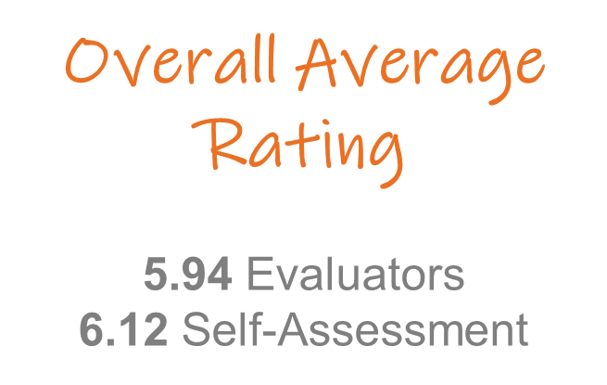
Career Readiness Ratings at a Glance - Evaluator Feedback
Highest rating behaviors
1.Treat other people, including those of different backgrounds, beliefs, and gender, with fairness and respect
2.Show a high level of dedication toward doing a good job
3.Demonstrate dependability (e.g., report consistently, and on time, for work or meetings)
4.Write in a way that conforms to the basic principles of spelling, grammar, and punctuation
5.Have an attention to detail, resulting in few if any errors in their work
Lowest rating behaviors
1.Accurately summarize and interpret data
2.Use innovative thinking to go beyond traditional methods
3.Use technology to improve efficiency and productivity of their work
4.Show an awareness of own strengths and areas for development
5.Multi-task well in a fast-paced environment

Slide 13
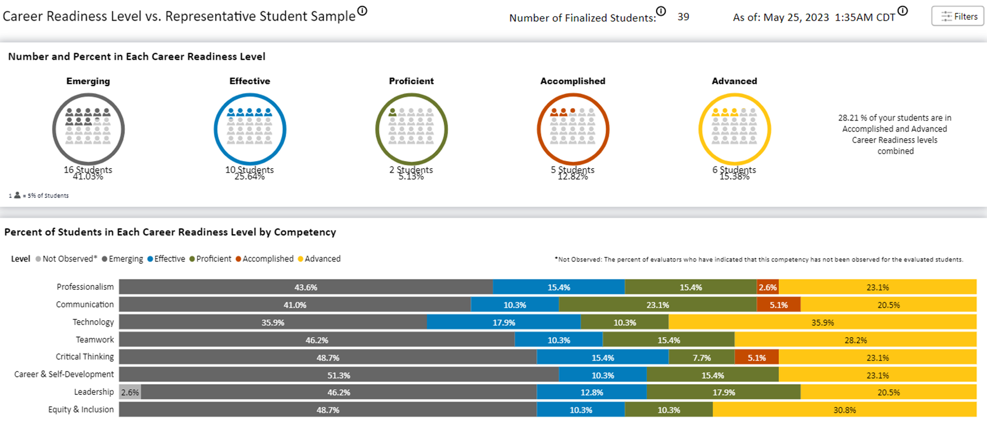
National Comparison

Slide 14
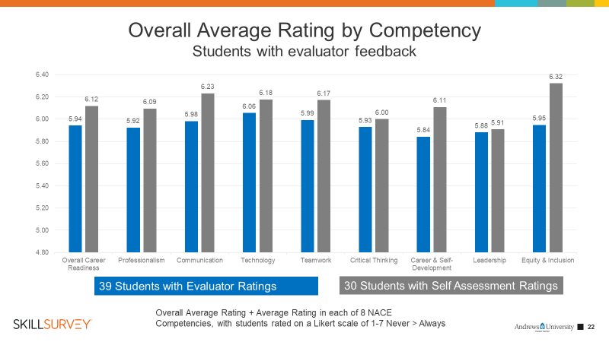
Overall Average Rating by Competency

Slide 15
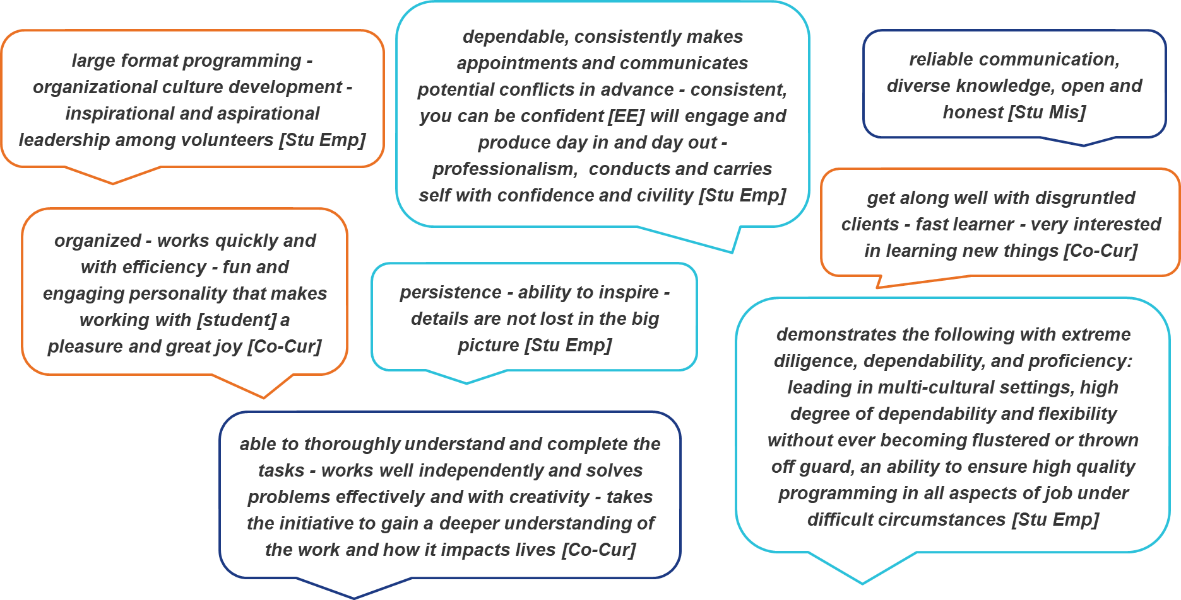
Evaluator Comments on Students’ Areas of Strengths

Slide 16
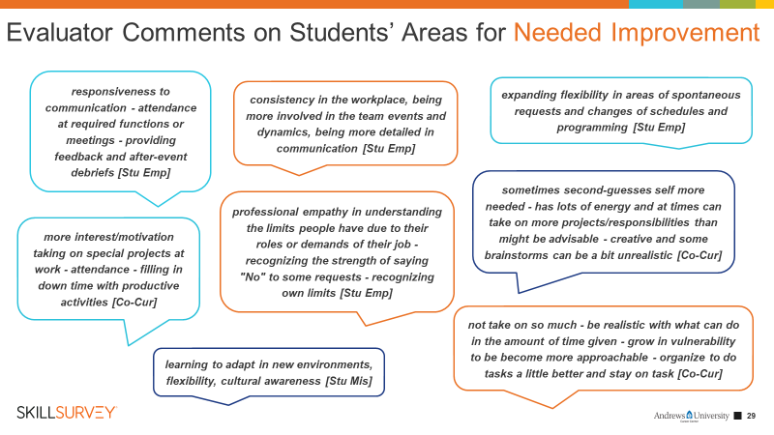

Slide 17
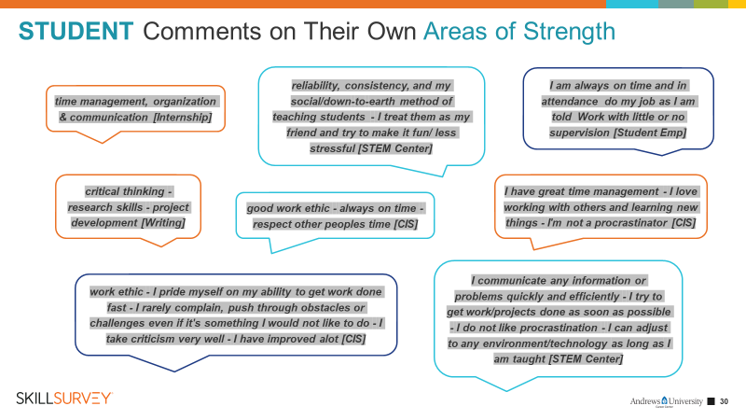

Slide 18
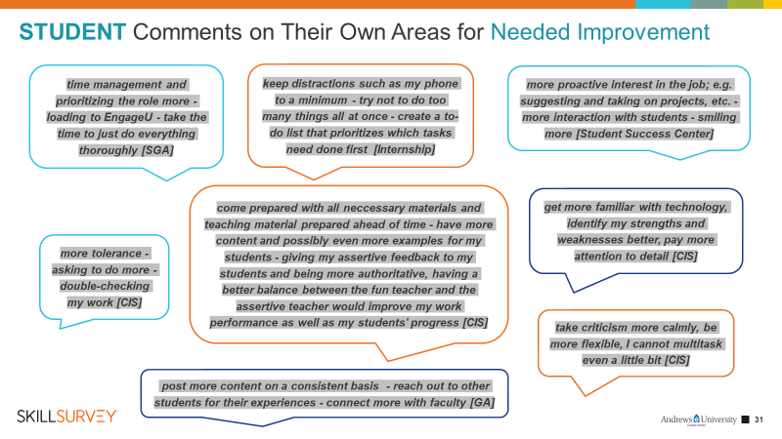

Slide 19
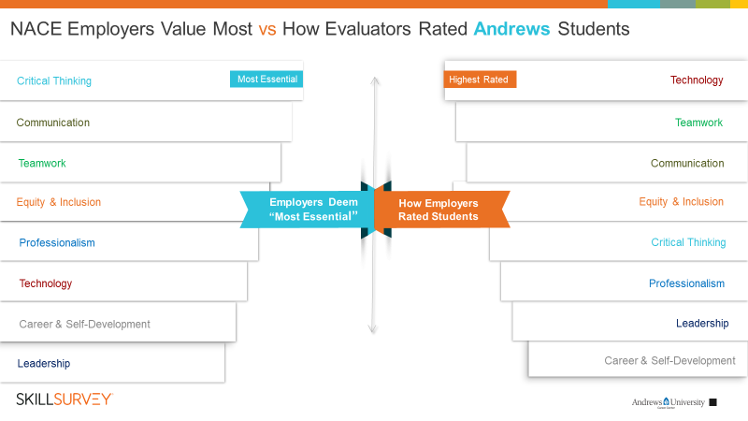

Slide 20
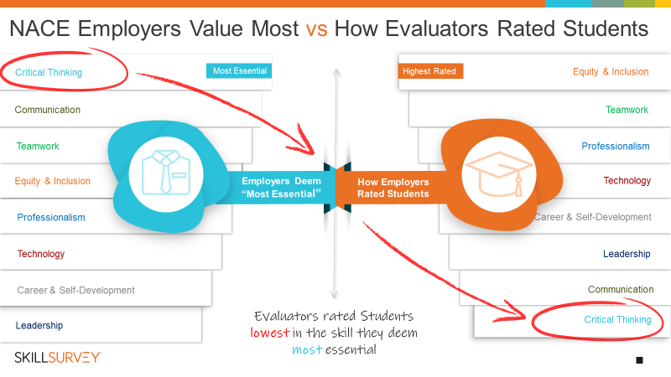
Notes:
National

Slide 21
How it works
Student Employee supervisor opt-in
Identify NACE competencies for mentorship
Semesterly 2-hour orientation
Conduct monthly, 20-minute 1:1 or group mentorship meetings
Student evaluations
Students participate in professional development (led by Career Center, CFE, Dept. of Religion)
  Speaker Series, Lunch and Learns, Career Coaching Sessions, Reflection exercise
Notes:
Student Eligibility & Commitment
Must be a currently enrolled undergraduate student
Must be employed as a student employee on campus (paid and unpaid positions)
Must have an identified direct supervisor willing to participate in the program and who has completed and submitted the Going on Vocation Application Form
Must have at least 4 semesters remaining
Attendance at a 2-hour orientation
Completion of a 10-minute career readiness self evaluation via SkillSurvey each year
Participation in a student evaluation briefing with supervisor at the end of the year
Participation in 9 hours of professional development activities each semester
Supervisor Eligibility & Commitment
Identification of NACE career readiness competencies for focus of mentorship and development with each student employee
Attendance at a 2-hour orientation
Commitment to 20 minutes per month of mentorship meetings (group of individual)
Completion of a 10-minute student evaluation via SkillSurvey at the end of the year for each student employee
Completion of a student evaluation for each student employee and briefing with each student at the end of the year
Completion and submission of the Going on Vocation Application form before the deadline on Sept. 1, 2023

Slide 22
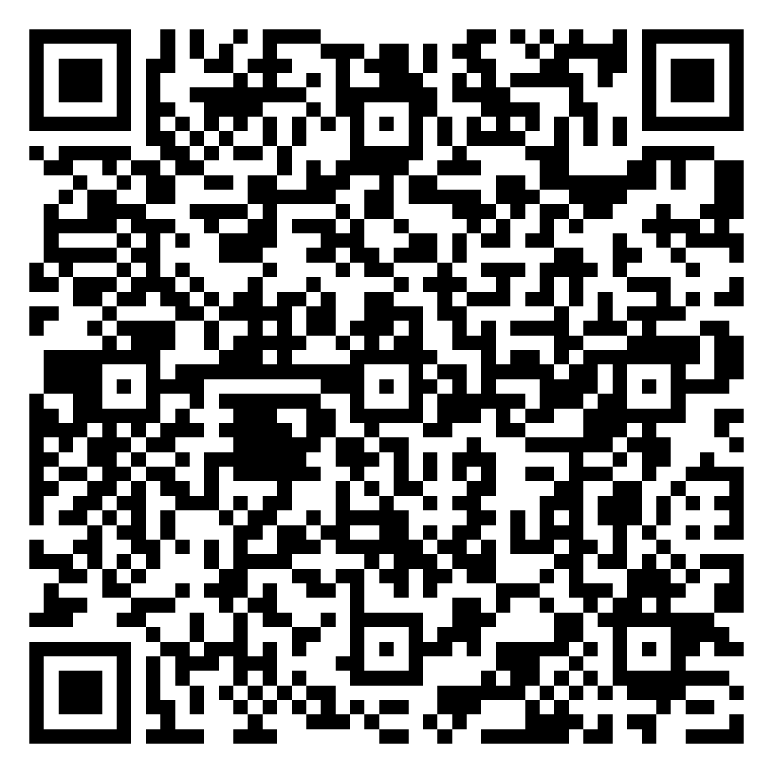
How to participate
Submit Going on Vocation Application Form
www.andrews.edu/go/career
  Going on Vocation page
Deadline: Sept. 1
Contact: Joydel Trail
  joydel@andrews.edu, (269) 471-6214

