Slide 1
Identifying your role in the Student Experience
Presented by: Joshua Baltazar

Slide 2
OBJECTIVES
Learn and understand our audience
Know our tools
Identify your role in the student experience
Inspire you to always be thinking about and render exceptional customer service in all aspects of your jobs

Slide 3
AUDIENCE
Who do we provide service to?
          Students
          Faculty
          Staff
          Parents
          Alumni
          The Community
          Each other!

Slide 4




AUDIENCE
Generation Z
1995 -2009
Millennials 1981-1994
Generation X 1965-1980
Baby Boomers 1946-1964
60 million
20% of the
U.S. population in 2020.
75 million
50% of the workforce in 2020
66 million
20% of the workforce in the U.S. in 2020
74 million and declining 22% of the U.S. workforce in 2020
Grew up surrounded by technology
Barely remember 9/11
Shaped by mass shootings and helicopter parents
Grew up in a time of economic, political, and social change
iPhone generation
“Peter Pan
generation,”
delaying adulthood
Creators of the
sharing economy
Financial habits shaped by 2008 financial crisis
Social media
“Sloan Rangers”, “Yuppies”
Average 7 career changes in their lifetime
“MTV Generation”
“Late to marry, quick to divorce”
Independent, resourceful, and self- sufficient
The first TV generation
Experienced two-income households
Lived through JFK and Martin Luther King assassinations
Strong work ethic
and goal-oriented
Source: http://fourhooks.com/Amarketing/the-generation-guide-millennials-gen-x-y-z-and-baby-boomers-art5910718593/

Slide 5

AUDIENCE
Qualities of Generation Z
Fiscally Frugal
Multitaskers
Connected
Aware
Brand Loyal
Diverse
Confident
Short Attention Span
Resourceful
Entrepreneurial
Smartphone Natives
8-Second Attention Span
Communicate Online
48%
Nonwhite
Perceive Information Visually
Environmentally Aware
Source: www.npr.org/2018/11/15/668106376/generation-z-is-the-most-racially-and-ethnically-diverse-yet

Slide 6
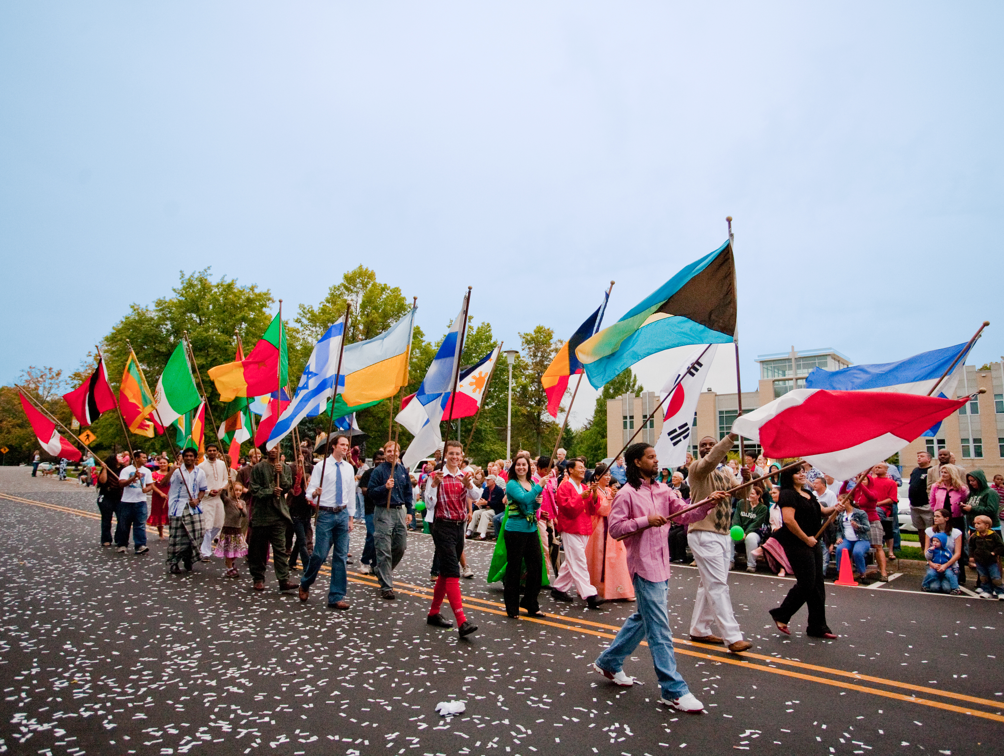
AUDIENCE
Common Challenges Faced by International Students In the USA
                Mastering the English language
                Making new friends
                Battling homesickness
                Culture change and festive periods
                Financial crunch
                Getting used to the climate
                Not being able to communicate with family

Slide 7
AUDIENCE
Andrews University Undergraduate vs Graduate Students
Top 5 Out of Class needs

Slide 8
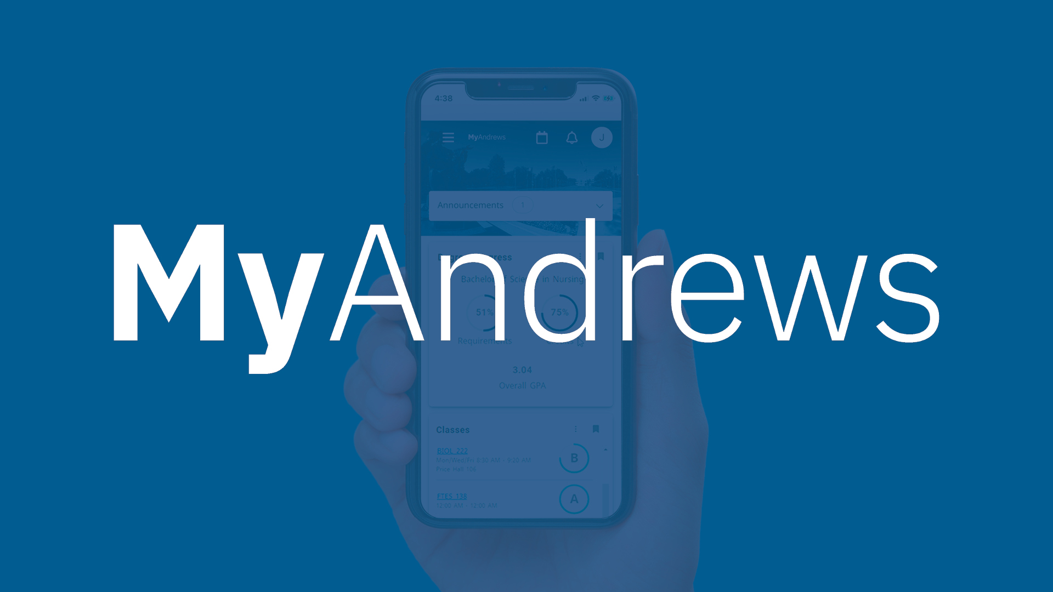
https://www.andrews.edu/go/myandrews

Slide 9

CUSTOMER SERVICE
Develop a customer service mindset
This means that students would choose Andrews University because we:
          care about them,
          help them unlock their potential,
          treat them with care and respect,
          proactively listen to their needs and concerns,
          keep them informed about things that could affect them,
          and, most importantly, provide them with accurate and timely answers to their questions.
Don’t use the phrase “it’s not my job”
Keep the campus clean
Encourage the use of Personality and Personalization

Slide 10
CUSTOMER SERVICE
We need to be competent and knowledgeable about how we do our jobs
Look through the lens of the student
Every student touchpoint is an opportunity to build a relationship
Always deliver on your promises
Always be an ambassador for Christ

Slide 11
ACTIVITIES
    Yes and…
    The Vacation
    Thank you

Slide 12
What is your role in the
student experience?

Slide 13
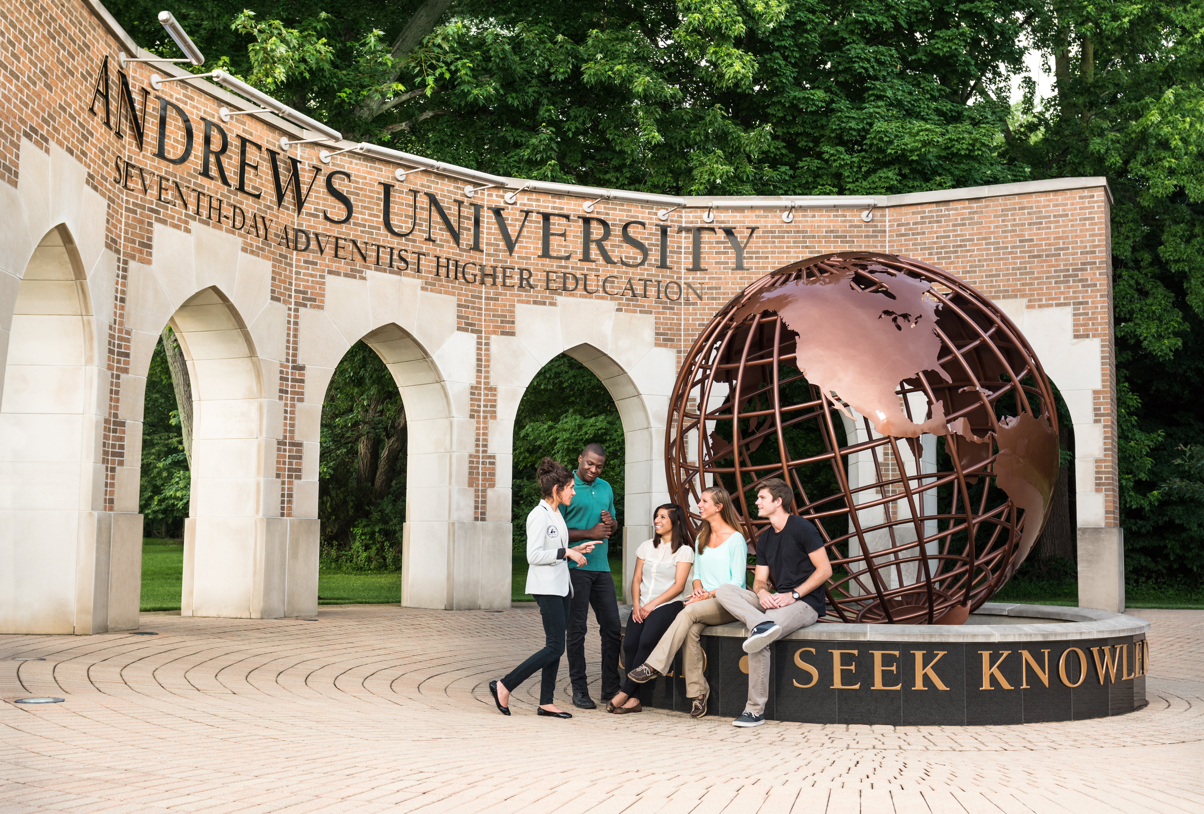
CONCLUSION
Organizational Values
  Compassion
  Trust
  Integrity
  Humility
  Wellbeing
  Justice
  Innovation

Slide 14
CONTACT INFORMATION
Joshua Baltazar
Service Systems Architect
Office of the Provost
212 Administration Building
baltad@andrews.edu
MyAndrews Portal
https://www.andrews.edu/go/myandrews

