Slide 1
Rich Task Denise Shaver

Slide 2
Rick Tasks:
Interdisciplinary project
Employs various teaching and learning methods
http://learningschool.wikispaces.com/What+is+a+Rich+Task

Slide 3
Display Learning Progress
Real World Issue
Reflective
Collaborative
Foster Active learning
Interesting
Skill development
Aubusson, P., Burke, P., Schuck, S., Kearnery, M. & Friscknecht, B. (2014). Teahers Choosing Rich Task: The Moderating Impact of Technology on Student Learning, Enjoyment, and Preparation. Educational Researcher, 43 (5).

Slide 4
Degree Qualifications Profile
Broad Integrative Knowledge
Applied and Collaborative Learning
Describes and evaluates the ways in which at least two fields address and interpret a problem in science, the arts, society, human services, economic life, or technology
Prepares and presents a project or appropriate demonstration linking knowledge or skills acquired in one or more fields of study

Slide 5
Think-Pair-Share
Do you have any assignments that are rich according to this definition?
Real World
Reflective
Collaborative
Foster Active Learning
Interesting
Skill Development
3 minutes

Slide 6
Inclusive Teaching
Inclusive teaching strategies refer to any number of teaching approaches that address the needs of students with a variety of backgrounds, learning styles, and abilities. These strategies contribute to an overall inclusive learning environment, in which students feel equally valued.
http://www.cte.cornell.edu/teaching-ideas/building-inclusive-classrooms/inclusive-teaching-strategies.html

Slide 7
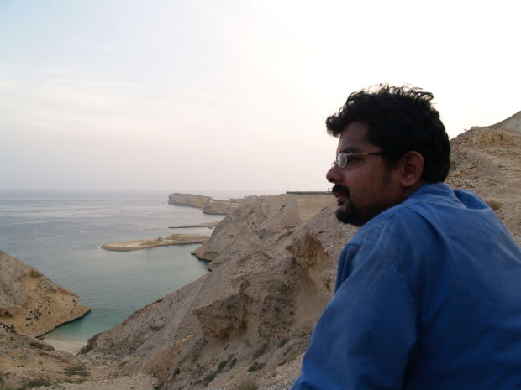
Inclusive AU examples
Ponder the definition of inclusive teaching
Identify two instructional techniques you use
How can you enhance your inclusive approach?
5 minutes
Image URI: http://mrg.bz/xOc6wt
End

Slide 8
Globalization
Learners aware of global inter-connectivity
Values transnational interdependence
Collaboration extends beyond national borders
Focus on multicultural perspectives
Global civic knowledge

Slide 9
Globalization Assessment

Slide 10
Technology Inclusion
Interdisciplinary
Inclusive
Global
Project
Technology
Wiki-spaces
Google docs
Google Present-
ations
Digital Story telling
Videocon-ferences

Slide 11
Rich Assignment Ideas
Collaborative | Individual
Defend contextual word spelling variation (Wikispaces) | Present oral story (Digital storyboard)
Different perspectives on same topic (Google Presentations) | Argue an opposing perspective (Google docs)
Peer idea exchange (Videoconference) | Academic journaling (Blogs)

Slide 12
Examples
Have you tried these?
Academic journaling
Digital Storytelling
Google Presentations

Slide 13
Works Cited
Aubusson, P., Burke, P., Schuck, S., Kearnery, M. & Friscknecht, B. (2014). Teahers Choosing Rich Task: The Moderating Impact of Technology on Student Learning, Enjoyment, and Preparation. Educational Researcher, 43 (5).
http://www.cte.cornell.edu/teaching-ideas/building-inclusive-classrooms/inclusive-teaching-strategies.html
http://learningschool.wikispaces.com/What+is+a+Rich+Task

