Slide 1
New challenges in education: Diversity and Multiculturalism in a Global Environment
M. Alfredo mejia, drph, ms, rdn
Andrews University
Department of public health and wellness

Slide 2
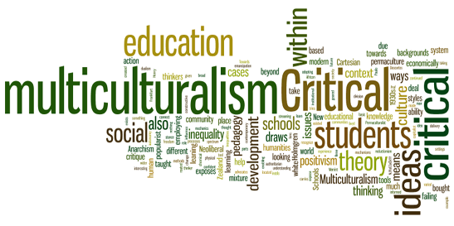

Slide 4
Acquiring cultural competencies in a customer oriented educational market
Multicultural Immersion?
Formal Instruction?

Slide 5
The reality of globalization
Transformations of personal identity in a multicultural environment
Multilingualism
Bilingualism
Soldatova, G. and M. Geer (2013). "“Glocal” Identity, Cultural Intelligence and Language Fluency." Procedia - Social and Behavioral Sciences 86: 469-47

Slide 6
Required competencies of faculty in a customer oriented educational market
Cultural competence
Cultural intelligence

Slide 7
Cultural intelligence (CQ)
“…refers to ability that someone has, so he can build good interaction with other people and do interpersonal tasks.”
Crowne, K. A. (2009). "The relationships among social intelligence, emotional intelligence and cultural intelligence." Organization Management Journal 6(3): 148-163.

Slide 8
Learning activity
Discuss in small groups the following question:
How a diverse environment, like Andrews, can foster growth in Cultural Intelligence (CQ)?

Slide 9
Learning activity
Take a few minutes to assess your Cultural Intelligence (CQ)

Slide 10
Metacognitive Cultural Intelligence (CQ)
Questionnaire Items | Your Score 1 ………………… 7 Strongly Strongly Disagree Agree
I am conscious of the cultural knowledge I use when interacting with people with different cultural backgrounds.
I adjust my cultural knowledge as I interact with people from a culture that is unfamiliar to me.
I am conscious of the cultural knowledge as I apply to cross-cultural interactions.
I check the accuracy of the cultural knowledge as I interact with people from different cultures.
TOTAL SCORE (4-28)
Copyrighted by the Cultural Intelligence Center 2005. The Cultural Intelligence Scale can be used for research.

Slide 11
Cognitive Cultural Intelligence (CQ)
Questionnaire Items | Your Score 1 ………………… 7 Strongly Strongly Disagree Agree
I know the legal and economic systems of other cultures.
I know the rules (e.g., vocabulary, grammar) if the other languages.
I know the cultural values and religious beliefs of other cultures.
I know the marriage systems of the other cultures.
I know the arts and crafts of the other cultures.
I know the rules for expressing nonverbal behaviors in other cultures.
TOTAL SCORE (6-42)
Copyrighted by the Cultural Intelligence Center 2005. The Cultural Intelligence Scale can be used for research.

Slide 12
Motivational Cultural Intelligence (CQ)
Questionnaire Items | Your Score 1 ………………… 7 Strongly Strongly Disagree Agree
I enjoy interacting with people from different cultures.
I am confident that I can socialize with locals in a culture that is unfamiliar to me.
I am sure I can deal with the stresses of adjusting to a culture that is new to me.
I enjoy living in cultures that are unfamiliar to me.
I am confident that I can get accustomed to the shopping conditions in a different culture.
TOTAL SCORE (5-35)
Copyrighted by the Cultural Intelligence Center 2005. The Cultural Intelligence Scale can be used for research.

Slide 13
Behavioral Cultural Intelligence (CQ)
Questionnaire Items | Your Score 1 ………………… 7 Strongly Strongly Disagree Agree
I change my verbal behavior (e.g., accent, tone) when a cross-cultural interaction requires it.
I use pause and silence differently to suit different cross-cultural situations.
I vary the rate of my speaking when a cross-cultural situation requires it.
I change my nonverbal behavior when a cross-cultural situation requires it.
I alter my facial expressions when a cross-cultural interaction requires it.
TOTAL SCORE (5-35)
Copyrighted by the Cultural Intelligence Center 2005. The Cultural Intelligence Scale can be used for research.

Slide 14
Growing in cultural intelligence

Slide 15
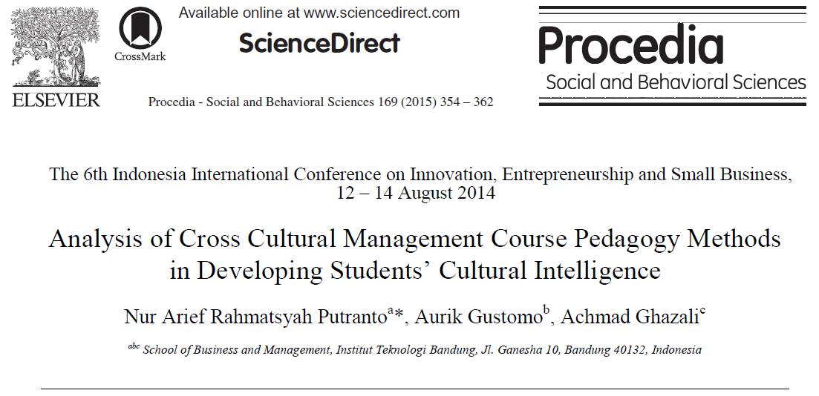
Cultural intelligence (CQ)
Treatments to improve CQ:
Lecturing (least effective)
Reading literature
Sharing session
Field trip (most effective)
Putranto, N. A. R., et al. (2015). "Analysis of Cross Cultural Management Course Pedagogy Methods in Developing Students’ Cultural Intelligence." Procedia - Social and Behavioral Sciences 169: 354-362.

Slide 16
Cultural intelligence (CQ)
Treatments to improve CQ:
Lecturing (least effective)
Reading literature
Sharing session
Field trip (most effective)
All the four methods increase cultural intelligence
Putranto, N. A. R., et al. (2015). "Analysis of Cross Cultural Management Course Pedagogy Methods in Developing Students’ Cultural Intelligence." Procedia - Social and Behavioral Sciences 169: 354-362.

Slide 17
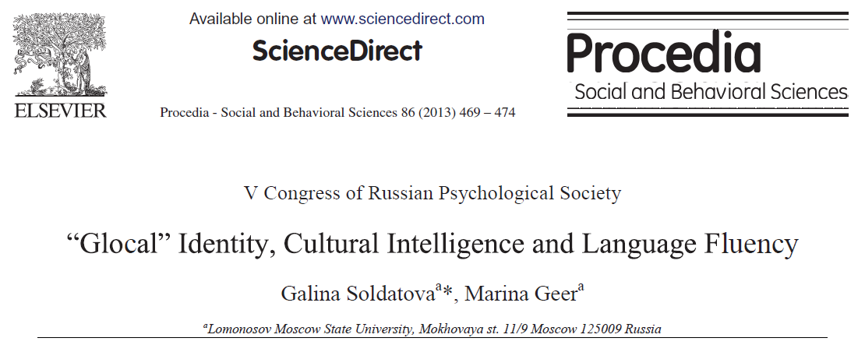
Soldatova, G. and M. Geer (2013). "“Glocal” Identity, Cultural Intelligence and Language Fluency." Procedia - Social and Behavioral Sciences 86: 469-47

Slide 18
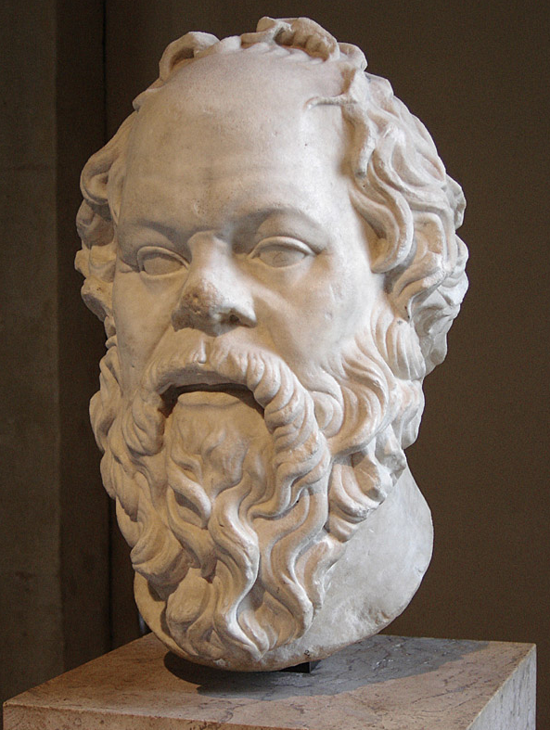
“I am a citizen, not of Athens nor Greece, but from the world.”
Socrates
Contemporary identity:
“I am a citizen, of Athens, Greece and the World.”
Soldatova, G. and M. Geer (2013). "“Glocal” Identity, Cultural Intelligence and Language Fluency." Procedia - Social and Behavioral Sciences 86: 469-47

Slide 19
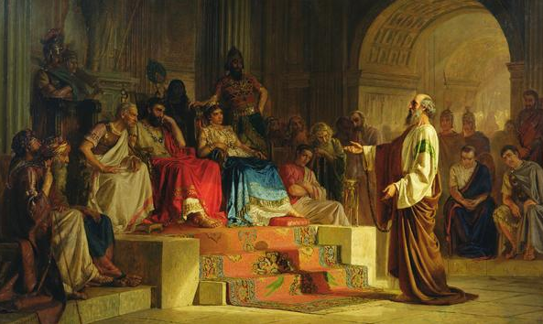
People with high cultural intelligence
“To the weak I became weak, to win the weak. I have become all things to all people so that by all possible means I might save some.”
1 Corinthians 9:22
“I am obligated both to Greeks and non-Greeks, both to the wise and the foolish.”
Romans 1:14

Slide 20
Levels of cultural intelligence (CQ)
Universal
(knowledge about the world)
Real
(knowledge and ability to deal within different cultural settings, within concrete circumstances “here and now”)
Cultural
(knowledge about another culture or cultures)
Soldatova, G. and M. Geer (2013). "“Glocal” Identity, Cultural Intelligence and Language Fluency." Procedia - Social and Behavioral Sciences 86: 469-47

Slide 21
Learning activity
Discuss in small groups the following question:
Share some ideas that have been effective increase your personal cultural intelligence or the cultural competence of your students.

Slide 22
GRACIAS THANKS MERCI OBRIGADO

