Slide 1
2010 Assessment report
Teacher Education Council
November 2, 2010
Andrews University School of Education

Slide 2
SED Programs & Enrollment 2009-2010
Teaching, Learning, & Curriculum | Educational & Counseling Psychology | Leadership & Educational Administration
Teacher Educationª (~150) Elementary Secondary Curriculum & Instructionª | School Counseling^{b} (5) School Psychology^{c} (21) Special Educationª (1) Comm. Counseling^{b} (20) Educational Psychology (27) Counseling Psychology (26) | K-12 Educ. Admin.^{d} (30) Higher Educ. Admin. (32) Leadership (118)
ªNCATE and corresponding Specialized Professional Associations (SPAs) ^{b}CACREP ^{c}NASP and NCATE ^{d}NCATE and ELCC

Slide 3
SED Conceptual Framework
Worldview
Human Growth & Change
Groups, Leadership & Change
Communication & Technology
Research & Evaluation
Personal & Professional Growth

Slide 4
SED Dispositions
The SED graduate . . .
Believes that all students can learn
Is committed to service
Values fairness
Values personal and professional growth
Is committed to inquiry
Values respectful communication
Recognizes personal leadership responsibility
Values diversity

Slide 5
SED Assessment System
Impact on P-12 Student Learning
Professional Knowledge, Skills, & Dispositions
Content Knowledge
Candidate Performance
Program Quality
Curriculum
Field Experiences
Quality & Diversity
Enrollment
Trends & Diversity
Candidate Suppport Services
Advisement, Library, Technology, Career Placement Services
Unit Operations
Governance
Leadership & Structures
Policies & Procedures
Budget Allocations
& Expenditures
Facilities
Faculty Performance
Qualifications
Preparation, Professional Development,
& Experience
Performance
Teaching,Scholarship,
& Service
Workload
Faculty Performance
Program Quality
Candidate Performance

Slide 6
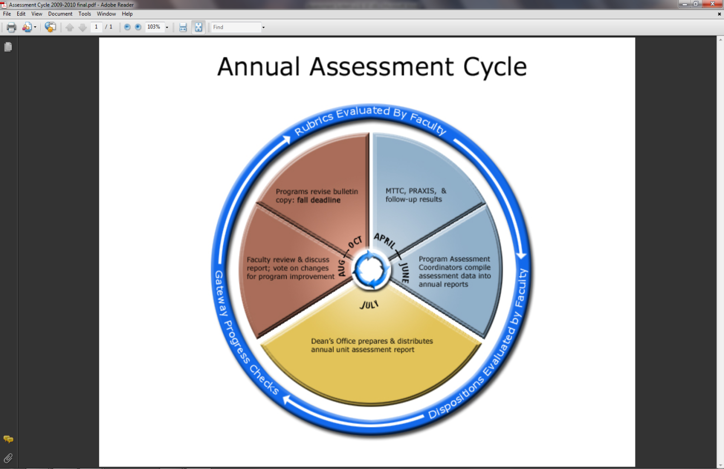
SED Assessment Cycle

Slide 7
Assessments in SED
Course grades
Dispositions ratings
Rubrics for key assignments
Standardized tests (MTTC, PRAXIS)
Comprehensive exams
Portfolios
Field/clinical performance ratings
Thesis/Dissertation

Slide 8
Teacher Education

Slide 9
Enrollment, 2009-2010
Program | Elem # | Sec # |  | Program | Elem # | Sec #
Art |  | 5 |  | Int. Lang.: Spanish |  | 13
Biology |  | 1 |  | Language Arts | 10
Chemistry |  | 1 |  | Math & Math Education | 14
Communication |  | 2 |  | Music Education |  | 27
English |  | 31 |  | Physics |  | 1
ESL |  | *1 |  | Political Science |  | 1
History |  | 6 |  | Religion |  | 4
Integrated Science | 1 | 2 |  | Social Studies | 5 | 11
Int. Lang.: French |  | 1 |  | *MAT students | 12 | 5
Numbers from Banner, may include students not yet accepted into teacher education.

Slide 10
Program Completion 2009-2010
Number completing student teaching = 27
Program completion rate (6 yrs) = 90%
Number of program completers = 27
  Percent minority candidates = 41%
  Percent in high need areas = 52%
  (math, sciences, world languages)

Slide 11
Michigan test for Teacher Certification
Basic Skills
  22 candidates
  100% pass rate vs. 91% statewide
Content Area Tests
  28 candidates
  96% pass rate vs. 85% statewide

Slide 12
CAS Course Grade summaries
Content Area | # (in all courses*) | % Satisfactory C+ or above
Art | 28 | 100
Biology | 2 | 100
Chemistry | 2 | 100
Communication | 26 | 93
English | 77 | 72
History, Pol. Sci., Social Studies, Econ | 131 | 80
International Languages | 6 | 100
Mathematics | 39 | 54
Physics | 5 | 83
*# may include same students in multiple classes

Slide 13
Portfolio rubrics
Course | Rubric | # Students | % at Levels 3-5* | Mean*
EDTE165 | Portfolio rubric | 56 | 90 | 3.5
EDTE408 | Element 1 (worldview) | 24 | 97 | 4.5
EDTE408 | Element 2 (growth & change) | 24 | 93 | 4.4
EDTE408 | Element 3 (groups, leadership, & change) | 24 | 93 | 4.4
EDTE408 | Element 4 (communication & technology) | 24 | 91 | 4.4
EDTE408 | Element 5 (research & evaluation) | 24 | 93 | 4.4
EDTE408 | Element 6 (personal & professional growth) | 24 | 88 | 4.2
EDTE408 | Element 7 (content) | 24 | 85 | 4.2
*Percentage and mean include all indicators on rubric

Slide 14
Other key rubrics
Course | Rubric | # Students | % at Levels 3-5* | Mean*
EDTE288 | Clinical Observation & Interaction Matrix | 32 | 94 | 4.5
EDTE408 | Micro-teaching Assessment | 26 | 98 | 4.6
EDTE417 | Implementation Plan | 2 | 100 | 5.0
EDTE424 | Test Creation Project | 24 | 98 | 4.7
EDTE424 | Philosophy of Assessment | 24 | 99 | 4.7
EDTE459 | Summative Evaluation | 13 | 100 | 4.8
EDTE480 | Classroom Management Plan | 18 | 100 | 4.7
*Percentage and mean include all indicators on rubric

Slide 15
Student teaching rubrics
Course | Rubric | # Students | % at Levels 3-5* | Mean*
EDTE487 | Impact on K-12 Student Learning | 18 | 99 | 4.4
EDTE488/ 588 | Student Teaching Summative Evaluation | 11 | 98 | 4.6
*Percentage and mean include all indicators on rubric

Slide 16
Educational & Counseling Psychology

Slide 17
Summary of Program Assessments
Program | # Enrolled 2009-10 | PRAXIS | Comps | Portfolio | Intern. | National Exam | Dissert
School Counseling | 5 |  | 1/1 |  | 2/2 | 1/1
School Psychology | 21 | 4/4 | 4/5 | 2/2 | 2/2
Community Counseling | 20 |  | 8/8 |  | 10/12 | 1/1
Counseling Psychology | 26 |  | -- |  | -- |  | --
Educational Psychology | Masters 9+22 EdS 7 Doctoral 11 |  | 48/50 |  |  |  | 1/1

Slide 18
Sample of program Improvements
Cohort admission
Additional instruction in weak areas
Brown Bag Lunch and Learn
Revised comprehensive exams
Review sessions
New CACREP standards

Slide 19
plans for improvement
Need better recruiting
Prepare self-study for CACREP visit in 2011
Community Counseling (48 credits) to become Clinical Mental Health Counseling (60 credits)
Develop Culture, Trauma, and Resiliency Research Center
Encourage students to participate in professional development & professional organizations

Slide 20
Leadership & Educational Administration

Slide 21
Summary of Program Assessments
Program | # enrolled 2009-10 | Portfolio | Comps | Dissertation Defense
K-12 Educational Administration | 30 | Masters: 2/2 | Masters: 3/3 EdS: 3/3 Doctoral: 4/4 | 4/4
Higher Education Administration | 32 | Masters: 3/3 | Doctoral: 3/3 | ---
Leadership | 118 | *14/14 | --- | *15/15
* For 2009 calendar year

Slide 22
program improvements
Required writing course
K-12 newsletter
EDRM505 required at beginning of research strand
Annual review of candidate progress & dispositions
K-12 application to ELCC September 2010
Presentation or publication of research required in Leadership
Notes:
EDRM505 = research methods and stats

Slide 23
Plans for Improvement
Improve recruitment & marketing
Support for group processes
Monitor research strand
Student participation in professional development
Advising process for online students
Integrate better feedback into programs
Reworking Higher Ed. website and other web modalities to better connect with students

Slide 24
Faculty Assessment

Slide 25
Student Evaluations of SED Courses & Teachers
851 respondents
5-pt Likert scale
  5 = strongly agree
  1 = strongly disagree

Slide 26
Selected Evaluation Statements (n=851): | Mean | St Dev
The instructor was enthusiastic about the subject matter. | 4.6 | 0.639
The instructor was respectful of all people and other points of view | 4.5 | 0.827
I gained a good understanding of the concepts and principles taught in this course | 4.3 | 0.807
The course was organized to accomplish the course objectives. | 4.3 | 0.946
Christian concepts were integrated into the course effectively | 4.3 | 0.919
The instructor motivated me to learn | 4.2 | 0.982
The course was challenging intellectually. | 4.2 | 0.874
This course helped me to respect gender and cultural diversity | 4.2 | 0.828
The way this course was taught helped me to learn | 4.1 | 1.025
This course helped me communicate effectively | 4.1 | 0.896
This course helped me think clearly | 4.1 | 0.936
Exams and other methods of evaluation were fair and accurate measures of my learning | 4.0 | 1.083
My overall rating of this instructor’s teaching effectiveness is: | 4.1 | 1.177
My overall rating of this course is: | 4.0 | 1.049

Slide 27
Unit Assessment

Slide 28
Unit performance Score from MDE
MTTC 30
Teacher Exit Surveys 5
Supervisor surveys 5
Program completion rate 10
Program review status 10
Diversity 5
High need content 5
Principal feedback received yes
Total Score 70/70
Notes:
MDE = Michigan Department of Education

Slide 29
SED Alumni and Employer Surveys
Collected spring 2010
2004-2005 and 2006-2007 graduates
57 alumni, 30 employers
Responses according to preparation received from AU SED
Scale: 5=excellent, 4=very well, 3=satisfactory, 2=somewhat, 1=not at all

Slide 30
Alumni & Employer Surveys,
2004-2005 &
2006-2007 combined

Slide 32
For your Reference
See http://www.andrews.edu/sed/ for:
SED Policy Handbook
SED Assessment System
2010 SED Annual Assessment Report
PowerPoint of this presentation
Thank you for your role in the delivery of quality programs at Andrews University SED

