Slide 1
Join us online from anywhere in the world, or in person on campus!
Must RSVP rimoni@andrews.edu by November 31, 2013. Please indicate online or on campus attendance.

Slide 3
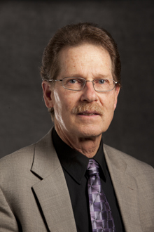
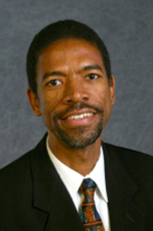
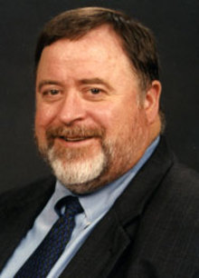
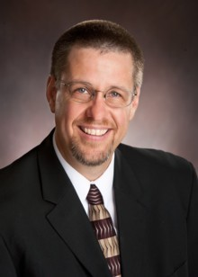
The University and the Professional Doctorate: Issues and Opportunities
DOCTOR OF MINISTRY ANNUAL CONFERENCE │ DECEMBER 5, 2013 │1ST PANEL, 10:30 AM – 11:20 AM EST
moderator
Andrea Luxton
PhD
Provost
panelist
Bruce Bauer
DMiss
Chair
World Mission
Professor
World Mission
panelist
Martin Hanna
PhD
Director
MA in Religion and Seminary Affiliations and Extensions
Associate Professor Historical Theology
panelist
Stanley Patterson
PhD
Chair,
Christian Ministry
Director,
Christian Leadership Center
feedback
David Penno
PhD
Project Coach
Doctor of Ministry

Slide 4
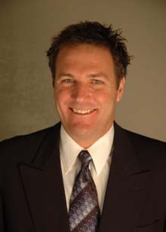
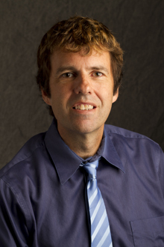
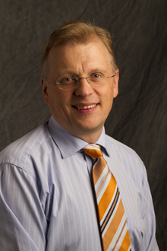
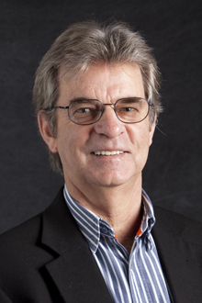
Doctor of Ministry Education Tomorrow: Where Are We Headed?
DOCTOR OF MINISTRY ANNUAL CONFERENCE │ DECEMBER 5, 2013 │2nd PANEL, 11:30 AM – 12:20 PM EST
moderator
Jiří Moskala
ThD, PhD
Dean
SDA Theological Seminary
Professor
Old Testament Exegesis
panelist
Steve Case
PhD
President
Involve Youth
Coordinator
DMin Youth Ministry Concentration
panelist
Kenley Hall
DMin
Director
Theological Field Education
Associate Professor
Christian Ministry
panelist
Darius Jankiewicz
PhD
Chair
Theology & Christian Philosophy
Professor
Historical Theology
panelist
Allan Walshe
DMin
Chair
Discipleship & Religion Education

Slide 5
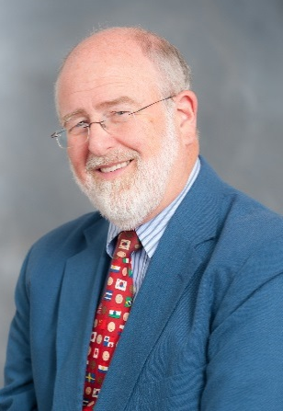
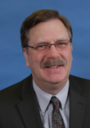
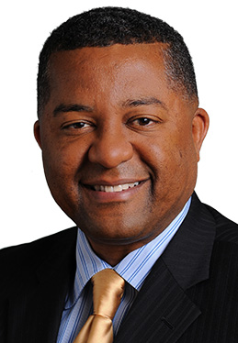
Professional Excellence in Ministry: What Are The Standards?
DOCTOR OF MINISTRY ANNUAL CONFERENCE │ DECEMBER 5, 2013 │3rd PANEL, 1:45 PM – 2:35 PM EST
moderator
Walt Williams
DMin
Retired Director
MA Pastoral Ministry
panelist
Ernie Furness
DMin
Ministerial Director
Southeastern California Conference
panelist
Ron Halvorsen, Jr
PhD
Senior Pastor
College View Seventh-day Adventist Church
panelist
Randy Roberts
DMin
Senior Pastor
Loma Linda University Church of Seventh-day Adventists
panelist
Ivan Williams, Sr.
DMin
Ministerial Director
North American Division

Slide 6
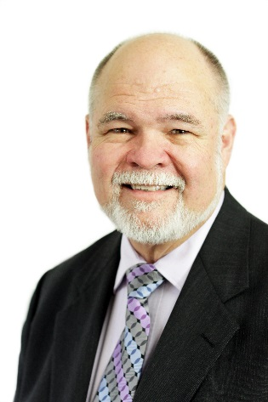
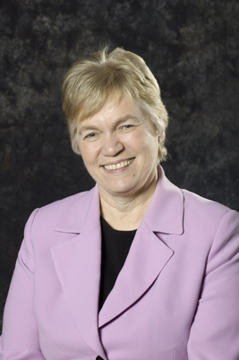
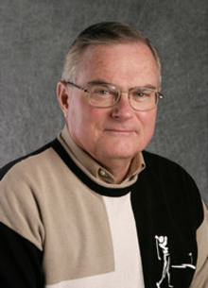
Forming the Scholar Practitioner for Ministry in a Professional Doctorate
DOCTOR OF MINISTRY ANNUAL CONFERENCE │ DECEMBER 5, 2013 │4th PANEL, 2:45 PM – 3:40 PM EST
moderator
Skip Bell
DMin
Director
Doctor of Ministry Program
Professor
Church Leadership
panelist
John Brunt
DMin
Senior Pastor
Azure Hills SDA Church
panelist
Steve Case
PhD
Coordinator
DMin Youth Ministry Concentration
President
Involve Youth
panelist
Andrea Luxton
PhD
Provost
panelist
Walt Williams
DMin
Retired Director MA Pastoral Ministry

