Slide 1
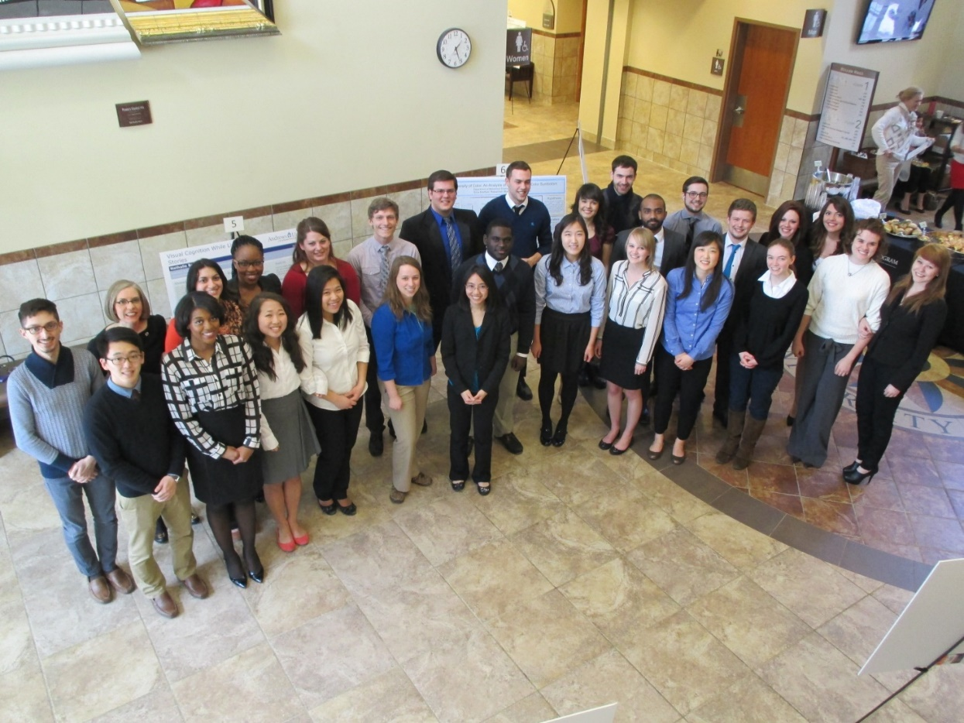
Celebrating Honors Seniors and Researchers 2014

Slide 2
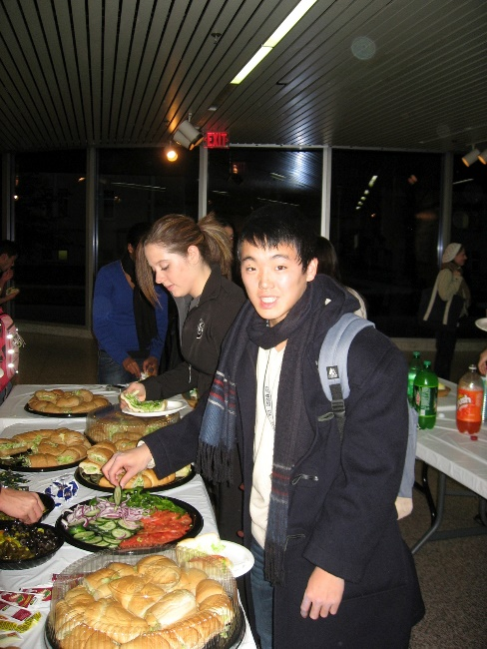
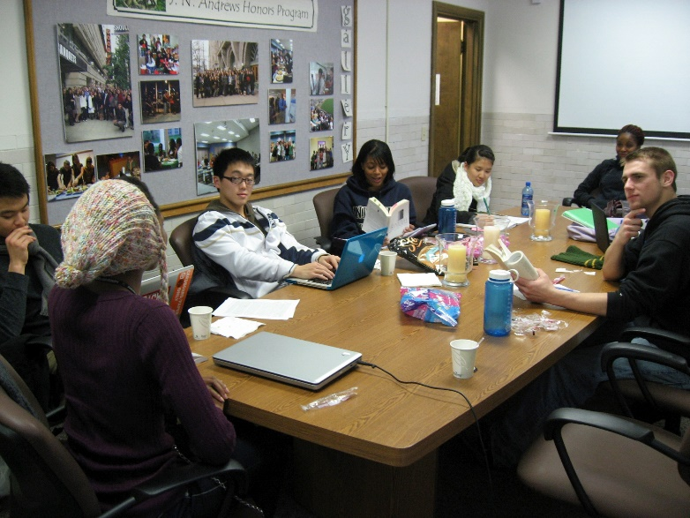
Jonathon Ahn
Biology, Biomedical concentration
Minor in Chemistry
Graduates May 2014
Accepted to Loma Linda University School of Medicine

Slide 3
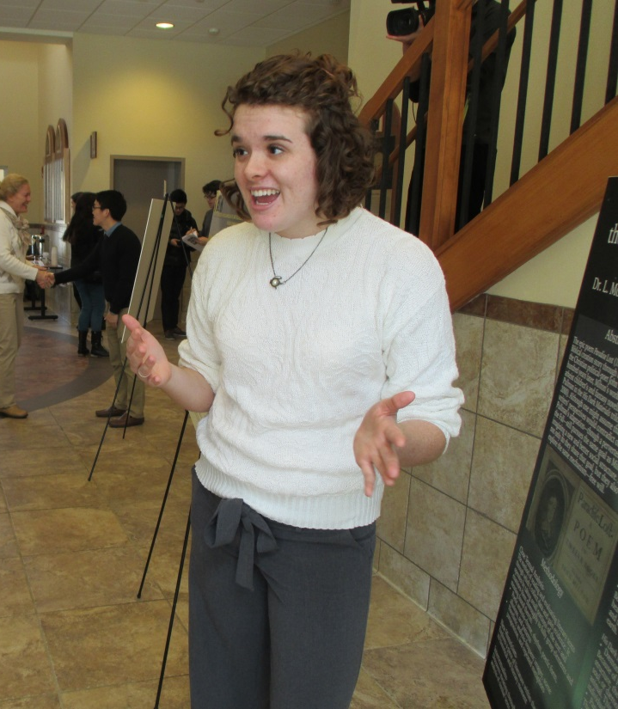
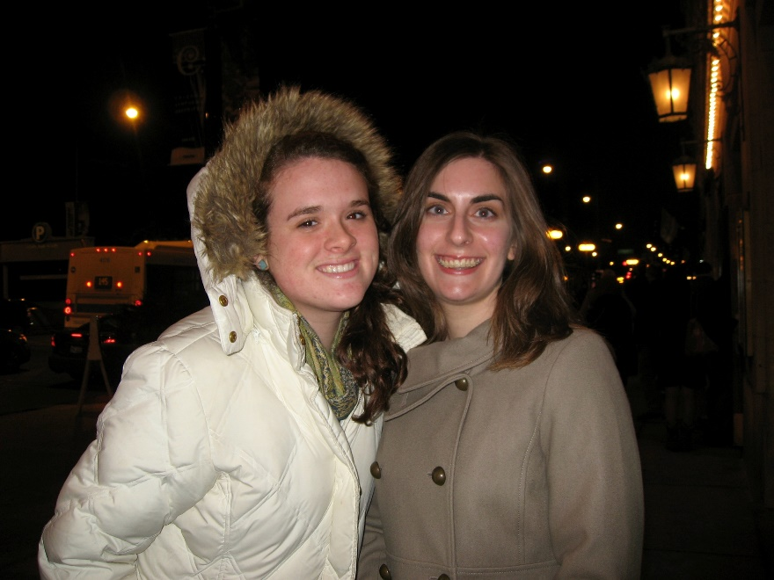
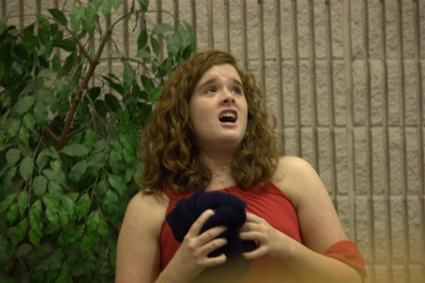
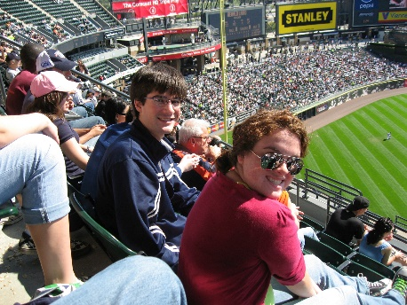
Jordan Arellano
English, Literature concentration
Minor in French
Graduates May 2014
Plans to travel abroad during the summer

Slide 4
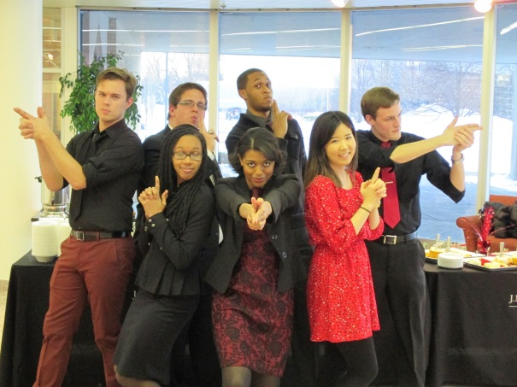
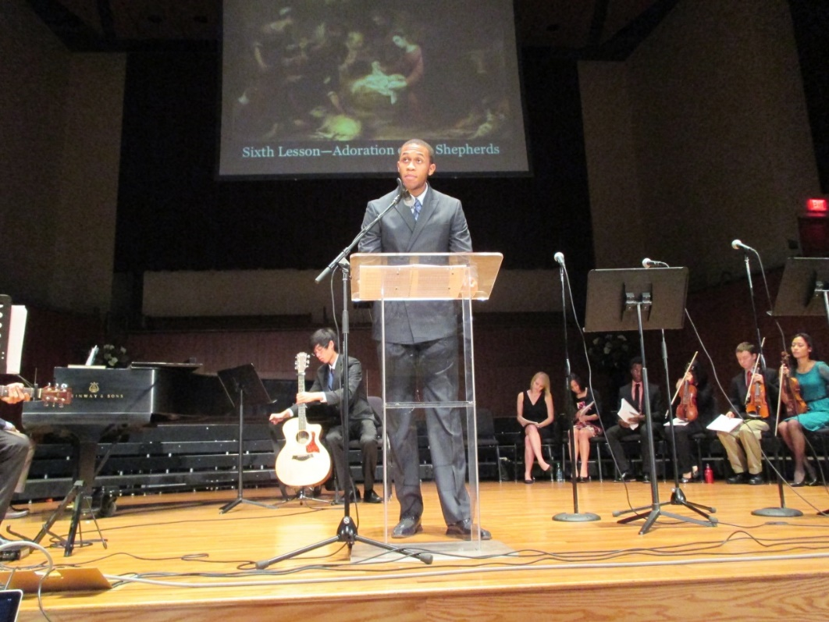
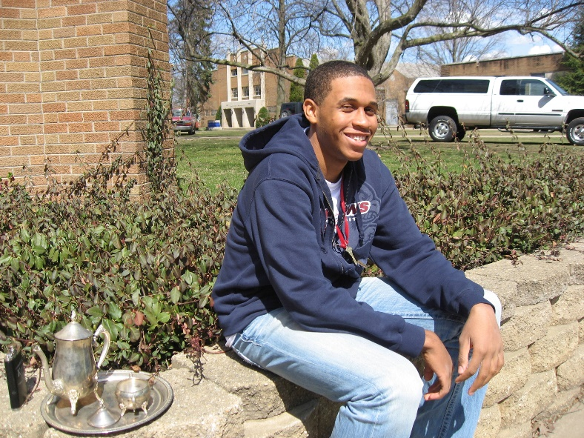
Clifford Allen
History
Graduates May 2014
Accepted to the University of Chicago to pursue an interdisciplinary Masters in Social Sciences

Slide 5
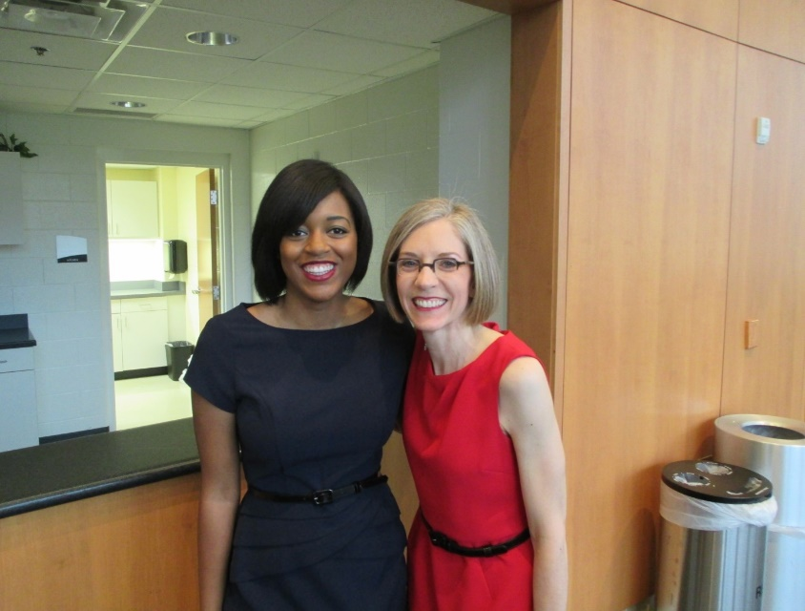
Kristen Bishop
Psychology, Behavioral Neuroscience concentration
Minor in Chemistry
Graduates May 2014
Accepted to Loma Linda University School of Medicine

Slide 6
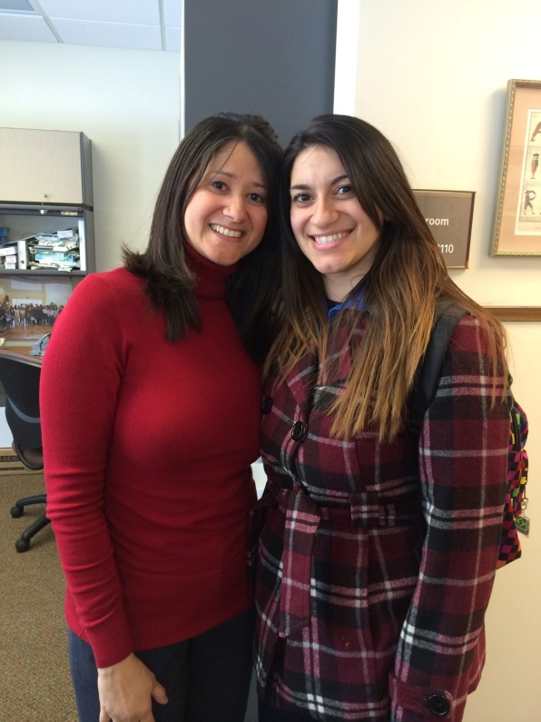
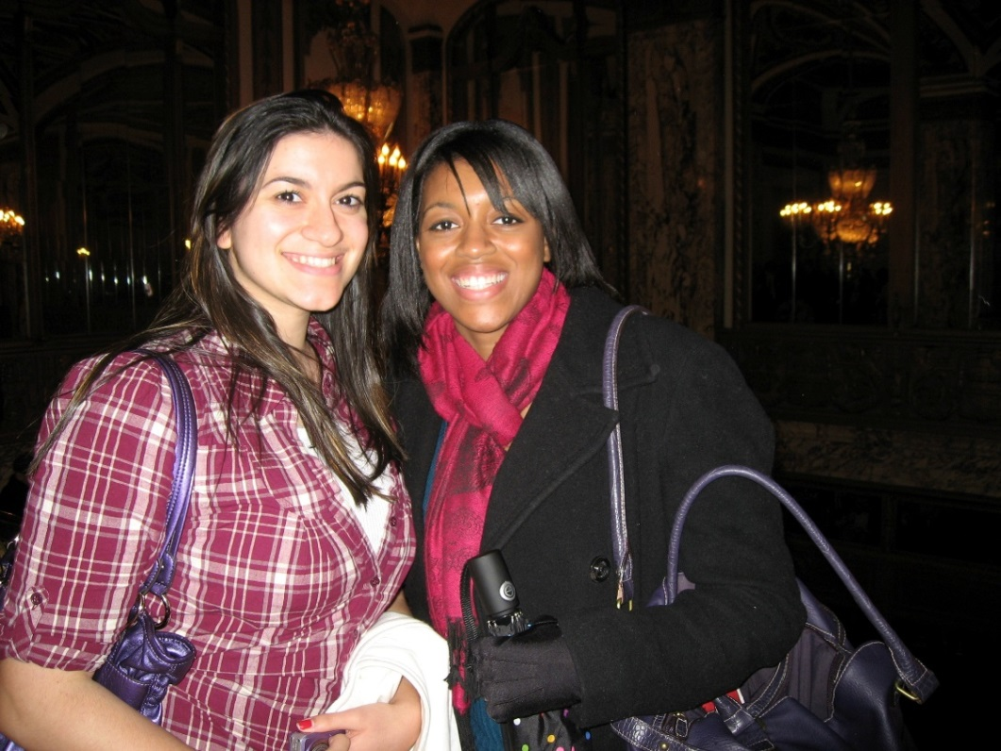
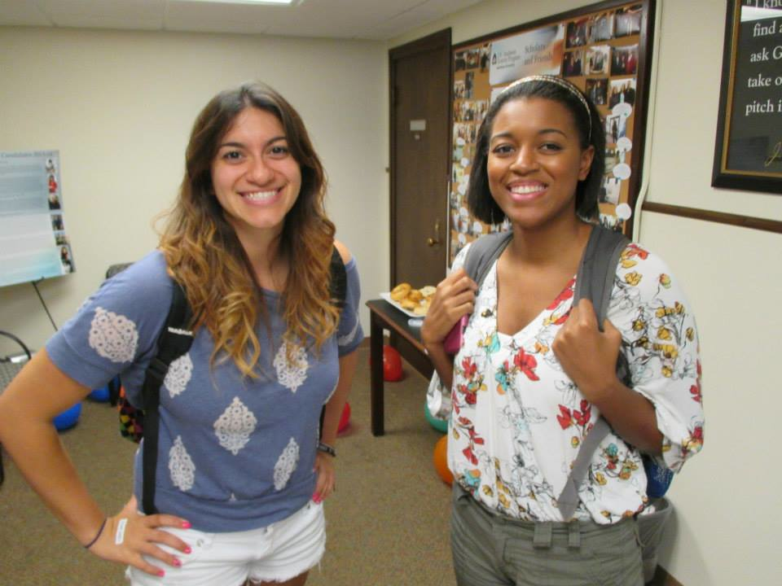
Nathalie Borges
Behavioral Neuroscience
Minor in Chemistry
Graduates May 2014
Accepted to Andrews University Physical Therapy Program

Slide 7
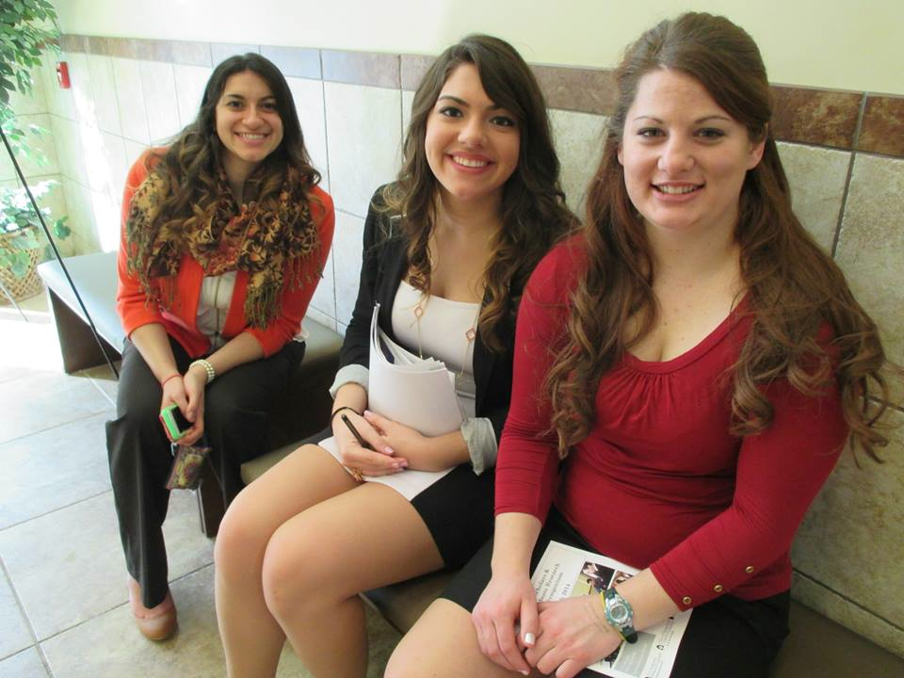
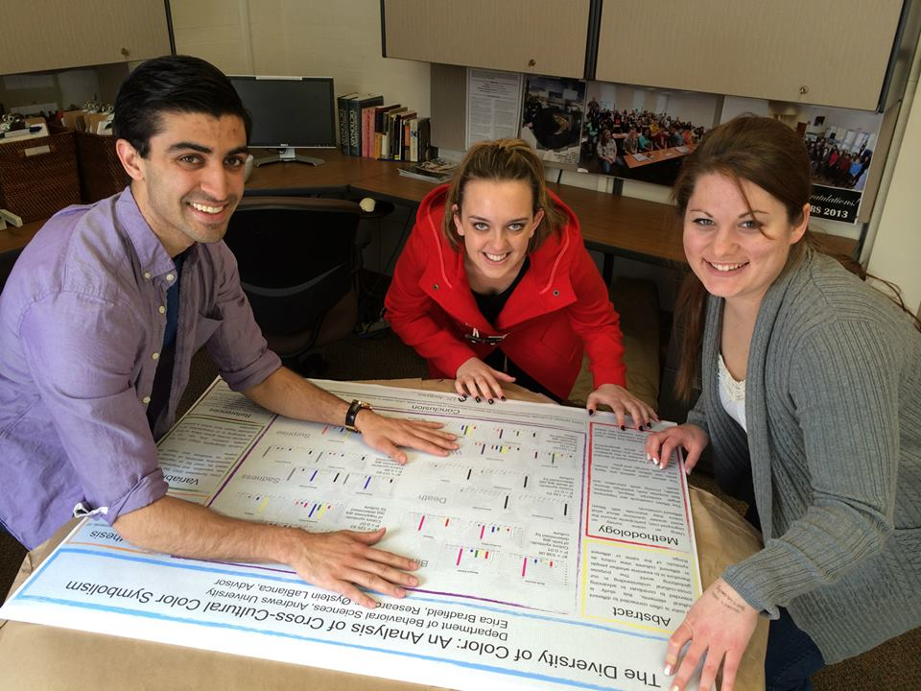
Erica Bradfield
Behavioral Science and French Studies
Minor in Visual Art
Graduates May 2014
Plans to work at Timber Ridge Camp over the summer and then work at Oshkosh Camporee

Slide 8
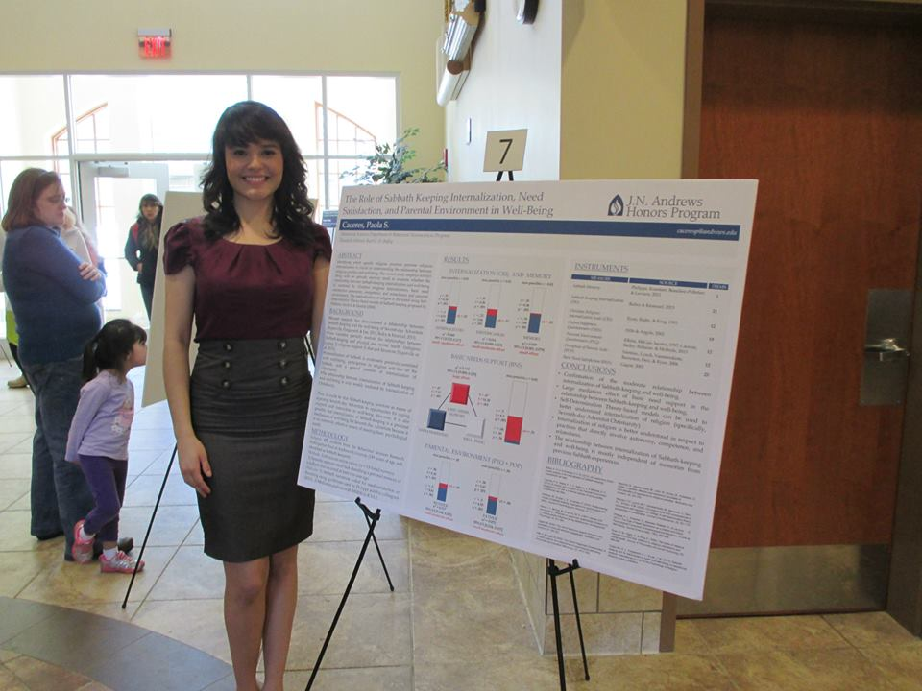
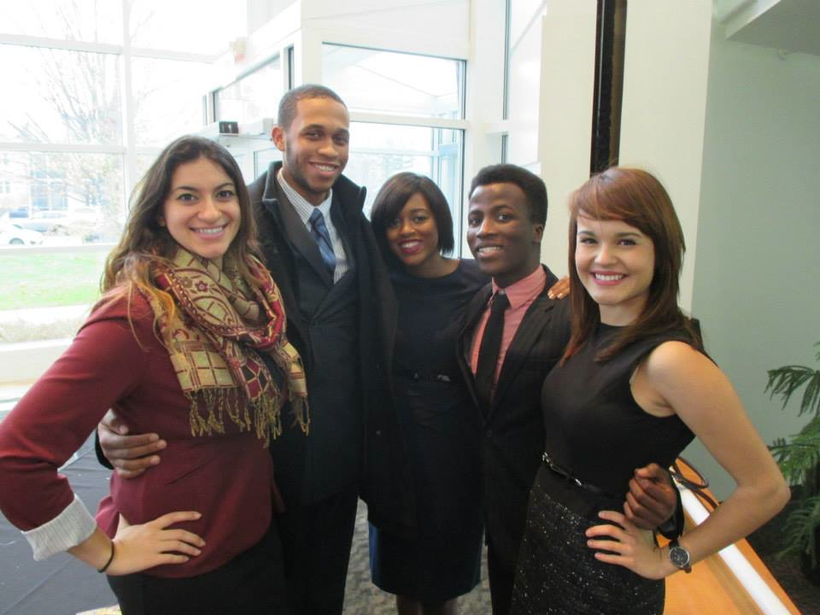
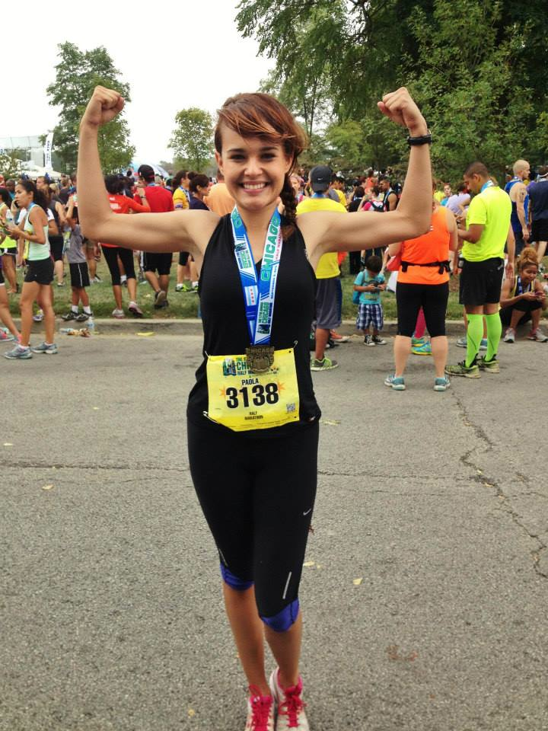
Paola Caceres
Psychology, Behavioral Neuroscience concentration
Minor in French
Plans to study abroad in France and then graduate in May 2015

Slide 9
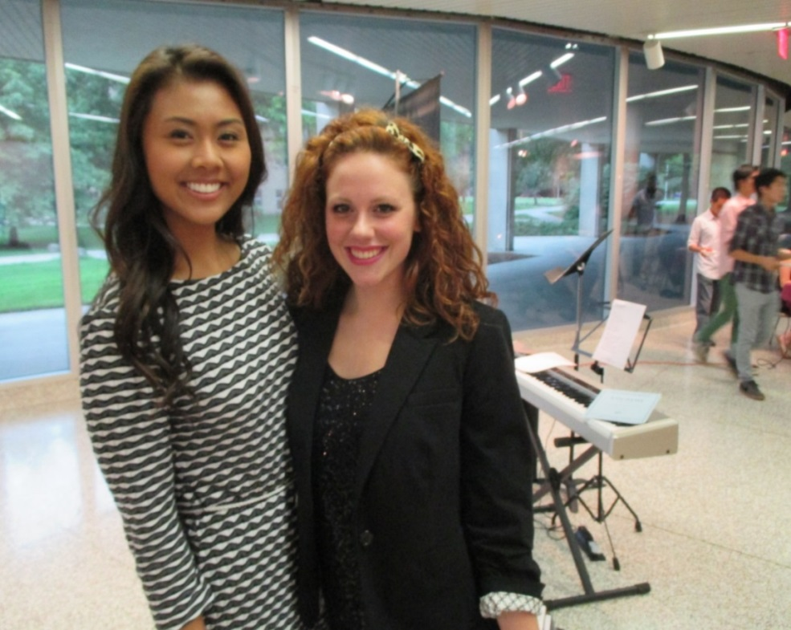
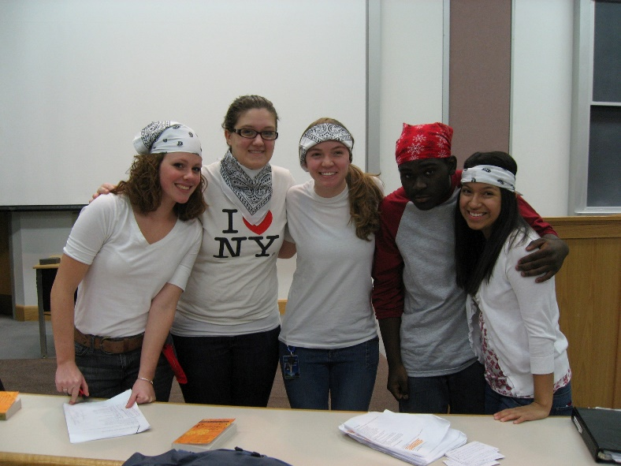
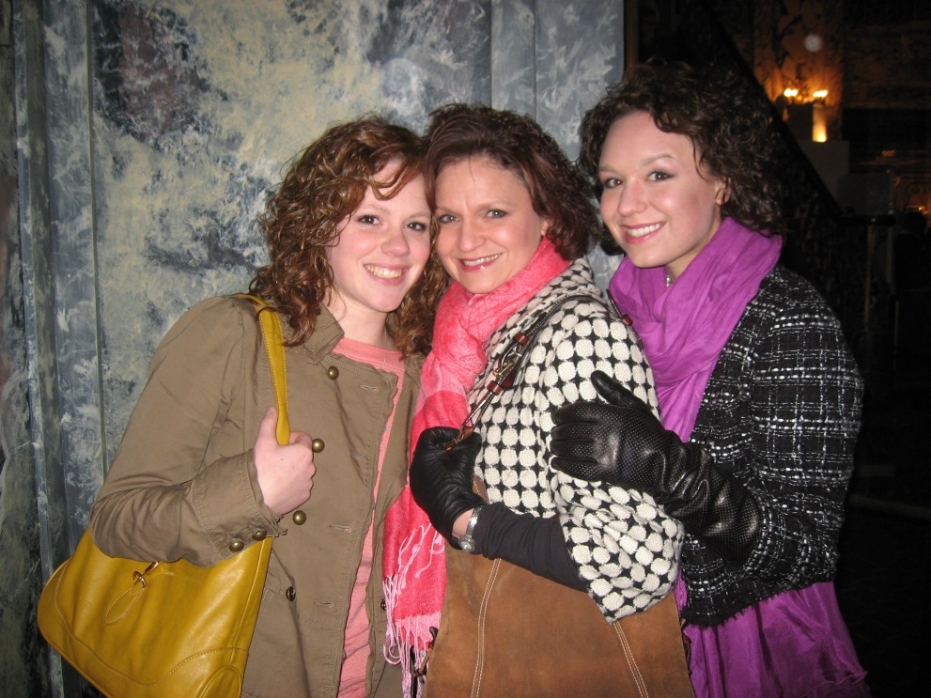
Ilana Cady
Music Performance, Piano
Will finish Bachelors at Andrews

Slide 10
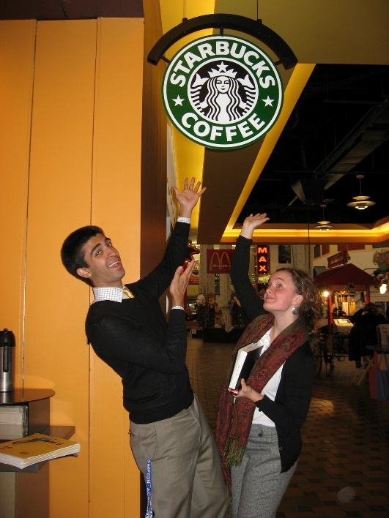
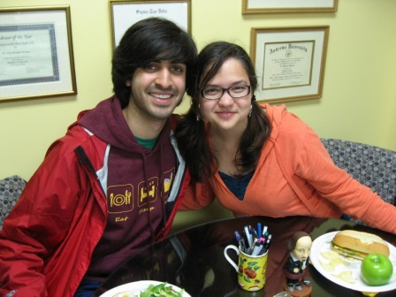
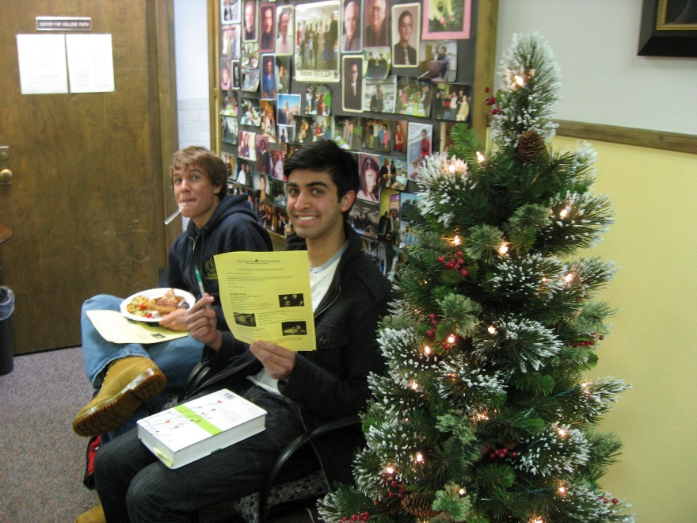
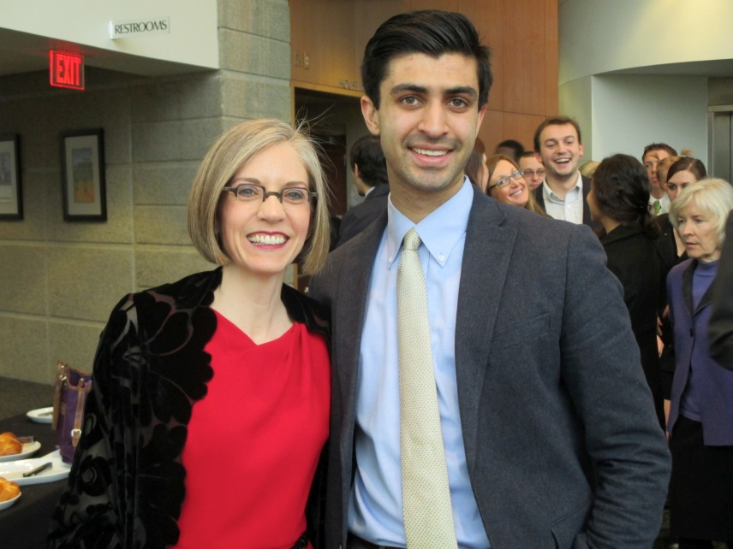
Matthew Chacko
English and Biology
Minor in Chemistry
Graduates May 2014
Accepted to MA in English at Syracuse University, Georgetown, Villanova, University of Washington, Washington State, University of Oregon, Ball State, Kent State, Fordham University, University of Kansas, and Rutgers-Camden
Will attend Syracuse University for MA in English with full funding

Slide 11
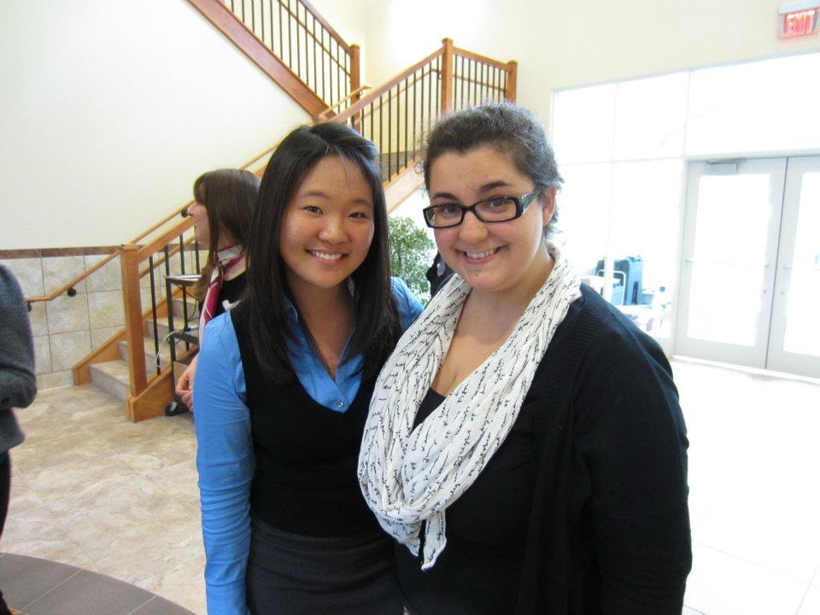
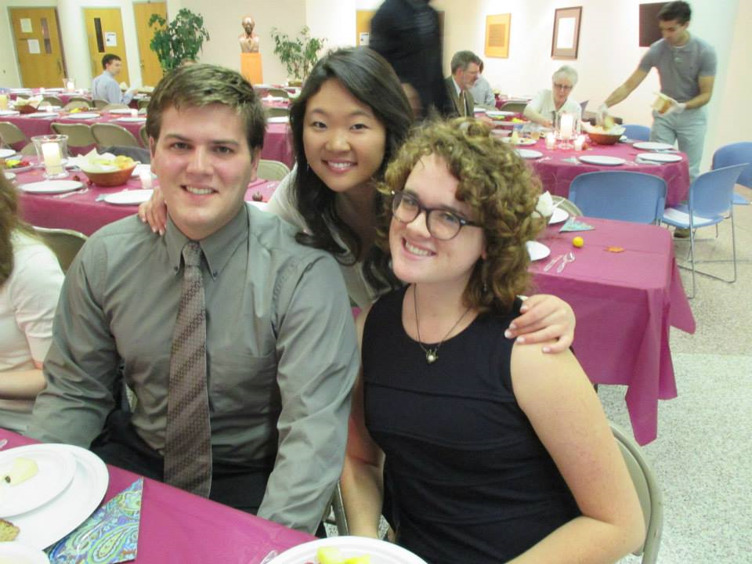
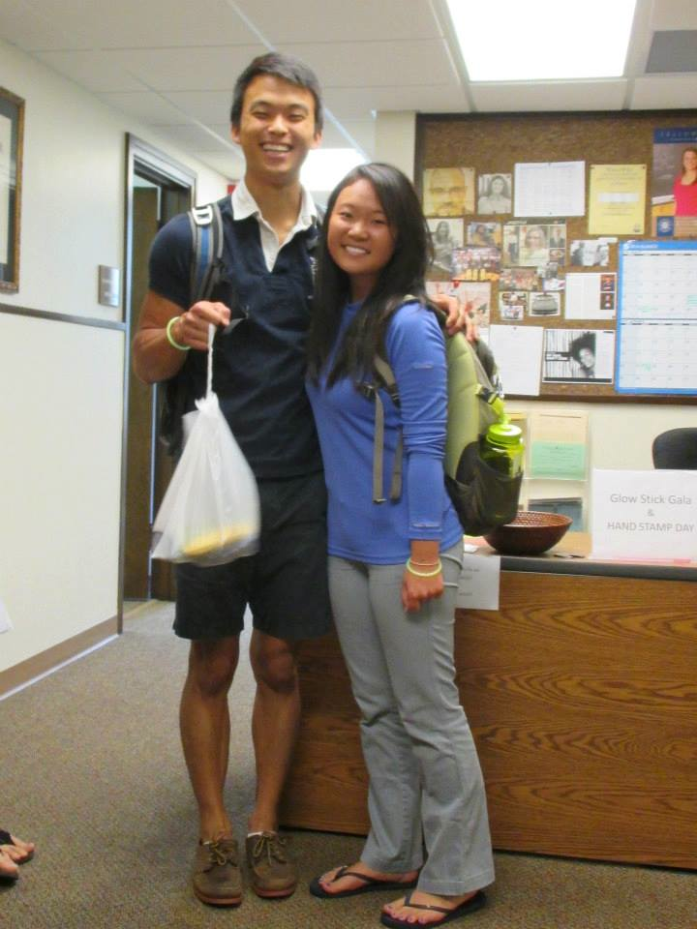
Kristin Chung
Biology, Biomedical concentration
Minor in Chemistry
Graduates May 2014
Accepted to Loma Linda University School of Medicine

Slide 12
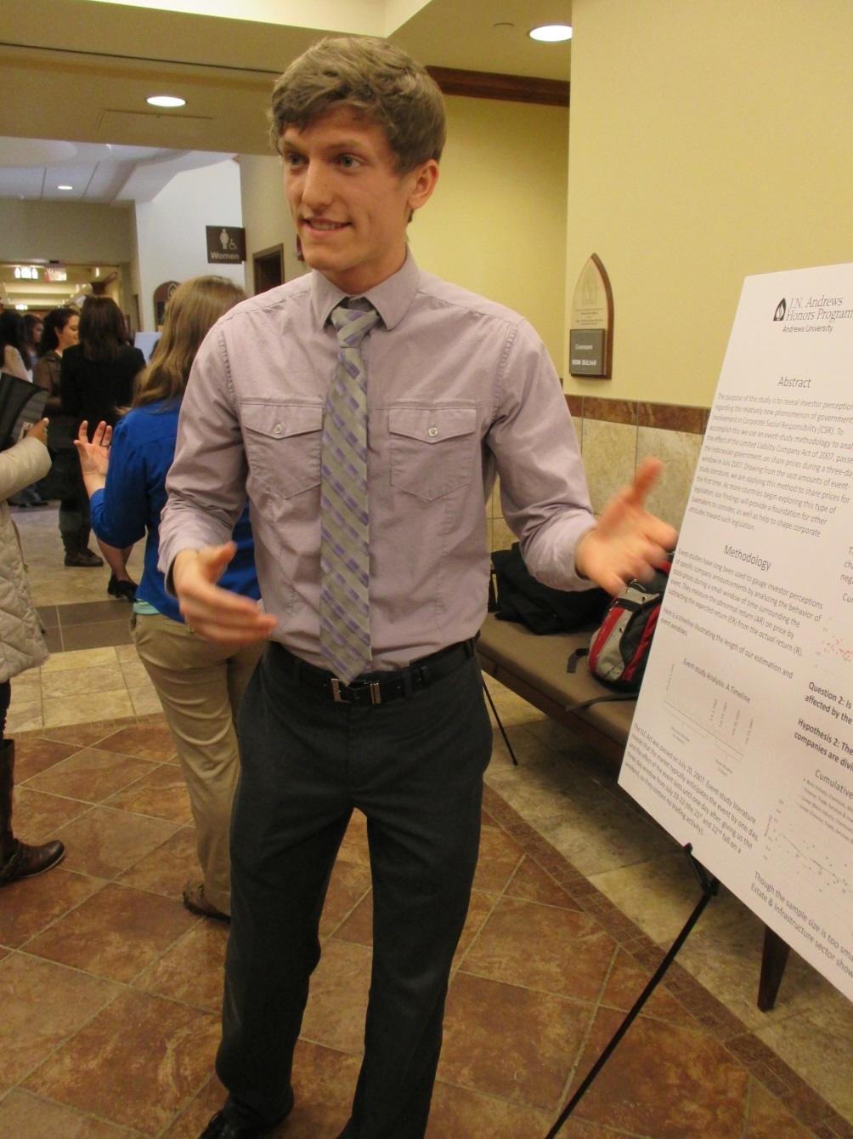
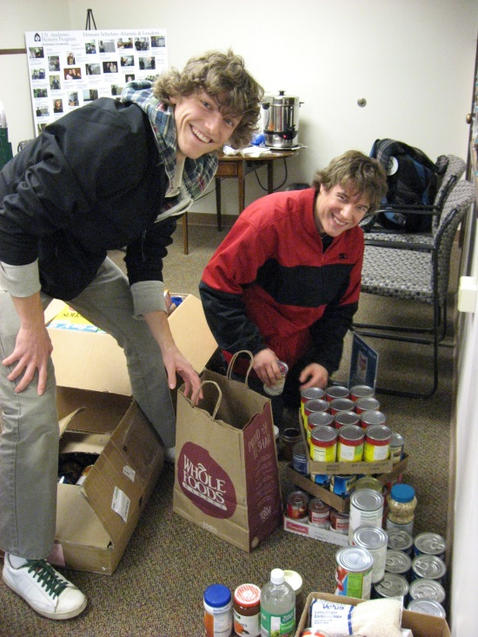
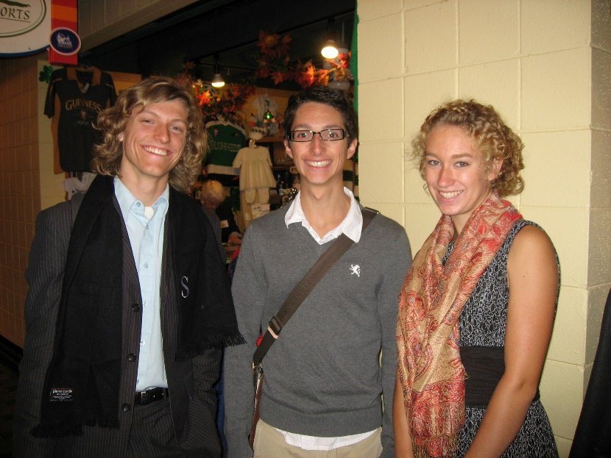
Stephen Erich
International Business
Graduates May 2014

Slide 13
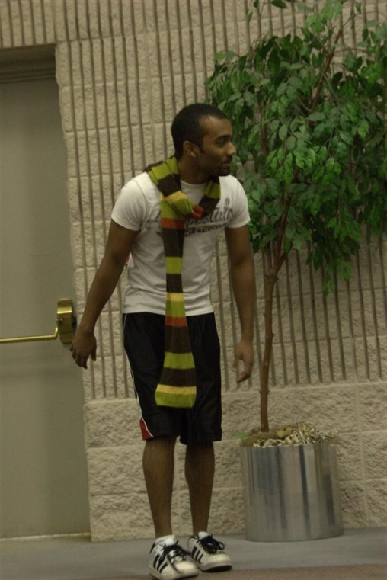
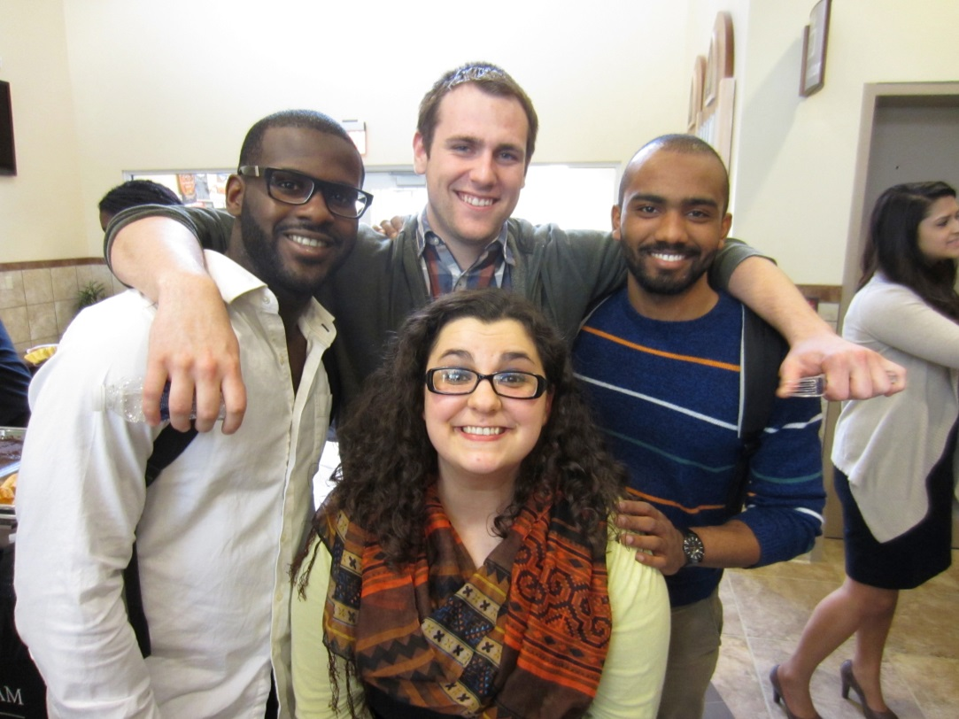
Philip Giddings
Biology, Biomedical concentration
Minor in Chemistry
Graduates May 2014
Accepted to Loma Linda School of Medicine (2015)

Slide 14
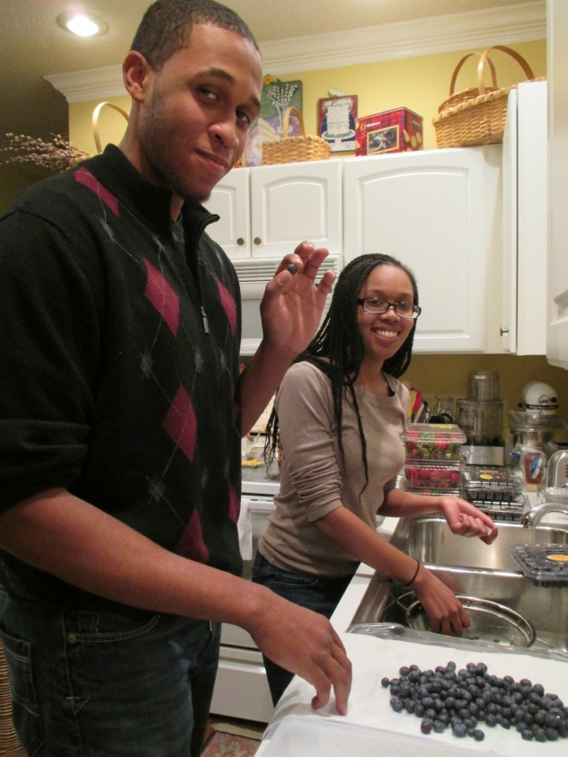
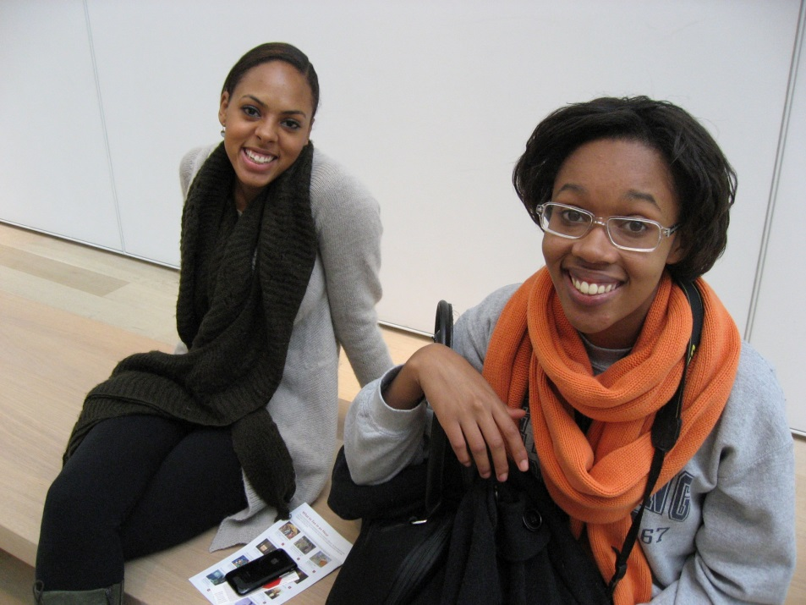
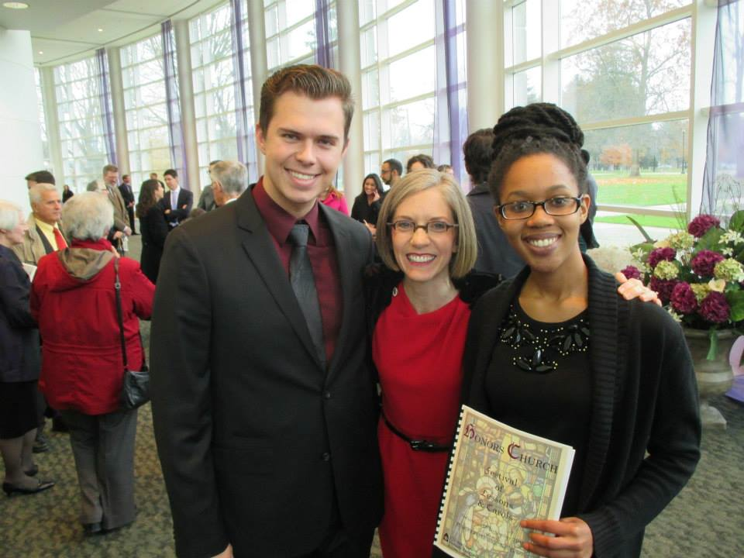
Givan Hinds
Pre-Physical Therapy
Minor in Fitness Education
Accepted to MPH Program at Loma Linda University

Slide 15
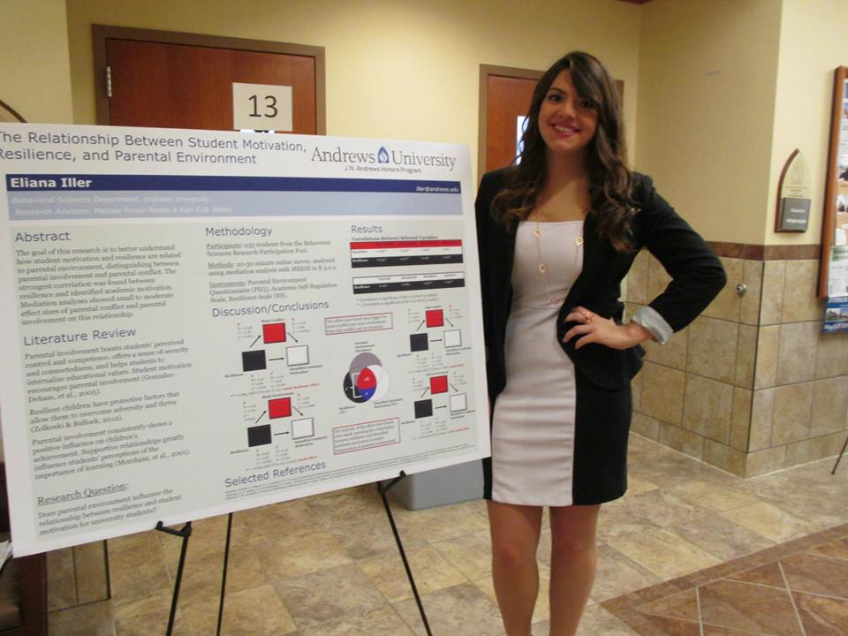
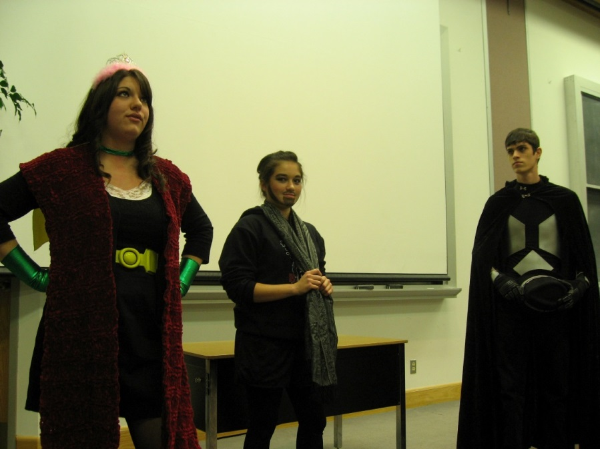
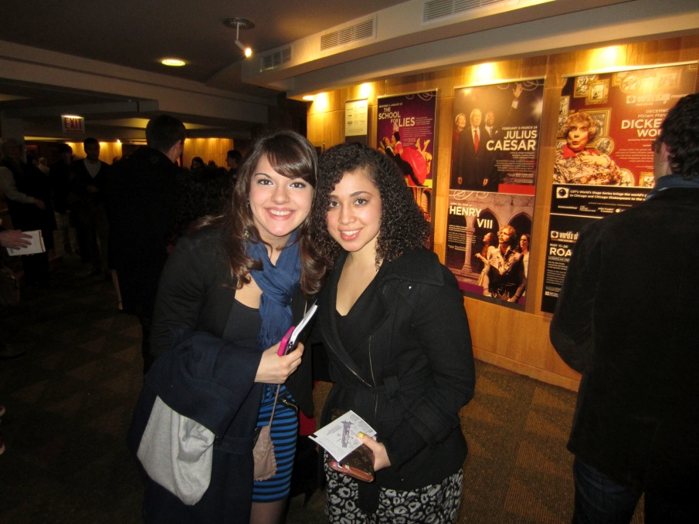
Eliana Iller
Psychology & Spanish for Translation
Graduates May 2014
Will work as an intern next year and then apply to PhD programs in Clinical Psychology

Slide 16
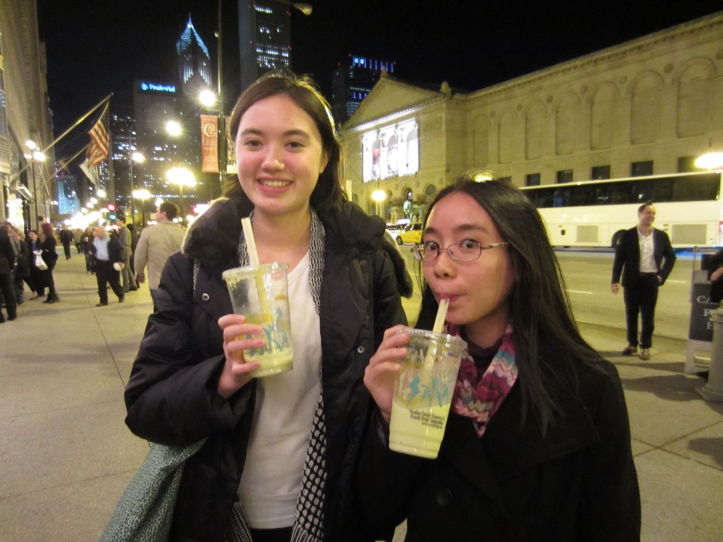
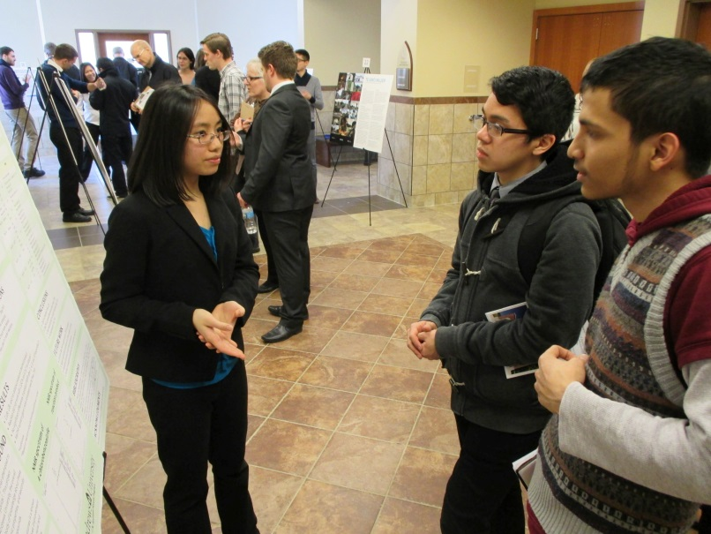
Michelle Imperio
Nutrition Science
Minor in Chemistry
Graduates May 2014
Accepted to Loma Linda University School of Medicine

Slide 17
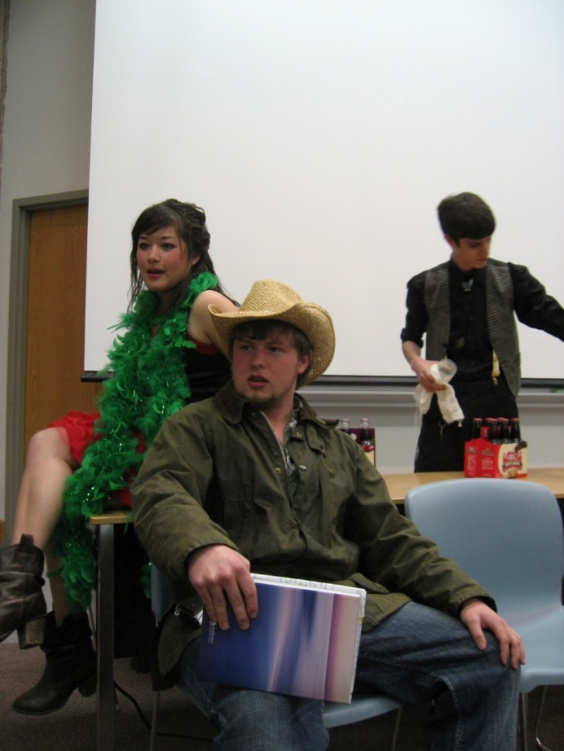
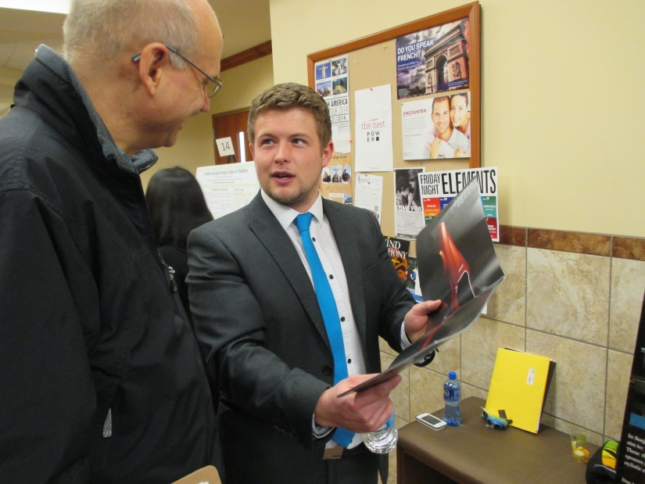
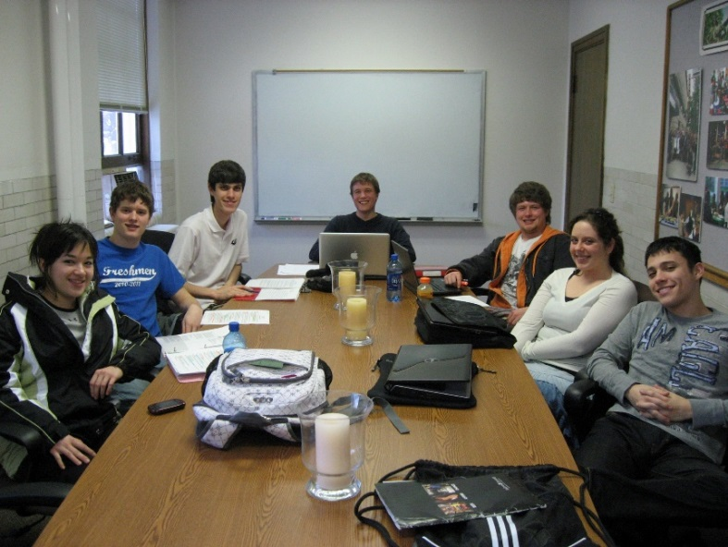
John Irvine
English, Literature concentration
Graduates Summer 2014
Plans to join the Royal Air Force and later attend law school

Slide 18
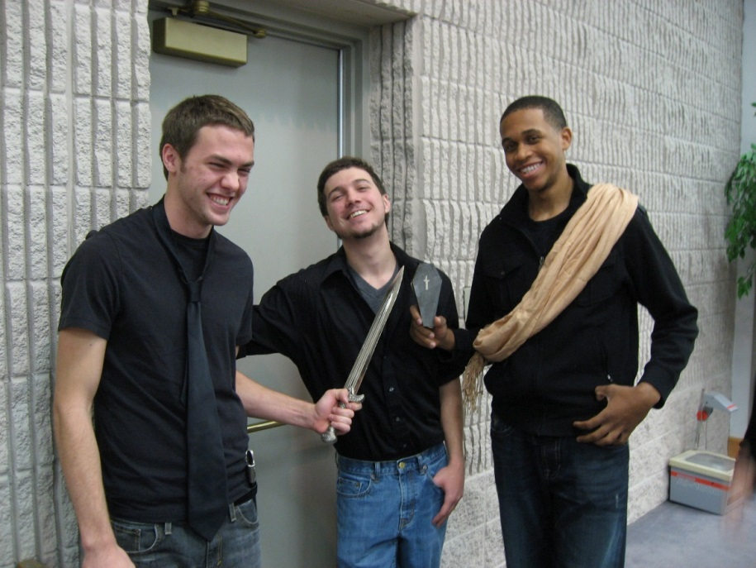
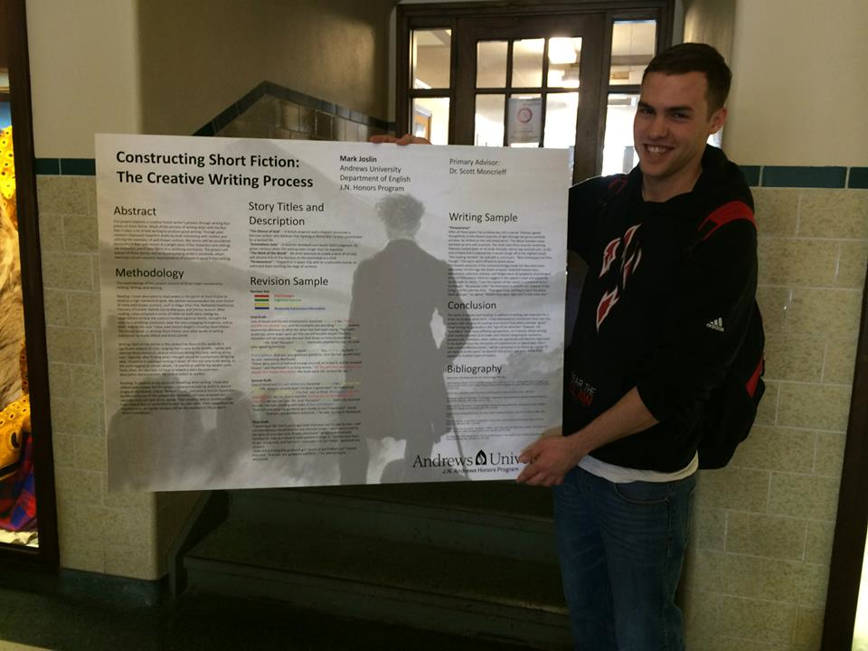
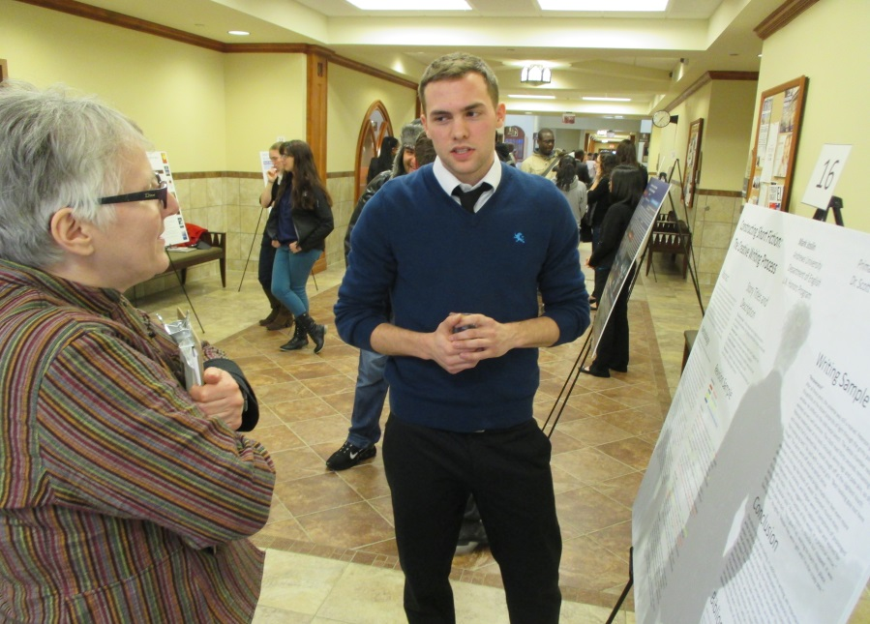
Mark Joslin
English, Writing concentration
Minor in History
Accepted to law school at Michigan State University (with substantial funding)

Slide 19
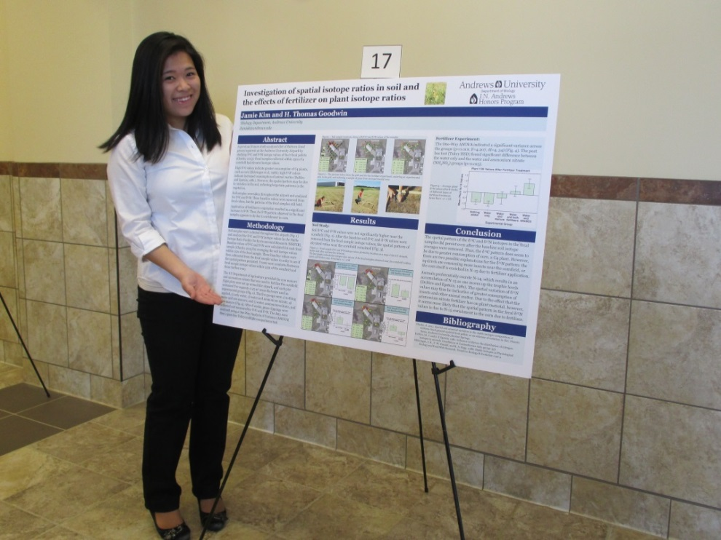
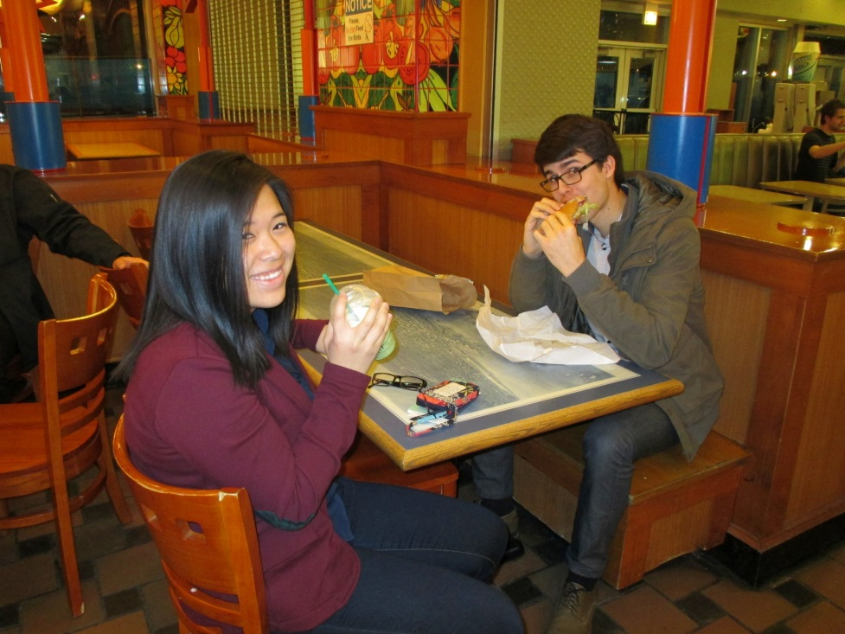
Jamie Kim
Biology, Neuroscience concentration
Minor in Chemistry
Graduates May 2014
Accepted to Loma Linda University School of Dentistry

Slide 20
Travis King
Dietetics
Graduates May 2014
Will serve as a Dietetic Intern at Spectrum Health in Grand Rapids, MI

Slide 21
Chelsea Lake
Music
Graduates May 2014
Plans to attend graduate school in music history

Slide 22
Christine Lee
Biology, Biomedical concentration
Minor in Chemistry
Graduates May 2014
Accepted to Loma Linda University School of Medicine

Slide 23
Lynda Lee
Art, Visual Art concentration, Pre-Dent
Minor in Chemistry
Graduates May 2014
Accepted to Loma Linda University School of Dentistry

Slide 24
Kirk Maynard
Visual Arts Education, Secondary Certification

Slide 25
Ivan Ruiz
Visual Communication, Graphic Design emphasis
Graduates May 2014
Will work as a graphic designer at Thesis, Inc.

Slide 26
Jacina Shultz
English, Concentration in Writing
Mathematics Minor
Graduates May 2014
Plans to pursue theology on the masters and doctoral level, aiming to ultimately teach at the college level.

Slide 27
Cheryl Simpson
Psychology
Minor in Portuguese
Will work as an administrative assistant in the MA Religion program at the Seventh-day Adventist Theological Seminary

Slide 28
Samantha Snelling
Physics and Mathematics
Graduates May 2014
Plans to work as a contract teacher in the Physics Department while applying to graduate schools

Slide 29
Allegra Stennett
International Business and French Studies
Graduates May 2014
Plans to work as a Corporate and Investment Bank Analyst at J.P. Morgan

Slide 30
Kyungje Sung
Biology, Biomedical Concentration
Chemistry Minor
Accepted to Loma Linda University School of Medicine

Slide 31
David Thomas
Biology, Biomedical concentration
Chemistry Minor
Graduates May 2014
Accepted to Loma Linda University School of Medicine

Slide 32
Erik Thordarson
Biology, Biomedical concentration
Chemistry Minor
Graduates May 2014
Accepted to Loma Linda University School of Medicine

Slide 33
Ross Trecartin
Biology, Biomedical concentration
Chemistry Minor
Graduates May 2014
Accepted to Loma Linda University School of Medicine

Slide 34
Kathleen Wilson
English, Concentration in Literature
Graduates May 2014
Plans to do ESL instruction in Korea

Slide 35
Tyler Yasa
Business Administration
Graduates May 2014
Currently serving as the District Manager at the South Bend Vector Marketing Corporation

