Slide 1
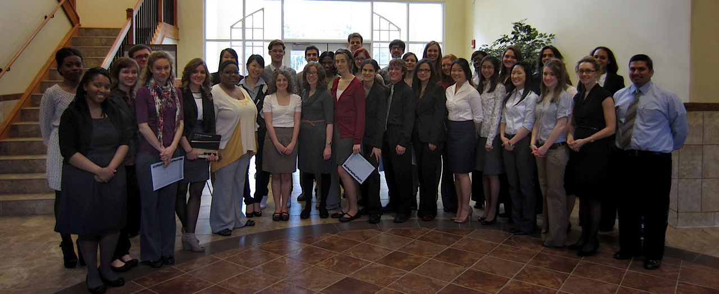
Celebrating Honors Seniors Spring 2012

Slide 2
Adam Shull
Engineering and Chemistry
Marrying Shastin Purvis, Honors alum and medical student at Mayo Medical School

Slide 3
Aleksandra Kozlova-Harris
Biology, Behavioral Neuroscience concentration
Accepted to Loma Linda Medical School

Slide 4
Amy Nadane
Biology, Biomedical concentration
Accepted to veterinary school at Michigan State University

Slide 5
April Grube
History
Accepted to MA in History programs at George Washington University, University of North Carolina-Charlotte, and Washington State University

Slide 6
Arianna Lashley
Psychology, Behavioral Neuroscience concentration
Plans to work as a guest English teacher in Korea through the EPIK organization

Slide 7
Arielle Cady
Music Performance
Accepted to pursue a Masters in Violin Performance with an emphasis in Musicology at Andrews University
Received a teaching assistantship scholarship to work with Dr. Lilianne Doukhan

Slide 8
Bradley Sica
Political Science
Accepted to the University of Maine Law School, the Maurice A. Dean School of Law at Hofstra University, and Pace Law School
Will attend University of Maine Law School

Slide 9
Carolyn Davis
English
Accepted to MA programs at the State University of New York-Buffalo, University of Maryland, Boston College, Carnegie Mellon University, and New York University
Will attend Boston College

Slide 10
Carrie Mesiar
Animal Science, Pre-veterinary concentration
Accepted to veterinary school at the University of Oregon and the University of Wisconsin, Madison
Will attend University of Wisconsin

Slide 11
Catherine Tetz
English and Music
Accepted to MA programs at Washington State University and Kent State University with teaching assistantships
Will attend Washington State University

Slide 12
Daniel Colon Hidalgo
Biology, Biomedical concentration
Accepted to medical school at Northwestern University and Loma Linda Medical School

Slide 13
Debbie-Ann Francis
Communication, International Communication concentration
Spanish Studies
Going where God leads!

Slide 14
Elena Milosavljevic
Biology, Biomedical concentration
Accepted to Loma Linda Medical School

Slide 15
Erica Bruso
Visual Communication, Graphic Design
Marrying Andrews University student Jonathan Bissell

Slide 16
Gina Kang
Biology, Biomedical concentration
Accepted to Loma Linda Medical School

Slide 17
Isaac Kim
Biology, Biomedical concentration
Accepted to Loma Linda Medical School

Slide 18
James Yoon
Biology, Biomedical concentration
Accepted to Loma Linda Medical School

Slide 19
Jarrod Lutz
English, Writing emphasis
Communication Arts minor
Secondary Education Certification

Slide 20
Jason Lemon
Spanish Studies

Slide 21
Jason Miller
Psychology and Political Science
Has spent the past semester serving as a Congressional Intern in the office of Congressman Fred Upton of Michigan's 6th district
Plans a year of Student Missionary work and will apply to enter law school Fall of 2013

Slide 22
Jeremy Burton
English, Literature emphasis
French Studies
Accepted to The New School for a Master of Fine Arts in Creative Writing (for children)
Has been selected for a Departmental Merit Scholarship

Slide 23
Johanna Nielsen
Communications, English minor
Will spend a year in her home state of Washington getting Community Emergency Response training; managing her businesses, and hopes to intern at a non-profit organization.
She hopes to pursue a Masters in Emergency Management or International Development

Slide 24
Jonathan Koch
English and Political Science
Marrying Chantelle Krym, Andrews alum, in June
Plans to attend law school at the University of Michigan in the fall
Accepted to law school at Georgetown University, Notre Dame University, the College of William and Mary, and the University of Michigan

Slide 25
Jose Quezada
Architecture
Plans to finish his Master of Architecture at Andrews University.
Will be touring Europe with the School of Architecture this summer

Slide 26
Kelley Wolff
Accounting
Spanish minor

Slide 27
Kylene Cave
English, Literature emphasis
Will work as a legal intern and prepare for the LSAT exam before applying to law school for the 2013-14 school year

Slide 28
Lauren Martin
Biology and French
Accepted to Northwestern University’s School of Medicine and Loma Linda Medical School
Will be attending Northwestern University to pursue a MD/Masters in Public Health program; hopes to become a clinician and administrator for an international aid organization

Slide 29
Lauren Van Putten
Biology, Pre-med, minors in Photography and Chemistry
Plans to attend medical school in the fall

Slide 30
Melissa Breetzke
Spanish Translation
Will spend time in South America doing various translating jobs and possibly studying Portuguese

Slide 31
Melissa McCormick
Biology, Biomedical concentration
Accepted to Loma Linda Medical School

Slide 32
Michael Swenson
Theology, Pastoral Ministry concentration
Accepted to MA in Theological Studies programs at Boston University, Emory University, and Vanderbilt University

Slide 33
Naudline Pierre
Fine Arts, Painting emphasis and Graphic Design Minor
Plans to continue creating art and complete a Master of Fine Arts degree

Slide 34
Rachelle Booth
Dietetics, minors in Fitness Education and Communications
Will complete an internship with Spectrum Health in Grand Rapids, MI as part of the requirements for earning the Registered Dietician licensure

Slide 35
Robert Erich
Management
Communication Studies minor

Slide 36
Sarah Gane
Religion and Behavioral Sciences, Anthropological Archaeology concentration
Will be marrying Kevin Burton, and pursuing a Masters in Religion (systematic theology emphasis) at the Seventh-day Adventist Theological Seminary. Kevin is currently pursuing a Masters in Religion (historical theology emphasis).

Slide 37
Sarah Lee
Behavioral Sciences, Public Health concentration
Accepted to Loma Linda Medical School

Slide 38
Shelli Meulemans
Dietetics, Spanish, Fitness Education minor
After a yearlong dietetics internship with Andrews University, will sit for her Registered Dietician exam

Slide 39
Steffie-Ann Dujon
Biology, Biomedical concentration
Chemistry minor

Slide 40
Sunny Kim
Biology, Neuroscience concentration
Accepted to Loma Linda Medical School

Slide 41
Theron Calkins
English and Math
Plans to work as a guest English teacher in Korea through the EPIK organization

