Slide 1
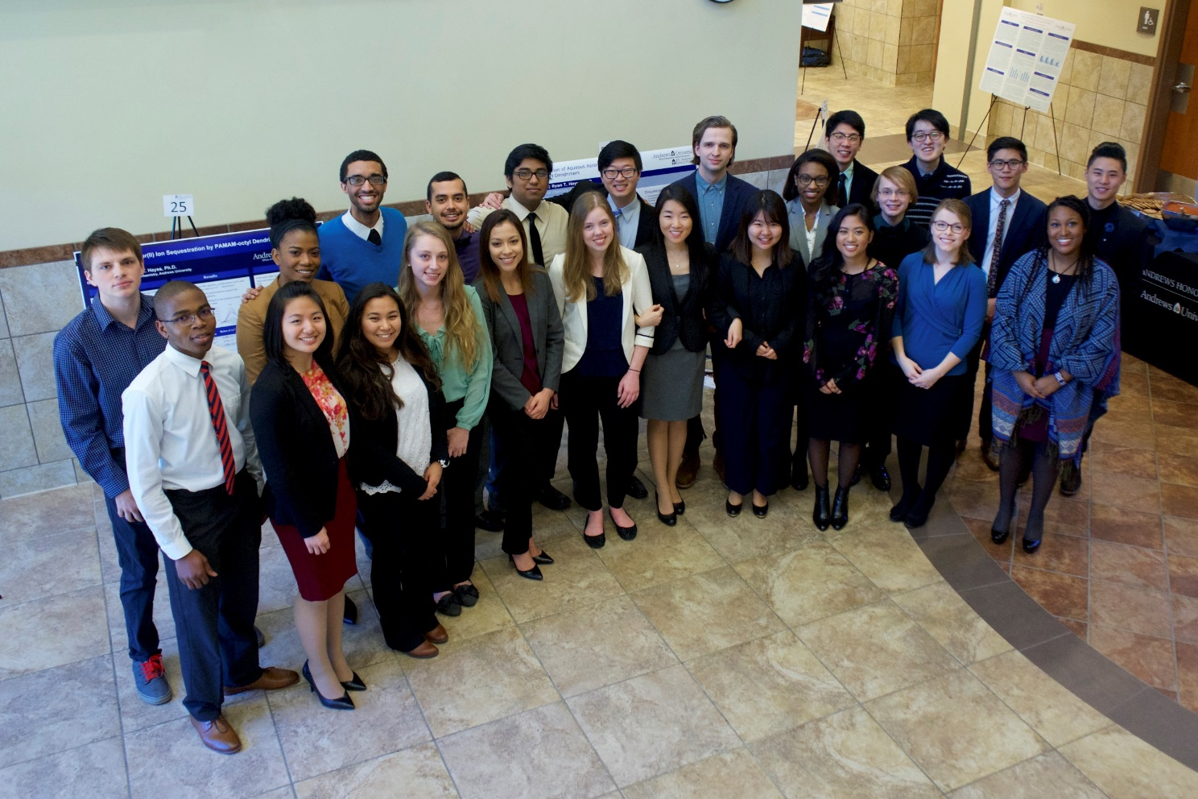
Congratulations Honors Seniors and Researchers 2016 – 2017

Slide 2
Alejandra Castillo
English
Concentration in Literature
Minor in Music
Plans to…

Slide 3
Purin Chirachevin
Biology
Biomedical Concentration
Minor in Chemistry
Plans to attend Loma Linda University School of Medicine in Fall 2017

Slide 4
Gabrielle Cook
Biology
Biomedical Concentration
Minor in Chemistry
Plans to…

Slide 5
Jonathan Doram
Music Education
Secondary Certification
Minor in History
Plans to…

Slide 6
Josias Flores
Religion
Minor in Family Studies
Plans to…

Slide 7
Ludanne Francis
English
Literature Concentration
Accepted to University of Michigan Emerging Research Scholars Program

Slide 8
Austin Huh
Spanish Studies
Minor in Chemistry
Plans to…

Slide 9
Irene Hwang
Biochemistry
Minor in Biology
Accepted to dental schools at:
Loma Linda University, University of Washington, University of Pennsylvania College of Dentist Medicine, University of Washington School of Dentistry, University of California Los Angeles School of Dentistry, University of California San Francisco School of Dentistry

Slide 10
Viktoria Kolpacoff
Mathematics
Minor in Biology
Will be attending Duke University, MS in Biostatistics with funding
Also accepted to Emory University and Central Michigan University

Slide 11
Lukasz Krzywon
Physics and Mathematics Double Major
Plans to…

Slide 12
Darley Magno
Biology
Biomedical Concentration
Minor in Chemistry
Plans to…

Slide 13
Steven Mann-Rojas
Computing
Computer Science Concentration
Plans to…

Slide 14
Karel Marshall
Mathematics
Plans to take a gap year and work as an applied mathematician.

Slide 15
Hannah Mbungu
Nutrition and Dietetics
Minor in Chemistry
Plans on going to Palau as a Student Missionary
Will be teaching 4th grade at Palau SDA Elementary School

Slide 16
Christopher McLean-Wheeler
English, Writing Concentration
Communication
Plans to…

Slide 17
Mercedes McLean-Wheeler
Religion, Secondary Education
English, English Education, Secondary Certification
History, Secondary Certification
Plans to…

Slide 18
Ansel Nam
Liberal Arts: Sciences
Plans to…

Slide 19
Joshua Pazvakawambwa
Engineering
Electrical & Computer Engineering Concentration
Plans to serve as an Electrical Engineering Missionary in Chad with Adventist Health International for a year

Slide 20
Melisa Ruhupatty
International Business
Minor in Accounting
Plans to…

Slide 21
Stanford Shin
Biology, Biomedical Concentration
Minor in Chemistry
Plans to…

Slide 22
Erik Vyhmeister
Physics and Mathematics Double Major
Plans to…

Slide 23
Andrew Walayat
Biology, Biomedical Concentration
Minor in Chemistry
Plans to…

Slide 24
Maria Wixwat
Psychology
Minor in German
Plans to attend the University of Oregon

Slide 25
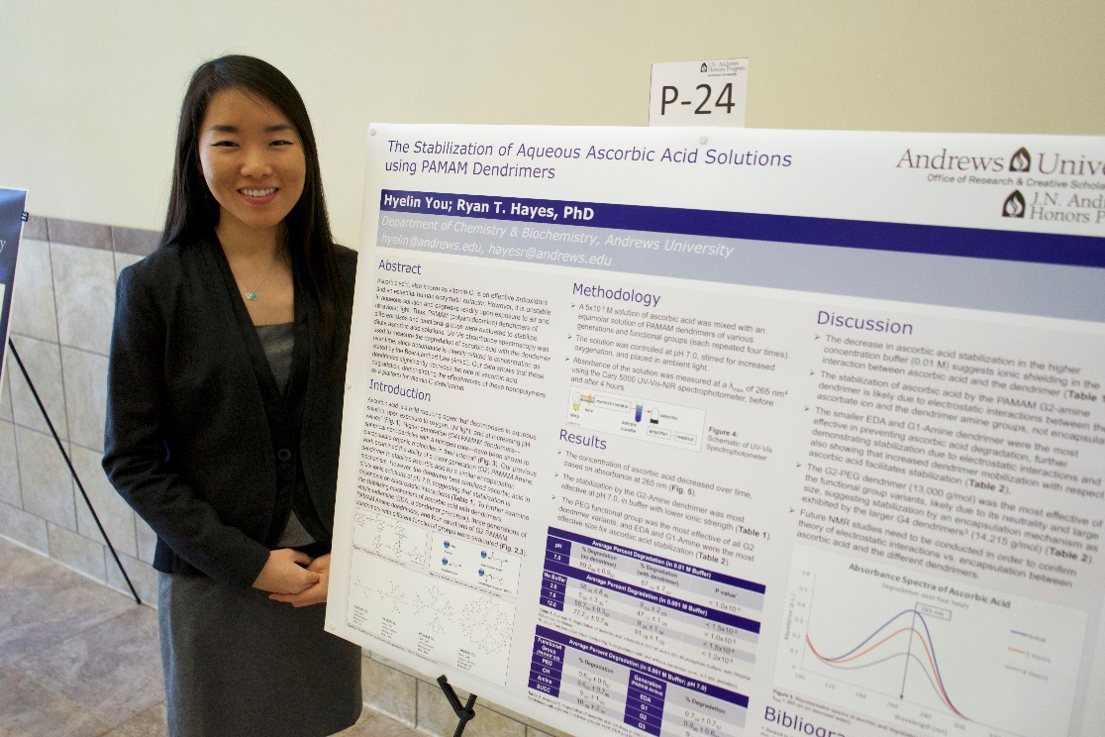
Hyelin You
Biochemistry and Spanish Studies Double Major
Plans to attend Loma Linda University School of Medicine in Fall 2017

