Slide 1
How to Be Fit, Strong, and Amazing
Maxine Umana

Slide 2
1 Corinthians 3:16
Don't you know that you yourselves are God's temple and that God's Spirit dwells in your midst?

Slide 3
How invested are you in yourself?

Slide 4
Why Workout?
Pro’s
Stress Reliever
Body
Strengthen your immune system
Con’s
Lack of physical activity effects your overall health

Slide 5
Fitness Saved Me
Unhealthy path to self destruction
Junk Food
Skipping Meals
Exercise + Healthy Eating = Losing Weight, Gaining Muscles, etc
Fitness Programs
Life RX
Temporary Solutions
Raw Diets
Juicing

Slide 6
My Fitness and Health Journey…
Undergrad
Freshman 15
School
Part-time Work
Fast-food
2 year gap
Part-time Work
Moving Out
No Fitness
Junk Food Grocery Shopping
Grad
Fitness
School
Part-time Work
Partial Smart Grocery Shopping
2 year gap
Fitness
Smarter Grocery Shopping
Part-time Work
Grad School, and Beyond…
Tone It Up!!!!!

Slide 7
“Karena Dawn and Katrina Scott aren't just photogenic best buddies; the co-founders of Tone It Up have a proven nutrition and fitness track record of delivering svelte, healthy, sexy bodies. Their holistic approach responses to core issues; from self-confidence and motivation to workout plans, eating habits, and daily fitness challenges.”

Slide 9
A day, a week, a month in Ms. Maxine’s Life
Weekly/Daily Schedule
Morning/Evening Rituals
Active Rest Day
Workouts
Meal Prep (Sunday)
Journal
Meals
Eat every 3 hours
5 meals a day
Mantra “Lean, Clean, Green”
Journal

Slide 10
Positive Reinforcement
Vision Board
Instagram
Post-its
Journal

Slide 11
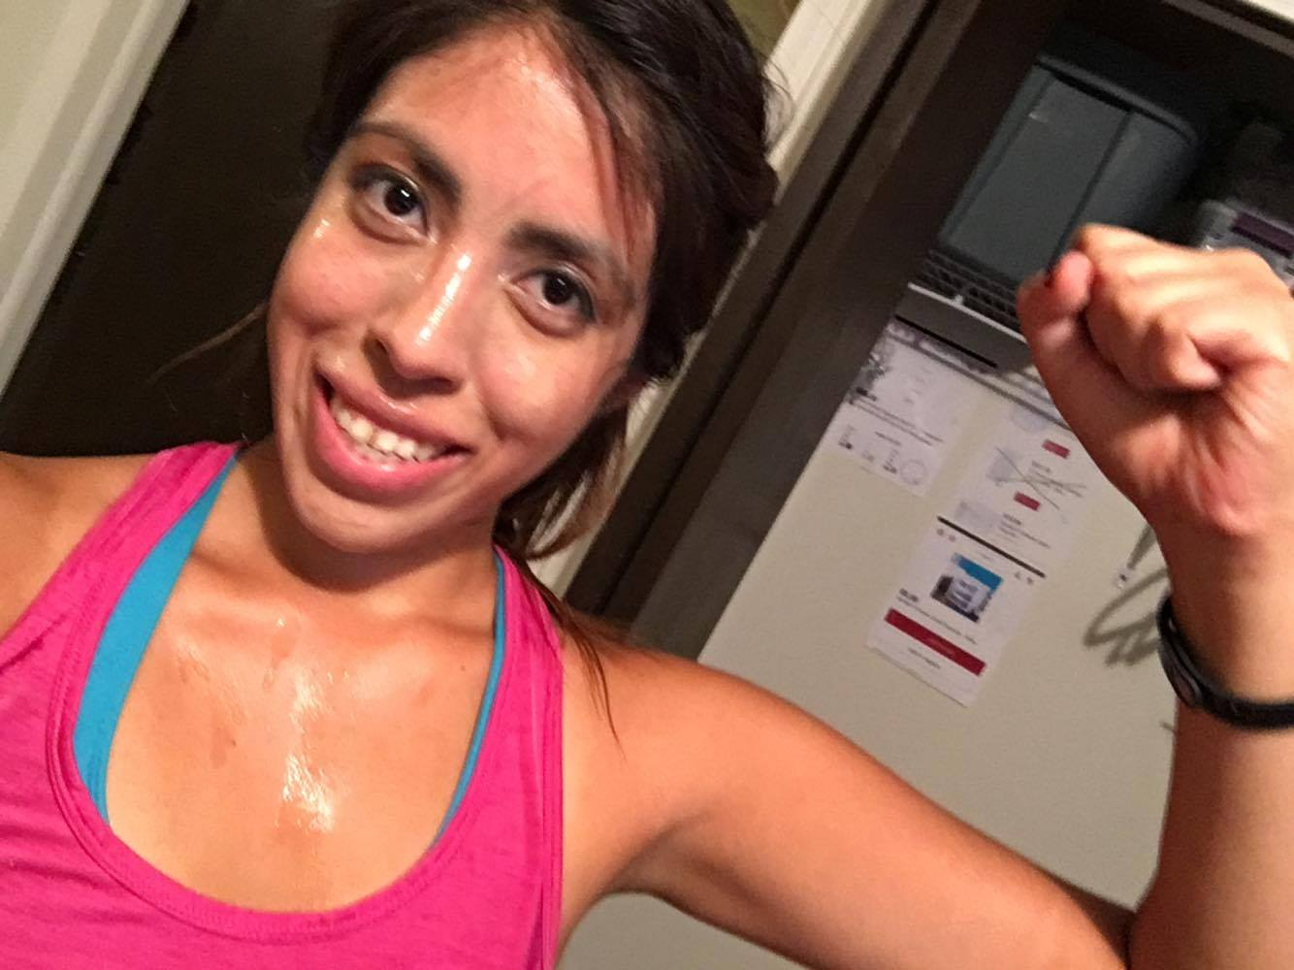
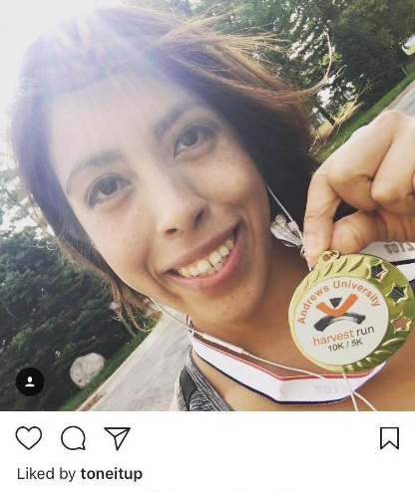
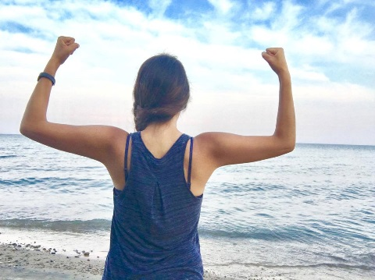
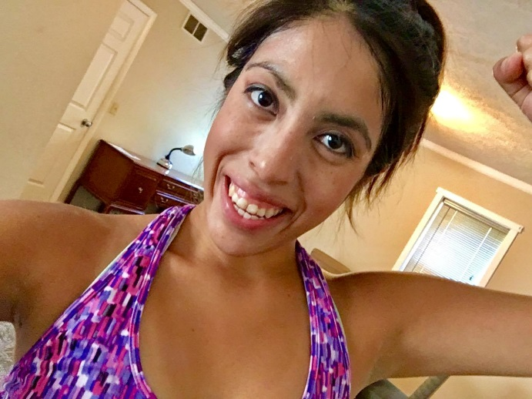
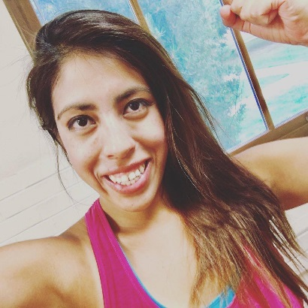

Slide 12
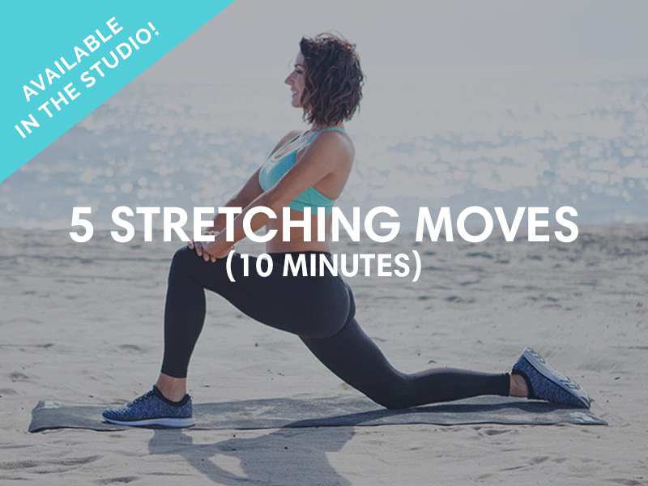
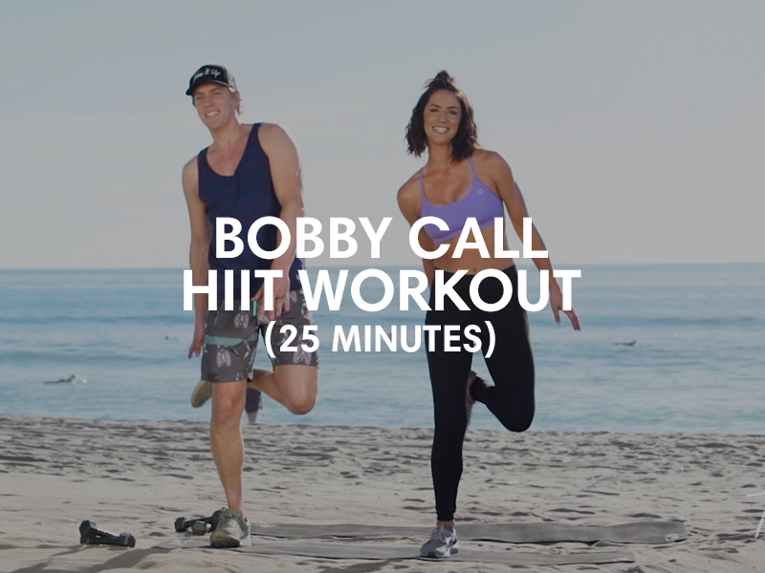

Slide 14
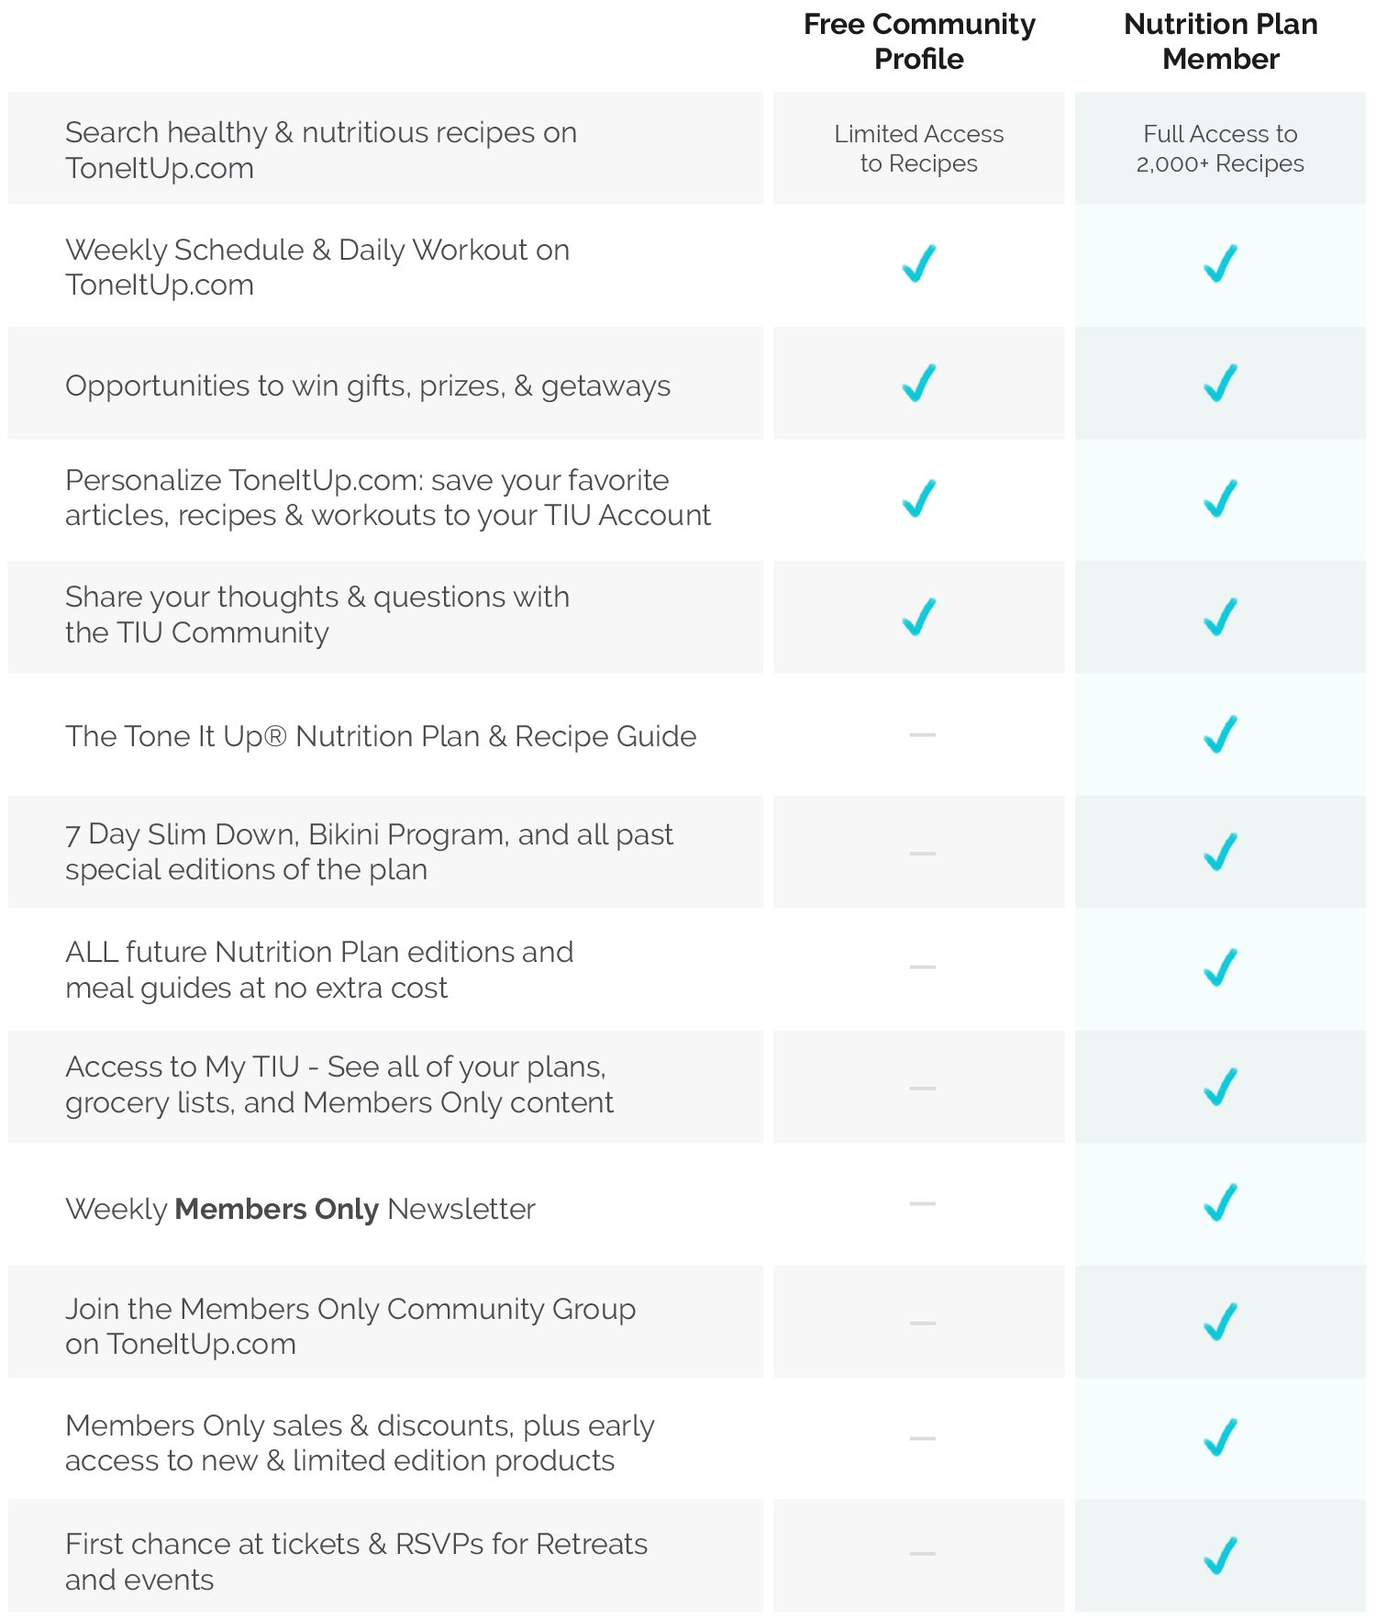
$150 (One-time Membership Fee)
Access to all versions of the plan: Regular, Gluten Free, Pescetarian, Vegetarian, GF Vegetarian, Vegan

Slide 15
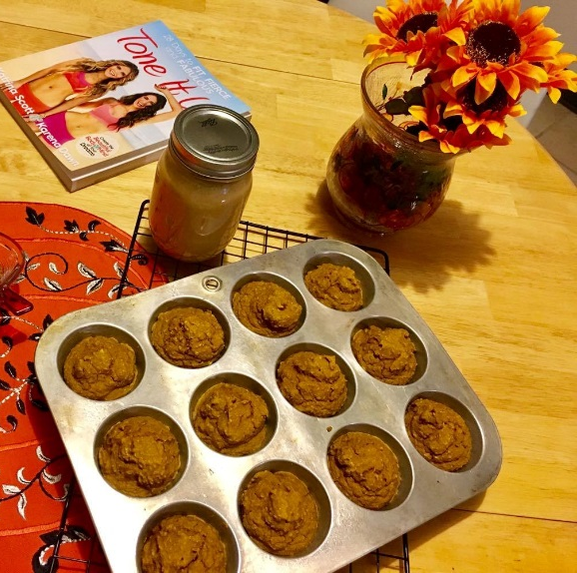
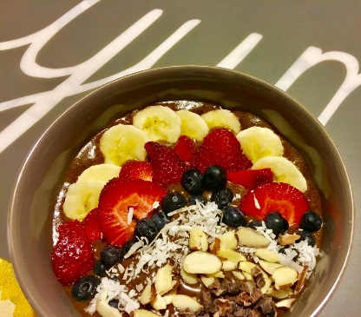
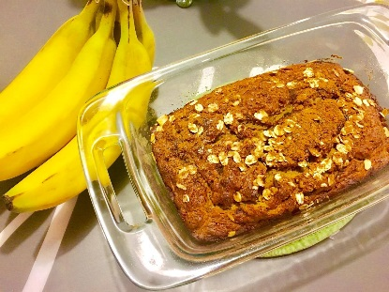
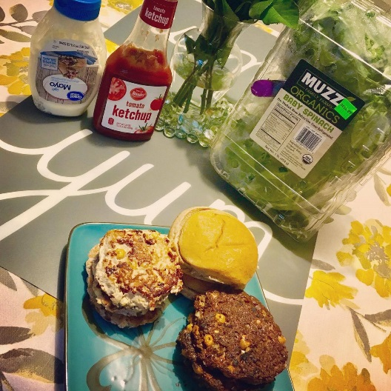
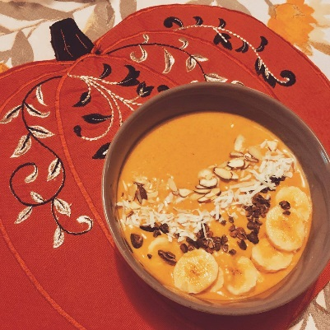
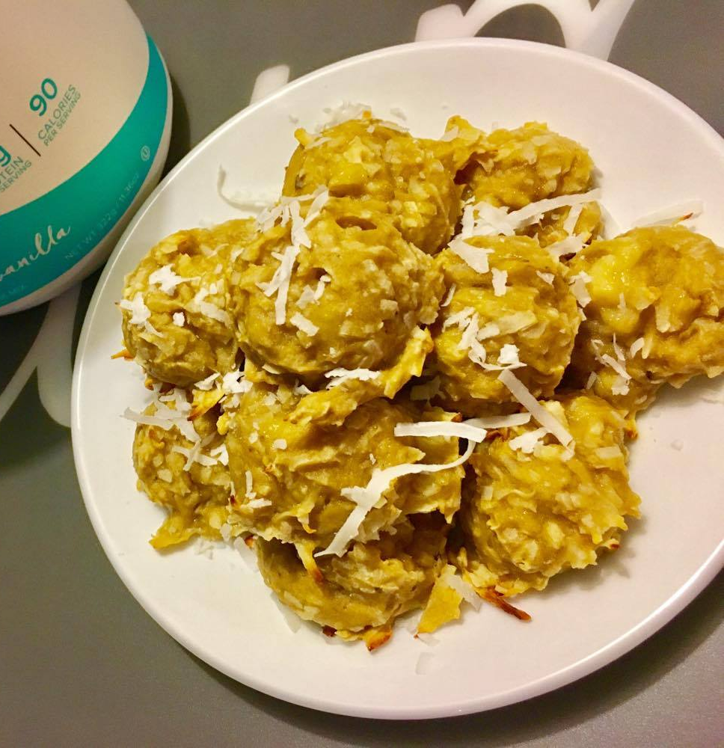
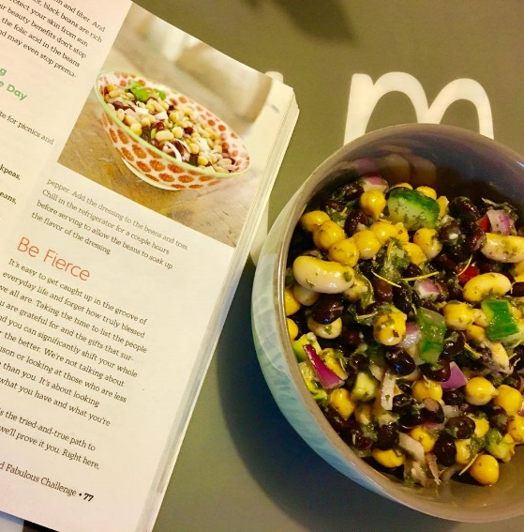

Slide 16
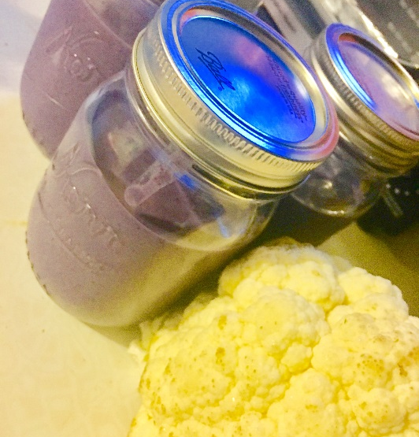
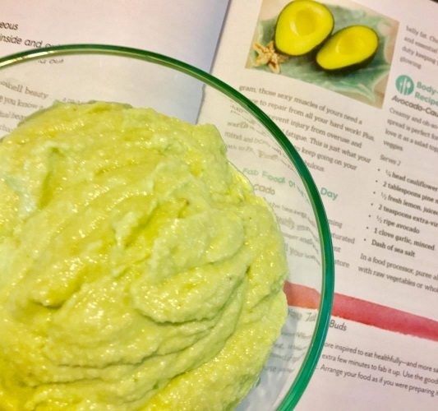
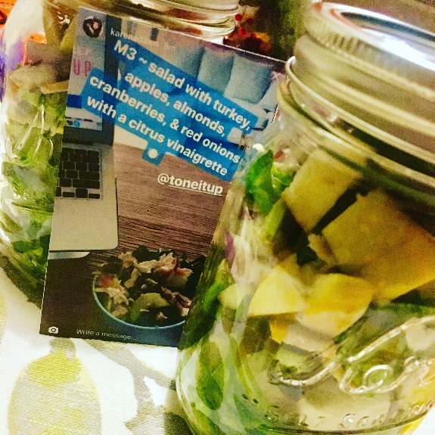
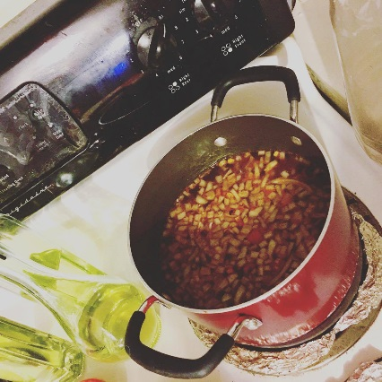

Slide 17
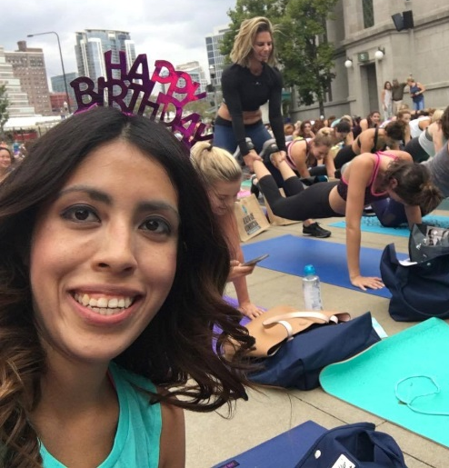
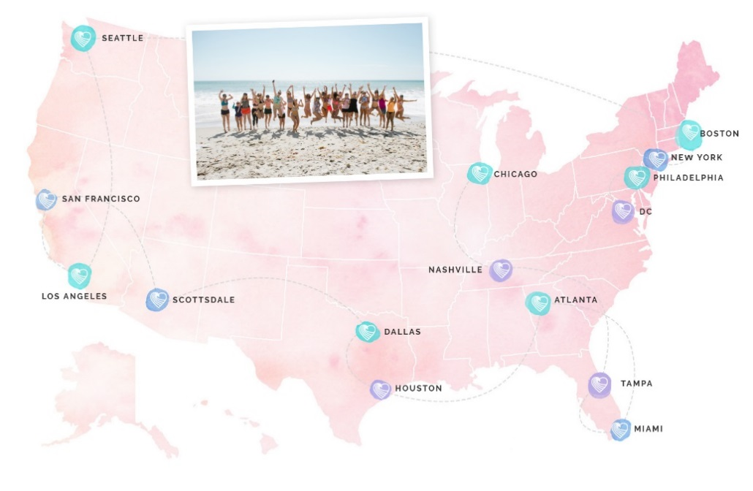
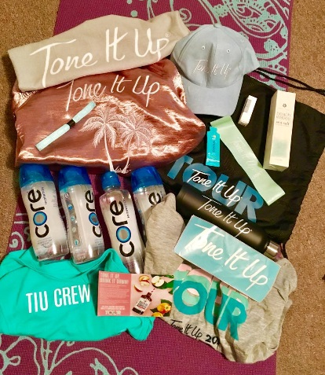
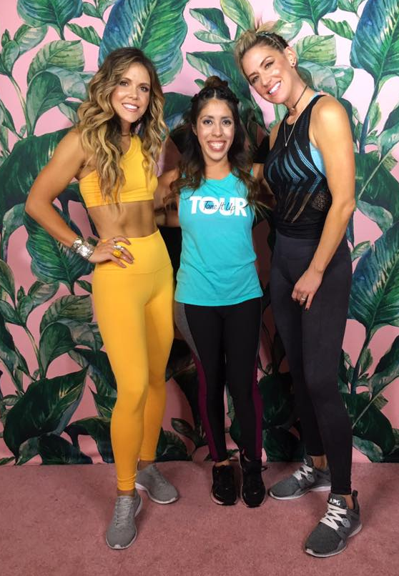
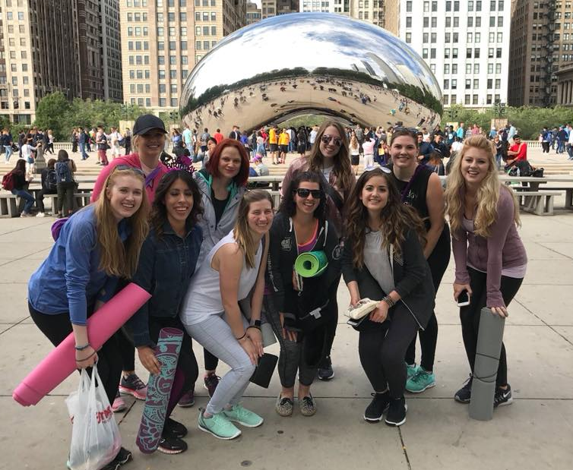
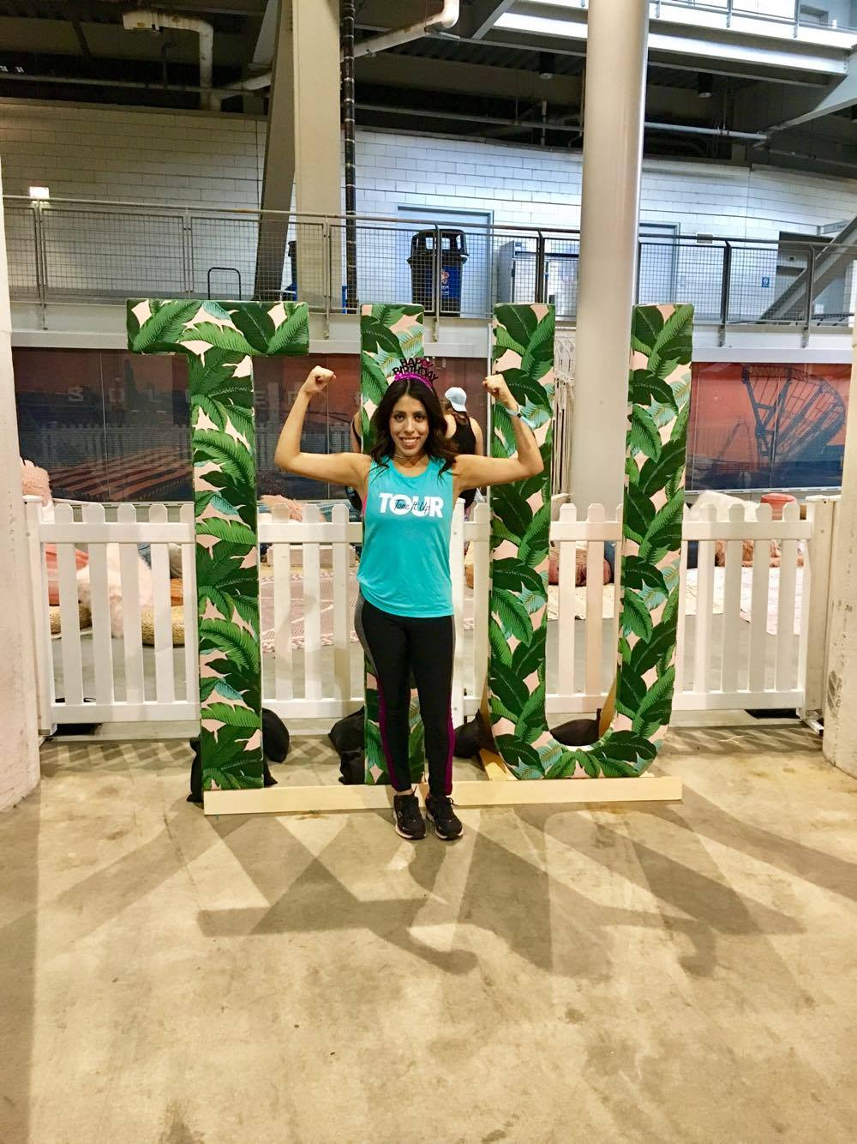

Slide 18
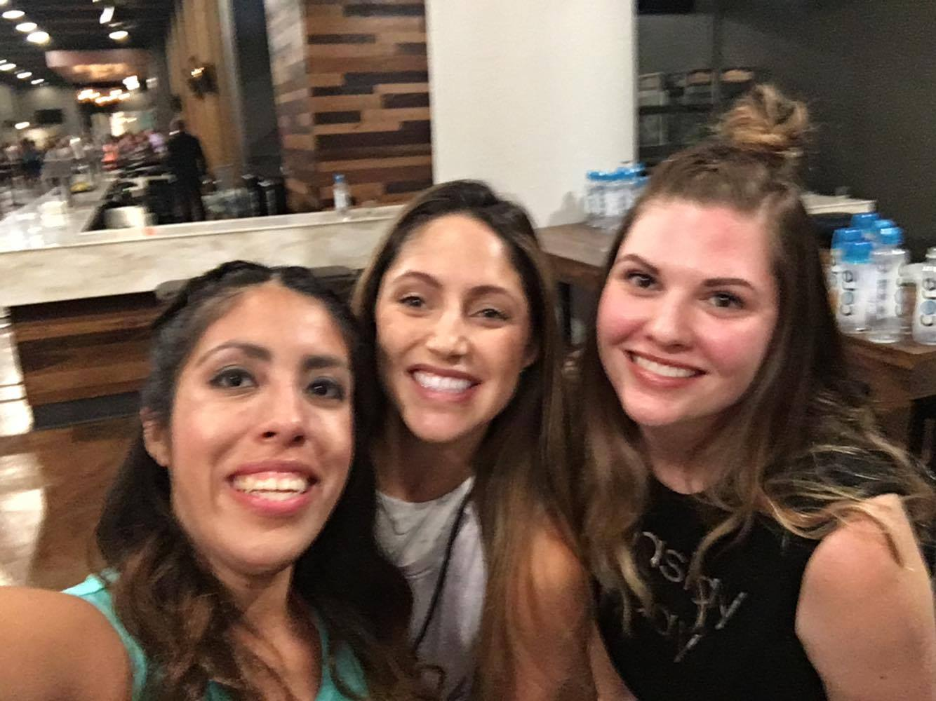
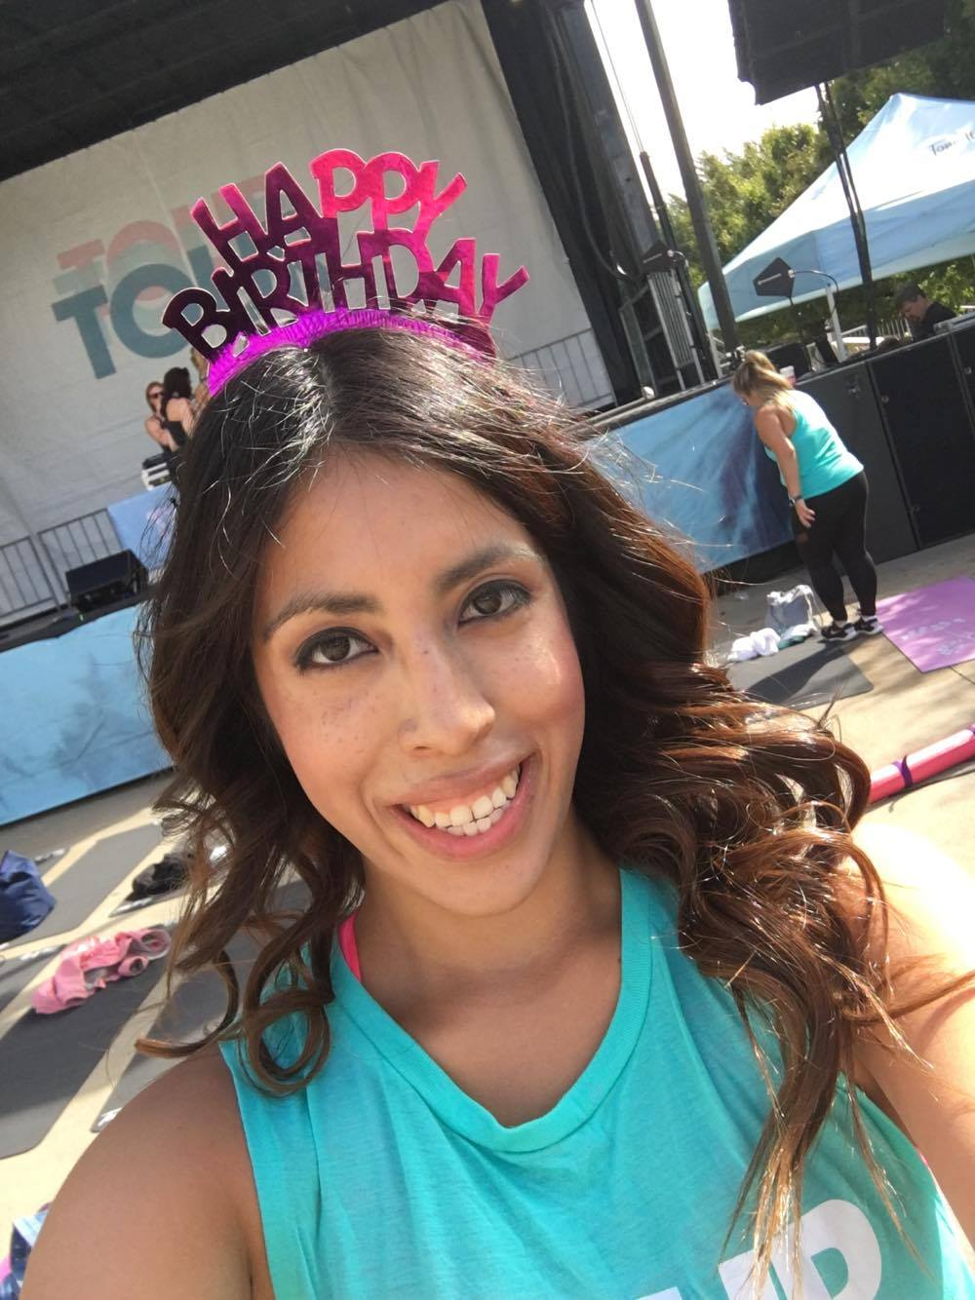
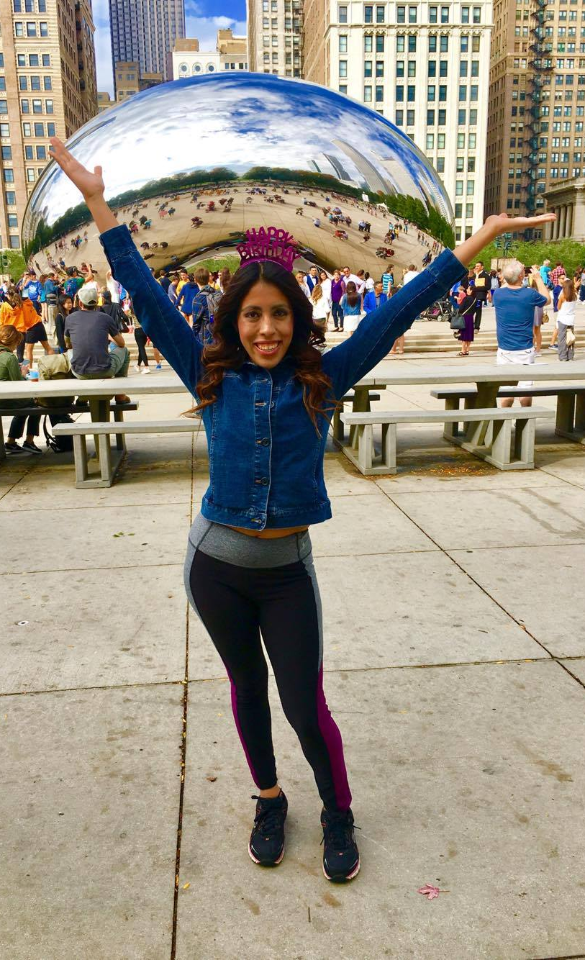
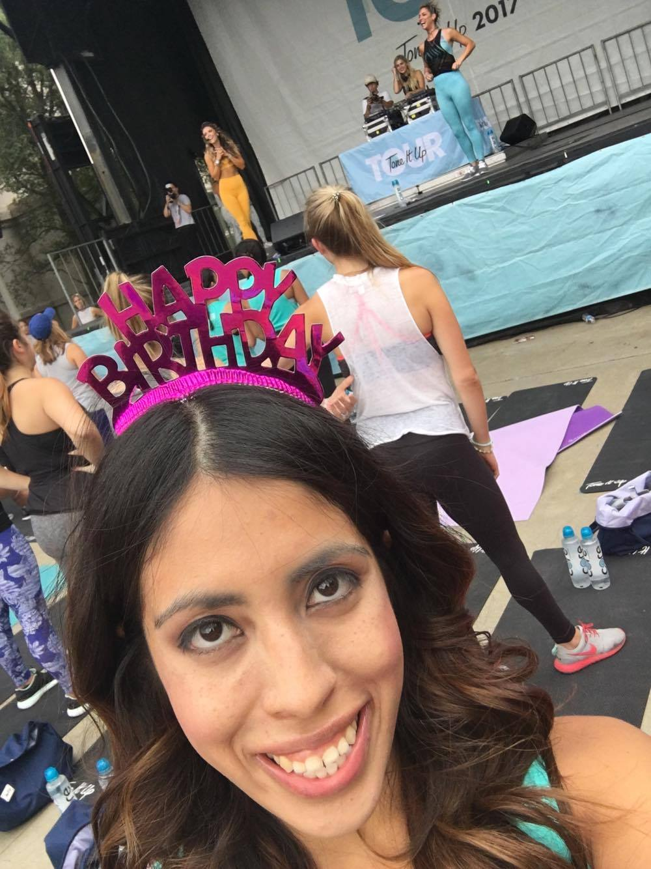
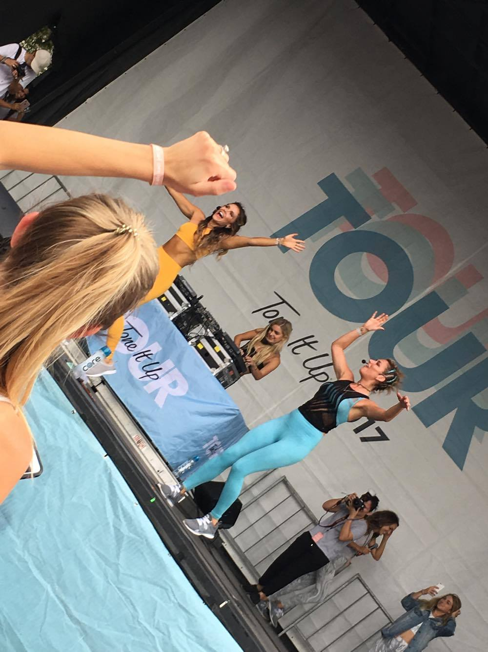

Slide 19
“Workout because you love your body, not because you hate it.”
Female Fitness Programs
Tone It Up
Jillian Michaels
Dorm Gym
Male Fitness Programs
Dorm Gym
Joint Fitness Programs
LIFE RX
YMCA
Planet Fitness
Pilates
Track
Sports/Intramurals
Yoga
Zumba
Walking/Jogging/Running
Swimming
Fitbit
Etc.

Slide 20
How and When to Workout?
How?
Get organized
Gear, journal, workout schedule, and meal prep
Where?
Home, Gym, Outside, Beach, etc
When?
Anytime!!!
Eat?
Before or after workouts
Don’t skip meals
More conscious
Treat Yourself!

Slide 21
Create a workout space dedicated to Fitness!
Dumbbells
Exercise ball
Resistance Bands
Sliders
Yoga Mat
Foam Roller
Water bottle
Candles & anything inspirational to you
Mirror for your form

Slide 22
Balancing Health/Fitness and College
God first
Be realistic and learn to compromise
Listen to Your Body
Plan your week
Support System
Set goals

Slide 23
How invested are you in yourself?

