Slide 1
Banner 9 General Orientation
Notes:
As most of you have heard, Ellucian has released a new interface for administrative Banner. This interface abandons technology that is no longer considered modern and secure (oracle forms). As an institution, we must fully adopt Banner 9 by December 31, 2018, with a few rare exceptions that will be identified by Ellucian. Please note that self-service Banner (e.g. where you view your paychecks) is not affected by this deadline, but will slowly be adopting a new interface with improved functionality.
Today we’re going to talk about some of the differences between Banner 8 (INB) and Banner 9, new navigation options in Banner 9, and the timelines and best practices for Banner 9 adoption.
What we don’t be covering today are tasks specific to your department (e.g. we won’t cover how to run payroll, confer degrees, etc).

Slide 2
Banner 9 vs 8
General Differences in Navigation

Slide 3
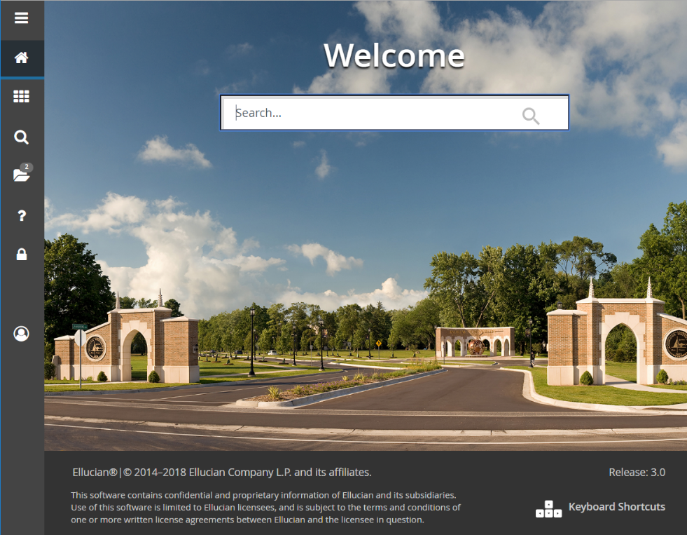
General Menu  Landing Page
Notes:
From the moment you log in, you will see this difference. What in Banner 8 was the menu has become the landing page in Banner 9. Note: this interface may also be referred to as Application Navigator.

Slide 4
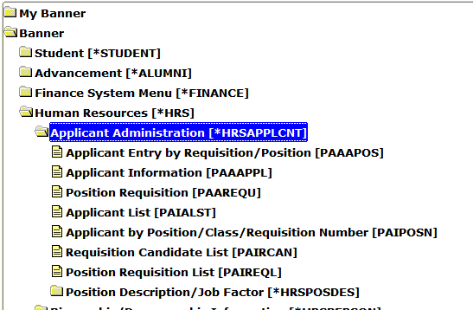
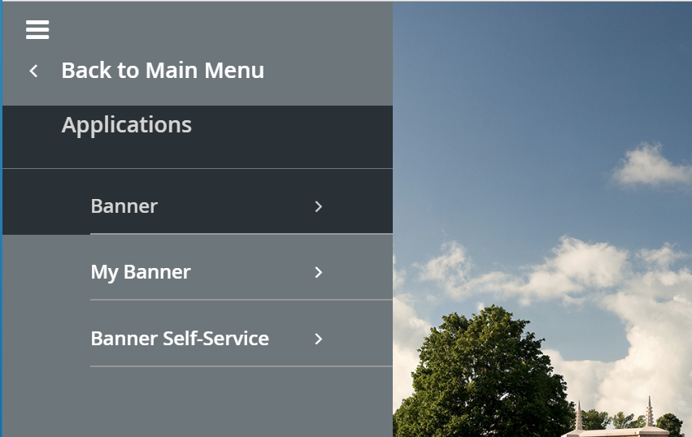
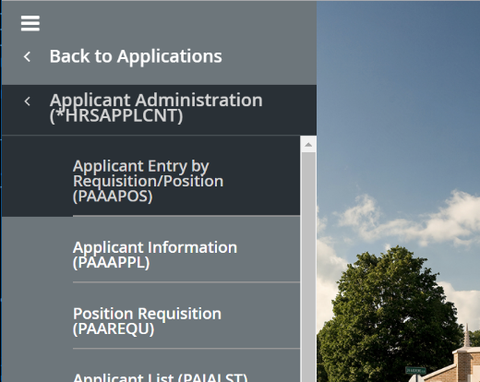
Menu Navigation  Applications: My Banner, Banner, Banner Self-Service
Ctrl +M
Notes:
The menu navigation is now just one piece of the landing page menu, under Applications. Additionally, applications will include Self-Service along with the Administrative Banner pages. (This is why this interface is sometimes references as Application Navigator).

Slide 5
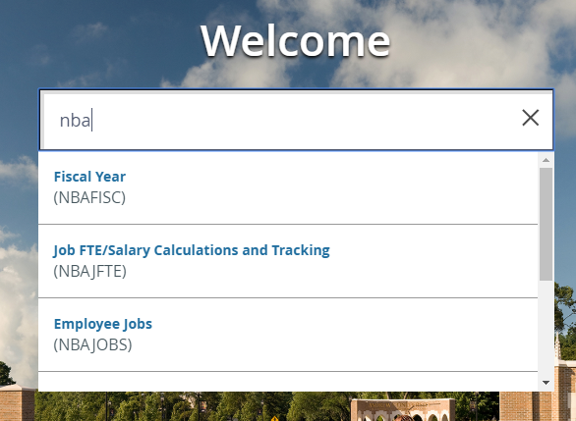
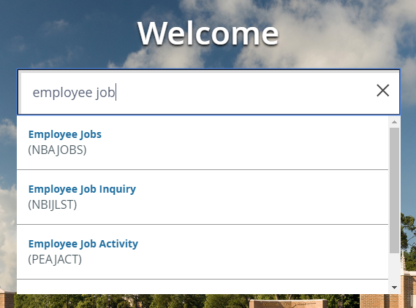
Navigation to Form  Searching for Page
Notes:
In Banner 8, you went to a form by typing in the 7-character name in the “Go To…” box. Now, you can either type those into the search box on the landing page, or type some of the description to receive a list of possible matches. Beware…there is an “auto-complete” feature that can sometimes take what you’re starting to type, assume it knows where you want to go, and take you to a completely different form. Note: after typing in your 7-charcter name, you can just hit enter, or you can select from the list returned.

Slide 6
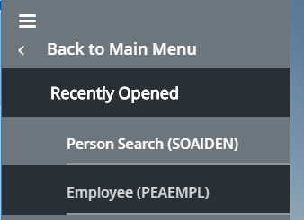
Recent forms  Recently Opened Pages
Ctrl +Y
Notes:
If you make use of the recently opened forms functionality, that is now available in the menu as Recently Opened, and will list all pages that you’ve accessed in that particular session.

Slide 7
Close Form  Close Page
Ctrl +Q
Notes:
Ctrl +Q still works to close the page and return you to the landing page. It is recommended that you also do this before signing out of Banner.

Slide 8
Close/Logout of Banner  Sign Out of App NAV
Ctrl +Q
Ctrl +Shift +F
Notes:
In Banner 8, you just kept clicking on the Black X to logout out. Now you need to click on the Lock icon.

Slide 9
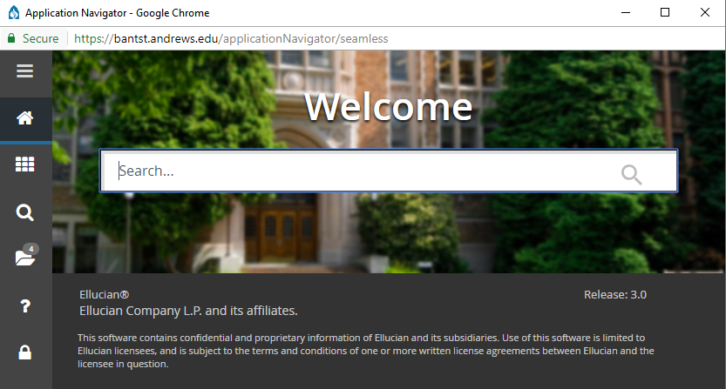
Logout of Multiple Sessions  Sign Out of Last Window or at end of Day
Ctrl +Q
Ctrl +Shift +F
Notes:
Along with that, in 8, we used to tell you make sure you logged out of each session when you had multiple windows open, or that would leave a session hanging and mess you up in your session count. In Banner 9, it’s the opposite. Only sign out of your last window. If you are closing out of multiple windows (trying to leave one open to keep using), signing out will sign you out of all “sessions”.

Slide 10
Form Online Help  Page Help
Ctrl +Shift +L
Notes:
Online help has moved the main menu bar, but is only available once you are actually in a page (not from the main landing page).

Slide 11
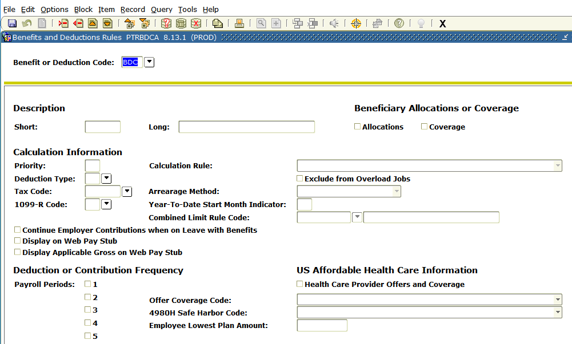
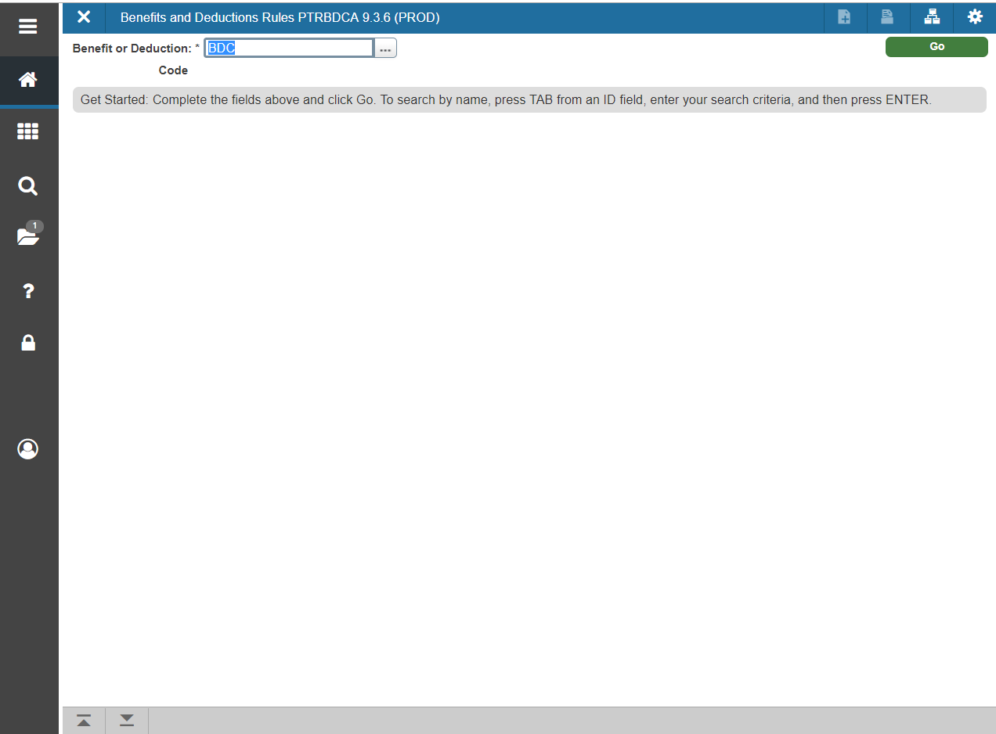
See data in Form  See Data on Page
Ctrl +PageDown  Alt + PageDown
Notes:
Ctrl Page Down now becomes Alt Page Down. On most keyboards, this can still be a one-handed stroke, but your muscle memory may need to adapt to a wider stretch or using different fingers.

Slide 12
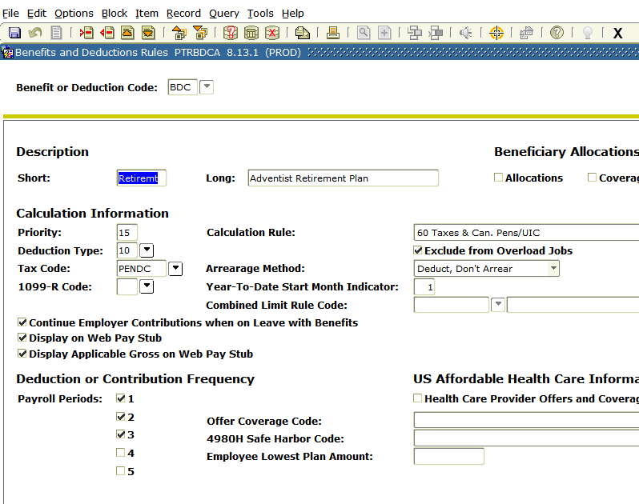
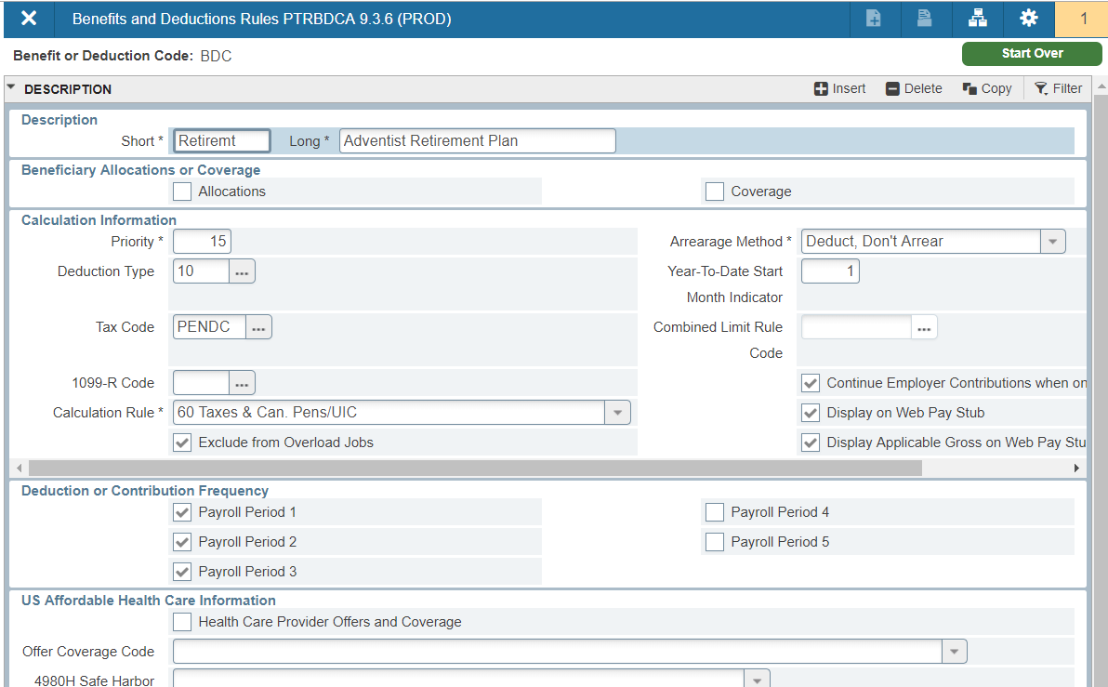
Rollback  Start Over (refresh)
Shift +F7  F5
Notes:
Shift-F7/Rollback now becomes F5/Start-over or refresh, which is the shortcut for refreshing in most browsers.

Slide 13
Person ID Lookup: Drop Down  Ellipses
Notes:
In many places, querying within a field has changed from clicking on the drop-down arrow to using the ellipses. To look up someone’s ID number, you can still use F9 to access SOAIDEN. In some cases, on lookup pages, the drop down arrow has been replaces by a search button for each option.

Slide 14
Name Quick Search: Tab to Name field  Tab to Hidden Field
Notes:
Some of you knew that if you didn’t enter an ID number, and tabbed to the name field, you could type in the individuals name (with last comma first), and find the person that way. Wildcards should be used, the screen to choose from multiple options behaves a little differently that just looking up in the ID field. In Banner 9, the Name field isn’t there when first navigating to the page. But you can still tab into it and use the old method to search by name.

Slide 15
Key Block: Static  Collapsed &Variable
Notes:
In Banner 8, key block layout was static. In Banner 9, the key bock will be expanded for initial entry, but will collapse to a different display layout when you go down to access the data on the page. Additionally, the layout is variable depending on the width of your window…data will move around if you resize your window.

Slide 16
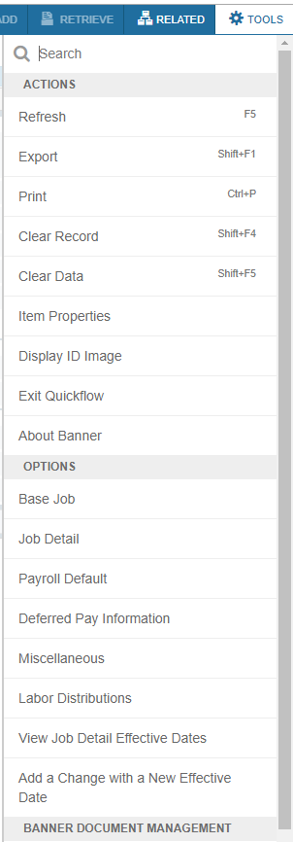
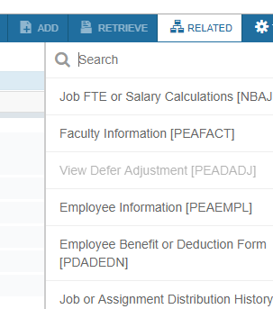
Options Menu  Related & Tools Menus
Notes:
Items that could be found under the Options menu have been split between the Related and the Tools menus. If the Option was for that particular form (tab navigation or taking action on that data), it moved to the Tools menu. If the Option was to go to another form, it moved to the Related menu.

Slide 17
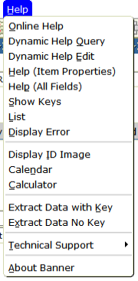
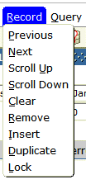
Item, Record, Tools & Help Menus  Tools Menu
Notes:
Most of the other items available under the Item, Record, and Help menus also moved to the Tools menu.

Slide 18
Extract Data  Export
Notes:
Extracting Data has now become Export, available under the Tools menu. However, it’s still only available if it has been turned on for that page. If you think Exporting would be helpful, but it’s not working, please work with your Banner Support Specialist to determine if export can function for that particular page.

Slide 19
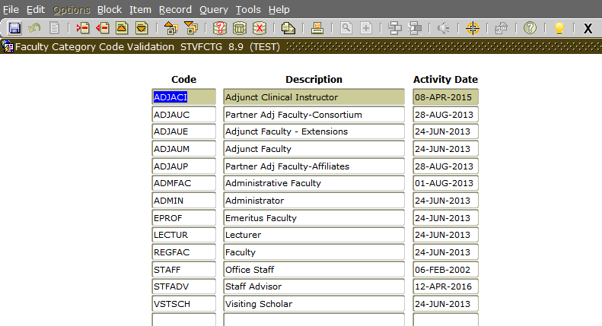
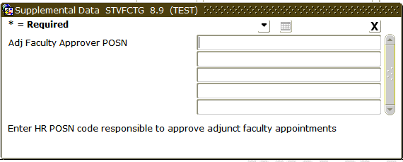
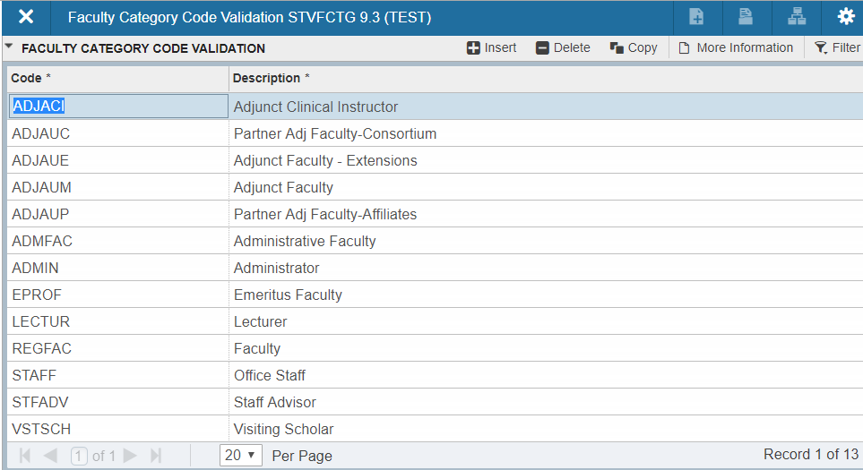
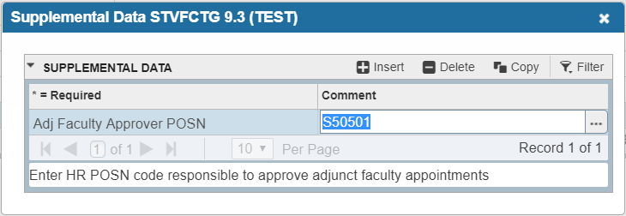
Supplemental Data Engine Fields: Lightbulb  More information
Data in field: document icon is filled in/darkened
Ctrl +D  Ctrl +Shift +U
Notes:
The Supplemental Data Engine is used to add fields to a form or page, when we’ve determine additional data collection is necessary and the SDE fields work well with the page. These additional fields used to be available with the lightbulb. It there were no SDE fields, the lightbulb was grayed out, if fields existed, it was colored in, and if there was data in the fields for the particular record, the lightbulb was shining or “hairy”. Now, a “More Information” label will appear when SDE fields exist, and that icon will change from a blank document to a darker/filled-in document where there is data in those fields.

Slide 20
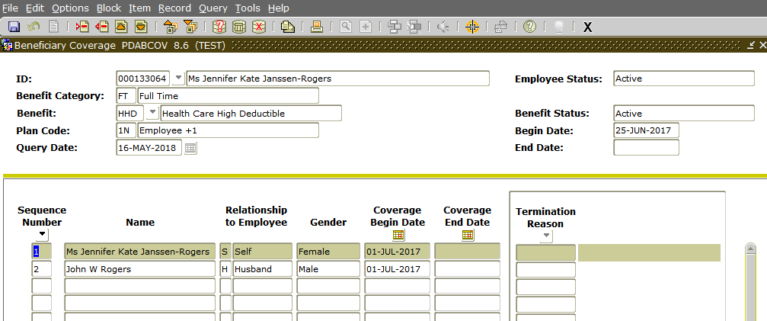
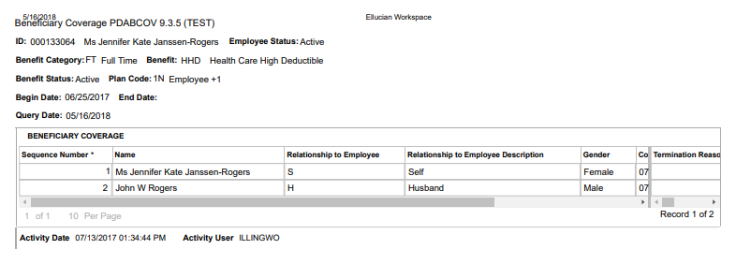
Banner Print Screen  Print Page
Shift +F8  Ctrl +P
Printing behaves best in Chrome
Notes:
Banner Print Screen functionality is changing significantly with the change to variable width screens. In Banner 8, you were able to print exactly what was on the screen. This doesn’t necessarily translate into Banner 9. Most people have had the best printing success when using Chrome as their browser. If you have a business process need to print your screen, and are unable to achieve the desired printouts, please work with your Banner Support Specialist to report the need and issue to Ellucian.

Slide 21
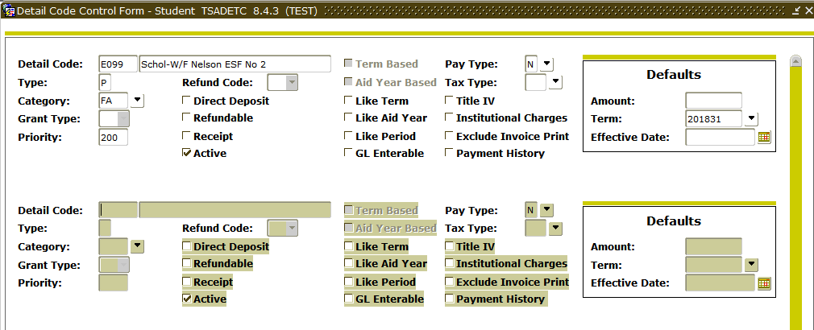
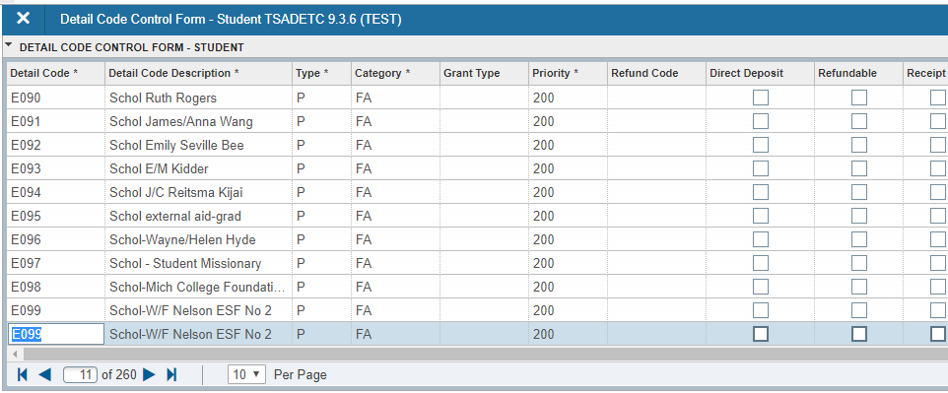
Insert Record/Copy Above  Copy Record
On Record to Copy: F6 then F4  F4 on record to copy
Notes:
If you wish to copy a record, you used to need to insert a new (blank) record, and then copy the record above (F6, then F4). In Banner 9, make sure you are on the record you want to copy, then copy to create a new record below or after the original one (just F4).

Slide 22
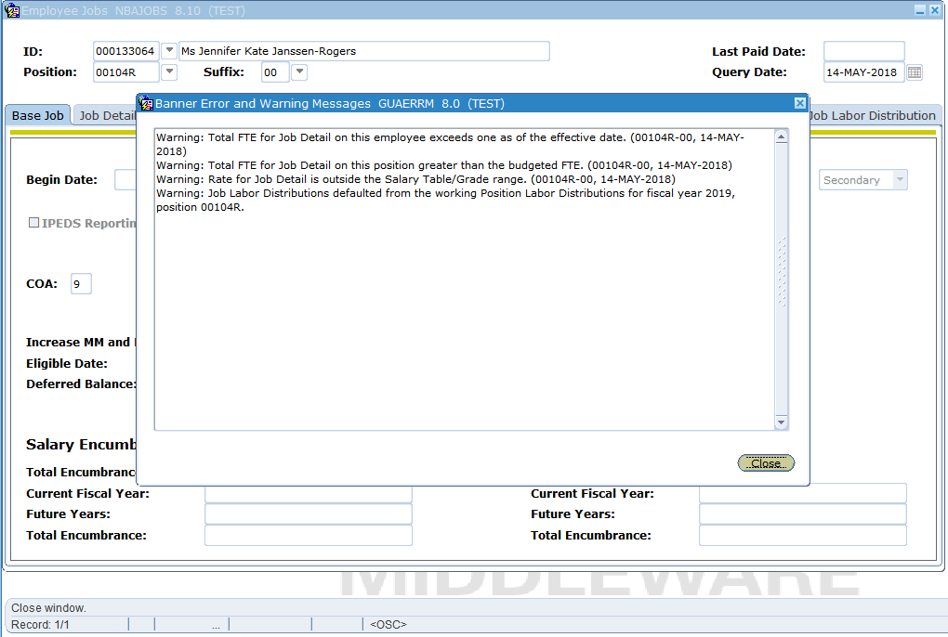
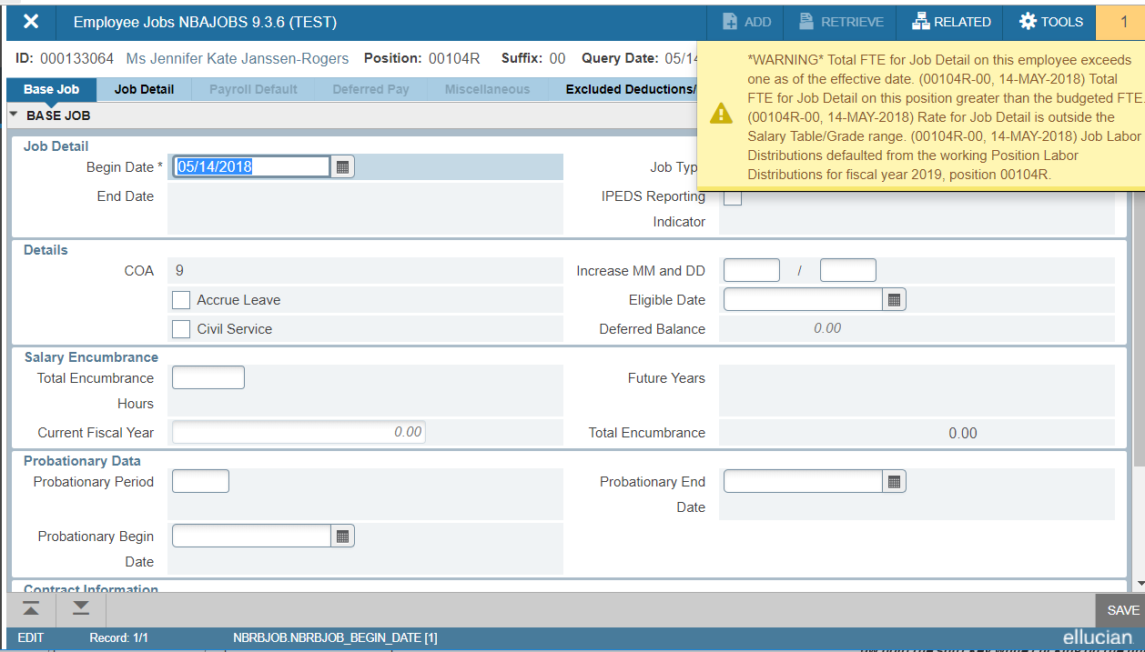
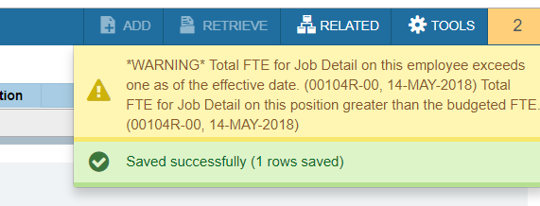
Errors (red) Warnings (yellow) Success Messages (green)
Click on number to make messages disappear
Notes:
Warnings, Errors, and success messages are moving from a combination of pop-up boxes and message bar messages to the message center in the upper right. A number will only appear once you’ve received a message, and you can click on that number to toggle the messages on/off. In addition to red for errors, yellow for warnings, and green for success messages, I’ve also seen blue which seems to be associated with processing messages. Note that some messages will still require acknowledgement. In this case, the warning to longer needs to be “closed”, but some messages may require you to click on, for example, Okay within the message.

Slide 23
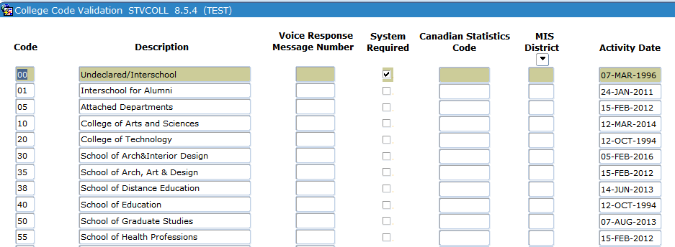
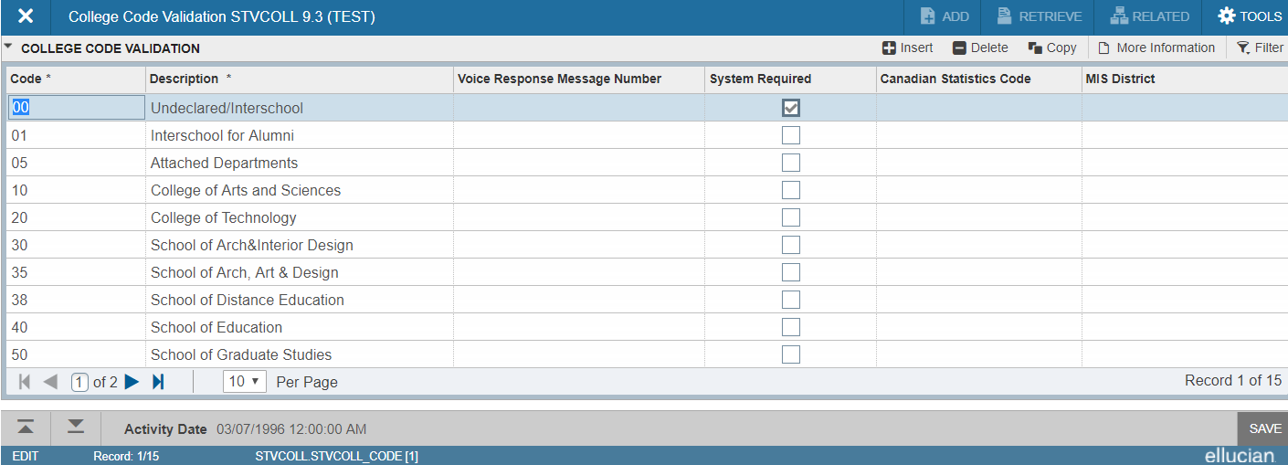
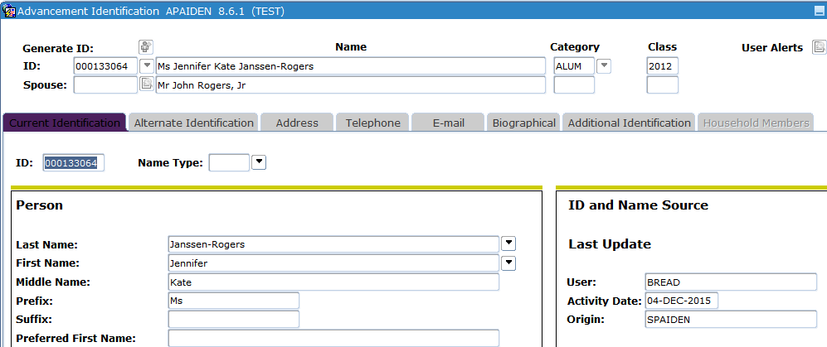
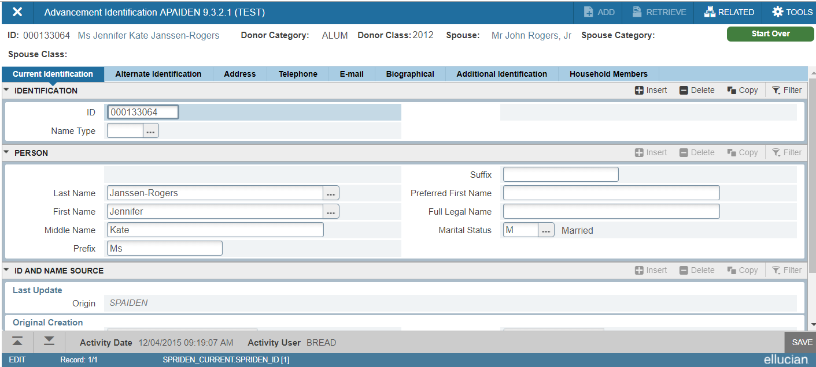
Activity Date & Username
Notes:
The username and activity date associated with record changes/saves has moved from the body of the page down to an informational bar at the bottom of the page. This may mean whole fields and columns have “disappeared” from your page. In the case of STVCOLL, there is no more Activity Date column, and in the case of the IDEN forms, the date and username have moved from the page to the lower bar, but Origin still remains up in the page. This data will be displayed for whichever record is selected on the page.

Slide 24
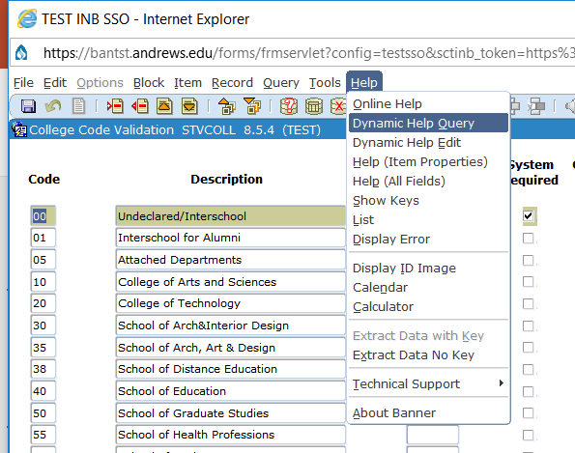
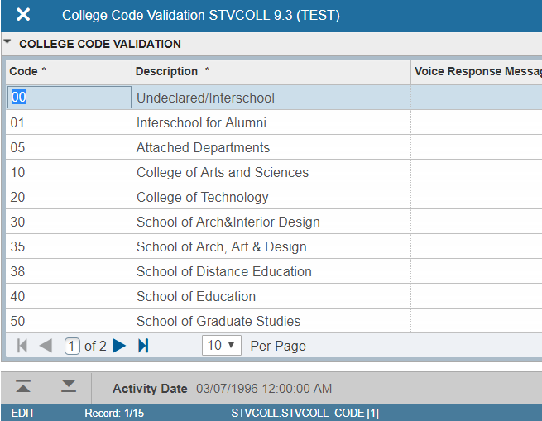
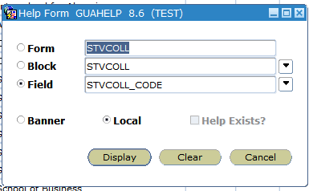
Table/Column Name
Notes:
If someone from ITS is trying to help you figure out a problem with a specific field, they may have asked you to look up this information on what table and column that field is pointing to in the back-end database. That information is now displayed in an informational bar at the bottom. Please note that your window may need to be fully expanded to display this.

Slide 25
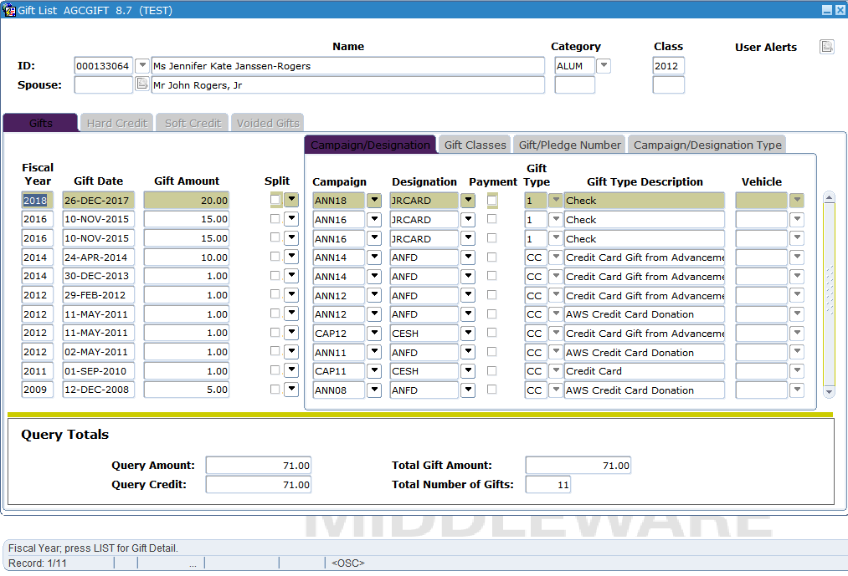
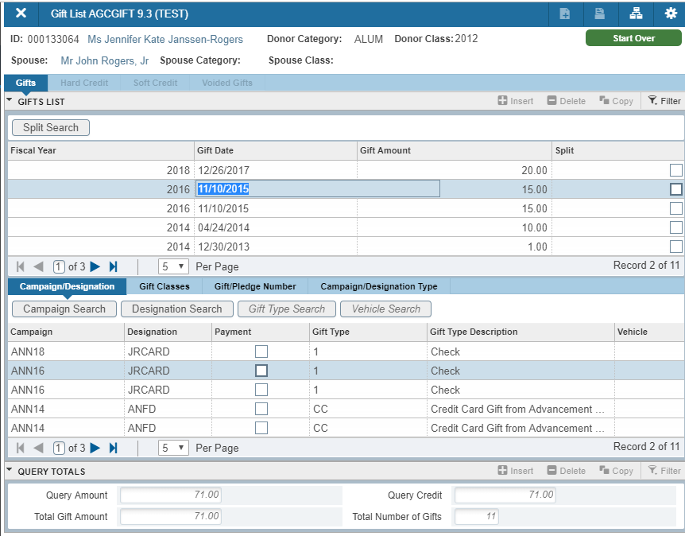
Location of additional Tabs/data
Tabs might be in a separate section below, search might be a new button
Notes:
As Ellucian attempted to be ready for the approaching deadline, they used a quick-convert tool to quickly convert all of the forms from Oracle Forms to the new interface. Depending on the form, this may result in some visual changes. This is an example I’ve seen repeated on a few pages. The data that used to be linear for each record, perhaps split across tabs, it now split into separate sections of the form. Moving from one record to the next will be mirrored in the other sections.

Slide 26
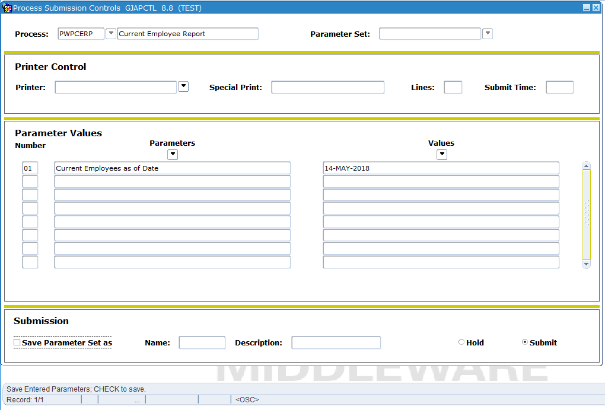
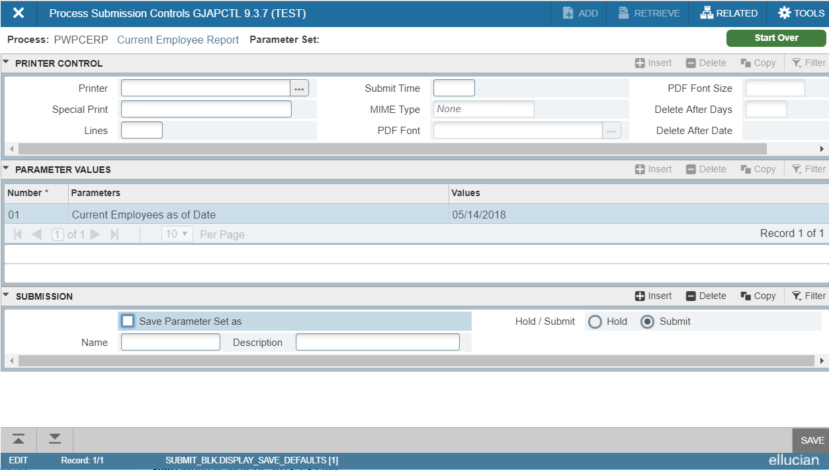
Process Submission Control (jobSUB)
Notes:
Not much has changed about submitting your reports an processes, although fields have been added to the Printer Control section. We are not yet using the new functionality. Note that your submission sequence number is moving from the bottom message bar to the message center in the upper right-hand corner.

Slide 27
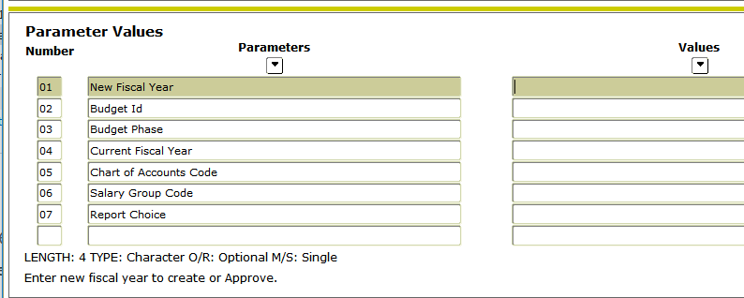
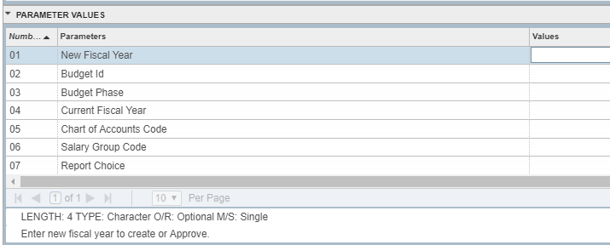
Process Submission Control (jobSUB) – Parameter Help
Parameter Drop-Down list
(may have to scroll)
F9  F9
Notes:
This slide was not originally included in the training sessions. Parameter help text in in the same basic area, but the way to pull up a list of valid entries for a parameter has changed from the drop-down arrow to the ellipses (which you may have to scroll over to see).

Slide 28
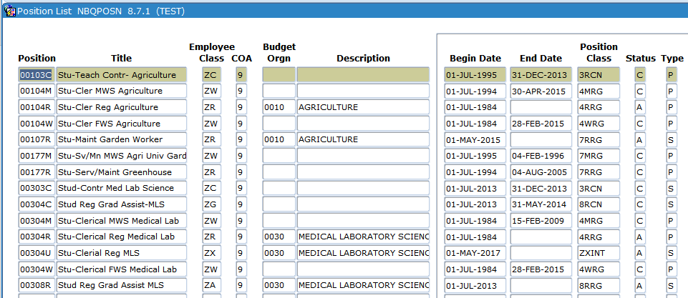
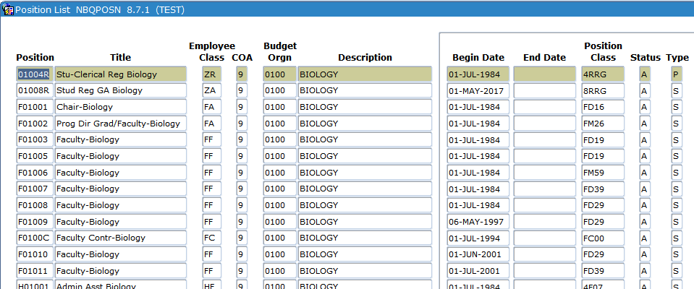
Query in Form  Filter: Basic & Advanced
In Banner 8: F7, type in field you want to query on, then F8
Notes:
In Banner 8, you were inputting your query directly into the fields available on the form. Searching was limited to positives (e.g. you couldn’t say that you wanted records with a field blank, numbers greater than a certain amount, etc).

Slide 29
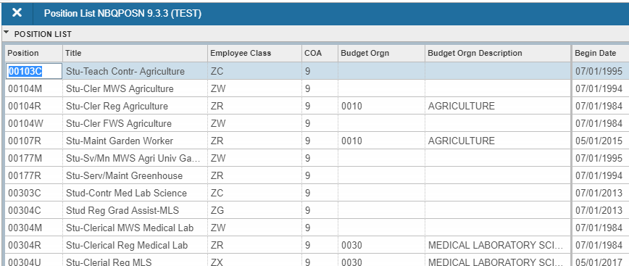
Query in Form  Filter: Basic & Advanced
In Banner 9 Basic Filter: click on Filter (F7), type data in the field(s) you want to query on, then click on Go (F8)
Notes:
In Banner 9, filtering opens up fields to input your search parameters in. Basic Filter allows for the same sort of search capabilities as were present in Banner 8.

Slide 30
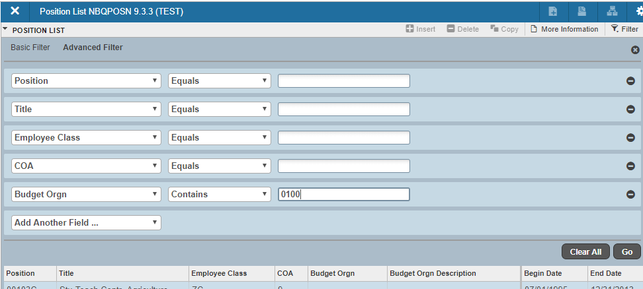
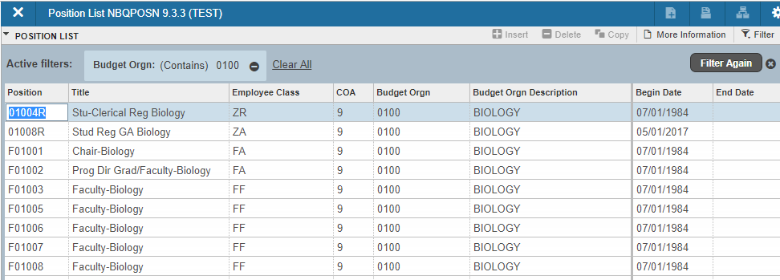
Query in Form  Filter: Basic & Advanced
In Banner 9 Advanced Filter: click on Filter (F7), select comparison operator and type data in the field(s) you want to query on, then click on Go (F8)
Notes:
You can toggle to the Advance Filter to use more robust comparison operators like “Is NULL”, greather than, etc.

Slide 31
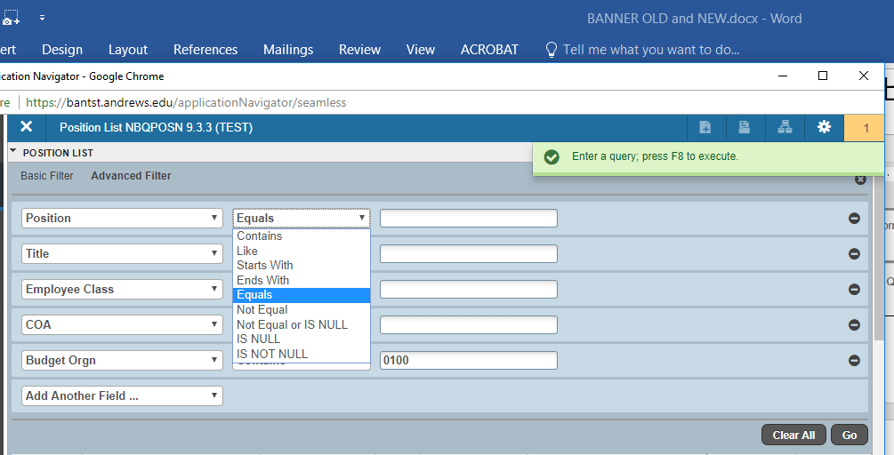
Query in Form  Filter: Basic & Advanced
Basic Filter is first 5 fields, can use wildcards, can add other fields
Advanced Filter also defaults to first 5 fields, can add other fields, more options for comparison (e.g. Contains, Starts With, is NULL, etc)
Notes:
Basic Filter defaults to the first 5 fields displayed on the page. In both Advanced and Basic filter, fields can be removed or added. If you are having difficulty filtering for the data you want, please work with your Banner Support Specialist. Examples might include if a field you want to filter on is not available to add.

Slide 32
Banner 9 Record Navigation
Things that are new to navigation in Banner 9
Notes:
Now we’re going to go over some of the record navigation that only applies to Banner 9.

Slide 33
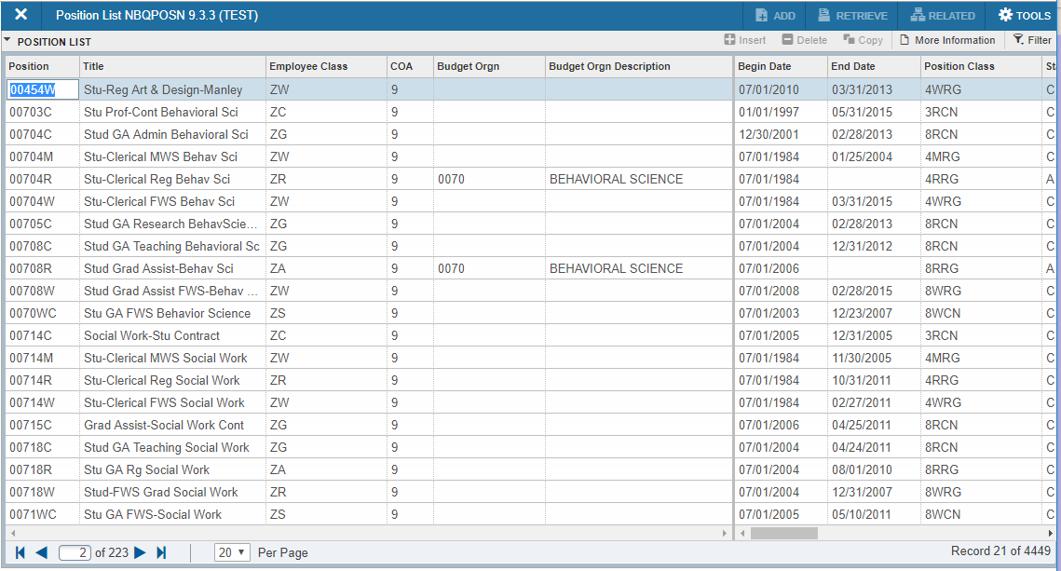
Pagination for multiple records on page
Use arrows to move forward or backward through pages
Change the number of records displayed on the page
Use jump arrows to move forward to last page or backward to first page, can also type in page number and tab to jump to that page
See which record you’re on and how many total records have been returned
Notes:
When multiple records are returned, especially when displayed linearly with multiple on the page, you will want to notice the pagination displayed on the bottom. You can move between pages using the arrows at the bottom left, change the number of records returned per page, and see which record you’re on out of the total count of records.

Slide 34
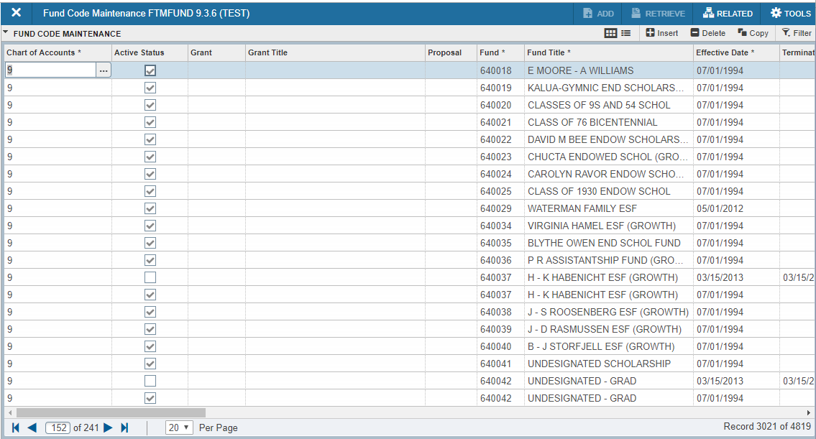
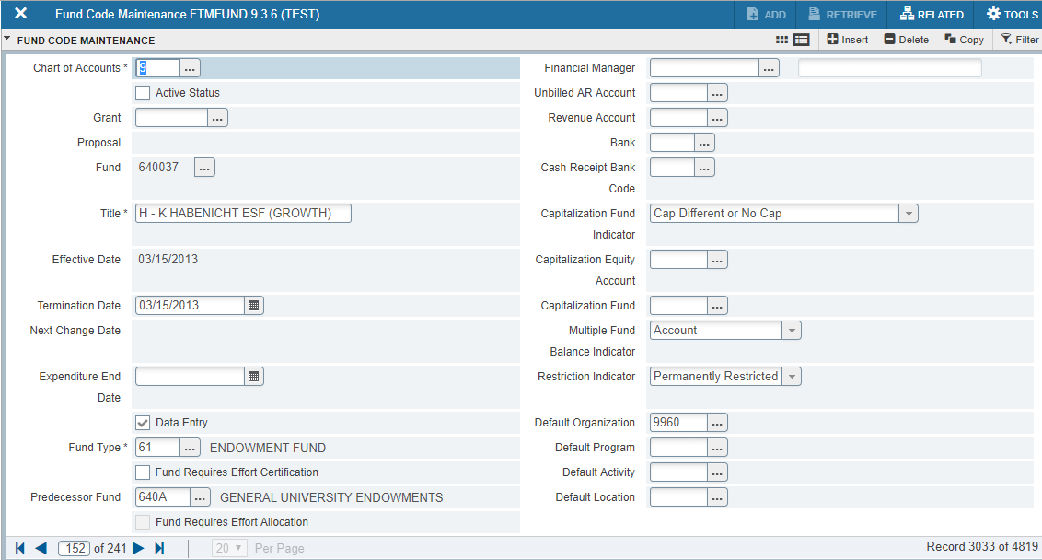
Multiple to Single record toggle
Use to toggle (Ctrl +G) between multiple and single records, available on some forms
Notes:
Some few forms allow you to toggle between multiple records arranged in a linear fashion and individual records displaying in the “page” layout.

Slide 35
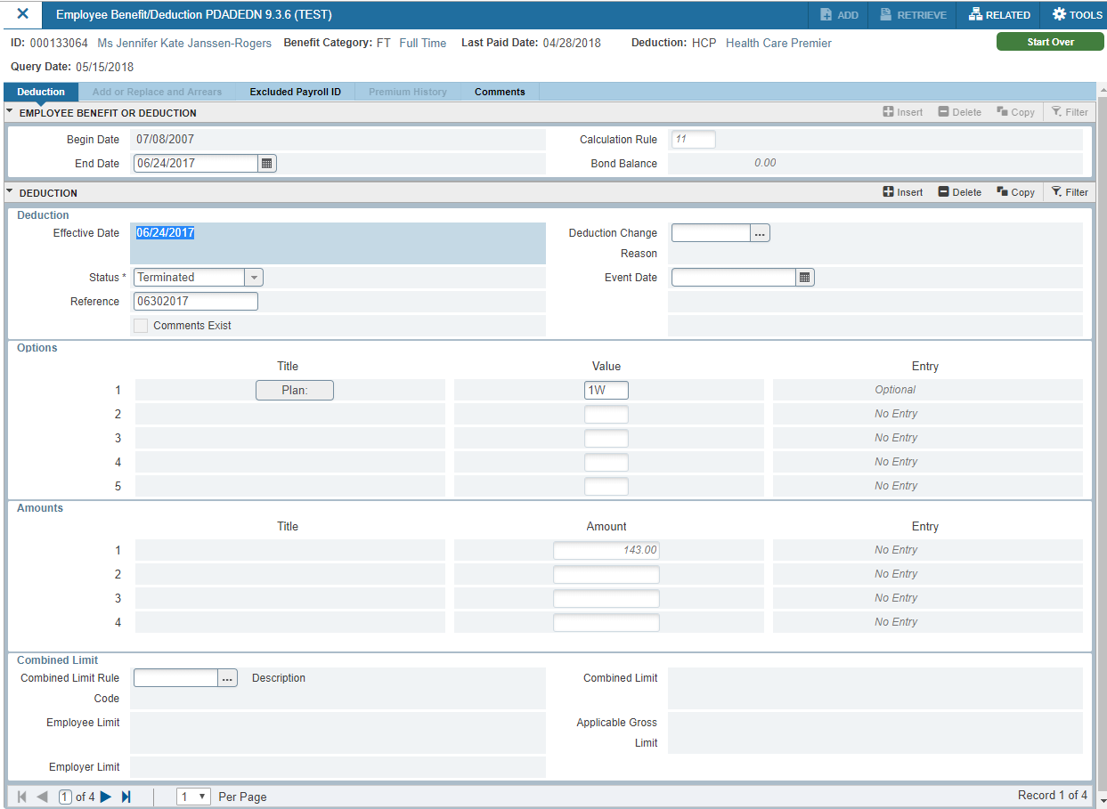
Single Record display, multiple effective dates/Other single record display
Use pagination to move between multiple effective dates (changing number per page doesn’t work)
Notes:
In some forms, when data isn’t displayed in a linear fashion, one record per page will be displayed and pages can be used to navigate between those records.

Slide 36
Sort by Column
Columns whose title is followed by an * (asterisk) can be used to sort the records, triangle displays once applied. (Some others MAY also sort.)
Notes:
You can sort by column names. In theory, this applies to columns where an astirsk by the name, but some others also work. If it isn’t allowed, you can see the error displayed. An arrow will appear when a column has been selected to sort.

Slide 37
Change Column Size (not Sticky)
Hover on line between column headings until you see the move icon:
Notes:
You can resize columns, but note that this is not sticky. Grab the each between column headings and drag.

Slide 38
Drag Columns (not sticky)
Click on Column Heading to drag that column, release to place
Notes:
Columns can be moved, once again, this is not sticky. The moment you refresh or close that page, you will lose your arrangement. But this can be handy on forms that are really spread out. For instance, here, the Attended check box is off the page from where ID and Name are displayed. Dragging it over allows the user to quickly check off those who attended.

Slide 39
Icon Labels when window resized
Labels by icons disappear when window is shrunk
Notes:
Note that when you resize your window, the labels for the icons may disappear. The icons will always be visable.

Slide 40
Banner 9 Adoption
Timelines & Best Practices
Notes:
So, we’ve covered most of the navigational differences between Banner 8 and Banner 9. Now we’re going talk about the Banner 9 adoption timelines and best practices.

Slide 41
Important Dates for Banner 9
June 2018: Users should be striving to adopt Banner 9 as their primary interface
September 10, 2018: BANNER 8 access will be turned off
Forms which don’t work in 9 will still be used in 8
December 31, 2018: End of life for Banner 8
Notes:
These are the critical dates as we move forward with our Banner 9 adoption. While December 31st is the final deadline, we need to ensure we are prepared for that by making Banner 9 our primary interface on September 10, 2018. We’ll talk about each of these a little more.

Slide 42
Now through September 9, 2018
Users should be striving to adopt Banner 9 as their primary interface, spending majority of their time in Banner 9
Make sure you’ve done your tasks at least once in Banner 9
First time through, check in Banner 8 to ensure data was saved appropriately
If you have something you only do once per year or vary rarely, ask for a clone to TEST and do concurrent processing in 8 and 9, checking for same results
TEST -> Banner 9
PROD -> Banner 8
Report frustrations and problems to Banner Support Specialist for reporting to Ellucian
Design frustrations including bad form conversions, bad tabbing, etc
Data doesn’t save and/or processes don’t kick off or behave as expected
Other defects or bugs
Notes:
Now that you’ve been generally oriented to Banner 9, we are asking that you begin your adoption efforts if you haven’t already. Moving forward, you should be trying to spend the majority of your time in Banner 9. Make sure you’ve at least attempted all of your tasks in Banner 9 (we recommend that you double check your results in Banner 8 the first time through; there have been some instances where data didn’t get saved appropriately). Problems will most likely be on the page level, not the user level. IE, If it doesn’t work for you, there’s probably an error on the page and it won’t work for anyone else, either).
If you are doing tasks that only happen once per semester, once per year, or ever more rarely, please ask for a clone so that you can run concurrent processing in Banner 8 and Banner 9, comparing results. This might include things done to prepare for the fiscal year, the academic year, the new semester, etc. Once your Banner Support Specialist informs you that a clone has been completed, initiate your tasks in TEST using Banner 9 and in PROD using Banner 8. Ensure that your results match.
As you begin your adoption efforts, work closely with your Banner Support Specialist and others in Administrative Systems. Report frustrations and errors, so that we can report them to Ellucian. We are using this time to ensure Ellucian is aware of our problems and starts working on defect resolutions.

Slide 43
September 10, 2018 through December 31, 2018
Links to Banner 8 will be removed
Application Navigator will be primary access point
Forms identified as problems in Banner 9 will direct to Banner 8 out of Application Navigator
As problems resolve, forms will be switched to use the Banner 9 interface
Continue reporting any frustrations or bugs to Banner Support Specialist
Notes:
Once we globally adopt Banner 9 on September 10, 2018 (which is the Monday after drop/add), we will remove access directly to the Banner 8 interface. If certain pages are not working, those pages can be set to direct to the Banner 8 version from the landing page in Banner 9. You’ll just type in that form name and it will take you to the Banner 8 version. As defects are corrected, we’ll point those pages back to use the Banner 9 version. Please continue working very closely with your Banner Support Specialist to address frustrations and defects.

Slide 44
January 1, 2019
All users must use Banner 9 for all tasks
Rare exceptions may be identified by Ellucian, but with limited shelf-life
Ellucian will continue to update and convert Banner 8 self-service applications
They are not affected by end-of-life for Oracle forms
Notes:
Beginning January 1, only very rare exceptions, identified by Ellucian, will continue to work in Banner 8.Those exceptions will have a short shelf-life.
This whole time, we’ve been talking about Administrative Banner. Self-Service Banner, where you might see your paycheck, submit grades, go through registration is not tied in with this particular deadline. Ellucian is working on converting the self-service modules from Banner 8 to Banner 9, including improved and new functionality, but the same deadlines don’t apply.

Slide 45
Banner Support Specialists
Jennifer Janssen-Rogers, x6132, jjanssen@andrews.edu: Finance and Human Resources
Darryl Kotanko, x6718, kotanko@andrews.edu: Advancement and Enrollment
Eloy Wade, x3129, eloy@andrews.edu: Student Academic and Accounts Receivable/Student Financial Services
Notes:
This is the contact information and areas of coverage for the Banner Support Specialists. Distributed users (users who do limited functions in Administrative Banner and/or are not part of an administrative department) should try contacting the administrative department associated with their tasks before the applicable Banner Support Specialist.

