Slide 4

Paying For College 101
A Virtual Presentation

Slide 5

Financing College
Can I afford it?
What is financial need?
What is financial aid?
FAFSA
  When do I apply?
  Where can I get it?
Who can help me?
Notes:
As you start planning to go to college, you and your family may have questions such as: “How much will it cost?”, “Can I afford it?”, and “Where do I go for help?”. To assist you in finding the answers to these questions, you first need to learn some of the basics.

Slide 6

Ways to Pay for College
Financial Aid Programs
529 Savings & Prepaid Tuition Programs
Employer Tuition Reimbursement Plan
Tuition Benefits
Tuition Payment Plans
Notes:
When deciding where to go to college, money shouldn’t be the first thing you think about. Yes, college is expensive. But there are ways to pay for it if you plan ahead.
Financial Aid Programs - Financial aid for college refers to specific borrowed, given or earned money that can be found through a variety of sources, including state, federal, institutional, and private financial aid programs. Improve your chances of receiving financial aid by doing research, planning carefully, and applying early.
529 Savings & Prepaid Tuition Programs - 529s are state-sponsored college funding programs designed to help families save for future college costs.
Employer Tuition Reimbursement Plans - If you work while you’re in college, your employer may offer an employer tuition reimbursement plan. These types of plans allow your employer to pay for part of, or all of your tuition. Such plans are available at certain companies, and each company’s policies are different. Contact potential employers whom you’d like to work for during college to learn about their unique plans.
Tuition Benefits - If your parent works at a college or university, you might want to consider attending that school to save money. Many colleges offer employees, and/or children of employees, free part-time tuition as an employee benefit.
Tuition Payment Plans - Tuition payment plans provide you with the option to budget your tuition. Plans vary among colleges. Some allow you to pay multiple installments over several months. Others require that you pay one lump sum per semester. A possible advantage to most tuition payment plans is that you might not incur the interest and finance charges that come with loans and borrowed money.

Slide 7

Calculating Financial Need
Cost of Attendance (COA)
-Tuition and fees
-Room and board
-Books and supplies
-Transportation
-Miscellaneous personal expenses

Slide 8
EFC
Expected Family Contribution
Student contribution
Measurement of student’s & family’s ability to pay postsecondary educational expenses
Parent contribution
(dependent students)

Slide 9

Financial Need
Cost of attendance (COA)
- Expected family contribution (EFC)
= Financial Need

Slide 10

Sources of Financial Aid
Employers
Federal
Government
States
Colleges &
Universities
Private
Sources

Slide 11
Types of Financial Aid
FREE
MONEY
Grants & Scholarships
EARNED
MONEY
Work-Study (Student Labor)
BORROWED MONEY
Loans
Notes:
There are two basic types of financial aid, gift aid and self-help aid.
Free Money is usually in the form of grants and scholarships. It is assistance that does not have to be repaid.
Grants are usually awarded based on a family’s financial need.
Scholarships may be awarded on the basis of academic achievement, athletic ability, artistic talent, background, or other attributes you may possess.
Earned Money requires you to take a bit more responsibility and includes work opportunities and loans. .
Work-study allows you an opportunity to earn money while you’re in college. The money you earn is paid directly to you and it is up to you to use this money wisely.
Borrowed Money
Student loans are financial aid that must be repaid and should always be considered as a last resort for paying for college.

Slide 12
U.S. Department of Education
Federal Financial Aid Programs
  Federal Pell Grant
  $6,345 for 2020-21
  Federal Supplemental Education Opportunity Grant
  $4,000 (AU Max = $1,000)
NOTE: TITLE IV FUNDS-FAFSA Required
Notes:
By simply completing and submitting your Free Application for Federal Student Aid (FAFSA), you will be considered for the Federal Pell Grant, Federal Supplemental Educational Opportunity Grant (FSEOG), Academic Competitiveness Grant (ACG) or the Science & Mathematics Access to Retain Talent (SMART) Grant.

Slide 13
U.S. Department of Education
Federal Loan Programs
2020-21 Stafford Loans
2.75% fixed, Subsidized, 6 month grace period
2.75% fixed, Unsubsidized, 6 month grace period
4.30% fixed, Graduate Unsubsidized, 6 month grace period
2020-21 PLUS Loan
5.30% fixed, within 60 days after disbursement, unless deferred
KNOW
  Borrowers Rights & Responsibilities
  Loan Repayment
  Deferment & Forbearance
  Entrance & Exit Counseling
  Title IV regulations
CONSIDER
  Subsidized vs. Unsubsidized
  Interest Rate
  Grace Period
Notes:
Both you and your parents can borrow from a variety of loan programs to help with your educational expenses. These funds require repayment, usually with interest. Please remember to borrow responsibly!

Slide 14
Institutional Aid
& Private Sources
College
  Andrews Partnership Scholarship (FAFSA not required)
  Student Financial Services Web Site > www.andrews.edu/sfs
  Academic Department
Private
  Local, state, and national agencies, associations, organizations
  Employers
Trusted sources of information
  U.S. Department of Education > www.studentaid.ed.gov
  FAFSA on the Web > www.fafsa.ed.gov
Notes:
After looking at federal and state sources of financial aid, it’s always a good idea to look at institutional aid and private sources.
Colleges, universities and other higher education institutions also offer financial aid assistance to their students. The financial aid office is the best place on campus to find out about financial aid.
Many agencies, associations, corporations, and civic, religious and philanthropic groups also provide money for college students. There are different eligibility requirements, award amounts, application forms and deadlines, so be sure to research them carefully.
Access to other trusted sources of information can be found at collegezone.com.

Slide 15
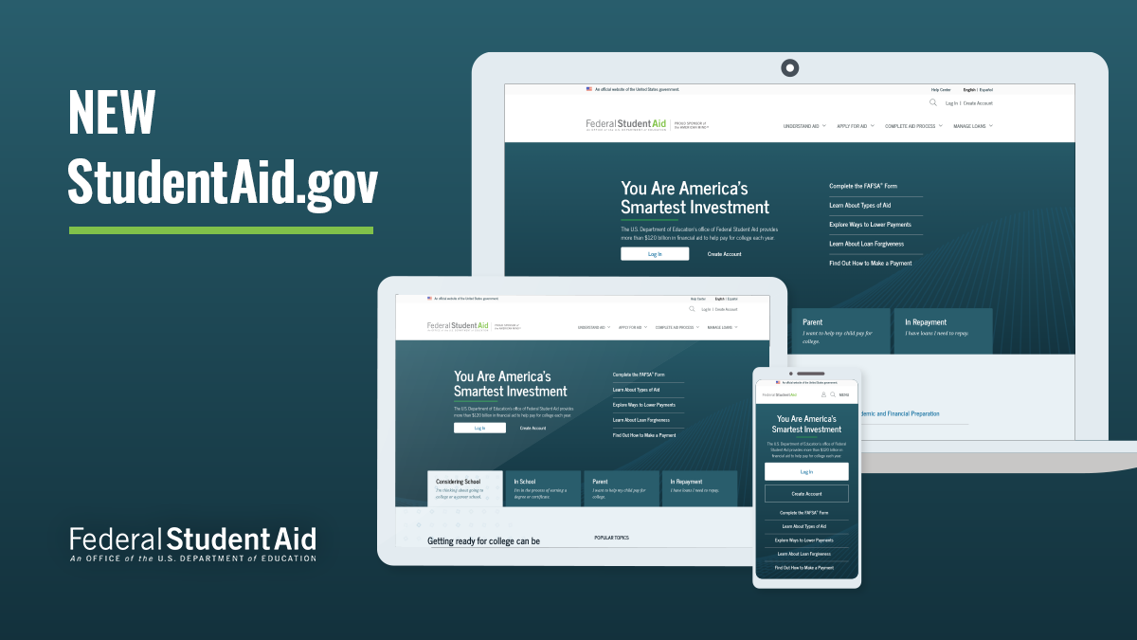
Applying for Financial Aid
  FSA ID
  www.fsaid.ed.gov
  FAFSA
  www.fafsa.ed.gov
  FAFSA Forecast
  www.fafsa.ed.gov
  Net Price Calculator www.andrews.edu/go/npc
  Institutional Forms
October 1
Note:
Communicate with each college to inquire about steps you need to take
to have a complete application.
Notes:
The first step in applying for federal and state financial aid programs is the completion of the Free Application for Federal Student Aid (FAFSA). A FAFSA can be obtained from several places - on the Internet at www.fafsa.ed.gov, the high school counselor, college financial aid office, or the local library. The FSA ID is your electronic passport to federal student aid online. Some independent colleges and private scholarship programs may require more data than is requested on the FAFSA. The form used most often in this process is the CSS/Financial Aid PROFILE, which is administered by the College Scholarship Service (CSS), a division of the College Board organization.
Be sure to communicate with each college to inquire about the steps you need to take to have a ‘complete application’.

Slide 16
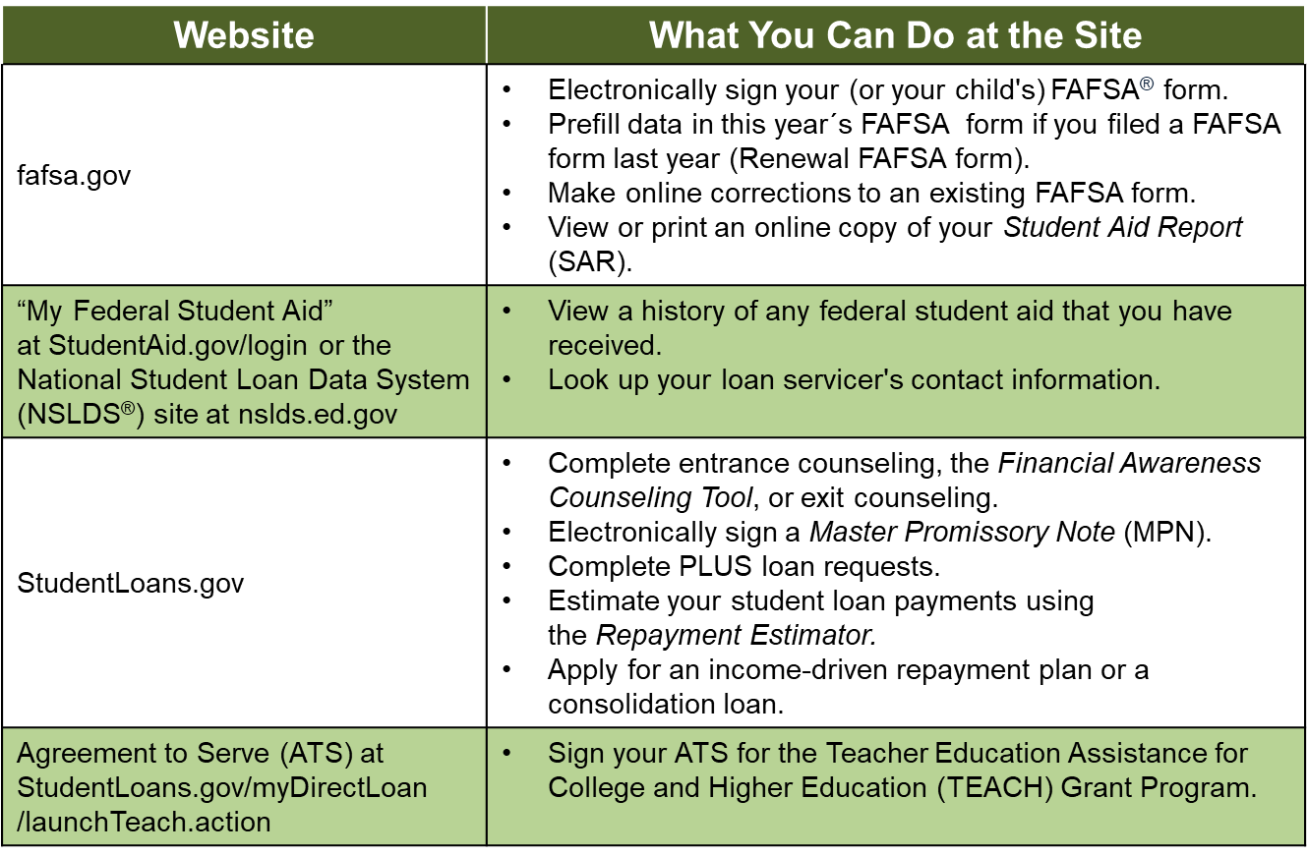
Using Your FSA ID

Slide 17
Applying for Financial Aid
It starts at fafsa.gov.
    Apply on or after October 1 but as early as possible to meet all deadlines. State deadlines are at fafsa.gov. School deadlines are listed on schools’ websites.
    Use student FSA ID to start the application; saves time and confusion.
    Need help? Use the help functions within the FAFSA form (including live chat) or call 1-800-4-FED-AID.
    Don’t forget: watch for the confirmation page that says your FAFSA form has been submitted. THEN log out.
START EARLY

Slide 18
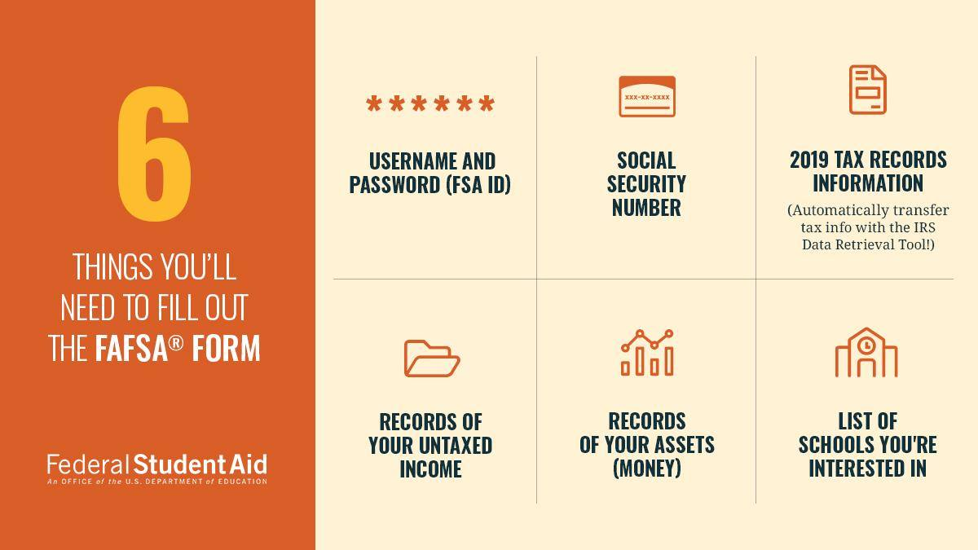
Before you begin

Slide 19
IRS Data Retrieval
While completing FAFSA, applicant may submit real-time
request to IRS for tax data
IRS will authenticate taxpayer’s identity
If match found, IRS sends real-time results to applicant in
new window
Applicant chooses whether or not to transfer data to FAFSA
Available after refund process has been completed for taxes.
Participation is voluntary but suggested.
Will reduce documents requested by financial aid office
Not available to certain applicants
IRS Transcript Request available at www.irs.gov.

Slide 20

Transcript by Mail
What You Need
  SSN or
    Individual Tax Identification Number (ITIN)
  date of birth
  mailing address from your latest tax return

Slide 21
12 Common FAFSA Mistakes
Not completing the FAFSA
Not using the correct website
Not getting a FSA ID ahead of time
Waiting to fill out the FAFSA
Not filing by the deadline
Not using your FSA ID to start the FAFSA
Not reading definitions carefully
Entering incorrect information
Not reporting parent information
Listing only one college
Not using the IRS Data Retrieval Tool
Not signing the FAFSA
SOURCE: BLOG.ED.GOV

Slide 22
Special Circumstances
Change in income
Change in employment status
Unusual medical expenses not covered by insurance
Change in parent marital status
Unusual dependent care expenses
Student cannot obtain parental information
Sibling tuition for primary or secondary education

Slide 23
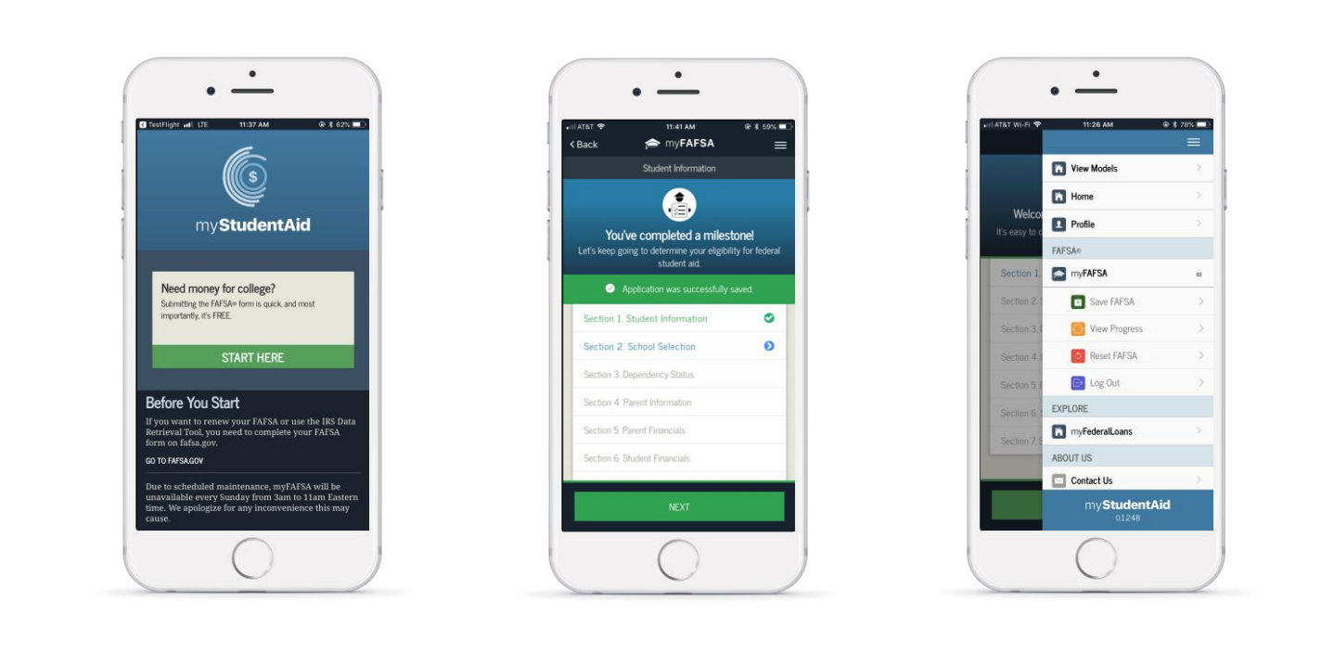


Student Aid Mobile App

Slide 24

Do the Math
  Don’t underestimate your options.
  Never assume you’re too poor to attend college or too rich to receive some type of financial aid.
  Don’t become overwhelmed by the price of attending college, it may not be what it seems.
Notes:
When applying for financial aid:
Don’t underestimate your options.
Never assume you’re too poor to attend college or too rich to receive some type of financial aid.
Don’t become overwhelmed by the price of attending college, it may not be what is seems.

Slide 25

Steps for Students
Start planning for the future now.
Complete the admission process.
Apply for FSA ID, complete FAFSA, upload IRS data.
Receive, revise & edit the Student Aid Report (SAR).
Consider award letters in determining out-of-pocket.
Respond to college offers ASAP.
Advise school(s) of external scholarships.
Renew the FAFSA every year ASAP.
Notes:
To review:
1st Start planning for the future
2nd Complete the application process
3rd Apply for PIN and complete FAFSA
4th Receive, revise and edit the Student Aid Report
5th Consider award letters
6th Respond to college offers
7th Advise school(s) of outside scholarships
8th Renew the FAFSA every year!

Slide 26

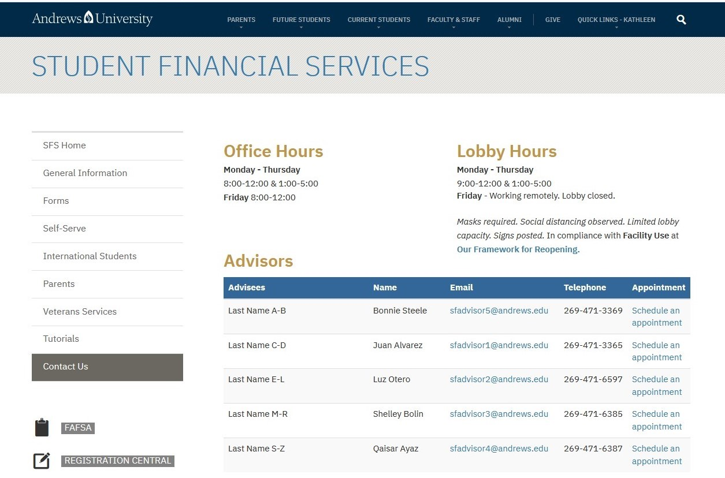

Need help?
www.andrews.edu/sfs

Slide 27





Contact Us
4150 Administration Drive
Berrien Springs, MI 49104-0750
269.471.3334
sfs@andrews.edu
www.andrews.edu/sfs

