Slide 1
Solve Quadratic Equations
Algebra 2
Chapter 3

Slide 2
This Slideshow was developed to accompany the textbook
  Big Ideas Algebra 2
  By Larson, R., Boswell
  2022 K12 (National Geographic/Cengage)
Some examples and diagrams are taken from the textbook.
Slides created by
Richard Wright, Andrews Academy
rwright@andrews.edu

Slide 3
3-01 Complex Numbers (3.2)
Objectives:
Evaluate expressions that result in complex numbers.
Add, subtract, multiply, and divide complex numbers.

Slide 4
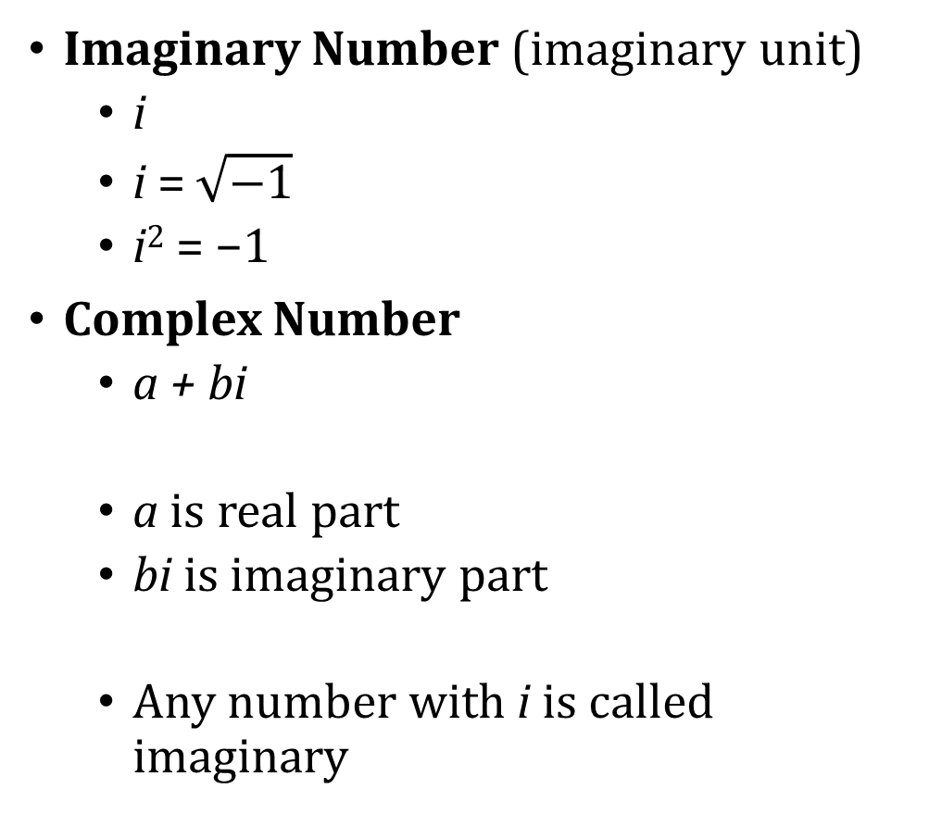

3-01 Complex Numbers (3.2)
Imaginary Number (imaginary unit)
  i
  i = $\sqrt{−1}$
  i² = −1
Complex Number
  a + bi
  a is real part
  bi is imaginary part
  Any number with i is called imaginary
$\sqrt{−9}$
$\sqrt{−12}$
Notes:
$$\sqrt{9}\sqrt{−1}=3i$$
$$\sqrt{4}\sqrt{3}\sqrt{−1} → 2\sqrt{3}i$$

Slide 5
3-01 Complex Numbers (3.2)
Adding and Subtracting Complex Numbers
  Add the same way you add (x + 4) + (2x – 3) = 3x+1
  Combine like terms
Simplify
  (−1 + 2i) + (3 + 3i)
  (2 – 3i) – (3 – 7i)
  2i – (3 + i) + (2 – 3i)
Notes:
2 + 5i
−1 + 4i
−1 − 2i

Slide 6
3-01 Complex Numbers (3.2)
Multiplying complex numbers
  FOIL
  Remember i² = −1
Multiply
  –i(3 + i)
  (2 + 3i)(−6 − 2i)
  (1 + 2i)(1 – 2i)
Notes:
−3i – i² = −3i – (−1) = 1 – 3i
−12 – 4i – 18i – 6i² = −12 – 22i – 6(−1) = −6 – 22i
1 – 2i + 2i – 4i² = 1 – 4(−1) = 5

Slide 7
3-01 Complex Numbers (3.2)
Notice on the last example that the answer was just real
Complex conjugate → same numbers just opposite sign on the imaginary part
  When you multiply complex conjugates, the product is real
Dividing Complex Numbers
  To divide, multiply the numerator and denominator by the complex conjugate of the denominator
  No imaginary numbers are allowed in the denominator when simplified

Slide 8


3-01 Complex Numbers (3.2)
Divide
$\frac{2−7i}{1+i}$
$\frac{2i}{2−i}$
Notes:
$$\frac{2−7i}{1+i}=\frac{\left(2−7i\right)}{\left(1+i\right)}\frac{\left(1−i\right)}{\left(1−i\right)}=\frac{2−2i−7i+7i^{2}}{1−i+i−i^{2}}=\frac{2−9i+7\left(−1\right)}{1−\left(−1\right)}=\frac{−5−9i}{2}=−\frac{5}{2}−\frac{9}{2}i$$
$$\frac{2i}{2−i}=\frac{2i\left(2+i\right)}{\left(2−i\right)\left(2+i\right)}=\frac{4i+2i^{2}}{4+2i−2i−i^{2}}=\frac{4i+2\left(−1\right)}{4−\left(−1\right)}=\frac{−2+4i}{5}=−\frac{2}{5}+\frac{4}{5}i$$

Slide 9
3-02 Solve Quadratic Equations by Factoring (3.1)
Objectives:
Factor quadratic expressions.
Solve quadratic equations by factoring.

Slide 10
3-02 Solve Quadratic Equations by Factoring (3.1)
Factoring is the opposite of FOILing
Factoring undoes multiplication
(x + 2)(x + 5) = x² + 7x + 10
  x + 2 called binomial
  x² + 7x + 10 called trinomial

Slide 11
3-02 Solve Quadratic Equations by Factoring (3.1)
Factor a Quadratic in the form of ax² + bx + c,
Factor out any common terms first, then factor what’s left
Write two sets of parentheses like ( )( ).
Guess: Find two expressions whose product is ax² and put them at the beginning of each set of parentheses.
Guess: Find two expressions whose product is c and put them at the end of each set of parentheses. Pay attention + and – signs.
Check: Calculate the outers + inners and compare it to the middle bx.
  If the outers + inners = bx, then the factoring is correct.
  If the outers + inners = –bx (the correct number but wrong sign), then change the signs in the parentheses.
  Otherwise, retry with new guesses.

Slide 12
3-02 Solve Quadratic Equations by Factoring (3.1)
Factor
  x² – 3x – 18
  n² – 3n + 9
r² + 2r – 63
Notes:
(x – 6)(x + 3)
Cannot be factored
(r + 9)(r – 7)

Slide 13
3-02 Solve Quadratic Equations by Factoring (3.1)
Factor
  14x² + 2x – 12
3x² – 18x
Notes:
2(7x² + x – 6) → 2(7x – 6)(x + 1)
3x(x – 6)

Slide 14
3-02 Solve Quadratic Equations by Factoring (3.1)
Factor
  2x² – 32
Notes:
2(x² – 16) → 2(x – 4)(x + 4)

Slide 15
3-02 Solve Quadratic Equations by Factoring (3.1)
Zero Product Property
  If a·b = 0, then either a or b is 0.
Solve a Quadratic Equation by Factoring
Make the quadratic expression equal 0.
Factor the quadratic expression.
Set each factor equal to zero as two separate equations.
Solve each equation.
Check your solutions

Slide 16
3-02 Solve Quadratic Equations by Factoring (3.1)
Solve
  x² – x – 42 = 0
Notes:
x² – x – 42 = 0 → (x – 7)(x + 6) = 0 →
x – 7 = 0 → x = 7
x + 6 = 0 → x = −6
Solutions are x = −6, 7

Slide 17
3-02 Solve Quadratic Equations by Factoring (3.1)
Solve
  9t² – 12t + 4 = 0
  3x – 6 = x² – 10
Notes:
(3t – 2)² = 0 → 3t – 2 = 0 → 3t = 2 → t = 2/3
Put in standard form
x² – 3x – 4 = 0
(x – 4)(x + 1) = 0
x – 4 = 0 → x = 4
x + 1 = 0 → x = -1

Slide 18
3-03 Solve Quadratic Equations by Graphing and Finding Square Roots (3.1)
Objectives:
Solve quadratic equations by graphing.
Solve quadratic equations using square roots.

Slide 19
3-03 Solve Quadratic Equations by Graphing and Finding Square Roots (3.1)
Solving Quadratic Equations by
Graphing
Make the equation equal zero.
Graph the equation.
Find the x-values of the x-intercepts.
Square Roots
Solve for the squared expression.
Take a square root. Remember to put ±.
Finish solving for x.
Check your solutions.

Slide 20

3-03 Solve Quadratic Equations by Graphing and Finding Square Roots (3.1)
Solve by graphing
$x^{2}−2x−3=0$
Notes:
Graph
Solutions are x-intercepts
x = 3, x = −1

Slide 21
3-03 Solve Quadratic Equations by Graphing and Finding Square Roots (3.1)
Solve by using square roots.
2x² + 14 = 70
4x² + 20 = 16
Notes:
$$2x^{2}+14=70$$
$$2x^{2}=56$$
$$x^{2}=28$$
$$x=±\sqrt{28}=±\sqrt{4·7}=±2\sqrt{7}$$
$$4x^{2}+20=16$$
$$4x^{2}=−4$$
$$x^{2}=−1$$
$$x=±\sqrt{−1}=±i$$

Slide 22


3-03 Solve Quadratic Equations by Graphing and Finding Square Roots (3.1)
$\frac{3}{4}{\left(x+1\right)}^{2}=10$
$2x^{2}=5x^{2}+24$
Notes:
$$\frac{3}{4}{\left(x+1\right)}^{2}=10$$
$${\left(x+1\right)}^{2}=\frac{40}{3}$$
$$x+1=±\sqrt{\frac{40}{3}}$$
$$x+1=±\frac{\sqrt{40}}{\sqrt{3}}$$
$$x+1=±\frac{2\sqrt{10}}{\sqrt{3}}=±\frac{2\sqrt{10}}{\sqrt{3}}·\frac{\sqrt{3}}{\sqrt{3}}=±\frac{2\sqrt{30}}{3}$$
$$x=−1±\frac{2\sqrt{30}}{3}$$
$$2x^{2}=5x^{2}+24$$
$$−3x^{2}=24$$
$$x^{2}=−8$$
$$x=2\sqrt{2}i$$

Slide 23
3-03 Solve Quadratic Equations by Graphing and Finding Square Roots (3.1)
A fruit stand charges $3 per pound of apples and sells 20 pounds each day. They try dropping the price by $0.50 and sell 5 more pounds a day. How much should the fruit stand charge to maximize their daily revenue? What is their maximum daily revenue?
Notes:
Revenue is price × number sold
$$R=p×s$$
$$p=\left(2−0.1x\right)$$
$$s=\left(20+5x\right)$$
Where x is the number of times the price is dropped.
$$R=\left(3−0.5x\right)\left(20+5x\right)=60+5x−2.5x^{2}=−2.5x^{2}+5x+60$$
Maximum at vertex
$$x=−\frac{b}{2a}$$
$$x=−\frac{5}{2\left(−2.5\right)}=1$$
$$R=−2.5{\left(1\right)}^{2}+5\left(1\right)+60=62.50$$
They should lower the price one time to $2.50 per pound to get a revenue of $62.50

Slide 24
3-04 Solve Quadratic Equations by Completing the Square (3.3)
Objectives:
Solve quadratic equations by completing the square.
Rewrite a general form quadratic in standard (vertex) form.

Slide 25


3-04 Solve Quadratic Equations by Completing the Square (3.3)
The Perfect Square
${\left(x+3\right)}^{2}$
${\left(x+k\right)}^{2}=x^{2}+2kx+k^{2}$
$=ax^{2}+bx+c$
In a perfect square,
$c={\left(\frac{b}{2}\right)}^{2}$
Notes:
=(x + 3)(x + 3)
= x² + 2(3x) + 3²
= x² + 6x + 9

Slide 26

3-04 Solve Quadratic Equations by Completing the Square (3.3)
Complete the square and then factor.
  $x^{2}+8x$
Notes:
Add ${\left(\frac{8}{2}\right)}^{2}= 42 = 16$ to get a perfect square or (x + 4)²

Slide 27
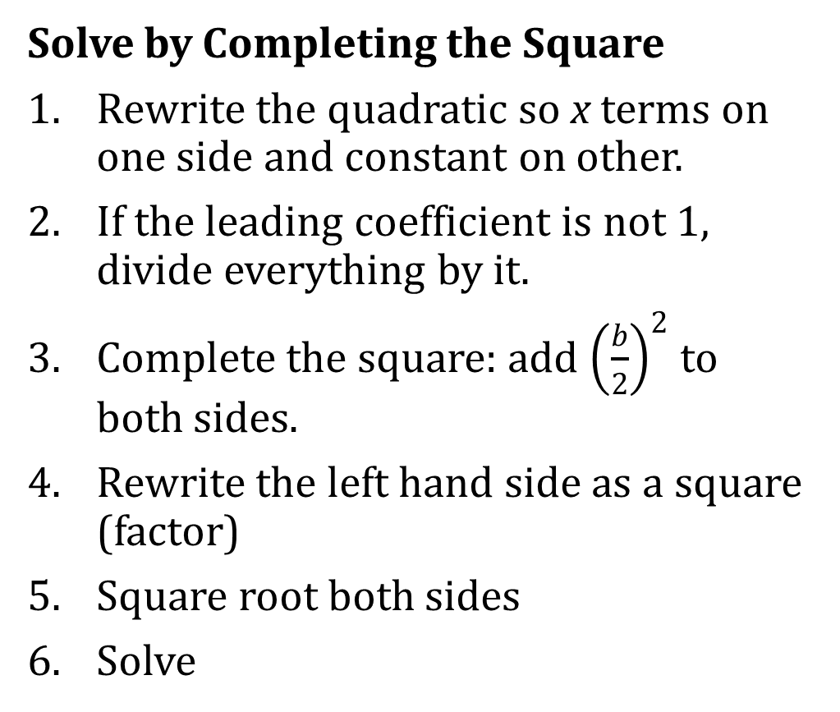

3-04 Solve Quadratic Equations by Completing the Square (3.3)
Solve by Completing the Square
Rewrite the quadratic so x terms on one side and constant on other.
If the leading coefficient is not 1, divide everything by it.
Complete the square: add ${\left(\frac{b}{2}\right)}^{2}$ to both sides.
Rewrite the left hand side as a square (factor)
Square root both sides
Solve
  $x^{2}+6x=16$
Notes:
It already is
$x^{2}+6x+{\left(\frac{6}{2}\right)}^{2}=16+{\left(\frac{6}{2}\right)}^{2}$
$$x^{2}+6x+32=16+9$$
$${\left(x+3\right)}^{2}=25$$
$$x+3=±5$$
$$x=−3±5$$
$$x=2, −8$$

Slide 28

3-04 Solve Quadratic Equations by Completing the Square (3.3)
Solve $x^{2}−18x+5=0$
Notes:
$$x^{2}−18x+5=0$$
$$x^{2}−18x=−5$$
$$x^{2}−18x+9^{2}=−5+9^{2}$$
$${\left(x−9\right)}^{2}=76$$
$$x−9=±\sqrt{76}$$
$$x=9±2\sqrt{19}$$

Slide 29

3-04 Solve Quadratic Equations by Completing the Square (3.3)
Solve $2x^{2}−11x+12=0$
Notes:
$$2x^{2}−11x=−12$$
$$x^{2}−\frac{11}{2}x=−6$$
$$x^{2}−\frac{11}{2}x+{\left(−\frac{\frac{11}{2}}{2}\right)}^{2}=−6+{\left(−\frac{\frac{11}{2}}{2}\right)}^{2} → {\left(−\frac{\frac{11}{2}}{2}\right)}^{2}={\left(−\frac{11}{4}\right)}^{2}=\frac{121}{16}$$
$${\left(x−\frac{11}{4}\right)}^{2}=\frac{25}{16}$$
$$x−\frac{11}{4}=±\frac{5}{4}$$
$$x=\frac{11}{4}±\frac{5}{4}=\frac{11±5}{4}=4,\frac{3}{2}$$

Slide 30
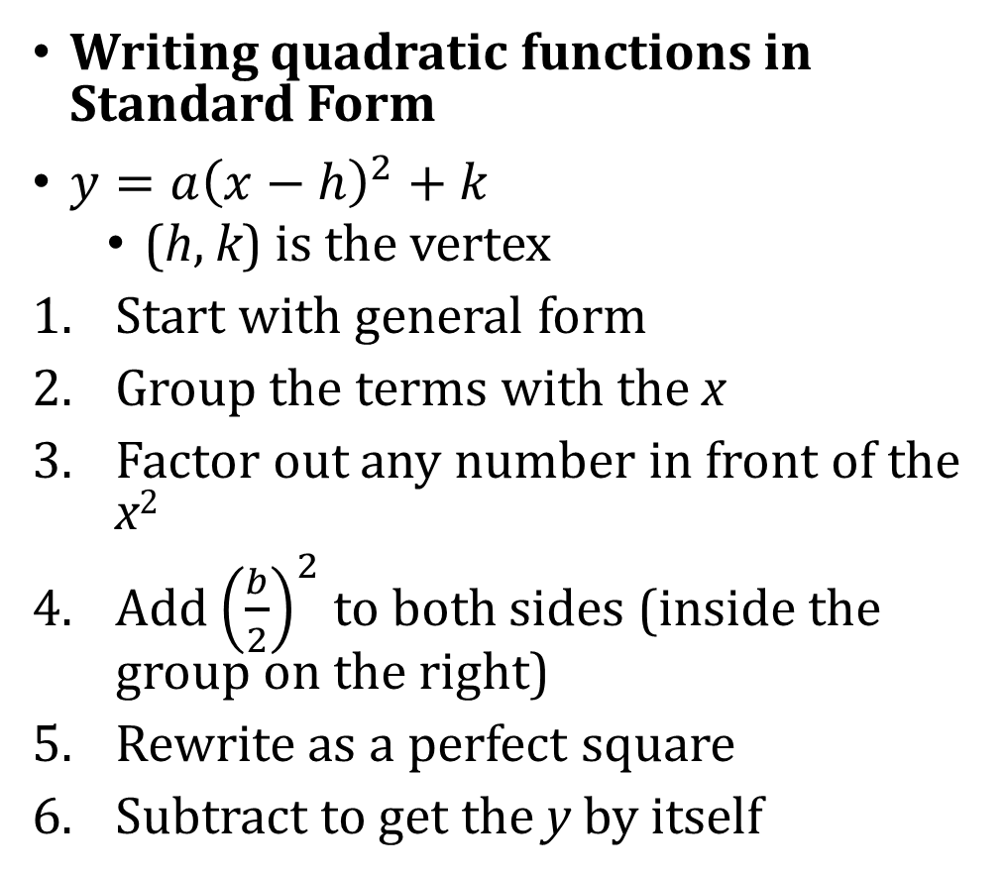

3-04 Solve Quadratic Equations by Completing the Square (3.3)
Writing quadratic functions in Standard Form
$y=a{\left(x−h\right)}^{2}+k$
  (h, k) is the vertex
Start with general form
Group the terms with the x
Factor out any number in front of the x²
Add ${\left(\frac{b}{2}\right)}^{2}$ to both sides (inside the group on the right)
Rewrite as a perfect square
Subtract to get the y by itself
  $y=2x^{2}+12x+16$
Notes:
2. $y=(2x^{2}+12x)+16$
3. $y=2(x^{2}+6x)+16$
4. $y+2\left(9\right)=2\left(x^{2}+6x+9\right)+16$
5. $y+18=2{\left(x+3\right)}^{2}+16$
6. $y=2{\left(x+3\right)}^{2}−2$
Vertex is at (−3, −2)
−2 is the minimum for this function
Find the max or min by completing the square to find the vertex

Slide 31
3-05 Solve Quadratic Equations using the Quadratic Formula (3.4)
Objectives:
Use the discriminant to classify solutions to quadratic equations.
Use the quadratic formula to solve quadratic equations.

Slide 32
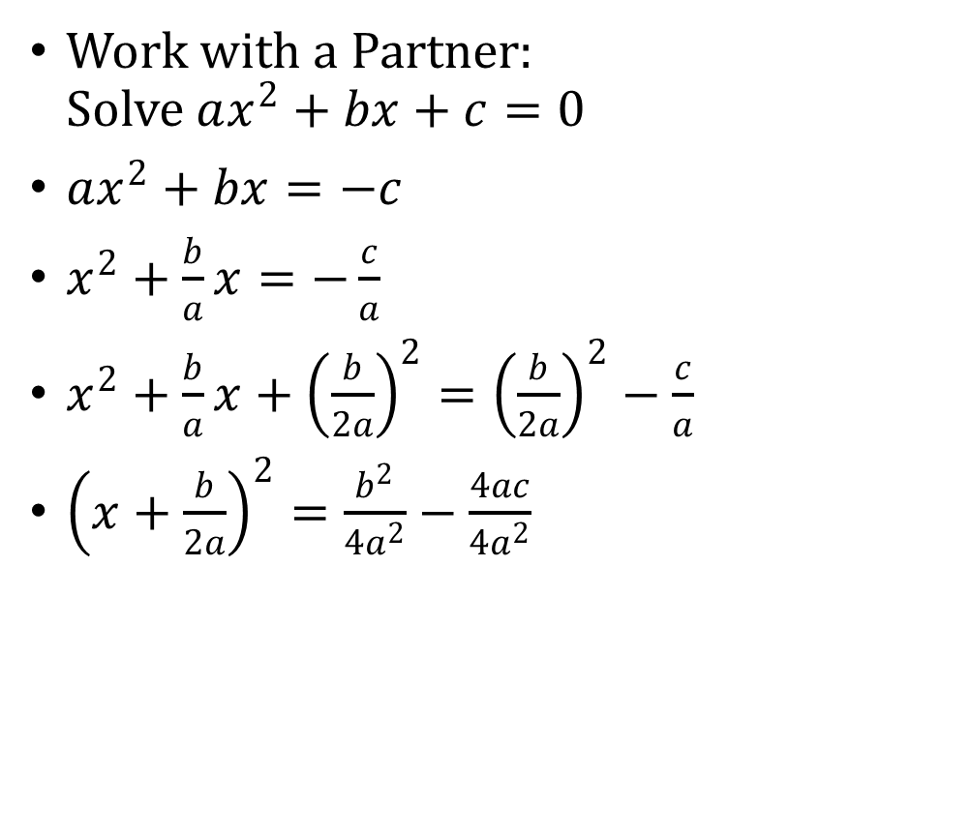

3-05 Solve Quadratic Equations using the Quadratic Formula (3.4)
Work with a Partner:
Solve $ax^{2}+bx+c=0$
$ax^{2}+bx=−c$
$x^{2}+\frac{b}{a}x=−\frac{c}{a}$
$x^{2}+\frac{b}{a}x+{\left(\frac{b}{2a}\right)}^{2}={\left(\frac{b}{2a}\right)}^{2}−\frac{c}{a}$
${\left(x+\frac{b}{2a}\right)}^{2}=\frac{b^{2}}{4a^{2}}−\frac{4ac}{4a^{2}}$
${\left(x+\frac{b}{2a}\right)}^{2}=\frac{b^{2}−4ac}{4a^{2}}$
$x+\frac{b}{2a}=±\sqrt{\frac{b^{2}−4ac}{4a^{2}}}$
$x=−\frac{b}{2a}±\frac{\sqrt{b^{2}−4ac}}{2a}$
$x=\frac{−b±\sqrt{b^{2}−4ac}}{2a}$
Notes:
$ax^{2}+bx+c=0$
$x^{2}+\left(\frac{b}{a}\right)x+\left(\frac{c}{a}\right)=0$ Divide by a to get a = 1
$x^{2}+\left(\frac{b}{a}\right)x=−\left(\frac{c}{a}\right)$ Add –(c/a) to get x’s by self
$x^{2}+\left(\frac{b}{a}\right)x+{\left(\frac{b}{2a}\right)}^{2}=−\left(\frac{c}{a}\right)+{\left(\frac{b}{2a}\right)}^{2}$ Add the square of half of middle to get perfect square
${\left(x+\left(\frac{b}{2a}\right)\right)}^{2}=−\frac{c}{a}+\frac{b^{2}}{4a^{2}}$ Factor left
$x+\left(\frac{b}{2a}\right)=±\sqrt{\frac{−4ac+b^{2}}{4a^{2}}}$ Square root
$x=−\frac{b}{2a}±\sqrt{\frac{b^{2}−4ac}{4a^{2}}}$ Subtract
$x=\frac{\left(−b±\sqrt{b^{2}−4ac}\right)}{2a}$ Simplify

Slide 33
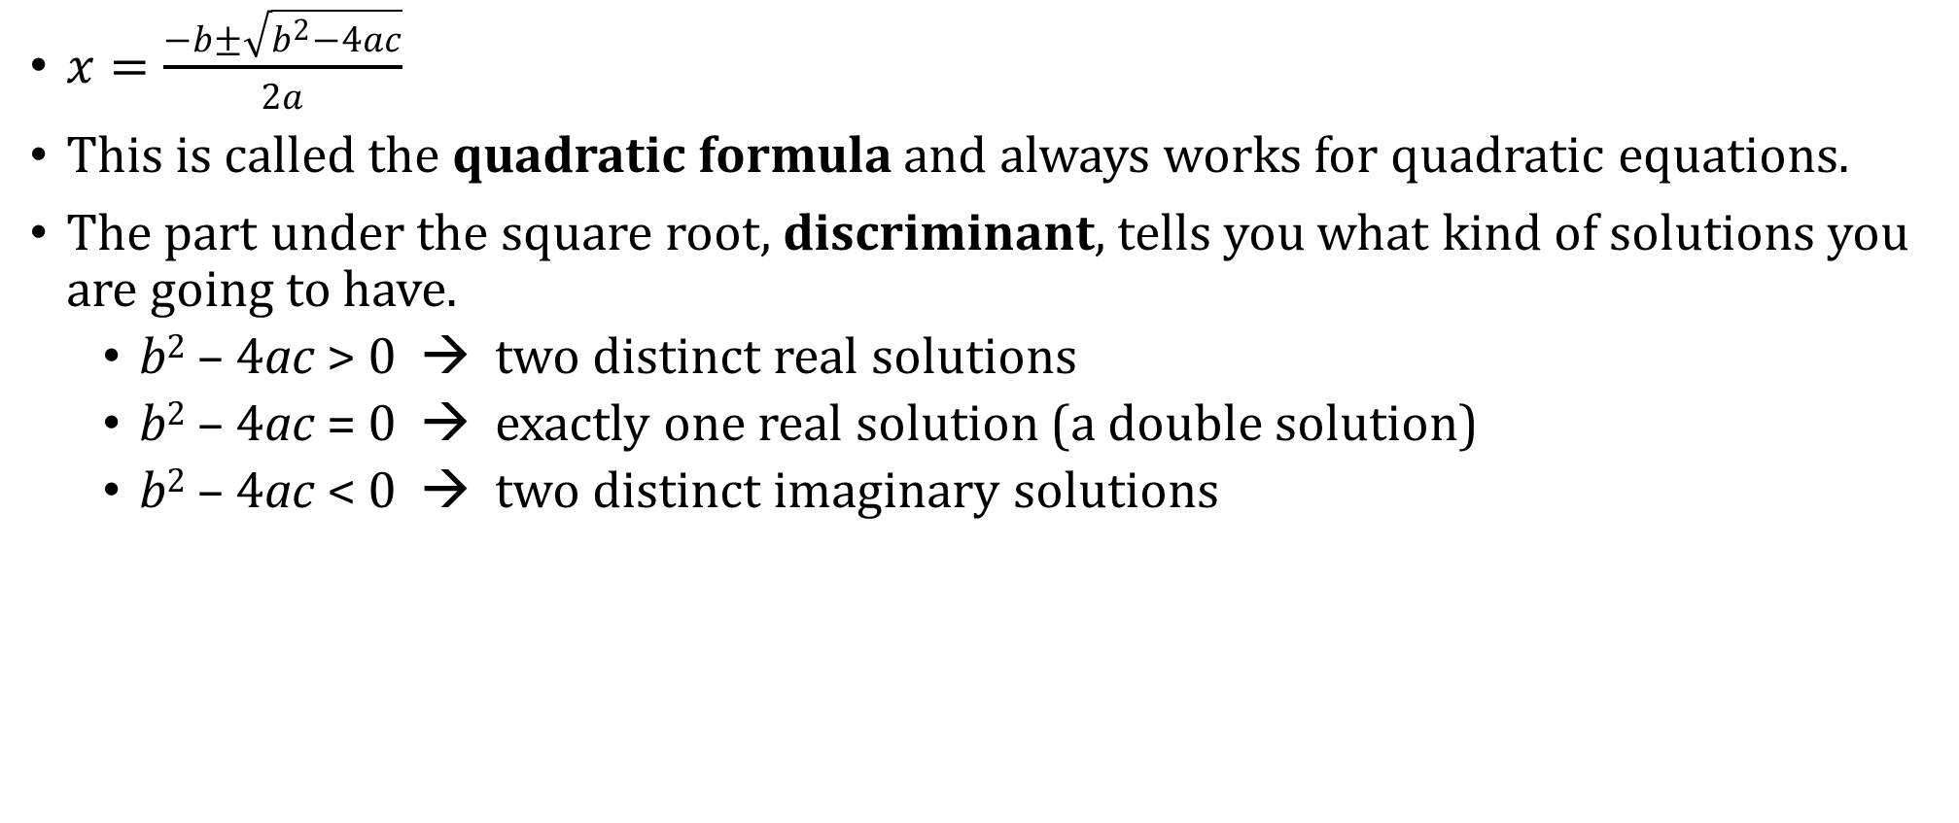
3-05 Solve Quadratic Equations using the Quadratic Formula (3.4)
$x=\frac{−b±\sqrt{b^{2}−4ac}}{2a}$
This is called the quadratic formula and always works for quadratic equations.
The part under the square root, discriminant, tells you what kind of solutions you are going to have.
  b² – 4ac > 0 → two distinct real solutions
  b² – 4ac = 0 → exactly one real solution (a double solution)
  b² – 4ac < 0 → two distinct imaginary solutions

Slide 34


3-05 Solve Quadratic Equations using the Quadratic Formula (3.4)
What types of solutions to
$5x^{2}+3x−4=0$?
Solve $5x^{2}+3x=4$
Notes:
$b^{2}−4ac=3^{2}−4(5)(−4)=9+80=89$ → two distinct real roots
Put in standard form → $5x^{2}+3x−4=0$
Quadratic formula → $x=\frac{\left(−3±\sqrt{32−4\left(5\right)\left(−4\right)}\right)}{2\left(5\right)}$
Simplify → $\frac{−3±\sqrt{89}}{10}$

Slide 35

3-05 Solve Quadratic Equations using the Quadratic Formula (3.4)
Solve $4x^{2}−6x+3=0$
Notes:
$$4x^{2}−6x+3=0$$
$$x=\frac{6±\sqrt{{\left(−6\right)}^{2}−4\left(4\right)\left(3\right)}}{2\left(4\right)}$$
$$x=\frac{6±\sqrt{36−48}}{8}$$
$$x=\frac{6±\sqrt{−12}}{8}$$
$$x=\frac{6±2\sqrt{3}i}{8}$$
$$x=\frac{3±\sqrt{3}i}{4} (reduce top and bottom by 2)$$

Slide 36

3-05 Solve Quadratic Equations using the Quadratic Formula (3.4)
Find a possible pair of integer values for a and c so that the equation
$ax^{2}−12x+c=0$ has the given number and type of solution(s). Then write the equation.
a. one real solution
b. two imaginary solutions
Notes:
$$ax^{2}−12x+c=0$$
Discriminant with 1 real solution
$$b^{2}−4ac=0$$
$${\left(−12\right)}^{2}−4ac=0$$
$$144=4ac$$
$$36=ac$$
Sample Answer: $a=9, c=4→9x^{2}−12x+4=0$
Discriminant with two imaginary solutions
$$b^{2}−4ac<0$$
$${\left(−12\right)}^{2}−4ac<0$$
$$144<4ac$$
$$36<ac$$
Sample Answer: $a=10, c=5→10x^{2}−12x+5=0$

Slide 37

3-05 Solve Quadratic Equations using the Quadratic Formula (3.4)
Real life problems
The height of an object that is hit or thrown up or down can be modeled by
$h\left(t\right)=−16t^{2}+v_{0}t+s_{0}$
where v₀ is the initial velocity (up +, down −), and s₀ is the initial height

Slide 38
3-06 Solving Quadratic Equations by Any Method (Review)
Objectives:
Choose the best method to solve quadratic equations.
Solve quadratic equations without a method given.

Slide 39
3-06 Solving Quadratic Equations by Any Method (Review)
Choose the Best Method to Solve a Quadratic Equation
To most efficiently solve a quadratic equation,
If x appears only once and it is squared—either x² or (x – k)²— solve by taking square roots.
If both x² and x appear, make the equation equal to zero and…
  Try solving by factoring.
  If it cannot be factored quickly, solve by completing the square or the quadratic formula.
  Graphing is usually only as a last resort for complicated problems.

Slide 40


3-06 Solving Quadratic Equations by Any Method (Review)
Solve
$x^{2}+6x+5=0$
$3x^{2}−12=5x$
Notes:
$$x^{2}+6x+5=0$$
Factor
$$\left(x+5\right)\left(x+1\right)=0$$
$$x+5=0 or x+1=0$$
$$x=−5 or−1$$
$$3x^{2}−12=5x$$
$$3x^{2}−5x−12=0$$
Factor
$$\left(3x+4\right)\left(x−3\right)=0$$
$$3x+4=0 or x−3=0$$
$$x=−\frac{4}{3} or 3$$

Slide 41


3-06 Solving Quadratic Equations by Any Method (Review)
$4x^{2}=375−x^{2}$
$x^{2}+5x−7=0$
Notes:
$$4x^{2}=375−x^{2}$$
$$5x^{2}=375$$
Square roots
$$x^{2}=75$$
$$x=±5\sqrt{3}$$
$$x^{2}+5x−7=0$$
Try factoring (doesn’t work)
Use quadratic formula
$$x=\frac{−b±\sqrt{b^{2}−4ac}}{2a}$$
$$x=\frac{−5±\sqrt{5^{2}−4\left(1\right)\left(−7\right)}}{2\left(1\right)}$$
$$x=\frac{−5±\sqrt{53}}{2}$$

Slide 42

3-06 Solving Quadratic Equations by Any Method (Review)
$3x^{2}=54x$
Notes:
$$3x^{2}=54x$$
Factor
$$3x^{2}−54x=0$$
$$3x\left(x−18\right)=0$$
$$x=0 or x−18=0$$
$$x=0 or 18$$

Slide 43
3-07 Solve Quadratic Inequalities (3.6)
Objectives:
Solve quadratic inequalities in one variable algebraically.
Solve quadratic inequalities in one variable graphically.

Slide 44
3-07 Solve Quadratic Inequalities (3.6)
Solve inequalities in one variable.
Make = 0
Factor or use the quadratic formula to find the zeros
Graph the zeros on a number line (notice it cuts the line into three parts)
Pick a number in each of the three parts as test points
Test the points in the original inequality to see true or false
Write inequalities for the regions that were true
p² − 4p ≤ 5
0
Notes:
p² – 4p – 5 ≤ 0
(p – 5)(p + 1) ≤ 0
Zeros are 5, −1
test points = −2, 0, 6
–2 → 4 – 4(−2) ≤ 5 → 12 ≤ 5 false
0 → 0 – 4(0) ≤ 5 → 0 ≤ 5 true
6 → 36 – 4(6) ≤ 5 → 12 ≤ 5 false
middle region true so –1 ≤ p ≤ 5

Slide 45

3-07 Solve Quadratic Inequalities (3.6)
Solve $x^{2}−4x>45$
Notes:
$$x^{2}−4x>45$$
$$x^{2}−4x−45>0$$
Factor
$$\left(x+5\right)\left(x−9\right)>0$$
Zeros
$$x+5=0 or x−9=0$$
$$x=−5 or 9$$
Graph and pick test points (−6, 0, 10)
Test points
−6: ${\left(−6\right)}^{2}−4\left(−6\right)>45 →60>45$ true
0: ${\left(0\right)}^{2}−4\left(0\right)>45 →0>45$ false
10: ${\left(10\right)}^{2}−4\left(10\right)>45→60>45$ true
Solution
$$x<−5 or x>9$$

Slide 46
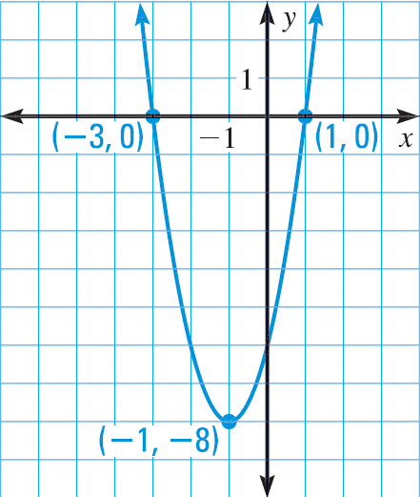
3-07 Solve Quadratic Inequalities (3.6)
Or you could also solve the quadratic inequality in one variable by graphing the quadratic
  Make the inequality = 0
  Plot points on a number line
  Quick graph
    When the graph is below the x-axis; ≤ 0
    When the graph is above the x-axis; ≥ 0
Notes:
2x² + 4x – 6 ≤ 0 when -3 ≤ x ≤ 1
2x² + 4x – 6 ≥ 0 when x ≤ -3 or x ≥ 1

Slide 47


3-07 Solve Quadratic Inequalities (3.6)
Solve using a graph.
$$x^{2}+x−20>0$$
Notes:
$$x^{2}+x−20>0$$
Factor
$$\left(x+5\right)\left(x−4\right)>0$$
Zeros
$$x+5=0 or x−4=0$$
$$x=−5 or x=4$$
Plot the zeros
Sketch quick graph of $x^{2}+x−20$
Opens up
Because > 0, choose the x-values where the graph is above the x-axis.
$$x<−5 or x>4$$

Slide 48

3-07 Solve Quadratic Inequalities (3.6)
Solve using a graph.
$$−2x^{2}−9x−4≥0$$
Notes:
$$−2x^{2}−9x−4≥0$$
Factor
$$\left(2x+1\right)\left(−x−4\right)≥0$$
Zeros
$$2x+1=0 or −x−4=0$$
$$x=−\frac{1}{2} or x=−4$$
Plot the zeros
Sketch quick graph of $−2x^{2}−9x−4$
Opens down
Because ≥ 0, choose the x-values where the graph is above the x-axis.
$$−4≤x≤−\frac{1}{2}$$

