Slide 1
Exponential and Logarithmic Functions
Algebra 2
Chapter 6
Notes:
Chapter 6

Slide 2
This Slideshow was developed to accompany the textbook
Big Ideas Algebra 2
By Larson, R., Boswell
2022 K12 (National Geographic/Cengage)
Some examples and diagrams are taken from the textbook.
Slides created by
Richard Wright, Andrews Academy
rwright@andrews.edu

Slide 3
6-01 Exponent Properties and e (5.2, 6.2)
After this lesson…
I can simplify expressions with exponents.
I can simplify expressions involving e.
I can rewrite expressions with e as decimals.

Slide 4

6-01 Exponent Properties and e (5.2, 6.2)
Using Properties of Rational Exponents
$x^{m}⋅x^{n}=x^{m+n}$ (Product Property)
${\left(xy\right)}^{m}=x^{m}y^{m}$ (Power of a Product Property)
${\left(x^{m}\right)}^{n}=x^{mn}$ (Power of a Power Property)
$\frac{x^{m}}{x^{n}}=x^{m−n}$ (Quotient Property)
${\left(\frac{x}{y}\right)}^{m}=\frac{x^{m}}{y^{m}}$ (Power of a Quotient Property)
$x^{−m}=\frac{1}{x^{m}}$ (Negative Exponent Property)

Slide 5


6-01 Exponent Properties and e (5.2, 6.2)
Simplify the expression. Write your answer using only positive exponents.
Example 292#3
${\left(\frac{3w}{2x}\right)}^{4}$
Try 292#1
$6b^{0}$
Notes:
$${\left(\frac{3w}{2x}\right)}^{4}=\frac{3^{4}w^{4}}{2^{4}x^{4}}=\frac{81w^{4}}{16x^{4}}$$
$$6b^{0}=6·1=6$$

Slide 6

6-01 Exponent Properties and e (5.2, 6.2)
e
Called the natural base
Named after Leonard Euler who discovered it
(Pronounced “oil-er”)
Found by putting really big numbers into ${\left(1+\frac{1}{n}\right)}^{n}$ = 2.718281828459…
Irrational number like π

Slide 7


6-01 Exponent Properties and e (5.2, 6.2)
Simplifying natural base expressions
Just treat e like a regular variable
Example (305#5)
${\left(5e^{7x}\right)}^{4}$
Try 305#3
$\frac{11e^{9}}{22e^{10}}$
Notes:
$${\left(5e^{7x}\right)}^{4}=5^{4}e^{7x·4}=625e^{28x}$$
$$\frac{11e^{9}}{22e^{10}}=\frac{1}{2}e^{9−10}=\frac{1}{2}e^{−1}=\frac{1}{2e}$$

Slide 8


6-01 Exponent Properties and e (5.2, 6.2)
Evaluate the natural base expressions using your calculator
Example 305#29
Rewrite in the form $y=ab^{x}$
$y=e^{−0.75t}$
Try 305#31
$y=2e^{0.4t}$
Notes:
$$y=e^{−0.75t}={\left(e^{−0.75}\right)}^{t}={0.472}^{t}$$
$$y=2e^{0.4t}=2{\left(e^{0.4}\right)}^{t}=2{\left(1.492\right)}^{t}$$

Slide 9
6-01 Exponent Properties and e (5.2, 6.2)
Assignment (20 total)
Properties of Exponents: 292#1-4;
Simplifying e: 305#1-10 odd;
Changing e to decimal: 305#25-28 all;
Mixed Review: 306#43, 45, 51, 53 (no graph), 55 (no graph)

Slide 10
6-02 Exponential Growth and Decay Functions (6.1)
After this lesson…
• I can identify and graph exponential growth and decay functions.
• I can write exponential growth and decay functions.
• I can solve real-life problems using exponential growth and decay functions.

Slide 11
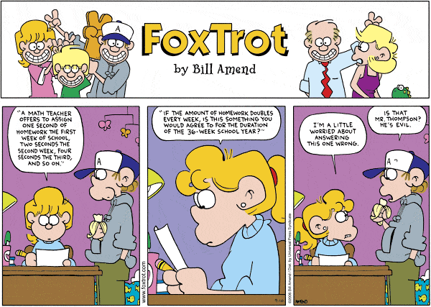
6-02 Exponential Growth and Decay Functions (6.1)

Slide 12
8-1 Exponential Growth
Notes:
How much work will be done the last week of school?
Formula is 2^{n-1}
Plug in 36: 2³⁶⁻¹ = 3.436x10¹⁰ seconds → 9544371.769 hours → 397682.157 days → 1088.8 years

Slide 13
WRIGHT

Slide 14
6-02 Exponential Growth and Decay Functions (6.1)
Work with a partner.
Calculate how much time you will spend on your homework the last week of the 36-week school year. You start with 1 second of homework on week one and double the time every week.
Notes:
$$2^{35}$$

Slide 15
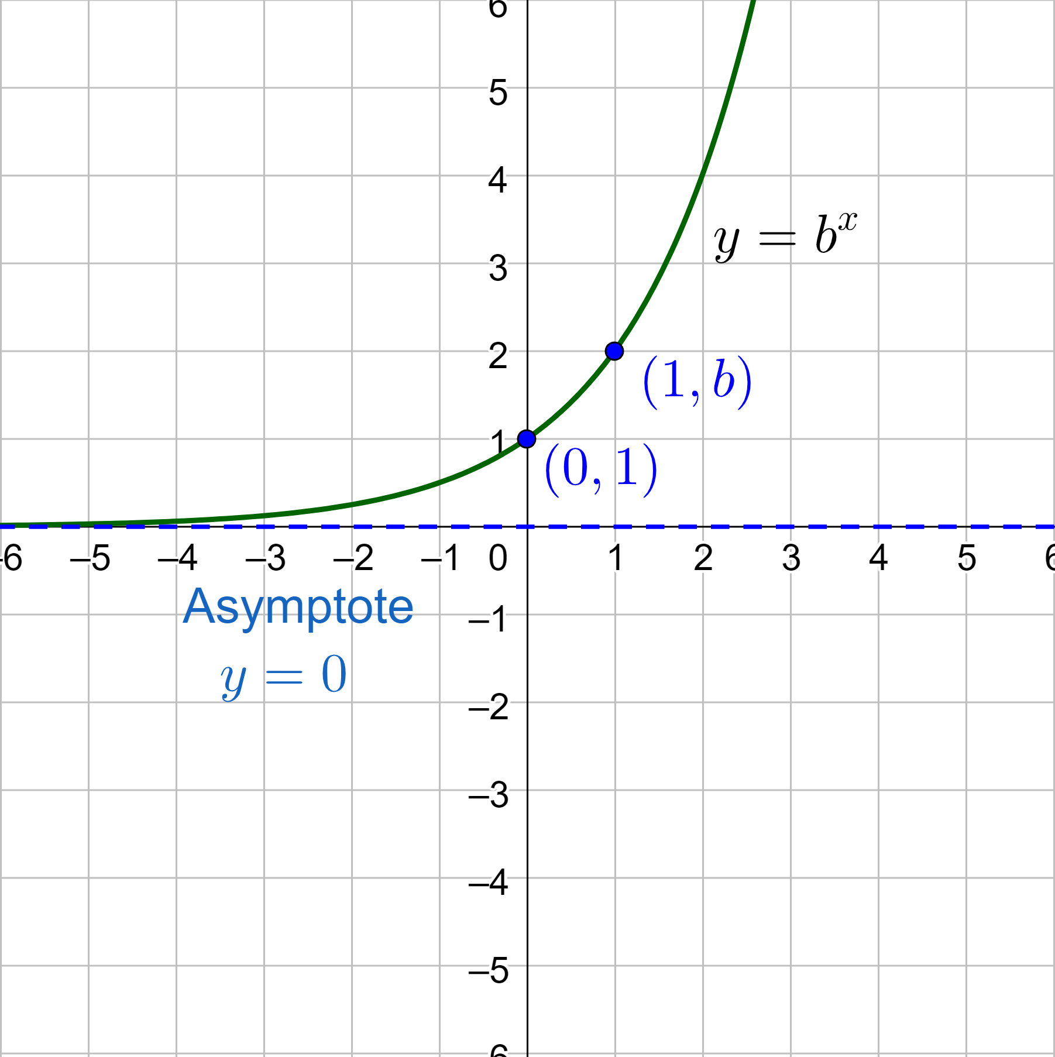
6-02 Exponential Growth and Decay Functions (6.1)
Exponential Function
y = b^{x}
Base (b) is a positive number other than 1
Exponential Growth
Always increasing and rate of change is increasing
b > 1
y-intercept is (0, 1)
Horizontal asymptote y = 0
b is the growth factor

Slide 16
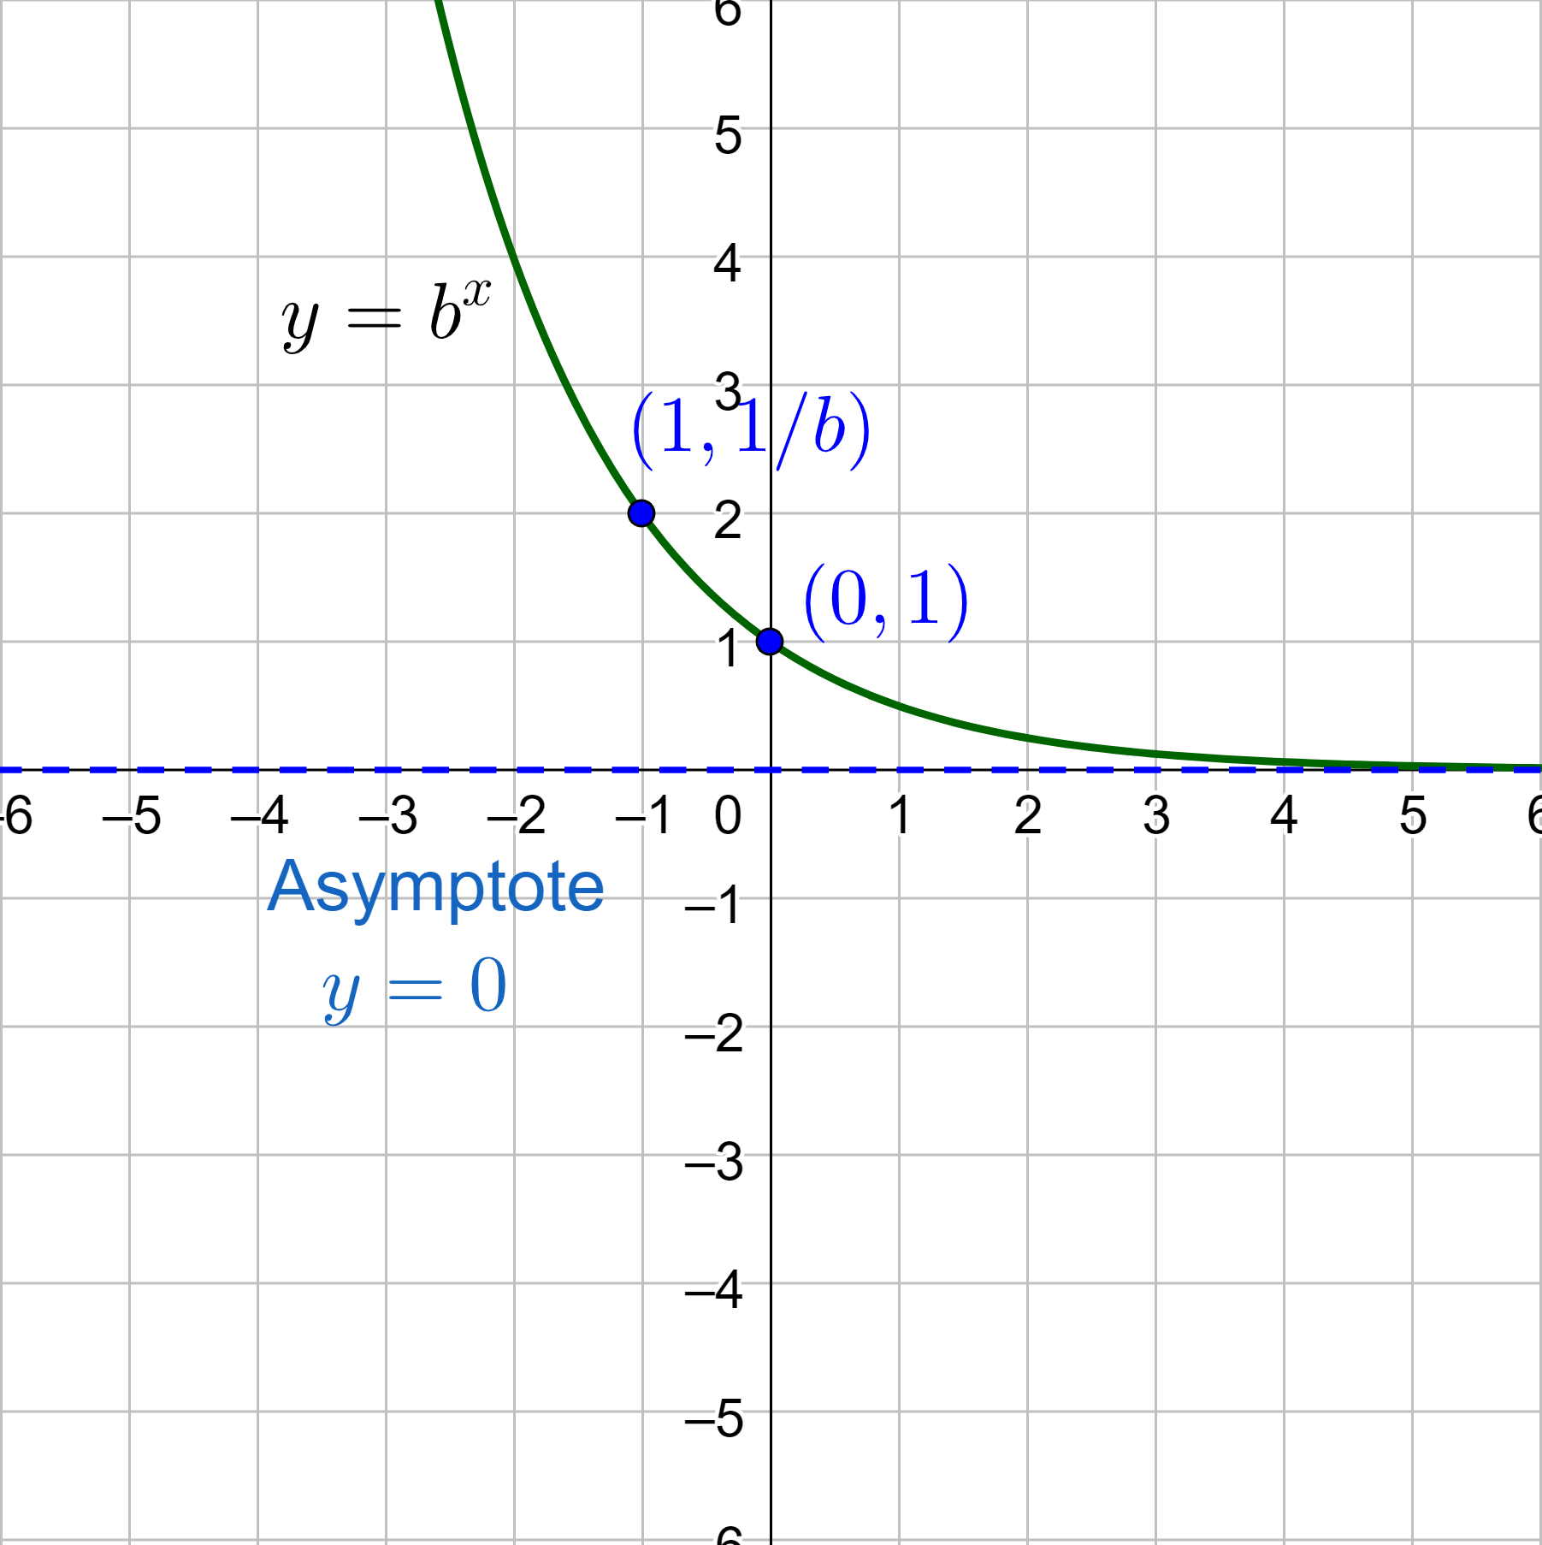
6-02 Exponential Growth and Decay Functions (6.1)
Exponential Decay
Always decreasing and rate of change is decreasing
0 < b < 1
y-intercept is (0, 1)
Horizontal asymptote y = 0
b is the decay factor

Slide 17

6-02 Exponential Growth and Decay Functions (6.1)
Example 298#9
Determine whether each function represents exponential growth or exponential decay. Then graph the function. $f\left(x\right)={\left(\frac{1}{6}\right)}^{x}$
Notes:
b = 1/6 < 1 exponential decay

Slide 18

6-02 Exponential Growth and Decay Functions (6.1)
Try 298#11
Determine whether each function represents exponential growth or exponential decay. Then graph the function. $y={\left(\frac{4}{3}\right)}^{x}$
Notes:
b = 4/3 > 1 exponential growth

Slide 19
6-02 Exponential Growth and Decay Functions (6.1)
Exponential Growth Model (word problems)
$y=a{\left(1+r\right)}^{t}$
y = current amount
a = initial amount
r = growth percent
1 + r = growth factor
t = time
Exponential Decay Model (word problems)
$y=a{\left(1−r\right)}^{t}$
y = current amount
a = initial amount
r = decay percent
1 – r = decay factor
t = time

Slide 20

6-02 Exponential Growth and Decay Functions (6.1)
Example: 298#20
The population P (in millions) of Peru during a recent decade can be approximated by $P=28.22{\left(1.01\right)}^{t}$, where t is the number of years since the beginning of the decade.
(a) Determine whether the model represents exponential growth or decay
(b) identify the annual percent increase or decrease in population
(c) Estimate when the population was about 30 million
Notes:
Base is 1.01 > 1 growth
1.01 = 1 + r → 0.01 = r = 1%
$30=28.22{\left(1.01\right)}^{t}$ $1.063={1.01}^{t}$ $\log_{1.01}{1.063}={\log_{1.01}{1.01}}^{t}$ $6.15=t$ about 6.2 years since the beginning of the decade

Slide 21

6-02 Exponential Growth and Decay Functions (6.1)
Try 298#19
The value of a mountain bike y (in dollars) can be approximated by the model $y=200{\left(0.65\right)}^{t}$, where t is the number of years since the bike was purchased.
(a) Determine whether the model represents exponential growth or decay
(b) Identify the annual percent increase or decrease
(c) Estimate when the value of the bike will be $50
Notes:
Base = 0.65 < 1 decay
0.65 = 1 – r → -0.35 = -r → r = 0.35 = 35%
$50=200{\left(0.65\right)}^{t}$ $0.25={0.65}^{t}$ $\log_{0.65}{0.25}=\log_{0.65}{{0.65}^{t}}$ $3.22=t$ about 3.2 years after it was purchased

Slide 22

6-02 Exponential Growth and Decay Functions (6.1)
Compound Interest
$A=P{\left(1+\frac{r}{n}\right)}^{nt}$
A = amount at time t
P = principle (initial amount)
r = annual rate
n = number of times interest is compounded per year
Example: 299#39
Find the balance in the account earning compound interest after 6 years when the principle is $3500. r = 2.16%, compounded quarterly
Try 299#41
Notes:
$$A=P{\left(1+\frac{r}{n}\right)}^{nt}$$
$$A=3500{\left(1+\frac{0.0216}{4}\right)}^{4\left(6\right)}=\$3982.92$$
$$A=3500{\left(1+\frac{0.0126}{12}\right)}^{12\left(6\right)}=\$3688.56$$

Slide 23
6-02 Exponential Growth and Decay Functions (6.1)
Assignment: 20 total
Graphing Exponential Growth and Decay: 298#7-15 odd
Exponential Growth and Decay Models: 298#19-22, 44
Compound Interest: 299#35, 39, 40, 41, 42
Mixed Review: 300#53, 54, 55, 61, 63

Slide 24
6-03 Rewrite Exponential as Logarithmic Functions (6.3)
After this lesson…
I can evaluate logarithms.
I can rewrite exponential equations as logarithmic equations.
I can rewrite logarithmic equations as exponential equations.

Slide 25


6-03 Rewrite Exponential as Logarithmic Functions (6.3)
Logarithms are exponents
$\log_{b}{a}=$ exponent of b to get a
Example: 312#13
$\log_{3}{81}$
Try 312#15
$\log_{3}{3}$
Notes:
$$\log_{3}{81}$$
$$3^{x}=81$$
$$x=4$$
Can use trial and error
$$\log_{3}{3}$$
$$3^{x}=3$$
$$x=1$$

Slide 26


6-03 Rewrite Exponential as Logarithmic Functions (6.3)
Calculator has two logs
Common Log: log = $\log_{10}{}$
Natural Log: ln = $\log_{e}{}$
(Some calculators can do log of any base.)
Example: 312#23
$\log{6}$
Try 312#25
$\ln{\frac{1}{3}}$
Notes:
$$\log{6}=0.778$$
$$\ln{\frac{1}{3}}=−1.099$$

Slide 27
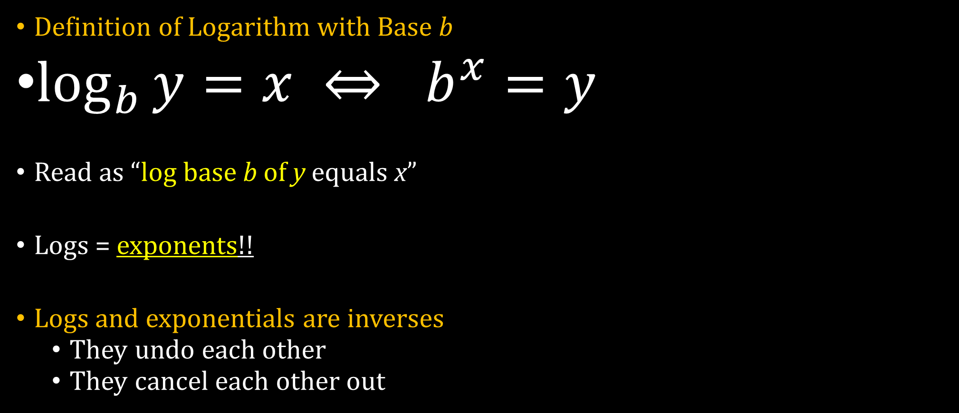
6-03 Rewrite Exponential as Logarithmic Functions (6.3)
Definition of Logarithm with Base b
$\log_{b}{y}=x ⇔ b^{x}=y$
Read as “log base b of y equals x”
Logs = exponents!!
Logs and exponentials are inverses
They undo each other
They cancel each other out
Notes:
3² = 9
8⁰ = 1
5⁻² = 1/25

Slide 28


6-03 Rewrite Exponential as Logarithmic Functions (6.3)
Example: 312#1
Rewrite as an exponential
$\log_{3}{9}=2$
Try 312#7
Rewrite as a log
$6^{2}=36$
Notes:
$$\log_{3}{9}=2$$
Base = 3, exponent = 2, other = 9
$$3^{2}=9$$
$$6^{2}=36$$
Base = 6, exponent = 2, other = 36
$$\log_{6}{36}=2$$

Slide 29


6-03 Rewrite Exponential as Logarithmic Functions (6.3)
Simplify log expressions
If exponential with base b and log with base b are inside each other, they cancel
Example: 312#31
$7^{\log_{7}{x}}$
Try 312#35
$\log_{3}{3^{2x}}$
Notes:
$$7^{\log_{7}{x}}=7^{\log_{7}{x}}=x$$
$$\log_{3}{3^{2x}}=\log_{3}{3^{2x}}=2x$$

Slide 30
6-03 Rewrite Exponential as Logarithmic Functions (6.3)
Assignment (20 total)
Evaluate logs: 312#13, 15, 17, 23, 25
Rewrite logs as exponentials: 312#1, 3, 5
Rewrite exponentials as logs: 312#7, 9, 11
Simplify expressions: 312#31, 33, 35, 37
Mixed Review: 314#75, 77, 79, 83, 85

Slide 31
6-04 Logarithmic Properties (6.5)
After this lesson…
I can expand logarithms.
I can condense logarithms.
I can evaluate logarithms using the change-of-base formula.

Slide 32

6-04 Logarithmic Properties (6.5)
Product Property
$\log_{b}{uv}=\log_{b}{u}+\log_{b}{v}$
Quotient Property
$\log_{b}{\frac{u}{v}}=\log_{b}{u}−\log_{b}{v}$
Power Property
$\log_{b}{u^{n}}=n\log_{b}{u}$

Slide 33


6-04 Logarithmic Properties (6.5)
Expand logarithms
Rewrite as several logs
Example: 327#13
$\log{10x^{5}}$
Try 327#15
$\ln{\frac{x}{3y}}$
Notes:
$$\log{10x^{5}}$$
Product property
$$\log{10}+\log{x^{5}}$$
Power property
$$\log{10}+5\log{x}$$
Simplify
$$1+5\log{x}$$
$$\ln{\frac{x}{3y}}$$
Quotient and power properties
$$\ln{x}−\ln{3}−\ln{y}$$

Slide 34


6-04 Logarithmic Properties (6.5)
Condense logs
Try to write as a single log
Example: 327#25
$\log_{5}{4}+\frac{1}{3}\log_{5}{x}$
Try 327#23
$6\ln{x}+4\ln{y}$
Notes:
$$\log_{5}{4}+\frac{1}{3}\log_{5}{x}$$
Power Property
$$\log_{5}{4}+\log_{5}{x^{\frac{1}{3}}}$$
Product Property
$$\log_{5}\left(4x^{\frac{1}{3}}\right)$$
Write as radical (because of fractional exponent)
$$\log_{5}{4 \sqrt[3]{x}}$$
$$6\ln{x}+4\ln{y}$$
Power Property
$$\ln{x^{6}}+\ln{y^{4}}$$
Product property
$$\ln{x^{6}y^{4}}$$

Slide 35


6-04 Logarithmic Properties (6.5)
Change-of-Base Formula
$\log_{c}{u}=\frac{\log_{b}{u}}{\log_{b}{c}}$
This lets you evaluate any log on a calculator
Example: 327#31
Evaluate $\log_{9}{15}$
Try 327#29
Evaluate $\log_{4}{7}$
Notes:
$$\log_{9}{15}=\frac{\log{15}}{\log{9}}=1.232$$
$$\log_{4}{7}=\frac{\log{7}}{\log{4}}=1.404$$

Slide 36

6-04 Logarithmic Properties (6.5)
Assignment: 20 total
Expand logs: 327#11-17 odd
Condense logs: 327#21-27 odd
Change-of-base formula: 327#29-35 odd
Problem Solving: 327#37-38 (Use $L=10\log{\frac{I}{{10}^{−12}}}$)
Mixed Review: 328#46, 47, 51, 57, 59, 61

Slide 37
6-05 Graph Exponential and Logarithmic Functions (6.4)
After this lesson…
I can graph exponential functions.
I can graph logarthmic functions.
I can find inverses of exponential and logarithmic functions.

Slide 38
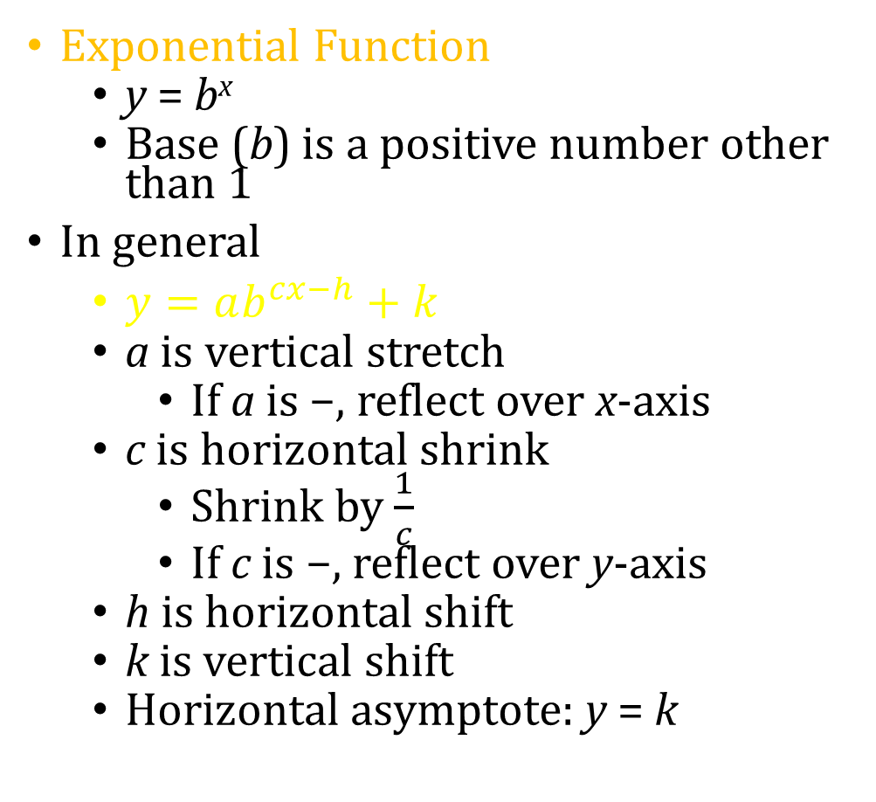
6-05 Graph Exponential and Logarithmic Functions (6.4)
Exponential Function
y = b^{x}
Base (b) is a positive number other than 1
In general
$y=ab^{cx−h}+k$
a is vertical stretch
If a is −, reflect over x-axis
c is horizontal shrink
Shrink by $\frac{1}{c}$
If c is −, reflect over y-axis
h is horizontal shift
k is vertical shift
Horizontal asymptote: y = k

Slide 39
6-05 Graph Exponential and Logarithmic Functions (6.4)
Graph Exponential Functions
Find and graph the horizontal asymptote
Make a table of values
Plot points and draw the curve
Make sure the curve is near the asymptotes at the edge of the graph

Slide 40

6-05 Graph Exponential and Logarithmic Functions (6.4)
Example: 320#17
(a) Describe the transformations. (b) Then graph the function. $g\left(x\right)=−2^{x−3}$
Notes:
Transformations: a = -1, h = 3, k = 0
Reflection in x-axis (−a) and shift 3 to right
Horizontal asymptote: y = 0

Slide 41

6-05 Graph Exponential and Logarithmic Functions (6.4)
Try 320#15
(a) Describe the transformations. (b) Then graph the function. $g\left(x\right)=e^{2x}$
Notes:
Transformations: a = 1, c = 2, h = 0, k = 0
Horizontal shrink by factor of 1/2
Horizontal asymptote: y = 0

Slide 42
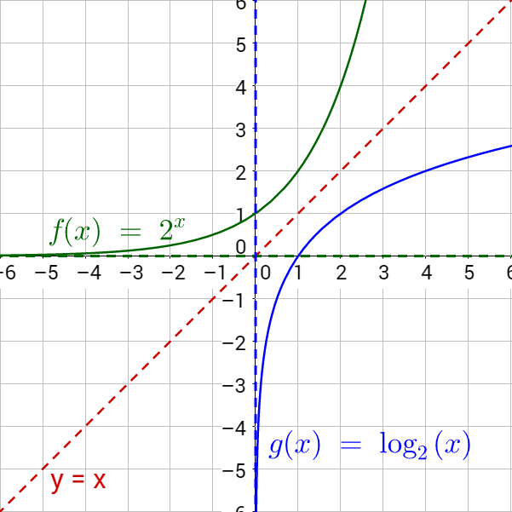

6-05 Graph Exponential and Logarithmic Functions (6.4)
Logarithmic Function
$y=\log_{b}{x}$
Base (b) is a positive number other than 1
Logarithms and exponentials are inverses
x and y are switched
Graphically, reflected over y = x
Horizontal asymptote becomes vertical asymptote

Slide 43
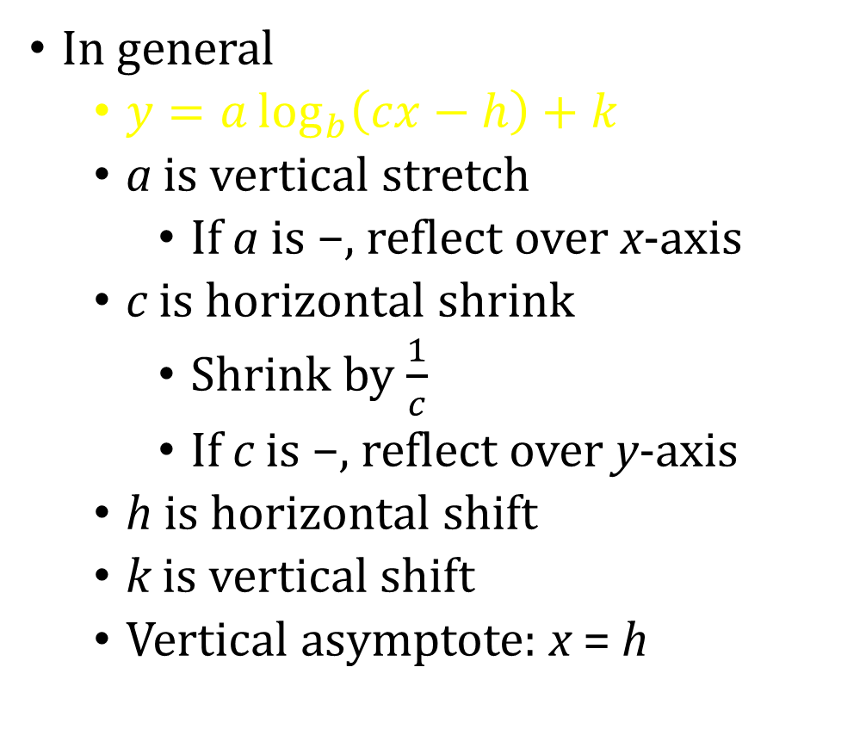
6-05 Graph Exponential and Logarithmic Functions (6.4)
In general
$y=a\log_{b}\left(cx−h\right)+k$
a is vertical stretch
If a is −, reflect over x-axis
c is horizontal shrink
Shrink by $\frac{1}{c}$
If c is −, reflect over y-axis
h is horizontal shift
k is vertical shift
Vertical asymptote: x = h
Graph Logarithmic Functions
Find and graph the vertical asymptote
Make a table of values
You may need to use the change-of-base formula
Plot points and draw the curve
Make sure the curve is near the asymptotes at the edge of the graph
Notes:
To put in calculator, you might need to use change-of-base formula
$$y=\log_{3}{x}$$
$$y=\frac{\log{x}}{\log{3}}$$

Slide 44

6-05 Graph Exponential and Logarithmic Functions (6.4)
Example: 320#27
(a) Describe the transformations. (b) Then graph the function. $g\left(x\right)=−\log_{1/5}\left(x−7\right)$
Notes:
Transformations: a = -1, h = 7, k = 0
Reflection in x-axis (−a) and shift 7 to right
Vertical asymptote: x = 7

Slide 45

6-05 Graph Exponential and Logarithmic Functions (6.4)
Try 320#25
(a) Describe the transformations. (a) Then graph the function. $g\left(x\right)=3\log_{4}{x}−5$
Notes:
Transformations: a = 3, h = 0, k = -5
Vertical stretch by factor of 3; vertical shift up 5
Vertical asymptote: x = 0

Slide 46


6-05 Graph Exponential and Logarithmic Functions (6.4)
Find the inverse
Isolate log or exponential part
Switch x and y
Then rewrite as exponential or log
Example: 313#47
$y=\ln\left(x−1\right)$
Try 313#51
$y=5^{x}−9$
Notes:
$$y=\ln\left(x−1\right)$$
$$x=\ln\left(y−1\right)$$
Base = e, exponent = x, other = y – 1
$$y−1=e^{x}$$
$$y=e^{x}+1$$
$$y=5^{x}−9$$
$$y−9=5^{x}$$
$$x−9=5^{y}$$
Base = 5, exponent = y, other x – 9
$$y=\log_{5}\left(x−9\right)$$

Slide 47
6-05 Graph Exponential and Logarithmic Functions (6.4)
Assignment: 15 total
Graph Exponential Functions: 320#15, 17, 21
Graph Logarithmic Functions: 313#57, 59; 320#25, 27
Find Inverses: 313#43, 45, 47, 51
Mixed Review: 322# 53, 55, 62, 65

Slide 48
6-06 Solve Exponential and Logarithmic Equations (6.6)
After this lesson…
I can solve exponential equations.
I can solve logarithmic equations.

Slide 49


6-06 Solve Exponential and Logarithmic Equations (6.6)
Solving Exponential Equations
Method 1) if the bases are equal, then exponents are equal
Example: 334#3
$5^{x−3}={25}^{x−5}$
Try 334#1
$2^{3x+5}=2^{1−x}$
Notes:
$$5^{x−3}={25}^{x−5}$$
Write at same base
$$5^{x−3}=5^{2\left(x−5\right)}$$
Since bases are same, exponents are the same
$$x−3=2\left(x−5\right)$$
$$x−3=2x−10$$
$$−3=x−10$$
$$7=x$$
$$2^{3x+5}=2^{1−x}$$
Since bases are same, exponents are the same
$$3x+5=1−x$$
$$4x+5=1$$
$$4x=−4$$
$$x=−1$$

Slide 50


6-06 Solve Exponential and Logarithmic Equations (6.6)
Solving Exponential Equations
Method 2) take log of both sides
Example: 334#9
$5{\left(7\right)}^{5x}=60$
Try 334#11
$3e^{4x}+9=15$
Notes:
$$5{\left(7\right)}^{5x}=60$$
$$7^{5x}=12$$
Log both side with base 7
$$\log_{7}{7^{5x}}=\log_{7}{12}$$
$$5x=\log_{7}{12}$$
$$x=\frac{\log_{7}{12}}{5}≈0.255$$
$$3e^{4x}+9=15$$
$$3e^{4x}=6$$
$$e^{4x}=2$$
Log both sides with base e
$$\ln{e^{4x}}=\ln{2}$$
$$4x=\ln{2}$$
$$x=\frac{\ln{2}}{4}≈0.173$$

Slide 51


6-06 Solve Exponential and Logarithmic Equations (6.6)
Solving Logarithmic Equations
Method 1) if the bases are equal, then logs are equal
Example 334#17
$\ln\left(4x−12\right)=\ln{x}$
Try 334#19
$\log_{2}\left(3x−4\right)=\log_{2}{5}$
Notes:
$$\ln\left(4x−12\right)=\ln{x}$$
Since logs are the same, the stuff in logs are the same
$$4x−12=x$$
$$−12=−3x$$
$$4=x$$
$$\log_{2}\left(3x−4\right)=\log_{2}{5}$$
Since logs are the same, the stuff in the logs are the same
$$3x−4=5$$
$$3x=9$$
$$x=3$$

Slide 52


6-06 Solve Exponential and Logarithmic Equations (6.6)
Solving Logarithmic Equations
Method 2) exponentiating both sides
Make both sides exponents with the base of the log
Example: 334#21
$\log_{2}\left(4x+8\right)=5$
Try 334#22
$\log_{3}\left(2x+1\right)=2$
Notes:
$$\log_{2}\left(4x+8\right)=5$$
Exponentiate with base 2
$$2^{\log_{2}\left(4x+8\right)}=2^{5}$$
$$4x+8=32$$
$$4x=24$$
$$x=6$$
$$\log_{3}\left(2x+1\right)=2$$
Exponentiate with base 3
$$3^{\log_{3}\left(2x+1\right)}=3^{2}$$
$$2x+1=9$$
$$2x=8$$
$$x=4$$

Slide 53
6-06 Solve Exponential and Logarithmic Equations (6.6)
Assignment (20 total)
Solve Exponential Equations: 334#1, 3, 5, 7, 9, 11, 13
Solve Logarithmic Equations: 334#17, 19, 21, 22, 23, 25, 27, 29
Mixed Review: 336#75, 77, 79, 83, 87

Slide 54
6-07 Modeling with Exponential and Logarithmic Functions (6.7)
After this lesson…
I can use a common ratio to determine whether data can be represented by an exponential function.
I can use technology to find exponential models and logarithmic models for sets of data.

Slide 55
6-07 Modeling with Exponential and Logarithmic Functions (6.7)
Choosing Functions to Model Data
For equally spaced x-values
If y-values have common ratio (multiple) → exponential
If y-values have finite differences → polynomial

Slide 56
6-07 Modeling with Exponential and Logarithmic Functions (6.7)
Determine the type of function represented by each table.
Example: 342#3
Try 342#1
Notes:
Finite differences
4 3 7 16 30 49
-1 4 9 14 19
5 5 5 5
2rd order differences are constant → quadratic
Common ratio r = 4 → exponential

Slide 57
6-07 Modeling with Exponential and Logarithmic Functions (6.7)
Use the regression feature on a graphing calculator
TI-84
Enter points in STAT → EDIT
To see points go Y= and highlight Plot1 and press ENTER to keep it highlighted
Press Zoom and choose ZoomStat
Go to STAT → CALC → ExpReg for exponential OR LnReg for logarithmic
NumWorks
Choose Regression from homescreen
In Data tab, enter points
Go to Graph tab
To change regression type, press OK and choose a different regression
Read the answer off the bottom of the graph

Slide 58
6-07 Modeling with Exponential and Logarithmic Functions (6.7)
Determine whether the data show an exponential relationship. Then write a function that models the data.
Example 342#20
Try 342#19
Notes:
Use technology
$$y=11.12{\left(1.77\right)}^{x}$$
$$y=8.88{\left(1.21\right)}^{x}$$

Slide 59
6-07 Modeling with Exponential and Logarithmic Functions (6.7)
Assignment: 15 total
Determine Type of Model: 342#1-4
Find Model from Table: 342#19, 20, 21, 22, 30, 31, 32
Mixed Review: 344#39, 41, 47, 49

