Slide 1
Quadratic Functions and Factoring
Algebra 2
Chapter 4
Notes:
Algebra II 4

Slide 2
This Slideshow was developed to accompany the textbook
  Larson Algebra 2
  By Larson, R., Boswell, L., Kanold, T. D., & Stiff, L.
  2011 Holt McDougal
Some examples and diagrams are taken from the textbook.
Slides created by
Richard Wright, Andrews Academy
rwright@andrews.edu

Slide 3

4.1 Graph quadratic Functions in Standard Form

Slide 4
This Slideshow was developed to accompany the textbook
  Larson Algebra 2
  By Larson, R., Boswell, L., Kanold, T. D., & Stiff, L.
  2011 Holt McDougal
Some examples and diagrams are taken from the textbook.
Slides created by
Richard Wright, Andrews Academy
rwright@andrews.edu

Slide 5

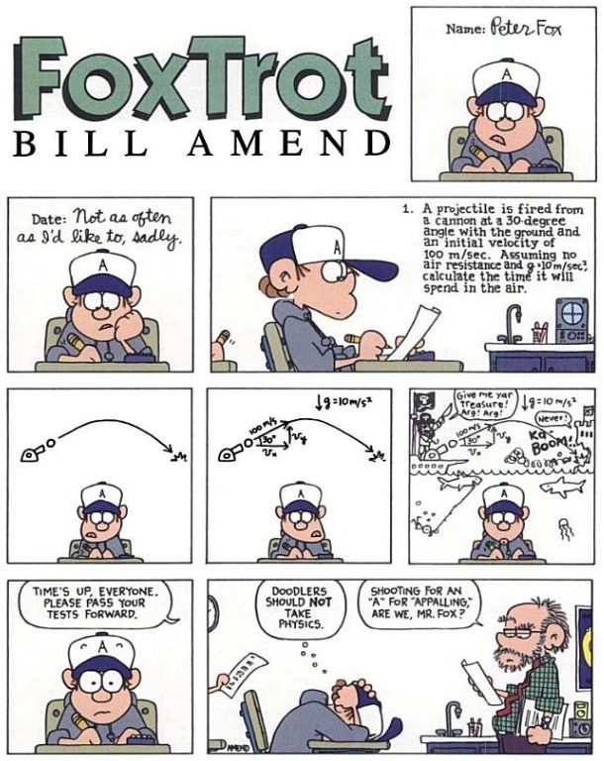
4.1 Graph quadratic Functions in Standard Form
Many physical events can be modeled with quadratic equations such as projectile motion.
The graph of a projectile versus time looks exactly like the path the projectile takes.

Slide 6
4.1 Graph quadratic Functions in Standard Form

Slide 7
4.1 Graph quadratic Functions in Standard Form

Slide 8
4.1 Graph quadratic Functions in Standard Form

Slide 9
4.1 Graph quadratic Functions in Standard Form

Slide 10

4.1 Graph quadratic Functions in Standard Form
Quadratic Function
  y = ax² + bx + c
Shape is a “u” or parabola
  Opens up if a > 0; down if a < 0
  If |a| > 1, then narrower than y = x²
  If |a| < 1, then wider than y = x²
Vertex → highest or lowest point
  x-coordinate is found by $−\frac{b}{2a}$
  y-coordinate found by plugging $−\frac{b}{2a}$ into the equation
Axis of symmetry → $x=−\frac{b}{2a}$

Slide 11
4.1 Graph quadratic Functions in Standard Form
How to Graph (Standard Form)
  Find and plot the vertex
  Make a table around the vertex
  Draw the curve through all 5 points

Slide 12
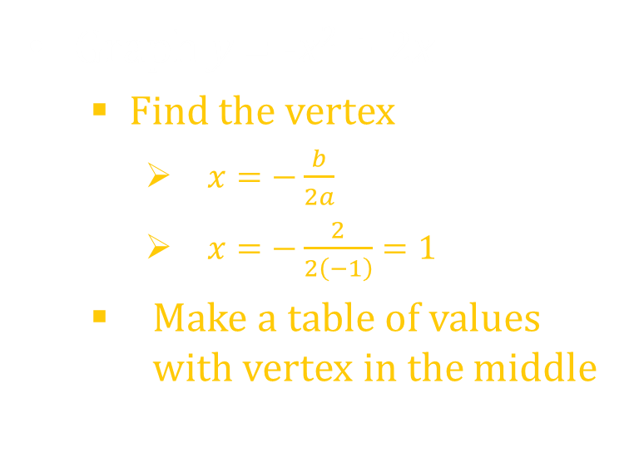
4.1 Graph quadratic Functions in Standard Form
Graph y = -x² + 2x
  Find the vertex
    $x=−\frac{b}{2a}$
    $x=−\frac{2}{2\left(−1\right)}=1$
  Make a table of values with vertex in the middle
x | -2 | -1 | 0 | 1 | 2 | 3 | 4
y | -8 | -3 | 0 | 1 | 0 | -3 | -8

Slide 13
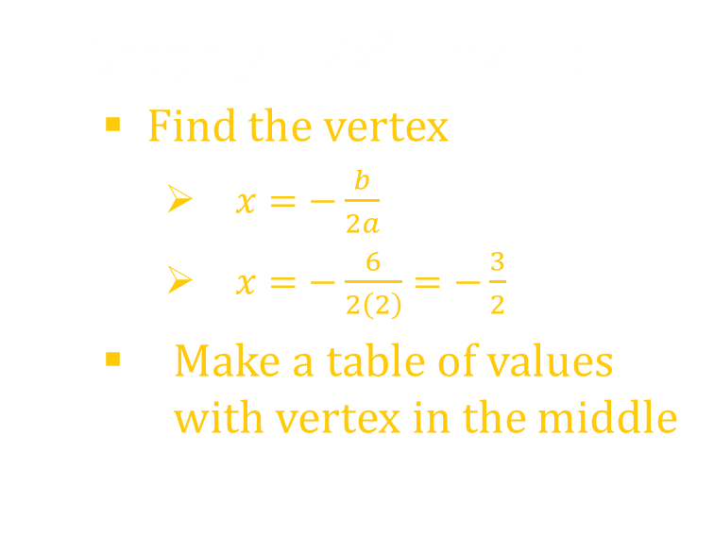
4.1 Graph quadratic Functions in Standard Form
Graph y = 2x² + 6x + 3
  Find the vertex
    $x=−\frac{b}{2a}$
    $x=−\frac{6}{2\left(2\right)}=−\frac{3}{2}$
  Make a table of values with vertex in the middle
x | -4 | -3 | -2 | -3/2 | -1 | 0 | 1
y | 11 | 3 | -1 | -3/2 | -1 | 3 | 11
Notes:
Vertex at (-1.5, -1.5) → other points (-3, 3), (-2, -1), (-1, -1), (0, 3), (1, 11)

Slide 14
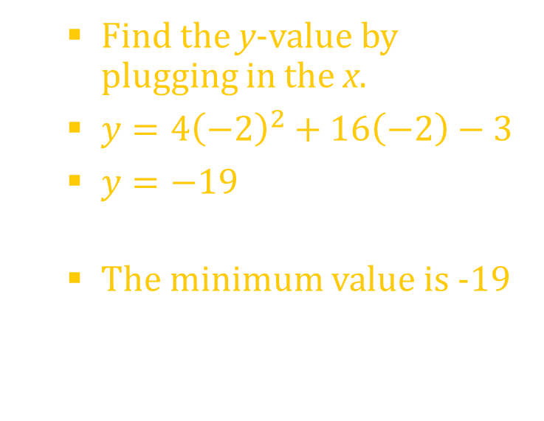
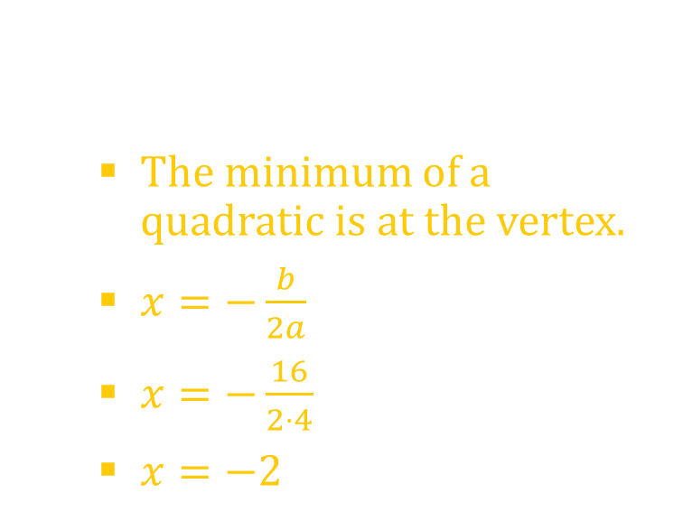
4.1 Graph quadratic Functions in Standard Form
Find the minimum value of y = 4x² + 16x – 3
  The minimum of a quadratic is at the vertex.
  $x=−\frac{b}{2a}$
  $x=−\frac{16}{2⋅4}$
  $x=−2$
  Find the y-value by plugging in the x.
  $y=4{\left(−2\right)}^{2}+16\left(−2\right)−3$
  $y=−19$
  The minimum value is -19
Notes:
Minimum occurs at vertex: x = -b/2a → x = -16/(2∙4) = -2
y = 4(-2)² + 16(-2) – 3 = -19
The minimum value is -19

Slide 15
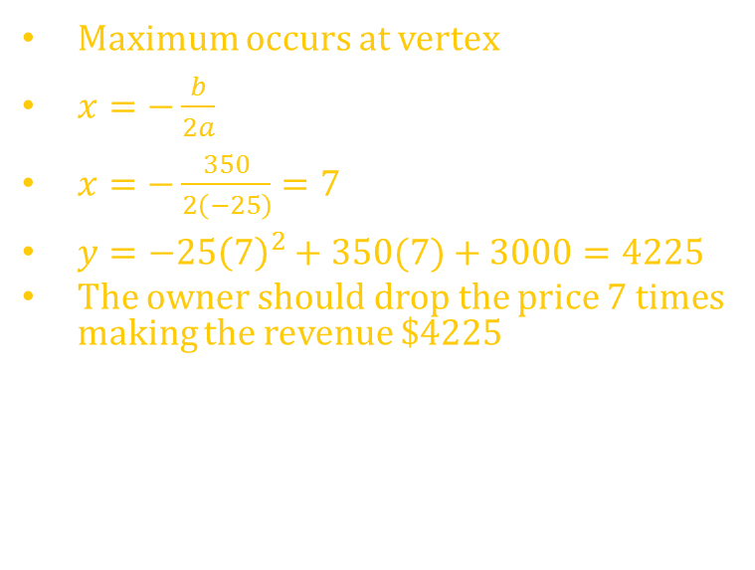
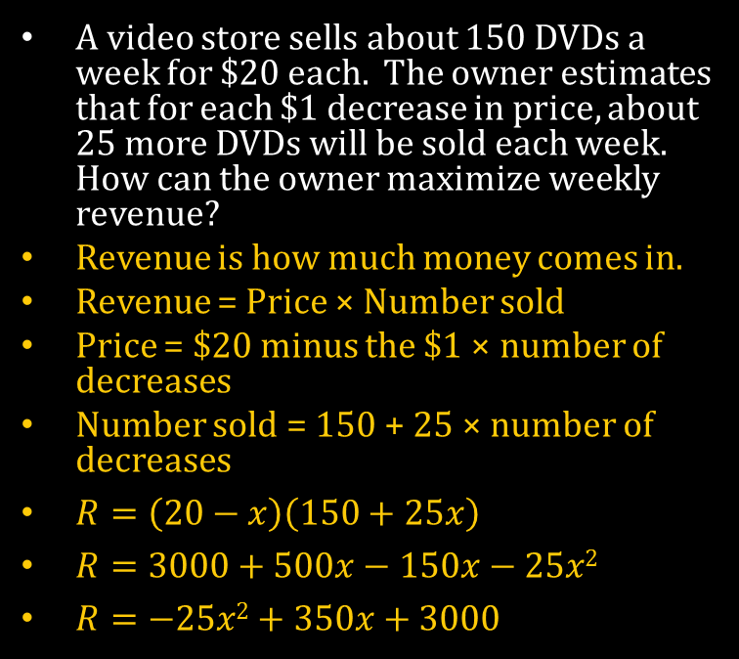
4.1 Graph quadratic Functions in Standard Form
A video store sells about 150 DVDs a week for $20 each. The owner estimates that for each $1 decrease in price, about 25 more DVDs will be sold each week. How can the owner maximize weekly revenue?
Revenue is how much money comes in.
Revenue = Price × Number sold
Price = $20 minus the $1 × number of decreases
Number sold = 150 + 25 × number of decreases
$R=\left(20−x\right)\left(150+25x\right)$
$R=3000+500x−150x−25x2$
$R=−25x2+350x+3000$
Maximum occurs at vertex
$x=−\frac{b}{2a}$
$x=−\frac{350}{2\left(−25\right)}=7$
$y=−25{\left(7\right)}^{2}+350(7)+3000=4225$
The owner should drop the price 7 times making the revenue $4225

Slide 16
Homework Quiz
4.1 Homework Quiz

Slide 17
4.2 Graph Quadratic Functions in Vertex or Intercept Form

Slide 18
This Slideshow was developed to accompany the textbook
  Larson Algebra 2
  By Larson, R., Boswell, L., Kanold, T. D., & Stiff, L.
  2011 Holt McDougal
Some examples and diagrams are taken from the textbook.
Slides created by
Richard Wright, Andrews Academy
rwright@andrews.edu

Slide 19
4.2 Graph Quadratic Functions in Vertex or Intercept Form
Vertex Form
  y = a(x – h)² + k
  (h, k) is vertex
  x = h is axis of symmetry
(h, k) is the vertex because, if h and k = 0, then y = ax²
  The vertex of this is zero (from yesterday)
  We learned before that
    h is how far the graph moves right
    k is how far the graph moves up
Graph same way as before
  Find the vertex and make a table

Slide 20
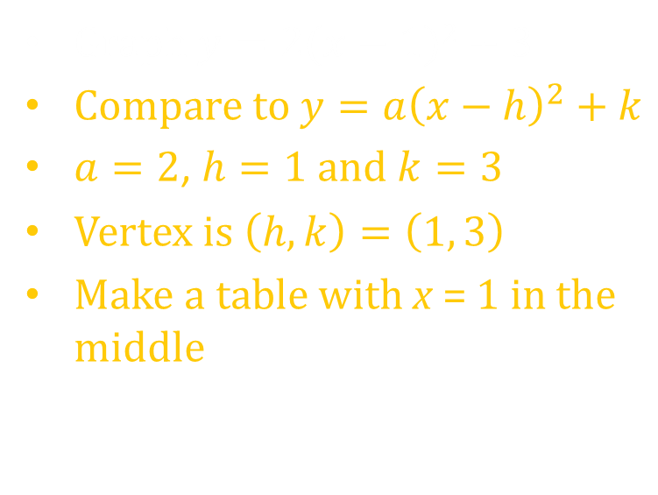
4.2 Graph Quadratic Functions in Vertex or Intercept Form
Graph $y=2(x−1)2+3$
Compare to $y=a{\left(x−h\right)}^{2}+k$
$a=2$, $h=1$ and $k=3$
Vertex is $\left(h,k\right)=\left(1, 3\right)$
Make a table with x = 1 in the middle
x | -2 | -1 | 0 | 1 | 2 | 3 | 4
y | 21 | 11 | 5 | 3 | 5 | 11 | 21

Slide 21

4.2 Graph Quadratic Functions in Vertex or Intercept Form
Intercept Form
  $y=a(x−p)(x−q)$
  x-intercepts are p and q
  axis of symmetry is halfway between p and q
Graph the intercepts and find the axis of symmetry.
  Vertex → x-coordinate is axis of symmetry, plug in to equation to find y-coordinate

Slide 22
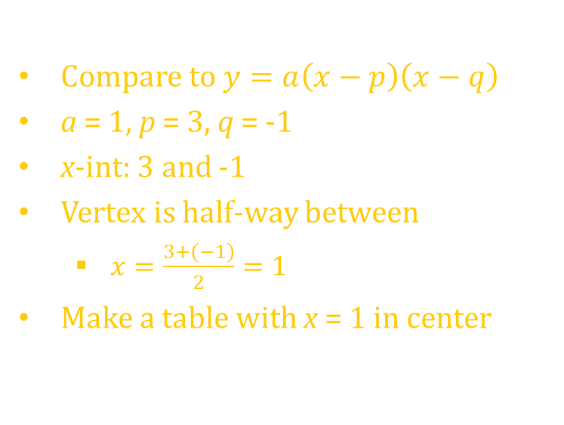
4.2 Graph Quadratic Functions in Vertex or Intercept Form
Graph $y=(x−3)(x+1)$
Compare to $y=a\left(x−p\right)\left(x−q\right)$
a = 1, p = 3, q = -1
x-int: 3 and -1
Vertex is half-way between
  $x=\frac{3+\left(−1\right)}{2}=1$
Make a table with x = 1 in center
x | -2 | -1 | 0 | 1 | 2 | 3 | 4
y | 5 | 0 | -3 | -4 | -3 | 0 | 5
Notes:
Vertex at (1, -4) → x-int at (3, 0) and (-1, 0)

Slide 23
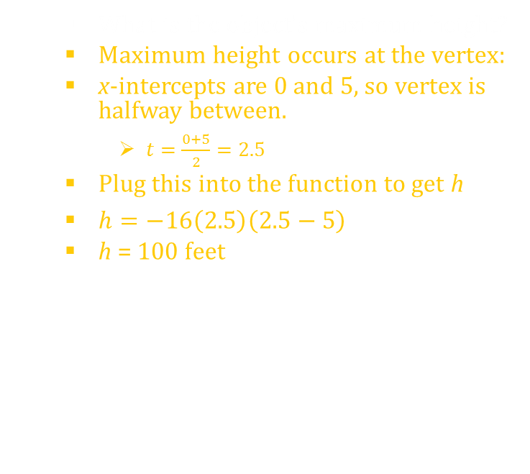

4.2 Graph Quadratic Functions in Vertex or Intercept Form
If an object is propelled straight upward from Earth at an initial velocity of 80 feet per second, its height after t seconds is given by $h(t)=−16t\left(t−5\right)$.
  How many seconds after it is propelled will the object hit the ground?
  This is in intercept form
  $y=−16\left(t−0\right)\left(t−5\right)$
  Thus it will be at zero height at the x-intercepts which are at t = 0 or t = 5 seconds
  Choose the answer that makes sense:
  t = 5 s
  What is the object’s maximum height?
  Maximum height occurs at the vertex:
  x-intercepts are 0 and 5, so vertex is halfway between.
    $t=\frac{0+5}{2}=2.5$
  Plug this into the function to get h
  $h=−16\left(2.5\right)\left(2.5−5\right)$
  h = 100 feet
Notes:
This is in intercept form y = -16(t – 0)(t – 5)
Thus it will be at zero height when either (t – 0) = 0 or (t – 5) = 0. t – 5 = 0 → t = 5 seconds
Maximum height occurs at the vertex: intercepts are 0 and 5, so vertex is at t = 2.5
h(2.5) = -16(2.5)(2.5 – 5) = 100 feet

Slide 24


4.2 Graph Quadratic Functions in Vertex or Intercept Form
FOIL
To multiply $\left(x+2\right)\left(x−3\right)$
  First → $x·x=x^{2}$
  Outer → $−3x$
  Inner → $2x$
  Last → $2·−3 = −6$
  Add together → $x^{2}−x−6$
To multiply ${\left(x−2\right)}^{2}$
  $\left(x−2\right)\left(x−2\right)$
  FOIL
  $x^{2}−4x+4$

Slide 25

4.2 Graph Quadratic Functions in Vertex or Intercept Form
Write the quadratic function in standard form
  $y=−\left(x−2\right)\left(x−7\right)$
FOIL
  $y=−\left(x^{2}−7x−2x+14\right)$
Simplify
  $y=−\left(x^{2}−9x+14\right)$
  $y=−x^{2}+9x−14$
Notes:
y = -(x – 2)(x – 7) → y = -(x² – 7x – 2x + 14) → y = -(x² – 9x + 14) → y = -x² + 9x – 14

Slide 26
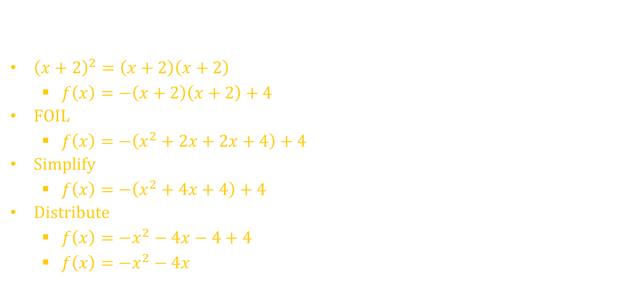
4.2 Graph Quadratic Functions in Vertex or Intercept Form
Write the quadratic function in standard form
  $f\left(x\right)=−{\left(x+2\right)}^{2}+4$
${\left(x+2\right)}^{2}=\left(x+2\right)\left(x+2\right)$
  $f\left(x\right)=−\left(x+2\right)\left(x+2\right)+4$
FOIL
  $f\left(x\right)=−\left(x^{2}+2x+2x+4\right)+4$
Simplify
  $f\left(x\right)=−\left(x^{2}+4x+4\right)+4$
Distribute
  $f\left(x\right)=−x^{2}−4x−4+4$
  $f\left(x\right)=−x^{2}−4x$
Notes:
f(x) = -(x + 2)² + 4 → f(x) = -(x + 2)(x + 2) + 4 → f(x) = -(x² + 2x + 2x + 4) + 4 → f(x) = -(x² + 4x + 4) + 4 → f(x) = -x² – 4x – 4 + 4 → f(x) = -x² – 4x

Slide 27
Homework Quiz
4.2 Homework Quiz

Slide 28
4.3 Solve x² + bx + c = 0 by Factoring

Slide 29
This Slideshow was developed to accompany the textbook
  Larson Algebra 2
  By Larson, R., Boswell, L., Kanold, T. D., & Stiff, L.
  2011 Holt McDougal
Some examples and diagrams are taken from the textbook.
Slides created by
Richard Wright, Andrews Academy
rwright@andrews.edu

Slide 30
4.3 Solve x² + bx + c = 0 by Factoring
Factoring is the opposite of FOILing
Factoring undoes multiplication
(x + 2)(x + 5) = x² + 7x + 10
  x + 2 called binomial
  x² + 7x + 10 called trinomial

Slide 31
4.3 Solve x² + bx + c = 0 by Factoring
Factoring trinomial
  ax² + bx + c
Write two sets of parentheses ( )( )
Guess and Check
The Firsts multiply to make ax²
The Lasts multiply to make c
Check to make sure the Outers + Inners make bx

Slide 32
4.3 Solve x² + bx + c = 0 by Factoring
Factor the expression
  x² – 3x – 18
  ( )( )
    Test outers + inners: 2x + -9x = -7x
    Not -3x so doesn’t work
  ( )( )
    Test outers + inners: 3x + -6x = -3x
    This is -3x, so it works
  n² – 3n + 9
  ( )( )
    Test outers + inners: -3n + -3n = -6n
    Not -3n so doesn’t work
  ( )( )
    Test outers + inners: -1n + -9n = -10n
    Not -3n, so doesn’t work
  We have no more factors of 9, so this is not factorable
n
− 3
n
− 3
x
− 9
x
+ 2
n
− 9
n
− 1
x
− 6
x
+ 3
Notes:
(x – 6)(x + 3)
Cannot be factored

Slide 33
4.3 Solve x² + bx + c = 0 by Factoring
Factor the expression
  r² + 2r – 63
  ( )( )
    Test outers + inners: 7r + -9r = -2r
    Not 2r so doesn’t work
  ( )( )
    Test outers + inners: -7r + 9r = 2r
    This is 2r, so it works
r
− 9
r
+ 7
r
+ 9
r
− 7
Notes:
(r + 9)(r – 7)

Slide 34
4.3 Solve x² + bx + c = 0 by Factoring
Special patterns
  Difference of Squares
    a² – b² = (a – b)(a + b)
  Perfect Squares
    a² ± 2ab + b² = (a ± b)²
Factor
  x² – 9
  Difference of squares
    x² − 3²
  (x − 3)(x + 3)
Notes:
Difference of Squares: x² – 9 = (x – 3)(x + 3)

Slide 35
4.3 Solve x² + bx + c = 0 by Factoring
Special patterns
  Difference of Squares
    a² – b² = (a – b)(a + b)
  Perfect Squares
    a² ± 2ab + b² = (a ± b)²
Factor
  w² – 18w + 81
  Perfect Square
    w² − 2×9×w + 9²
  (w − 9)²
Notes:
Perfect Squares: w² – 18w + 81 = (w – 9)²

Slide 36
4.3 Solve x² + bx + c = 0 by Factoring
Solving quadratic equations by factoring
  The solutions to quadratic equation are called zeros
Zero Product Property
  Zero times anything = 0
  If ab = 0, then a = 0, b = 0, or both.
  Thus we can factor a quadratic equation (remember factoring gives you at least two pieces multiplied together) and set each factor equal to zero to solve.

Slide 37


4.3 Solve x² + bx + c = 0 by Factoring
Solve
  $x^{2}−x−42=0$
  $\left(x−7\right)\left(x+6\right)=0$
  $x−7=0$ $x+6=0$
  $x=7$ $x=−6$
  Solutions are x = -6, 7
  $x^{2}−8x+16=0$
  $\left(x−4\right)\left(x−4\right)=0$
  $x−4=0$ $x−4=0$
  $x=4$ $x=4$
  Solutions are x = 4
Check outers + inners = bx:
-4x + -4x = -8x ✔
Check outers + inners = bx:
6x + -7x = -x ✔
Notes:
x² – 8x + 16 = 0 → (x – 4)(x – 4) = 0 →
x – 4 = 0 → x = 4
Solutions are x = 4

Slide 38
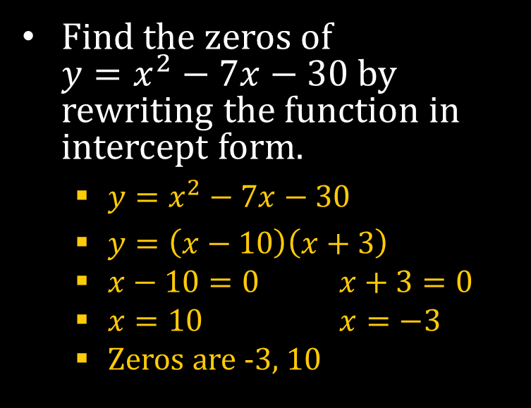

4.3 Solve x² + bx + c = 0 by Factoring
Finding Zeros
  Zeros are the values of x when y = 0
    Also called x-intercepts or roots
  When you find zeros make $y=0$ and solve
Find the zeros of
$y=x^{2}−7x−30$ by rewriting the function in intercept form.
  $y=x^{2}−7x−30$
  $y=\left(x−10\right)\left(x+3\right)$
  $x−10=0$ $x+3=0$
  $x=10$ $x=−3$
  Zeros are -3, 10

Slide 39
Homework Quiz
4.3 Homework Quiz

Slide 40
4.4 Solve ax² + bx + c = 0 by Factoring

Slide 41
This Slideshow was developed to accompany the textbook
  Larson Algebra 2
  By Larson, R., Boswell, L., Kanold, T. D., & Stiff, L.
  2011 Holt McDougal
Some examples and diagrams are taken from the textbook.
Slides created by
Richard Wright, Andrews Academy
rwright@andrews.edu

Slide 42
4.4 Solve ax² + bx + c = 0 by Factoring
Very similar to yesterday’s lesson
Two differences
  Factor monomial first
  Make a work just like c

Slide 43
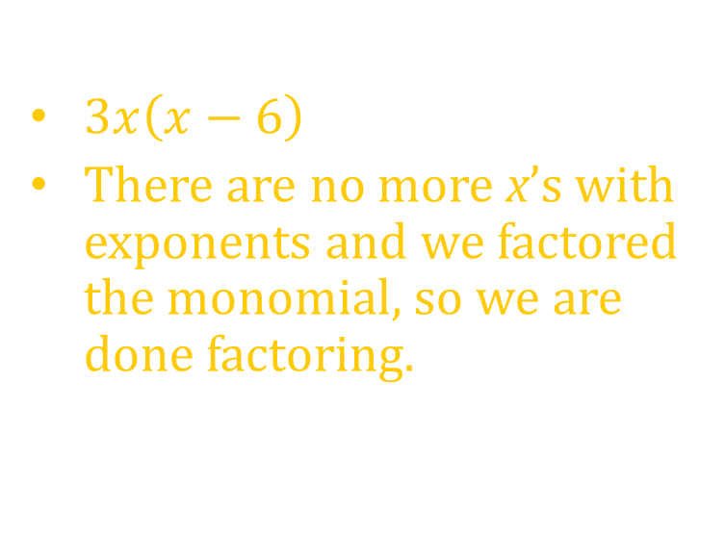

4.4 Solve ax² + bx + c = 0 by Factoring
Monomial First
  Factor out any common terms first, then factor what’s left
$14x^{2}+2x−12$
$2\left(7x^{2}+x−6\right)$
2( )( )
Check outers + inners:
  7x + -6x = x ✔
$3x^{2}−18x$
$3x\left(x−6\right)$
There are no more x’s with exponents and we factored the monomial, so we are done factoring.
7x
− 6
x
+1
Notes:
2(7x² + x – 6) → 2(7x – 6)(x + 1)
3x(x – 6)

Slide 44

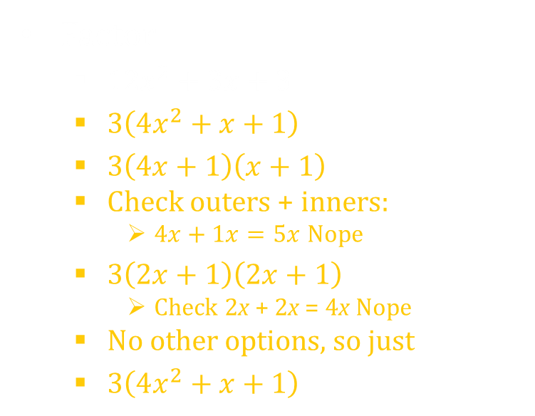
4.4 Solve ax² + bx + c = 0 by Factoring
Factor
  $12x^{2}+3x+3$
  $3\left(4x^{2}+x+1\right)$
  $3\left(4x+1\right)\left(x+1\right)$
  Check outers + inners:
    $4x+1x=5x$ Nope
  $3\left(2x+1\right)\left(2x+1\right)$
    Check 2x + 2x = 4x Nope
  No other options, so just
  $3\left(4x^{2}+x+1\right)$
  $2x^{2}−32$
  $2\left(x^{2}−16\right)$
  Difference of squares
  $2\left(x−4\right)\left(x+4\right)$
Notes:
3(4x² + x + 1)
2(x² – 16) → 2(x – 4)(x + 4)

Slide 45
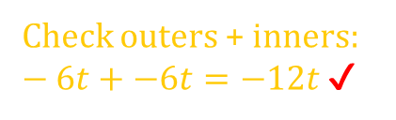
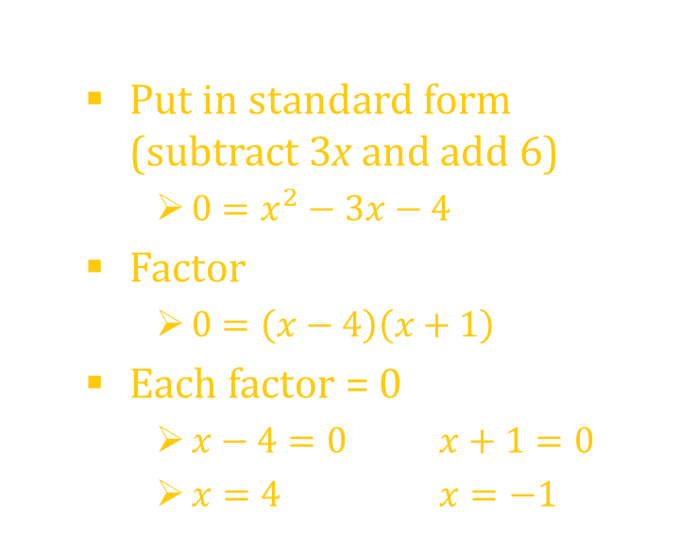
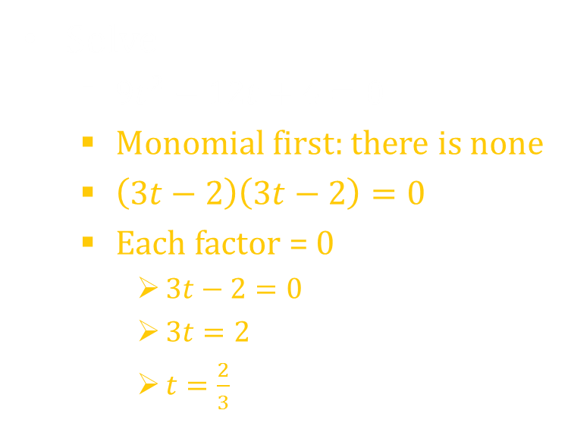
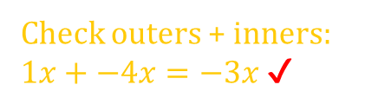
4.4 Solve ax² + bx + c = 0 by Factoring
Solve
  $9t^{2}−12t+4=0$
  Monomial first: there is none
  $\left(3t−2\right)\left(3t−2\right)=0$
  Each factor = 0
    $3t−2=0$
    $3t=2$
    $t=\frac{2}{3}$
  $3x−6=x^{2}−10$
  Put in standard form (subtract 3x and add 6)
    $0=x^{2}−3x−4$
  Factor
    $0=\left(x−4\right)\left(x+1\right)$
  Each factor = 0
    $x−4=0$ $x+1=0$
    $x=4$ $x=−1$
Check outers + inners: $−6t+−6t=−12t$ ✔
Check outers + inners: $1x+−4x=−3x$ ✔
Notes:
ANS: (3t – 2)² = 0 → 3t – 2 = 0 → 3t = 2 → t = 2/3
ANS: Put in standard form
x² – 3x – 4 = 0
(x – 4)(x + 1) = 0
x – 4 = 0 → x = 4
x + 1 = 0 → x = -1

Slide 46
4.4 Solve ax² + bx + c = 0 by Factoring
You are designing a garden. You want the garden to be made up of a rectangular flower bed surrounded by a border of uniform width to be covered with decorative stones. You have decided that the flower bed will be 22 feet by 15 feet, and your budget will allow for enough stone to cover 120 square feet. What should be the width of the border?
22
x
15
x

Slide 47

4.4 Solve ax² + bx + c = 0 by Factoring
Outer rectangle area – inner rectangle area = 120
$\left(2x+22\right)\left(2x+15\right)−\left(22\right)\left(15\right)=120$
$4x^{2}+30x+44x+330−330=120$
$4x^{2}+74x=120$
$4x^{2}+74x−120=0$
Factor monomial:
  $2\left(2x^{2}+37x−60\right)=0$
Factor trinomial:
  $2\left(2x−3\right)\left(x+20\right)=0$
Each factor = 0
  $2x−3=0$ $x+20=0$
  $2x=3$ $x=−20$
  $x=\frac{3}{2}$ Can’t use negative numbers
Border is 3/2 feet or 1.5 feet or 18 inches
22
x
15
x

Slide 48
Homework Quiz
4.4 Homework Quiz

Slide 49
4.5 Solve Quadratic Equations by Finding Square Roots

Slide 50
This Slideshow was developed to accompany the textbook
  Larson Algebra 2
  By Larson, R., Boswell, L., Kanold, T. D., & Stiff, L.
  2011 Holt McDougal
Some examples and diagrams are taken from the textbook.
Slides created by
Richard Wright, Andrews Academy
rwright@andrews.edu

Slide 51
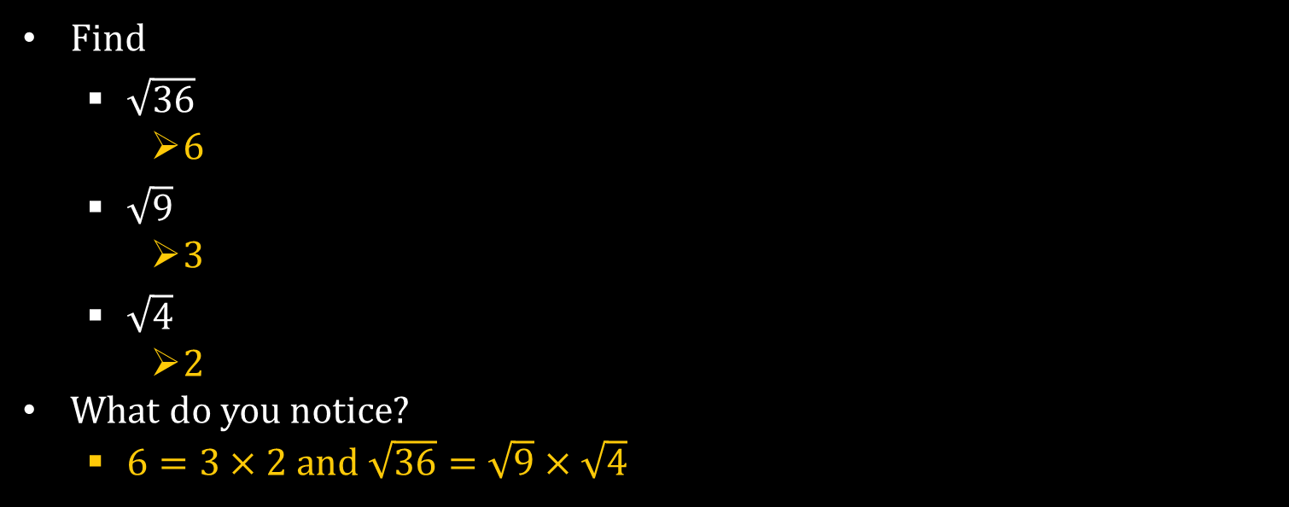
4.5 Solve Quadratic Equations by Finding Square Roots
Find
  $\sqrt{36}$
    6
  $\sqrt{9}$
    3
  $\sqrt{4}$
    2
What do you notice?
  $6=3×2$ and $\sqrt{36}=\sqrt{9}×\sqrt{4}$
Notes:
√36 = √9√4

Slide 52


4.5 Solve Quadratic Equations by Finding Square Roots
Square Root Definition
  If a² = b, then a is the square root of b
  A positive number has 2 square roots shown by $\sqrt{b}$ and $−\sqrt{b}$
  Expression with radical sign is called a radical expression
Simplifying
  All perfect squares taken out
  No radicals in denominator
$$\sqrt{36}$$
radical sign
radicand
Notes:
The term radical comes from Latin “radix” which means “root”. Other terms with same root: “Radish”, “eradicate” (pull out be roots)

Slide 53

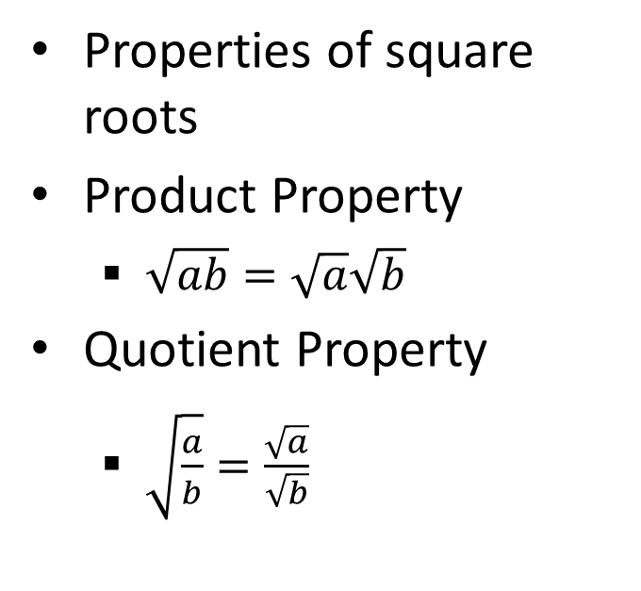
4.5 Solve Quadratic Equations by Finding Square Roots
Properties of square roots
Product Property
  $\sqrt{ab}=\sqrt{a}\sqrt{b}$
Quotient Property
  $\sqrt{\frac{a}{b}}=\frac{\sqrt{a}}{\sqrt{b}}$
Simplify
  $\sqrt{500}$
    $\sqrt{100}\sqrt{5}$
    $10\sqrt{5}$
  $3\sqrt{12}\sqrt{6}$
    $3\sqrt{72}$
    $3\sqrt{36}\sqrt{2}$
    $3\left(6\right)\sqrt{2}$
    $18\sqrt{2}$

Slide 54




4.5 Solve Quadratic Equations by Finding Square Roots
Simplify
  $\sqrt{\frac{25}{3}}$
    $\frac{5}{\sqrt{3}}$
    $\frac{5\sqrt{3}}{\sqrt{3}\sqrt{3}}$
    $\frac{5\sqrt{3}}{3}$
$\frac{5}{2+\sqrt{3}}$
  $\frac{5\left(2−\sqrt{3}\right)}{\left(2+\sqrt{3}\right)\left(2−\sqrt{3}\right)}$
  $\frac{10−5\sqrt{3}}{4−3}$
  $10−5\sqrt{3}$
Multiply top and bottom by conjugate $\left(2−\sqrt{3}\right)$ to remove the radical from the denominator.
Multiply top and bottom by $\sqrt{3}$ to remove the radical from the denominator.

Slide 55


4.5 Solve Quadratic Equations by Finding Square Roots
Solving Quadratic Equations by finding square roots
  When? Only 1 term with x and it is squared
  Isolate the square and then take the ±√
Solve
  $3−5x^{2}=−9$
  $−5x^{2}=−12$
  $x^{2}=\frac{12}{5}$
  $x=±\sqrt{\frac{12}{5}}$
  $x=±\frac{\sqrt{12}}{\sqrt{5}}$
  $x=±\frac{2\sqrt{3}\sqrt{5}}{\sqrt{5}\sqrt{5}}$
  $x=±\frac{2\sqrt{15}}{5}$
Solve for the x².
Rationalize the denominator by multiplying top and bottom by $\sqrt{5}$.
Notes:
ANS: -5x² = -12 → x² = 12/5 → x = ±√(12/5) → x = ±√12/√5 → x=±2√3 √5 / √5 √5 → x = ±2√15 / 5
ANS: (x – 2)² = 7 → x – 2 = ±√7 → x = 2 ± √7

Slide 56


4.5 Solve Quadratic Equations by Finding Square Roots
Solve
  $3{\left(x−2\right)}^{2}=21$
  ${\left(x−2\right)}^{2}=7$
  $x−2=±\sqrt{7}$
  $x=2±\sqrt{7}$
Solve for the squared portion.
Take $±$ square root.

Slide 57
Homework Quiz
4.5 Homework Quiz

Slide 58
4.6 Perform Operations with Complex Numbers

Slide 59
This Slideshow was developed to accompany the textbook
  Larson Algebra 2
  By Larson, R., Boswell, L., Kanold, T. D., & Stiff, L.
  2011 Holt McDougal
Some examples and diagrams are taken from the textbook.
Slides created by
Richard Wright, Andrews Academy
rwright@andrews.edu

Slide 60
4.6 Perform Operations with Complex Numbers
When we were young we learned to count.
Then as we got older we learned to operate with combining those counting numbers.
Next we learned about negative numbers and fractions. With this came more rules for the operations.
Finally we are going to learn about complex numbers and the rules for dealing with them.

Slide 61


4.6 Perform Operations with Complex Numbers
Imaginary Number (imaginary unit)
  i
  i = $\sqrt{−1}$
  i² = -1
Simplify
  $\sqrt{−9}$
    $\sqrt{9}\sqrt{−1}$
    $3i$
  $\sqrt{−12}$
    $\sqrt{4}\sqrt{3}\sqrt{−1}$
    $2\sqrt{3}i$
Notes:
3i
i√4√3 → 2i√3

Slide 62
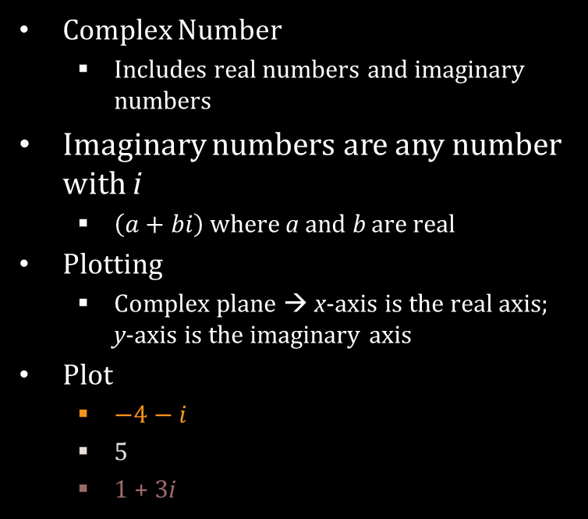
4.6 Perform Operations with Complex Numbers
i
Complex Number
  Includes real numbers and imaginary numbers
Imaginary numbers are any number with i
  $\left(a+bi\right)$ where a and b are real
Plotting
  Complex plane → x-axis is the real axis; y-axis is the imaginary axis
Plot
  $−4−i$
  5
  1 + 3i
Real

Slide 63


4.6 Perform Operations with Complex Numbers
Adding and Subtracting Complex Numbers
  Add the same way you add
  $$\left(x+4\right)+\left(2x−3\right)=3x+1$$
  Combine like terms
Simplify
  $\left(−1+2i\right)+\left(3+3i\right)$
  $\left(−1+3\right)+\left(2i+3i\right)$
  $2+5i$

Slide 64


4.6 Perform Operations with Complex Numbers
Simplify
  $\left(2−3i\right)−\left(3−7i\right)$
  $\left(2−3\right)+\left(−3i−−7i\right)$
  $−1+4i$
  $2i−\left(3+i\right)+\left(2−3i\right)$
  $\left(−3+2\right)+\left(2i−i+−3i\right)$
  $−1−2i$

Slide 65


4.6 Perform Operations with Complex Numbers
Multiplying complex numbers
  FOIL
  Remember $i^{2}=−1$
Multiply
  $−i\left(3+i\right)$
  $−3i−i^{2}$
  $−3i−\left(−1\right)$
  $1−3i$

Slide 66


4.6 Perform Operations with Complex Numbers
Multiply
  $\left(2+3i\right)\left(−6−2i\right)$
  $−12−4i−18i−6i^{2}$
  $−12−22i−6\left(−1\right)$
  $−12−22i+6$
  $−6−22i$
  $\left(1+2i\right)\left(1−2i\right)$
  $1−2i+2i−4i^{2}$
  $1−4\left(−1\right)$
  $1+4$
  $5$
Notes:
-3i – i² = 1 – 3i
-12 – 4i – 18i – 6i² = -6 – 22i
1 – 2i + 2i – 4i² = 5

Slide 67
4.6 Perform Operations with Complex Numbers
  Notice on the last example that the answer was just real
Complex conjugate → same numbers just opposite sign on the imaginary part
  When you multiply complex conjugates, the product is real
Dividing Complex Numbers
  To divide, multiply the numerator and denominator by the complex conjugate of the denominator
  No imaginary numbers are allowed in the denominator when simplified

Slide 68


4.6 Perform Operations with Complex Numbers
Divide
$\frac{2−7i}{1+i}$
$\frac{\left(2−7i\right)\left(1−i\right)}{\left(1+i\right)\left(1−i\right)}$
$\frac{2−2i−7i+7i^{2}}{1−i+i−i^{2}}$
$\frac{2−9i+7\left(−1\right)}{1−\left(−1\right)}$
$\frac{−5−9i}{2}$
$−\frac{5}{2}−\frac{9}{2}i$
Multiply the top and bottom by the conjugate of the denominator.

Slide 69
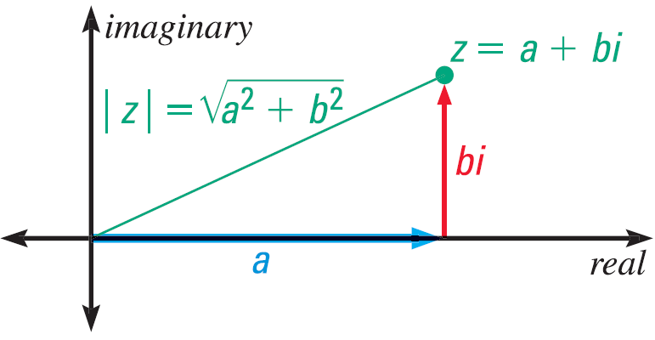


4.6 Perform Operations with Complex Numbers
Absolute Value
  Distance a number is from the origin
  $\left|a+bi\right|=\sqrt{a^{2}+b^{2}}$
    This is the distance formula (or Pythagorean Theorem)
Find $\left|2−4i\right|$
  $\sqrt{2^{2}+{\left(−4\right)}^{2}}$
  $\sqrt{4+16}$
  $\sqrt{20}$
  $\sqrt{4}\sqrt{5}$
  $2\sqrt{5}$

Slide 70

4.6 Perform Operations with Complex Numbers
Mandelbrot Set
  Fractal picture created using complex numbers
In the following pictures
  the black is part of the Mandelbrot Set
  The color is based on the number of iterations before $\left|z\right|>\sqrt{5}$
Notes:
We’ll find out about z later

Slide 71

4.6 Perform Operations with Complex Numbers

Slide 72

4.6 Perform Operations with Complex Numbers
Solve the quadratic equation
  $x^{2}−8=−36$
  $x^{2}=−28$
  $x=±\sqrt{−28}$
  $x=±\sqrt{4}\sqrt{7}\sqrt{−1}$
  $x=±2\sqrt{7}i$

Slide 73
Homework Quiz
4.6 Homework Quiz

Slide 74
4.7 Complete the Square

Slide 75
This Slideshow was developed to accompany the textbook
  Larson Algebra 2
  By Larson, R., Boswell, L., Kanold, T. D., & Stiff, L.
  2011 Holt McDougal
Some examples and diagrams are taken from the textbook.
Slides created by
Richard Wright, Andrews Academy
rwright@andrews.edu

Slide 76


4.7 Complete the Square
The Perfect Square
${\left(x+3\right)}^{2}$
$\left(x+3\right)\left(x+3\right)$
$x^{2}+3x+3x+3^{2}$
$x^{2}+2\left(3x\right)+3^{2}$
$x^{2}+6x+9$
${\left(x+k\right)}^{2}=x^{2}+2kx+k^{2}$
Compare to $ax^{2}+bx+c$
If you know the middle coefficient (b), then c is
  $c={\left(\frac{b}{2}\right)}^{2}$
Notes:
=(x + 3)(x + 3)
= x² + 2(3x) + 32
= x² + 6x + 9

Slide 77

4.7 Complete the Square
What should c be to make a perfect square
  $x^{2}+8x+c$
  $c={\left(\frac{b}{2}\right)}^{2}$
  $c={\left(\frac{8}{2}\right)}^{2}$
  $c=4^{2}$
  $c=16$
Notes:
you have to add (8/2)² = 4² = 16 to get a perfect square or (x + 4)²

Slide 78

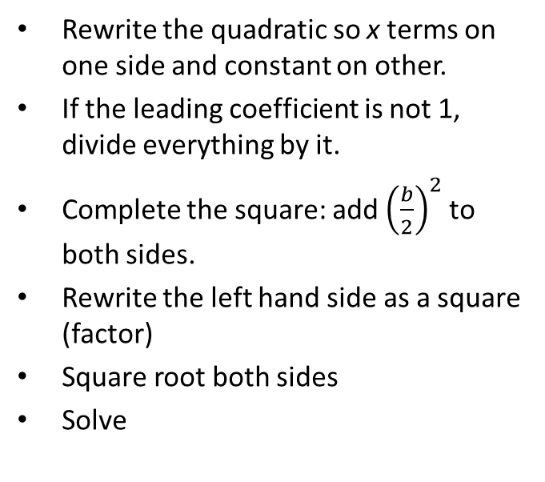
4.7 Complete the Square
Rewrite the quadratic so x terms on one side and constant on other.
If the leading coefficient is not 1, divide everything by it.
Complete the square: add ${\left(\frac{b}{2}\right)}^{2}$ to both sides.
Rewrite the left hand side as a square (factor)
Square root both sides
Solve
  x² + 6x = 16
  It already is
  x² + 6x + ${\left(\frac{6}{2}\right)}^{2}$= 16 + ${\left(\frac{6}{2}\right)}^{2}$
  x² + 6x + 3² = 16 + 9
  (x + 3)² = 25
  x + 3 = ± 5
  x = -3 ± 5
  x = 2, -8

Slide 79


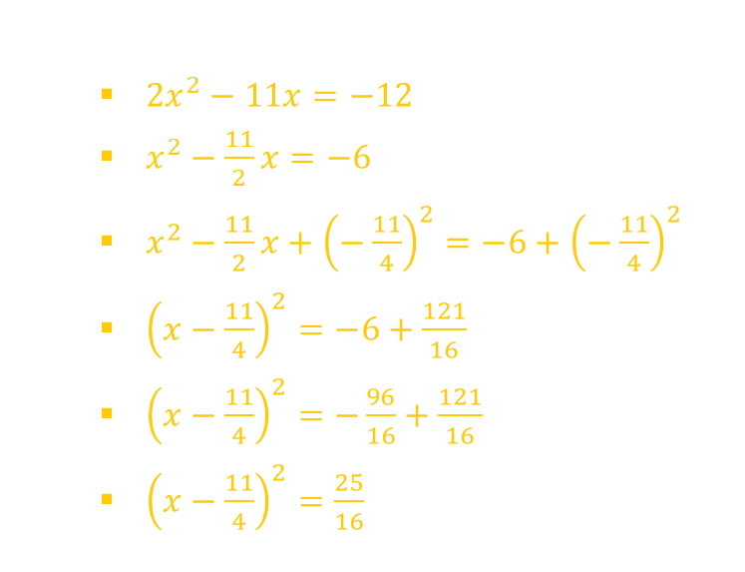
4.7 Complete the Square
Get constant on other side.
Solve $2x^{2}−11x+12=0$
  $2x^{2}−11x=−12$
  $x^{2}−\frac{11}{2}x=−6$
  $x^{2}−\frac{11}{2}x+{\left(−\frac{11}{4}\right)}^{2}=−6+{\left(−\frac{11}{4}\right)}^{2}$
  ${\left(x−\frac{11}{4}\right)}^{2}=−6+\frac{121}{16}$
  ${\left(x−\frac{11}{4}\right)}^{2}=−\frac{96}{16}+\frac{121}{16}$
  ${\left(x−\frac{11}{4}\right)}^{2}=\frac{25}{16}$
  $x−\frac{11}{4}=±\frac{5}{4}$
  $x=\frac{11}{4}±\frac{5}{4}$
  $x=\frac{11±5}{4}$
  $x=4, \frac{3}{2}$
Solve for x.
Divide to get a = 1.
Add ${\left(\frac{b}{2}\right)}^{2}$ to both sides.
Write left as square and simplify right.

Slide 80




4.7 Complete the Square
The area of the rectangle is 56. Find the value of x.
$A=lw$
$4x\left(2x+3\right)=56$
$8x^{2}+12x=56$
$x^{2}+\frac{3}{2}x=7$
$x^{2}+\frac{3}{2}x+{\left(\frac{3}{4}\right)}^{2}=7+{\left(\frac{3}{4}\right)}^{2}$
$\left(x+\frac{3}{4}\right)2 =7+\frac{9}{16}$
  ${\left(x+\frac{3}{4}\right)}^{2}=\frac{121}{16}$
  $x+\frac{3}{4}=±\sqrt{\frac{121}{16}}$
  $x+\frac{3}{4}=±\frac{11}{4}$
  $x=−\frac{3}{4}±\frac{11}{4}$
  $x=\frac{8}{4}=2 and\frac{−14}{4}=−\frac{7}{2}$
$$4x$$
$$2x+3$$
Notes:
4x(2x + 3) = 56
8x² + 12x = 56
x² + 3/2 x = 7
x² + 3/2 x + (3/4)² = 7 + 9/16
(x + ¾)² = 121/16
x + ¾ = ±√(121/16)
x + ¾ = ±11/4
x = -3/4 ± 11/4
x = 8/4 = 2 and 14/4 = 7/2

Slide 81


4.7 Complete the Square
Writing quadratic functions in Vertex Form
$y=a{\left(x−h\right)}^{2}+k$
  $\left(h, k\right)$ is the vertex
Start with standard form
Group the terms with the x
Factor out any number in front of the x²
Add ${\left(\frac{b}{2}\right)}^{2}$ to both sides (inside the group on the right)
Rewrite as a perfect square
Subtract to get the y by itself
  $y=2x^{2}+12x+16$
  $y=\left(2x^{2}+12x\right)+16$
  $y=2\left(x^{2}+6x\right)+16$
  $y+2\left(9\right)=2\left(x^{2}+6x+9\right)+16$
  $y+18=2{\left(x+3\right)}^{2}+16$
  $y=2{\left(x+3\right)}^{2}−2$
  Vertex is at (-3, -2)
  -2 is the minimum for this function
  Find the max or min by completing the square to find the vertex

Slide 82
Homework Quiz
4.7 Homework Quiz

Slide 83
4.8 Use the Quadratic Formula and the Discriminant

Slide 84
This Slideshow was developed to accompany the textbook
  Larson Algebra 2
  By Larson, R., Boswell, L., Kanold, T. D., & Stiff, L.
  2011 Holt McDougal
Some examples and diagrams are taken from the textbook.
Slides created by
Richard Wright, Andrews Academy
rwright@andrews.edu

Slide 85
4.8 Use the Quadratic Formula and the Discriminant
Completing the square was a long laborious process. Today we can develop a method to make it quicker.

Slide 86


4.8 Use the Quadratic Formula and the Discriminant
Solve $ax^{2}+bx+c=0$
$ax^{2}+bx=−c$
$x^{2}+\frac{b}{a}x=−\frac{c}{a}$
$x^{2}+\frac{b}{a}x+{\left(\frac{b}{2a}\right)}^{2}={\left(\frac{b}{2a}\right)}^{2}−\frac{c}{a}$
${\left(x+\frac{b}{2a}\right)}^{2}=\frac{b^{2}}{4a^{2}}−\frac{4ac}{4a^{2}}$
${\left(x+\frac{b}{2a}\right)}^{2}=\frac{b^{2}−4ac}{4a^{2}}$
$x+\frac{b}{2a}=±\sqrt{\frac{b^{2}−4ac}{4a^{2}}}$
$x=−\frac{b}{2a}±\frac{\sqrt{b^{2}−4ac}}{2a}$
Notes:
2x² + 6x – 4 = 0 ax² + bx + c = 0
x² + 3x – 2 = 0 Divide by 2 to get a = 1 x² + (b/a)x + (c/a) = 0
x² + 3x = 2 Add two to get x’s by self x² + (b/a)x = -(c/a)
x² + 3x + (3/2)² = 2 + (3/2)² Add the square of half of middle to get perfect square x² + (b/a)x + (b/2a)² = -(c/a) + (b/2a)²
(x + 3/2)² = 2 + 9/4 Factor left (x + (b/2a))² = -c/a + b²/4a²
x + 3/2 = ±√(17/4) Square root x + (b/2a) = ±√((-4ac+b²)/(4a²))
x = -3/2 ±√(17/4) Subtract x = -b/2a ±√((b²-4ac)/(4a²))
x = (-3±√17)/2 Simplify x = (-b±√(b²-4ac))/2a

Slide 87

4.8 Use the Quadratic Formula and the Discriminant
$x=\frac{−b±\sqrt{b^{2}−4ac}}{2a}$
This is called the quadratic formula and always works for quadratic equations.
It even finds the complex solutions.
The part under the square root, discriminant, tells you what kind of solutions you are going to have.
  $b^{2}−4ac>0$ → two distinct real solutions
  $b^{2}−4ac=0$ → exactly one real solution (a double solution)
  $b^{2}−4ac<0$ → two distinct imaginary solutions

Slide 88


4.8 Use the Quadratic Formula and the Discriminant
What types of solutions to $5x^{2}+3x−4=0$?
  Find the discriminant
  $b^{2}−4ac$
  3² – 4(5)(-4)
  9 + 80
  89 > 0
  Two distinct real roots
Solve $5x^{2}+3x=4$
  Put in standard form
    $5x^{2}+3x−4=0$
  Quadratic formula
    $x=\frac{−b±\sqrt{b^{2}−4ac}}{2a}$
    $x=\frac{−3±\sqrt{3^{2}−4\left(5\right)\left(−4\right)}}{2\left(5\right)}$
  Simplify
    $x=\frac{−3±\sqrt{89}}{10}$
Notes:
3² – 4(5)(-4) = 9 + 80 = 89 → two distinct real roots
Put in standard form → 5x² + 3x – 4 = 0
Quadratic formula → x = (-3±√(3²-4(5)(-4)))/(2(5))
Simplify → (-3±√(89))/10

Slide 89


4.8 Use the Quadratic Formula and the Discriminant
Solve $4x^{2}−6x+3=0$
  $x=\frac{−b±\sqrt{b^{2}−4ac}}{2a}$
  $x=\frac{6±\sqrt{{\left(−6\right)}^{2}−4\left(4\right)\left(3\right)}}{2\left(4\right)}$
  $x=\frac{6±\sqrt{36−48}}{8}$
  $x=\frac{6±\sqrt{−12}}{8}$
  $x=\frac{6±2\sqrt{3}i}{8}$
  $x=\frac{6}{8}±\frac{2\sqrt{3}}{8}i$
  $x=\frac{3}{4}±\frac{\sqrt{3}}{4}i$
Notes:
$$4x^{2}−6x+3=0$$
$$x=\frac{6±\sqrt{{\left(−6\right)}^{2}−4\left(4\right)\left(3\right)}}{2\left(4\right)}$$
$$x=\frac{6±\sqrt{36−48}}{8}$$
$$x=\frac{6±\sqrt{−12}}{8}$$
$$x=\frac{6±2\sqrt{3}i}{8}$$
$$x=\frac{3±\sqrt{3}i}{4} (reduce top and bottom by 2)$$

Slide 90
Homework Quiz
4.8 Homework Quiz

Slide 91
4.9 Graph and Solve Quadratic Inequalities

Slide 92
This Slideshow was developed to accompany the textbook
  Larson Algebra 2
  By Larson, R., Boswell, L., Kanold, T. D., & Stiff, L.
  2011 Holt McDougal
Some examples and diagrams are taken from the textbook.
Slides created by
Richard Wright, Andrews Academy
rwright@andrews.edu

Slide 93
4.9 Graph and Solve Quadratic Inequalities
Often in real-life, what we are looking for is a range instead of just one value.
An example is how many tickets must be purchased to make at least $500?
That means real-life often uses inequalities.

Slide 94

4.9 Graph and Solve Quadratic Inequalities
Graph inequalities
Graph the quadratic as if it were an equation
  Find the vertex $\left(−\frac{b}{2a}\right)$
  Make a table of values choosing points on both sides of the vertex
  Graph the points and connect the dots

Slide 95
4.9 Graph and Solve Quadratic Inequalities
Dotted line or solid line
Shade
  Pick a test point (not on the line)
  Try plugging it in the inequality
  If you get a true statement shade that side of the line
  If you get a false statement shade the other side of the line.

Slide 96

4.9 Graph and Solve Quadratic Inequalities
Graph $y≥x^{2}+4x+1$
  Find vertex:
    $x=−\frac{b}{2a}$
    $x=−\frac{4}{2\left(1\right)}=−2$
  Make table
  Solid line because equal to
  Pick (0, 0) to test
    $0≥0^{2}+4\left(0\right)+1$
    $0≥1$
    False, shade other side of curve
x | y
-5 | 6
-4 | 1
-3 | -2
-2 | -3
-1 | -2
0 | 1
1 | 6

Slide 97
4.9 Graph and Solve Quadratic Inequalities
Solve inequalities in one variable.
Make = 0
Factor or use the quadratic formula to find the zeros
Graph the zeros on a number line (notice it cuts the line into three parts)
Pick a number in each of the three parts as test points
Test the points in the original inequality to see true or false
Write inequalities for the regions that were true
p² – 4p ≤ 5
p² – 4p – 5 ≤ 0
(p – 5)(p + 1) ≤ 0
  Zeros are 5, -1
test points = -2, 0, 6
  –2 → 4 – 4(-2) ≤ 5 → 12 ≤ 5 false
  0 → 0 – 4(0) ≤ 5 → 0 ≤ 5 true
  6 → 36 – 4(6) ≤ 5 → 12 ≤ 5 false
middle region true so –1 ≤ p ≤ 5
0

Slide 98

4.9 Graph and Solve Quadratic Inequalities
Or You could also solve the quadratic inequality in one variable by graphing the quadratic
  Make the equation = 0
  Graph
  When the graph is below
  the x-axis; ≤ 0
  When the graph is above
  the x-axis; ≥ 0
Notes:
2x² + 4x – 6 ≤ 0 when -3 ≤ x ≤ 1
2x² + 4x – 6 ≥ 0 when x ≤ -3 or x ≥ 1

Slide 99
Homework Quiz
4.9 Homework Quiz

Slide 100
4.10 Write Quadratic Functions and Models

Slide 101
This Slideshow was developed to accompany the textbook
  Larson Algebra 2
  By Larson, R., Boswell, L., Kanold, T. D., & Stiff, L.
  2011 Holt McDougal
Some examples and diagrams are taken from the textbook.
Slides created by
Richard Wright, Andrews Academy
rwright@andrews.edu

Slide 102
4.10 Write Quadratic Functions and Models
We can easily find the equations of lines (y = mx + b), but curves are a little more tricky.
Today we will learn how to fit a quadratic function to some given points.

Slide 103


4.10 Write Quadratic Functions and Models
Vertex Form → given vertex and one other point
  $y=a{\left(x−h\right)}^{2}+k$
  Fill in the vertex (h, k)
  Plug in your other point (x, y) and find a
  Write the equation
Write the equation of the parabola with vertex at $\left(−2, 1\right)$, point at $\left(1, −1\right)$.
  $y=a{\left(x+2\right)}^{2}+1$
  $−1=a{\left(1+2\right)}^{2}+1$
  $−1=9a+1$
  $−2=9a$
  $a=−\frac{2}{9}$
  $y=−\frac{2}{9}{\left(x+2\right)}^{2}+1$
(h, k)
(x, y)

Slide 104


4.10 Write Quadratic Functions and Models
Intercept Form → given the x-intercepts and one other point
  Fill in $y=a\left(x−p\right)\left(x−q\right)$ with the intercepts (p and q)
  Plug in your other point (x, y) and find a
  Write the equation
Write the equation of parabola with x-ints of 1 and 4, point at (2, -6).
  $y=a\left(x−1\right)\left(x−4\right)$
  $−6=a\left(2−1\right)\left(2−4\right)$
  $−6=a\left(1\right)\left(−2\right)$
  $a=3$
  $y=3\left(x−1\right)\left(x−4\right)$
Notes:
ANS: y = a(x – 1)(x – 4) → -6 = a(2 – 1)(2 – 4) → -6 = a(1)(-2) → a = 3 → y = 3(x – 1)(x – 4)

Slide 105
4.10 Write Quadratic Functions and Models
Standard Form → any 3 points
  Use one of the above two and simplify OR
  Fill in the x and y of ax² + bx + c = y with each of the three points creating a system of three equations with the variables of a, b, and c
  Solve the system
  Write your equation

Slide 106


4.10 Write Quadratic Functions and Models
Find the equation of the parabola through points $\left(−2, −1\right)$, $\left(1, 11\right)$, $\left(2, 27\right)$.
Fill in the x and y of $ax^{2}+bx+c=y$ with each of the three points.
  $a{\left(−2\right)}^{2}+b\left(−2\right)+c=−1$
    $4a−2b+c=−1$
  $a{\left(1\right)}^{2}+b\left(1\right)+c=11$
    $a+b+c=11$
  $a{\left(2\right)}^{2}+b\left(2\right)+c=27$
    $4a+2b+c=27$
Solve the system of the three equations.
  $\left\{\begin{aligned}4&a−2&b+c=−1 \\ &a+&b+c=11 \\ 4&a+2&b+c=27\end{aligned}\right.$
  Use a method from chapter 3 like elimination to solve.

Slide 107


4.10 Write Quadratic Functions and Models
$\left\{\begin{aligned}4&a−2&b+c=−1 \\ &a+&b+c=11 \\ 4&a+2&b+c=27\end{aligned}\right.$
First two equations (2nd times -1)
  $\begin{aligned}4&a−2&b+&c=−1 \\ −&a−&b−&c=−11\end{aligned}$
  $3a −3b =−12$
  $a−b=−4$
Last two equations (2nd times -1)
  $\begin{aligned}−&a−&b−&c=−11 \\ 4&a+2&b+&c=27\end{aligned}$
  $3a + b =16$
Combine shorter equations
  $\begin{aligned}&a−&b=−4 \\ 3&a+&b=16\end{aligned}$
  $4a =12$
  $a=3$
Back substitute to find b and c
  $a−b=−4$
    $3−b=−4$
    $b=7$
  $a+b+c=11$
    $3+7+c=11$
    $c=1$
$y=3x^{2}+7x+1$

Slide 108
4.10 Write Quadratic Functions and Models
Best-Fitting Quadratic Regression
  (Graphing Calculators)
  Gives the best-fitting quadratic model for a given set of at least 3 data points
Steps
  Push STAT
  Select Edit…
  Enter x values in L1 and y values in L2
  Push STAT
  Select CALC → QuadReg
  Push Enter to Calculate.

Slide 109
Homework Quiz
4.10 Homework Quiz

