Slide 1
Reasoning and Proofs
Geometry
Chapter 2

Slide 2
This Slideshow was developed to accompany the textbook
  Big Ideas Geometry
  By Larson and Boswell
  2022 K12 (National Geographic/Cengage)
Some examples and diagrams are taken from the textbook.
Slides created by
Richard Wright, Andrews Academy
rwright@andrews.edu

Slide 3
2.1 Conditional Statements
Objectives: By the end of the lesson,
• I can write conditional statements.
• I can write biconditional statements.

Slide 4
2.1 Conditional Statements
Determine whether each conditional statement is true or false. Justify your answer.
i. If yesterday was Wednesday, then today is Thursday.
ii. If an angle is acute, then it has a measure of 30°.
iii. If a month has 30 days, then it is June.
iv. If △ADC is a right triangle, then the Pythagorean Theorem is valid for △ADC.
v. If a polygon is a quadrilateral, then the sum of its angle measures is 180°.
vi. If points A, B, and C are collinear, then they lie on the same line.

Slide 5
2.1 Conditional Statements
Conditional Statement
Logical statement with two parts
Hypothesis
Conclusion
Often written in If-Then form
If part contains hypothesis
Then part contains conclusion
  If we confess our sins, then He is faithful and just to forgive us our sins. 1 John 1:9
Notes:
Red is hypothesis, Gray is conclusion

Slide 6
2.1 Conditional Statements
If-then statements
p → q
The if part implies that the then part will happen.
The then part does NOT imply that the first part happened.
If you are hungry, then you should eat.
John is hungry, so…
Megan should eat, so…
Notes:
John is hungry, so… he should eat.
Megan should eat, so… no conclusion. This is backwards. She could be diabetic and need to eat to get her blood sugar level correct.

Slide 7
2.1 Conditional Statements
Negation
~p
Turn it to the opposite.
  Example:
    The board is white.
Notes:
The board is not white.

Slide 8
2.1 Conditional Statements
Converse
q → p
Switch the hypothesis and conclusion
Example:
  If we confess our sins, then he is faithful and just to forgive us our sins.
    p = we confess our sins
    q = he is faithful and just to forgive us our sins
  Converse = If he is faithful and just to forgive us our sins, then we confess our sins.
  Does not necessarily make a true statement
  (He may be faithful and just, but many people still don’t ask for forgiveness.)

Slide 9
2.1 Conditional Statements
Inverse
~p → ~q
Negating both the hypothesis and conclusion
Example:
  If we confess our sins, then he is faithful and just to forgive us our sins.
    p = we confess our sins
    q = he is faithful and just to forgive us our sins
  Inverse = If we don’t confess our sins, then he is not faithful and just to forgive us our sins.
  Not necessarily true (He is still faithful and just even if we do not confess.)

Slide 10
2.1 Conditional Statements
Contrapositive
~q → ~p
Take the converse of the inverse
Example:
  If we confess our sins, then he is faithful and just to forgive us our sins.
    p = we confess our sins
    q = he is faithful and just to forgive us our sins
  Contrapositive (inverse of converse) = If he is not faithful and just to forgive us our sins, then we won’t confess our sins.
  Always true.

Slide 11
2.1 Conditional Statements
Write the following in If-Then form and then write the converse, inverse, and contrapositive
  All whales are mammals.
Notes:
If-Then: If it is a whale, then it is a mammal.
Converse: If it is a mammal, then it is a whale.
Inverse: If it is not a whale, then it is not a mammal.
Contrapositive: if it is not a mammal, then it is not a whale.

Slide 12
2.1 Conditional Statements
Biconditional Statement
Logical statement where the if-then and converse are both true
Written with “if and only if”
iff
  An angle is a right angle if and only if it measure 90°.

Slide 13
2.1 Conditional Statements
  All definitions can be written as if-then and biconditional statements
  Rewrite the definition as a biconditional.
Perpendicular Lines
Lines that intersect to form right angles
m ⊥ r
m
r
Notes:
If-then: If lines intersect to form right angles, then they are perpendicular.
Biconditional: Lines are perpendicular iff they intersect to form right angles.

Slide 14
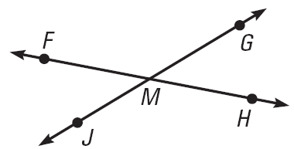

2.1 Conditional Statements
Use the diagram shown. Decide whether each statement is true. Explain your answer using the definitions you have learned.
∠JMF and ∠FMG are supplementary
Point M is the midpoint of $\overline{FH}$
∠JMF and ∠HMG are vertical angles.
$\overset{⃡}{FH}⊥\overset{⃡}{JG}$
69 #2, 4, 6, 8, 10, 12, 14, 16, 18, 20, 24, 26, 28, 30, 32, 49, 68, 71, 74, 76
Notes:
True, linear pairs are supplementary
False, no information given
True, intersecting lines form vertical angles
False, no information given

Slide 15
2.2A Inductive Reasoning
Objectives: By the end of the lesson,
• I can use inductive reasoning to make conjectures.

Slide 16
2.2A Inductive Reasoning
Geometry, and much of math and science, was developed by people recognizing patterns
We are going to use patterns to make predictions this lesson

Slide 17
2.2A Inductive Reasoning
Conjecture
  Unproven statement based on observation
Inductive Reasoning
  First find a pattern in specific cases
  Second write a conjecture for the general case

Slide 18
2.2A Inductive Reasoning
Sketch the fourth figure in the pattern
Describe the pattern in the numbers 1000, 500, 250, 125, … and write the next three numbers in the pattern
Notes:
Each number is ½ the previous number: 62.5, 31.25, 15.625

Slide 19
2.2A Inductive Reasoning
Given the pattern of triangles below, make a conjecture about the number of segments in a similar diagram with 5 triangles
Make and test a conjecture about the product of any two odd numbers
Notes:
Each figure has two more segments
Third figure has seven segment, so 5th has 7 + 2 + 2 = 11
Product means multiply
Try several: 3(5) = 15; 7(11) = 77; 9(3) = 27
Looks like the product of two odd numbers is odd

Slide 20
2.2A Inductive Reasoning
The only way to show that a conjecture is true is to show all cases
To show a conjecture is false is to show one case where it is false
  This case is called a counterexample

Slide 21
2.2A Inductive Reasoning
Find a counterexample to show that the following conjecture is false
  The value of x² is always greater than the value of x
78 #1, 2, 4, 6, 7, 8, 10, 12, 13, 14, 36, 43, 45, 46, 49
Notes:
Sample answer: let x = ½; x² = ¼

Slide 22
2.2B Deductive Reasoning
Objectives: By the end of the lesson,
• I can use deductive reasoning to verify conjectures.
• I can distinguish between inductive and deductive reasoning.

Slide 23
2.2B Deductive Reasoning
Deductive Reasoning
  Use facts, definitions, properties, laws of logic to form an argument.
Deductive reasoning
  Always true
  General → specific
Inductive reasoning
  Sometimes true
  Specific → general

Slide 24
2.2B Deductive Reasoning
Law of Detachment
If the hypothesis of a true conditional statement is true, then the conclusion is also true.
Detach means comes apart, so the 1st statement is taken apart.
Example:
  If we confess our sins, then He is faithful and just to forgive us our sins. 1 John 1:9
  Jonny confesses his sins
  God is faithful and just to forgive Jonny his sins

Slide 25
2.2B Deductive Reasoning
If you love me, keep my commandments.
I love God.
____________________________________
If you love me, keep my commandments.
I keep all the commandments.
____________________________________
Notes:
I keep the commandments
Not Valid

Slide 26
2.2B Deductive Reasoning
Law of Syllogism
If these statement are true,
If hypothesis p, then conclusion q.
If hypothesis q, then conclusion r.
then this statement is true
If hypothesis p, then conclusion r.
If we confess our sins, He is faithful and just to forgive us our sins.
If He is faithful and just to forgive us our sins, then we are blameless.
If we confess our sins, then we are blameless.

Slide 27
2.2B Deductive Reasoning
If you love me, keep my commandments.
If you keep my commandments, you will be happy.
______________________________________
If you love me, keep my commandments.
If you love me, then you will pray.
______________________________________
78 #16, 17, 18, 19, 21, 22, 24, 25, 26, 30, 32, 34, 40, 51, 54

Slide 28
2.3 Postulates and Diagrams
Objectives: By the end of the lesson,
• I can identify postulates represented by diagrams.
• I can sketch a diagram given a verbal description.
• I can interpret a diagram.

Slide 29
2.3 Postulates and Diagrams
Postulates (axioms)
  Rules that are accepted without proof (assumed)
Theorem
  Rules that are accepted only with proof

Slide 30
2.3 Postulates and Diagrams
Basic Postulates (Memorize for quiz!)
  Through any two points there exists exactly one line.
  A line contains at least two points.
  If two lines intersect, then their intersection is exactly one point.
  Through any three noncollinear points there exists exactly one plane.

Slide 31
2.3 Postulates and Diagrams
Basic Postulates (continued)
  A plane contains at least three noncollinear points.
  If two points lie in a plane, then the line containing them lies in the plane.
  If two planes intersect, then their intersection is a line.

Slide 32
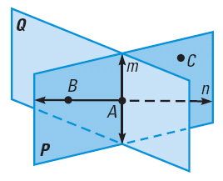
2.3 Postulates and Diagrams
Which postulate allows you to say that the intersection of plane P and plane Q is a line?
Use the diagram to write examples of the 1st three postulates from this lesson.
Notes:
If two planes intersect, then their intersection is a line.
Line n passes through points A and B.
Line n contains points A and B
Line m and line n intersect at point A

Slide 33
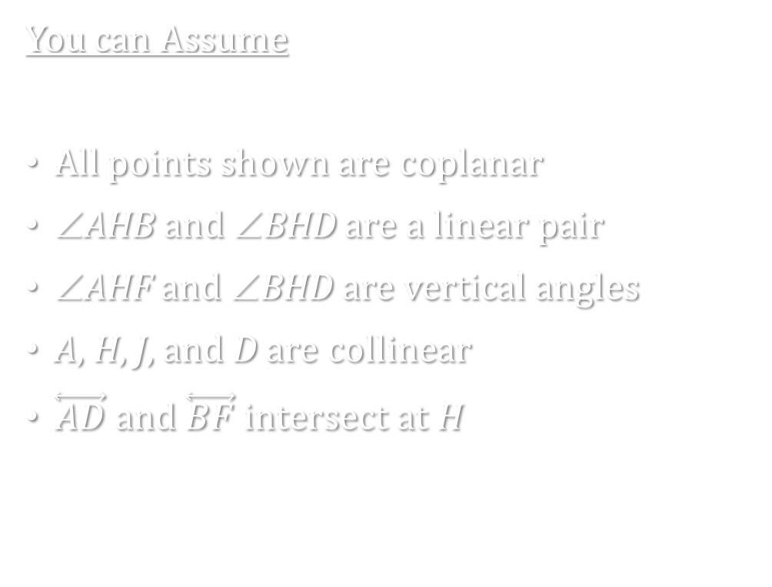
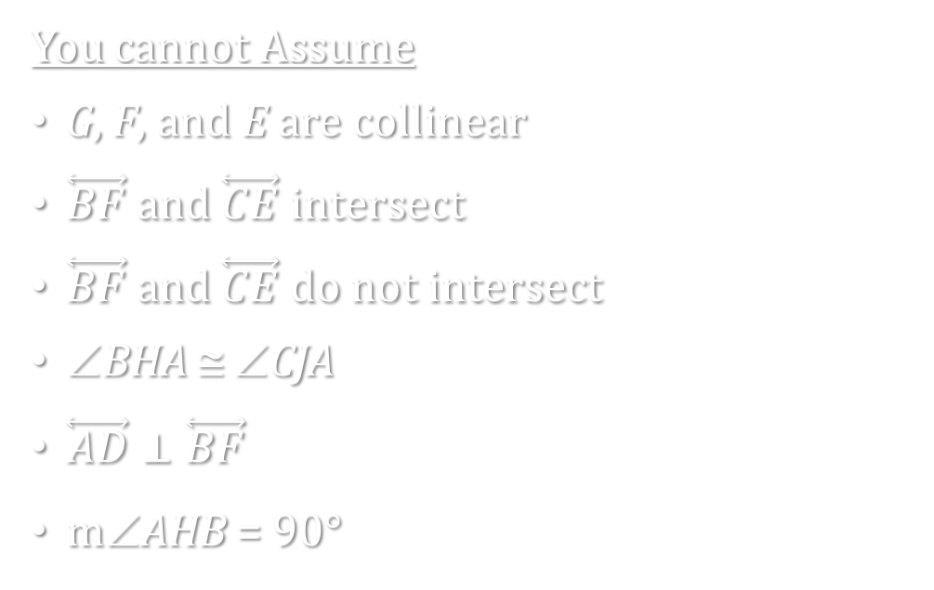
2.3 Postulates and Diagrams
P
B
C
Interpreting a Diagram
A
H
J
You can Assume
All points shown are coplanar
∠AHB and ∠BHD are a linear pair
∠AHF and ∠BHD are vertical angles
A, H, J, and D are collinear
$\overset{⃡}{AD}$ and $\overset{⃡}{BF}$ intersect at H
D
F
E
G
You cannot Assume
G, F, and E are collinear
$\overset{⃡}{BF}$ and $\overset{⃡}{CE}$ intersect
$\overset{⃡}{BF}$ and $\overset{⃡}{CE}$ do not intersect
∠BHA ≅ ∠CJA
$\overset{⃡}{AD}⊥\overset{⃡}{BF}$
m∠AHB = 90°

Slide 34
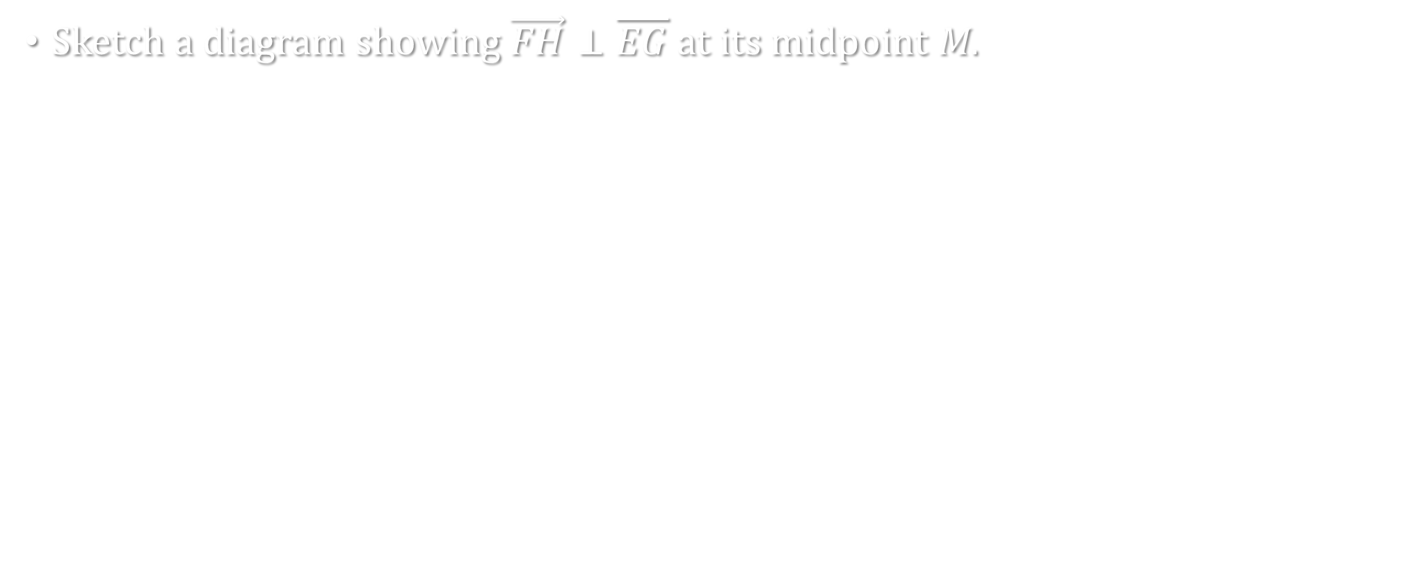
2.3 Postulates and Diagrams
Sketch a diagram showing $\vec{FH}⊥\overline{EG}$ at its midpoint M.

Slide 35
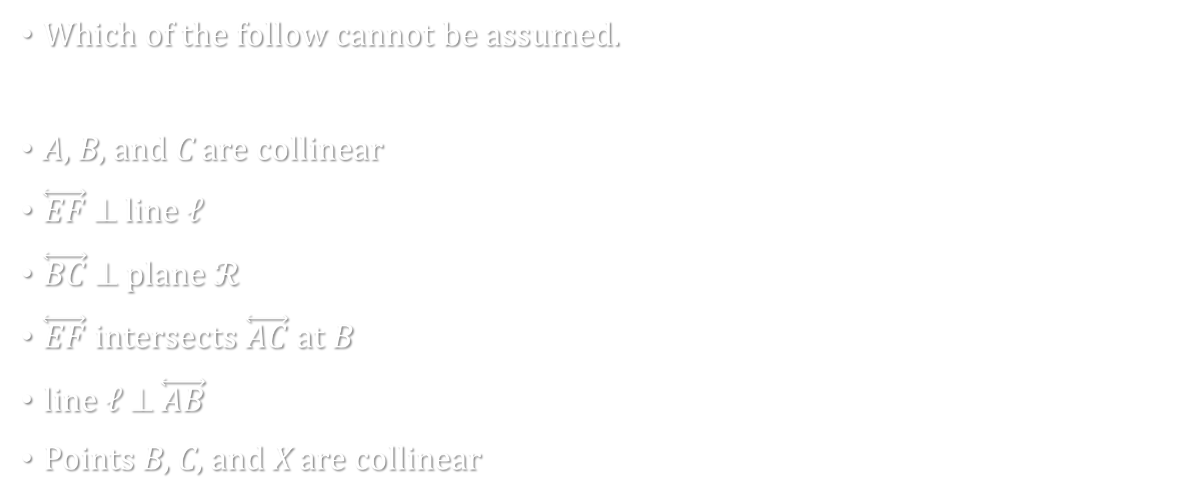


2.3 Postulates and Diagrams
Which of the follow cannot be assumed.
A, B, and C are collinear
$\overset{⃡}{EF}$ ⊥ line ℓ
$\overset{⃡}{BC}$ ⊥ plane $ℛ$
$\overset{⃡}{EF}$ intersects $\overset{⃡}{AC}$ at B
line ℓ ⊥ $\overset{⃡}{AB}$
Points B, C, and X are collinear
$$𝓡$$
E
C
X
A
B
ℓ
$$𝓢$$
F
85 #2, 4, 6, 8, 10, 12, 14, 16, 18, 20, 21, 22, 23, 25, 26, 31, 32, 36, 38, 39
Notes:
BC ⊥ plane R
line ℓ ⊥ AB
Points B, C, and X are collinear

Slide 36
2.4 Algebraic Reasoning
Objectives: By the end of the lesson,
• I can identify algebraic properties of equality.
• I can use algebraic properties of equality to solve equations.
• I can use properties of equality to solve for geometric measures.

Slide 37
2.4 Algebraic Reasoning
When you solve an algebra equation, you use properties of algebra to justify each step.
Segment length and angle measure are real numbers just like variables, so you can solve equations from geometry using properties from algebra to justify each step.

Slide 38
2.4 Algebraic Reasoning
Property of Equality | Numbers
Reflexive | a = a
Symmetric | a = b, then b = a
Transitive | a = b and b = c, then a = c
Add and Subtract | If a = b, then a + c = b + c
Multiply and divide | If a = b, then a · c = b · c
Substitution | If a = b, then a may be replaced by b in any equation or expression
Distributive | a(b + c) = ab + ac

Slide 39
2.4 Algebraic Reasoning
Name the property of equality the statement illustrates.
  If m∠6 = m∠7, then m∠7 = m∠6.
  If JK = KL and KL = 12, then JK = 12.
  m∠W = m∠W
Notes:
Symmetric
Transitive
Reflexive

Slide 40
2.4 Algebraic Reasoning
Solve the equation and write a reason for each step
  14x + 3(7 – x) = -1
Solve A = ½ bh for b.
Notes:
14x + 21 – 3x = -1 distributive
11x + 21 = -1 definition of add (optional step)
11x = -22 subtraction
x = -2 division
A = ½ bh
2A = bh multiplication
2A/h = b division
b = 2A/h symmetric

Slide 41
2.4 Algebraic Reasoning
Given: m∠ABD = m∠CBE
Show that m∠1 = m∠3
92 #2, 4, 6, 8, 10, 16, 20, 22, 24, 28, 30, 32, 34, 36, 38, 53, 54, 60, 61, 63
A
C
1
B
2
3
D
E
Notes:
m∠ABD = m∠CBE (given)
m∠ABD = m∠1 + m∠2 (angle addition post.)
m∠CBE = m∠2 + m∠3 (angle addition post.)
m∠1 + m∠2 = m∠2 + m∠3 (substitution)
m∠1 = m∠3 (subtraction)

Slide 42
2.5 Proving Statements about
Segments and Angles
Objectives: By the end of the lesson,
• I can explain the structure of a two-column proof.
• I can write a two-column proof.
• I can identify properties of congruence.

Slide 43
2.5 Proving Statements about
Segments and Angles
Pay attention today, we are going to talk about how to write proofs.
Proofs are like making a peanut butter and jelly sandwich.
Given: Loaf of bread, jar of peanut butter, and jelly sitting on counter
Prove: Make a peanut butter and jelly sandwich
Notes:
Ask: What do we do now? (write down ideas generated on the board)
Ask: Is there any special order for this? (yes, there is and have students start to put the steps in order)
If a student wants a step, such as spread peanut butter on the bread, respond by asking where the peanut butter came from or what are you using. You cannot use an object until you get it.
Write the steps in the first column with justifications for each step in the second column

Slide 44
2.5 Proving Statements about
Segments and Angles
Congruence of segments and angles is reflexive, symmetric, and transitive.
Writing proofs follow the same step as the sandwich.
  Write the given and prove written at the top for reference
  Start with the given as step 1
  The steps need to be in an logical order
  You cannot use an object without it being in the problem
  Remember the hypothesis states the object you are working with, the conclusion states what you are doing with it
  If you get stuck ask, “Okay, now I have _______. What do I know about ______ ?” and look at the hypotheses of your theorems, definitions, and properties.

Slide 45
2.5 Proving Statements about
Segments and Angles
Complete the proof by justifying each
Given: Points P, Q, and S are collinear
Prove: PQ = PS – QS
P Q S
Statements
Points P, Q, and S are collinear
PS = PQ + QS
PS – QS = PQ
PQ = PS – QS
Reasons
Given
Segment addition post
Subtraction
Symmetric
Notes:
Students are to come up with reasons

Slide 46
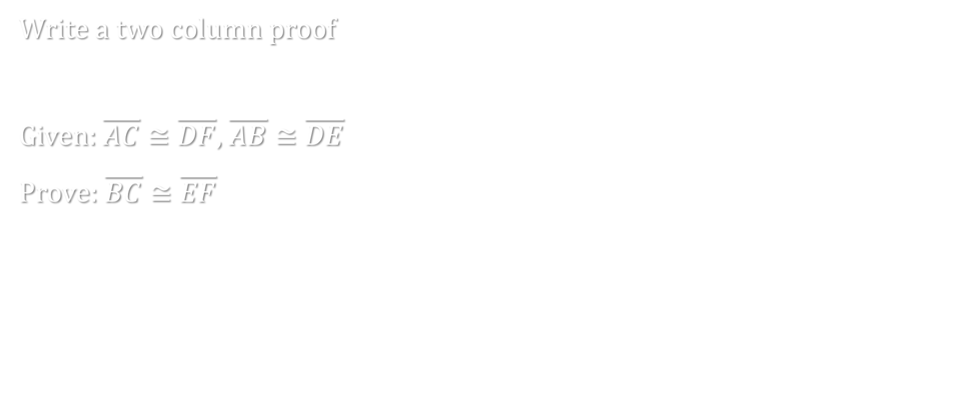
2.5 Proving Statements about
Segments and Angles
Write a two column proof
Given: $\overline{AC}≅\overline{DF}$, $\overline{AB}≅\overline{DE}$
Prove: $\overline{BC}≅\overline{EF}$
A B C
D E F
Notes:
AC ≅ DF, AB ≅ DE (given)
AC = DF, AB = DE (def ≅ segments)
AC – AB = DF – DE (subtraction =)
AC = AB + BC, DF = DE + EF (segment addition post)
AC – AB = BC, DF – DE = EF (subtraction =)
DF – DE = BC (substitution =)
BC = EF (substitution =)
BC ≅ EF (def ≅ segments)

Slide 47
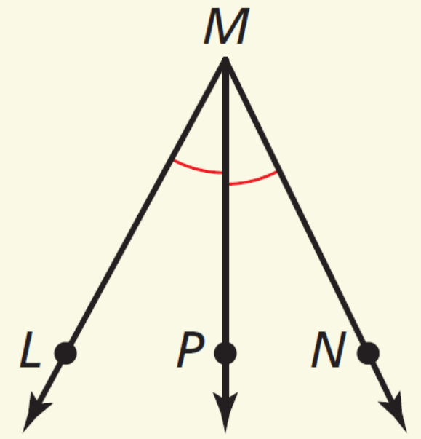
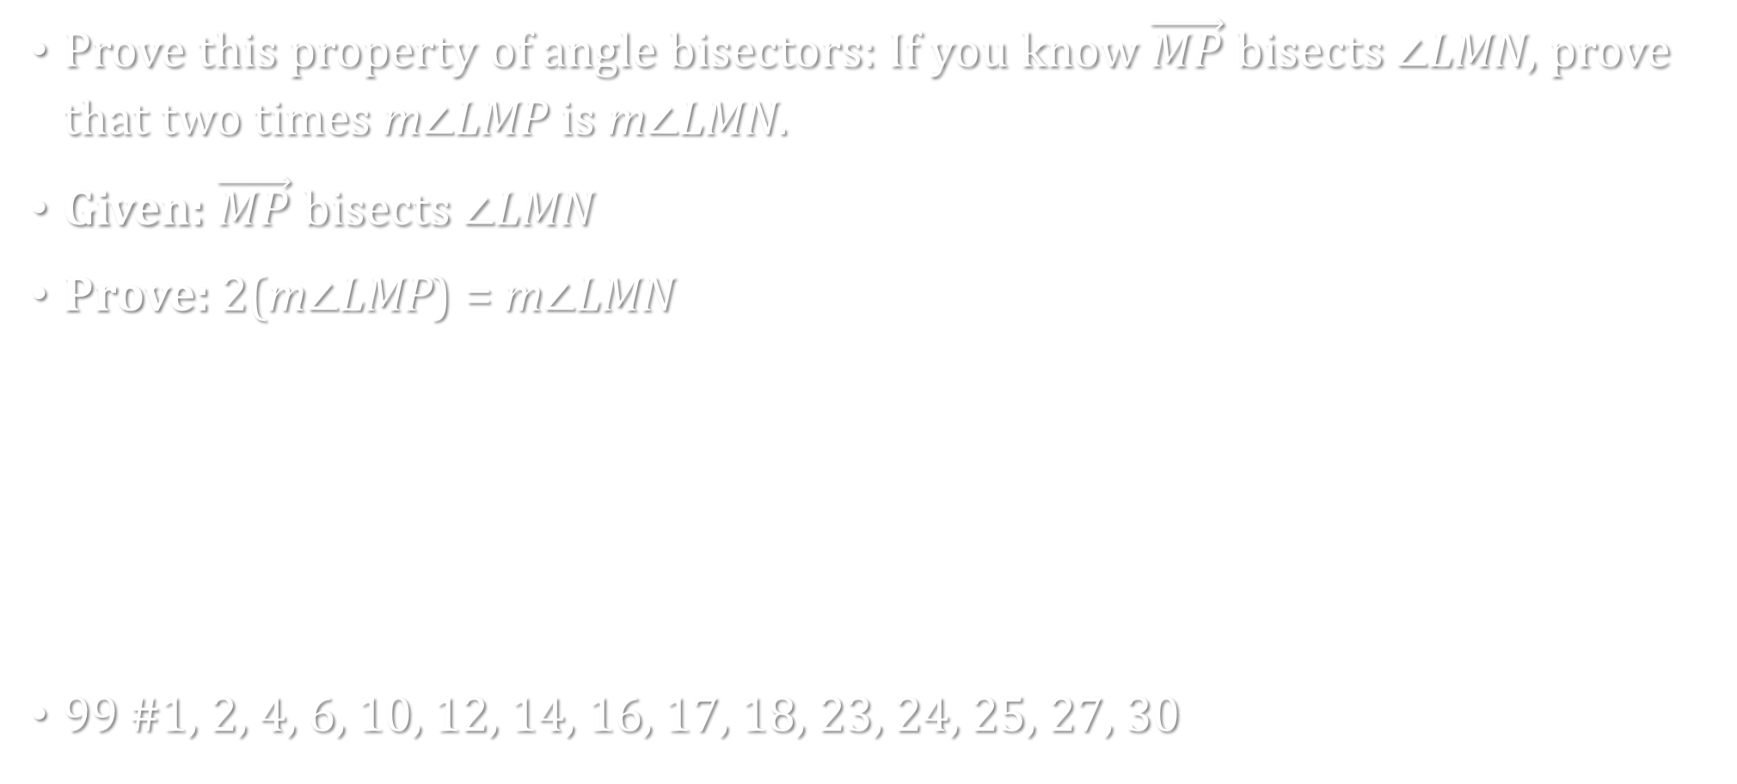
2.5 Proving Statements about
Segments and Angles
Prove this property of angle bisectors: If you know $\vec{MP}$ bisects ∠LMN, prove that two times m∠LMP is m∠LMN.
Given: $\vec{MP}$ bisects ∠LMN
Prove: 2(m∠LMP) = m∠LMN
99 #1, 2, 4, 6, 10, 12, 14, 16, 17, 18, 23, 24, 25, 27, 30
Notes:
STATEMENTS REASONS
1. $\vec{MP}$ bisects ∠LMN. 1. Given
2. ∠LMP ≅ ∠NMP 2. Definition of angle bisector
3. m∠LMP = m∠NMP 3. Definition of congruent angles
4. m∠LMP + m∠NMP = m∠LMN 4. Angle Addition Postulate
5. m∠LMP + m∠LMP = m∠LMN 5. Substitution Property of Equality
6. 2(m∠LMP) = m∠LMN 6. Distributive Property

Slide 48
2.6 Proving Geometric Relationships
Objectives: By the end of the lesson,
• I can prove geometric relationships by writing fl owchart proofs.
• I can prove geometric relationships by writing paragraph proofs.

Slide 49
2.6 Proving Geometric Relationships
All right angles are congruent
Congruent Supplements Theorem
If two angles are supplementary to the same angle (or to congruent angles), then they are congruent
Congruent Complements Theorem
If two angles are complementary to the same angle (or to congruent angles), then they are congruent

Slide 50
2.6 Proving Geometric Relationships
Linear Pair Postulate
If two angles form a linear pair, then they are supplementary
Vertical Angles Congruence Theorem
Vertical angles are congruent

Slide 51
2.6 Proving Geometric Relationships
Find x and y
3x − 2
y
2x + 4
Notes:
3x – 2 = 2x + 4 → x = 6
y = 180 – (3x – 2) = 180 – (3(6) − 2) = 180 – (18 − 2) = 180 – 16 = 164

Slide 52
2.6 Proving Geometric Relationships
Given: ℓ ⊥ m, ℓ ⊥ n
Prove: ∠1 ≅ ∠2
ℓ
1
m
n
2
Statements
Reasons
Notes:
ℓ ⊥ m, ℓ ⊥ n (given)
∠1 and ∠2 are right angles (def of ⊥ lines)
∠1 ≅ ∠2 (All rt ∠’s are ≅)

Slide 53
2.6 Proving Geometric Relationships
Write a paragraph proof.
Given:
  ∠1 and ∠3 are complements
  ∠3 and ∠5 are complements
Prove: ∠1 ≅ ∠5
8
1
7
2
6
3
5
4
Notes:
We are given ∠1 and ∠3 are complements and ∠3 and ∠5 are complement. By the congruent complements theorem ∠1 ≅ ∠5.

Slide 54
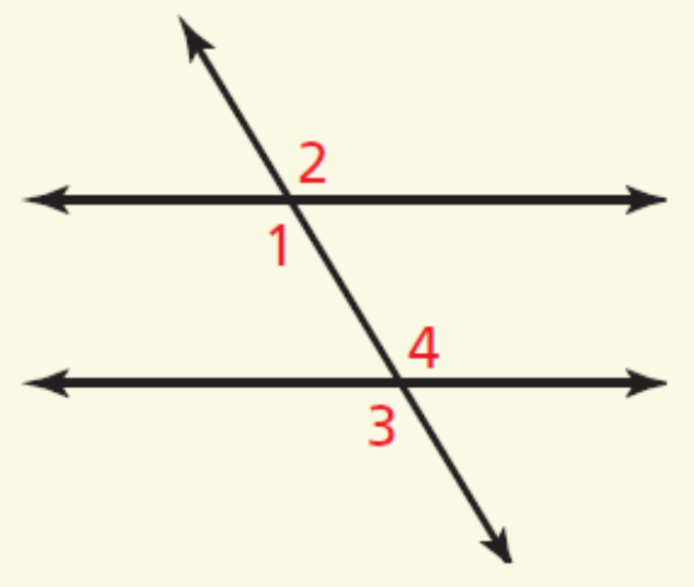
2.6 Proving Geometric Relationships
Write a flow proof.
Given ∠1 ≅ ∠4
Prove ∠2 ≅ ∠3
∠1 ≅ ∠4
∠2 ≅ ∠4
Given
Transitive
∠2 ≅ ∠1
Vert. ∠‘s ≅
∠2 ≅ ∠3
Transitive
∠4 ≅ ∠3
Vert. ∠‘s ≅
107 #2, 4, 6, 8, 10, 12, 13, 15, 17, 18, 19, 24, 26, 29, 31

