Slide 1
Properties of Transformations
Geometry
Chapter 4
Notes:
Geometry 4

Slide 2
This Slideshow was developed to accompany the textbook
  Big Ideas Geometry
  By Larson and Boswell
  2022 K12 (National Geographic/Cengage)
Some examples and diagrams are taken from the textbook.
Slides created by
Richard Wright, Andrews Academy
rwright@andrews.edu

Slide 3
4.1 Translations
After this lesson…
• I can translate figures.
• I can write a translation rule for a given translation.
• I can explain what a rigid motion is.
• I can perform a composition of translations on a figure.

Slide 4

4.1 Translations

Slide 5
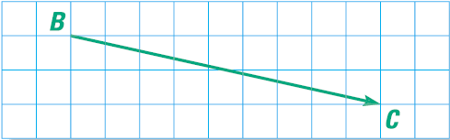

4.1 Translations
Vector ($\overset{⃑}{BC}$)
  Measurement with Direction and Magnitude (size)
  Represented by an arrow
  Component form $〈$hori, vert$〉$
    $\overset{⃑}{BC}=〈9,−2〉$
Horizontal Component
Vertical Component
Initial Point
Terminal Point
Notes:
Can be used to describe translations

Slide 6
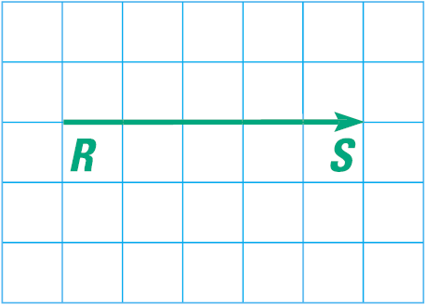
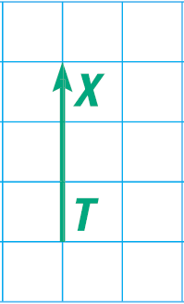
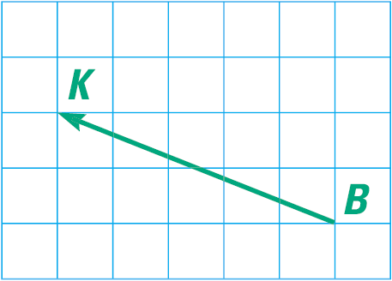
4.1 Translations
Name the vector and write its component form
Notes:
$$\overset{⃑}{RS}=〈5,0〉$$
$$\overset{⃑}{TX}=〈0,3〉$$
$$\overset{⃑}{BK}=〈−5,2〉$$

Slide 7

4.1 Translations
Transformation
  Moves or changes a figure
  Original called preimage (i.e. ΔABC)
  New called image (i.e. ΔA′B′C′)
Translation
  Moves every point the same distance in the same direction
  $\left(x,y\right)→(x+a,y+b)$
    where the $⟨a,b⟩$ is the translation vector

Slide 8

4.1 Translations
The vertices of ΔLMN are L(2, 2), M(5, 3), N(9, 1). Translate ΔLMN using vector $〈−2, 6〉$.
Notes:
Translation is (x, y)→(x-2, y+6)
L’(0, 8), M’(3, 9), N’(7, 7)

Slide 9
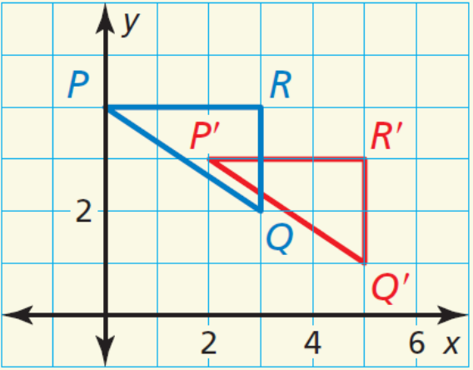
4.1 Translations
Write a rule for the translation of ΔPQR to ΔP′Q′R′.
Notes:
(x, y) → (x + 2, y − 1)

Slide 10
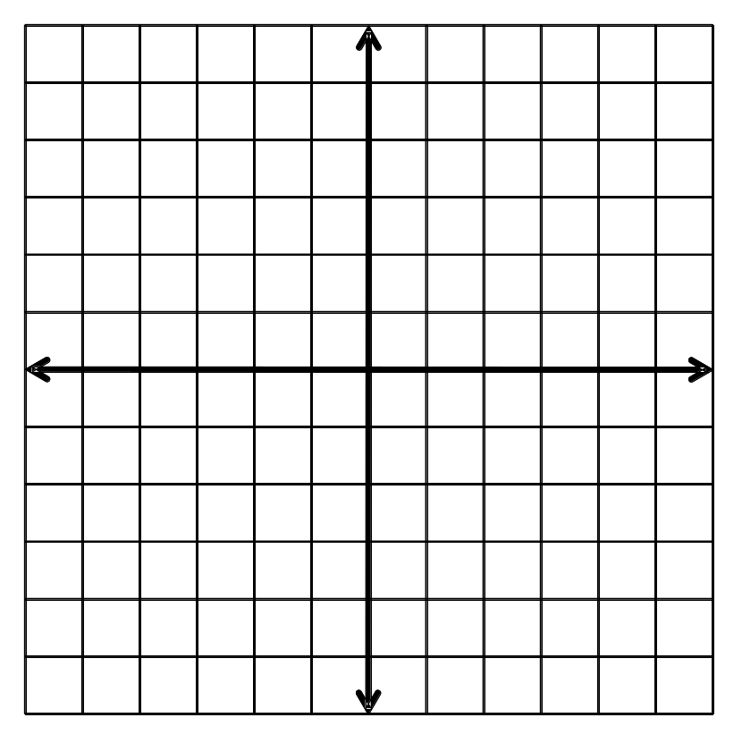
4.1 Translations
Draw ΔRST with vertices R(2, 2), S(5, 2), and T(3, -2). Find the image of each vertex after the translation (x, y) → (x + 1, y + 2). Graph the image using prime notation.
Notes:
R’(3, 4), S’(6, 4), T’(4, 0)

Slide 11
4.1 Translations
Rigid Motion
  Transformation that preserves length and angle measure.
  A congruence transformation
Translation Theorem
A translation is a rigid motion.

Slide 12
4.1 Translations
Composition of Transformations
  Two or more transformations combined into a single transformation
Composition Theorem
The composition of two (or more) rigid motions is a rigid motion.

Slide 13

4.1 Translations
Graph $\overline{RS}$ with endpoints R(−8, 5) and S(−6, 8). Graph its image after the composition.
Translation: (x, y) → (x − 1, y + 4)
Translation: (x, y) → (x + 4, y − 6)
172 #2, 4, 6, 8, 10, 12, 14, 16, 18, 20, 22, 24, 26, 28, 32, 42, 43, 44, 48, 52
Notes:
Translation 1: (x, y) → (x − 1, y + 4)
R(−8, 5) → R′(−8 − 1, 5 + 4)= R′(−9, 9)
S(−6, 8) → S′(−6 − 1, 8 + 4) = S′(−7, 12)
Translation 2: (x, y) → (x + 4, y − 6)
R′(−9, 9) → R′(−9 + 4, 9 − 6) = R′(−5, 3)
S′(−7, 12) → S′(−7 + 4, 12 − 6) = S′(−3, 6)

Slide 14
4.2 Reflections
After this lesson…
• I can reflect figures.
• I can perform compositions with reflections.
• I can identify line symmetry in polygons.

Slide 15
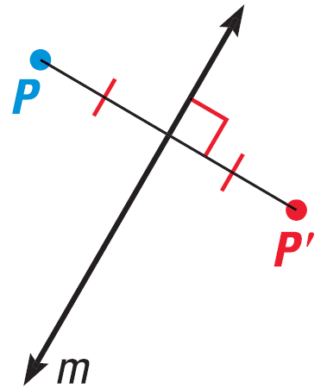
4.2 Reflections
Reflection
  Transformation that uses a line like a mirror to reflect an image.
  That line is called Line of Reflection
  P and P′ are the same distance from the line of reflection
  The line connecting P and P′ is perpendicular to the line of reflection

Slide 16
4.2 Reflections
Graph a reflection of ΔABC where A(1, 3), B(5, 2), and C(2, 1) in the line x = 2.
Notes:
New points are A(3, 3), B(-1, 2), C(2, 1)

Slide 17
4.2 Reflections
Coordinate Rules for Reflections
  Reflected in x-axis: (a, b) → (a, −b)
  Reflected in y-axis: (a, b) → (−a, b)
  Reflected in y = x: (a, b) → (b, a)
  Reflected in y = −x: (a, b) → (−b, −a)
Reflection Theorem
A reflection is an rigid motion.

Slide 18
4.2 Reflections
Graph ΔABC with vertices A(1, 3), B(4, 4), and C(3, 1). Reflect ΔABC in the lines y = −x and y = x.
Notes:
y = -x: new points A(-3, -1), B(-4, -4), C(-1, -3)
y = x: new points A(3, 1), B(4, 4), C(1, 3)

Slide 19
4.2 Reflections
The vertices of ΔLMN are L(−3, 3), M(1, 2), and N(−2, 1). Find the reflection of ΔLMN in the y-axis.
Notes:
(a, b) → (−a, b)
L(−3, 3) → L′(3, 3)
M(1, 2) → M′(−1, 2)
N(−2, 1) → N′(2, 1)

Slide 20
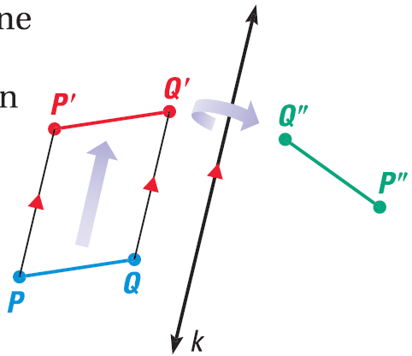
4.2 Reflections
Composition of Transformations
  Two or more transformations combined into a single transformation
Glide Reflection
  Translation followed
  by reflection over a line parallel
  to the translation

Slide 21
4.2 Reflections
The vertices of ΔABC are A(3, 2), B(−1, 3), and C(1, 1). Find the image of ΔABC after the glide reflection.
Translation: (x, y) → (x, y − 4)
Reflection: Over y-axis
Notes:
New points after translation: A’(3, -2), B’(-1, -1), C’(1, -3)
New points after reflection: A’’(-3, -2), B’’(1, -1), C’’(-1, -3)

Slide 22
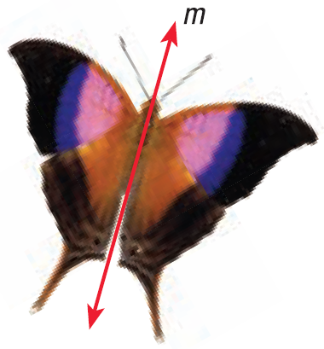
4.2 Reflections
Line symmetry
  The figure can be mapped to itself by a reflection
  The line of reflection is called Line of Symmetry
Humans tend to think that symmetry is
beautiful

Slide 23


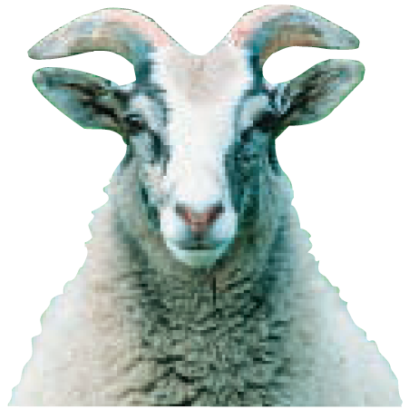
4.2 Reflections
How many lines of symmetry does the object appear to have?
180 #2, 4, 6, 8, 10, 12, 14, 16, 18, 20, 22, 24, 26, 28, 30, 45, 49, 51, 54, 55
Notes:
Flower: 4 lines of symmetry
Sea Star: 5 lines of symmetry
Goat: 1 line of symmetry

Slide 24
4.3 Rotations
After this lesson…
• I can rotate figures.
• I can perform compositions with rotations.
• I can identify rotational symmetry in polygons.

Slide 25
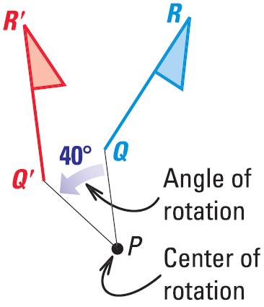
4.3 Rotations
Rotation
  Figure is turned about a point called center of rotation
  The amount of turning is angle of rotation
Rotation Theorem
A rotation is a rigid motion.

Slide 26
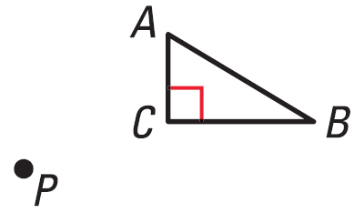
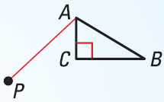
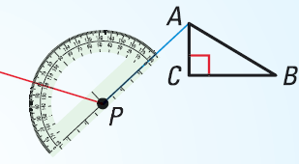

4.3 Rotations
Draw a 120° rotation of ΔABC about P.
Draw a segment from A to P.
Draw a ray to form a 120° angle with $\overline{PA}$

Slide 27
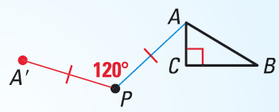
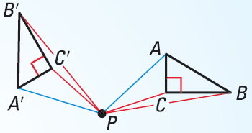
4.3 Rotations
Draw A′ so that PA′ = PA
Repeat steps 1-3 for each vertex. Draw ΔA′B′C′.

Slide 28
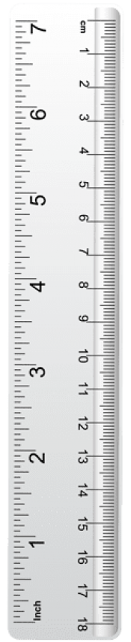
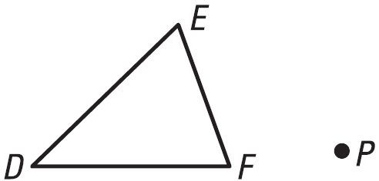
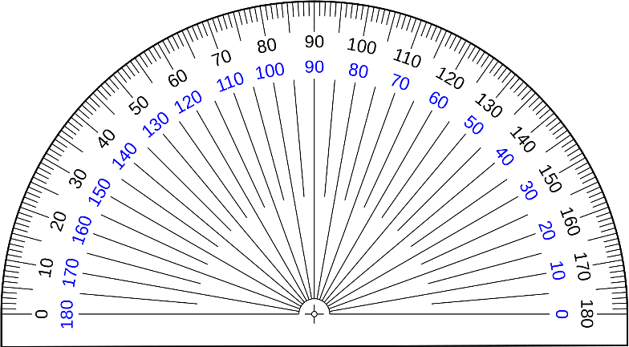
4.3 Rotations
Draw a 50° counterclockwise rotation of ΔDEF about P.
D′

Slide 29
4.3 Rotations
Draw a 50° counterclockwise rotation of ΔDEF about P.
E′
D′

Slide 30
4.3 Rotations
Draw a 50° counterclockwise rotation of ΔDEF about P.
E′
F′
D′

Slide 31
4.3 Rotations
Draw a 50° counterclockwise rotation of ΔDEF about P.
E′
F′
D′

Slide 32
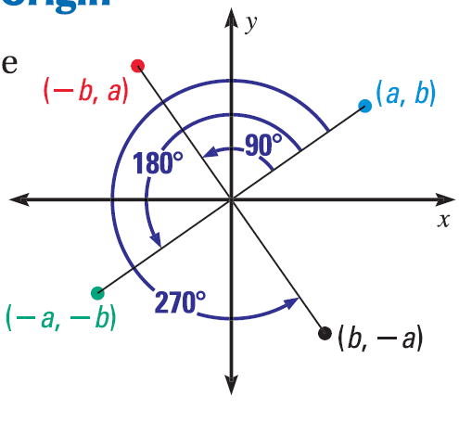
4.3 Rotations
Coordinate Rules for Counterclockwise Rotations about the Origin
90°: (a, b) → (−b, a)
180°: (a, b) → (−a, −b)
270°: (a, b) → (b, −a)

Slide 33
4.3 Rotations
If E(−3, 2), F(−3, 4), G(1, 4), and H(2, 2). Find the image for a 270° rotation about the origin.
Notes:
(a, b) → (b, −a)
E(−3, 2) → E′(2, 3)
F(−3, 4) → F′(4, 3)
G(1, 4) → G′(4, −1)
H(2, 2) → H′(2, −2)

Slide 34

4.3 Rotations
Graph $\overline{RS}$ with endpoints R(1, −3) and S(2, −6) and its image after the composition.
Rotation: 180° about the origin
Reflection: in the y-axis
Notes:
Rotation: (a, b) → (-a, -b)
R(1, −3) → R′(−1, 3)
S(2, −6) → S′(−2, 6)
Reflection: (a, b) → (-a, b)
R′(−1, 3) → R″(1, 3)
S′(−2, 6) → S″(2, 6)

Slide 35
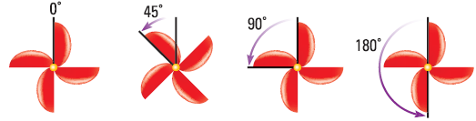
4.3 Rotations
Rotational Symmetry
  The figure can be mapped to itself by a rotation of 180° or less about the center of the figure
  The center of rotation is called the Center of Symmetry
Notes:
Note: the 45° is not a symmetry

Slide 36

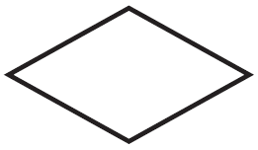
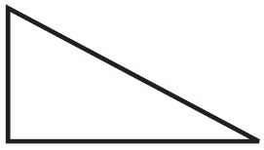
4.3 Rotations
Does the figure have rotational symmetry? What angles?
188 #2, 4, 6, 8, 10, 12, 14, 16, 18, 20, 22, 24, 26, 28, 30, 40, 42, 43, 46, 47
Notes:
Rhombus: 180°
Octagon: 90°, 180°
Triangle: none

Slide 37
4.4 Congruence and Transformations
After this lesson…
• I can identify congruent figures.
• I can describe congruence transformations.
• I can use congruence transformations to solve problems.

Slide 38
4.4 Congruence and Transformations
Congruent ≅
Exactly the same shape and size.
Congruent
Not Congruent

Slide 39
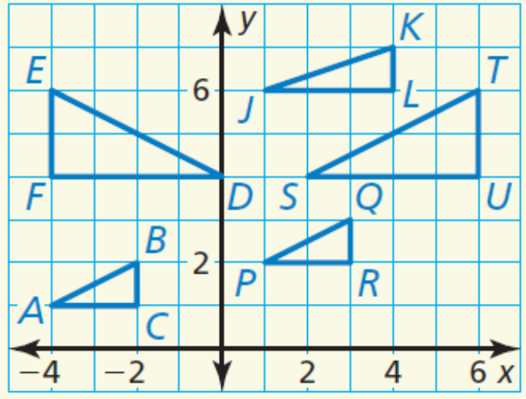
4.4 Congruence and Transformations
Identify any congruent figures in the coordinate plane. Explain.
Notes:
△ABC ≅ △PQR, △DEF ≅ △STU; △PQR is a translation 5 units right and 1 unit up of △ABC. △STU is a reflection of △DEF in the line x = 1.

Slide 40
4.4 Congruence and Transformations
Congruence Transformation
  Transformation with rigid motion
  Preimage ≅ image

Slide 41
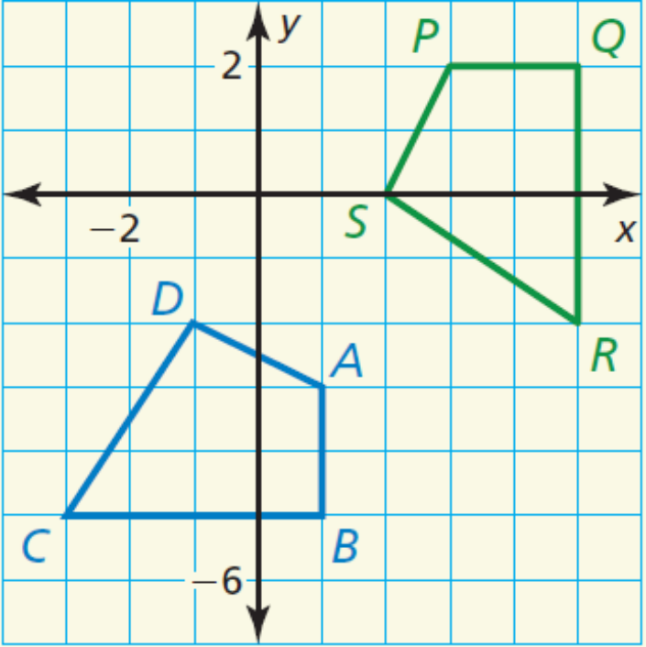
4.4 Congruence and Transformations
Describe a congruence transformation that maps quadrilateral ABCD to quadrilateral PQRS.
Notes:
90° rotation about the origin, followed by a translation 1 unit up

Slide 42
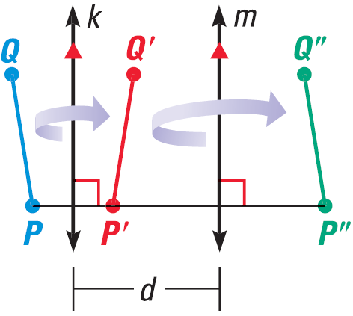
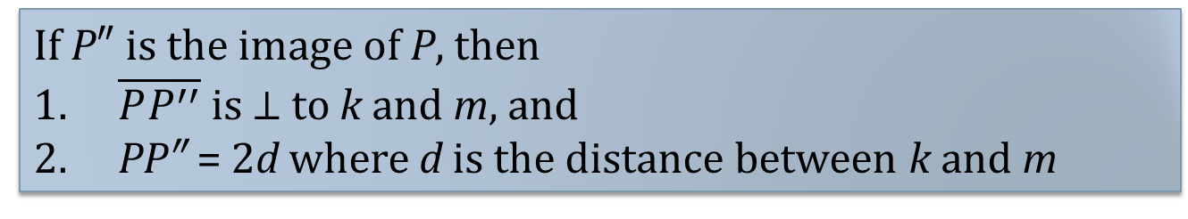
4.4 Congruence and Transformations
Reflections in Parallel Lines Theorem
If lines k and m are parallel, then a reflection in line k followed by a reflection in line m is the same as a translation.
If P″ is the image of P, then
$\overline{PP^{′′}}$ is $⊥$ to k and m, and
PP″ = 2d where d is the distance between k and m

Slide 43
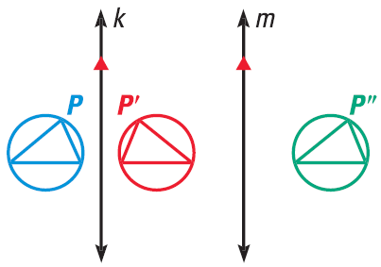
4.4 Congruence and Transformations
Use the figure below. The distance between line k and m is 1.6 cm.
The preimage is reflected in line k, then in line m. Describe a single transformation that maps the blue figure to the green.
What is the distance from P and P″?
Notes:
Translation in the x direction
2(1.6 cm) = 3.2 cm (Reflections in Parallel Lines Thrm)

Slide 44
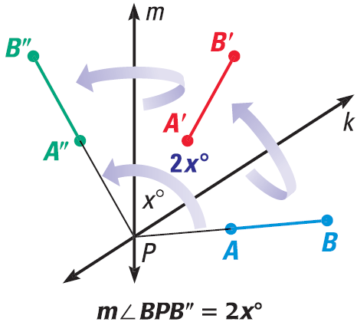
4.4 Congruence and Transformations
Reflections in Intersecting Lines Theorem
If lines k and m intersect at point P, then a reflection in line k followed by a reflection in line m is the same as a rotation about point P.
The angle of rotation is 2x°, where x° is the measure of the acute or right angle formed k and m.

Slide 45
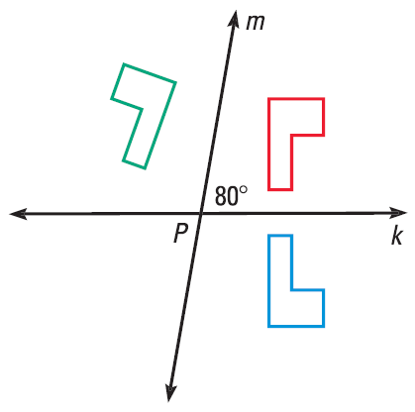
4.4 Congruence and Transformations
In the diagram, the preimage is reflected in line k, then in line m. Describe a single transformation that maps the blue figure to the green.
196 #2, 4, 6, 8, 10, 12, 14, 15, 16, 18, 20,
24, 26, 28, 35, 36, 42, 46, 49, 50
Notes:
Counterclockwise rotation of 160° about point P

Slide 46
4.5 Dilations
After this lesson…
• I can identify dilations.
• I can dilate figures.
• I can solve real-life problems involving scale factors and dilations.

Slide 47
4.5 Dilations
Dilation
  Enlarge or reduce
  Image is similar to preimage
  Scale factor is k
    If 0 < k < 1, then reduction
    If k > 1, then enlargement

Slide 48
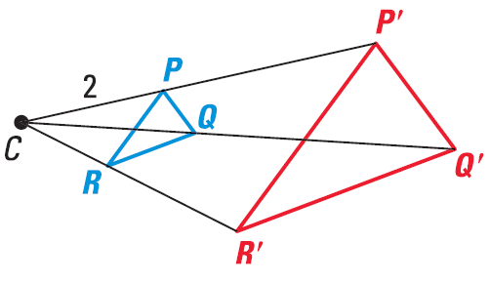

4.5 Dilations
The image point P′ lies on $\vec{CP}$. The scale factor k is a positive number such that $k=\frac{CP^{′}}{CP}$ and $k≠1$
Scale factor is $\frac{\text{image}}{\text{preimage}}$
Notes:
Scale

Slide 49
4.5 Dilations
Coordinate Rule for Dilations
  (x, y) → (kx, ky)
  Where k is the scale factor

Slide 50
4.5 Dilations
Graph △PQR with vertices P(4, 6), Q(−4, 2), and R(2, −6) and its image after a dilation with a scale factor of 0.5.
Notes:
(x, y) → (kx, ky)
P(4, 6) → P′(0.5·4, 0.5·6) = P′(2, 3)
Q(−4, 2) → Q′(0.5·−4, 0.5·2) = Q′(−2, 1)
R(2, −6) → R′(0.5·2, 0.5·−6) = R′(1, −3)

Slide 51

4.5 Dilations
Draw and label ΔRST, then construct a dilation of ΔRST with R as the center of dilation and a scale factor of 3.
Draw ΔRST, then draw rays $\vec{RS}$ and $\vec{RT}$
Using a ruler, measure RS. Multiply by the scale factor. Using the ruler mark this length RS′ on $\vec{RS}$. Repeat for the other rays.
Draw ΔR′S′T′

Slide 52
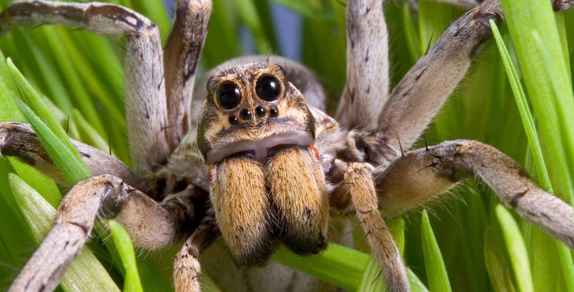
4.5 Dilations
You are using a magnifying glass that shows the image of an object as three times the object’s actual size. Determine the actual length of a spider when the image of the spider seen through the magnifying glass is 6.75 centimeters long.
204 #2, 4, 6, 8, 10, 14, 16, 18, 20, 22, 24, 26,
28, 34, 38, 50, 52, 55, 56, 59
Notes:
$$k=3=\frac{image}{preimage}$$
$$3=\frac{6.75}{preimage}$$
$$3·preimage=6.75$$
$$preimage=2.25 cm$$

Slide 53
4.6 Similarity and Transformations
After this lesson…
• I can perform similarity transformations.
• I can describe similarity transformations.
• I can prove that figures are similar.

Slide 54
4.6 Similarity and Transformations
Similar figures
  Same shape; different sizes
Similarity Transformation
  Dilation or
  Composition of dilation and another transformation

Slide 55

4.6 Similarity and Transformations
Graph △ABC with vertices A(12, −6), B(0, −3), and C(3, −9) and its image after the similarity transformation.
Reflection: in the y-axis
Dilation: $\left(x, y\right)→\left(\frac{1}{3}x,\frac{1}{3}y\right)$
Notes:
Reflection: (x, y) → (−x, y)
A(12, −6) → A′(−12, −6)
B(0, −3) →B′(0, −3)
C(3, −9) → C′(−3, −9)
Dilation: $\left(x, y\right)→\left(\frac{1}{3}x,\frac{1}{3}y\right)$
$$A^{′}\left(−12, −6\right)→A^{″}\left(\frac{1}{3}\left(−12\right),\frac{1}{3}\left(−6\right)\right)=A^{″}\left(−4, −2\right)$$
$$B^{′}\left(0, −3\right)→B^{″}\left(\frac{1}{3}\left(0\right),\frac{1}{3}\left(−3\right)\right)=B^{″}\left(0, −1\right)$$
$$C^{′}\left(−3, −9\right)→C^{″}\left(\frac{1}{3}\left(−3\right),\frac{1}{3}\left(−9\right)\right)=C^{″}\left(−1, −3\right)$$

Slide 56
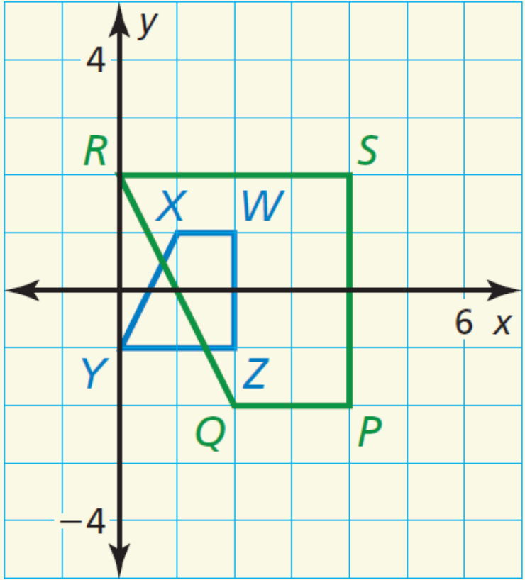
4.6 Similarity and Transformations
Describe a similarity transformation that maps trapezoid WXYZ to trapezoid PQRS.
211 #2, 4, 6, 8, 10, 12, 13, 14, 16, 17, 19, 21, 22, 23, 24, 28
Skip 12, do 13 instead
Notes:
Sample answer: reflection in the x-axis, followed by a dilation with a scale factor of 2

