Slide 1
Circles
Geometry
Chapter 10

Slide 2
This Slideshow was developed to accompany the textbook
  Big Ideas Geometry
  By Larson and Boswell
  2022 K12 (National Geographic/Cengage)
Some examples and diagrams are taken from the textbook.
Slides created by
Richard Wright, Andrews Academy
rwright@andrews.edu

Slide 3
10.1 Lines and Segments that Intersect Circles
After this lesson…
• I can identify special segments and lines that intersect circles.
• I can use properties of tangents to solve problems.

Slide 4
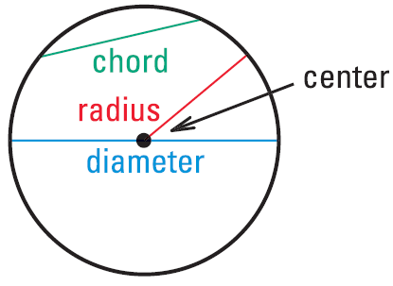
10.1 Lines and Segments that Intersect Circles
Circle
  All the points a given distance from a central point in a plane
  Named by the center
Radius (r) – the distance from the center of the circle to the edge.
Chord – line segment that connects two points on a circle.

Slide 5
10.1 Lines and Segments that Intersect Circles
Diameter (d) – chord that goes through the center of the circle (longest chord = 2 radii)
  d = 2r
What is the radius of a circle if the diameter is 16 feet?
Notes:
$$d=2r$$
$$16=2r$$
$$8=r$$

Slide 6
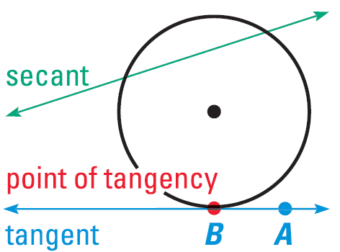
10.1 Lines and Segments that Intersect Circles
Secant
  Line that intersects a circle twice
Tangent
  Line that intersects a circle once

Slide 7
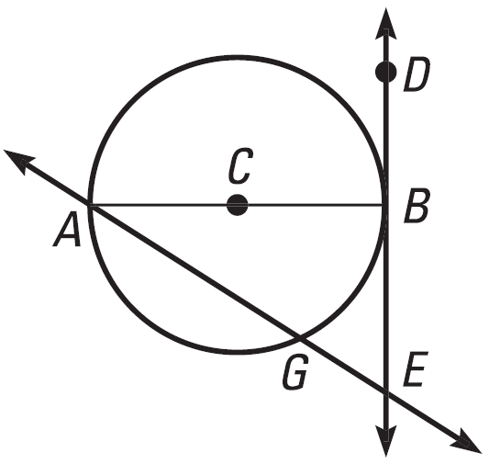
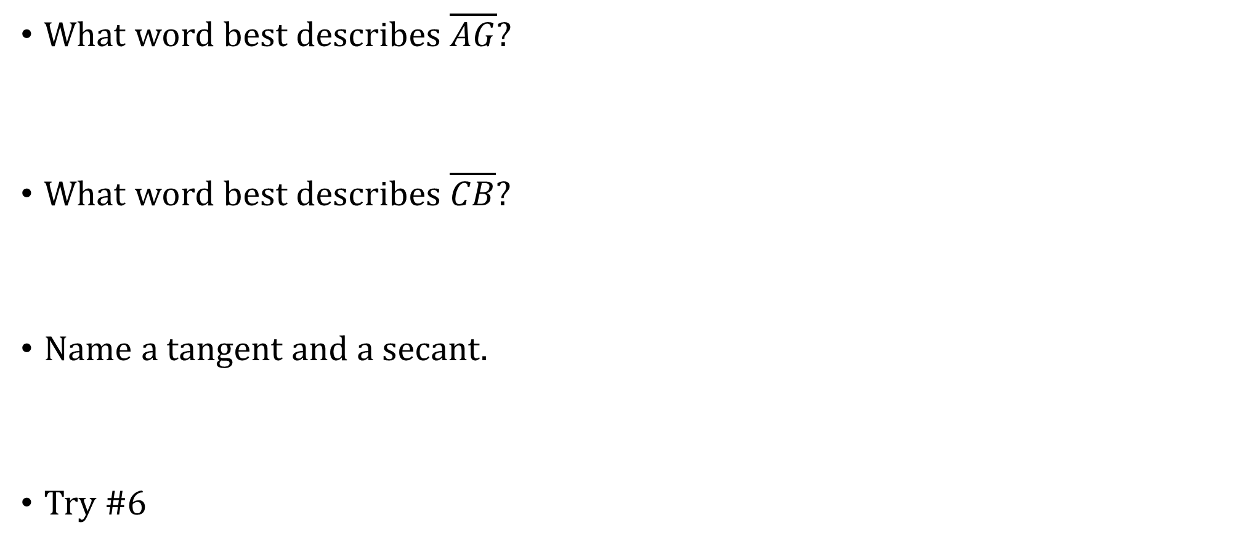
10.1 Lines and Segments that Intersect Circles
What word best describes $\overline{AG}$?
What word best describes $\overline{CB}$?
Name a tangent and a secant.
Try #6
Notes:
Chord
Radius
Tangent: $\overset{⃡}{DE}$
Secant: $\overset{⃡}{AG}$

Slide 8
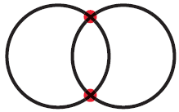
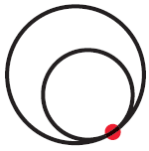

10.1 Lines and Segments that Intersect Circles
Two circles can intersect in 2 points
1 point
No points

Slide 9
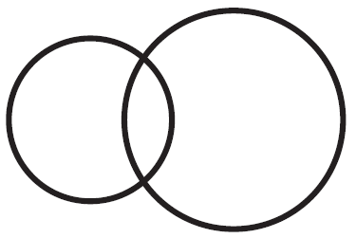
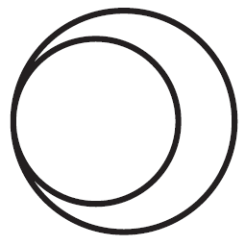

10.1 Lines and Segments that Intersect Circles
Common tangents
  Lines tangent to 2 circles
How many common tangents do the circles have?
Try #8
Notes:
2
1
none

Slide 10
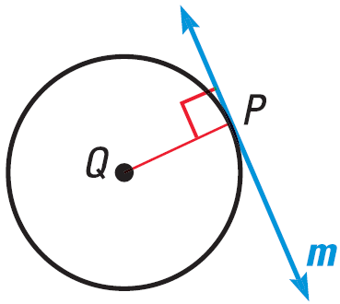
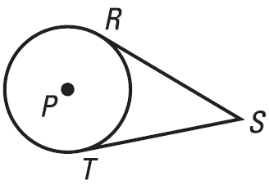
10.1 Lines and Segments that Intersect Circles
Tangent lines are perpendicular to radius.
Tangent segments from the same point are congruent.

Slide 11
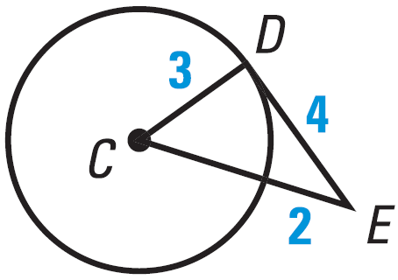
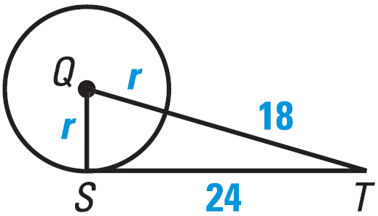
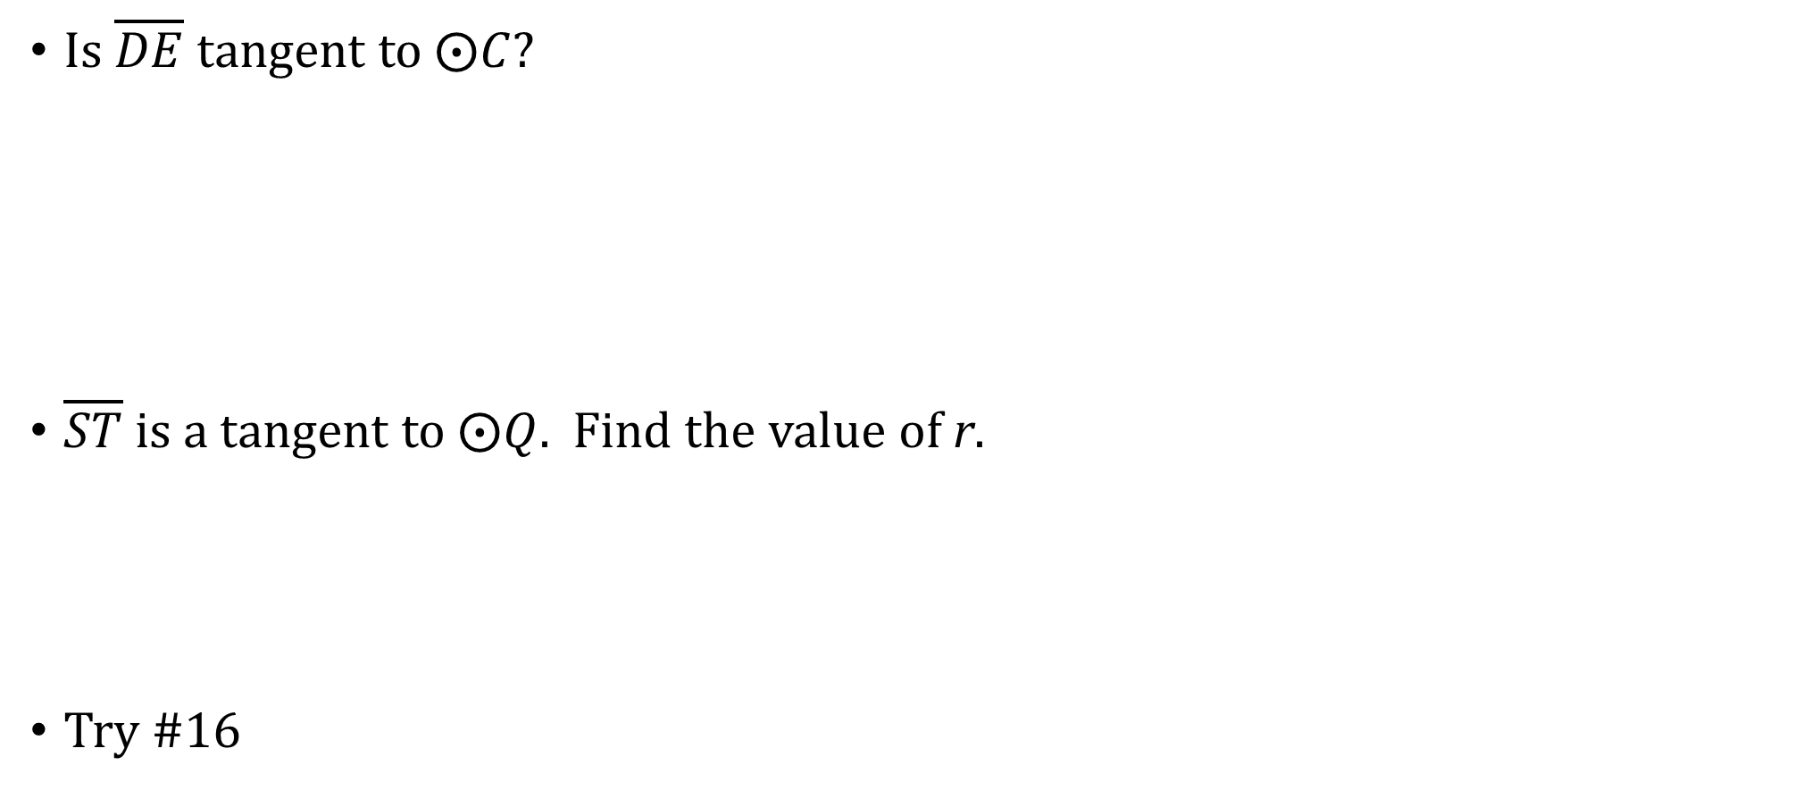
10.1 Lines and Segments that Intersect Circles
Is $\overline{DE}$ tangent to $⨀C$?
$\overline{ST}$ is a tangent to $⨀Q$. Find the value of r.
Try #16
Notes:
CE = 5
$$3^{2}+4^{2}=5^{2}$$
$$9+16=25$$
$$25=25$$
It makes a right angle, so CD ⊥ DE. Thus, DE is tangent
$$r^{2}+{24}^{2}={\left(r+18\right)}^{2}$$
$$r^{2}+576=r^{2}+36r+324$$
$$576=36r+324$$
$$252=36r$$
$$7=r$$

Slide 12
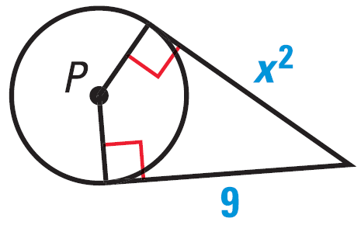
10.1 Lines and Segments that Intersect Circles
Find the value of x.
Try #24
Notes:
$$x^{2}=9$$
$$x=±3$$

Slide 13
10.2 Finding Arc Measures
After this lesson…
• I can find arc measures.
• I can identify congruent arcs.

Slide 14
10.2 Finding Arc Measures
How do you cut a pizza into eight equal pieces?
  You cut in half, half, and half
What measures are the angles in each piece?
  360 / 8 = 45°

Slide 15
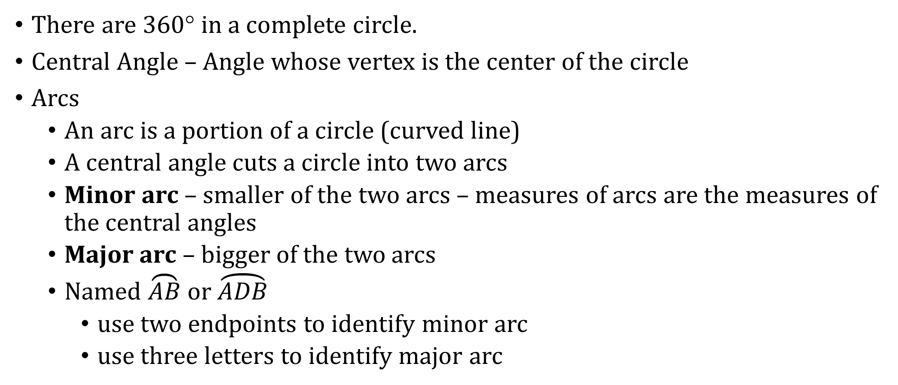
10.2 Finding Arc Measures
There are 360° in a complete circle.
Central Angle – Angle whose vertex is the center of the circle
Arcs
  An arc is a portion of a circle (curved line)
  A central angle cuts a circle into two arcs
  Minor arc – smaller of the two arcs – measures of arcs are the measures of the central angles
  Major arc – bigger of the two arcs
  Named $\overset{⏜}{AB}$ or $\overset{⏜}{ADB}$
    use two endpoints to identify minor arc
    use three letters to identify major arc

Slide 16
10.2 Finding Arc Measures
Name the minor arc and find its measure. Then name the major arc and find its measure.
Try #2
Notes:
Minor: $\overset{⏜}{AB}$, 135°
Major: $\overset{⏜}{ADB}$, 225°

Slide 17
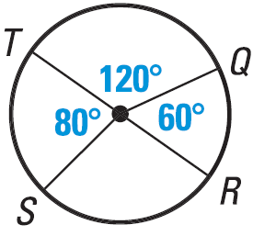

10.2 Finding Arc Measures
Identify as major arc, minor arc, or semicircle. Find the measure.
$\overset{⏜}{TQ}$
$\overset{⏜}{TQR}$
$\overset{⏜}{QRT}$
Try #8
Notes:
$\overset{⏜}{TQ}$ minor arc; 120°
$\overset{⏜}{TQR}$ semicircle; 180°
$\overset{⏜}{QRT}$ major arc; $m\overset{⏜}{RS}=360°−80°−120°−60°=100°$
$$m\overset{⏜}{QRT}=60°+100°+80°=240°$$

Slide 18
10.2 Finding Arc Measures
Semicircle – arc if the central angle is 180°
Similar Circles – all circles are similar
Congruent circles – same radius
Congruent arcs – same radius and measure

Slide 19
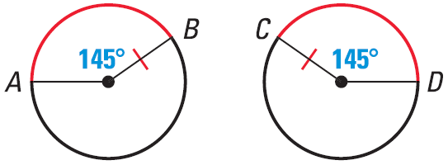
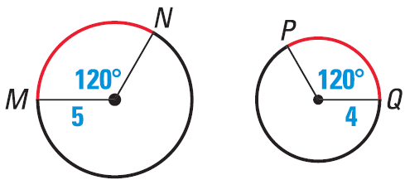
10.2 Finding Arc Measures
Tell whether the red arcs are congruent.
Try #16
Notes:
Yes; same radius and angle
No; different radius

Slide 20
10.3 Using Chords
After this lesson…
• I can use chords of circles to find arc measures.
• I can use chords of circles to find lengths.
• I can describe the relationship between a diameter and a chord perpendicular to a diameter.

Slide 21
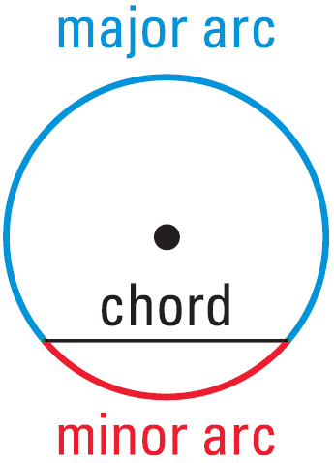
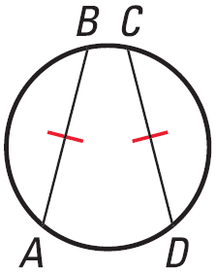

10.3 Using Chords
Chords divide a circle into a major and minor arc.
In the same circle, or $≅$ circles, two minor arcs are $≅$ iff their chords are $≅$.

Slide 22

10.3 Using Chords
Find $m\overset{⏜}{FG}$.
Notes:
120° (Congruent chords of congruent circles)

Slide 23
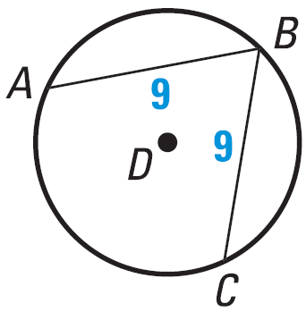

10.3 Using Chords
If $m\overset{⏜}{AB}=110°$, find $m\overset{⏜}{BC}$.
Try #2
Notes:
110°

Slide 24
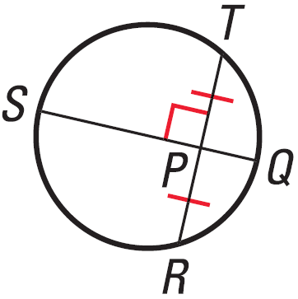
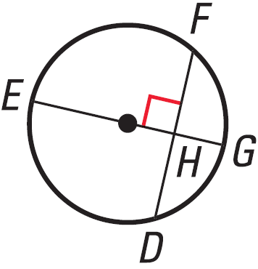
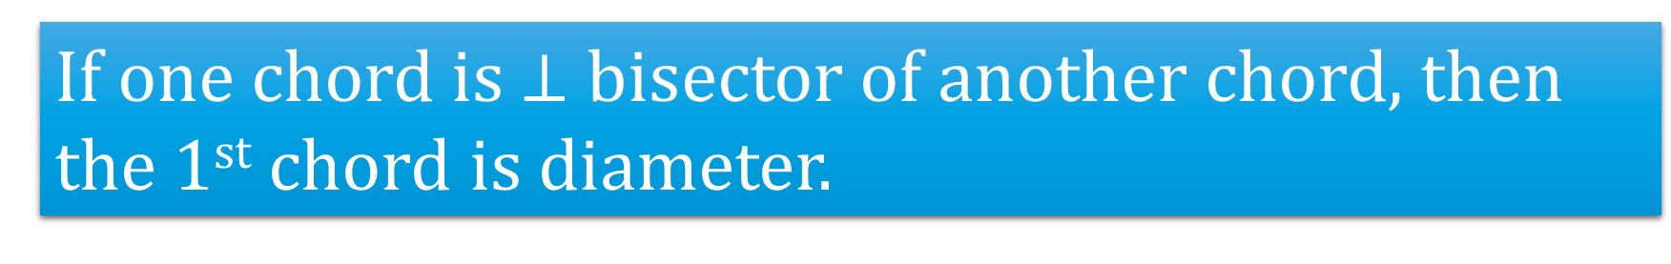
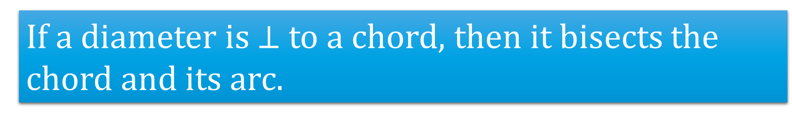
10.3 Using Chords
If one chord is $⊥$ bisector of another chord, then the 1st chord is diameter.
If a diameter is $⊥$ to a chord, then it bisects the chord and its arc.

Slide 25
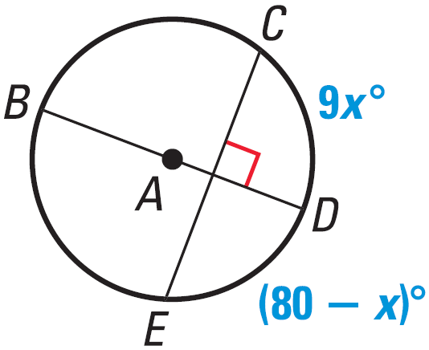

10.3 Using Chords
Find the measure of the indicated arc.
$\overset{⏜}{CD}$
$\overset{⏜}{CE}$
Try #6
Notes:
$$9x=80−x$$
$$10x=80$$
$$x=8$$
$$m\overset{⏜}{CD}=9\left(8\right)=72°$$
$$m\overset{⏜}{CE}=2\left(72°\right)=144°$$

Slide 26
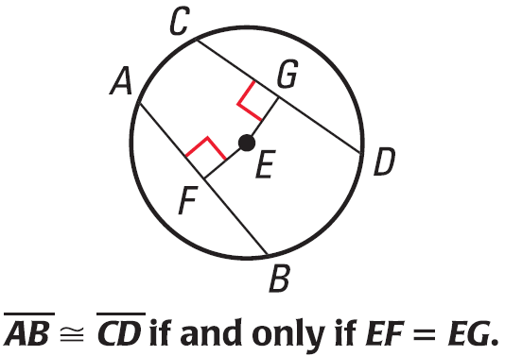
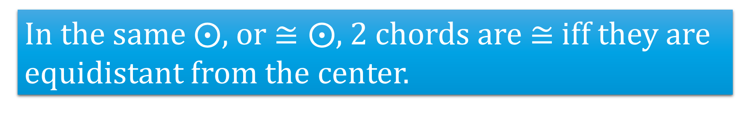
10.3 Using Chords
In the same $⨀$, or $≅⨀$, 2 chords are $≅$ iff they are equidistant from the center.

Slide 27
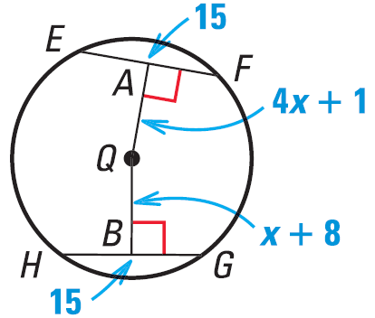
10.3 Using Chords
Find the value of x.
Try #14
Notes:
$$4x+1=x+8$$
$$3x+1=8$$
$$3x=7$$
$$x=\frac{7}{3}$$

Slide 28
10.4 Inscribed Angles and Polygons
After this lesson…
• I can find measures of inscribed angles and intercepted arcs.
• I can find angle measures of inscribed polygons.

Slide 29
10.4 Inscribed Angles and Polygons
What does inscribed mean?
  Writing ON something; engraving ON
Inscribed angle means the vertex ON the circle.

Slide 30
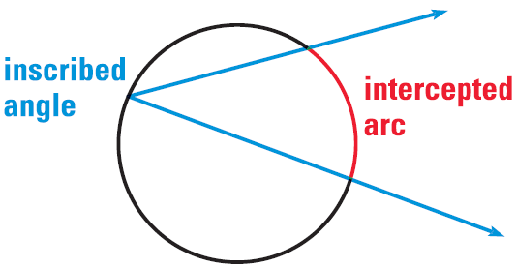
10.4 Inscribed Angles and Polygons
Inscribed Angle
  An angle whose vertex is on the edge of a circle and is inside the circle.
Intercepted Arc
  The arc of the circle that is in the angle.

Slide 31
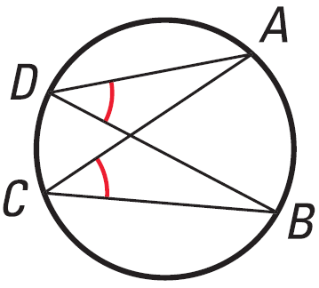
10.4 Inscribed Angles and Polygons
The measure of an inscribed angle is ½ the measure of the intercepted arc.
If two inscribed angles of the same or congruent circles intercept congruent arcs, then the angles are congruent.

Slide 32
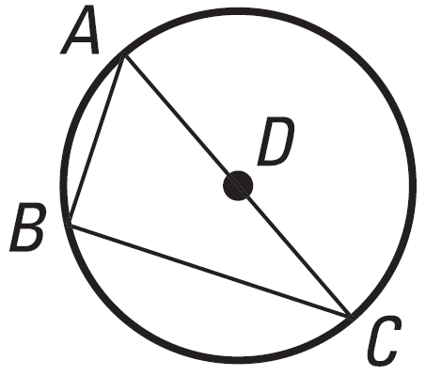
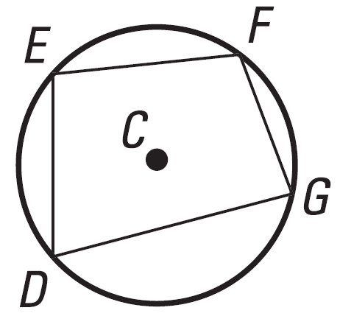
10.4 Inscribed Angles and Polygons
If an inscribed angle of a circle intercepts a semicircle, then the angle is a right angle
  ½ 180 (semicircle) = 90
If a quadrilateral is inscribed in a circle, then the opposite angles are supplementary.

Slide 33
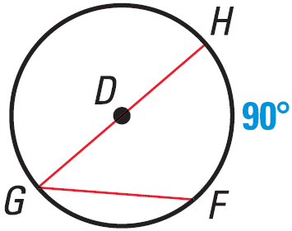
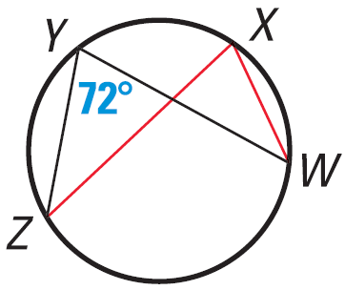
10.4 Inscribed Angles and Polygons
Find the measure of the red arc or angle.
Try #2
Notes:
$$\frac{1}{2}90°=45°$$
$$72°$$

Slide 34
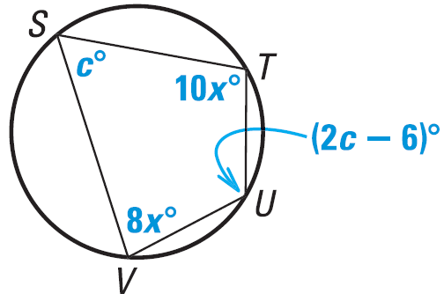
10.4 Inscribed Angles and Polygons
Find the value of each variable.
Try #12
Try #10
Notes:
$$5x=90$$
$$x=18$$
$$8x+10x=180$$
$$18x=180$$
$$x=10$$
$$c+\left(2c−6\right)=180$$
$$3c−6=180$$
$$3c=186$$
$$c=62$$

Slide 35
10.5 Angle Relationships in Circles
After this lesson…
• I can identify angles and arcs determined by chords, secants, and tangents.
• I can find angle measures and arc measures involving chords, secants, and tangents.
• I can use circumscribed angles to solve problems.

Slide 36
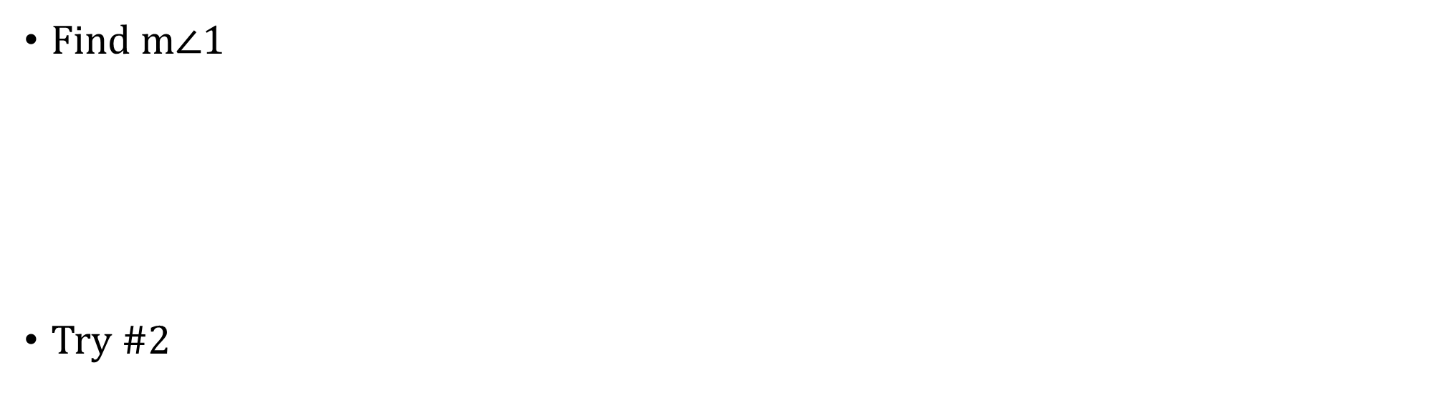
10.5 Angle Relationships in Circles
If a secant and a tangent intersect at the point of tangency, then the measure of each angle formed is one-half the measure of its intercepted arc.
Find m$∠$1
Try #2
Notes:
$$∠=\frac{1}{2}inscribed arc$$
$$m∠1=\frac{1}{2}\left(240°\right)=120°$$

Slide 37
10.5 Angle Relationships in Circles
Angles Inside the Circle Theorem
If two secants intersect in the interior of a circle, then the measure of an angle formed is ½ the sum of the measures of the arcs intercepted by the angle and its vertical angle.
Find the value of x.
Try #6
Notes:
$$∠=\frac{1}{2}\left(arc1+arc2\right)$$
$$angle between J and K=180°−94°=86°$$
$$86°=\frac{1}{2}\left(x°+80°\right)$$
$$172°=x+80°$$
$$x=92°$$

Slide 38
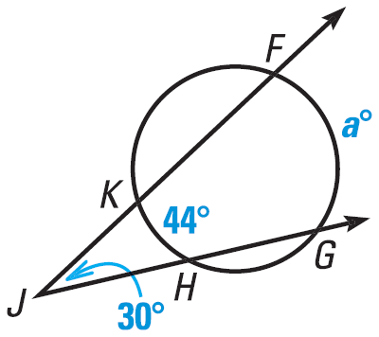
10.5 Angle Relationships in Circles
Angles Outside the Circle Theorem
If two secants, tangents, or one of each intersect in the exterior of a circle, then the measure of the angle formed is ½ the difference of the measures of the intercepted arcs.
What is the value of a?
Try #10
Notes:
$$m∠J=\frac{1}{2}\left(m\overset{⏜}{FG}−m\overset{⏜}{KH}\right)$$
$$30°=\frac{1}{2}\left(a°−44°\right)$$
$$60°=a°−44°$$
$$a=104$$

Slide 39
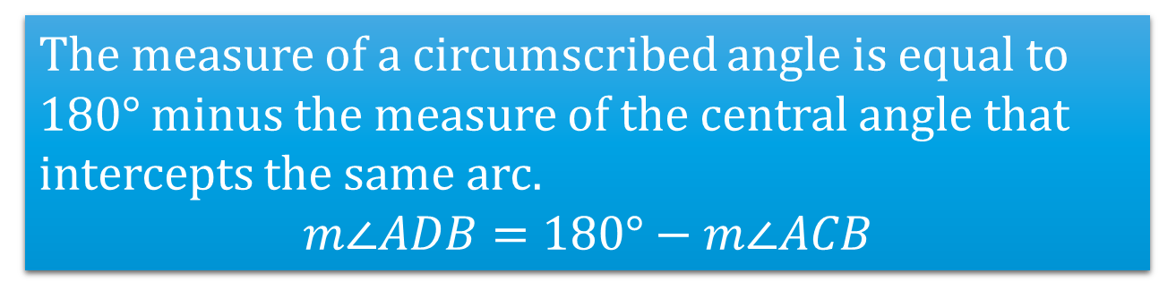
10.5 Angle Relationships in Circles
Circumscribed Angle Theorem
The measure of a circumscribed angle is equal to 180° minus the measure of the central angle that intercepts the same arc.
$$m∠ADB=180°−m∠ACB$$
What is the value of x?
Notes:
$$x=\frac{1}{2}m\overset{⏜}{AB}$$
$$m∠AOB=m\overset{⏜}{AB}=2x$$
$$m∠ADB=180°−m∠AOB$$
$$42°=180°−2x$$
$$−138°=−2x$$
$$69°=x$$

Slide 40
10.6 Segment Relationships in Circles
After this lesson…
• I can find lengths of segments of chords.
• I can identify segments of secants and tangents.
• I can find lengths of segments of secants and tangents.

Slide 41
10.6 Segment Relationships in Circles
A person is stuck in a water pipe with unknown radius. He estimates that surface of the water makes a 4 ft chord near the top of the pipe and that the water is 6 ft deep. How much room is available for his head?
4
6
Notes:
The chord can be subdivided into 2 ft and 2ft since the vertical line is a diameter. To answer the question we need to know the theorems in the section.

Slide 42
10.6 Segment Relationships in Circles
Segments of Chords Theorem
If two chords intersect in a circle, then the products of the measures of the segments of the chords are equal.
Take the example we started above.
  The segments of the horizontal chords are 2 and 2; the segments of the vertical chords are 6 and x
4
6
Notes:
$$2\left(2\right)=6x → x=\frac{4}{6}=\frac{2}{3} ft$$
Not much room for his head

Slide 43
10.6 Segment Relationships in Circles
Segments of Secants Theorem
If two secants are drawn to a circle from an exterior point, then the product of the measures of one secant segment and its external secant segment is equal to the product of the measures of the other secant segment and its external secant segment.
Find x in the diagram.
Notes:
$$\left(x+4\right)4=\left(12\right)3$$
$$\left(x+4\right)4=36$$
$$x+4=9$$
$$x=5$$

Slide 44
10.6 Segment Relationships in Circles
Segments of Secants and Tangents Theorem
If a tangent segment and a secant segment are drawn to a circle from an exterior point, then the square of the measure of the tangent segment is equal to the product of the measures of the secant segment and its external secant segment.
Find x in the diagram
Notes:
$$x^{2}=\left(27\right)12$$
$$x^{2}=324$$
$$x=18$$

Slide 45
10.7 Circles in the Coordinate Plane
After this lesson…
• I can write equations of circles.
• I can find the center and radius of a circle.
• I can graph equations of circles.
• I can write coordinate proofs involving circles.

Slide 46

10.7 Circles in the Coordinate Plane
Equation of a Circle
$${\left(x−h\right)}^{2}+{\left(y−k\right)}^{2}=r^{2}$$
Where (h, k) is the center and r is the radius
Write the equation of the circle in the graph.
Try #2
Notes:
Center (-5, 4); h = -5; k = 4
Radius r = 4
$${\left(x−h\right)}^{2}+{\left(y−k\right)}^{2}=r^{2}$$
$${\left(x−\left(−5\right)\right)}^{2}+{\left(y−4\right)}^{2}=4^{2}$$
$${\left(x+5\right)}^{2}+{\left(y−4\right)}^{2}=16$$

Slide 47
10.7 Circles in the Coordinate Plane
Write the standard equation of the circle.
Try #8
Notes:
$$r=\sqrt{{\left(x_{2}−x_{1}\right)}^{2}+{\left(y_{2}−y_{1}\right)}^{2}}$$
$$r=\sqrt{{\left(1−4\right)}^{2}+{\left(4−1\right)}^{2}}$$
$$r=\sqrt{18}=3\sqrt{2}$$
$${\left(x−h\right)}^{2}+{\left(y−k\right)}^{2}=r^{2}$$
$${\left(x−1\right)}^{2}+{\left(y−4\right)}^{2}={\left(3\sqrt{2}\right)}^{2}$$
$${\left(x−1\right)}^{2}+{\left(y−4\right)}^{2}=18$$

Slide 48
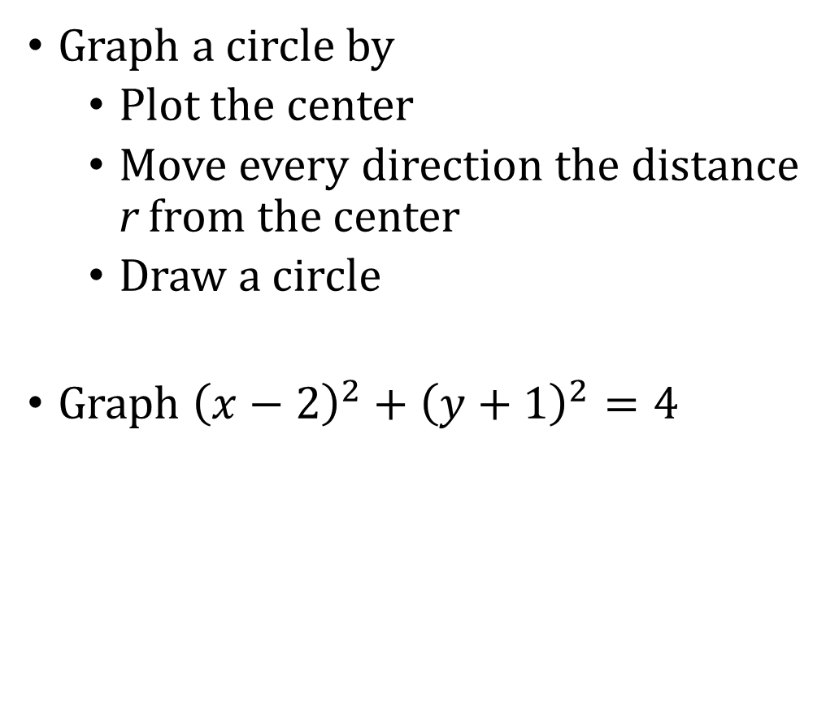
10.7 Circles in the Coordinate Plane
Graph a circle by
  Plot the center
  Move every direction the distance r from the center
  Draw a circle
Graph ${\left(x−2\right)}^{2}+{\left(y+1\right)}^{2}=4$
Notes:
Center (2, -1)
r² = 4 → r = 2

Slide 49

10.7 Circles in the Coordinate Plane
The point (1, 4) is on a circle centered at the origin. Prove or disprove that the point $\left(3, \sqrt{7}\right)$ is on the circle.
Try #19
Notes:
Center (0, 0)
$$r=\sqrt{{\left(1−0\right)}^{2}+{\left(4−0\right)}^{2}}=\sqrt{17}$$
$${\left(x−h\right)}^{2}+{\left(y−k\right)}^{2}=r^{2}$$
$${\left(x−0\right)}^{2}+{\left(y−0\right)}^{2}={\sqrt{17}}^{2}$$
$$x^{2}+y^{2}=17$$
Try the point
$${\left(3\right)}^{2}+{\left(\sqrt{7}\right)}^{2}=17$$
$$9+7=17$$
$$16≠17$$
The point is not on the circle

