Slide 1
Surface Area and Volume
Geometry
Chapter 12
Notes:
Geometry 12

Slide 2
This Slideshow was developed to accompany the textbook
  Larson Geometry
  By Larson, R., Boswell, L., Kanold, T. D., & Stiff, L.
  2011 Holt McDougal
Some examples and diagrams are taken from the textbook.
Slides created by
Richard Wright, Andrews Academy
rwright@andrews.edu

Slide 3
12.1 Explore Solids (12.1, New)
After this lesson…
I can classify solids.
I can use Euler’s Theorem.
I can describe cross sections.

Slide 4
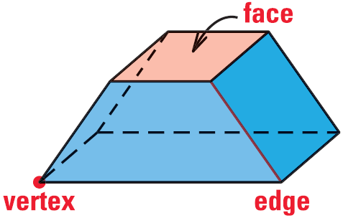
12.1 Explore Solids
Polyhedron
  Solid with polygonal sides
  Flat sides
Face
  Side
Edge
  Line segment
Vertex
  Corner

Slide 5
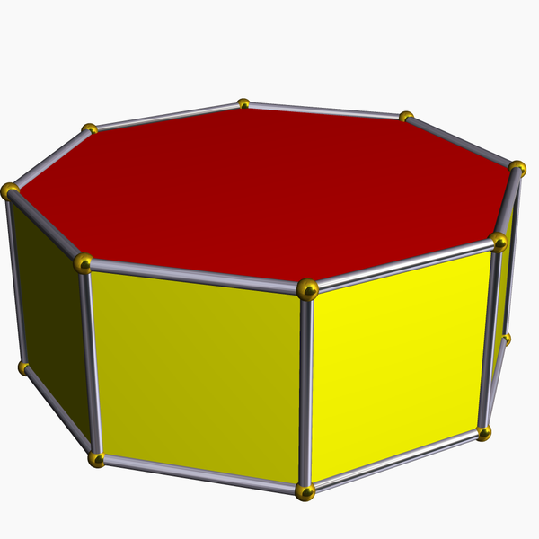
12.1 Explore Solids
Prism
  Polyhedron with two congruent surfaces on parallel planes (the 2 ends (bases) are the same)
  Named by bases (i.e. rectangular prism, triangular prism)
Cylinder
  Solid with congruent circular bases on parallel planes (not a polyhedron)

Slide 6
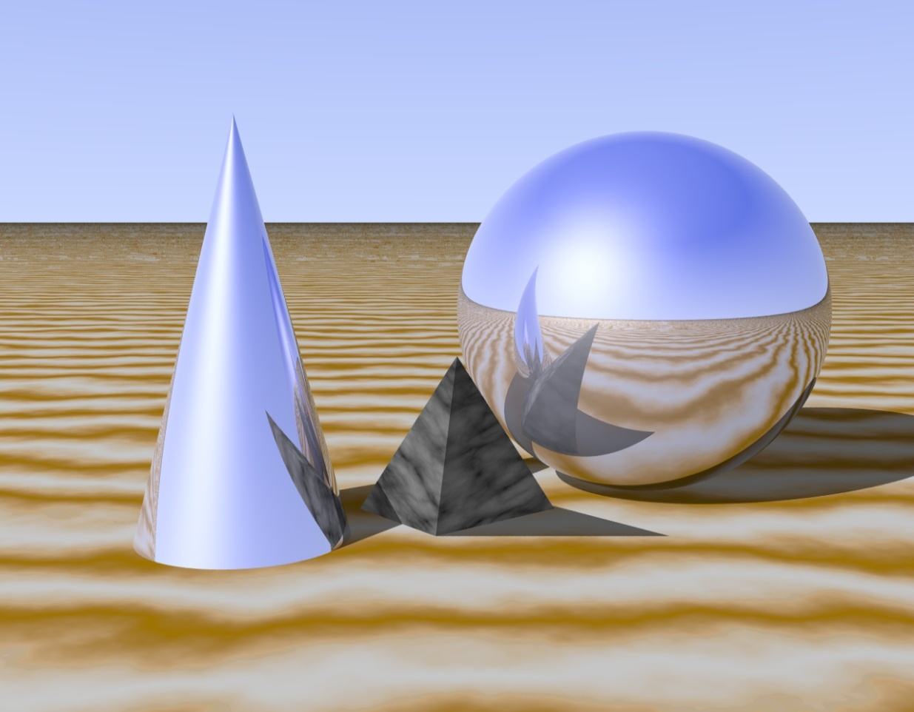
12.1 Explore Solids
Pyramid → polyhedron with all but one face intersecting in one point
Cone → circular base with the other surface meeting in a point (kind of like a pyramid)
Sphere → all the points that are a given distance from the center

Slide 7
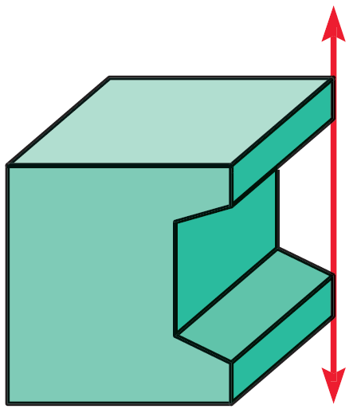
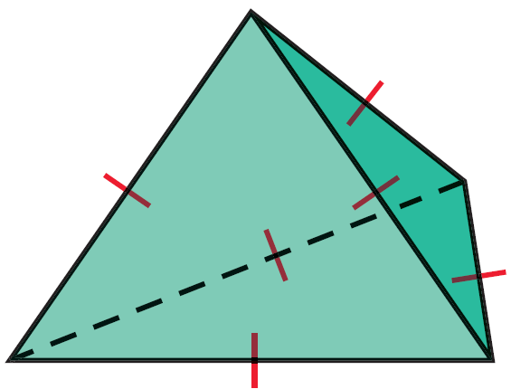
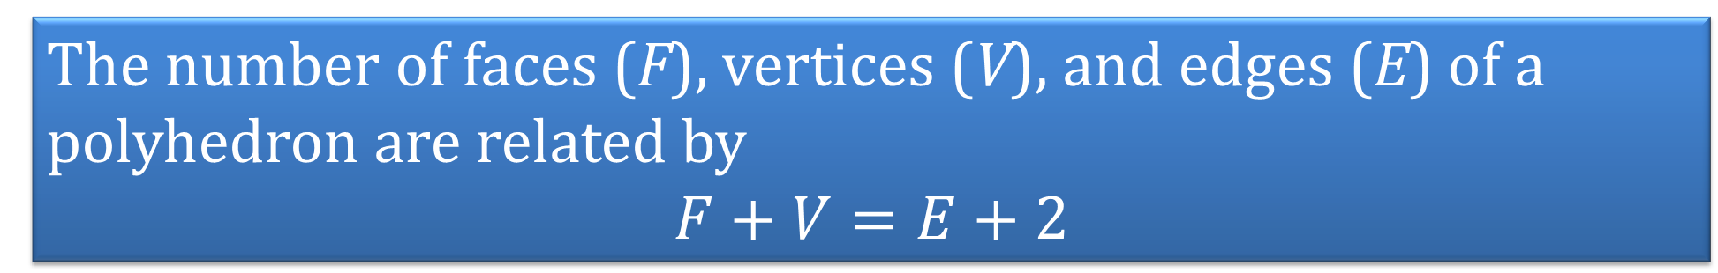
12.1 Explore Solids
Euler’s Theorem
The number of faces (F), vertices (V), and edges (E) of a polyhedron are related by
$$F+V=E+2$$
Convex
  Any two points can be connected with a segment completely inside the polyhedron
Concave
  Not convex
  Has a “cave”

Slide 8
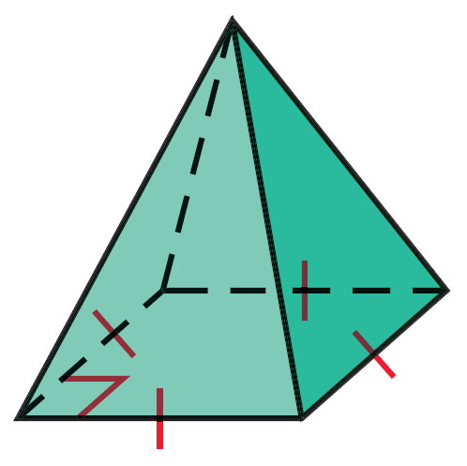
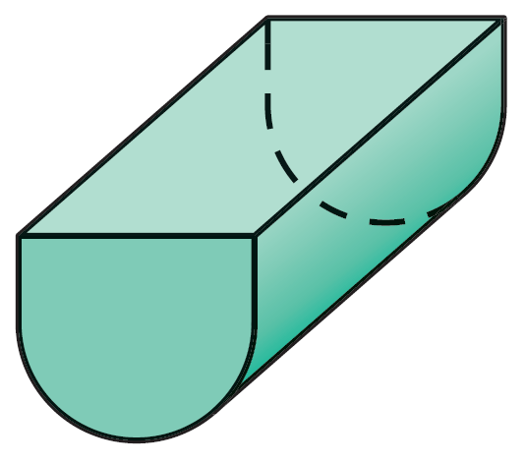
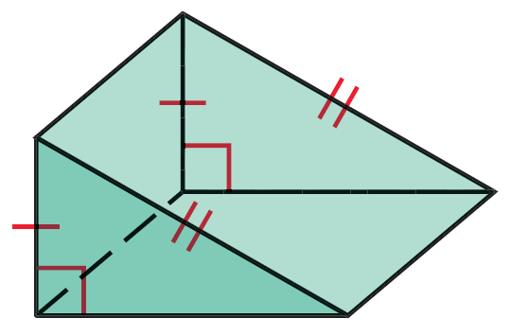
12.1 Explore Solids
Tell whether the solid is a polyhedron. If it is, name the polyhedron and find the number of faces, vertices, and edges and describe as convex or concave
Notes:
Polyhedron; Square Pyramid; 5 faces, 5 vertices, 8 edges; convex
Not a Polyhedron
Polyhedron; Triangular Prism; 5 faces, 6 vertices, 9 edges; convex

Slide 9
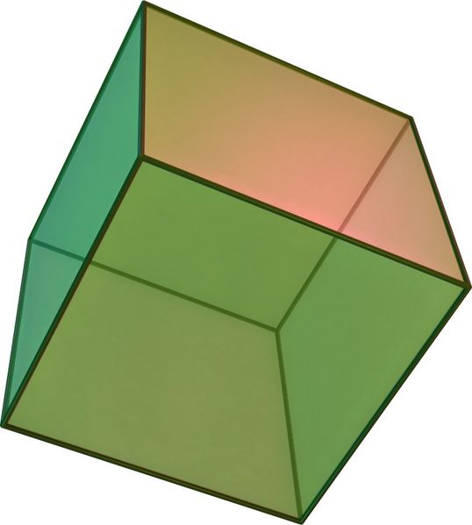
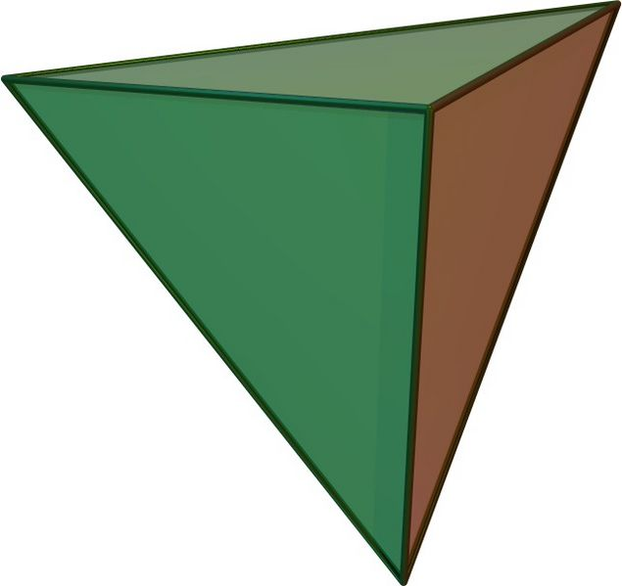
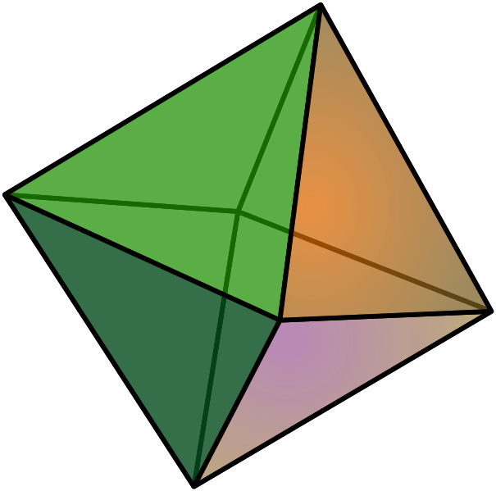
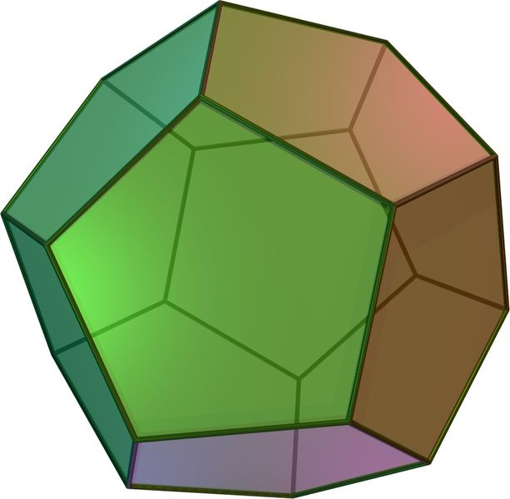
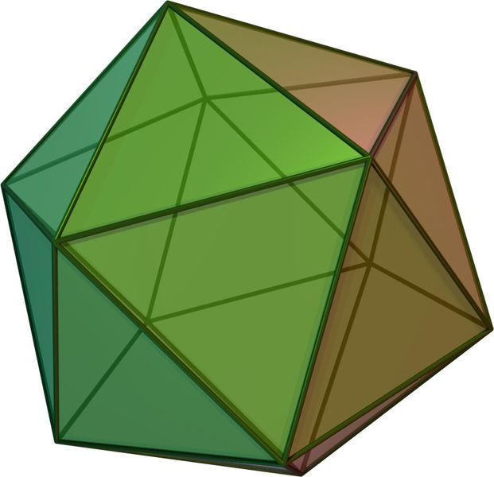
12.1 Explore Solids
Regular polyhedron
  Polyhedron with congruent regular polygonal faces
Only 5 types (Platonic solids)
  Tetrahedron → 4 faces (triangular pyramid)
  Hexahedron → 6 faces (cube)
  Octahedron → 8 faces (2 square pyramids put together)
  Dodecahedron → 12 faces (made with pentagons)
  Icosahedron → 20 faces (made with triangles)

Slide 10
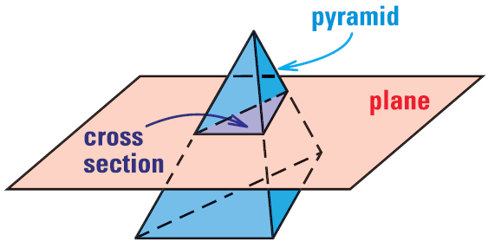
12.1 Explore Solids
Cross Section
  Imagine slicing a very thin slice of the solid
  The cross section is the 2-D shape of the thin slice

Slide 11
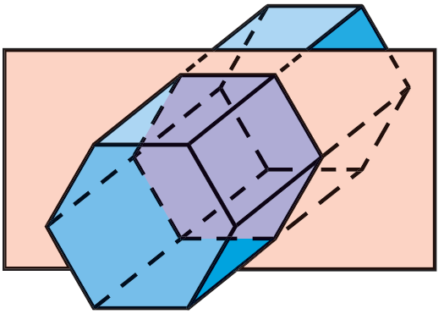
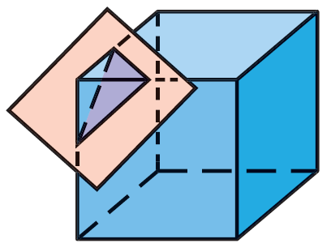
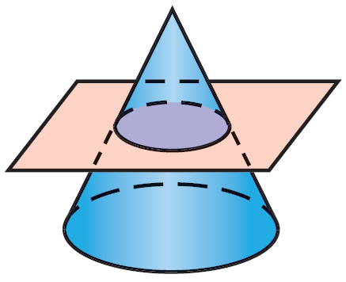
12.1 Explore Solids
Find the number of faces, vertices, and edges of a regular dodecahedron. Check with Euler’s Theorem.
Describe the cross section.
Notes:
Triangle
Circle
Hexagon

Slide 12
12.2 Surface Area of Prisms and Cylinders
After this lesson…
I can draw a net for a polyhedron.
I can find the surface area of prisms and cylinders

Slide 13
12.2 Surface Area of Prisms and Cylinders
Surface area = sum of the areas of each surface of the solid
  In order to calculate surface area it is sometimes easier to draw all the surfaces
Notes:
Some sports relie on having very little friction. In biking for example, the smaller the surface area of the tires, the less friction there is. And thus the faster the rider can go.
→ Draw the top triangle first (for some triangles you may have to count a horizontal space as 2)

Slide 14
12.2 Surface Area of Prisms and Cylinders
Nets
Imagine cutting the three dimensional figure along the edges and folding it out.
Start by drawing one surface, then visualize unfolding the solid.
To find the surface area, add up the area of each of the surfaces of the net.

Slide 15
12.2 Surface Area of Prisms and Cylinders
Parts of a right prism
Bases → parallel congruent surfaces (the ends)
Lateral faces → the other faces (they are parallelograms)
Lateral edges → intersections of the lateral faces (they are parallel)
Altitude → segment perpendicular planes containing the two bases with an endpoint on each plane
Height → length of the altitude
Base
Lateral Face
Lateral Edge
Altitude

Slide 16
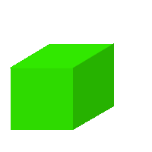
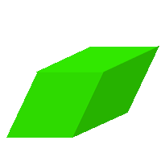
12.2 Surface Area of Prisms and Cylinders
Right prism
  Prism where the lateral edges are altitudes
Oblique prism
  Prism that isn’t a right prism

Slide 17
12.2 Surface Area of Prisms and Cylinders
Lateral Area (L) of Prisms
Area of the Lateral Faces
L = Ph
  L = Lateral Area
  P = Perimeter of base
  h = Height
Notes:
You can find the surface area by adding up the areas of each surface, but if you could use a formula, it would be quicker
All the lateral surfaces are rectangles
Area = bh
Add up the areas L = ah + bh + ch + … + dh
L = (a + b + c + … + d)h
Perimeter of base = a + b + c + … + d
L = Ph

Slide 18
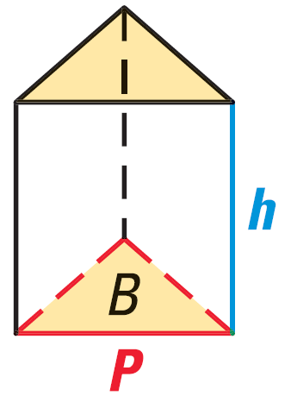
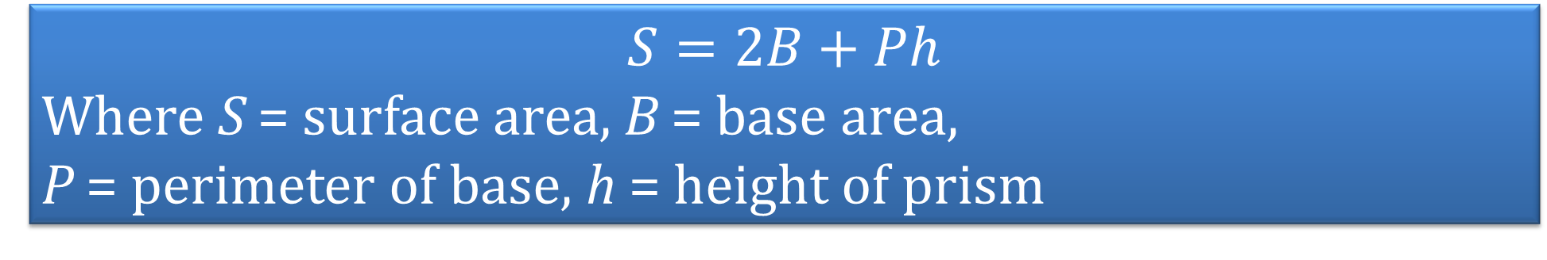
12.2 Surface Area of Prisms and Cylinders
Base Area (B)
  In a prism, both bases are congruent, so you only need to find the area of one base and multiply by two
Surface Area of a Right Prism
$$S=2B+Ph$$
Where S = surface area, B = base area,
P = perimeter of base, h = height of prism

Slide 19
12.2 Surface Area of Prisms and Cylinders
Draw a net for a triangular prism.
Find the lateral area and surface area of a right rectangular prism with height 7 inches, length 3 inches, and width 4 inches.
Notes:
/\


$$P=2\left(3\right)+2\left(4\right)=14$$
$$L=\left(14\right)\left(7\right)=98$$
$$B=3⋅4=12$$
$$A=2\left(12\right)+14\left(7\right)=122$$

Slide 20
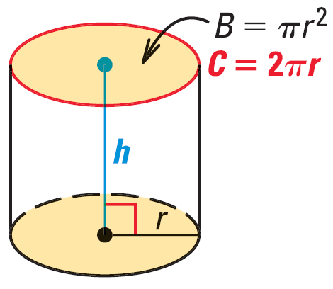
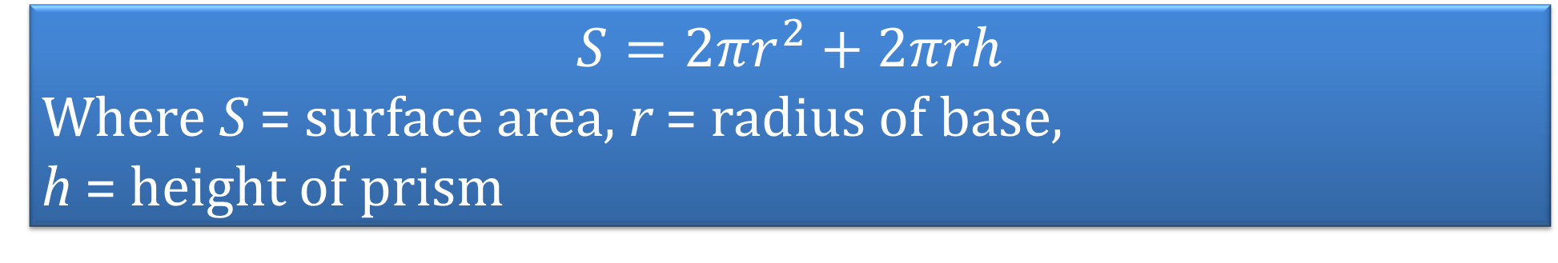
12.2 Surface Area of Prisms and Cylinders
Cylinders are the same as prisms except the bases are circles
  Lateral Area = L = 2πrh
Surface Area of a Right Cylinder
$$S=2πr^{2}+2πrh$$
Where S = surface area, r = radius of base,
h = height of prism

Slide 21
12.2 Surface Area of Prisms and Cylinders
The surface area of a right cylinder is 100 cm². If the height is 5 cm, find the radius of the base.
Draw a net for the cylinder and find its surface area.
2
5
Notes:
$$100=2πr^{2}+2πr\left(5\right)$$
$$100=2πr^{2}+10πr$$
$$0=2πr^{2}+10πr−100$$
$$0=r^{2}+5r−15.915$$
$$r=\frac{−5±\sqrt{5^{2}−4\left(1\right)\left(−15.915\right)}}{2\left(1\right)}$$
$$r=\frac{−5±\sqrt{88.662}}{2}$$
$$r=2.2, −7.2$$
Only 2.2 makes sense because the radius must be positive
$$S=2π2^{2}+2π\left(2\right)\left(5\right)$$
$$S=8π+20π=28π$$

Slide 22
12.3 Surface Area of Pyramids and Cones (12.4)
After this lesson…
I can find the surface area of pyramids.
I can find the surface area of cones.

Slide 23
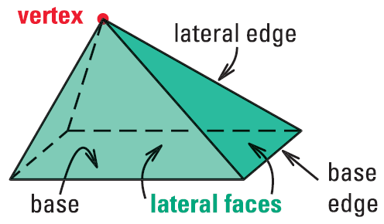
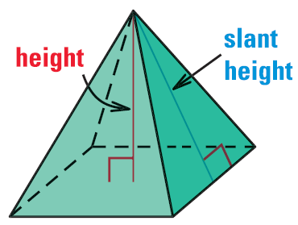
12.3 Surface Area of Pyramids and Cones (12.4)
Pyramids
All faces except one intersect at one point called vertex
The base is the face that does not intersect at the vertex
Lateral faces → faces that meet in the vertex
Lateral edges → edges that meet in the vertex
Altitude → segment that goes from the vertex and is perpendicular to the base

Slide 24
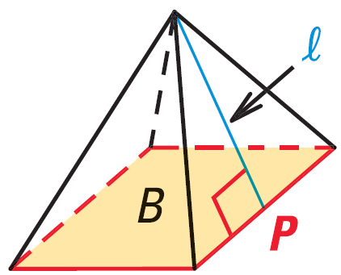
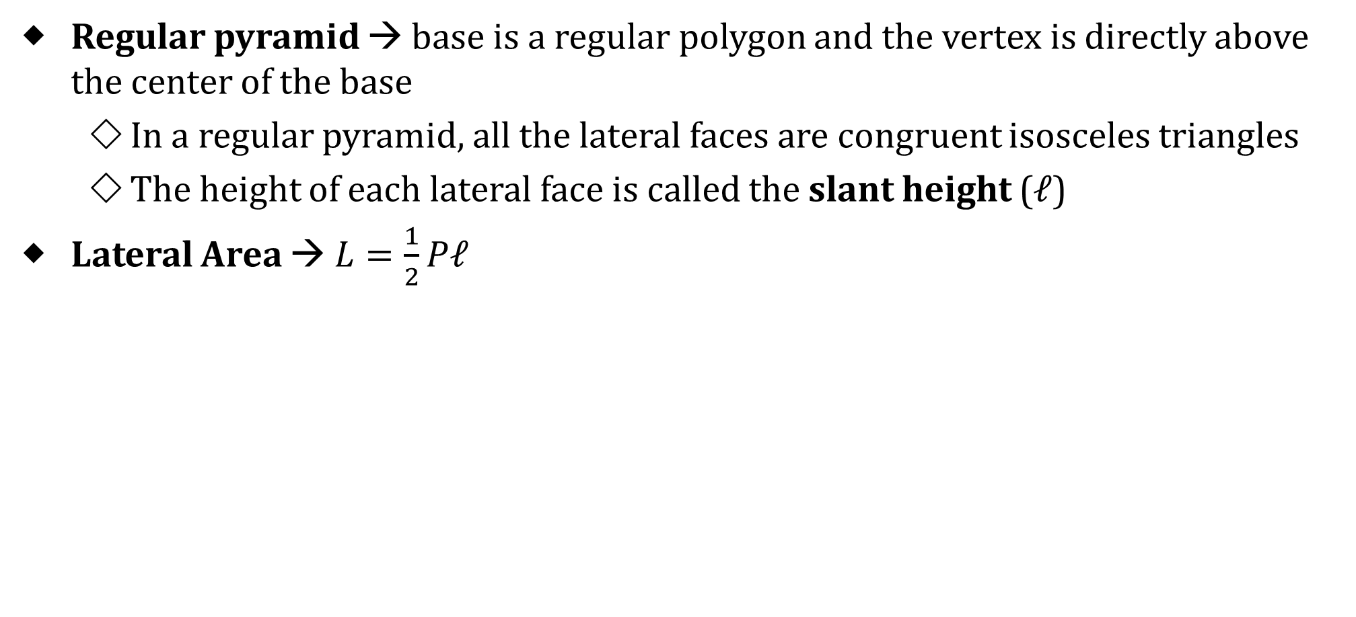

12.3 Surface Area of Pyramids and Cones (12.4)
Regular pyramid → base is a regular polygon and the vertex is directly above the center of the base
  In a regular pyramid, all the lateral faces are congruent isosceles triangles
  The height of each lateral face is called the slant height (ℓ)
Lateral Area → $L=\frac{1}{2}Pℓ$
Surface Area of a Regular Pyramid
$$S=B+\frac{1}{2}Pℓ$$
Where B = base area, P = base perimeter, ℓ = slant height
Notes:
Lateral area is ½ because the sides are triangles.

Slide 25
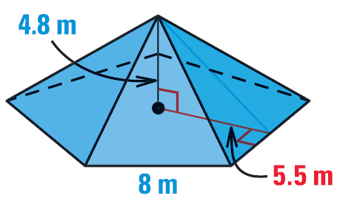
12.3 Surface Area of Pyramids and Cones (12.4)
Find the surface area of the regular pentagonal pyramid.
Notes:
Base Area
$$B=\frac{1}{2}Pa$$
$$B=\frac{1}{2}\left(5⋅8\right)\left(5.5\right)=110$$
$$ℓ^{2}={5.5}^{2}+{4.8}^{2}$$
$$ℓ=7.3$$
$$S=B+\frac{1}{2}Pℓ$$
$$S=110+\frac{1}{2}\left(5⋅8\right)\left(7.3\right)=256$$

Slide 26
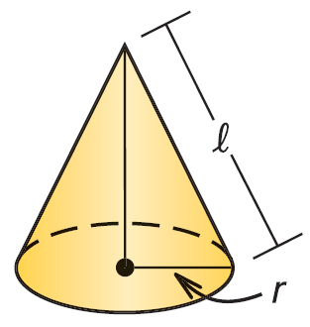

12.3 Surface Area of Pyramids and Cones (12.4)
Cones
Cones are just like pyramids except the base is a circle
Lateral Area = πrℓ
Surface Area of a Right Cone
$$S=πr^{2}+πrℓ$$
Where r = base radius, ℓ = slant height

Slide 27
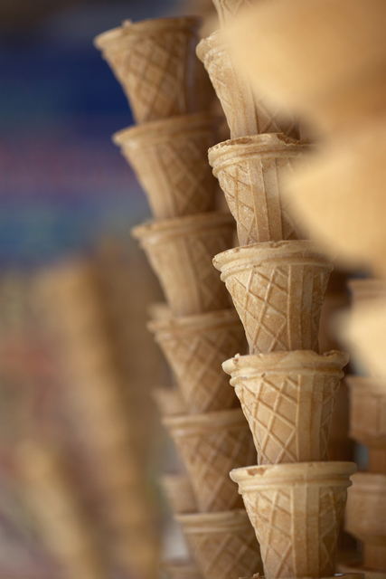
12.3 Surface Area of Pyramids and Cones (12.4)
The So-Good Ice Cream Company makes Cluster Cones. For packaging, they must cover each cone with paper. If the diameter of the top of each cone is 6 cm and its slant height is 15 cm, what is the area of the paper necessary to cover one cone?
Notes:
Looking for lateral area.
$$L=π3\left(15\right)=141.4 cm^{2}$$

Slide 28
12.4 Volume of Prisms and Cylinders (12.2)
After this lesson…
I can find volumes of prisms and cylinders.
I can solve real-life problems involving volumes of prisms and cylinders.

Slide 29
12.4 Volume of Prisms and Cylinders (12.2)
Create a right prism using geometry cubes
Count the lengths of the sides
Count the number of cubes.
Remember this to verify the formulas we are learning today.

Slide 30
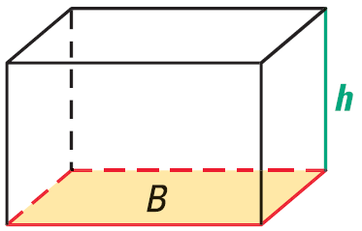
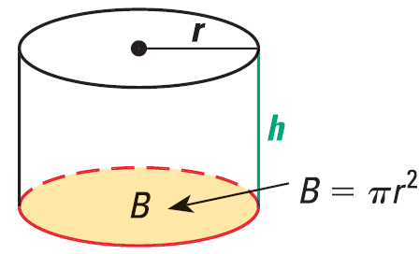


12.4 Volume of Prisms and Cylinders (12.2)
Volume of a Prism
$$V=Bh$$
Where B = base area, h = height of prism
Volume of a Cylinder
$$V=πr^{2}h$$
Where r = radius, h = height of cylinder

Slide 31
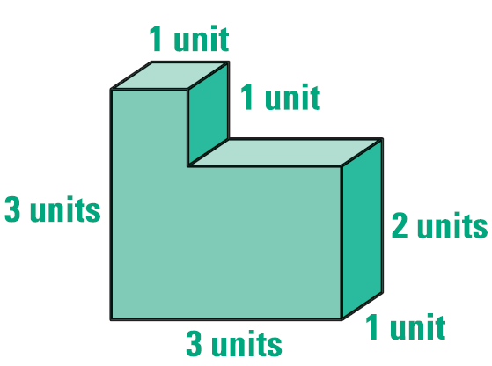
12.4 Volume of Prisms and Cylinders (12.2)
Find the volume of the figure
Notes:
Cut into two prisms
Top
$$V=1\left(1\right)\left(1\right)=1$$
Bottom
$$V=3\left(1\right)\left(2\right)=6$$
Total
$$V=1+6=7$$

Slide 32
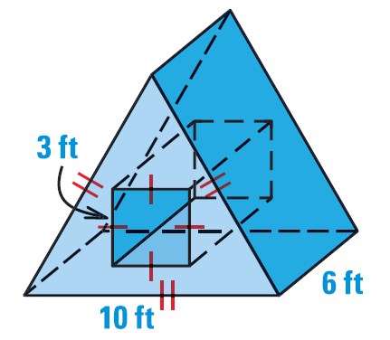
12.4 Volume of Prisms and Cylinders (12.2)
Find the volume.
Notes:
Base Area (front)
Find height of triangle
$$5^{2}+x^{2}={10}^{2}$$
$$25+x^{2}=100$$
$$x^{2}=75$$
$$x=5\sqrt{3}$$
Area=triangle - square
$$B=\frac{1}{2}\left(10\right)\left(5\sqrt{3}\right)−3^{2}$$
$$B=25\sqrt{3}−9≈34.301$$
Volume = Bh
$$V=\left(25\sqrt{3}−9\right)\left(6\right)=150\sqrt{s}−54≈205.8$$

Slide 33
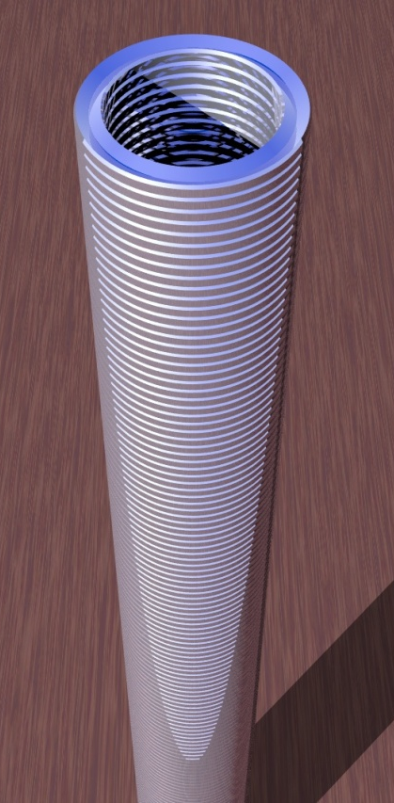
12.4 Volume of Prisms and Cylinders (12.2)
There are 150 1-inch washers in a box. When the washers are stacked, they measure 9 inches in height. If the inside hole of each washer has a diameter of ¾ inch, find the volume of metal in one washer.
Notes:
Find volume of washers without holes: V = π ½² 9 = 7.06858
Find volume of hole: V = π(3/8)² 9 = 3.97608
Find volume of washers with holes: 7.06858 – 3.97608 = 3.09251
Find volume of one washer: 3.09251/150 = 0.02 in³

Slide 34
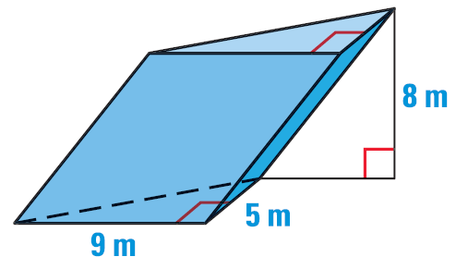
12.4 Volume of Prisms and Cylinders (12.2)
Cavalieri’s Principle
  If two solids have the same height and the same cross-sectional area at every level, then they have the same volume.
Find the volume.
Notes:
$$B=\frac{1}{2}\left(9\right)\left(5\right)=22.5 m^{2}$$
$$V=\left(22.5 m^{2}\right)\left(8 m\right)=180 m^{3}$$

Slide 35
12.5 Volume of Pyramids and Cones (12.3, 12.4)
After this lesson…
I can find volumes of pyramids and cones.
I can find volumes of composite solids.

Slide 36
12.5 Volume of Pyramids and Cones (12.3, 12.4)
How much ice cream will fill an ice cream cone?
How could you find out without filling it with ice cream?
What will you measure?

Slide 37
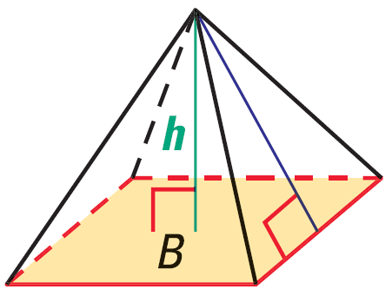
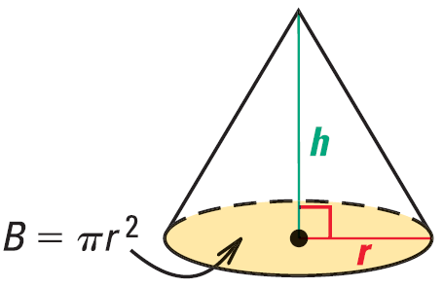


12.5 Volume of Pyramids and Cones (12.3, 12.4)
Volume of a Pyramid
$$V=\frac{1}{3}Bh$$
Where B = base area, h = height of pyramid
Volume of a Cone
$$V=\frac{1}{3}πr^{2}h$$
Where r = radius, h = height of cone

Slide 38
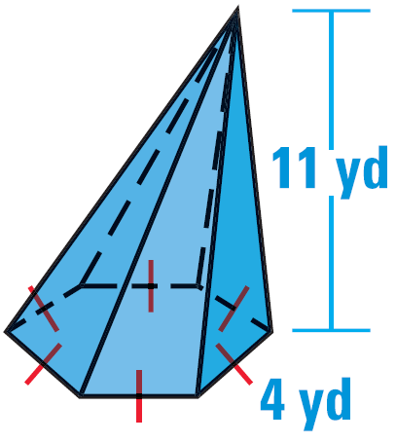
12.5 Volume of Pyramids and Cones (12.3, 12.4)
Find the volume.
Notes:
$$B=\frac{1}{2}Pa$$
$$\frac{1}{2}central angle=\frac{1}{2}\left(\frac{360}{6}\right)=30$$
$$\tan{30}=\frac{2}{a}$$
$$a=\frac{2}{\tan{30}}=3.464$$
$$B=\frac{1}{2}\left(4⋅6\right)\left(3.464\right)=41.569$$
$$V=\frac{1}{3}\left(41.569\right)\left(11\right)=152.42$$

Slide 39
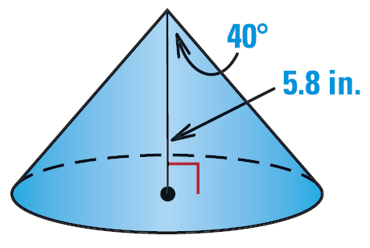
12.5 Volume of Pyramids and Cones (12.3, 12.4)
Find the volume.
Notes:
$$\tan{40}=\frac{r}{5.8}$$
$$r=5.8⋅\tan{40}=4.8668$$
$$V=\frac{1}{3}π{4.8668}^{2}⋅5.8=143.86$$

Slide 40
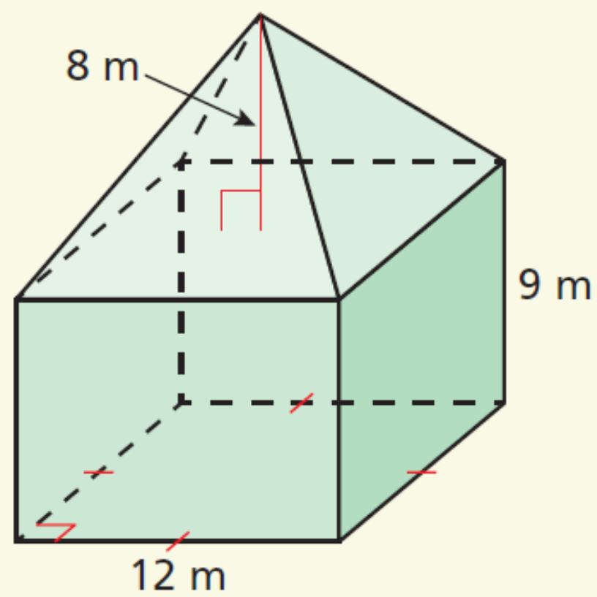
12.5 Volume of Pyramids and Cones (12.3, 12.4)
Find the volume of the composite solid.
Notes:
Pyramid:
$$V=\frac{1}{3}Bh$$
$$V=\frac{1}{3}\left({12}^{2}\right)\left(8\right)=384 m^{3}$$
Prism:
$$V=Bh$$
$$V=\left({12}^{2}\right)\left(9\right)=1296 m^{3}$$
Total:
$$384 m^{3}+1296 m^{3}=1680 m^{3}$$

Slide 41
12.6 Surface Area and Volume of Spheres (12.5)
After this lesson…
I can find the surface area of spheres.
I can find the volume of spheres.
I can find the volumes of composite solids.

Slide 42
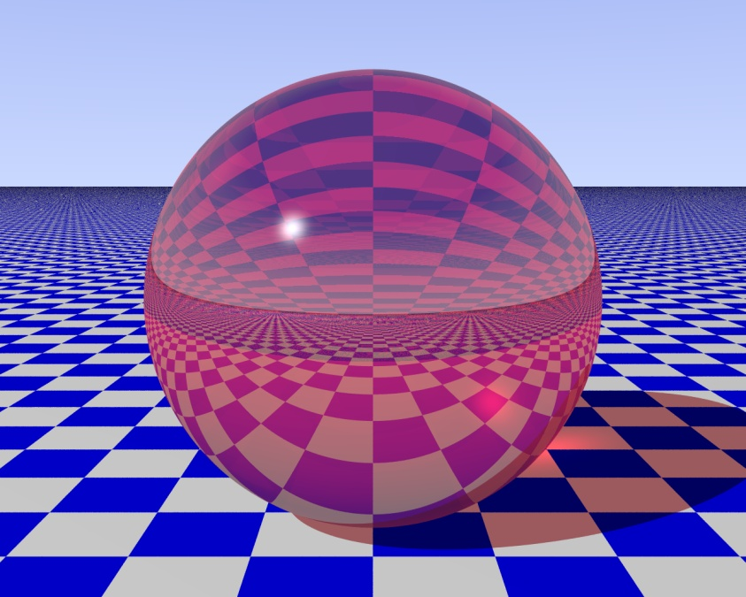
12.6 Surface Area and Volume of Spheres (12.5)
Terms
Sphere → all points equidistant from center
Radius → segment from center to surface
Chord → segment that connects two points on the sphere
Diameter → chord contains the center of the sphere
Tangent → line that intersects the sphere in exactly one place

Slide 43
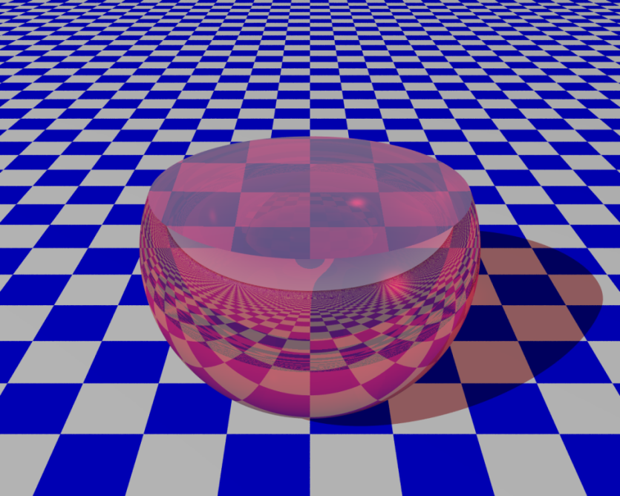
12.6 Surface Area and Volume of Spheres (12.5)
Intersections of plane and sphere
  Point → plane tangent to sphere
  Circle → plane not tangent to sphere
  Great Circle → plane goes through center of sphere (like equator)
    Shortest distance between two points on sphere
    Cuts sphere into two hemispheres

Slide 44

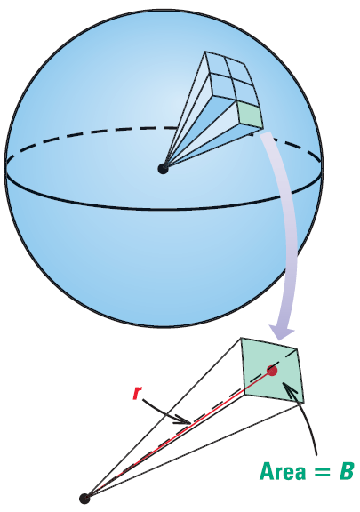


12.6 Surface Area and Volume of Spheres (12.5)
Surface Area of a Sphere
$$S=4πr^{2}$$
Where r = radius
  If you cut 4 circles into 8ths you can put them together to make a sphere
Volume of a Sphere
$$V=\frac{4}{3}πr^{3}$$
Where r = radius
Notes:
You can think about cutting a sphere into many small regular square pyramids.
V = 1/3 Bh → the area of all the bases is 4πr² and h = r

Slide 45
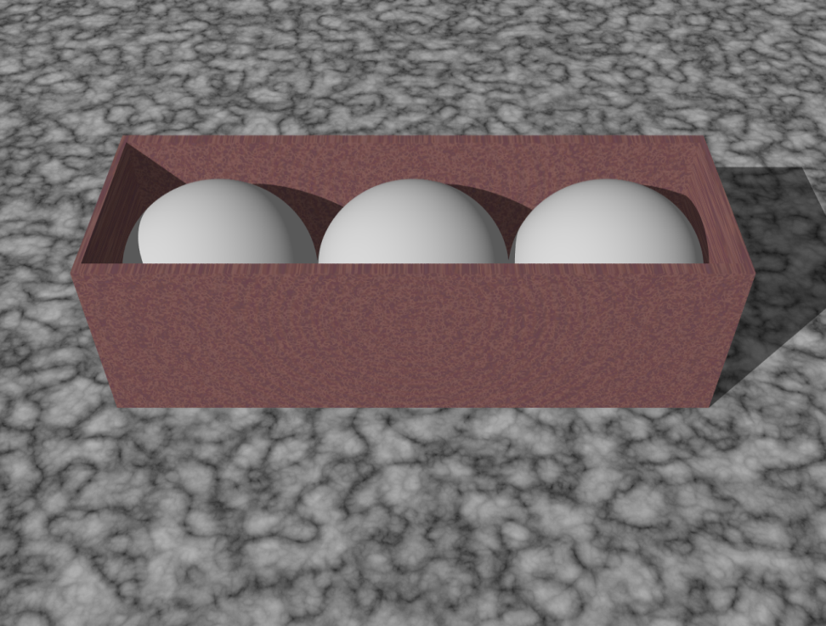
12.6 Surface Area and Volume of Spheres (12.5)
Find the volume of the empty space in a box containing three golf balls. The diameter of each is about 1.5 inches. The box is 4.5 inches by 1.5 inches by 1.5 inches.
Notes:
Volume of box: $4.5\left(1.5\right)\left(1.5\right)=10.125$
Volume of each ball: $\frac{4}{3}π.{75}^{3}=1.767$
Volume of empty space: $10.125−3\left(1.767\right)=4.824$

Slide 46
12.7 Solids of Revolution (12.7)
After this lesson…
I can sketch and describe solids of revolution.
I can find surface area and volumes of solids of revolution.
I can form solids of revolution in the coordinate plane.

Slide 47
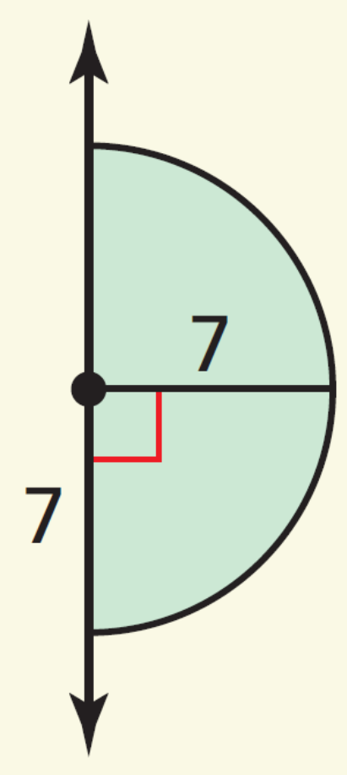
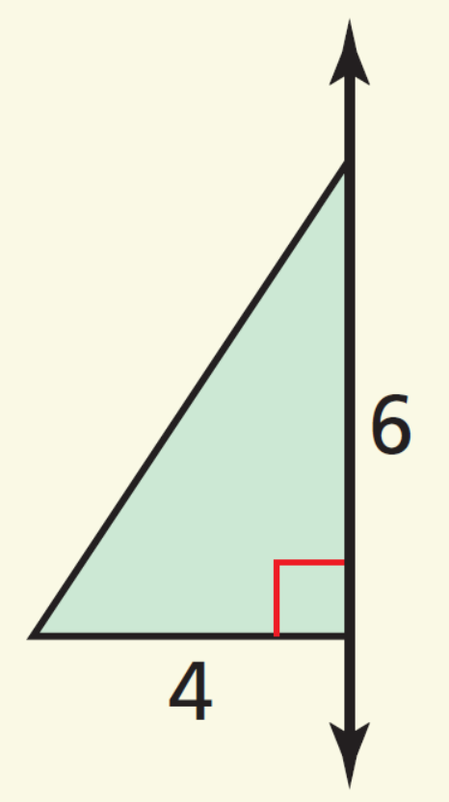
12.7 Solids of Revolution (12.7)
Solid of Revolution
  3D figure form by rotating a 2D shape around an axis
  The axis is the axis of revolution.
Sketch the solid produced by rotating the figure around the axis.
Notes:
cone with a height of 6 units and a radius of 4 units
sphere with a radius of 7 units

Slide 48

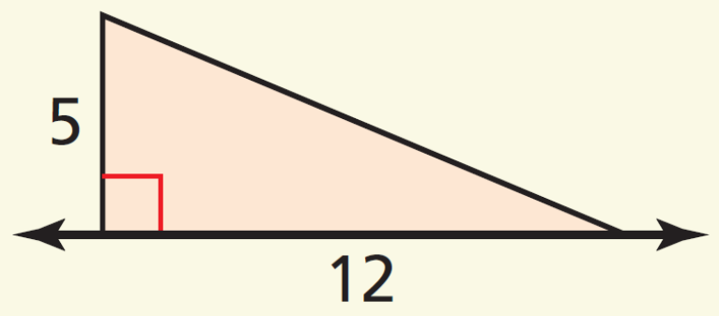
12.7 Solids of Revolution (12.7)
Sketch a two-dimensional shape and an axis of revolution that can form the grain silo shown.
Sketch and describe the solid produced by rotating the figure around the given axis. Then find its surface area.
Notes:
Looks like left or right half of the silo.
Makes a cone with radius 5 and height of 12
Slant height:
$$5^{2}+{12}^{2}=ℓ^{2}$$
$$169=ℓ^{2}$$
$$13=ℓ$$
$$SA=πr^{2}+πrℓ$$
$$SA=π{\left(5\right)}^{2}+π\left(5\right)\left(13\right)$$
$$SA=90π≈282.74$$

Slide 49
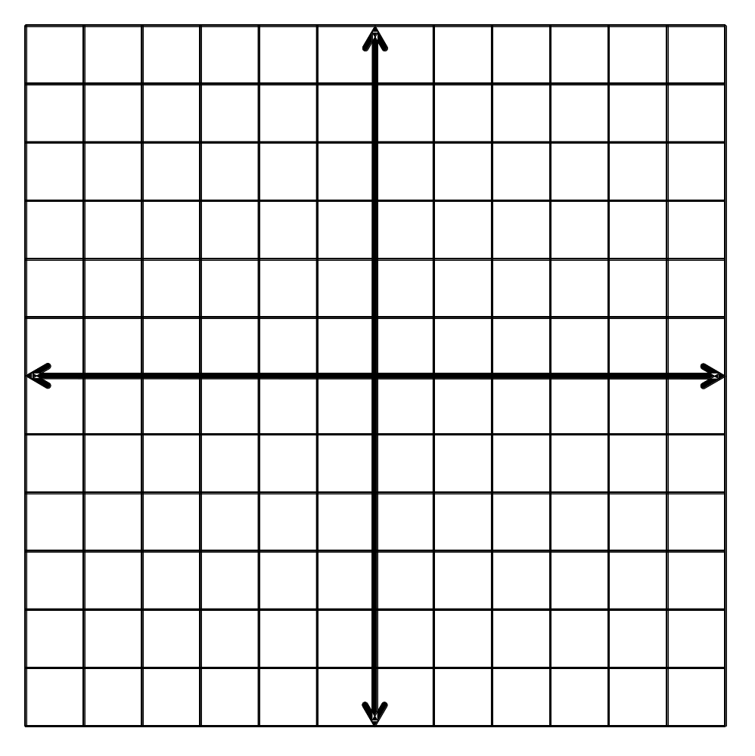
12.7 Solids of Revolution (12.7)
Sketch and describe the solid that is produced when the region enclosed by x = 0, y = 0, and y = x + 2 is rotated around the x-axis. Then find the volume of the solid.
Notes:
right cone with a radius of 2 units and a height of 2 units;
Volume:
$$V=\frac{1}{3}πr^{2}h$$
$$V=\frac{1}{3}π{\left(2\right)}^{2}\left(2\right)=\frac{8}{3}π≈8.38$$

