Slide 1
Properties of Circles
Geometry
Chapter 10
Notes:
Geometry 10

Slide 2
This Slideshow was developed to accompany the textbook
  Larson Geometry
  By Larson, R., Boswell, L., Kanold, T. D., & Stiff, L.
  2011 Holt McDougal
Some examples and diagrams are taken from the textbook.
Slides created by
Richard Wright, Andrews Academy
rwright@andrews.edu

Slide 3
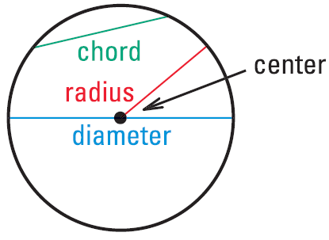
10.1 Use Properties of Tangents
Circle
  All the points a given distance from a central point in a plane
  Named by the center
Radius (r) – the distance from the center of the circle to the edge.
Chord – line segment that connects two points on a circle.

Slide 4
10.1 Use Properties of Tangents
Diameter (d) – chord that goes through the center of the circle (longest chord = 2 radii)
  d = 2r
What is the radius of a circle if the diameter is 16 feet?
Notes:
→ 16/2 = 8 feet

Slide 5
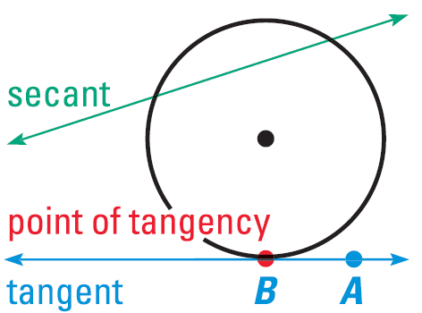
10.1 Use Properties of Tangents
Secant
  Line that intersects a circle twice
Tangent
  Line that intersects a circle once

Slide 6
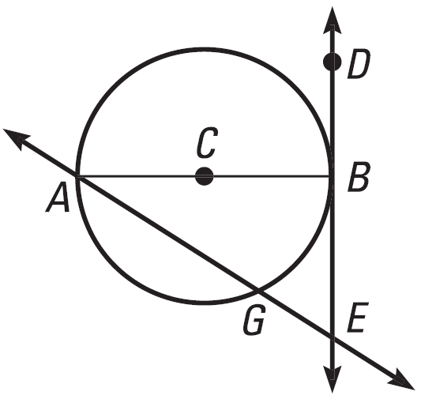

10.1 Use Properties of Tangents
What word best
describes $\overline{AG}$?
What word best describes $\overline{CB}$?
Name a tangent and a secant.
Notes:
Chord
Radius
Tangent: $\overset{⃡}{DE}$
Secant: $\overset{⃡}{AG}$

Slide 7
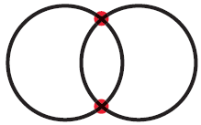
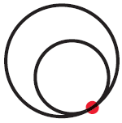

10.1 Use Properties of Tangents
Two circles can intersect in 2 points
1 point
No points

Slide 8
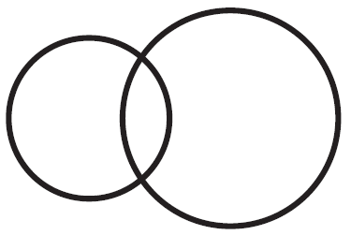
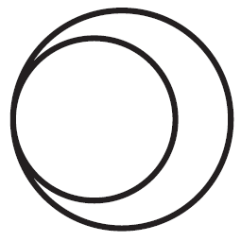

10.1 Use Properties of Tangents
Common tangents
  Lines tangent to 2 circles
How many common tangents do the circles have?
Notes:
2
1
none

Slide 9
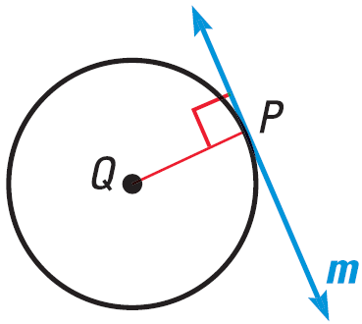
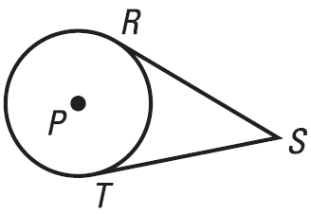
10.1 Use Properties of Tangents
Tangent lines are perpendicular to radius.
Tangent segments from the same point are congruent.

Slide 10
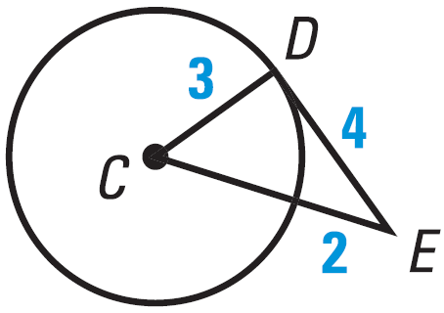
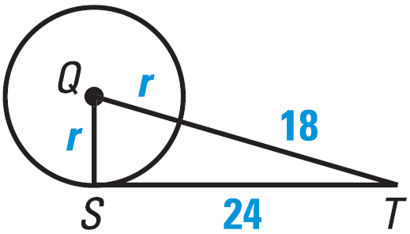

10.1 Use Properties of Tangents
Is $\overline{DE}$ tangent to $⨀C$?
$\overline{ST}$ is a tangent to $⨀Q$. Find the value of r.

Slide 11
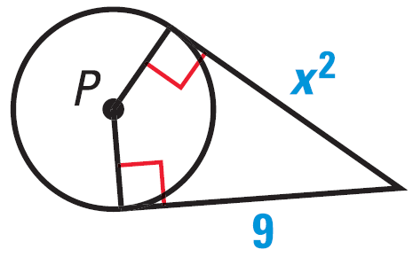
10.1 Use Properties of Tangents
Find the value of x.
655 #4-32 even, 36, 38, 43-47 all = 22

Slide 12
Answers and Quiz
10.1 Answers
10.1 Homework Quiz

Slide 13
10.2 Find Arc Measures
How do you cut a pizza into eight equal pieces?
  You cut in half, half, and half
What measures are the angles in each piece?
  360 / 8 = 45°

Slide 14

10.2 Find Arc Measures
There are 360° in a complete circle.
Central Angle – Angle whose vertex is the center of the circle
Arcs
  An arc is a portion of a circle (curved line)
  A central angle cuts a circle into two arcs
  Minor arc – smaller of the two arcs – measures of arcs are the measures of the central angles
  Major arc – bigger of the two arcs
  Named $\overset{⏜}{AB}$ or $\overset{⏜}{ADB}$
    use two endpoints to identify minor arc
    use three letters to identify major arc
A
C
B
D

Slide 15
10.2 Find Arc Measures
Semicircle – arc if the central angle is 180°
Similar Circles – all circles are similar
Congruent circles – same radius
Congruent arcs – same radius and measure

Slide 16
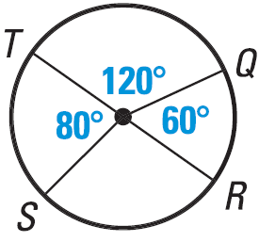

10.2 Find Arc Measures
Identify as major arc, minor arc, or semicircle. Find the measure.
$\overset{⏜}{TQ}$
$\overset{⏜}{TQR}$
$\overset{⏜}{QRT}$
Notes:
$\overset{⏜}{TQ}$ minor arc; 120°
$\overset{⏜}{TQR}$ semicircle; 180°
$\overset{⏜}{QRT}$ major arc; $m\overset{⏜}{RS}=360°−80°−120°−60°=100°$
$$m\overset{⏜}{QRT}=60°+100°+80°=240°$$

Slide 17
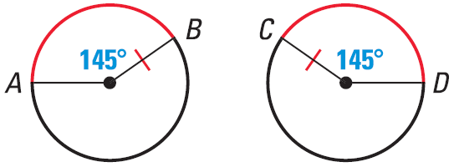
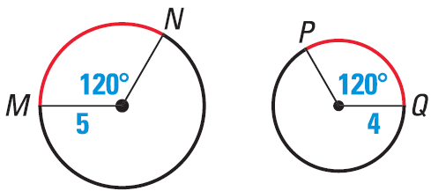
10.2 Find Arc Measures
Tell whether the red arcs are congruent.
661 #2-16 even, 20-24 even, 26-34 all = 20
Notes:
Yes; same radius and angle
No; different radius

Slide 18
Answers and Quiz
10.2 Answers
10.2 Homework Quiz

Slide 19
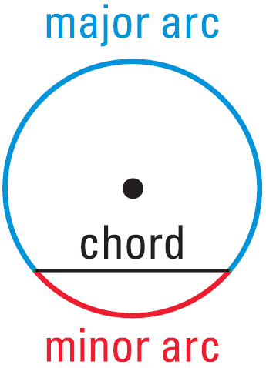
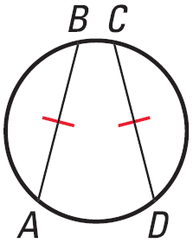
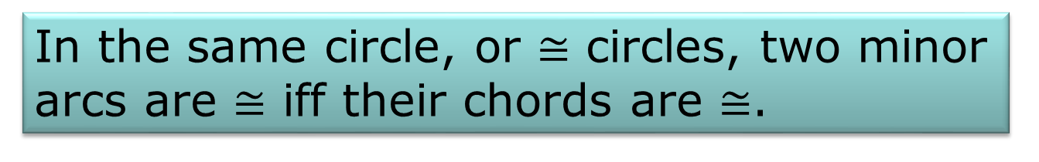
10.3 Apply Properties of Chords
Chords divide a circle into a major and minor arc.
In the same circle, or $≅$ circles, two minor arcs are $≅$ iff their chords are $≅$.

Slide 20
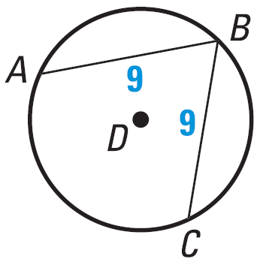

10.3 Apply Properties of Chords
If $m\overset{⏜}{AB}=110°$, find $m\overset{⏜}{BC}$.
Notes:
110°

Slide 21
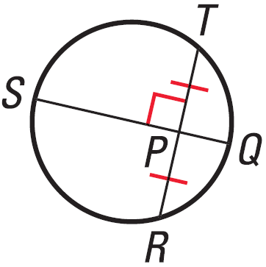
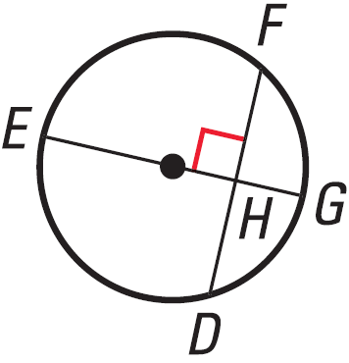
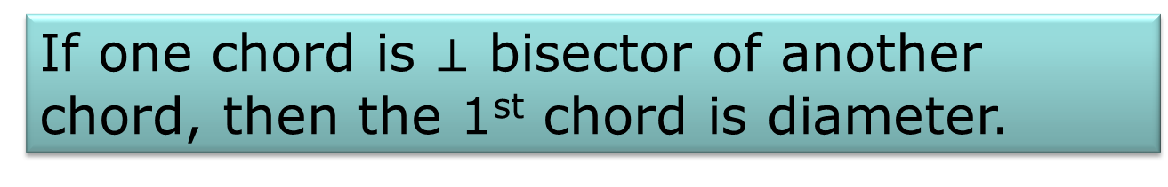
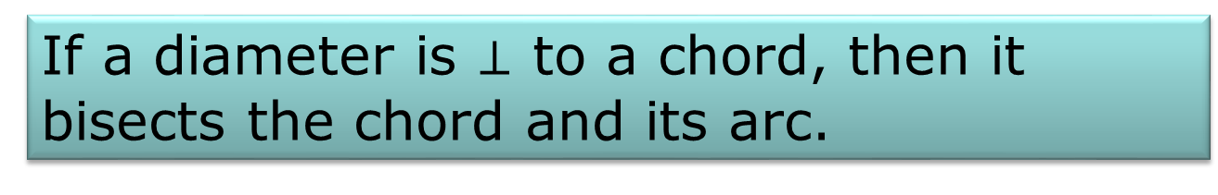
10.3 Apply Properties of Chords
If one chord is $⊥$ bisector of another chord, then the 1st chord is diameter.
If a diameter is $⊥$ to a chord, then it bisects the chord and its arc.

Slide 22
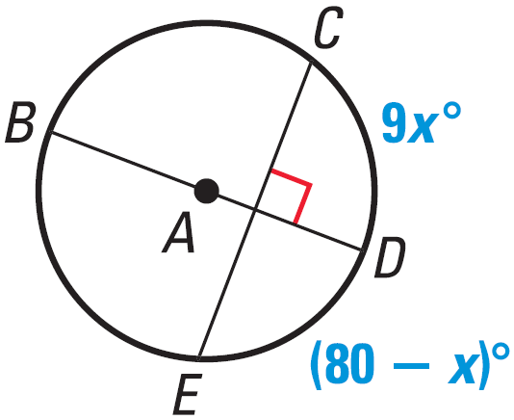

10.3 Apply Properties of Chords
Find the measure of the indicated arc.
$\overset{⏜}{CD}$
$\overset{⏜}{CE}$
Notes:
$$9x=80−x$$
$$10x=80$$
$$x=8$$
$$m\overset{⏜}{CD}=9\left(8\right)=72°$$
$$m\overset{⏜}{CE}=2\left(72°\right)=144°$$

Slide 23
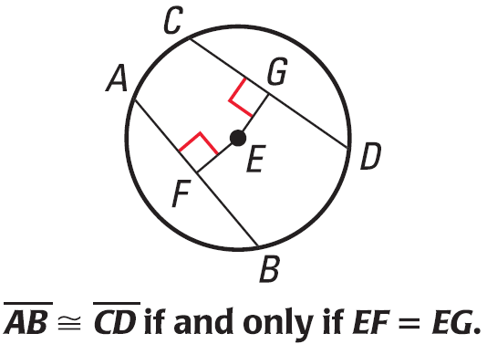
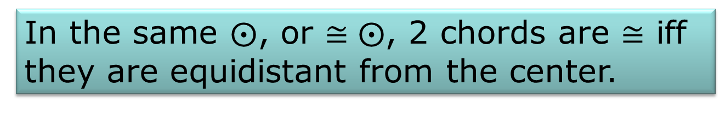
10.3 Apply Properties of Chords
In the same $⨀$, or $≅⨀$, 2 chords are $≅$ iff they are equidistant from the center.

Slide 24
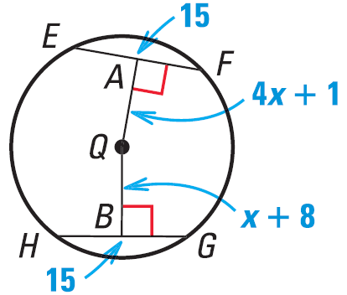
10.3 Apply Properties of Chords
Find the value of x.
667 #4-20 even, 24, 30, 35-37 all = 14
Extra Credit 670 #2, 4 = +2
Notes:
$$4x+1=x+8$$
$$3x+1=8$$
$$3x=7$$
$$x=\frac{7}{3}$$

Slide 25
Answers and Quiz
10.3 Answers
10.3 Homework Quiz

Slide 26
10.4 Use Inscribed Angles and Polygons
What does inscribed mean?
  Writing ON something; engraving ON
Inscribed angle means the vertex ON the circle.

Slide 27
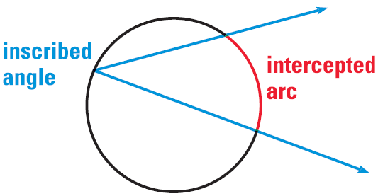
10.4 Use Inscribed Angles and Polygons
Inscribed Angle
  An angle whose vertex is on the edge of a circle and is inside the circle.
Intercepted Arc
  The arc of the circle that is in the angle.

Slide 28
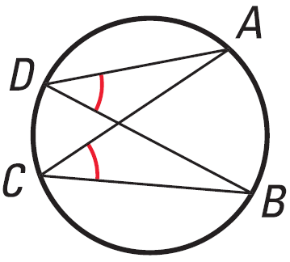
10.4 Use Inscribed Angles and Polygons
The measure of an inscribed angle is ½ the measure of the intercepted arc.
If two inscribed angles of the same or congruent circles intercept congruent arcs, then the angles are congruent.

Slide 29
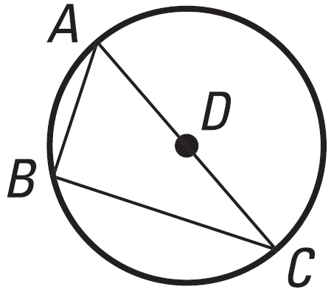
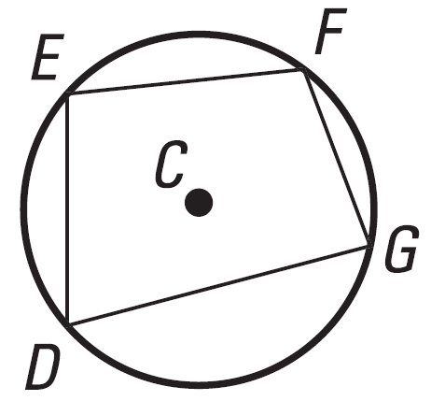
10.4 Use Inscribed Angles and Polygons
If an inscribed angle of a circle intercepts a semicircle, then the angle is a right angle
  ½ 180 (semicircle) = 90
If a quadrilateral is inscribed in a circle, then the opposite angles are supplementary.

Slide 30
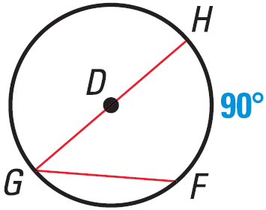
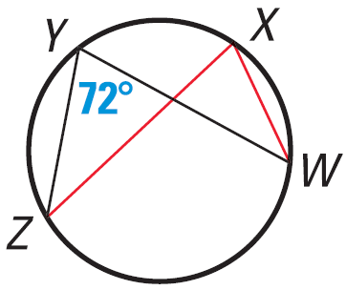
10.4 Use Inscribed Angles and Polygons
Find the measure of the red arc or angle.
Notes:
$$\frac{1}{2}90°=45°$$
$$72°$$

Slide 31
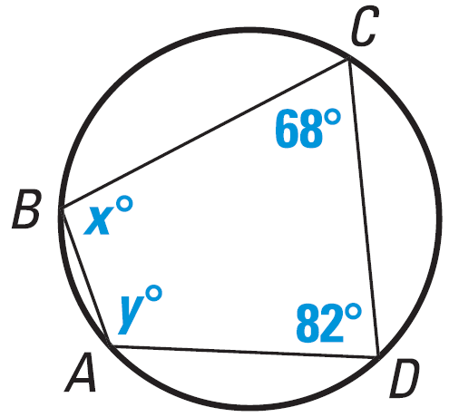
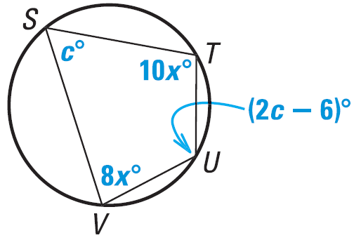
10.4 Use Inscribed Angles and Polygons
Find the value of each variable.
676 #4-24 even, 28 36, 38, 40-46 all = 21
Notes:
$$x+82°=180°$$
$$x=98°$$
$$y+68°=180°$$
$$y=112°$$
$$8x+10x=180$$
$$18x=180$$
$$x=10$$
$$c+\left(2c−6\right)=180$$
$$3c−6=180$$
$$3c=186$$
$$c=62$$

Slide 32
Answers and Quiz
10.4 Answers
10.4 Homework Quiz

Slide 33
10.5 Apply Other Angle Relationships in Circles
If a secant and a tangent intersect at the point of tangency, then the measure of each angle formed is one-half the measure of its intercepted arc.
Secant and Tangent intersect at point P on circle S. The angle formed measures 36°. What is the measure of the intercepted arc?
R
P
36
S
S
T
Notes:
ANS: ∠ = ½ arc → 36° = ½ x → x = 72°

Slide 34

10.5 Apply Other Angle Relationships in Circles
Angles Inside the Circle Theorem
If two secants intersect in the interior of a circle, then the measure of an angle formed is ½ the sum of the measures of the arcs intercepted by the angle and its vertical angle.
P
$m\overset{⏜}{RT}$ = 50, $m\overset{⏜}{PQ}$ = 120. What is m∠3?
R
1
4
3
S
2
T
Q
Notes:
ANS: m∠3 = ½ (mRT + mPQ) → m∠3 = ½ (50 + 120) = ½ 170 = 85°

Slide 35
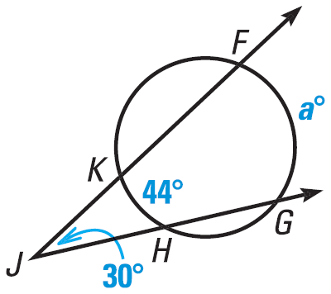
10.5 Apply Other Angle Relationships in Circles
Angles Outside the Circle Theorem
If two secants, tangents, or one of each intersect in the exterior of a circle, then the measure of the angle formed is ½ the difference of the measures of the intercepted arcs.
What is the value of a?
683 #4-26 even, 32-39 all = 20
Extra Credit 686 #2, 4 = +2
Notes:
$$m∠J=\frac{1}{2}\left(m\overset{⏜}{FG}−m\overset{⏜}{KH}\right)$$
$$30°=\frac{1}{2}\left(a°−44°\right)$$
$$60°=a°−44°$$
$$a=104$$

Slide 36
Answers and Quiz
10.5 Answers
10.5 Homework Quiz

Slide 37
10.6 Find Segment Lengths in Circles
A person is stuck in a water pipe with unknown radius. He estimates that surface of the water makes a 4 ft chord near the top of the pipe and that the water is 6 ft deep. How much room is available for his head?
4
6
Notes:
ANS: The chord can be subdivided into 2 ft and 2ft since the vertical line is a diameter. To answer the question we need to know the theorems in the section.

Slide 38
10.6 Find Segment Lengths in Circles
Segments of Chords Theorem
If two chords intersect in a circle, then the products of the measures of the segments of the chords are equal.
Take the example we started above.
  The segments of the horizontal chords are 2 and 2; the segments of the vertical chords are 6 and x
4
6
Notes:
2(2) = 6x → x = 4/6 = 2/3 ft Not much room for his head

Slide 39
10.6 Find Segment Lengths in Circles
Segments of Secants Theorem
If two secants are drawn to a circle from an exterior point, then the product of the measures of one secant segment and its external secant segment is equal to the product of the measures of the other secant segment and its external secant segment.
Find x in the diagram.
18
8
x
6
Notes:
8(8 + 18) = 6(x + 6) → 8(26) = 6x + 36 → 208 = 6x + 36 → 172 = 6x → 28.67 = x

Slide 40
10.6 Find Segment Lengths in Circles
Segments of Secants and Tangents Theorem
If a tangent segment and a secant segment are drawn to a circle from an exterior point, then the square of the measure of the tangent segment is equal to the product of the measures of the secant segment and its external secant segment.
Find x in the diagram
5
4
x
Notes:
x2 = 5(4 + 5) → x2 = 5(9) → x2 = 45 → x = 6.71

Slide 41
10.6 Find Segment Lengths in Circles
692 #2-24 even, 30-42 even = 19

Slide 42
Answers and Quiz
10.6 Answers
10.6 Homework Quiz

Slide 43
10.7 Write and Graph Equations of Circles
Standard equation of a circle
(x – h)² + (y – k)² = r²
(h, k) is the center of the circle and r is the radius

Slide 44
10.7 Write and Graph Equations of Circles
Identify the center and radius of the given circles
  (x – 3)² + (y + 2)² = 16
  x² + (y + 3)² = 4
Graph the above circles
  To graph plot the center point. Then go up, down, left and right from the center the distance of the radius. You now have four points around the center. Connect the points with a circle.
Notes:
center at (3, -2) and r = 4
center at (0, -3) and r = 2

Slide 45

10.7 Write and Graph Equations of Circles
Write an equation for a circle with center (2, -4) and r = $\sqrt{3}$
Notes:
ANS: ${\left(x−2\right)}^{2}+{\left(y+4\right)}^{2}={\sqrt{3}}^{2}→{\left(x−2\right)}^{2}+{\left(y+4\right)}^{2}=3$

Slide 46
10.7 Write and Graph Equations of Circles
Graph (x – 4)² + (y + 2)² = 36 and the line y = 2x – 2 and state whether the line is a tangent or secant.
702 #2-38 even, 42, 46-54 even = 25
Extra Credit 705 #2, 4 = +2
Notes:
ANS: Graph the circle → center at (4, -2) r = 6
Graph the line (use either slope intercept or table of values)
It is a secant line

Slide 47
Answers and Quiz
10.7 Answers
10.7 Homework Quiz

Slide 48
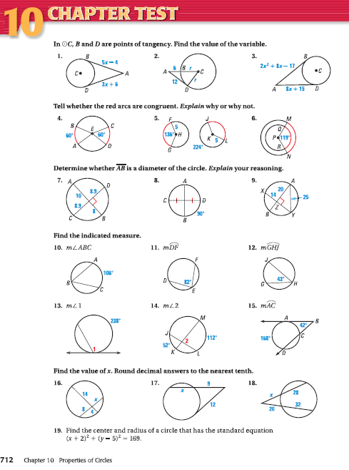
10.Review
712 #1-19 = 19

